Slide 1
Getting Started With Coding: Installing VS Code, Python, Git, Exploring GitHub Copilot, and Writing Your First Script
Essential steps for beginners to set up coding tools

Slide 2

Presentation Agenda
Setting Up Visual Studio Code
Installing and Configuring Python
Creating and Setting Up a GitHub Account
Introduction to GitHub Copilot for AI-Assisted Coding
Write your first Python script

Slide 3
Setting Up Visual Studio Code

Slide 4
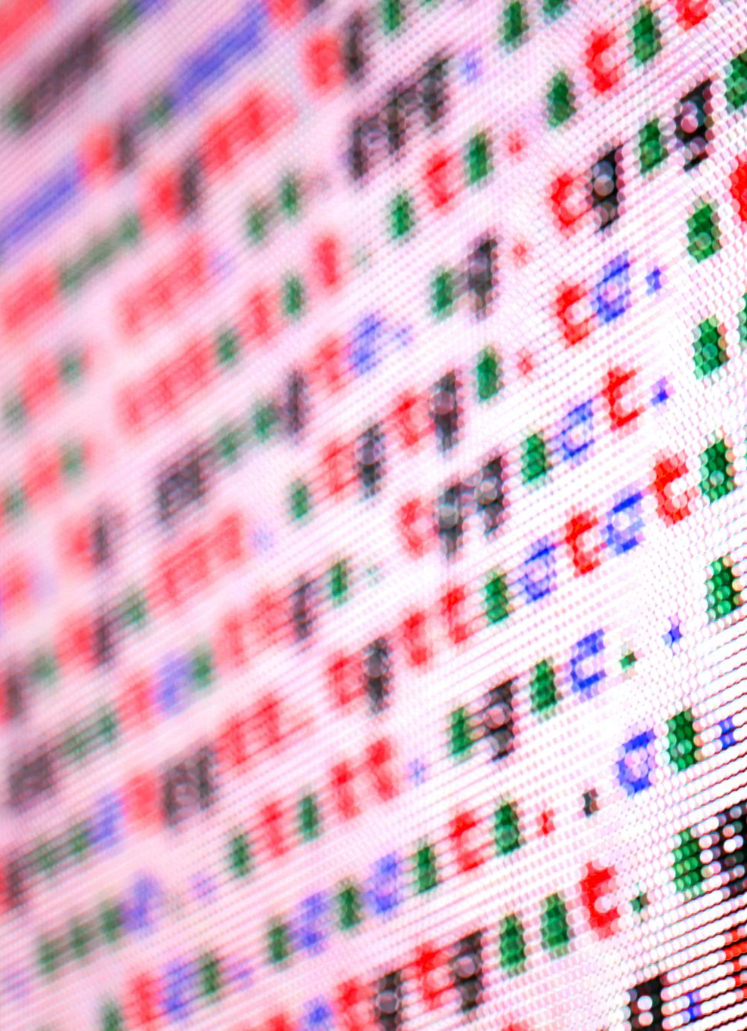
Downloading and Installing Visual Studio Code
Downloading Visual Studio Code
Access the official website to download the latest version of Visual Studio Code safely and securely.
Installation Process
Follow installation prompts specific to your operating system to complete setup quickly and easily.
Getting Started with Coding
Launch Visual Studio Code after installation to begin coding with a user-friendly interface and tools.

Slide 5

Configuring the Interface and Useful Extensions
Interface Customization
Users can personalize Visual Studio Code's interface to match their workflow and aesthetic preferences.
Python Support Extension
Installing the Python extension provides features like linting, debugging, and code completion.
Git Integration Extension
Git integration helps manage version control directly from the editor, streamlining coding workflow.

Slide 6

Setting up Your First Project Folder
Create Dedicated Folder
Start by creating a dedicated project folder to keep all related files organized and accessible.
Manage Files Easily
A project folder simplifies file management and navigation within your coding environment.

Slide 7
Installing and Configuring Python

Slide 8

Downloading and Installing Python
Official Python Website
Access the official Python website to find the latest version for download securely and reliably.
Download Latest Version
Download the most recent stable release of Python suitable for your operating system.
Installation Preparation
Follow installation prompts to properly set up Python, enabling development on your computer.

Slide 9

Verifying Installation and Running Your First Python Script
Check Python Installation
Confirm Python is installed by running version commands in the terminal or command prompt.
Write Simple Script
Create a basic Python script to test and ensure the Python environment is working correctly.
Execute Python Script
Run the Python script to verify successful installation and execution of Python programs.

Slide 10
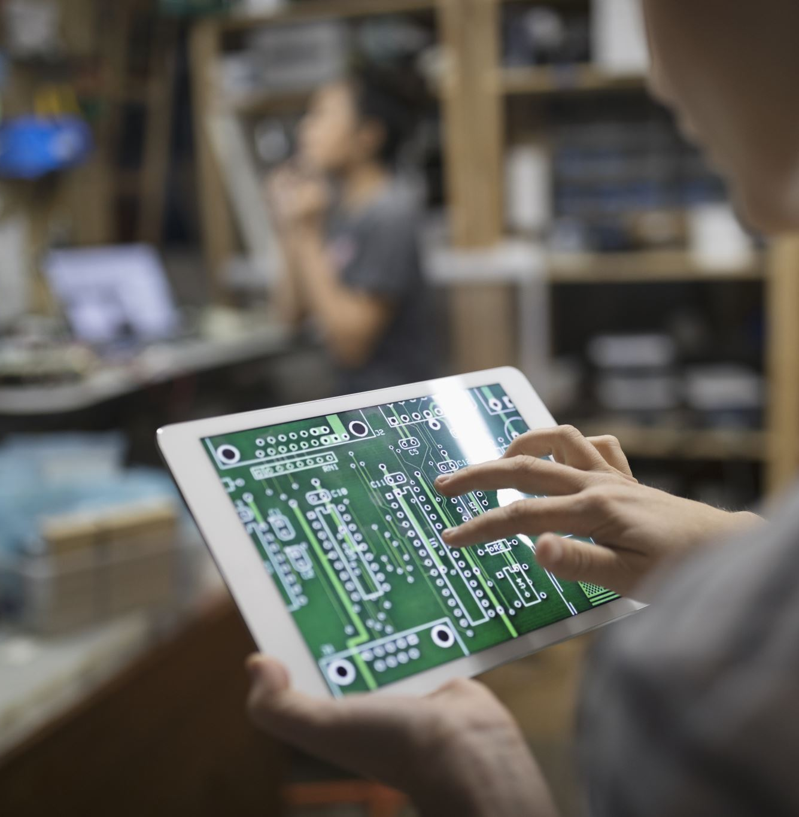
Installing Git: Step-by-Step Guide
Download Git from the official website for your operating system.
Follow the installation prompts to complete the setup.
Configure Git with your user name and email for proper commit tracking.
Verify installation by running git --version in the terminal.
Understand basic Git commands to get started with version control.

Slide 11
Creating and Setting Up a GitHub Account

Slide 12

Signing up for GitHub
Account Creation
Signing up on the GitHub website is the first step to create your personal account for using the platform's services.
Access to Features
Having a GitHub account enables access to version control, collaboration, and project management tools.

Slide 13

Exploring the GitHub Interface and Key Features
GitHub Dashboard
The dashboard provides an overview of repositories, notifications, and recent activities for efficient project management.
Repositories and Branches
Repositories store project files, and branches enable parallel development without affecting the main codebase.
Pull Requests
Pull requests allow team members to review and merge code changes collaboratively, ensuring quality and consistency.

Slide 14

Creating Your First Repository
Repository Setup
Creating a repository allows you to securely store your code in one centralized location.
Code Security
Repositories keep your projects safe and backed up, preventing data loss.
Collaboration
Repositories enable multiple users to collaborate and contribute on shared projects effectively.

Slide 15
Write Your First Python Script
Create the Script File
Launch your text editor, make a new file called 'hello.py', and type the following code: print('Hello, world!').
Execute the Script
Save your changes, then run the script in the terminal by entering 'python hello.py' to view the result.

Slide 16

Integrating Copilot with Visual Studio Code
Installing the Copilot Extension
Learn how to find and install the GitHub Copilot extension from the Visual Studio Code marketplace easily.
Enabling Copilot Features
Enable the Copilot extension and configure settings to start receiving AI-powered code suggestions.
Benefits of AI Suggestions
Utilize AI to improve coding efficiency, reduce errors, and accelerate software development.

Slide 17

Exploring Basic Features and Trying Example Code Completions
AI Code Completion
GitHub Copilot provides intelligent code completions, helping developers write code faster and with fewer errors.
Enhanced Coding Efficiency
Using code completions accelerates development by reducing manual typing and repetitive coding tasks.
Hands-on Experience
Trying example code completions demonstrates practical benefits and ease of integrating AI into coding workflows.

Slide 18

Capstone Project: Text-Based Adventure Game
Design an interactive story driven by user choices
Implement core game mechanics in Python
Use functions and control flow to navigate scenarios
Incorporate variables to track player status and inventory
Create multiple endings based on player decisions
Notes:
This slide aims to present the project to the students and gives an overview on what they will be building during the next sessions.

Slide 19

Kickstart Your Adventure Game
Create a Repository
Begin by creating a new repository on GitHub to organize and store your project files securely.
Clone to Local Machine
Clone the repository to your local machine using 'git clone' to start working with the files offline.
Craft a Welcome Message
Write a short, engaging welcome message to greet players at the start of your adventure game.
Commit and Push Changes
Commit your updates and push them to GitHub to track progress and share your work.

Slide 20
Conclusion
Development Environment Setup
Setting up Visual Studio Code and Python provides a powerful foundation for coding projects and development.
Version Control with GitHub
Creating a GitHub account enables efficient version control and collaboration on coding projects.
Coding Assistance with AI
Using GitHub Copilot offers AI-powered code suggestions to accelerate learning and development.

