Slide 1

Problem Solving Techniques & Basic Algorithms: From Calculator to Text-Based Adventure Game
Learning programming concepts through practical coding projects

Slide 2

Session Program
Introduction to Problem Solving and Basic Algorithms
Building a Simple Calculator: Applying Basic Algorithms
Developing a Text-Based Adventure Game
Project Workflow: From Setup to Collaboration
Notes:
--- We will cover an introduction to problem solving and algorithms, design and implementation of a calculator, development of a text-based adventure game, and project workflow including version control and collaboration. Image source: Microsoft 365 content library

Slide 3
Introduction to Problem Solving and Basic Algorithms
Notes:
--- This slide references information from the following file: https://microsofteur-my.sharepoint.com/personal/mamadiallo_microsoft_com/Documents/Documents/BAM/Slides/Week%201/Session-1.pdf Understanding Problem Solving in Programming, Key Concepts: Input/Output, Variables, and Expressions

Slide 4

Understanding Problem Solving in Programming
Interactive Story Design
Design an engaging story where player choices affect the narrative's direction and outcome.
Python Game Mechanics
Implement core game mechanics using Python, including functions and control flow to manage scenarios.
Player Status Tracking
Use variables effectively to track player status and inventory throughout the game.
Multiple Endings
Create diverse game endings based on player decisions, enhancing replayability and engagement.
Notes:
--- This slide references information from the following file: https://microsofteur-my.sharepoint.com/personal/mamadiallo_microsoft_com/Documents/Documents/BAM/Slides/Week%201/Session-1.pdf
Capstone Project: TextBased Adventure Game
• Design an interactive story driven by user choices • Implement core game mechanics in Python • Use functions and control flow to navigate scenarios • Incorporate variables to track player status and inventory • Create multiple endings based on player decisions Image source: Microsoft 365 content library

Slide 5
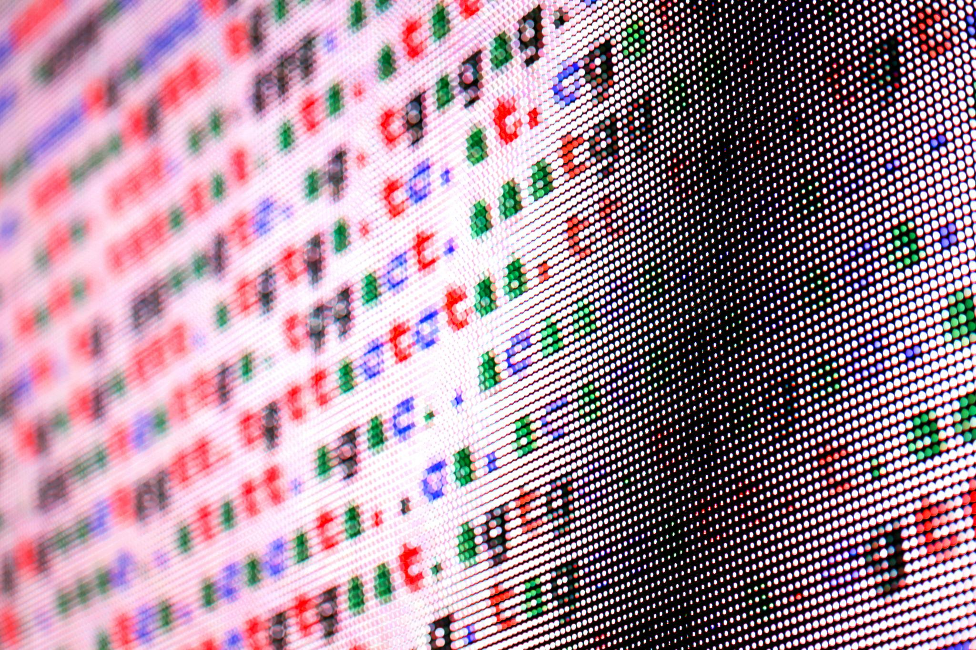
Key Concepts: Input/Output, Variables, and Expressions
Interactive Story Design
Create stories where user decisions influence the narrative flow and outcomes.
Core Game Mechanics
Implement fundamental game functions using Python programming language.
Functions and Control Flow
Use functions and control structures to navigate different game scenarios effectively.
Variables for Tracking
Employ variables to monitor player status, inventory, and game progress.
Notes:
--- This slide references information from the following file: https://microsofteur-my.sharepoint.com/personal/mamadiallo_microsoft_com/Documents/Documents/BAM/Slides/Week%201/Session-1.pdf
• Design an interactive story driven by user choices • Implement core game mechanics in Python • Use functions and control flow to navigate scenarios • Incorporate variables to track player status and inventory Image source: Microsoft 365 content library

Slide 6
Building a Simple Calculator: Applying Basic Algorithms
Notes:
--- This slide references information from the following file: https://microsofteur-my.sharepoint.com/personal/mamadiallo_microsoft_com/Documents/Documents/BAM/Slides/Week%201/Session-1.pdf Designing the Calculator: Inputs, Variables, and Expressions, Implementing Calculator Logic in Python

Slide 7

Designing the Calculator: Inputs, Variables, and Expressions
Create Script File
Open a text editor and create a new file named 'hello.py'. Type the Python code print('Hello, world!').
Execute Script
Save the file and run it in the terminal by entering 'python hello.py' to see the output message.
Notes:
--- This slide references information from the following file: https://microsofteur-my.sharepoint.com/personal/mamadiallo_microsoft_com/Documents/Documents/BAM/Slides/Week%201/Session-1.pdf Create the Script File Launch your text editor, make a new file called 'hello.py', and type the following code: print('Hello, world!'). Execute the Script Save your changes, then run the script in the terminal by entering 'python hello.py' to view the result. Image source: Microsoft 365 content library

Slide 8

Implementing Calculator Logic in Python
Writing a Simple Script
Create a basic Python script to verify the Python environment.
Building a Simple Calculator
Develop a Python program for basic arithmetic operations that prompts for two numbers and an operation, then displays the result.
Executing the Script
Run the script to confirm Python is installed and working.
Notes:
--- This slide references information from the following file: https://microsofteur-my.sharepoint.com/personal/mamadiallo_microsoft_com/Documents/Documents/BAM/Slides/Week%201/Session-1.pdf
Write Simple Script Create a basic Python script to test and ensure the Python environment is working correctly.
Execute Python Script Run the Python script to verify successful installation and execution of Python programs. Image source: Microsoft 365 content library

Slide 9
Text-Based Adventure Game
Notes:
--- This slide references information from the following file: https://microsofteur-my.sharepoint.com/personal/mamadiallo_microsoft_com/Documents/Documents/BAM/Slides/Week%201/Session-1.pdf Game Design: Interactive Story and User Choices, Programming Game Mechanics: Functions, Control Flow, and Variables

Slide 10
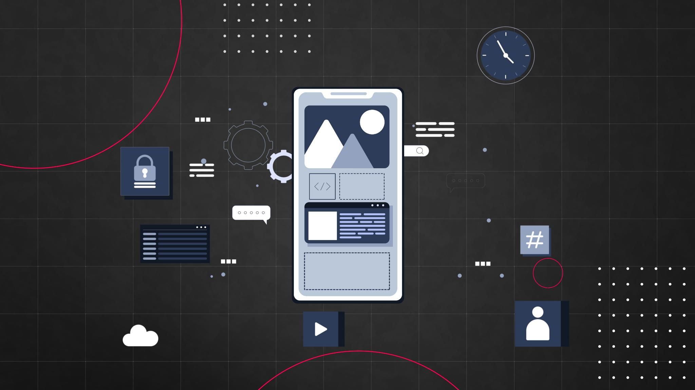
Game Design: Interactive Story and User Choices
Welcome Message
Craft a short and engaging welcome message to greet players at game start and set the tone.
First Problem Completion Message
Complete the first problem of the capstone project
Notes:
--- This slide references information from the following file: https://microsofteur-my.sharepoint.com/personal/mamadiallo_microsoft_com/Documents/Documents/BAM/Slides/Week%201/Session-1.pdf
Kickstart Your
Adventure Game
Create a Repository Begin by creating a new repository on GitHub to organize and store your project files securely.
Clone to Local Machine Clone the repository to your local machine using 'git clone' to start working with the files offline.
Craft a Welcome Message Write a short, engaging welcome message to greet players at the start of your adventure game. Image source: Microsoft 365 content library

Slide 11
Project Workflow: Collaboration on your first Pull Request
Notes:
--- This slide references information from the following file: https://microsofteur-my.sharepoint.com/personal/mamadiallo_microsoft_com/Documents/Documents/BAM/Slides/Week%201/Session-1.pdf Organizing Your Project with GitHub, Tracking Progress: Commit and Push Changes

Slide 12
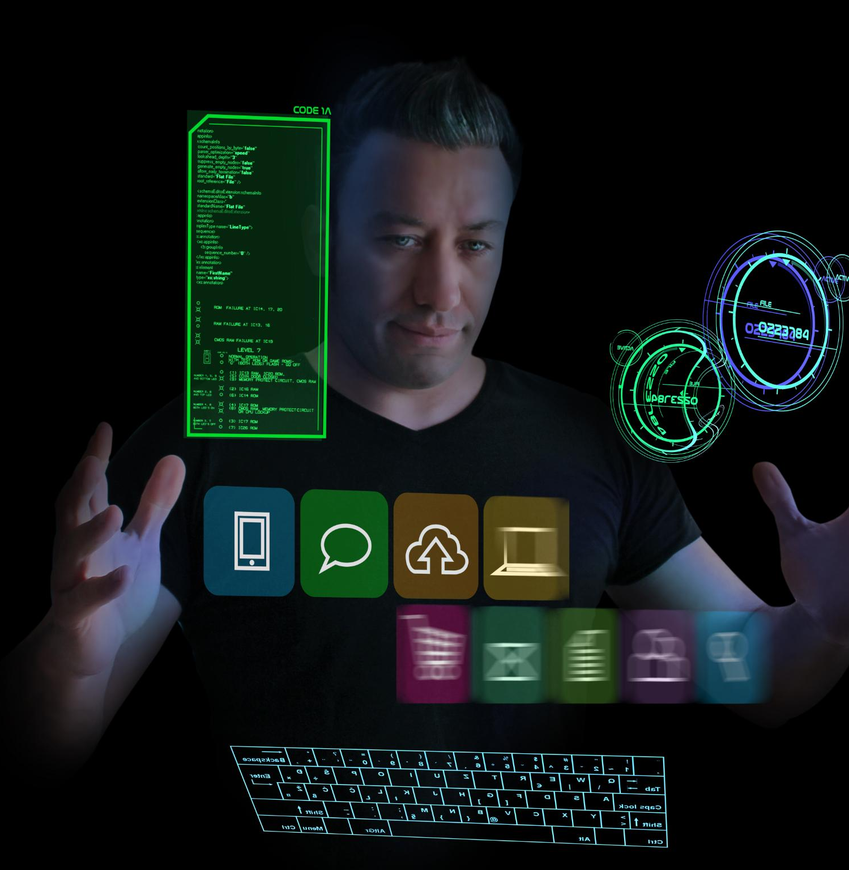
Tracking Progress: Commit and Push Changes
Commit Updates
Save changes locally by committing updates to keep track of progress and maintain history.
Push to Remote Repository
Push committed changes to a remote repository like GitHub to share work with collaborators.
Notes:
--- This slide references information from the following file: https://microsofteur-my.sharepoint.com/personal/mamadiallo_microsoft_com/Documents/Documents/BAM/Slides/Week%201/Session-1.pdf
Commit and Push Changes Commit your updates and push them to GitHub to track progress and share your work. Image source: Microsoft 365 content library

Slide 13

Collaborate with your team on GitHub
Create a PR
Propose your changes to the main branch with a detailed description.
Add teammate
Include a teammate as collaborator or reviewer.
Request review
Ask your team for feedback to ensure quality.
Notes:
--- This slide references information from the following file: https://microsofteur-my.sharepoint.com/personal/mamadiallo_microsoft_com/Documents/Documents/BAM/Slides/Week%201/Session-1.pdf
Create a Repository Begin by creating a new repository on GitHub to organize and store your project files securely.
Clone to Local Machine Clone the repository to your local machine using 'git clone' to start working with the files offline. Image source: Microsoft 365 content library

Slide 14
Conclusion
Problem Solving Mastery
Mastering problem solving enhances your ability to design effective solutions and develop functional programs.
Basic Algorithms Knowledge
Understanding basic algorithms is essential for creating efficient and engaging programs like calculators and games.
Project Workflow Skills
Following project workflow ensures organized development and successful program completion.

