Slide 1
Finalizing the Capstone Project: Developing a Text-Based Adventure Game in Python
Key steps to complete and present your Python game

Slide 2
Polishing Game Mechanics and Storyline
Refining Game Mechanics
Ensure smooth gameplay by balancing challenges and optimizing controls for better player experience.
Enhancing Storyline
Clarify narrative elements to increase player engagement and emotional connection with the game.
Improving User Interactions
Focus on intuitive user interfaces and responsive feedback to improve player interaction.

Slide 3
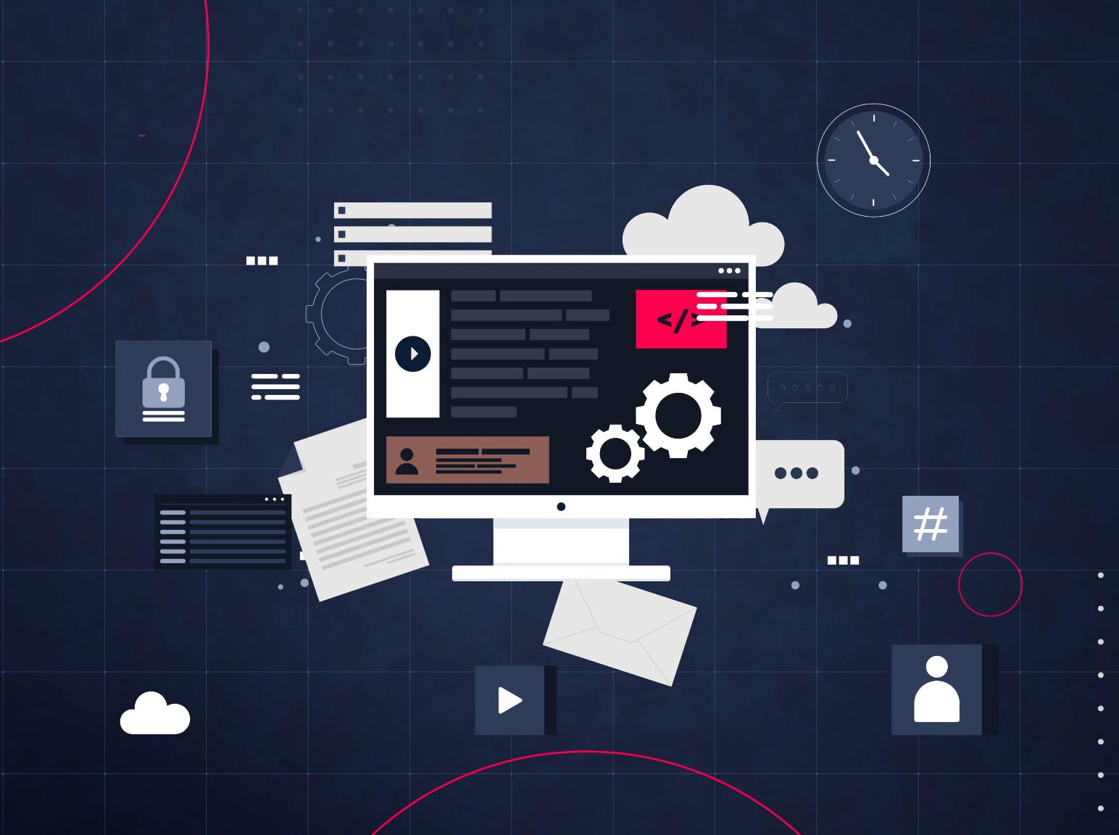
Testing, Debugging, and User Feedback
Thorough Testing
Conduct comprehensive testing to find and fix bugs ensuring software reliability and performance.
Bug Fixing
Identify software issues and debug them effectively to improve stability and functionality.
User Feedback
Gather user feedback from your team members to enhance usability and overall user experience in the product.
Iterative Improvement
Use iterative cycles of testing and feedback to create a polished and robust final product.

Slide 4

Documenting and Presenting the Final Project
Comprehensive Documentation
Create detailed documents outlining the game’s design, development stages, and user instructions.
Effective Presentation Planning
Organize a clear presentation to highlight project features and key learning outcomes.

Slide 5
Conclusion
Project Polishing
Careful refinement enhances the quality and user experience of the text-based adventure game.
Rigorous Testing
Thorough testing ensures the game functions correctly and meets design goals.
Effective Documentation
Clear documentation supports understanding and showcases students' development process.

