Slide 1
Session 3: Loops, Repetition, and Advancing the Adventure Game
Understanding Python loops to enhance game mechanics
Notes:
AI-generated content may be incorrect. --- In this session, we will explore the fundamentals of loops and repetition in Python, building on prior knowledge of conditionals and logic. We will also apply these concepts to enhance our adventure game, introducing more complex mechanics and player interactions.

Slide 2

Session 3 Agenda
Recap: Conditionals & Logic in Python
Introduction to Loops and Repetition
Applying Loops in Game Development
Capstone Project: Advancing the Adventure Game
Project Workflow and Collaboration
Notes:
--- We will begin with a recap of conditionals and logic in Python. Next, we'll dive into loops, their necessity, and syntax. Then, we'll see how loops are applied in game development, followed by our capstone project where we advance the adventure game. Finally, we'll cover project workflow and collaboration techniques. Image source: Microsoft 365 content library

Slide 3
Recap: Conditionals & Logic in Python
Notes:
--- This slide references information from the following file: https://microsofteur-my.sharepoint.com/personal/mamadiallo_microsoft_com/Documents/Documents/BAM/Slides/Week%201/Session%202.pdf,https://microsofteur-my.sharepoint.com/personal/mamadiallo_microsoft_com/Documents/Documents/BAM/Slides/Week%201/Session-1.pdf Review of Control Flow and Decision Making

Slide 4
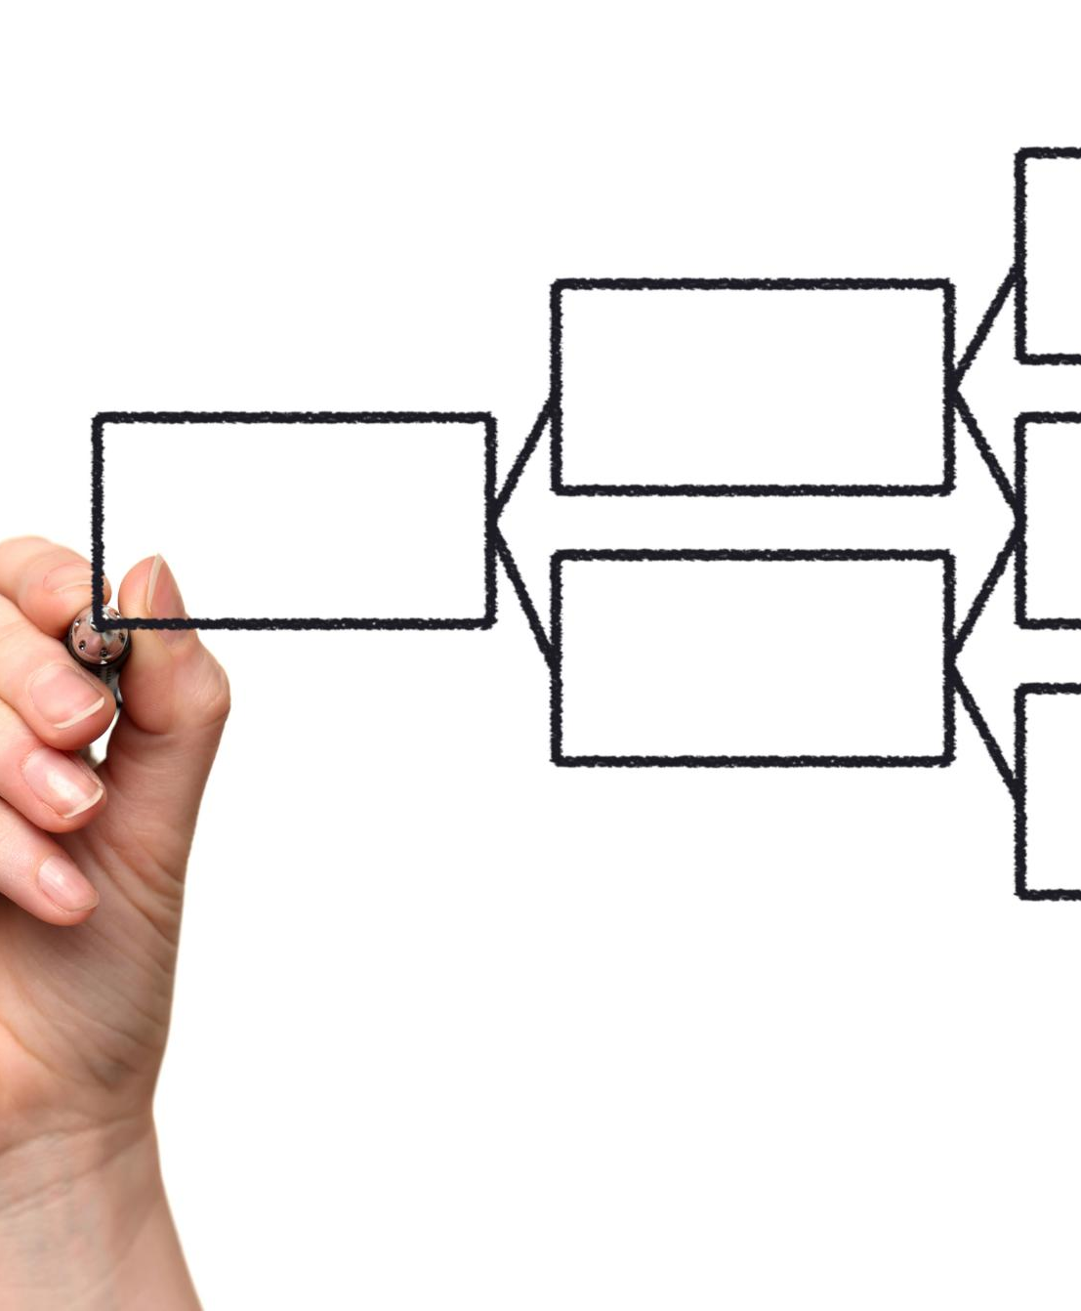
Review of Control Flow and Decision Making
Control Flow Concepts
Control flow structures guide program execution through decisions and loops based on conditions.
Conditional Statements These allow the program to choose different paths based on whether a condition is true or false, enabling dynamic decision-making.
Notes:
--- This slide references information from the following file: https://microsofteur-my.sharepoint.com/personal/mamadiallo_microsoft_com/Documents/Documents/BAM/Slides/Week%201/Session%202.pdf,https://microsofteur-my.sharepoint.com/personal/mamadiallo_microsoft_com/Documents/Documents/BAM/Slides/Week%201/Session-1.pdf
Functions and Control Flow Use functions and control structures to navigate different game scenarios effectively. • Use functions and control flow to navigate scenarios Image source: Microsoft 365 content library

Slide 5
Introduction to Loops and Repetition
Notes:
--- This slide references information from the following file: https://microsofteur-my.sharepoint.com/personal/mamadiallo_microsoft_com/Documents/Documents/BAM/Slides/Week%201/Session%202.pdf Understanding the Need for Repetition in Code, Types of Loops in Python and Their Syntax

Slide 6

Understanding the Need for Repetition in Code
Practical Coding Projects
Hands-on projects help reinforce programming concepts effectively through repetition and practice.
Problem Solving & Algorithms
Basic algorithms introduce problem solving skills essential for repetitive coding tasks.
Python Game Mechanics
Game mechanics in Python demonstrate real-world application of repetition in loops and control structures.
Notes:
--- This slide references information from the following file: https://microsofteur-my.sharepoint.com/personal/mamadiallo_microsoft_com/Documents/Documents/BAM/Slides/Week%201/Session%202.pdf
Learning programming concepts through practical coding projects
• Introduction to Problem Solving and Basic Algorithms
Python Game Mechanics Image source: Microsoft 365 content library

Slide 7
Types of Loops in Python and Their Syntax
For Loop in Python
For loops iterate over a sequence such as a list or range, executing code for each item.
While Loop in Python
While loops execute code repeatedly as long as a condition remains true.
Basic Arithmetic Program
Python program prompts for two numbers and an operation, then calculates and displays the result.
Notes:
--- This slide references information from the following file: https://microsofteur-my.sharepoint.com/personal/mamadiallo_microsoft_com/Documents/Documents/BAM/Slides/Week%201/Session%202.pdf Implement fundamental game functions using Python programming language. Develop a Python program for basic arithmetic operations that prompts for two numbers and an operation, then displays the result. Image source: Microsoft 365 content library

Slide 8
Applying Loops in Game Development
Notes:
--- This slide references information from the following file: https://microsofteur-my.sharepoint.com/personal/mamadiallo_microsoft_com/Documents/Documents/BAM/Slides/Week%201/Session%202.pdf Using Loops to Manage Game Scenarios and Player Choices, Examples: Looping Through Game Events and Player Actions

Slide 9

Using Loops to Manage Game Scenarios and Player Choices
Player Status Tracking
Use variables to keep track of player health, inventory, and status throughout the game.
Game Progress Monitoring
Employ variables to monitor game progress and manage player decisions using loops.
Notes:
--- This slide references information from the following file: https://microsofteur-my.sharepoint.com/personal/mamadiallo_microsoft_com/Documents/Documents/BAM/Slides/Week%201/Session%202.pdf
Player Status Tracking Use variables effectively to track player status and inventory throughout the game.
Variables for Tracking Employ variables to monitor player status, inventory, and game progress.

Slide 10

Examples: Looping Through Game Events and Player Actions
User-Driven Narrative
User decisions dynamically influence the story's direction and multiple possible outcomes.
Tracking Player Status
Variables are used to monitor player status, inventory, and progression throughout the game.
Notes:
--- This slide references information from the following file: https://microsofteur-my.sharepoint.com/personal/mamadiallo_microsoft_com/Documents/Documents/BAM/Slides/Week%201/Session%202.pdf Create stories where user decisions influence the narrative flow and outcomes.
Core Game Mechanics • Incorporate variables to track player status and inventory Image source: Microsoft 365 content library

Slide 11
Capstone Project: Advancing the Adventure Game
Notes:
--- This slide references information from the following file: https://microsofteur-my.sharepoint.com/personal/mamadiallo_microsoft_com/Documents/Documents/BAM/Slides/Week%201/Session%202.pdf,https://microsofteur-my.sharepoint.com/personal/mamadiallo_microsoft_com/Documents/Documents/BAM/Slides/Week%201/Session-1.pdf Completing the Second Problem: Expanding Game Mechanics, Implementing Loops for Player Interaction and Multiple Endings

Slide 12

Completing the Second Problem: Expanding Game Mechanics
Core Game Mechanics
Implement essential game mechanics using Python functions and control flow for scenario management.
Multiple Endings
Design the game to have multiple endings driven by player choices and decisions.
Notes:
--- This slide references information from the following file: https://microsofteur-my.sharepoint.com/personal/mamadiallo_microsoft_com/Documents/Documents/BAM/Slides/Week%201/Session%202.pdf,https://microsofteur-my.sharepoint.com/personal/mamadiallo_microsoft_com/Documents/Documents/BAM/Slides/Week%201/Session-1.pdf • Developing a Text-Based Adventure Game Implement core game mechanics using Python, including functions and control flow to manage scenarios. • Create multiple endings based on player decisions

Slide 13

Implementing Loops for Player Interaction and Multiple Endings
Multiple Endings Creation
Design diverse game endings driven by player decisions to boost replayability and engagement.
Player Interaction Loops
Use loops to create dynamic player interactions that influence game outcomes and narrative flow.
Welcome Message Design
Craft a short, engaging welcome message to set the tone and greet players at game start.
Notes:
--- This slide references information from the following file: https://microsofteur-my.sharepoint.com/personal/mamadiallo_microsoft_com/Documents/Documents/BAM/Slides/Week%201/Session%202.pdf,https://microsofteur-my.sharepoint.com/personal/mamadiallo_microsoft_com/Documents/Documents/BAM/Slides/Week%201/Session-1.pdf Create diverse game endings based on player decisions, enhancing replayability and engagement.
Game Design: Interactive
Story and User Choices Craft a short and engaging welcome message to greet players at game start and set the tone. Image source: Microsoft 365 content library

Slide 14
Project Workflow and Collaboration
Notes:
--- This slide references information from the following file: https://microsofteur-my.sharepoint.com/personal/mamadiallo_microsoft_com/Documents/Documents/BAM/Slides/Week%201/Session%202.pdf Tracking Progress and Pushing Changes to GitHub, Collaborating with Teammates and Reviewing Code

Slide 15

Tracking Progress and Pushing Changes to GitHub
Commit Updates Locally
Save changes locally by committing updates to track progress and maintain version history.
Push to Remote Repository
Push committed changes to a remote repository like GitHub to share work with collaborators.
Notes:
--- This slide references information from the following file: https://microsofteur-my.sharepoint.com/personal/mamadiallo_microsoft_com/Documents/Documents/BAM/Slides/Week%201/Session%202.pdf
Commit Updates Save changes locally by committing updates to keep track of progress and maintain history.
Push to Remote Repository Push committed changes to a remote repository like GitHub to share work with collaborators.

Slide 16

Collaborating with Teammates and Reviewing Code
Create a Pull Request
Propose your code changes to the main branch with a clear and detailed description.
Add Teammate as Reviewer
Include a teammate as a collaborator or reviewer to contribute to the code review process.
Request Team Review
Ask your team for feedback to ensure code quality and consistency before merging.
Notes:
--- This slide references information from the following file: https://microsofteur-my.sharepoint.com/personal/mamadiallo_microsoft_com/Documents/Documents/BAM/Slides/Week%201/Session%202.pdf
Create a PR Propose your changes to the main branch with a detailed description. Add teammate Include a teammate as collaborator or reviewer. Request review Ask your team for feedback to ensure quality.

Slide 17
Conclusion
Understanding Loops
We enhanced our knowledge of loops and their role in creating dynamic game functionality.
Advancing Game Development
Developed an adventure game that incorporates interactive and engaging experiences for players.
Teamwork and Project Skills
Improved collaboration and project management skills essential for successful game creation.

