Slide 1
Mastering Debugging, Code Quality, and Presentation Skills
Enhancing coding proficiency and technical communication effectively

Slide 2

Session Agenda
Effective Debugging Strategies in Python
Ensuring High Code Quality in Python Projects
Develop Effective Technical Presentation skills
Notes:
--- We will explore four main areas: effective debugging strategies, ensuring high code quality, writing Pythonic and robust code, and presenting code and technical concepts effectively. Each section will provide actionable insights and best practices. Image source: Microsoft 365 content library

Slide 3
Effective Debugging Strategies in Python

Slide 4

Common Types of Bugs in Python
Syntax Errors
Syntax errors occur when Python code does not follow the correct structure or grammar rules, causing the interpreter to fail.
Runtime Exceptions
Runtime exceptions happen during program execution, often due to invalid operations like division by zero or missing files.
Logical Errors
Logical errors are mistakes in the program logic that produce incorrect results without crashing the program.
Performance Issues
Performance issues occur when code runs inefficiently, causing slow execution and resource overuse.
Notes:
--- Python developers often face syntax errors, runtime exceptions, logical errors, and performance issues. Understanding these common bugs helps in diagnosing problems faster and writing more reliable code. Image source: Microsoft 365 content library

Slide 5
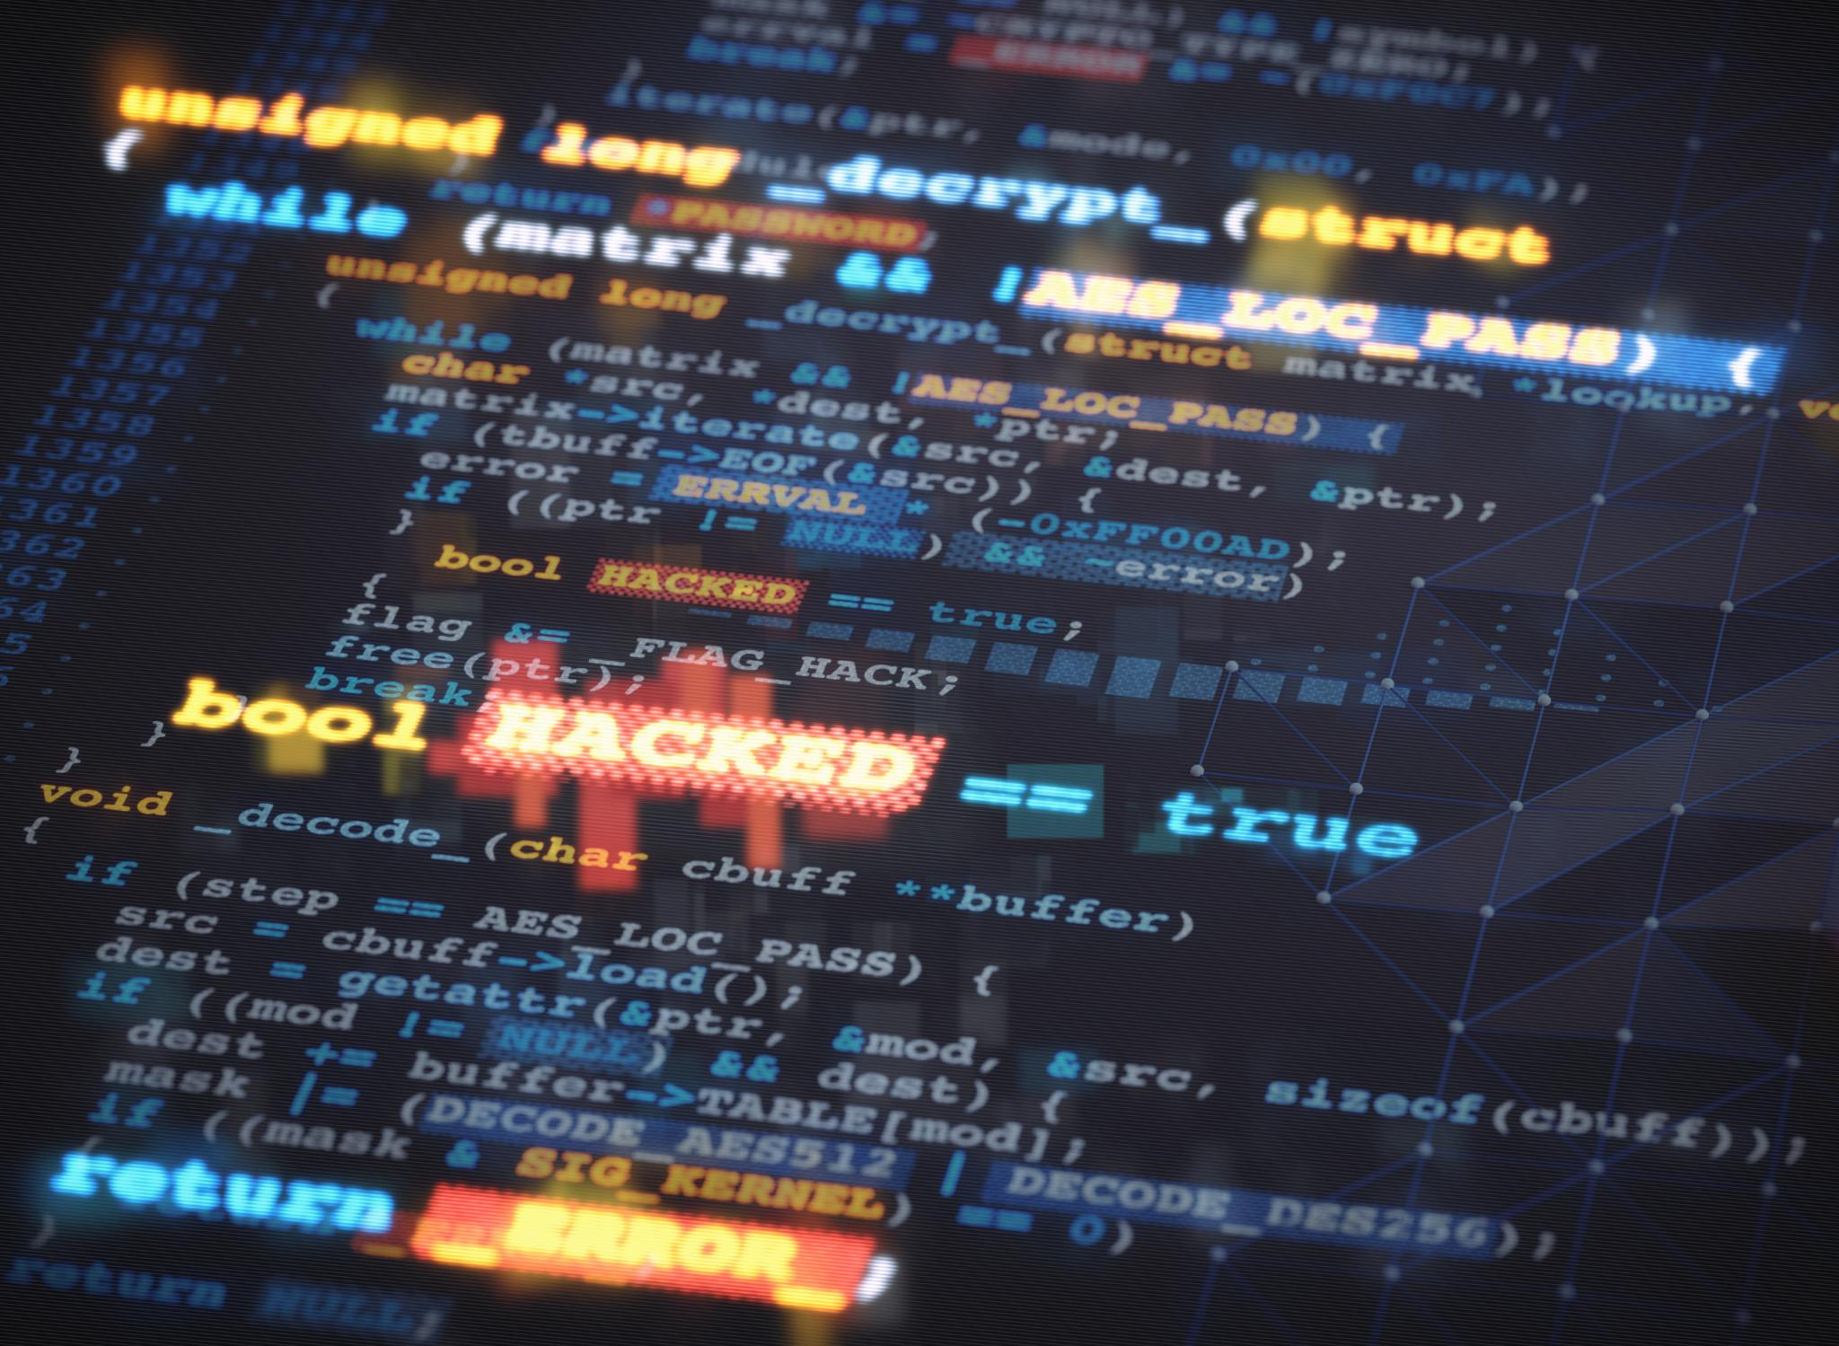
Utilizing Python’s Debugging Tools (E.g., Pdb, Breakpoints)
Interactive Debugging with pdb
The pdb tool allows for interactive debugging and detailed inspection of Python code at runtime.
Using Breakpoints
Breakpoints pause program execution at specified lines to help identify and fix code issues effectively.
Step-by-Step Code Inspection
Debugging tools enable stepwise execution to trace code logic and understand program flow clearly.
Notes:
--- Python provides powerful debugging tools like pdb for interactive debugging and breakpoints to pause execution. Leveraging these tools enables step-by-step code inspection and quick identification of issues. Image source: Microsoft 365 content library

Slide 6

Best Practices for Tracking and Resolving Errors
Clear Error Messages
Writing clear and descriptive error messages helps quickly identify and understand issues in the code.
Using Logging
Logging important events and errors provides a history that aids in tracking bugs and system behavior.
Isolating Code Sections
Isolating code sections allows targeted debugging and reduces complexity when identifying error sources.
Iterative Testing
Iterative testing helps validate fixes step-by-step, ensuring bugs are resolved without introducing new errors.
Notes:
--- Effective debugging involves writing clear error messages, using logging, isolating code sections, and iterative testing. Adhering to these practices accelerates bug resolution and improves code reliability. Image source: Microsoft 365 content library

Slide 7

Code Review Processes and Collaborative Development
Knowledge Sharing
Code reviews promote knowledge exchange among team members, enhancing collective expertise and reducing errors early.
Pull Request Collaboration
Using pull requests enables structured collaboration and systematic review, improving code quality effectively.
Peer Feedback Benefits
Peer feedback during reviews strengthens team cohesion and helps identify potential issues quickly.
Notes:
--- Code reviews foster knowledge sharing and catch potential issues early. Collaborating through pull requests and peer feedback improves code quality and team cohesion. Image source: Microsoft 365 content library

Slide 8

Automated Testing and Linting Tools (E.g., Unittest, Pytest, Flake8)
Automated Testing Frameworks
Frameworks like unittest and pytest automate code testing to ensure correctness and reliability.
Code Linting Tools
Linting tools such as Flake8 enforce coding style and detect errors before runtime.
Notes:
--- Automated testing with frameworks like unittest and pytest ensures code correctness. Linting tools such as Flake8 help enforce style guidelines and catch errors before runtime. Image source: Microsoft 365 content library

Slide 9
Presenting Code and Technical Concepts Effectively

Slide 10
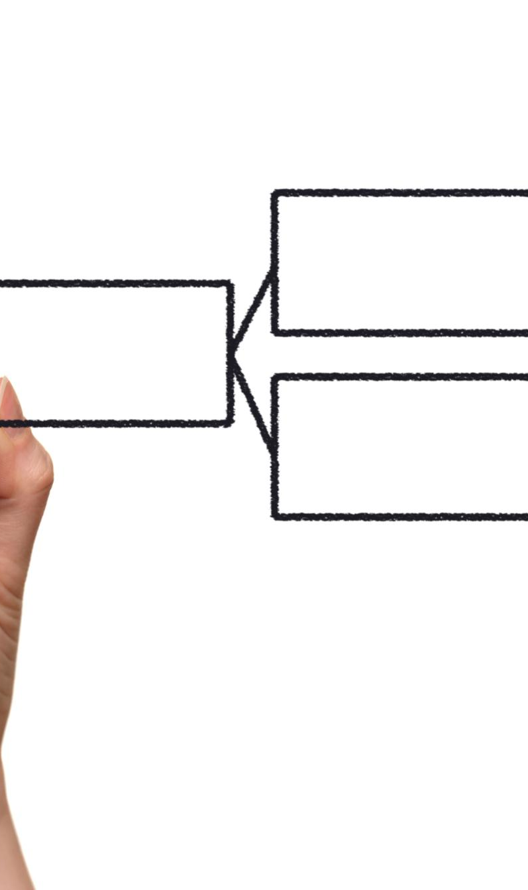
Structuring Technical Presentations for Clarity
Logical Flow
Start presentations with clear objectives to set the context and purpose for the audience.
Detailed Content
Follow objectives with detailed and organized content to provide depth and clarity.
Key Takeaways
Conclude with key takeaways to reinforce important points and aid audience retention.
Notes:
--- Organize presentations with a logical flow, starting with objectives, followed by detailed content, and concluding with key takeaways. This helps your audience follow and retain information. Image source: Microsoft 365 content library

Slide 11

Visual Aids: Using Code Examples and Diagrams
Code Snippets
Code snippets help illustrate programming concepts clearly and provide concrete examples for better understanding.
Flowcharts
Flowcharts visually represent processes and decision points, simplifying complex workflows for the audience.
Diagrams
Diagrams complement explanations by visually breaking down concepts and highlighting key relationships.
Notes:
--- Visual aids like code snippets, flowcharts, and diagrams clarify concepts and keep the audience engaged. Use them strategically to complement your explanations. Image source: Microsoft 365 content library

Slide 12

Engaging Your Audience and Handling Questions
Encourage Questions
Invite your audience to ask questions to promote engagement and clarify understanding.
Use Interactive Elements
Incorporate polls, quizzes, or discussions to make the session interactive and dynamic.
Respond Thoughtfully
Answer questions thoughtfully to foster deeper understanding and build rapport with your audience.
Notes:
--- Engage your audience by encouraging questions, using interactive elements, and responding thoughtfully. This fosters understanding and creates a dynamic learning environment. Image source: Microsoft 365 content library

Slide 13
Conclusion
Importance of Debugging
Effective debugging skills help identify and fix software errors quickly, improving reliability.
Code Quality Practices
Maintaining high code quality ensures maintainability and reduces future issues.
Effective Presentations
Clear presentations enhance team communication and knowledge sharing.

