Slide 1
A GPU Based DSP Front End
605.417 Introduction to GPU Programming
Michael DiBerardino
Notes:
Hello and welcome to my project presentation for Information Retrieval. My name is Michael DiBerardino.

Slide 2
Introduction
Digital Signal Processing front end
Gather RF from antenna
Typically FPGA
Real time streaming required
High bandwidth
Information content low
Compared to RF bandwidth
100 MHz+
Signal is heavily decimated
Voice: 100 MHz to 44.1 KHz

Slide 3
Idea
GPU’s combine parallelism with software
Massively parallel
Follow traditional software paradigms
Faster to program than FPGA’s
My current FPGA design at work takes 2.5 hours to compile
One mistake equates to 2.5 hours of lost time!
Implement DSP front end in GPU
Tune, Filter, Decimate

Slide 4
The Math
Tune
Complex multiplication
Generate Sin & Cos
Filter
1D convolution
1 multiply per thread
Parallel summation
log2(n)
Decimate
Modulo block id
Restrict copies from shared to global memory

Slide 5
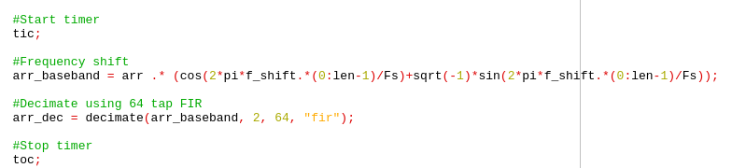
The Code - CPU
Only 2 lines in Octave
Involves library calls for decimation
Implemented in 1 thread

Slide 6
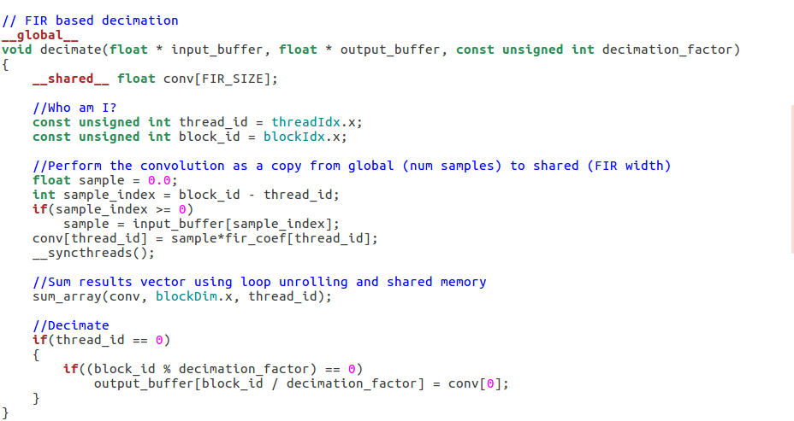
The Code - GPU
Kernel is only a few lines long
Convolution is 6 lines
Down-sample is 3 lines

Slide 7
Side by Side
CPU
Octave
Interpreted
Double precision
1 thread
GPU
Cuda
Compiled
Single precision
4096 blocks
One block per sample
64 threads
1 thread per filter tap
Sum 64 threads to get 1 data sample

Slide 8
Side by Side

Slide 9
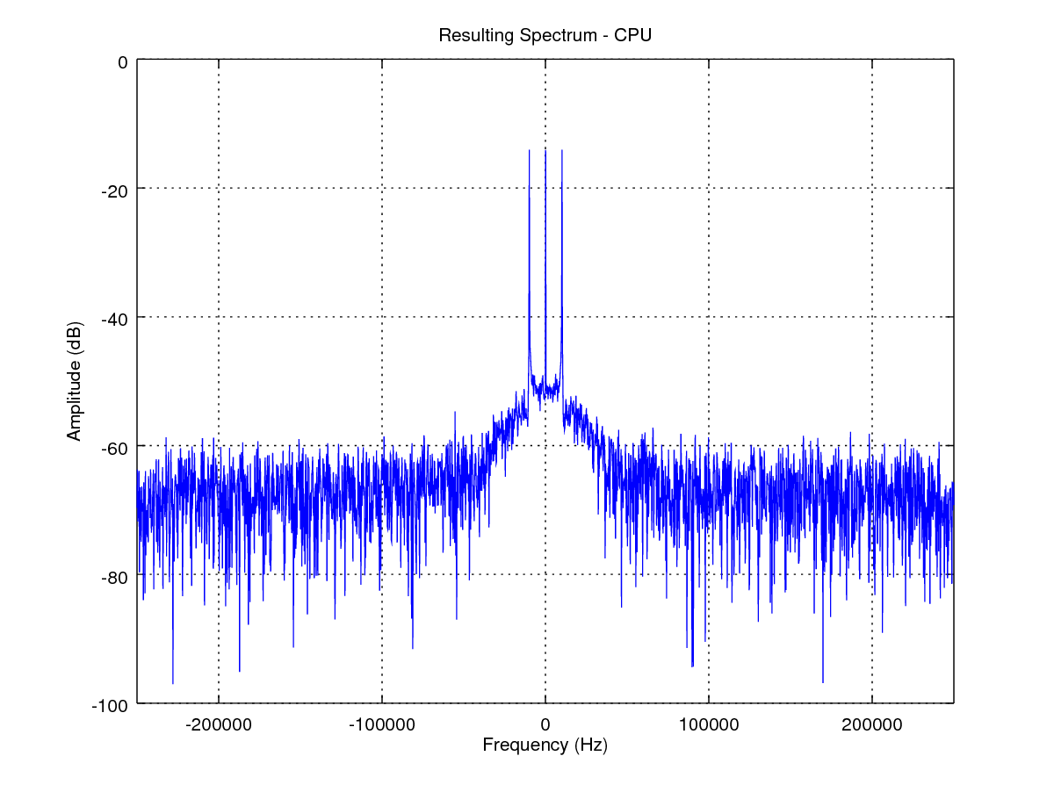
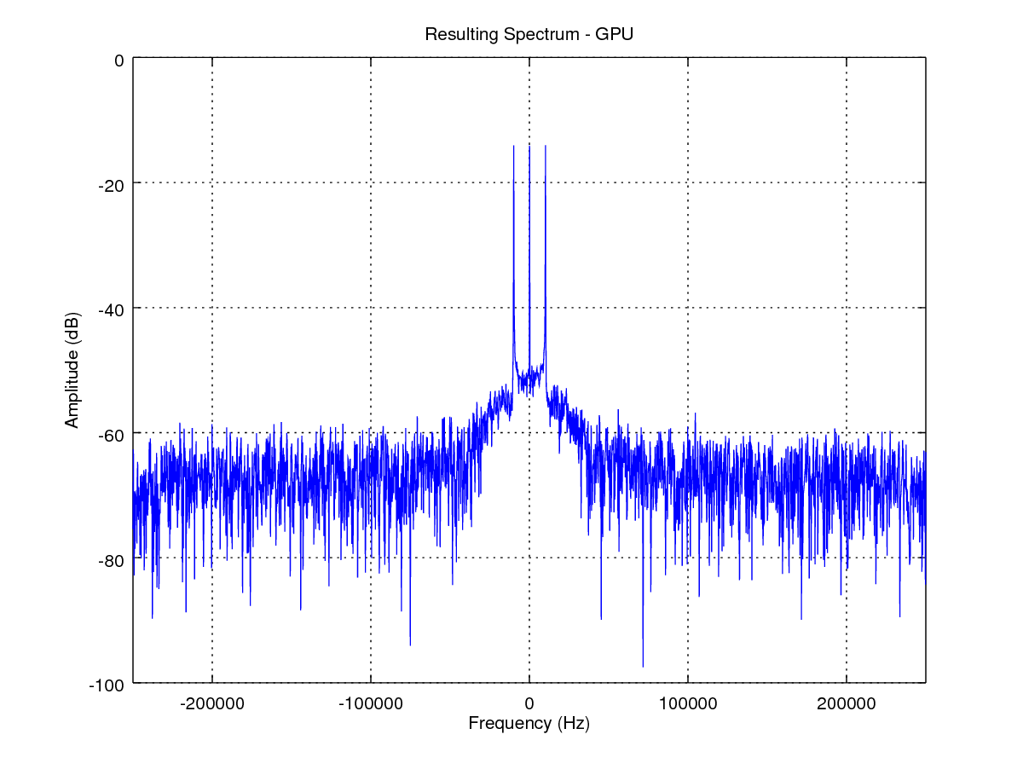
Side by Side
CPU result spectrum
3 signals of interest
GPU result spectrum
3 signals of interest

Slide 10
Conclusion
Successful implementation
GPU is
Faster than CPU
Roughly 10x
Just as accurate as CPU
Just as easy to code as CPU
Easier to code than FPGA
CPU & GPU spectra look identical
Minor variations in noise floor
Possibly different LSB rounding schemes

Slide 11
Future Work
Change decimation rate on the fly
Recalculate filter coefficients
Kaiser Window => Bessel functions
Include FFT
Another function frequently handled by FPGA
Can be made parallel
Max length is 65,535
Incorporate cohearant, sequential runs
Time interleave beginning and ending samples

