Slide 1
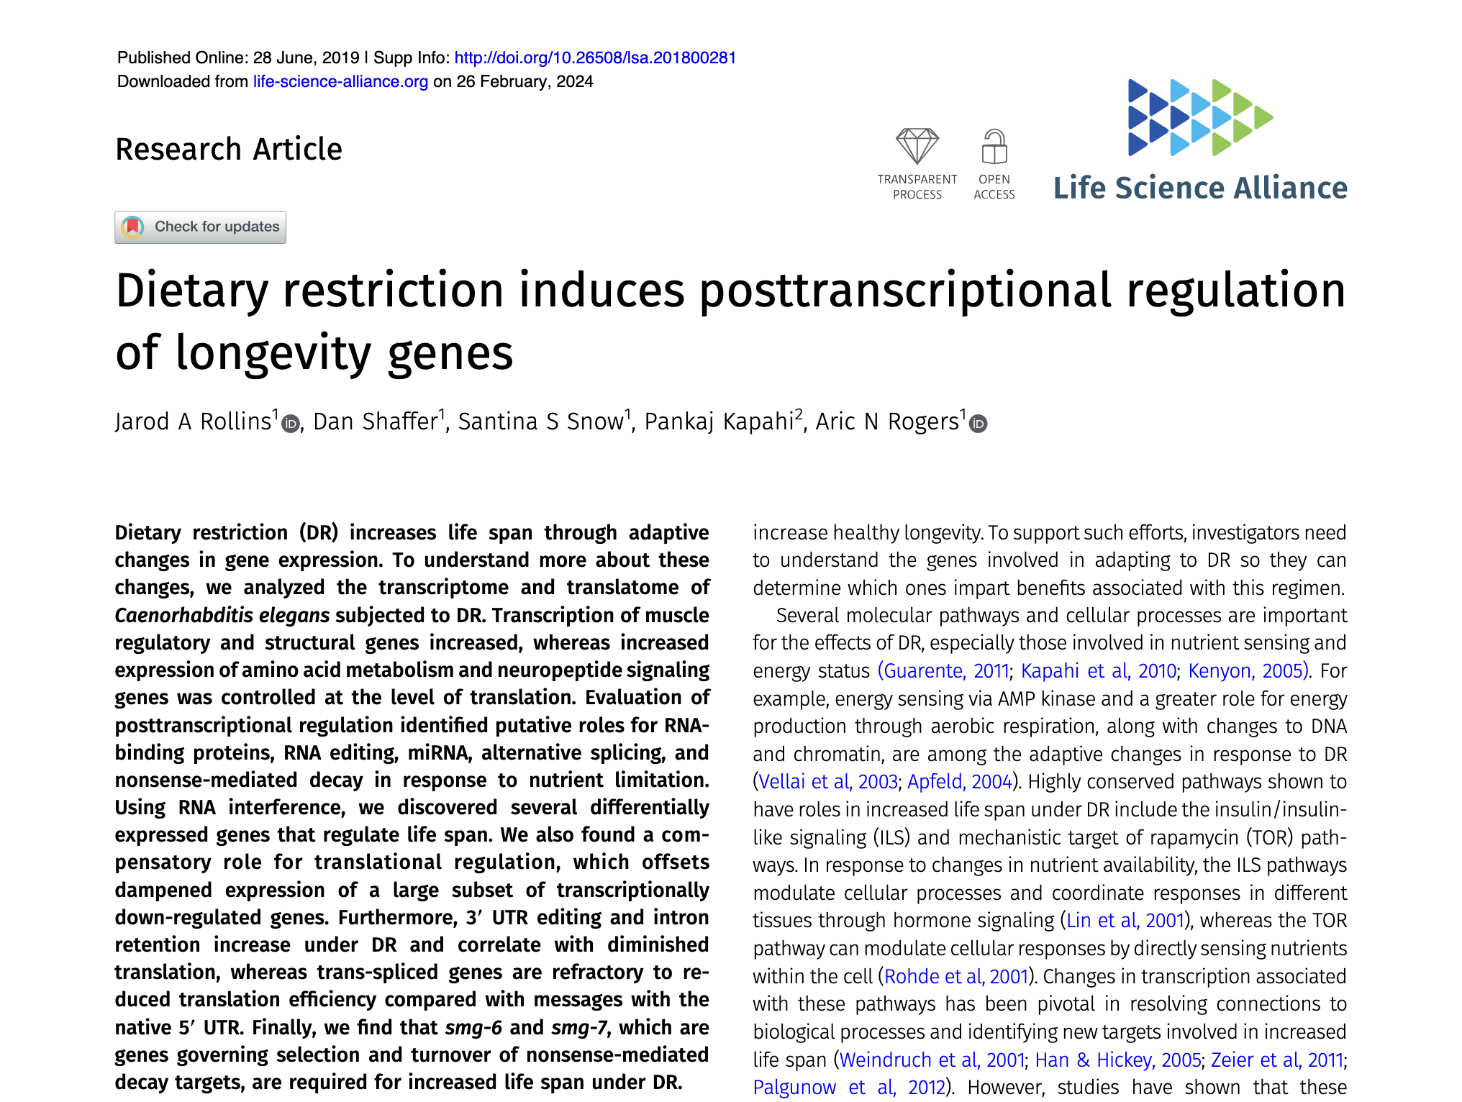
Experiment Overview
Rollins JA, Shaffer D, Snow SS, Kapahi P, Rogers AN. Dietary restriction induces posttranscriptional regulation of longevity genes. Life Sci Alliance 2019 Aug;2(4). doi: 10.26508/lsa.201800281. PMID: 31253655

Slide 2
Samples
C. elegans
AL-total_rep1
AL-total_rep2
AL-total_rep3
DR-total_rep1
DR-total_rep2
DR-total_rep3

Slide 3
Samples
C. elegans
AL-total_rep1
AL-total_rep2
AL-total_rep3
DR-total_rep1
DR-total_rep2
DR-total_rep3
AL = ad libitum
DR = dietary restriction
total = Total RNA
ploy = polysome bound RNA
Notes:
Multiple ribosome bount, actively being translated into proteins
DR is shown to icrease logenivty
Are these longevity-related changes caused by making more or less of certain genes? Or is it more about how those genes are used to make proteins — even if the genes themselves don’t change much

