Slide 1
EncryptStore
Presented by
Supervised to
Md Ibrahim Hossain
19CSE065
Session 2019-2020
Md. Monowar Hossain
Assistant Professor
Department of CSE
Notes:
NOTE:
To change the image on this slide, select the picture and delete it. Then click the Pictures icon in the placeholder to insert your own image.

Slide 2
Overview
Introduction
Objectives
Methodology
Some screenshots of running project
Experimental Results
Limitations
Conclusion & Future Scope

Slide 3
Introduction
EncryptStore is a project based on C language.
Personal data storage
Reduce user’s suffering
Multiple account facilities
Data encryption
Delete and Update option
Users can also delete their own account.

Slide 4
Objectives
To make this inventory system entirely in a c language based project
To help people suffering for remember everything
To handle all information in a project.
To manage the user’s details.
To provide people seeking easy dealing with proper security.

Slide 5
Methodology
Homepage
Registration system
Log in system
Filter data
Editing data
Delete data
Delete account
Check user existence
Log out option
Exiting Option

Slide 6
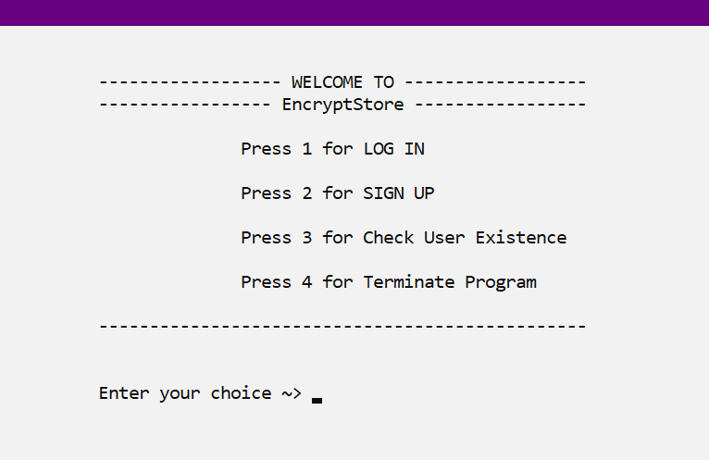
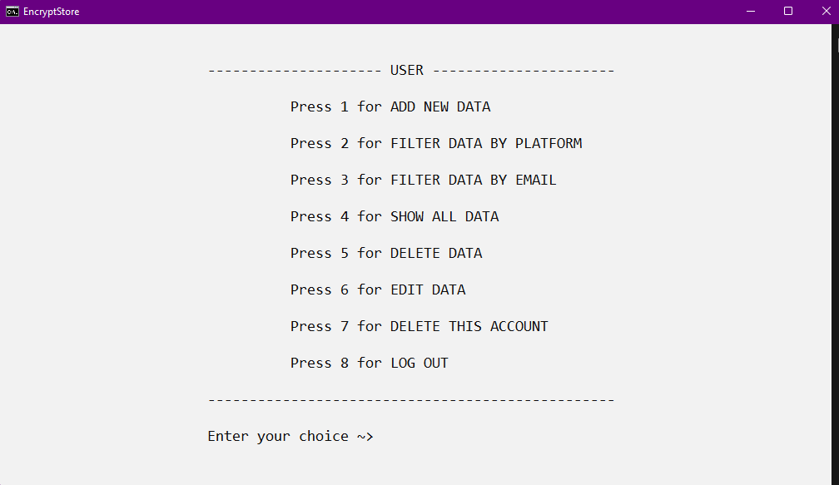
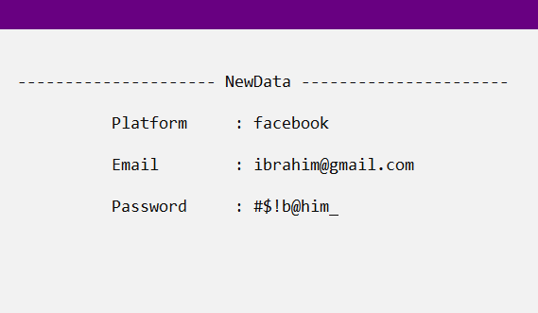
Some screenshots of running project

Slide 7
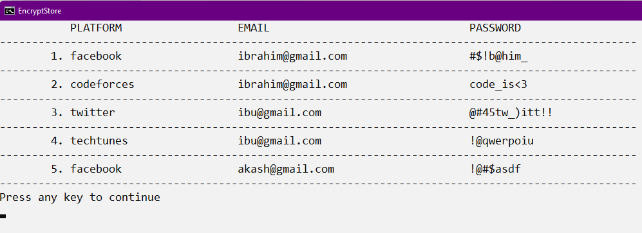
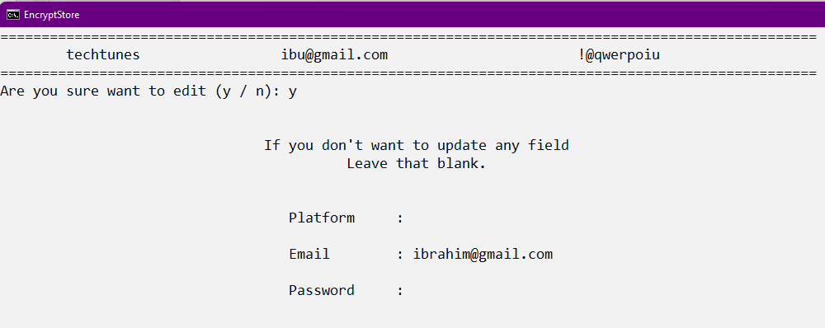
Experimental Results

Slide 8
Limitations
There is no online database
No backup option
Data hijacking

Slide 9
Conclusion & Future Scope
Can be modified more in future with more functions.
More secure system
Online Database
Advance data structure and algorithm
Improve front-end
Web base application

Slide 10
Thank you

