Slide 1
EcoSync UNIT 7
almamunmazumder1021@gmail.com
absiddik945@gmail.com
ibuhossain3@gmail.com

Slide 2
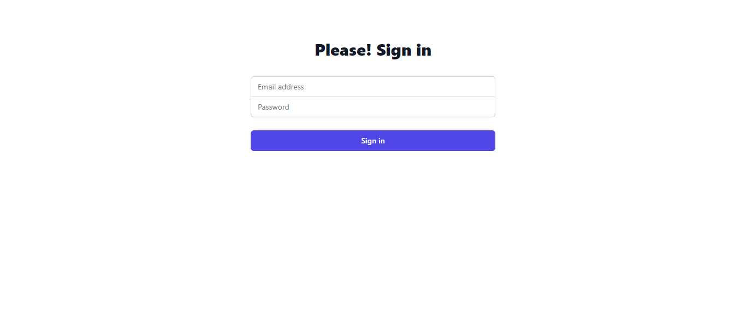
Login page

Slide 3
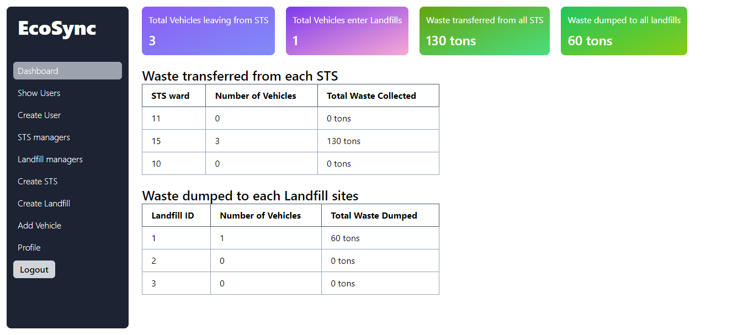
Dashboard

Slide 4
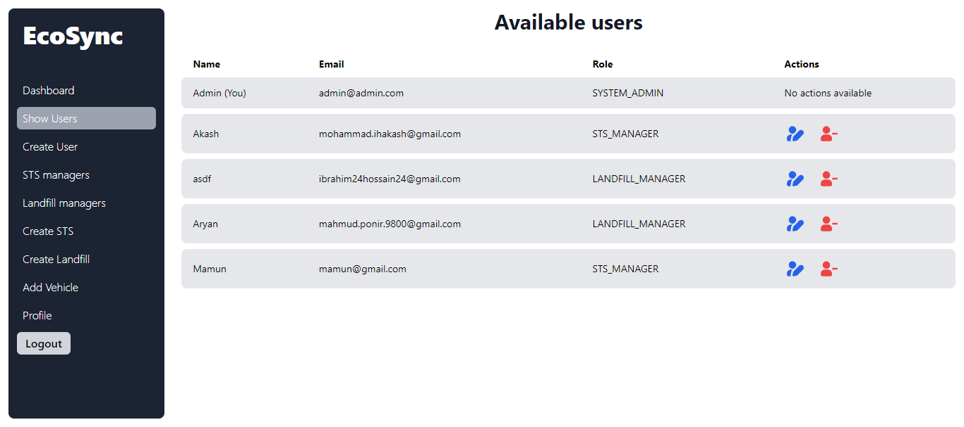
Show Users

Slide 5
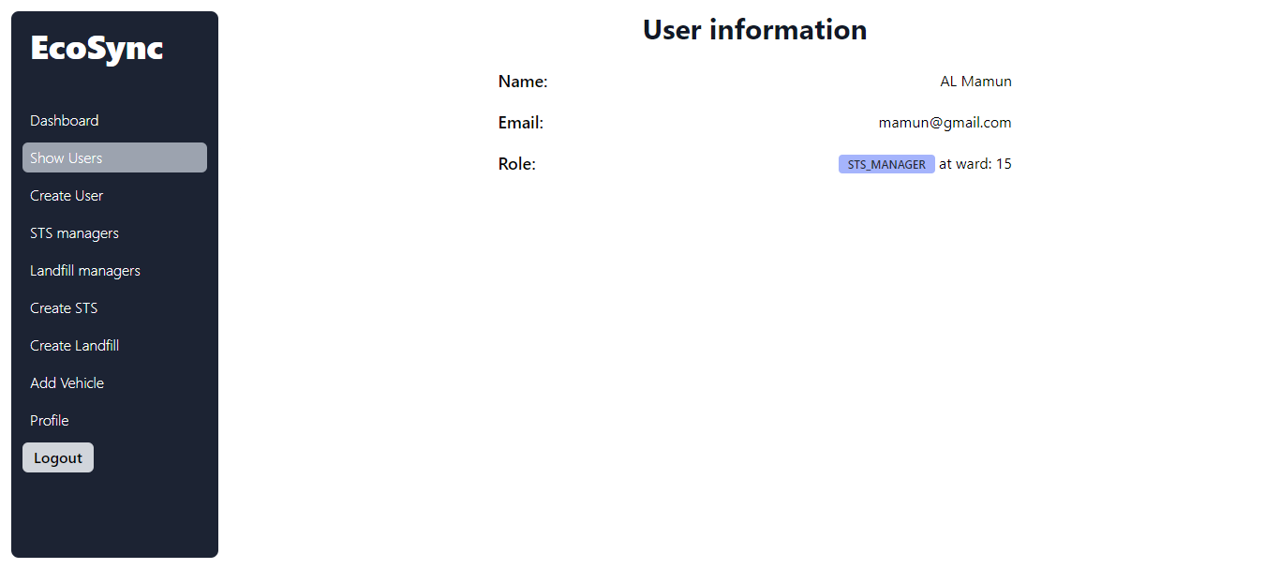
Individual User info page

Slide 6
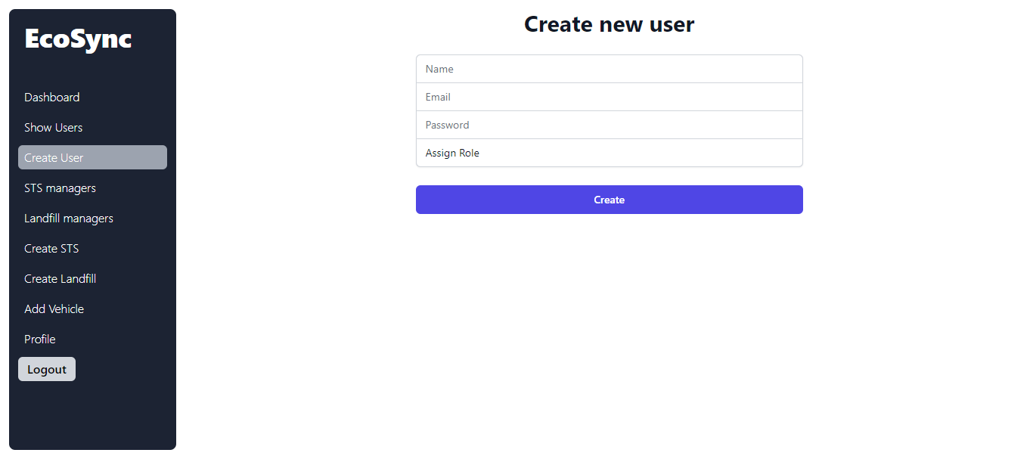
Create new User

Slide 7
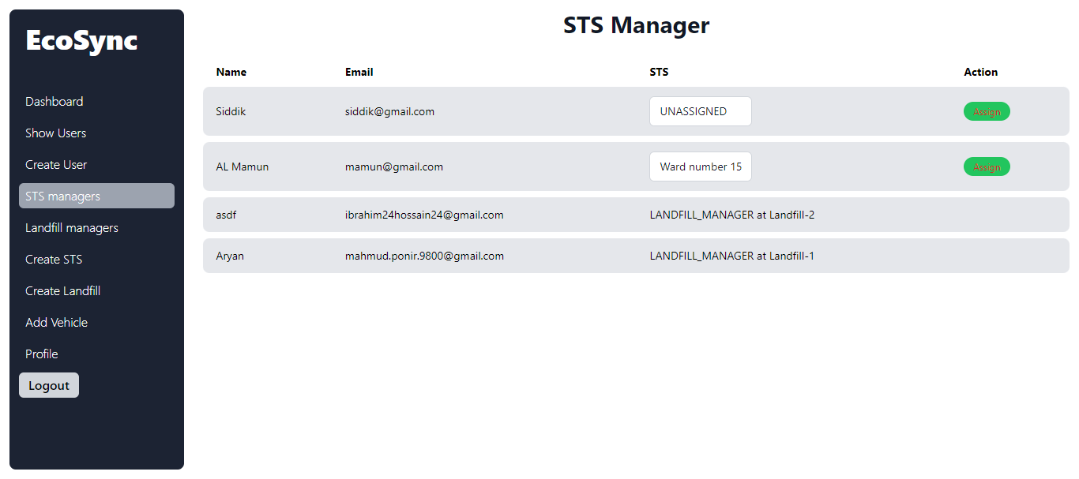
STS managers and assign user to manager

Slide 8
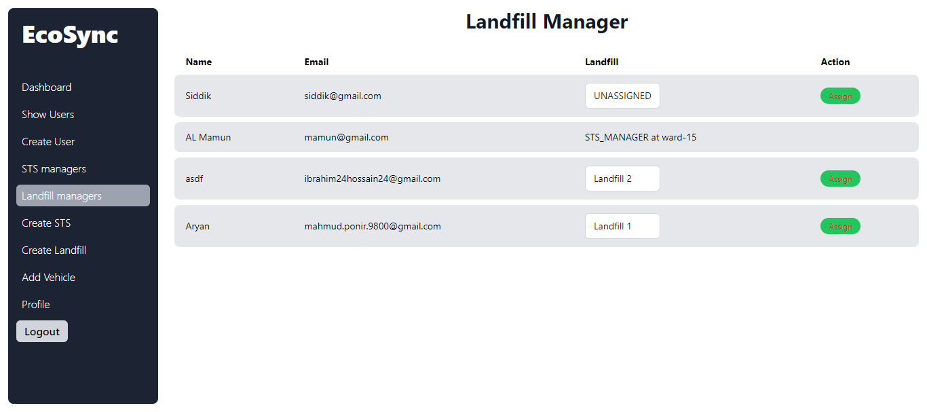
Landfill managers and assign user to manager

Slide 9
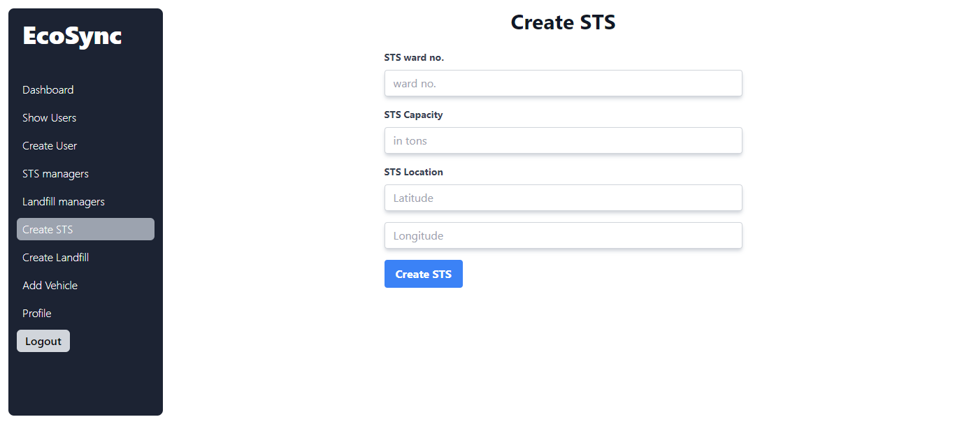
Create new STS

Slide 10
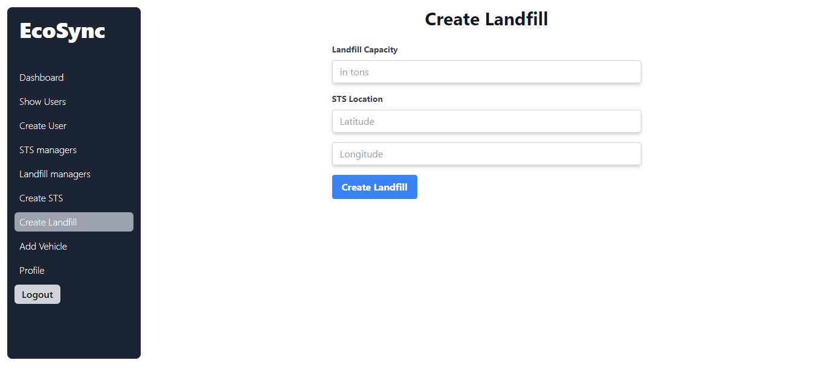
Create new Landfill site

Slide 11
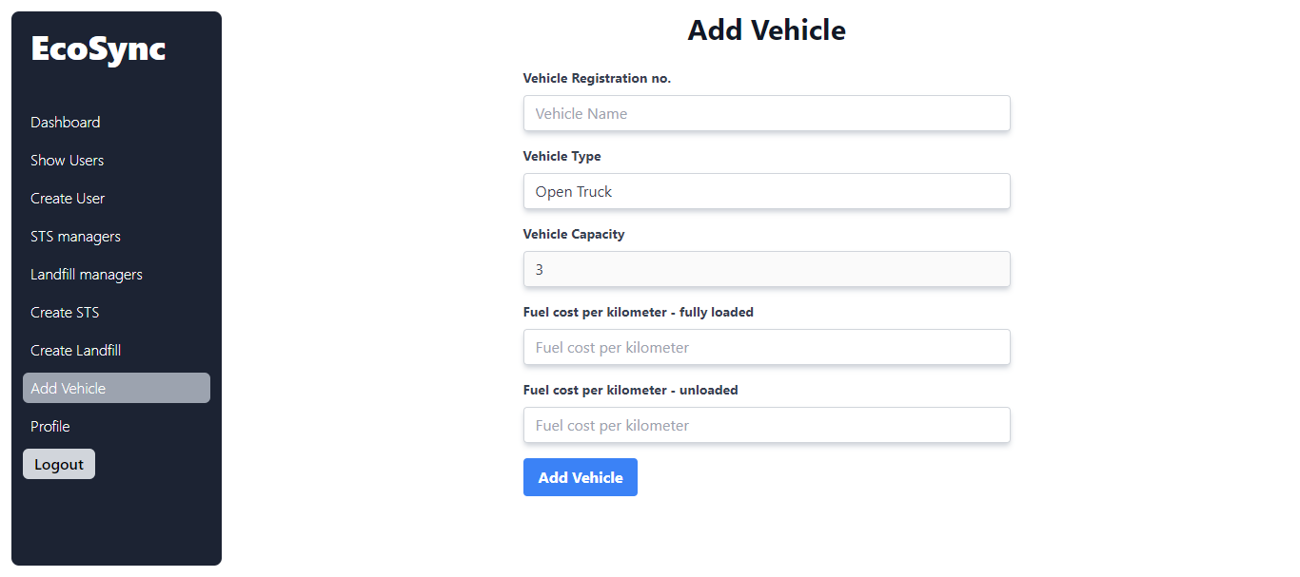
Add new Vehicle

Slide 12
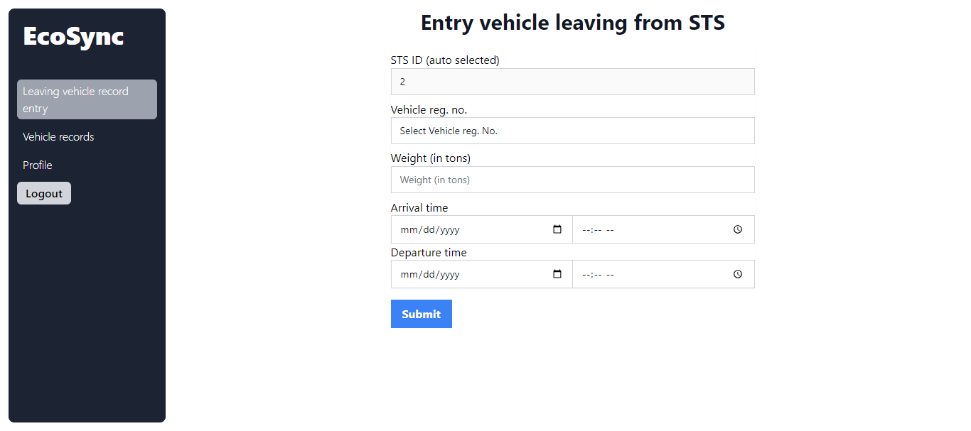
Add entry of vehicles leaving the STS

Slide 13
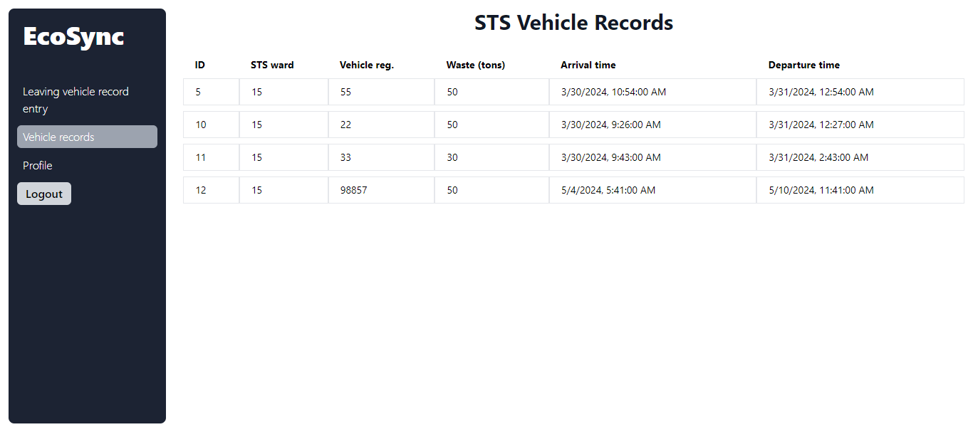
Records of vehicles leaving the STS

Slide 14
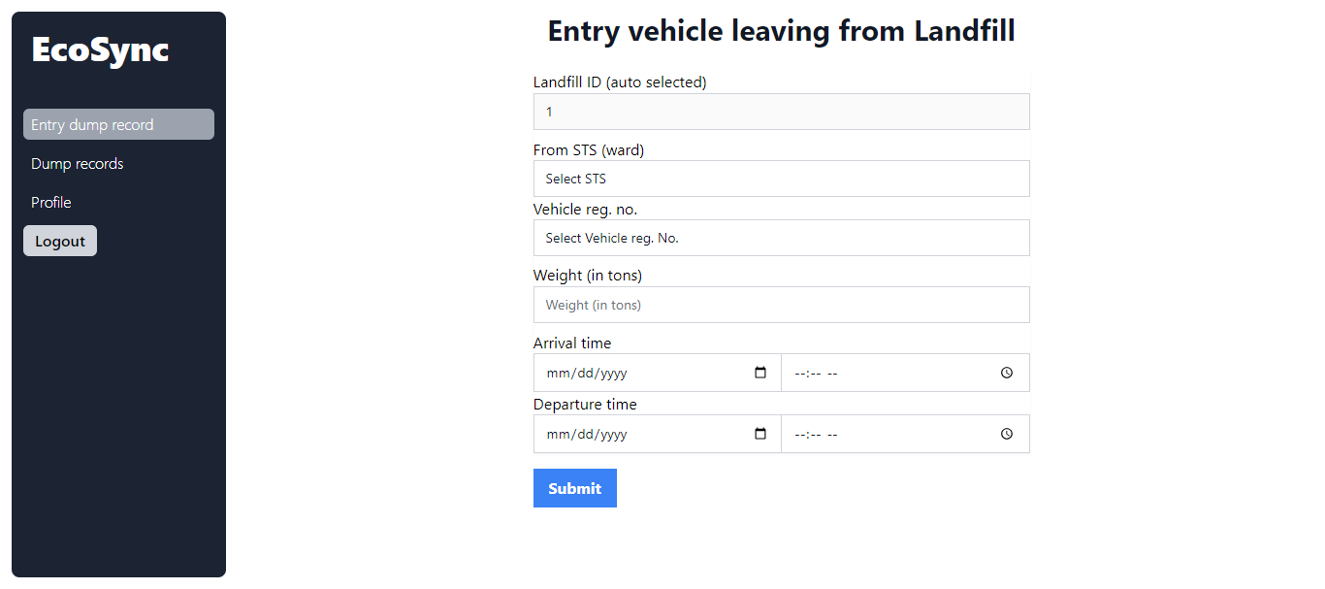
Add entry of truck dumping

Slide 15
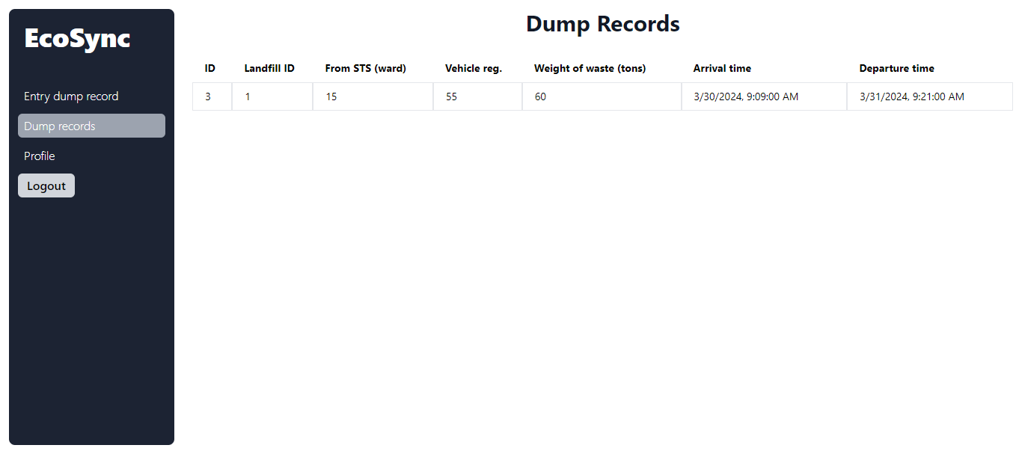
Records of truck dumping

Slide 16
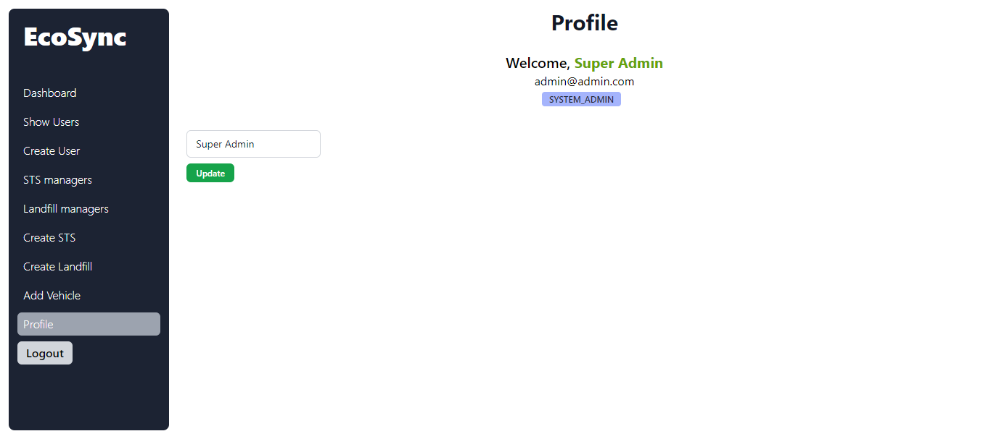
Profile view and update view

