Slide 1
EcoSync UNIT 7
almamunmazumder1021@gmail.com
absiddik945@gmail.com
ibuhossain3@gmail.com

Slide 2
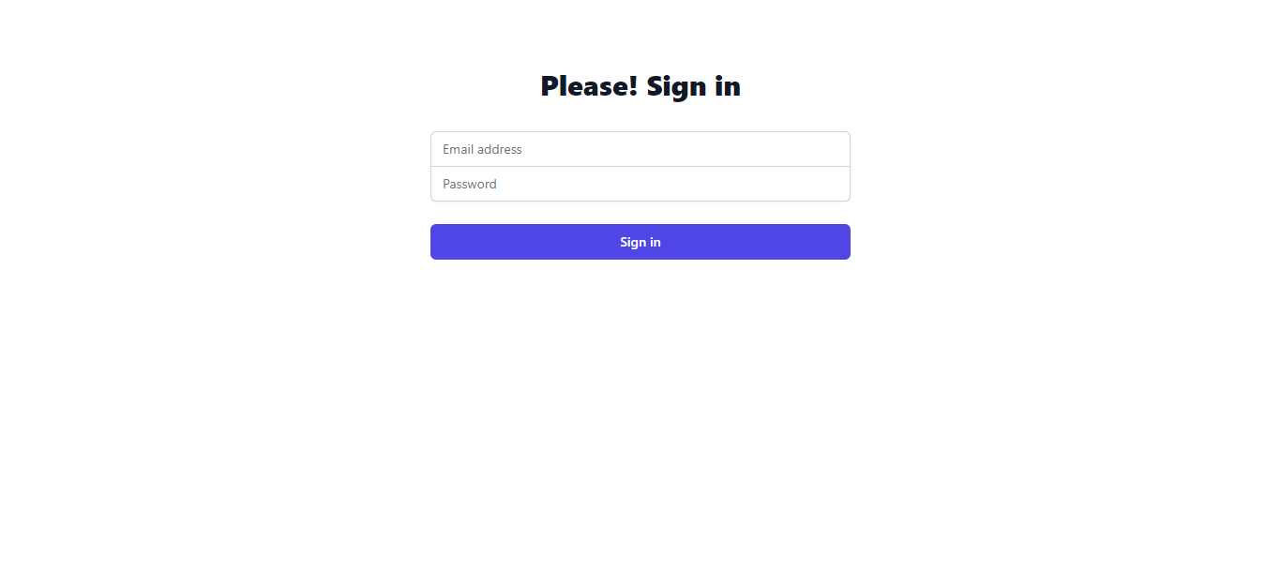
Login page

Slide 3
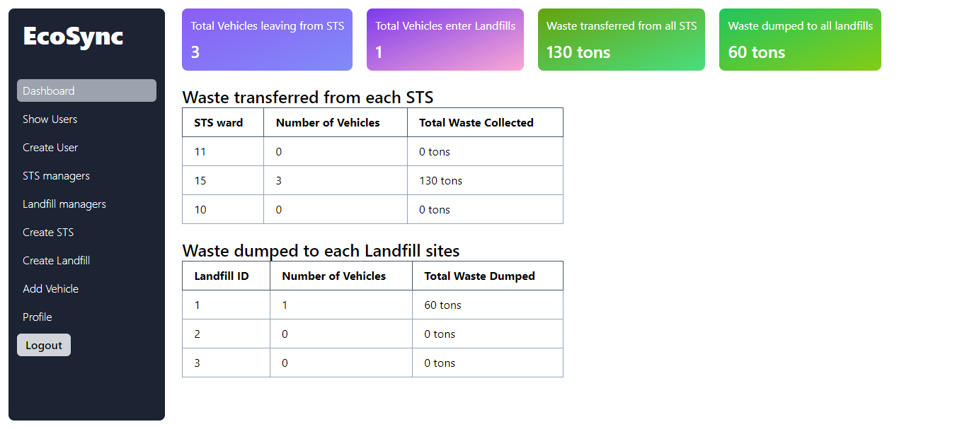
Dashboard

Slide 4
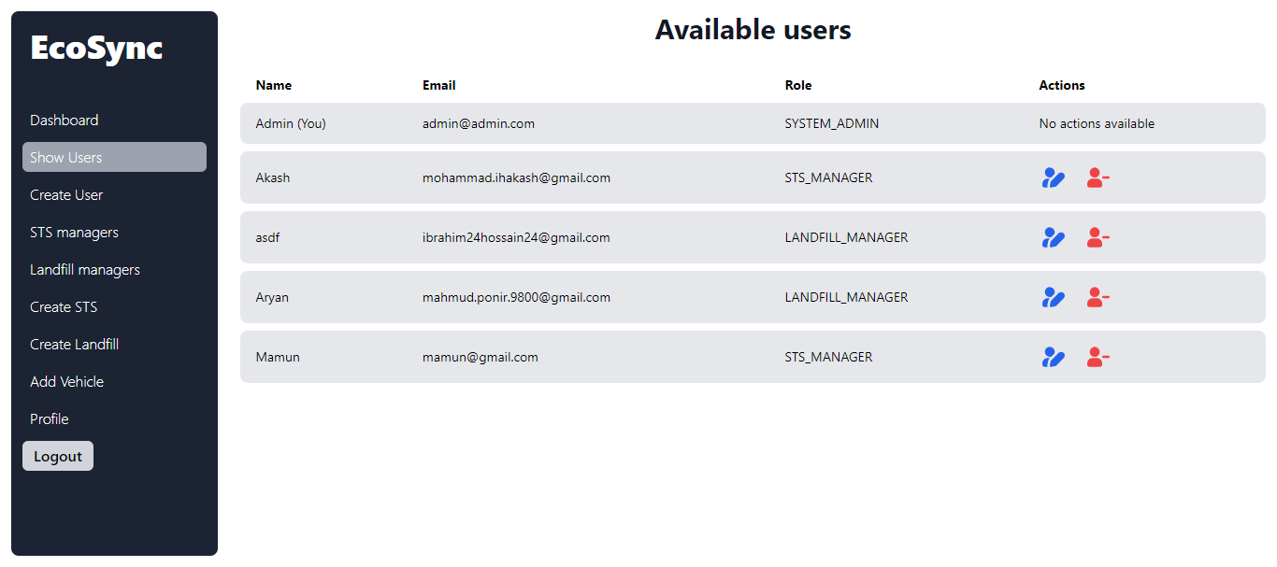
Show Users

