Slide 1



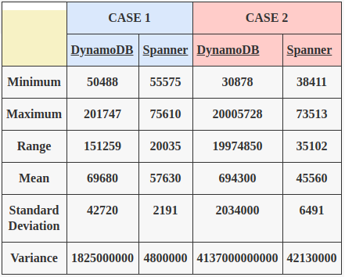
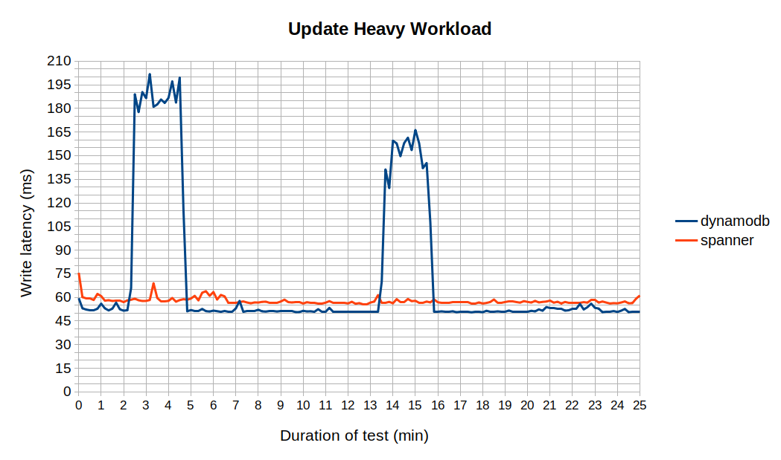
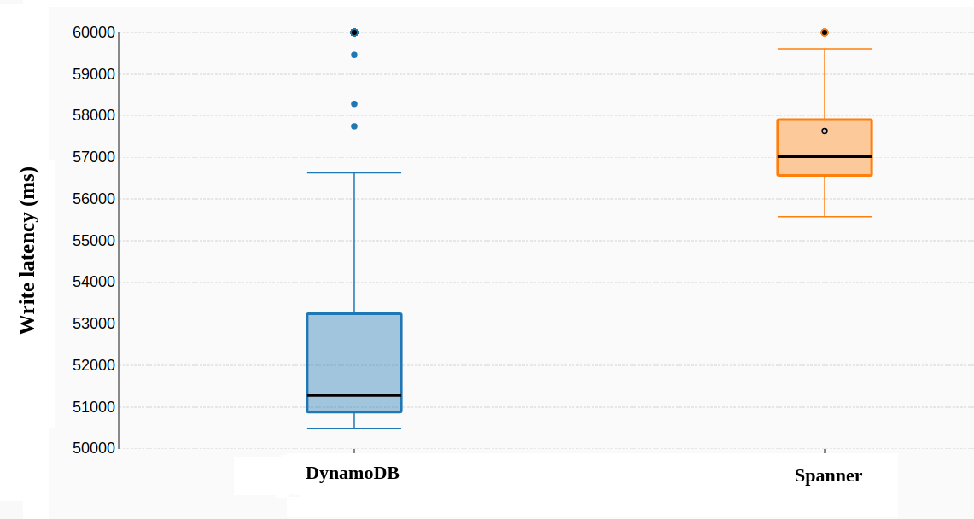
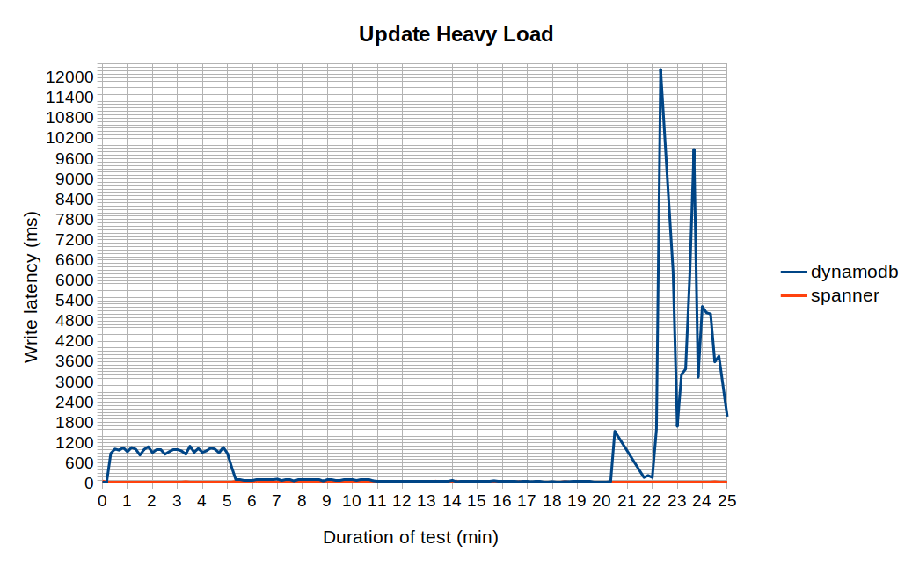
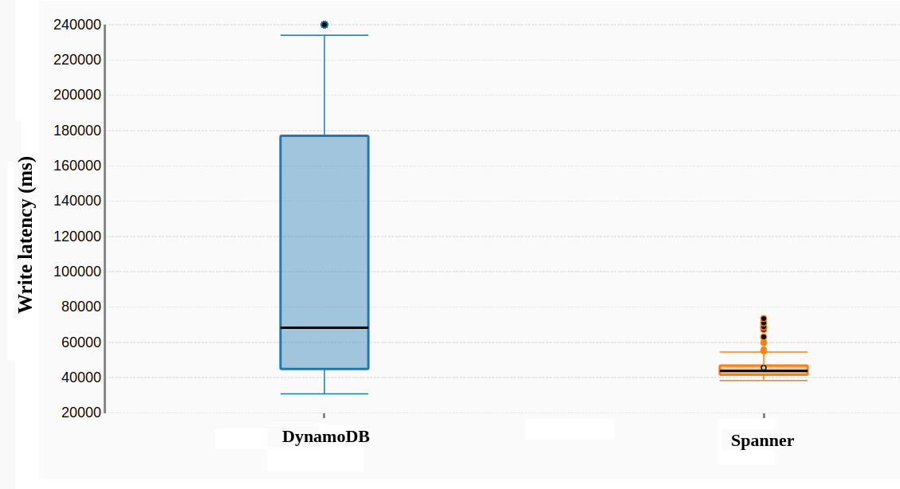
Enterprise Computing WS18/19
DynamoDB vs Spanner
Cloud Service Benchmarking
Research Question(s):
- What is AWS DynamoDB and Google Spanner’s write performance in terms of latency when both stores are introduced with update heavy workloads?
- How does the database record size affect the write latency of the two stores?
*** Experiments ***
CASE 1: (Records with field size 100 bytes):
Write latency (ms) line chart (field size 100 bytes)
Write latency (ms) box plot (field size 100 bytes)
CASE 2: (Records with field size 1000 bytes):
Write latency (ms) line chart (field size 1000 bytes)
Write latency (ms) box plot (field size 1000 bytes)
Conclusion:
- On average, both DynamoDB and Google Spanner respond within a reasonable amount of time (i.e. 50ms to 60ms) on small write requests.
- However, DynamoDB has an extremely slow performance when forced to deal with larger records which exceed the minimum provisioned read/write capacity. An interesting observation acquired during the benchmarking sessions was that the DynamoDB Autoscaler doesn’t kick in to increase the read/write capacity in any predictable pattern
- While Google Spanner has a very stable performance regardless of the size of the individual records, DynamoDB operates with progressively higher latencies and delivers inconsistent results when the item size increases.
Authors: Denis Rangelov, Martin Dichev (Group H)

