Slide 1



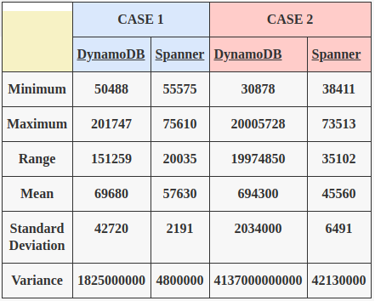
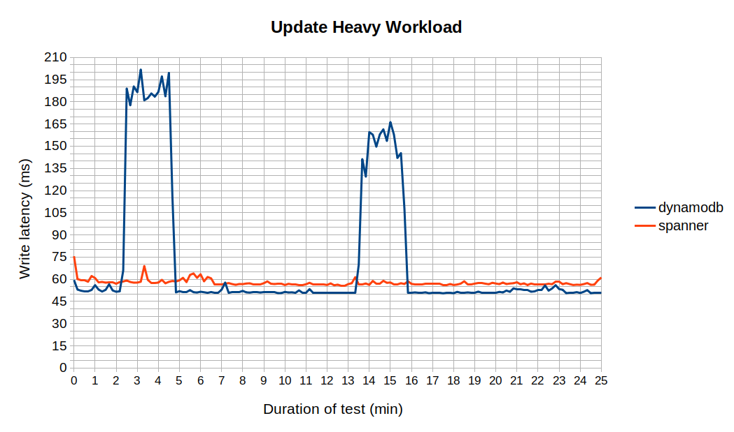
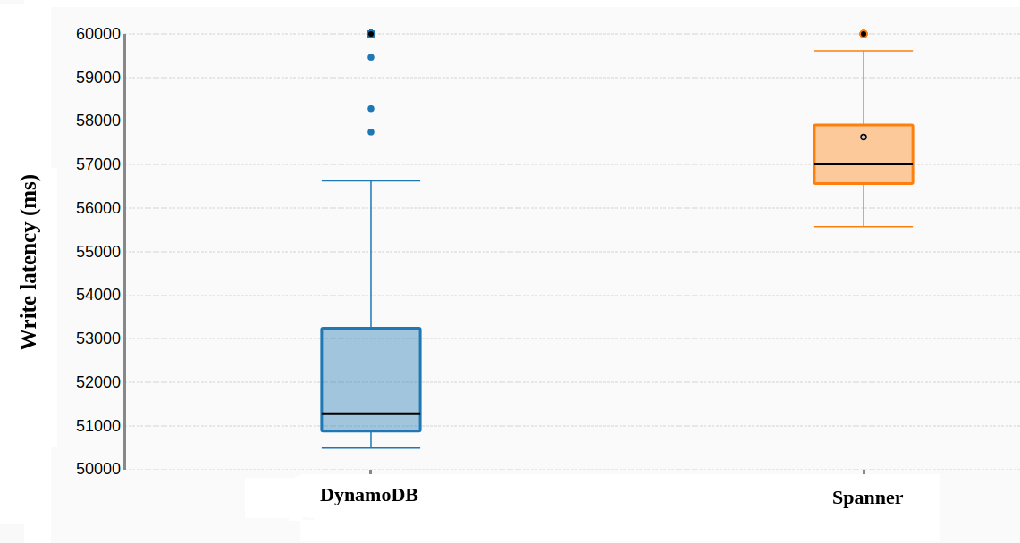
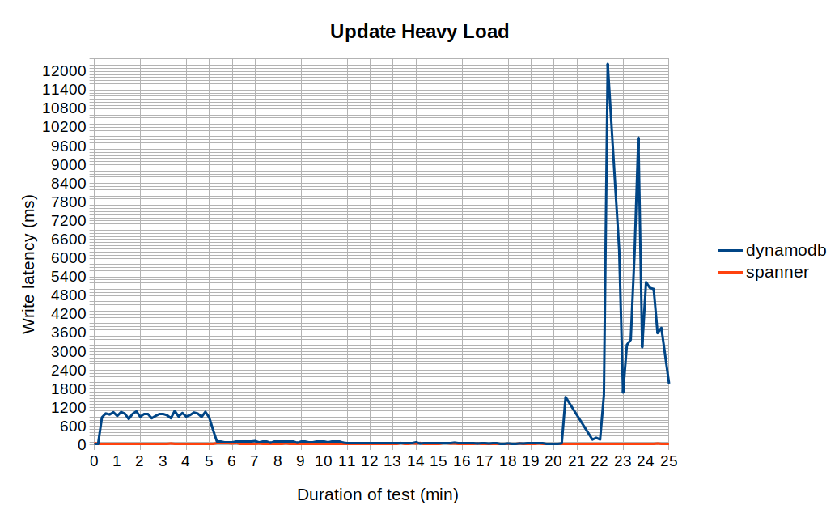
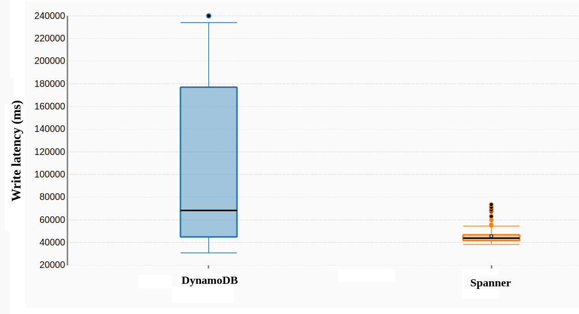
Enterprise Computing WS18/19
DynamoDB vs Spanner
Cloud Service Benchmarking
Research Question(s):
- What is AWS DynamoDB and Google Spanner’s write performance in terms of latency when both stores are introduced with update heavy workloads?
- How does the database record size affect the write latency of the two stores?
*** Experiments ***
CASE 1: (Records with field size 100 bytes):
Write latency (ms) line chart (field size 100 bytes)
Write latency (ms) box plot (field size 100 bytes)
CASE 2: (Records with field size 1000 bytes):
Write latency (ms) line chart (field size 1000 bytes)
Write latency (ms) box plot (field size 1000 bytes)
Conclusion:
- On average, both DynamoDB and Google Spanner respond within a reasonable amount of time (i.e. 50ms to 60ms) on small write requests.
- However, DynamoDB has an extremely slow performance when forced to deal with larger records which exceed the minimum provisioned capacity. An interesting observation was that the DynamoDB Autoscaler doesn’t kick in to increase the read/write capacity in any predictable pattern
- While Google Spanner has a very stable performance regardless of the size of the individual records, DynamoDB delivers unpredictable results when the item size increases.
Authors: Denis Rangelov, Martin Dichev (Group H)

