Slide 1



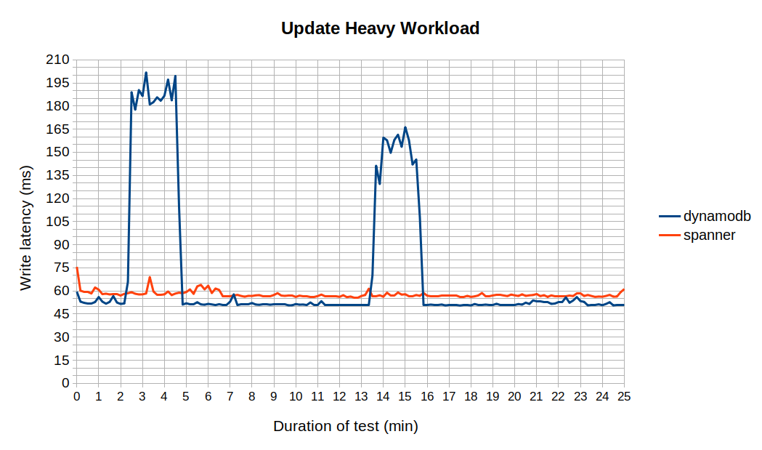
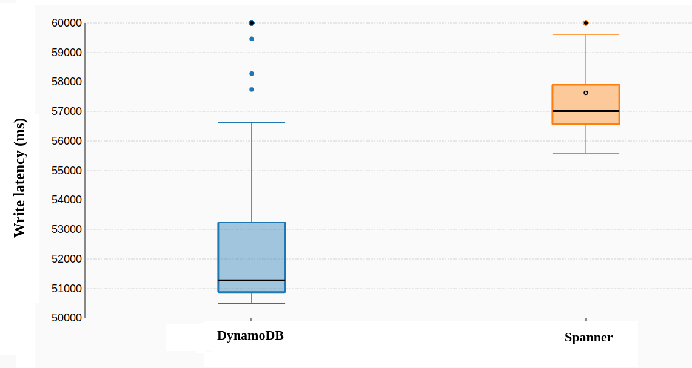
Enterprise Computing WS18/19
DynamoDB vs Spanner
Cloud Service Benchmarking
Research Question(s):
Authors:
- What is AWS DynamoDB and Google Spanner’s write performance in terms of latency when both stores are introduced with update heavy workloads?
- How does the database record size affect the write latency of the two stores?
(Group H)
- Denis Rangelov Matr. Number: 374115 - Martin Dichev Matr. Number: 358768
Experiments:
Write latency (ms) line chart (field size 100 bytes)
Write latency (ms) box plot (field size 100 bytes)

