Slide 1

Telecom Churn Analysis
DSC 530
Mohamed Idhrees Sanaulla

Slide 2
Dataset & Variables
Churn is a one of the biggest challenge in the telecom industry. We are going to analyze the data of company and find insights and stop customers from churning out to other telecom companies
We have 21 different variables in our dataset but below variables are primary used to find the impact on churn
Churn
Monthly Charges
Total Charges
Tenure
Gender
Senior Citizen
Data set I will be using from Kaggle(https://www.kaggle.com/palashfendarkar/wa-fnusec-telcocustomerchurn)

Slide 3
Dataset & Variables- Visualization
We are trying to understand how variables in a dataset relate to each other and how those relationships depend on other variables.
I will be using scatter plots, Seaborn scatter plots and histogram to visualize the data
Primary variable component that will be utilize for correlation is Churn with Monthly Charges and Total Charges
Other variables were chosen from the data set to analyze if there are any correlation between them with “Churn”.
The following variables are categorical; Tenure, Gender, Senior Citizen
We also made a bin/group based on Tenure to further find the data impacts

Slide 4
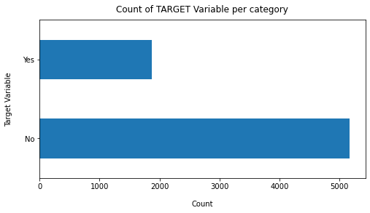
Explore Dataset and Variables
Actual Churn and Non-Churn
Total: 7043 recodes, Actual Churn 1869 and Non-Churn 5174. Data is highly imbalanced, ratio = 73:27, We will analyze the data with other features while taking the target values separately to get some insights

Slide 5
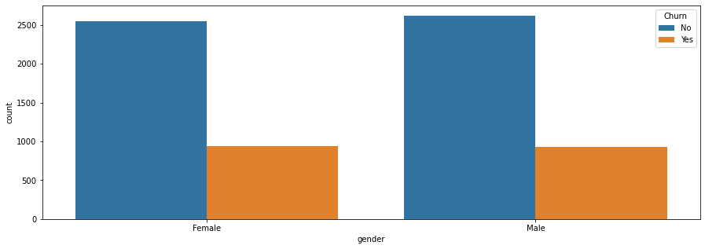
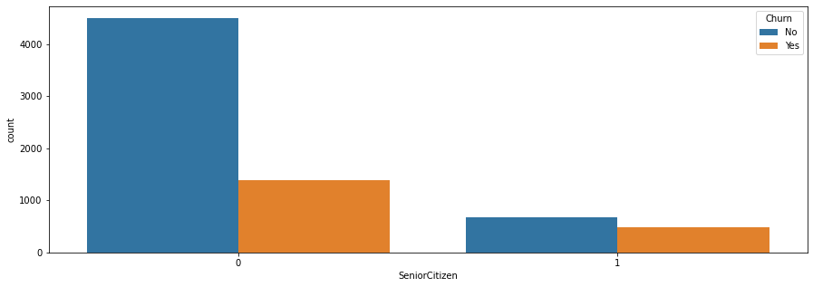
Explore Dataset and Variables
Churn vs Gender
Churn vs Senior Citizen
No outliers, spread between Gender and Churn on Senior Citizen gender seems to have some relationship with Churn

Slide 6
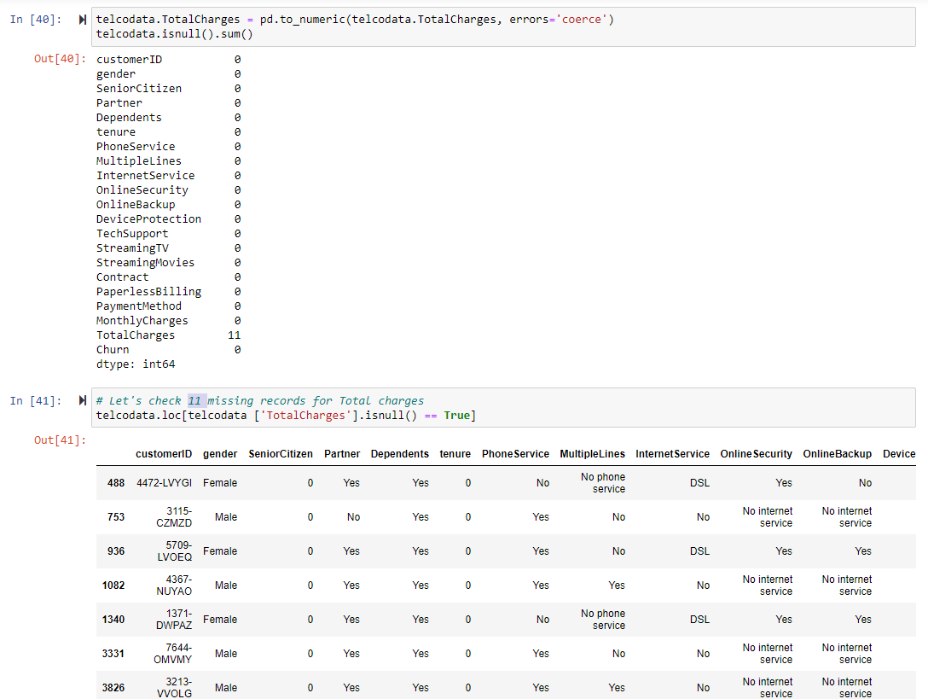
Cleansing Data for Outlier
We found outliers with Total Charges but seems to be missing values so it will be handled

Slide 7
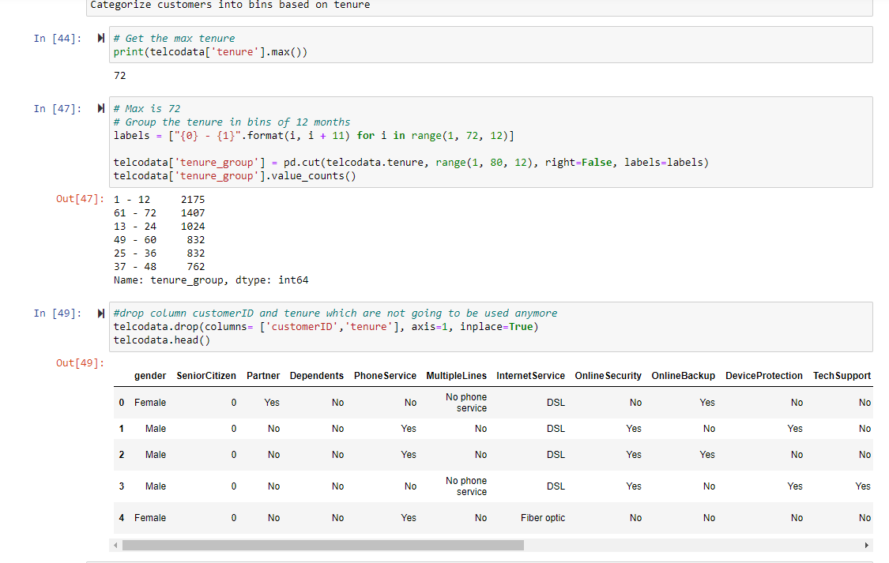
Preparing Data
Tenure variable have potential to give more insights, so we are going to create a bins for further exploration

Slide 8
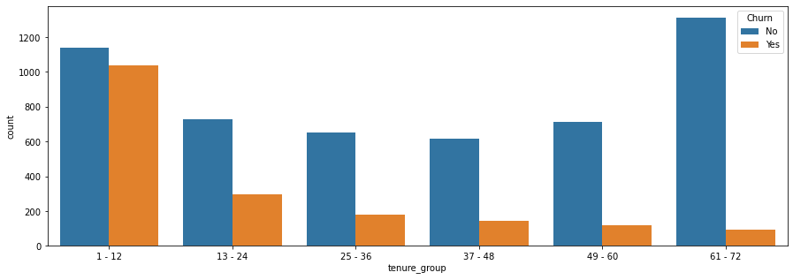
Explore Dataset and Variables
Churn vs tenure group
Churn on tenure group seems to have some relationship which can be furthered explored

Slide 9
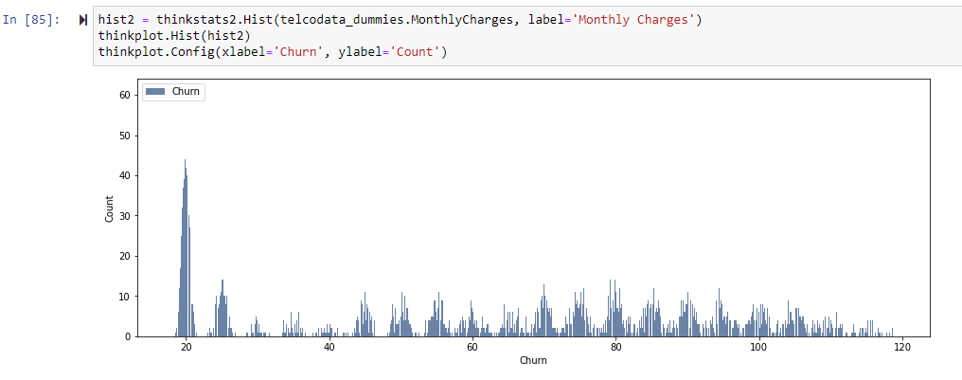
Explore Dataset and Variables
Churn vs Monthly Charges - Histogram

Slide 10
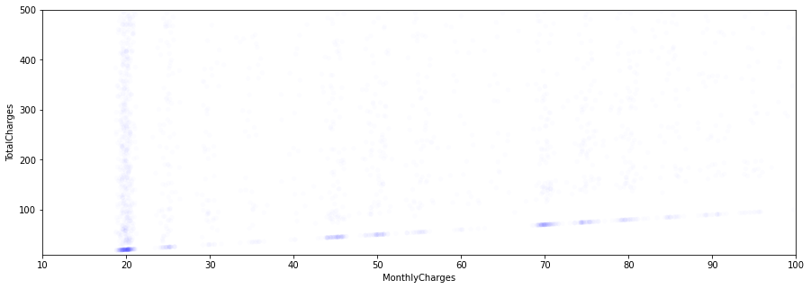
Explore Dataset and Variables
Churn vs Monthly Charges vs Total Charges- Histogram

Slide 11
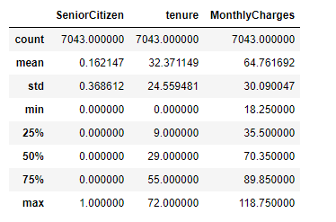
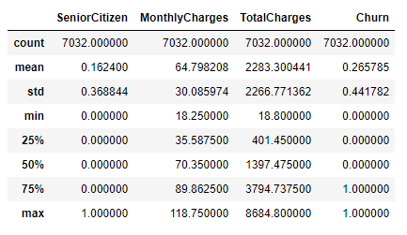
Count, Mean, STD, MIN, Percentile, MAX
Uncleansed Data
Cleansed Data

Slide 12
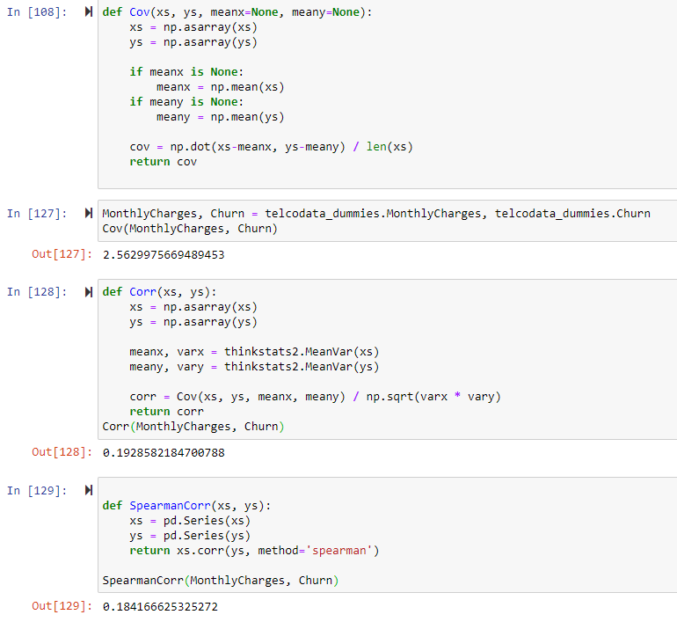
Covariance, Correlation and Spearman
Covariance and correlation tells positive relationship between Chrun and Monthly Charges, Spearman indicates the same as well!

Slide 13
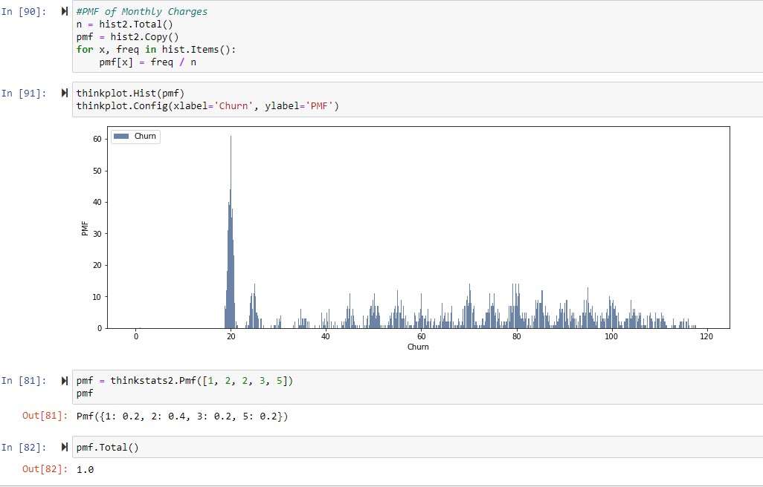
PMF

Slide 14
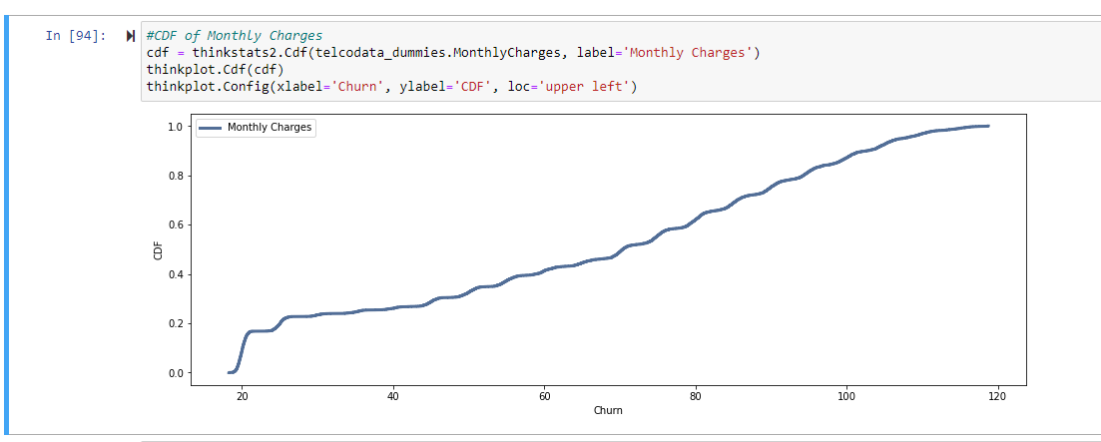
CDF

Slide 15
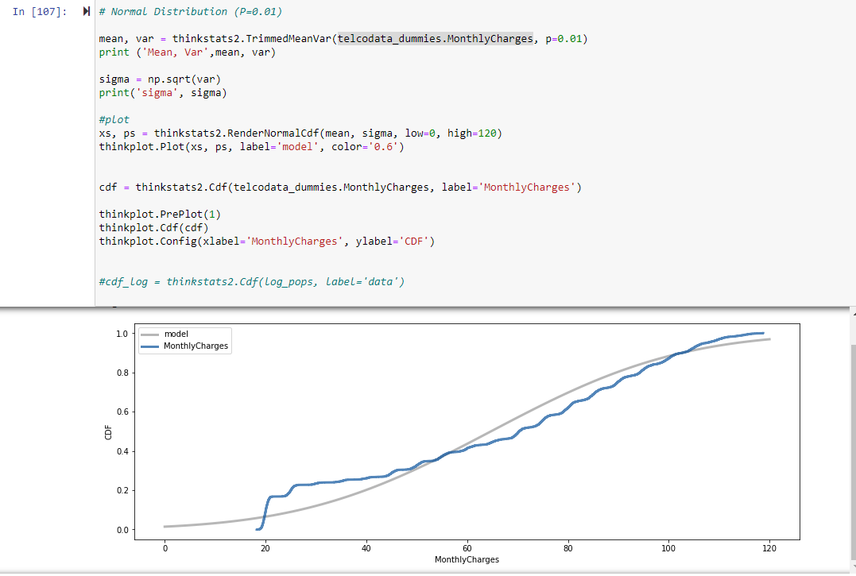
Normal Distribution

Slide 16
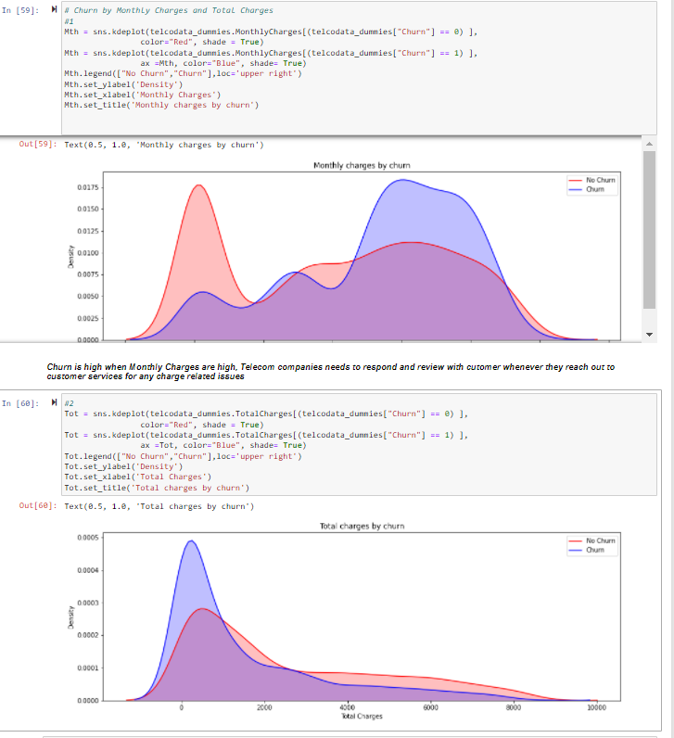
Distribution
Seaborn Plot proves the same what we derived PMF and CDF

Slide 17
Conclusions/Remarks
Churn is high when Monthly Charges are high, Telecom companies needs to respond and review with customer whenever they reach out to customer services for any charge related issues
higher Churn at lower Total Charges
However, if we combine the insights of 3 parameters Tenure, Monthly Charges & Total Charges then the picture is bit clear :- Higher Monthly Charge at lower tenure results into lower Total Charge. Hence, all these 3 factors viz Higher Monthly Charge, Lower tenure and Lower Total Charge are linked to High Churn

Slide 18
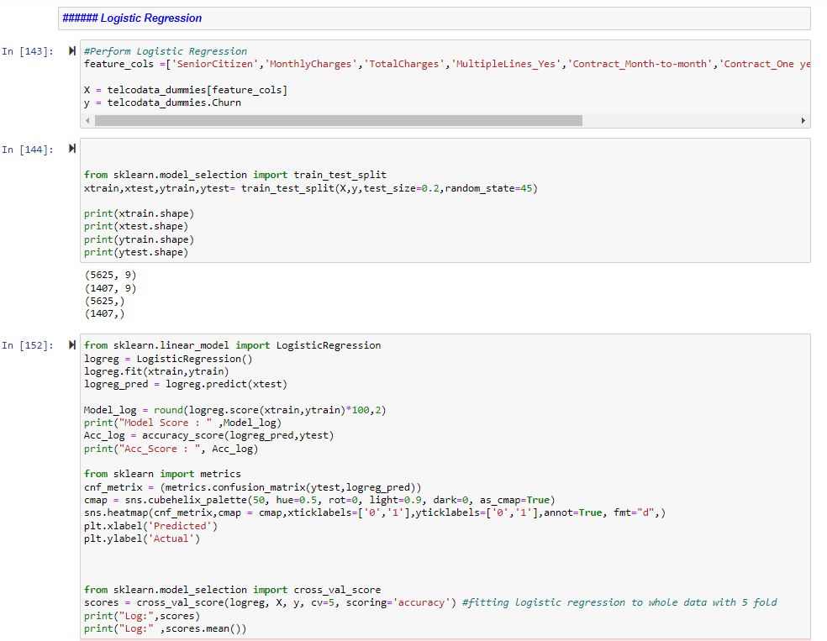
Logistic Regression

Slide 19
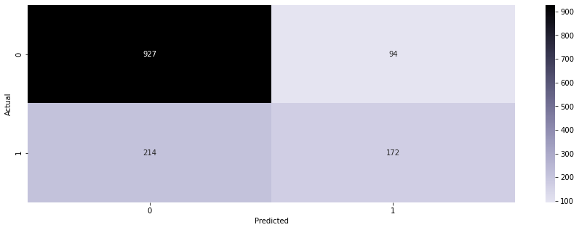
Logistic Regression - Evaluation
we've created a logistic regression and learned the computations happening at the back-end of a Logistic Regression.
We transformed these equations and mathematical functions into python codes.
We trained our logistic regression function as well

