Slide 1
CLUJ AI BUILDATHON 2026
🏙️
Cluj Civic AI
AI-powered urban infrastructure reporting
for a smarter Cluj-Napoca
Claude Vision AI
Next.js 15
PostgreSQL
Real-time Maps
Citizen & Gov Panels
Built at Cluj AI Buildathon · May 2026

Slide 2
THE PROBLEM
Urban infrastructure issues go unreported & unresolved
Citizens encounter daily problems — but reporting is slow, fragmented, and produces no visible action.
🕳️
📋
📍
No easy channel
Manual categorisation
No location tracking
Hotlines, social posts — no systematic follow-up
Every report triaged by hand — delays & misrouting
Problems lack GPS context for dispatch
🔇
📊
⚡
Zero transparency
No data for city hall
Critical issues missed
Citizens never know if their report was acted on
Authorities can't plan maintenance budgets
Hazards stay unresolved for weeks

Slide 3
OUR SOLUTION
One app. AI at the core. City-wide impact.
Cluj Civic AI connects citizens to local government through an intelligent, photo-first reporting platform.
1
📸 Snap a photo
Citizen photographs a problem — pothole, broken light, water leak — with their phone.
2
🤖 Claude Vision analyses instantly
AI classifies issue type, severity (LOW→CRITICAL), and writes a human-readable summary in seconds.
3
🗺️ GPS-pinned & submitted
The report is geo-tagged and routed to government officers with full context already attached.
4
✅ Track resolution in real time
Citizens follow status updates; officers log actions; the city gets aggregate analytics.

Slide 4
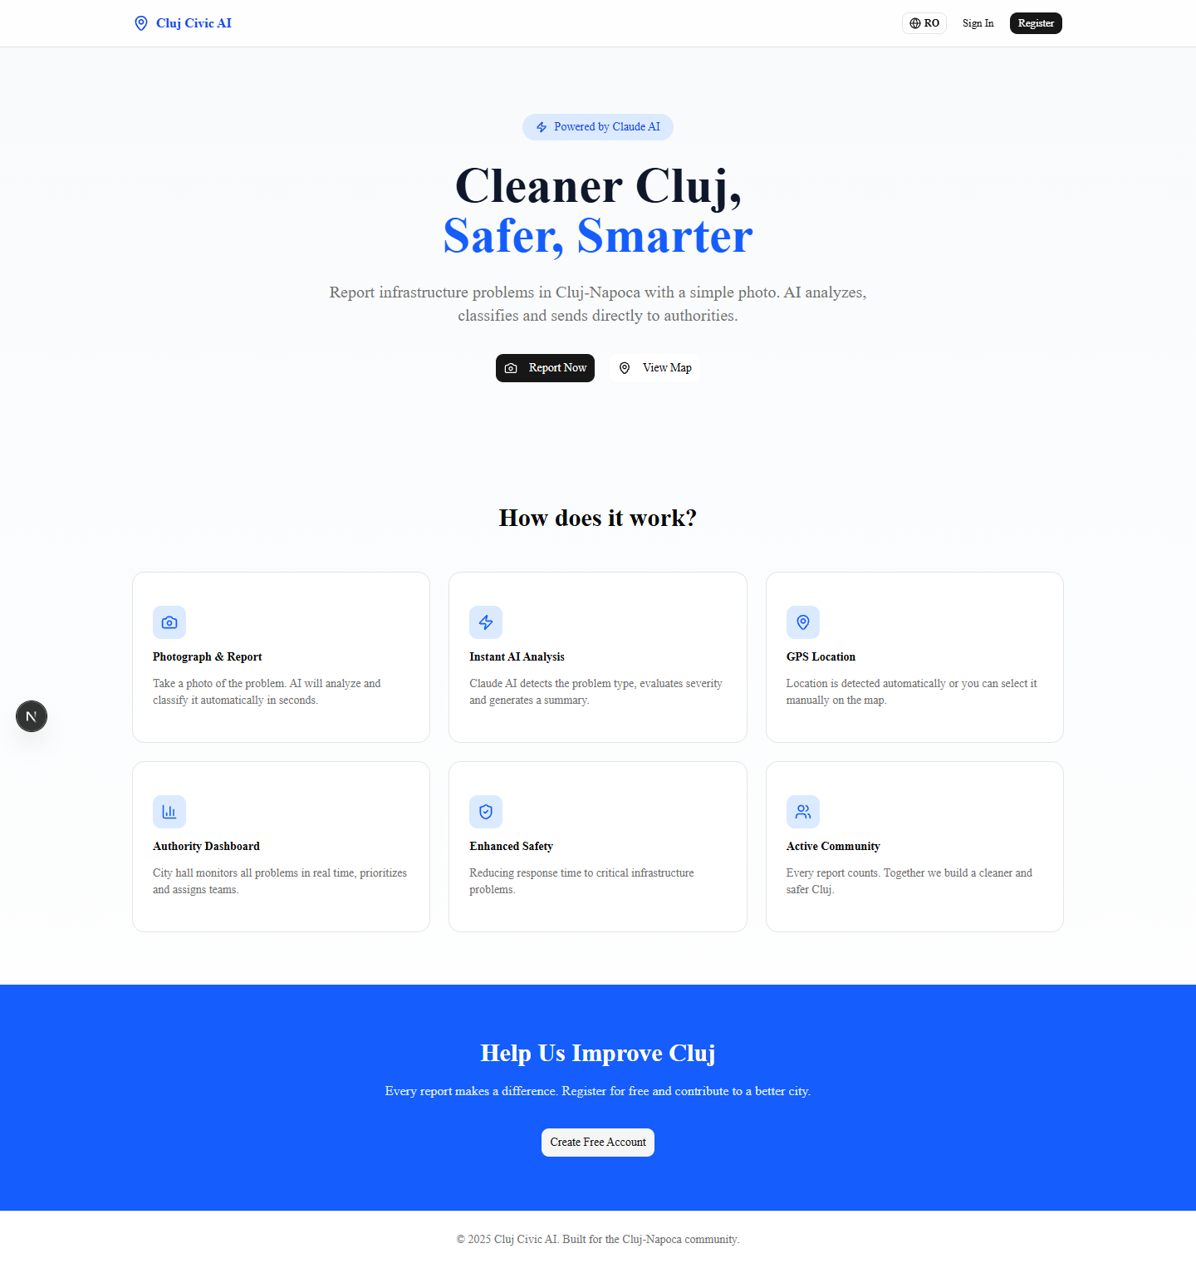
THE PLATFORM — LANDING PAGE
A clean, modern citizen-facing homepage

Slide 5
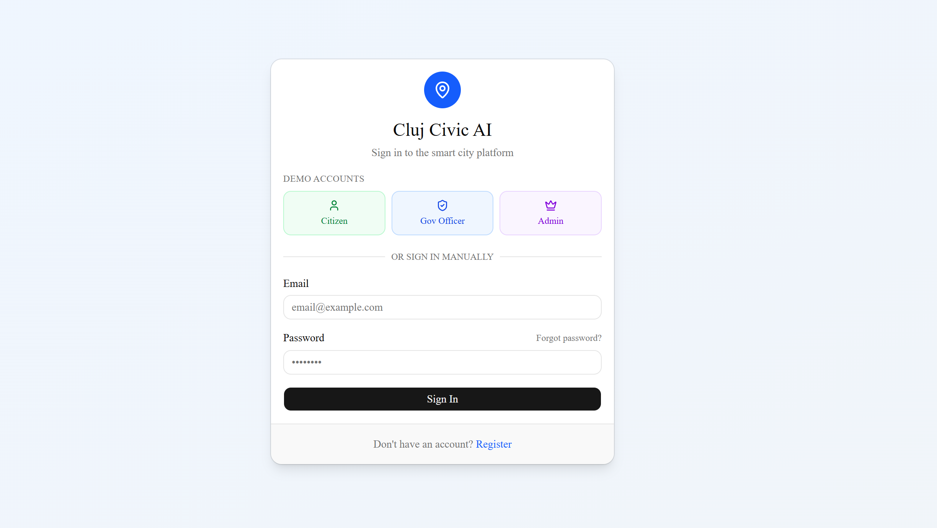
THE PLATFORM — LANDING PAGE
Log in Page

Slide 6
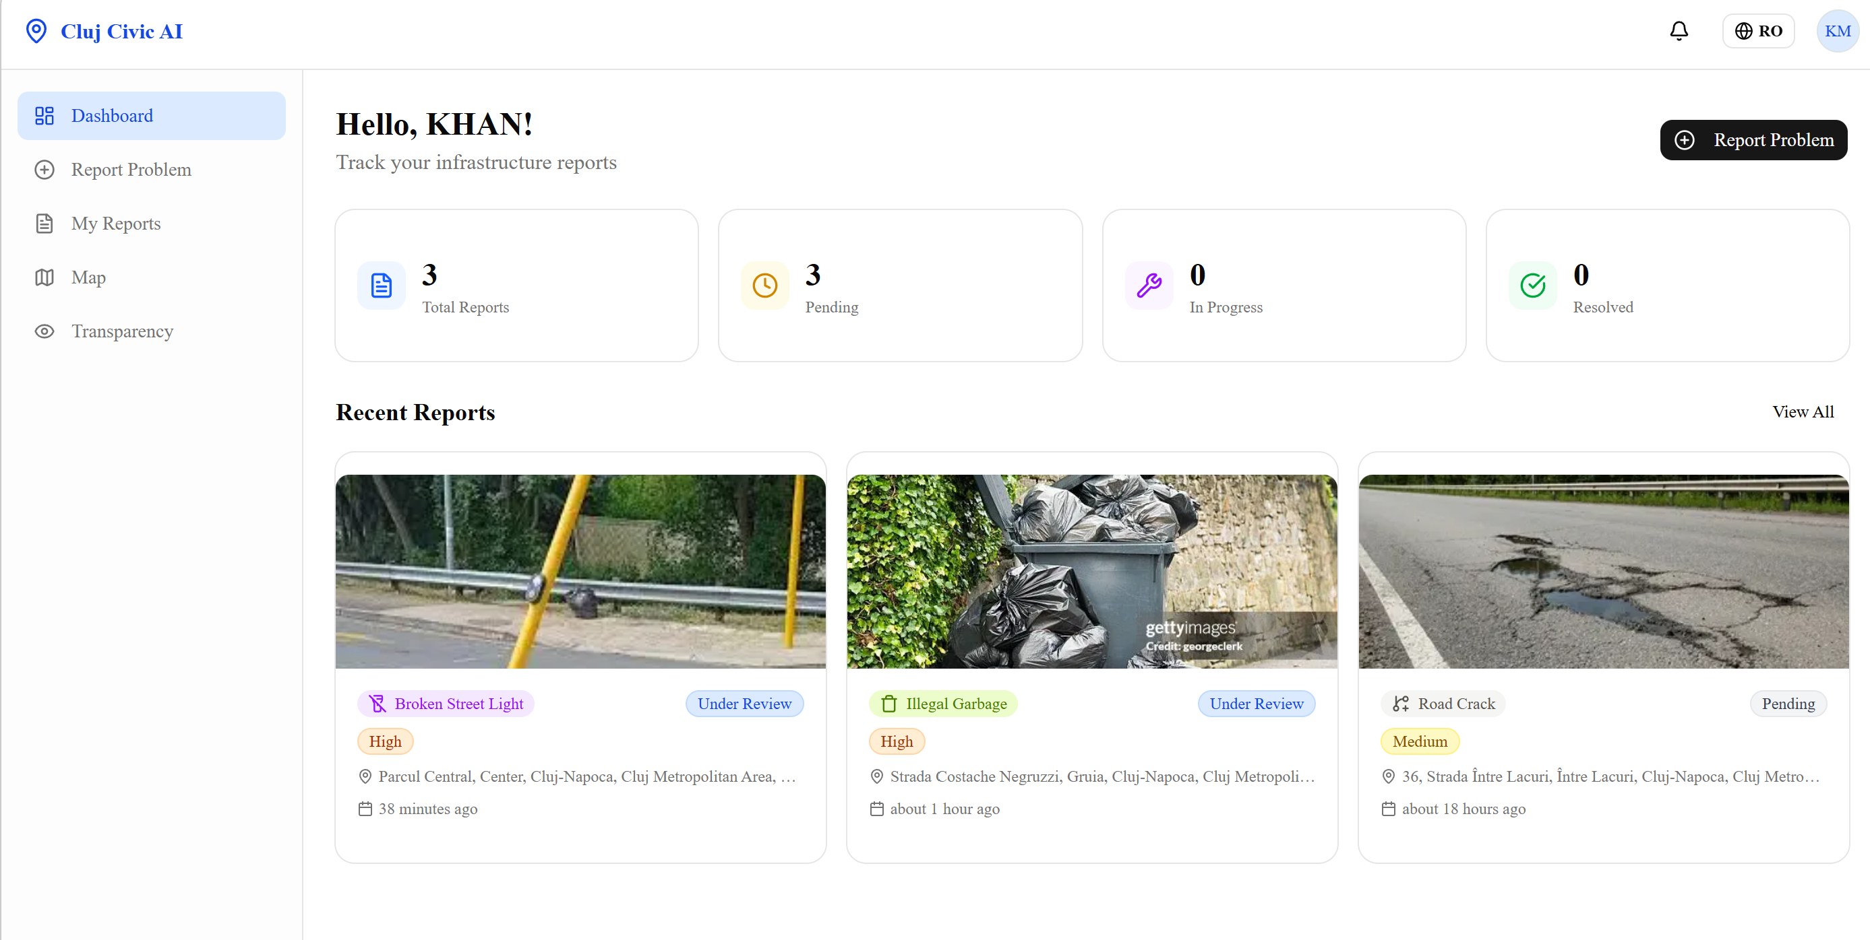
CITIZEN EXPERIENCE
Personal dashboard — at a glance

Slide 7
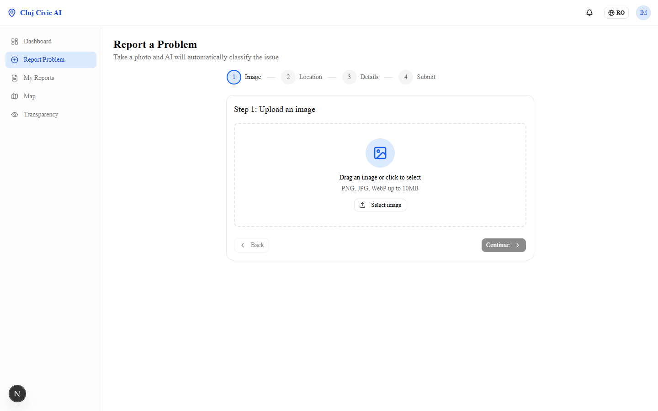
HOW IT WORKS — SUBMIT
4-step guided report submission
📸
Upload photo
Drag-drop or camera. Claude Vision analyses it instantly.
📍
Pin location
GPS auto-detects or click the map to place a pin.
✏️
Review details
AI pre-fills type, severity & summary — citizen can edit.
🚀
Submit
One tap. Report goes live in the government dashboard.

Slide 8
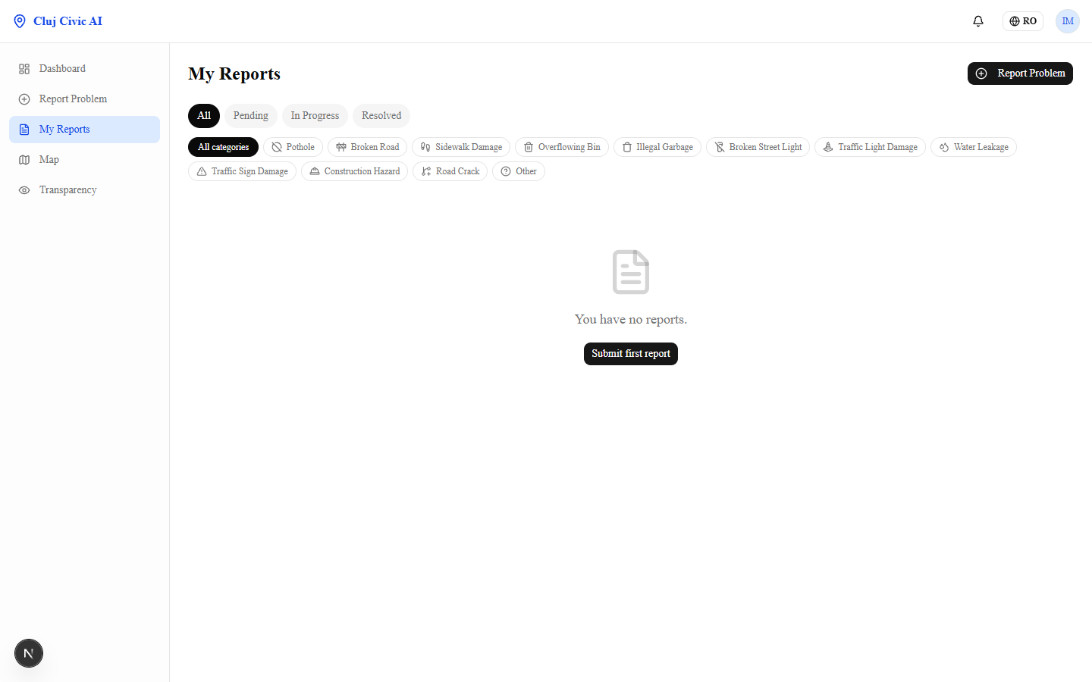
CITIZEN EXPERIENCE — MY REPORTS
Filter by status + category — track every report

Slide 9
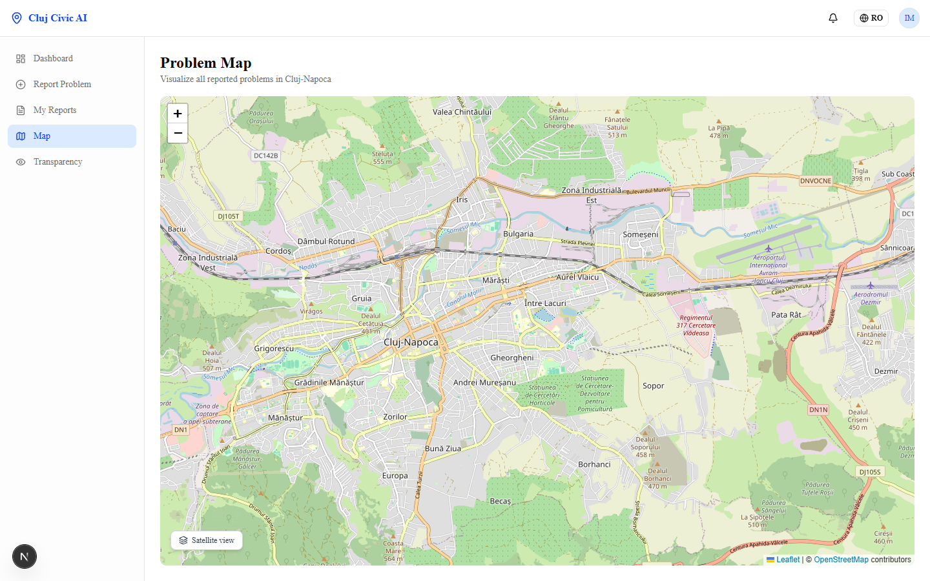
INTERACTIVE MAP
All reports on the map — street & satellite view
📍
GPS-pinned
Every report carries exact lat/lng coordinates.
🛰️
Satellite layer
Toggle between street map and Esri satellite imagery.
🎨
Severity colours
Markers coloured LOW→CRITICAL for instant triage.

Slide 10
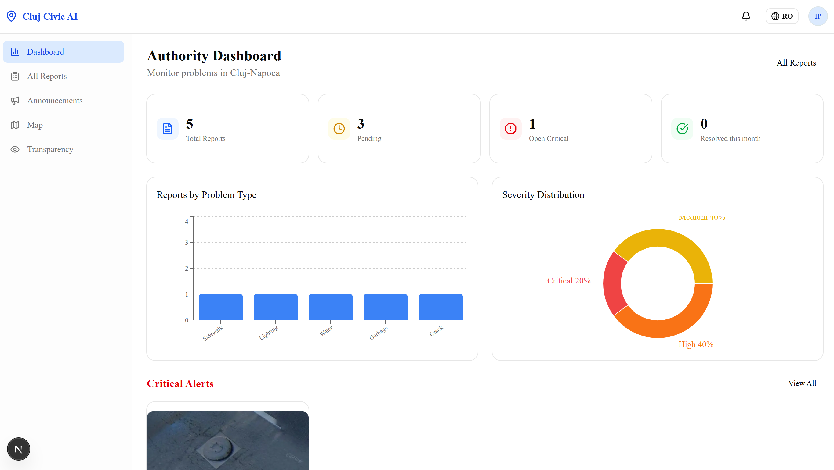
GOVERNMENT PANEL
Officers see everything — analytics, reports, actions
📊
Charts
Issue type bar chart + severity pie chart.
📋
All reports
Filter, sort, update status, log officer actions.
🔔
Status updates
Each status change is visible to the citizen instantly.

Slide 11
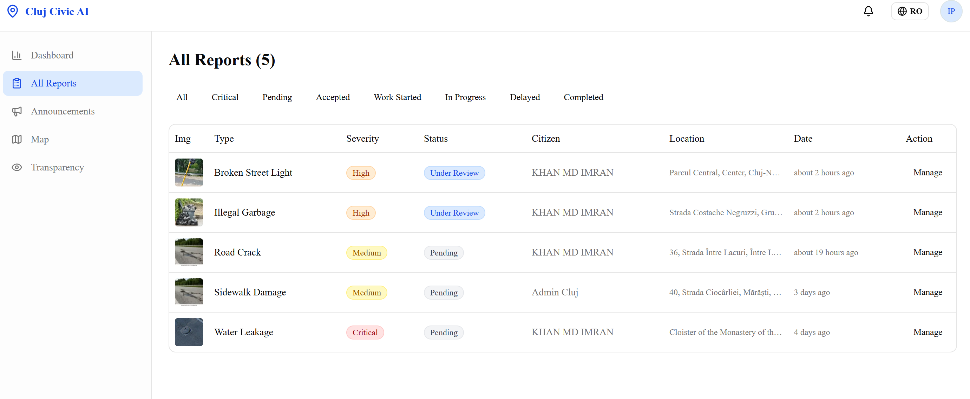
GOVERNMENT PANEL
Officers see everything — analytics, reports, actions

Slide 12
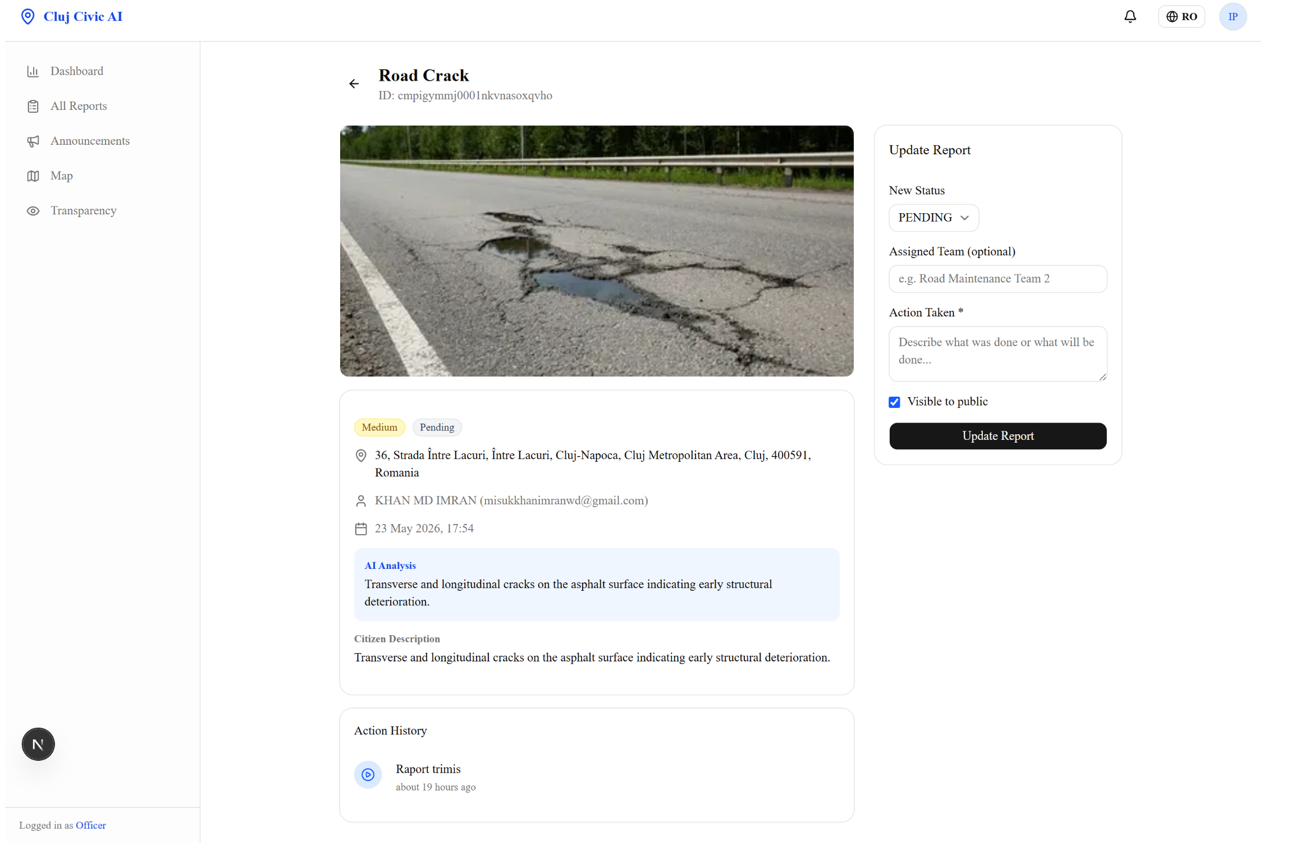
GOVERNMENT PANEL
Officers see everything — analytics, reports, actions

Slide 13
THE AI LAYER
Powered by Claude Vision API
claude-sonnet-4-6 → structured JSON output → auto-filled form
{
12 Issue Types
"issueType": "POTHOLE",
POTHOLE · BROKEN_ROAD · SIDEWALK_DAMAGE · GARBAGE · WATER_LEAKAGE · TRAFFIC_LIGHT_DAMAGE · and 6 more
"severity": "HIGH",
"summary": "Deep pothole, risk of vehicle damage",
4 Severity Levels
LOW cosmetic → MEDIUM weeks → HIGH hazard → CRITICAL same-day
"confidence": 91,
"additionalNotes":"Temporary marking recommended",
Demo Fallback
}
Hash-based deterministic scenarios ensure the app never breaks if AI is unavailable.

Slide 14
TECHNOLOGY STACK
Production-grade full-stack architecture
⚛️
🧠
🔐
🗄️
Next.js 15
Claude Sonnet
NextAuth v5
PostgreSQL
App Router + TypeScript
Vision AI Analysis
JWT Auth + Roles
Prisma ORM
☁️
🗺️
📊
✉️
Cloudinary
Leaflet + OSM
Recharts
Nodemailer
Image Storage & CDN
Interactive Maps
Analytics Charts
Password Reset Emails
🎨
✅
🌍
📡
Tailwind + shadcn
Zod + RHF
i18n Ready
pm2
UI Components
Validation & Forms
Multi-language Support
Persistent Server

Slide 15
WHAT'S NEXT
Roadmap to a full city platform
✅ Phase 1 — MVP (Done)
🔜 Phase 2 — Q3 2026
🚀 Phase 3 — 2027
→ Citizen photo reporting
→ Push / SMS notifications
→ Predictive maintenance AI
→ Claude Vision AI classification
→ Mobile PWA (installable)
→ Integration with Cluj City API
→ Government dashboard
→ Duplicate report detection
→ Resident satisfaction surveys
→ GPS maps (Street + Satellite)
→ Heat-map density view
→ Budget allocation AI
→ Report editing & deletion
→ Officer assignment & teams
→ Open data export
→ Forgot password + email
→ Public report feed
→ Multi-city rollout (Romania)
→ Account management
→ Multi-language (RO / HU / EN)
→ Category & status filtering
→ Analytics charts

Slide 16
CLUJ AI BUILDATHON 2026
Thank you! 🏙️
Let's build a smarter Cluj.
Cluj Civic AI proves that AI + civic tech can meaningfully
improve quality of life — one photo at a time.
🚀 Live Demo
📸 Submit Report
🗺️ View Map
🤖
⚡
🌍
Claude Sonnet 4.6
Next.js 15 + TypeScript
Open Infrastructure
Anthropic Vision API
Production-ready stack
OpenStreetMap + OSS
misukkhanimran@gmail.com

