Slide 1
Why Are Subscription Business
Models So Successful?
An Economic Perspective
Md. Atik Ahsan Ayon (251-35-295)
Md. Imtiaz (251-35-480)
Md. Ekramul Hasan (251-35-304)
Zannatul Ferdous Mim (251-35-411)
Rafsan Uddin Chowdhury (251-35-382)
01

Slide 2






What We'll Cover
Core Business Concept
Supply, Demand & Equilibrium
Understand the subscription model as a modern business structure and revenue strategy.
Evaluate how economic theory — pricing, scale, and consumer behavior — explains its success.
AGENDA
01
02
03
04
What is a
Subscription Model?
Key Economic
Concepts
Real-World
Example
Takeaways
& Q&A
02

Slide 3




Everyday Examples
A Simple Idea
Streaming
Subscription Box
Pay a little repeatedly,
not a lot
once.
Netflix, Spotify
Meal & grooming kits
Customers pay a recurring fee (weekly/monthly/yearly) for ongoing access to a product or service.
Membership
Software (SaaS)
Gyms, Amazon Prime
Adobe, AI
03

Slide 4
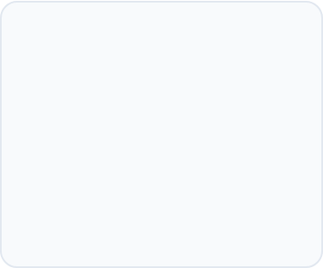

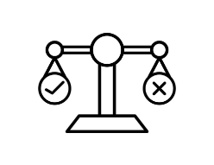


CONCEPT 01
Demand & the Psychology of Price
$150
$15/mo
Single upfront payment
Low predictable recurring cost
LOWER PSYCHOLOGICAL BARRIER
Large upfront capital cost
Small recurring monthly fee
Feels expensive & high friction
Feels accessible & budget-friendly
Shifts cost curve to widen total addressable market
High consumer purchase hesitation
Drives rapid consumer conversion
Economic Mechanism: Consumers over-index on immediate out-of-pocket costs versus cumulative future payments. Lowering upfront expenditure unlocks massive demand across price-sensitive segments.
04

Slide 5
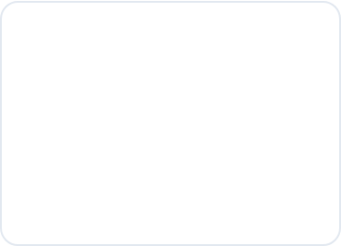

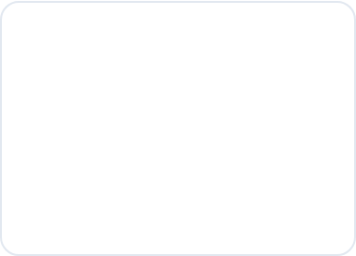




CONCEPT 02
Price Discrimination Through Tiers
Firms offer several plans so each customer self-selects the price closest to what they're willing to pay.
Basic Plan
Standard Plan
Premium Plan
$5 / month
$12 / month
$20 / month
Core entry-level features
Full HD feature access
Ultra HD 4K + Audio features
Ad-supported streaming
100% Ad-free experience
Offline downloads & storage
1 active screen/device
Up to 3 devices simultaneously
Unlimited concurrent devices
TARGET: PRICE SENSITIVE
TARGET: MAINSTREAM CONSUMERS
TARGET: POWER USERS & FAMILIES
ECONOMIC VALUE CREATION CHAIN
Tiered pricing enables price discrimination, allowing software companies to maximize ARPU (Average Revenue Per User) while preventing churn across different income brackets.
05

Slide 6

CONCEPT 03
Economies of Scale
For digital subscriptions, the cost of serving one more customer is nearly $0 so almost all extra revenue becomes profit.
More subscribers
Falling cost per user
Rising profit margin
06

Slide 7

CONCEPT 04 • CLO4
Market Equilibrium & Switching Costs
Low switching costs push subscription markets toward high volume, lower price — a new equilibrium point.
High switching cost
Fewer alternatives feel viable, so price can stay high.
Low switching cost
Easy to compare & cancel, so price settles closer to true value.
Equilibrium point
Where subscriber demand meets what firms will supply at that price.
The point where the two lines cross is the market equilibrium — the price and quantity subscribers and firms both settle on.
07

Slide 8

REAL-WORLD EXAMPLE
Streaming: Subscriptions at Scale
A global streaming platform shows every concept in action: tiered pricing, low switching friction, and economies of scale.
300M+
190+
3
~$0
Paid subscribers worldwide
Countries served from one platform
Price tiers to capture more of the market
Marginal cost to stream to one more user
08

Slide 9

Key Takeaways
Four economic forces behind the subscription boom
Behavioral pull
Smart pricing
Scale advantage
Sticky demand
Small recurring fees feel lighter than one big payment, so demand stays strong.
Tiered plans let firms capture value from every type of customer.
Near-zero cost per extra user turns growth directly into profit.
Switching costs and habit keep customers renewing, shaping market equilibrium.
09

Slide 10
Thank You
Questions & Discussion
10

