Slide 1

CSC503: Parallel Algorithms
By Massimo Di Pierro

Slide 2
Index
Parallel Architectures (shared, distributed, vectorial)
Parallel Programming Models (SIMD, MIMD)
Latency, Bandwidth, Speedup, Efficiency, Cost
Threads vs Processes with a Message Passing Interface
Network Topologies (BUS, SWITCH, MESH, TORUS, TREE)
PSIM (Python Parallel SIMulator)
Global Communication Functions and big-O
point-to-point Operations (SEND, RECV)
C/C++ programming with MPI
Examples: LA, Sorting, FFT, etc.
Optional topics

Slide 3
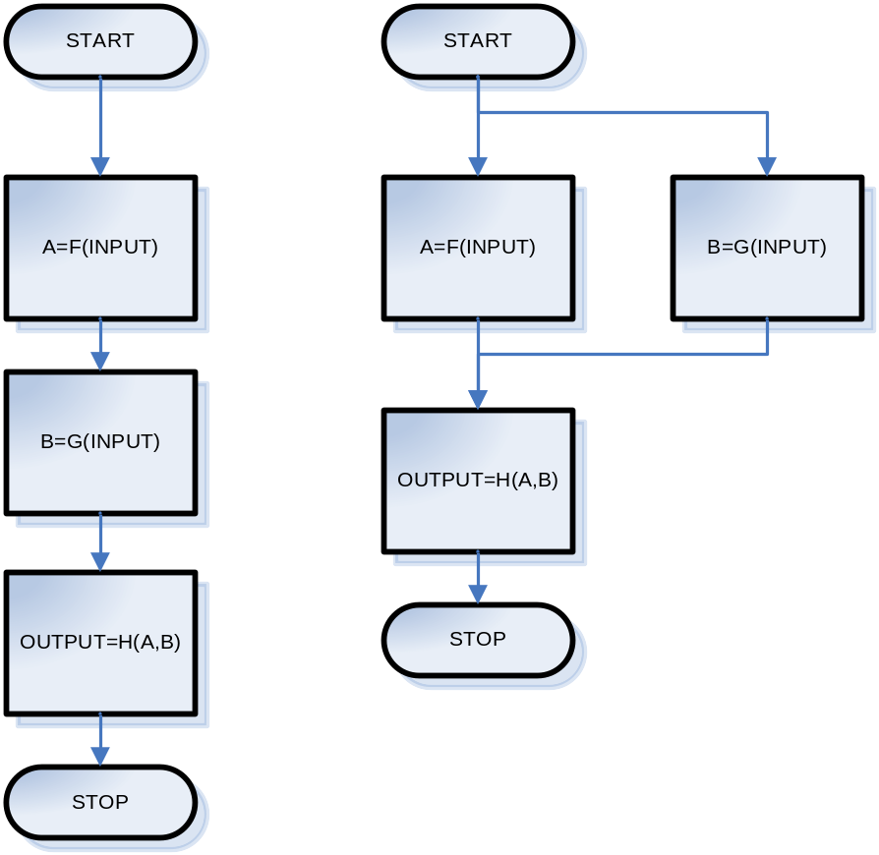
What is parallelization

Slide 4
Definition: FLOP and FLOPS
1 FLOPS = 1 Floating Point Instruction per second
1 MFLOPS = 1000000 FLOPS
1 GFLOPS = 1000000000 FLOPS
Example:
A computer can execute A=B*C+D three million times in one second. We say the computer has 6 MFLOPS
(* and + count as one Floating Point Instruction Each)

Slide 5
Definition: Latency
Latency in science is the time delay between the moment something is initiated and the moment its first effect appears.
Latency in Parallel Computing is the time delay between the moment a SEND is initiated and the moment the complementary RECV starts receiving data. (SEND and RECV are communication instructions executed by different processes)
Latency is usually measured in micro seconds
(1μs=1/1,000,000 of one second)

Slide 6
Definition: Bandwidth
Bandwidth in science measures the amount of data that can be transferred over a given channel in a time unit.
Bandwidth in Parallel Computing is the number of bits that can be transferred (in one direction) over a given network in one second.
Bandwidth is usually measured in bps (bits per second)
(1Gbps = 1,00,000,000 bits per second)

Slide 7
Example: Latency and Bandwidth
Start
Stop
RECV
SEND
Time
T = Latency
T = #Bytes * 8 / Bandwidth
Total Time = Ts + n * Tp
Where Ts = Latency
n = #Bytes
Tp = 8/Bandwidth

Slide 8

Example: Latency and Bandwidth
Network
10Gigabit Ethernet (GigE) Myrinet Infiniband | Ts 12 μs 5 μs 8 μs | Tp 0.00125 μs 0.00205 μs 0.00148 μs
old estimates from: http://www.gcn.com/online/vol1_no1/37802-1.html

Slide 9
More on Latency and Bandwidth
A communication (SEND – RECV) is “latency dominated” if Ts >> n * Tp
(In case of 10GigE when n << 10000)
A communication (SEND – RECV) is “bandwidth dominated” if Ts << n * Tp
(In case of 10GigE when n >> 10000)

Slide 10
Definition: CPU
CPU = Central Processing Unit
CPU Performance (FLOPS) is determined by:
Frequency (GHz)
Complexity of instructions
Pipeline length
Number of processing units
Algorithm!!!

Slide 11
Definition: Pipeline
Each CPU instruction is executed in steps and each step is executed in a different processing unit inside the CPU. The set of processing units is called pipeline.
This allows the CPU to execute different steps of different consecutive instructions concurrently.

Slide 12
Pipeline Example
Instruction A = (Step 1, Step 2, Step 3)
Instruction B = (Step 1, Step 2, Step 3)
Instruction C = (Step 1, Step 2, Step 3)
Step 1 Step 2 Step 3
Pipeline at Time 1: A … …
Pipeline at Time 2: B A …
Pipeline at Time 3: C B A
Pipeline at Time 4: … C B
Pipeline at Time 5: … … C

Slide 13
Pipeline Comments
Consider the case of a 3 stage pipeline….
In best case scenario the CPU can execute 3 instructions concurrently but it takes 3 cycles to complete each of them.
In worst case scenario the pipeline cannot be filled only one instruction at the time can be executed.
Advantage of pipeline architecture: division of labor tries to keep all components of the CPU busy at the same time.

Slide 14
Pipeline Comments
Example: A=3*5+2*8
The multiplications (3*5 and 2*8) can be pipelined because they are independent
The addition cannot be pipelined because it requires completion of the two multiplicaitons.
Moral: the algorithm affects performances

Slide 15
Definition: GPU
GPU = Graphical Processing Unit
Normally used for Graphics they are very powerful mathematical coprocessors for SIMD instructions such as “add two vectors”, “rotate a vector”, “scale a vector”, etc.

Slide 16
Definition: Computing Node
Computing Node = CPUs + GPUs + Ram
(on a single box / no networking)
Node Performance (FLOPS) is determined by:
CPU performance
Cache memory
Ram memory / latency / bandwidth
Algorithm!!!

Slide 17
Shared Memory Architecture
CPU
CPU
CPU
…..
CPU
Bus
Ram
Bottleneck: Bus latency and bandwidth

Slide 18
Distributed Memory Architecture
Network
CPU
CPU
CPU
…..
CPU
Bus
Bus
Bus
Bus
Ram
Ram
Ram
Ram
Bottleneck: Network latency and bandwidth

Slide 19
Hybrid Memory Architecture
Network
CPU
CPU
…..
CPU
CPU
Bus
Bus
Ram
Ram

Slide 20
Definition: Cluster Architecture
Cluster = A set of nodes + networking
Cluster Performance (FLOPS) is determined by:
Node speed (CPU, cache, ram, etc)
Interconnection speed (latency, bandwidth)
Algorithm!!!

Slide 21
Definition: SISD
SISD = Single Instruction, Single Data
Refers to an architecture that executes one instruction at the time (for example a single CPU architecture and the CPU has one pipeline only).
3+4
Usually single processor computers are considered SISD architectures.

Slide 22
Definition: SIMD
SIMD = Single Instruction, Multiple Data
Refers to an architecture that can execute the same instruction in parallel on multiple datasets.
(3,5,4,0,2) + (4,6,9,2,7)
GPUs are SIMD architectures. Cray-J90 has SIMD CPUs. G5 and Pentiums have some limited SIMD capability (MMX, SSE2, SSE3, AltiVec, etc.)

Slide 23
Definition: MISD
MISD = Multi Instruction, Single Data
Refers to an architecture that can execute multiple instructions in parallel on the same datasets.
3+4, 3*4

Slide 24
Definition: MIMD
MIMD = Multi Instruction, Multiple Data
Refers to an architecture that can execute multiple instructions in parallel on multiple datasets.
3+4, 2*5, 8-3
For example an Intel Duo has two cores and therefore it can execute two independent streams of instructions in parallel.

Slide 25
SIMD and MIMD
SIMD and MIMD are the main parallel programming paradigms and they depend on the underlying architecture.
SIMD and MIMD are not exclusive.
Examples:
A cluster of SIMD computers
An Intel Duo

Slide 26
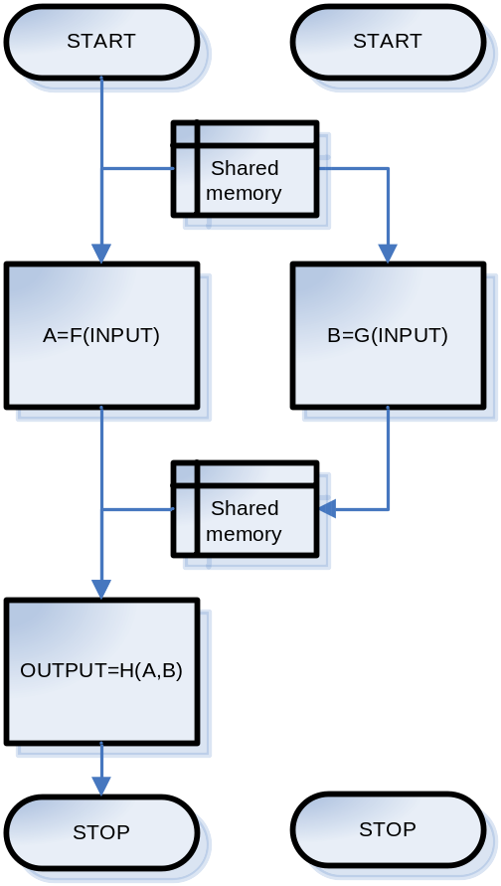
Threads vs Processes
A Threads is a single sequential flow of control within a program.
One Thread can spawn other threads and they will be executed in parallel if the architecture permits.
Threads share the same memory space.

Slide 27
Threads vs Processes
# example is in Python
from threading import *
def f(x): return x+4
def g(x): return x+6
def h(x,y): return x+y
class mythread(Thread):
def run(self): self.b=g(self.x)
x=4
t=mythread() # CREATE THREAD
t.x=x # SET INPUT x
t.start() # START THREAD
a=f(x)
t.join() # WAIT FOR THREAD
b=t.b # RETRIEVE OUTPUT b
print h(a,b)

Slide 28
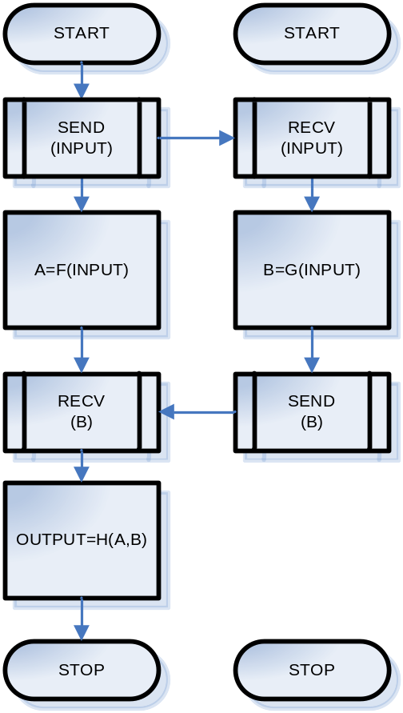
Threads vs Processes
An alternative to threads is using multiple processes.
Two processes different from two threads because they do not share memory space therefore they need to communicate (sockets?) in order to exchange information.
Caveat: Each one process can have multiple threads

Slide 29
Threads vs Processes
# example is in Python
from psim import *
comm=PSIM(2)
if comm.rank()==0:
x=4
comm.send(1,x) # SEND x
a=f(x)
b=comm.receive(1) # RECV b
print h(a,b)
elif comm.rank()==1:
x=comm.receive(0) # RECV x
b=g(x)
comm.send(0, b) # SEND b

Slide 30
Threads vs Processes
Is there a choice? No and Yes
No because on shared memory machines its is more efficient to use threads while on distributed memory machines (clusters) it is more efficient to use processes and a Message Passing Interface.
Yes because MPI runs on shared memory machines and because distributed memory machines can emulate shared memory (for example using OpenMP).

Slide 31
Definition: Speedup
Speedup(p,n) = T(1,n) / T(p,n)
Where:
T(1,n) Time to run on one process / one CPU
T(p,n) Time to run on p processes / p CPUs
n is the input size of the algorithm
NOTE:
Speedup(p,n) ~ p PERFECT!
Speedup(p,n) > 1 OK
Speedup(p,n) ≤ 1 BAD

Slide 32
Definition: Efficiency
Efficiency(p,n) = T(1,n) / (p * T(p,n))
= Speedup(p,n) / p
where:
T(1,n) Time to run on one process / one CPU
T(p,n) Time to run on p processes / p CPUs
n is the input size of the algorithm
NOTE:
0 < Efficiency(p,n) ≤ 1
Efficiency should increase when n increases
Efficiency should decrease when p increases

Slide 33
Definition: Cost
Cost(p,n) = p * T(p,n)
where:
T(p,n) Time to run on p processes / p CPUs
n is the input size of the algorithm
NOTE:
Cost(p,n) increases when p increases
Cost(p,n) increases when n increases

Slide 34
Definition: Cost Effective
p(n) such that dCost(p(n),n)/dn = 0
Examples:
T(p,n)=a*n*n/p+b*n*p
Cost(p,n) = a*n*n + b*n*p²
dCost(p(n),n)/dn= 2*a*n+b*p²+2*b*n*p = 0
P(n) = … FILL HERE

Slide 35
Computing running time T(p,n)
T(1,n) = TF(n) + TG(n) + TH
Here we assume that sizeof(A)=4 and sizeof(B)=4 do not depend on n, while sizeof(INPUT)=n

Slide 36
Threads vs Processes
In case of shared memory
T(2,n) = max(TF(n),TG(n)) + TH

Slide 37
Threads vs Processes
In case of distributed memory
T(2,n) = max(TF(n),TG(n)) + TH
+ (Ts + n*Tp)
+ (Ts + 4*Tp)
Remember we assumed sizeof(input)=n
and sizeof(B)=4

Slide 38

Network Topologies: 1D-mesh
Nodes are identified by one coordinate (i) and each node (i) can communicate only with (i-1) and (i+1)
The maximum time for a broadcast is proportional to (p-1). Why?

Slide 39
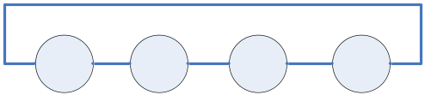
Network Topologies: 1D-ring
Nodes are identified by one coordinate (i) and each node (i) can communicate only with (i-1+p)%p and (i+1)%p
The maximum time for a broadcast is proportional to p/2. Why?

Slide 40
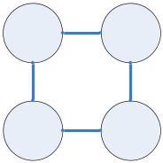
Network Topologies: 2D-mesh
Nodes are identified by two coordinates (i,j) and each node (i,j) can communicate only with (i-1,j) (i+1,j), (i,j-1), (i,j+1)
The maximum time for a broadcast is proportional to (p-1)*(p-1). Why?

Slide 41
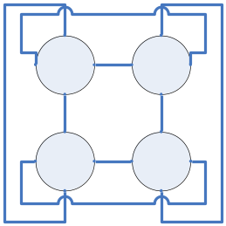
Network Topologies: 2D-ring
Nodes are identified by two coordinates (i,j) and each node (i,j) can communicate only with ((i-1+L)%L,j) ((i+1+L)%L,j), (i,(j-1_L)%L), (i,(j+1+L)%L) where L = sqrt(p)
The maximum time for a broadcast is proportional to (p/2)*(p/2). Why?

Slide 42
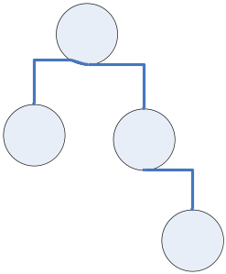
Network Topologies: tree
Nodes are connected in a tree structure and can only communicate with their parent and their children nodes.
The maximum time for a broadcast is proportional to (log p). Why?

Slide 43
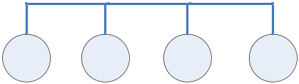
Network Topologies: bus
Nodes are connected via a bus, each node can communicate with any other node but only one SEND at the time is allowed.
Think of Ethernet.
The maximum time for a broadcast is proportional to (p-1). Why?

Slide 44
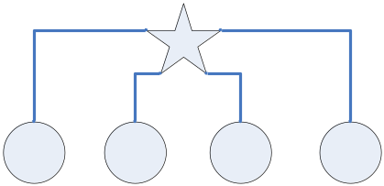
Network Topologies: switched
Nodes are connected via a switch, each node can communicate with any other node but each node can only perform one SEND or one RECV at one time.
Think of Ethernet with a switch.
Usually the switch is more expensive than the network!
The maximum time for a broadcast is proportional to (log p). Why?

Slide 45
Topologies Constraints
def BUS(i,j): return True
def SWITCH(i,j): return True
def MESH1(p): return lambda i,j,p=p: (i-j)**2==1
def TORUS1(p): return lambda i,j,p=p: (i-j+p)%p==1 or (j-i+p)%p==1
def MESH2(p):
q=int(math.sqrt(p)+0.1)
return lambda i,j,q=q: ((i%q-j%q)**2,(i/q-j/q)**2) in [(1,0),(0,1)]
def TORUS2(p):
q=int(math.sqrt(p)+0.1)
return lambda i,j,q=q: ((i%q-j%q+q)%q,(i/q-j/q+q)%q) in [(0,1),(1,0)] or
((j%q-i%q+q)%q,(j/q-i/q+q)%q) in [(0,1),(1,0)]
def TREE(i,j): return i==int((j-1)/2) or j==int((i-1)/2)

Slide 46
Point to Point Communications
SEND
RECV

Slide 47
Global Communications
One-to-All Broadcast
All-to-All Broadcast
All-to-One Reduce (global sum)
All-to-All Reduce
All-to-One Collect
Barrier

Slide 48
One-to-All Broadcast
x
x

Slide 49
All-to-All Broadcast
x0
x1
x2
x3
x4
x0,x1,x2,x3,x4

Slide 50
All-to-One Reduce
x0
x1
x2
x3
x4
x0+x1+x2+x3+x4

Slide 51
All-to-All Reduce
x0
x1
x2
x3
x4
x0+x1+x2+x3+x4

Slide 52
All-to-One Collect
x0
x1
x2
x3
x4
x0,x1,x2,x3,x4

Slide 53
Barrier
Forces all nodes to sleep until they all reach the same barrier. After that they all resume execution.
Barriers are very inefficient and can always be avoided!

Slide 54
PSIM
# created by Massimo Di Pierro
class PSIM:
def __init__(self,n,logfile=None,topology=SWITCH): ...
# allowed topologies: BUS, SWITCH, MESH1(p), TORUS1(p),
# MESH2(p), TORUS2(p), TREE
def rank(self): ...
def nprocs(self): ...
def topology(self,i,j): ...
def send(self,j,data): ...
def receive(self,j): ...
def one2all_broadcast(self, source, value): ...
def all2one_collect(self,destination,value): ...
def all2all_broadcast(self, value): ...
def all2one_reduce(self,destination,value,op=SUM): ...
# allowed global ops: SUM, MUL, MAX, MIN
def all2all_reduce(self,value,op=SUM): ...
def barrier(self): ...

Slide 55
PSIM.one2all_broadcast
# example is in Python
from psim import *
comm=PSIM(5)
print comm.one2all_broadcast(0,3)
--- OUTPUT ---
3 3 3 3 3

Slide 56
PSIM.all2all_broadcast
# example is in Python
from psim import *
comm=PSIM(5)
print comm.all2all_broadcast(comm.rank())
--- OUTPUT ---
[0,1,2,3,4]
[0,1,2,3,4]
[0,1,2,3,4]
[0,1,2,3,4]
[0,1,2,3,4]

Slide 57
PSIM.all2one_collect
# example is in Python
from psim import *
comm=PSIM(5)
print comm.rank(),comm.all2one_collect(0,2*comm.rank())
--- OUTPUT ---
1 []
2 []
3 []
4 []
0 [0,2,4,6,8]

Slide 58
PSIM.all2one_reduce
# example is in Python
from psim import *
comm=PSIM(5)
print comm.rank(),comm.all2one_reduce(0,2*comm.rank())
--- OUTPUT ---
1 None
2 None
3 None
4 None
0 20

Slide 59
PSIM.all2all_reduce
# example is in Python
from psim import *
comm=PSIM(5)
print comm.rank(),comm.all2all_reduce(2*comm.rank())
--- OUTPUT ---
1 20
2 20
3 20
4 20
0 20

Slide 60
PSIM.barrier
# example is in Python
from psim import *
comm=PSIM(5)
print ‘hello’
comm.barrier()
print ‘world’
--- OUTPUT ---
hello
hello
hello
hello
hello
world
world
world
world
world

