Slide 1
Capstone Project
AirBnb Bookings Analysis
By :- Md Ismail Quraishi

Slide 2
Points for discussion :
Data summary.
Neighbourhood with highest listings.
Total number of unique hosts, unique listings, number of neighbourhoods.
Stats on Neighbourhood_group.
Stats on Room type.
Top 5 hosts.
Highest minimum night.
Monthly, quarterly, yearly analysis.
Conclusions

Slide 3
Data summary:
id: Listing ID
name : Listing name
host_id: Host ID
host_name: Host Name
neighbourhood_group: Location
neighbourhood: Area
latitude: Latitude coordinates
longitude: Longitude coordinates
room_type: Listing space type
price: Price in dollars
minimun_nights: Amount of minimum nights
number_of_reviews: Number of reviews
last_review: Last review date
reviews_per_month: Number of reviews per month
calculated_host_listings_count: Amount of listing per host
availability_365: Number of days when listing is available

Slide 4
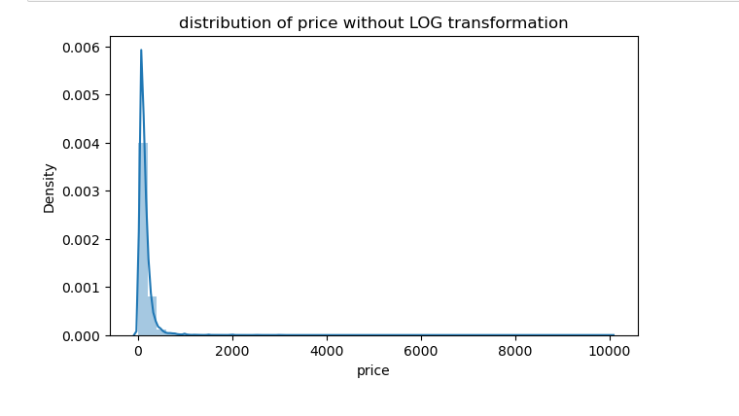
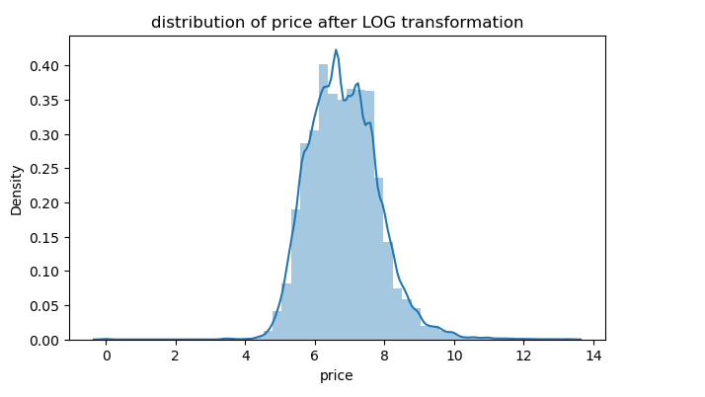
Distribution of price :
In first graph we can see that the distribution was positively skewed but after log transformation we can see in 2nd graph the distribution is very close to normal distribution.

Slide 5
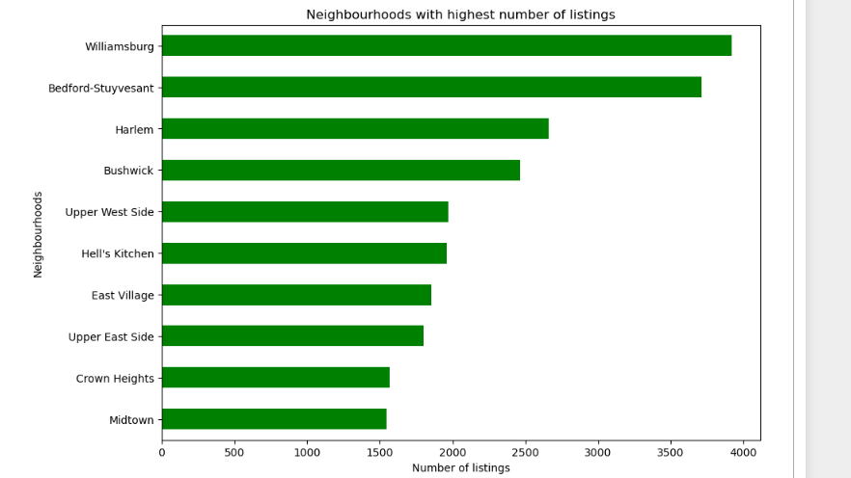
Neighbourhood_with highest listings:
Top 10 Neighbourhoods with highest listings are below :
Midtown : 1545
Crown Heights : 1564
Upper east side : 1798
East Village : 1853
Hell’s Kitchen : 1958
Upper West Side : 1971
Bushwick : 2465
Harlem : 2658
Bedford-Stuyvesant : 3714
Williamsburg : 3920

Slide 6
Total number of unique host, listings and neighbourhoods :
Number of hosts : 37457
Number of unique listings : 47906
Number of neighbourhoods : 221
Number of neighbourhood_gorup : 5 - (Brooklyn, Manhattan, Queens, Staten Island, Bronx)
Number of room type : 3 - (Private room, Entire Home/apt, Shared room)

Slide 7
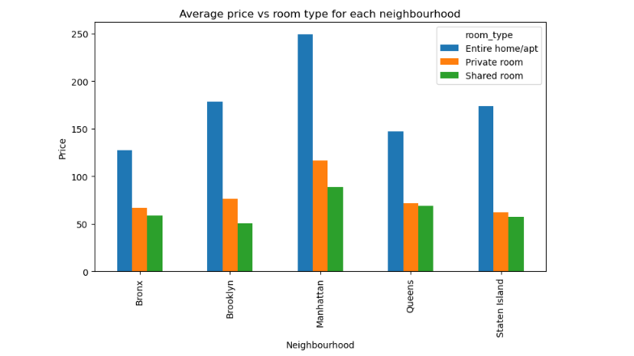
Stats on neighbourhood_group :
Average price vs room type for each neighbourhood group :
Manhattan :
Average Price for Entire home/apt : 249.24
Average Price for Private room : 116.81
Average Price for Shared room : 88.98
Bronx :
Average Price for Entire home/apt : 127.65
Average Price for Private room : 66.79
Average Price for Shared room : 58.61
Brooklyn :
Average Price for Entire home/apt : 178.36
Average Price for Private room : 76.51
Average Price for Shared room : 50.52
Queens :
Average Price for Entire home/apt : 147.05
Average Price for Private room : 71.78
Average Price for Shared room : 69.02
Staten Island :
Average Price for Entire home/apt : 173.85
Average Price for Private room : 62.29
Average Price for Shared room : 57.44

Slide 8
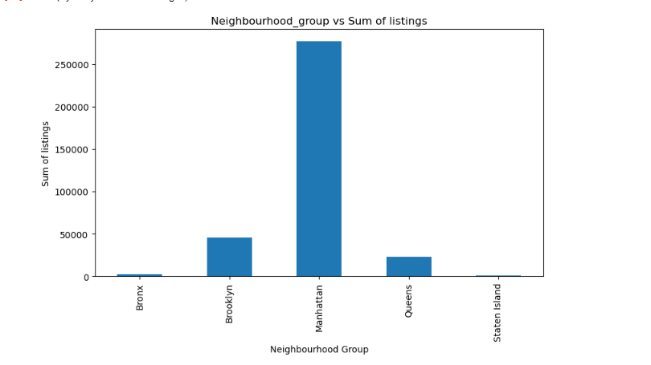
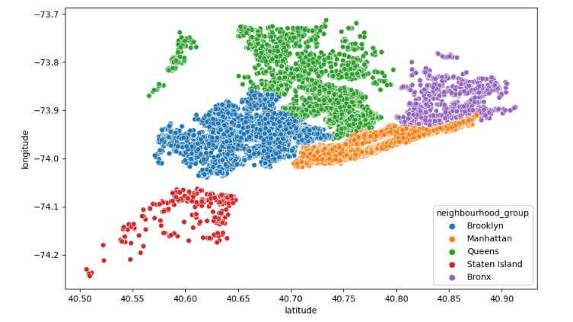
Sum of listings for each neighbourhood group:
Sum of listing in Manhattan is : 277044
Sum of listing in Bronx is : 2435
Sum of listing in Brooklyn is : 45908
Sum of listing in Queens is : 23003
Sum of listing in Staten Island is : 865

Slide 9
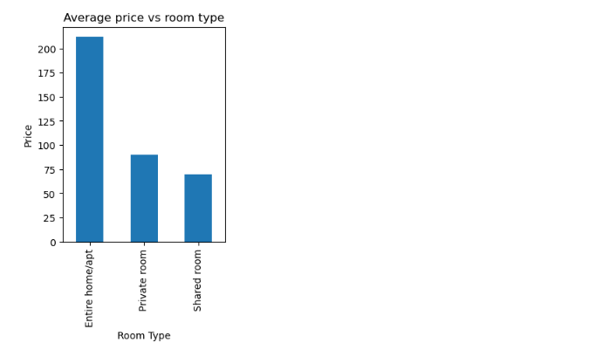
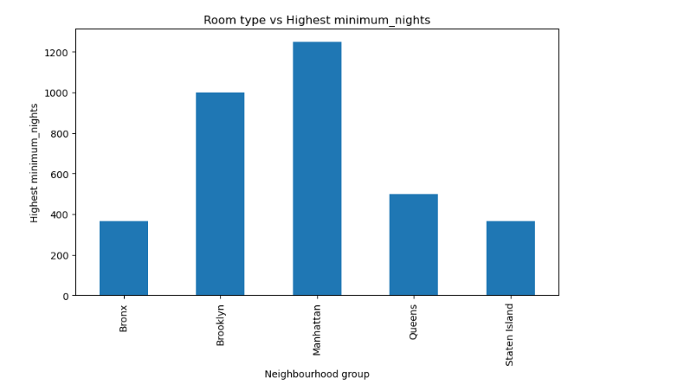
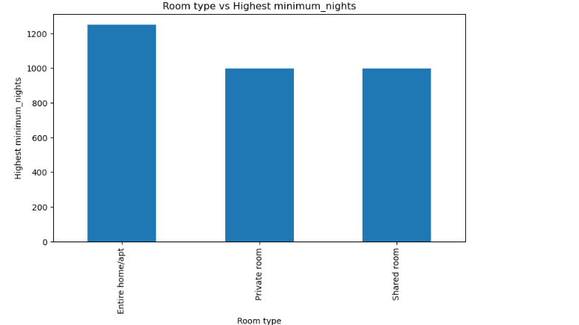
Stats on Room type :
Average price for each type of room :
Entire home/apt : 211.80
Private room : 89.79
Shared room : 70.07
Highest minimum night spent in each room type :
Entire home/apt : 1250 in Manhattan
Private room : 999
Shared room : 999

Slide 10
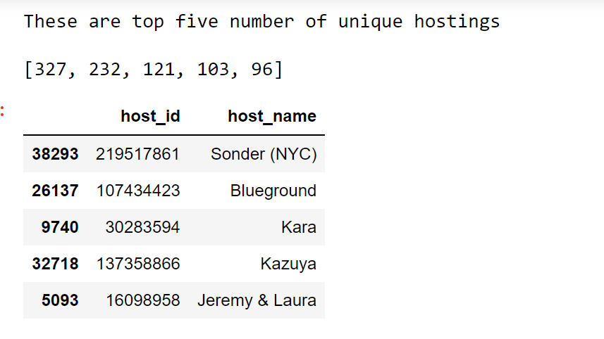
Top five hosts :
Host ID : Number of hostings
219517861 : 327
107434423 : 232
30283594 : 121
137358866 : 103
16098958 : 96
Highest minimum night:
Highest minimum night spent in Manhattan is : 1250 Entire home/apt

Slide 11
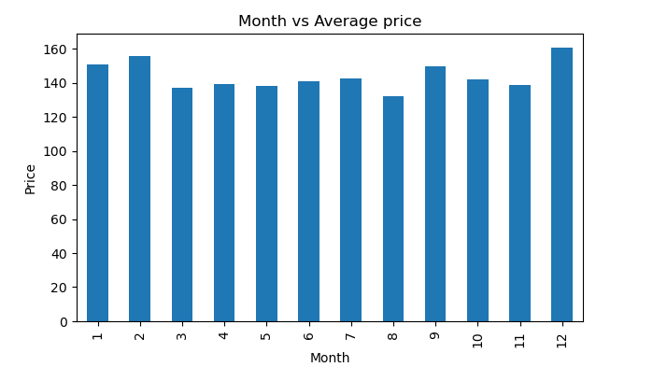
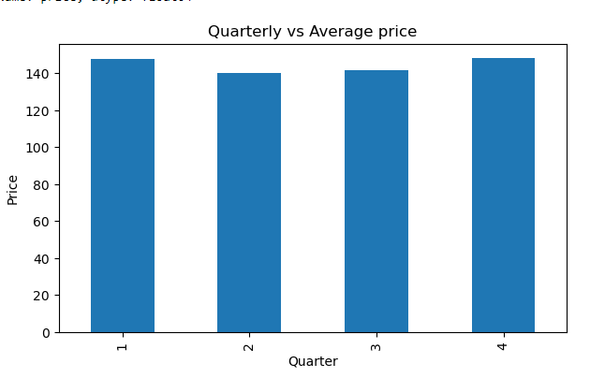
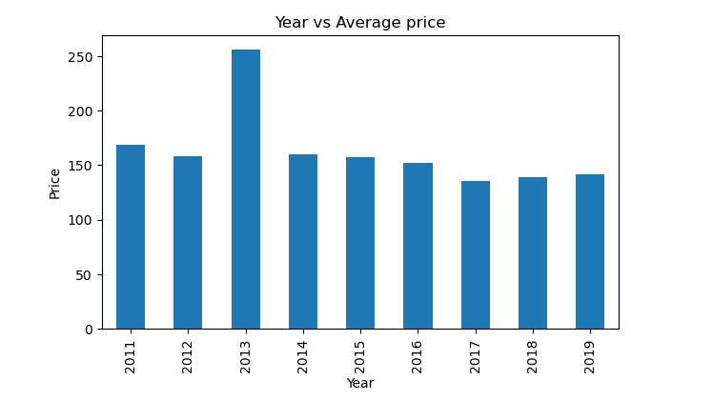
Monthly, Quarterly, Yearly analysis:
Here I am trying to understand the relation between month and average price, we can see that there is not much difference in price for different months only the mean price for january, february and december are slightly higher than others. The price might be higher for these months because of festivals like christmas, new year, and valentine day.
In case of yearly analysis average price is highest in 2013.

Slide 12
Conclusions :
There are 3% null values in name, 4% in host_name, 20.56% in last_reviews and 20.56% in reviews_per_month columns.
Number of unique hosts : 37457
Number of unique listings : 47906
Number of unique neighborhoods : 221
Number of unique neighbourhood_group : 5 ['Brooklyn' 'Manhattan' 'Queens' 'Staten Island' 'Bronx']
Number of unique room type : 3 ['Private room' 'Entire home/apt' 'Shared room']
Neighborhood groups with maximum number of listings : Manhattan (277073).
Top five unique hosts are : Sonder (NYC) with 327 hostings, Blueground with 232 hostings, Kara with 121 hostings, Kazuya with 103 hostings, Jeremy & Laura with 96 hostings.
Highest average price for Entire home/apt in Manhattan is 249.24
Highest average price for Private Room in Manhattan is 116.81
Highest average price for Shared Room in Manhattan is 88.98
Highest minimum nights spent for Entire Home/apt in Manhattan is 1250
Highest average price for year 2013 is 256.20
Neighborhood with highest listing is : Williamsburg ( 3920)
Sum of listings for all neighbourhood_group : Bronx (2435), Brooklyn (45908), Manhattan (277044), Queens (23003), Staten Island (865)

