Slide 1
Capstone Project
Netflix Movies And TV Shows Clustering
By :- Md Ismail Quraishi

Slide 2
Points for discussion :
Data Summary
Type Analysis.
Top 10 Countries.
Top 10 Directors.
Top 5 Release Year.
Top 5 Ratings.
Top 5 Genres.
Top 5 Actors.
Monthly Analysis.
Conclusions.

Slide 3
Data summary:
The dataset has total 7787 rows and 12 columns:
1. Show_id : show ID
2. type : Type of the show like movie or TV show
3. title : Title of the show
4. director : Director of the show
5. cast : Actors and actress of the show
6. country : Country of the origin of the show
7. date_added : Date when the show added to netflix
8. release_year : Release year
9. rating : rating
10. duration : duration of the show
11. listed_in : Listed in
12. description : Description of the shows

Slide 4
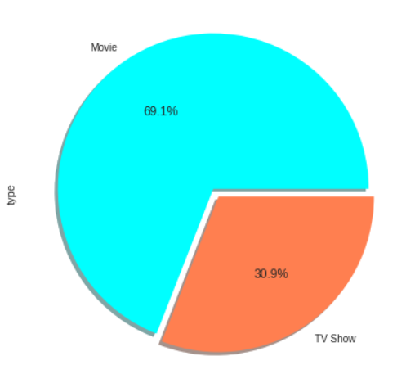
Type Analysis:
There are 30.9% TV Shows and 69.1% are Movies. Movies are more than twice of TV Shows. It may be because TV Shows produced in small small parts and Movies are complete so most of the people like Movies.

Slide 5
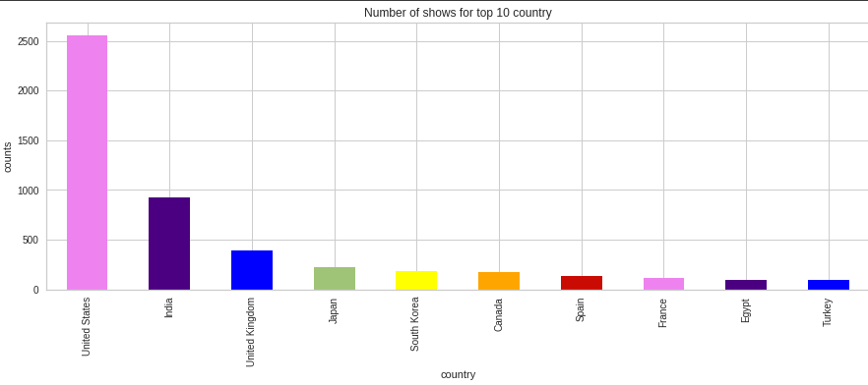
Top 10 Countries:
Top 10 countries are :
United States : 2500+
India : about 1000
United Kingdom : about 400
Japan : about 250
South Korea : about 200
Canada : about 200
Spain : about 100
France : about 100
Egypt : about 100
Turkey : about 100

Slide 6
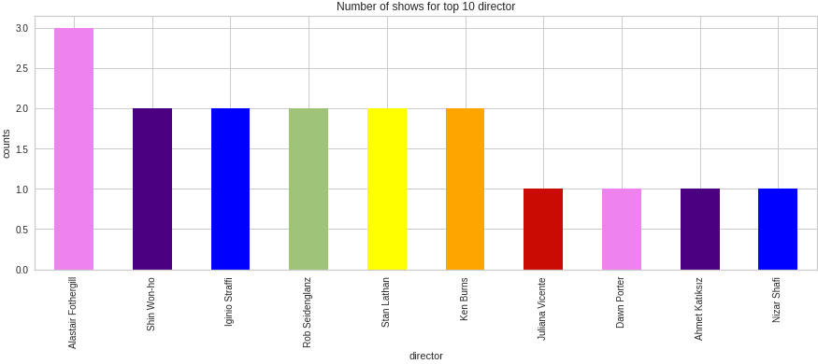
Top 10 Directors: TV Shows
Alastair Fothergill : 3
Shin Won-Ho : 2
Iginio Straffi : 2
Rob Seidenglanz : 2
Stan Lathan : 2
Ken Burns : 3
Juliana Vicente : 1
Dawn Porter : 1
Ahmet Katıksız : 1
Nizar Shafi : 1

Slide 7
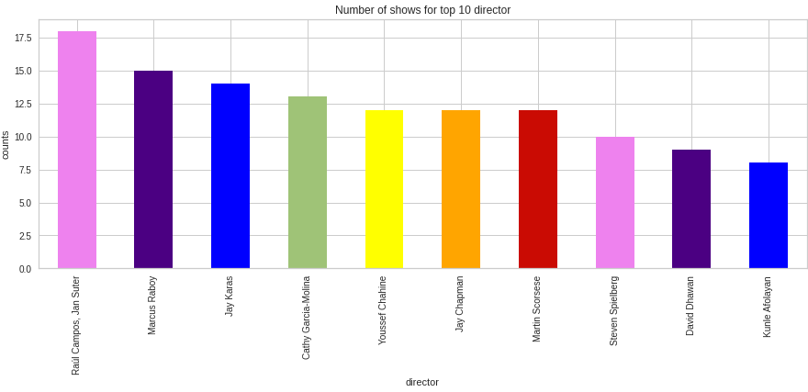
Movies:
Raúl Campos, Jan Suter : 18
Marcus Raboy : 16
Jay Karas : 14
Cathy Garcia-Molina : 13
Youssef Chahine : 12
Jay Chapman : 12
Martin Scorsese : 12
Steven Spielberg : 10
David Dhawan : 9
Kunle Afolayan : 8

Slide 8
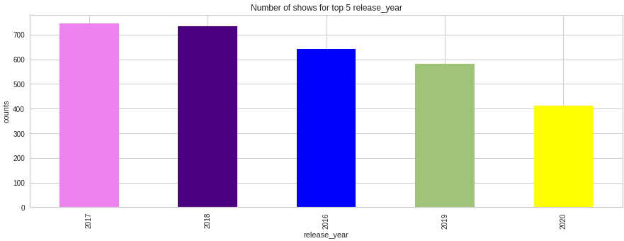
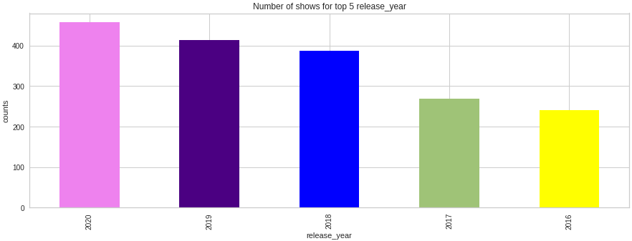
Top 5 Release Year:
Number of Movies released in each year:
2017 : 744
2018 : 734
2016 : 642
2019 : 582
2020 : 411
Number of TV Shows released in each year:
2020 : 457
2019 : 414
2018 : 387
2017 : 268
2016 : 240

Slide 9
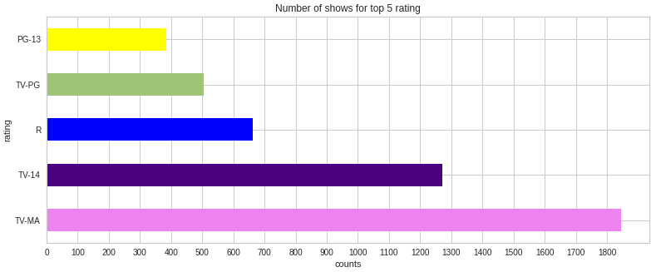
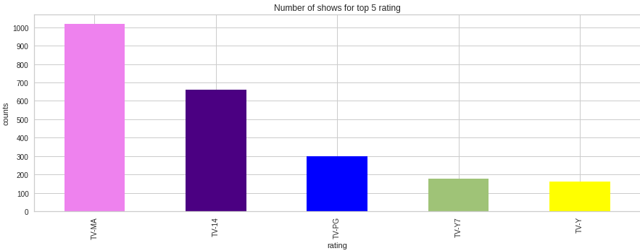
Top 5 Ratings:
Movies
TV-MA : 1845
TV-14 : 1272
R : 663
TV-PG : 505
PG-13 : 386
TV Shows:
TV-MA : 1018
TV-14 : 659
TV-PG : 301
TV-Y7 : 176
TV-Y : 163

Slide 10
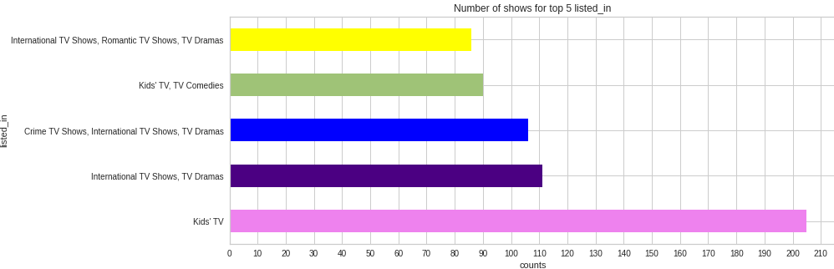
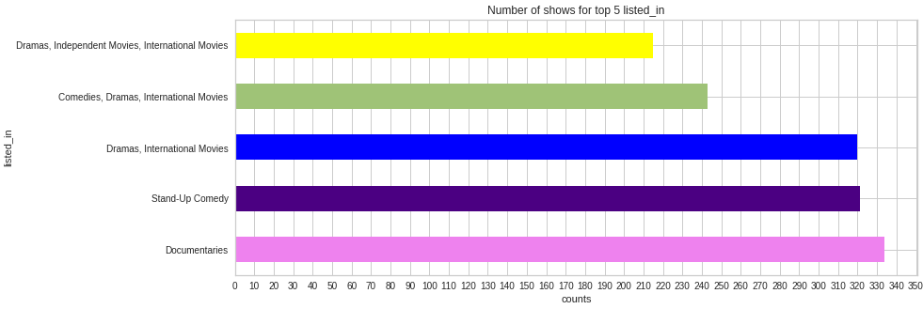
Top 5 Genres:
TV Shows
Kids' TV : 205
International TV Shows, TV Dramas : 111
Crime TV Shows, International TV Shows, TV Dramas : 106
Kids' TV, TV Comedies : 90
International TV Shows, Romantic TV Shows, TV Dramas : 86
Movies
Documentaries : 334
Stand-Up Comedy : 321
Dramas, International Movies : 320
Comedies, Dramas, International Movies : 243
Dramas, Independent Movies, International Movies : 215

Slide 11
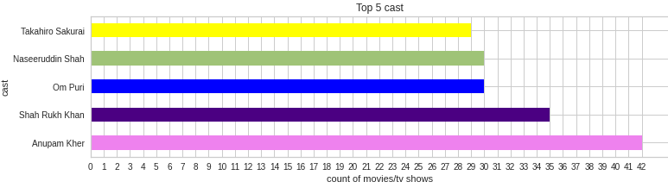
Top 5 Actors:
Anupam Kher : 42
Shah Rukh Khan : 35
Om Puri : 30
Naseeruddin Shah:30
Takahiro Sakurai : 29

Slide 12
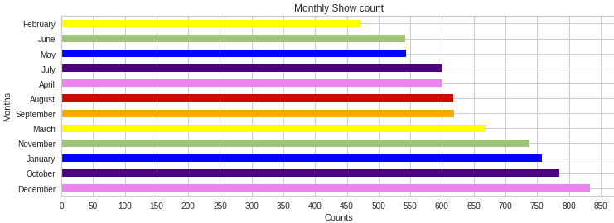
Monthly Analysis:
Total number of Shows for each month
December 833
October 785
January 757
November 738
March 669
September 619
August 618
April 601
July 600
May 543
June 542
February 472

Slide 13
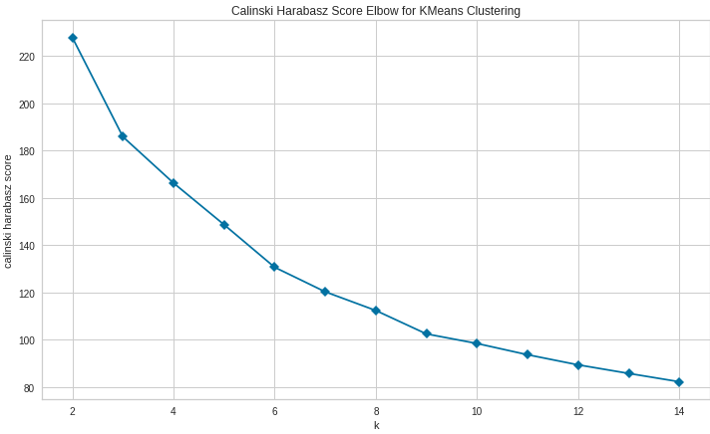
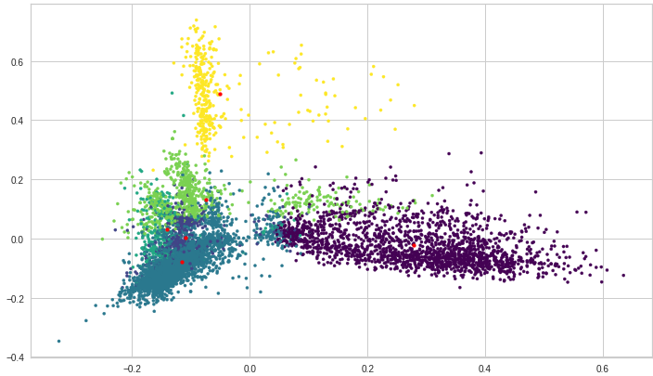
Model wise analysis:
KMeans
I think KElbow curve is good at n_clusters = 6 and silhouette is .046 also good therefore I choosed 6 clusters.

Slide 14
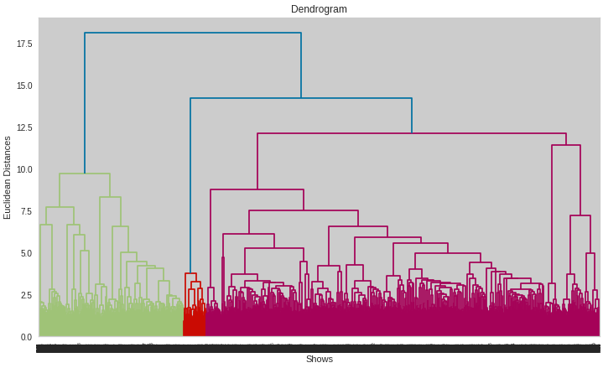
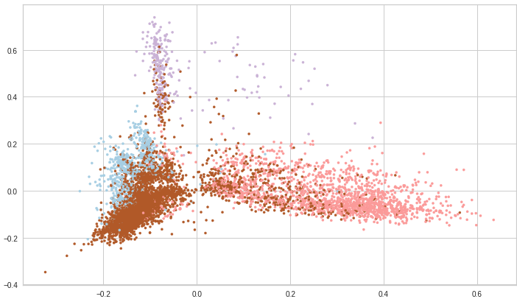
Model wise analysis:
Agglomerative Clustering
From the dendrogram visualization I found that there could be four good clusters for agglomerative clustering therefore I chosed 4 clusters in this case. And since my dataset is noisy therefore I am picking ‘ward’ method for making the clusters.

Slide 15
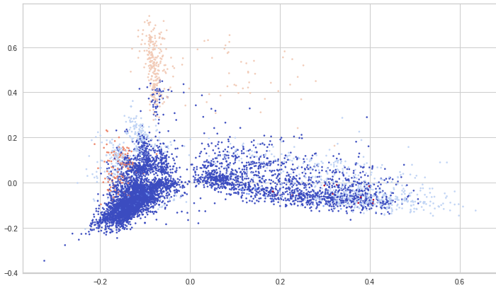
Model wise analysis:
DBScan Clustering
DBScan is good for less noisy data but in this case data is very noisy therefore the model is making a very big cluster and lot of tiny clusters.

Slide 16
Conclusions :
1. The dataset has 7787 rows and 12 columns.
2. There are 30.68% null values in director, 9.22% in cast column, 6.51% in country, 0.13 in date_added, and 0.09 on rating columns.
3. The dataset containing only movies has shape (5377,14) and for TV Shows has (2410,14).
4. Total number of features after vectorization is 40255.
5. Total features after dimensionality reduction is 364.
6. Kmeans clustering is giving good clusters therefore I would choose Kmeans with n_clusters = 6 because silhouette in this case is very good .046
7. Agglomerative clustering is also good but for high number of clusters it is not giving better cluster.
8. DBSCAN is giving a large size of cluster because my data is very noisy therefore in this case dbscan is not good.

