Slide 1
QUANTUM HACKS TEAM NAME:-CODE KRAFTERS Domain: Food Systems SRIJA MONDAL SATYAM MISHRA MOHAMMAD ISSAQH RAHUL DAS

Slide 2
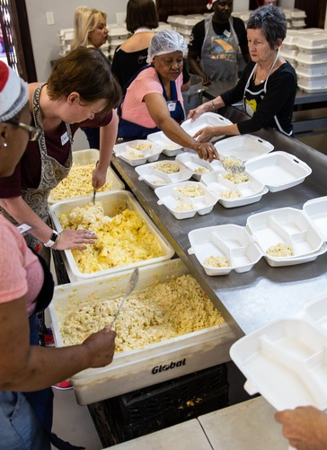
PROBLEM statement 6. Food Distribution Optimization for NGOs Spoilage-Aware Quantum-Inspired Food Distribution System Tagline Large quantities of food are wasted due to poor allocation. Relief organizations struggle with limited truck capacity. Perishable food often spoils before reaching needy people. Manual selection fails to maximize delivery impact. 1year – 80 million tonnes food wasted Everyday – 190 million people stay hungry Everymonth – 195 million people stay hungry
This Photo by Unknown Author is licensed under CC BY-ND

Slide 3
Why Existing Systems Fail
Manual Planning: Prone to human error, slow, and doesn’t scale with large datasets
As food items increase, possible allocation combinations grow exponentially
Manual entry means wrong expiry dates, quantities, or dietary restrictions → bad allocations.
Traditional systems can’t adapt to live inventory changes, sudden donations, or last-minute demand spikes
Food safety laws need batch tracking. Manual systems can’t prove where spoiled food came from..

Slide 4

SOLUTION
We designed a:
QUANTUM FOOD SPOILAGE OPTIMIZER
Food Data
↓
Priority Scoring
↓
Qfs Optimization Model
↓
Best Food Allocation

Slide 5
Quantum-Inspired Optimization QUBO-Based Optimization Engine
QUBO Mathematically Evaluates Multiple Food Combinations And Helps Select The Most Optimal Allocation
QUBO Formulation
Q(x)=I∑​ai​xi+ i,j∑​bij​xi​xj​
Binary Decision Variables
x​=1 → Include food item i in allocation
xi​=0 → Exclude food item i from allocation
QUBO =Quadratic Unconstrained Binary Optimization

Slide 6

Real-World Impact Impact & Applications
APPLICATIONS
NGO food distribution
Disaster relief logistics
Flood rescue operations
Smart ration allocation
Food bank optimization
BENIFITS
✅ Reduce food spoilage
✅ Improve truck utilization
✅ Deliver higher-priority food
✅ Faster allocation decisions
✅ Better humanitarian response

Slide 7
Future Scope
Future Enhancements
AI-based demand prediction
Multi-truck optimization
Real-time traffic integration
IoT inventory monitoring
Cloud-based relief coordination
Integration with real quantum hardware Vision

Slide 8
QFSO
“Feeding Smarter With Quantum-Inspired Optimization”
Final Statement:-
“we transformed food distribution into a spoilage-aware combinatorial optimization problem and solved it using qubo-based simulated annealing”.

Slide 9
Thank you
Code krafters
Srija mondal
Satyam Mishra
Mohammad issaqh
Rahul das

