Slide 1
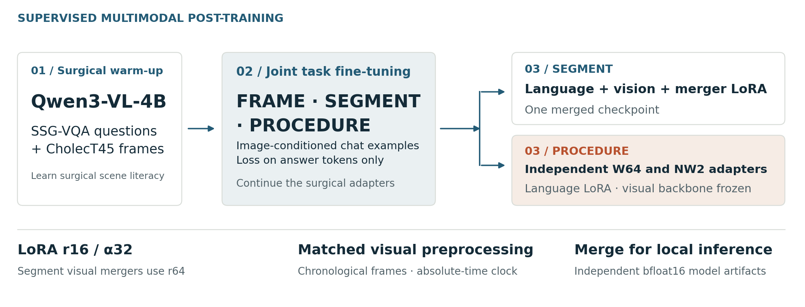
Surgical VLM post-training
A solo project by Divyanshu Mishra · Incision Impossible · ORena SAVE FOCUS 2026
Notes:
Two-stage supervised adaptation: surgical scene literacy followed by joint FOCUS fine-tuning. The Segment and Procedure checkpoints differ in their trainable visual components. Training code and full manifests are not included in the public inference release.

Slide 2
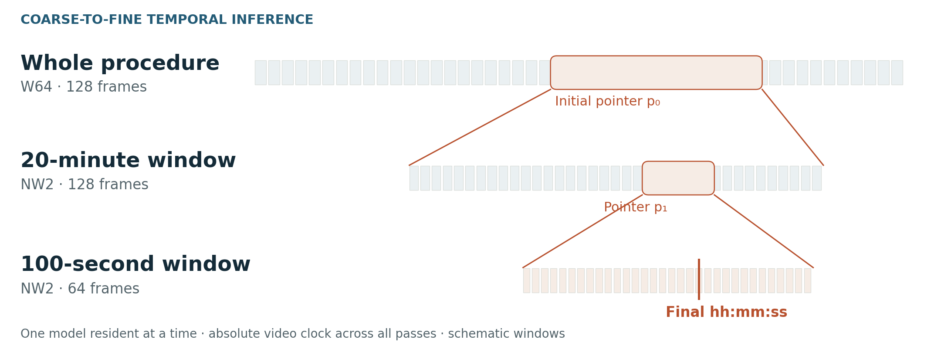
Answer, then zoom in
W64 → NW2 · local inference · one model resident at a time
Notes:
Procedure uses W64 for the full-video pointer and NW2 for both zoom passes. The three stages sample 128, 128 and 64 frames. Windows are 1200 and 100 seconds. The diagram is schematic and contains no patient imagery.

Slide 3
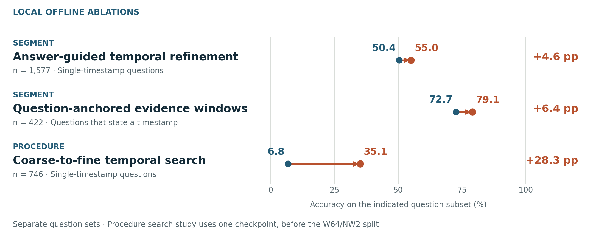
Evaluate the evidence policy
Local offline studies · separate subsets · gains are not additive
Notes:
Segment refinement: 50.4 to 55.0 percent on 1577 single-timestamp questions, earlier checkpoint. Segment question windows: 72.7 to 79.1 percent on 422 questions with stated times. Procedure search: 6.8 to 35.1 percent on 746 single-timestamp questions, one checkpoint, before the W64/NW2 split. These are not official challenge scores.

