Slide 1
Convolution Neural Networks
Deep Learning study week8

Slide 2
Keywords
CNN
Convolution
Filter, Stride, Padding
Pooling (Sampling)
Fully Connected Layer

Slide 3
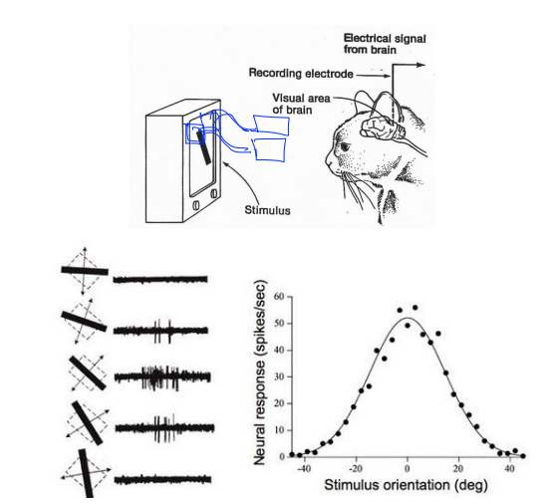
CNN
Input을 여러 개로 나누어 model 형성

Slide 4

Model with CNN
CONV
ReLU
Pooling
CONV
ReLU
Pooling
FC
(softmax…)
Result

Slide 5


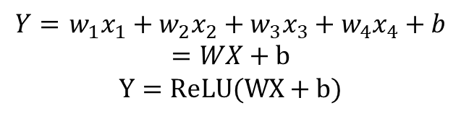
Convolution
Stride: 필터 이동 간격
$$\left\{x_{1},x_{2},x_{3},x_{4}\right\}=X$$
Filter 1
$$\left\{w_{1},w_{2},w_{3},w_{4}\right\}=W$$
Filter 2
$Y=$ $w_{1}x_{1}+w_{2}x_{2}+w_{3}x_{3}+w_{4}x_{4}+b$
$$=WX+b$$
$$Y=ReLU(WX+b)$$
Filter 3
⋯
28x28x6
Image: 32x32x3
Filter: 5x5x3
Filter N
Filter 3
Filter 2
Filter 1

Slide 6
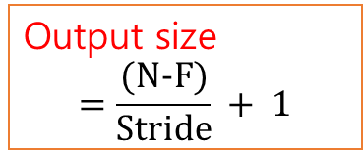
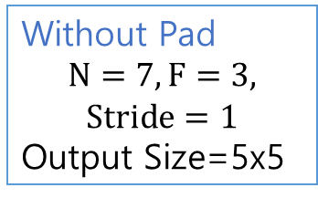
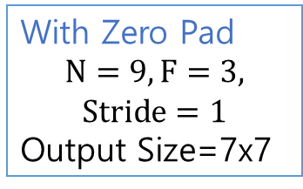
Output Size
0 | 0 | 0 | 0 | 0 | 0 | 0 | 0 | 0
0 |  |  |  |  |  |  |  | 0
0 |  |  |  |  |  |  |  | 0
0 |  |  |  |  |  |  |  | 0
0 |  |  |  |  |  |  |  | 0
0 |  |  |  |  |  |  |  | 0
0 |  |  |  |  |  |  |  | 0
0 |  |  |  |  |  |  |  | 0
0 | 0 | 0 | 0 | 0 | 0 | 0 | 0 | 0
Without Pad
$$N=7,F=3,$$
$$Stride=1$$
Output Size=5x5
With Zero Pad
$$N=9,F=3,$$
$$Stride=1$$
Output Size=7x7
Output size
$$=\frac{(N−F)}{Stride} + 1$$

Slide 7
Pooling (Subsampling)
Conv Layer
Resize

Slide 8
Max/Min/Mean Pooling
1 | 2
1 | 0
1 | 1 | 2 | 4
5 | 6 | 7 | 8
3 | 2 | 1 | 0
1 | 2 | 3 | 4
Min Pooling
3.25 | 3.25
2 | 2
Pooling을 사용하면 Feature 수를 줄여 Overfitting을 방지할 수 있다.
Mean Pooling
Max Pooling
6 | 8
3 | 4
Filter: 2x2
Stride: 2

Slide 9
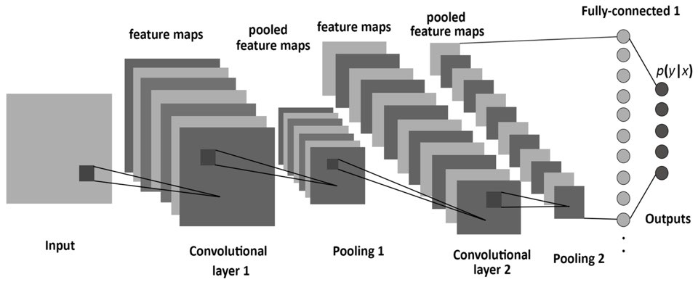
CNN Summary

Slide 10
CNN &
Fully Connected Layer
CONV
ReLU
Pooling
CONV
ReLU
Pooling
FC
(softmax…)
Result
정보를 2차원으로 해석, 예측 값을 계산
Feature Extraction
2차원을 1차원으로 평탄화하고,
계산된 값을 이용하여 분류
Classification

