Slide 1
NextHikes IT Solution
NLP PROJECT
Disaster Tweet
Classification
Using machine learning and NLP to tell real disaster alerts apart from ordinary tweets — in real time.
Name: Jameel
Data Exploration • Feature Engineering • Model Selection • Evaluation • Deployment
Project Submission: 15 September 2026

Slide 2
Background & Challenge
Twitter plays a central role in surfacing real-time information during emergencies. Disaster relief agencies and news outlets increasingly want to monitor the platform automatically for genuine alerts.
WHY IT MATTERS
10,000+
The challenge: many tweets use disaster words like “fire” or “flood” metaphorically. A useful model must read intent, not just keywords.
hand-classified tweets used to teach a model the difference
Goal
Classify tweets as Real Disaster vs. Not, fast enough to support continuous monitoring.
“Forest fire near La Ronge Sask. Canada”
Real disaster — literal, urgent, factual
“This traffic jam is an absolute disaster 😤”
Not a disaster — metaphorical use of the word
Disaster Tweet Classification
2

Slide 3
Project Objectives
⚙
◎
✵
⇄
Classification Model
Accuracy & Precision
Robustness
Scalability
Build an ML model that predicts whether a tweet describes a real disaster.
Minimize false alarms while catching genuine alerts quickly and reliably.
Handle slang, abbreviations, and cultural nuance across diverse tweets.
Process large tweet volumes in real time for continuous monitoring.
Disaster Tweet Classification
3

Slide 4
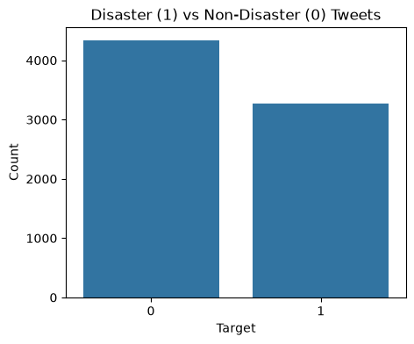
Part 1 — Data Exploration
7,613
Class Distribution
tweets, 5 columns
57.0%
0
Non-disaster tweets (class 0)
duplicate rows
43.0%
2,533
Disaster tweets (class 1)
missing location values
61
Mild imbalance — manageable without resampling.
missing keyword values
Disaster Tweet Classification
4

Slide 5
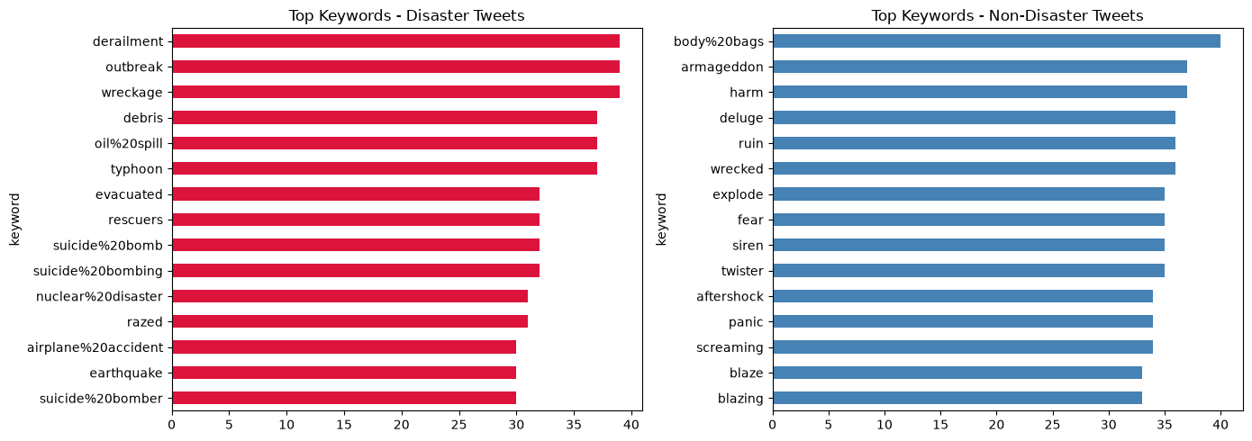
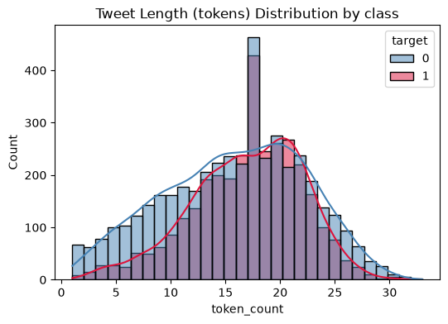
Data Preparation
1
Clean text
Most Frequent Keywords by Class
Lowercase; strip URLs, @mentions, hashtags, punctuation, and digits.
2
Tokenize
Split cleaned text into word tokens; derive a token-count feature.
3
Encode labels
Map target to 0 = non-disaster, 1 = disaster.
Word choice alone is a strong but imperfect signal — the same keyword shows up on both sides.
4
Split data
80/20 stratified split — 6,090 train rows, 1,523 test rows.
Tweet length (tokens) by class
Disaster Tweet Classification
5

Slide 6
Part 2 — Feature Engineering
∑
TF-IDF Vectorization
+
Extra Engineered Signals
• Up to 5,000 features
Hashtag count
• Unigrams + bigrams (ngram_range 1–2)
Number of # tags in the raw tweet
• English stop-words removed
Mention count
• Fit on training text, applied to test text
Number of @user mentions
Captures which words and short phrases matter most, weighted by how distinctive they are.
Tweet length
Raw character length of the tweet
Considered alongside Word2Vec/GloVe embeddings as an extension for richer semantic capture.
Disaster Tweet Classification
6

Slide 7
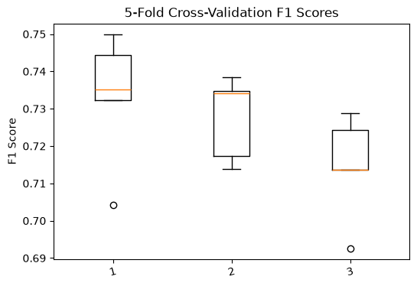
Model Selection & Cross-Validation
SELECTED
Logistic Regression
Multinomial Naive Bayes
Random Forest (200 trees)
0.733
0.728
0.715
Mean 5-fold CV F1
Mean 5-fold CV F1
Mean 5-fold CV F1
5-Fold CV F1 Spread
Logistic Regression on TF-IDF features gave the strongest and most consistent cross-validation F1-score, so it was carried forward for hyperparameter tuning.
Disaster Tweet Classification
7

Slide 8
Hyperparameter Tuning
GridSearchCV over Logistic Regression, 5-fold, scored on F1
1
l2
liblinear
C (inverse regularization)
Penalty
Solver
0.7326
The tuned model (best_model) is used for all evaluation on the held-out test set on the next slide.
BEST CV F1-SCORE
Disaster Tweet Classification
8

Slide 9
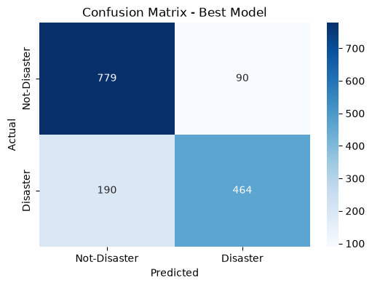
Part 3 — Model Evaluation
81.6%
83.8%
71.0%
76.8%
Accuracy
Precision
Recall
F1-score
Confusion Matrix (test set)
By Class
Not Disaster (0)
Precision 0.80 · Recall 0.90 · F1 0.85
Disaster (1)
Precision 0.84 · Recall 0.71 · F1 0.77
Support: 869 non-disaster, 654 disaster tweets (n = 1,523)
Disaster Tweet Classification
9

Slide 10
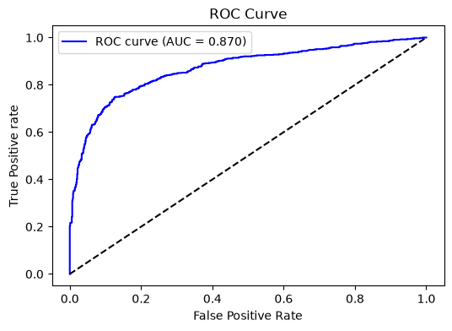
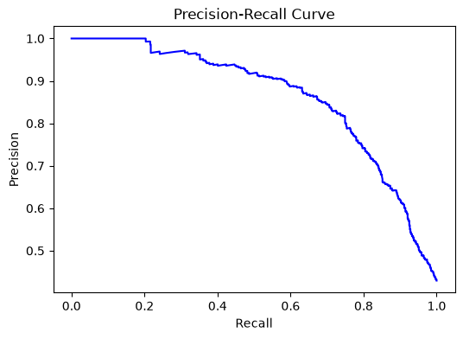
Threshold-Independent Performance
ROC Curve
Precision-Recall Curve
Shows the trade-off between true-positive and false-positive rate across thresholds.
More informative than ROC for the moderately imbalanced 57/43 class split.
Disaster Tweet Classification
10

Slide 11
Model Comparison & Generalization
Model | Mean CV F1
Logistic Regression | 0.7332
Multinomial Naive Bayes | 0.7277
Random Forest | 0.7146
Overfitting Check
0.828
Train F1-score
0.768
Logistic Regression on TF-IDF features was the most consistent performer across every candidate tested.
Test F1-score
A moderate, expected gap — the model generalizes reasonably well to unseen tweets rather than memorizing the training set.
Disaster Tweet Classification
11

Slide 12
Part 4 — Deployment Plan
Turning the trained model into a usable real-time tool
◇
Serialize
◇
Build the backend
Save the trained model and the TF-IDF vectorizer as .pkl files for reuse (already done: disaster_tweet_model.pkl, tfidf_vectorizer.pkl).
Wrap the model in a Flask or Django app that accepts tweet text and returns a prediction.
◇
Design the UI
Simple input box for pasting tweet text, with clear, immediate classification feedback.
Disaster Tweet Classification
12

Slide 13
Key Takeaways
✓
TF-IDF (1–2 n-grams) turned raw tweet text into a strong signal without needing deep embeddings.
✓
Logistic Regression outperformed Naive Bayes and Random Forest in cross-validation, and stayed on top after tuning.
✓
The final model reaches 81.6% accuracy and 0.77 F1 on unseen tweets, with a small train–test gap.
✓
Precision (0.84) edges out recall (0.71) — the model favors fewer false alarms over catching every alert.
Next step: wrap the serialized model in a Flask app and deploy it for continuous, real-time tweet monitoring.
Disaster Tweet Classification
13

