Slide 1
Markdown Sprint 4 Demo
July 2017 v0 1– Confidential
Notes:
#[TitlePage]

Slide 2
Overview
Main User Stories in this Sprint
Calculate total Markdown cost based on accepted/rejected recommendations [DONE]
Ability to accept or reject all recommendations at once [DONE]
Ability to run a scenario from the creation screen [PARTIALLY DONE]
Technical refactoring to prepare for recommendation revision [PARTIALLY DONE]
Ability to change language [DONE]
Cosmetic changes: row height reduction, show/hide columns, start of revise and landing page [DONE]
Stories deferred
Run a scenario from scenario creation screen (due to QA fail & lack of bandwidth)
Ability for the model to understand revisions (due to QA fail)
Process data from staging tables into Data Warehouse (due to lack of bandwidth)
Refactor the scenario entity into scenario and scenario details (due to lack of bandwidth)
Refactor the scenario creation process (due to lack of bandwidth)
Any request to the API should be secured with a JWT token (due to lack of suitable testing environment)
Comments
We still have an estimation problem with a lot of stories taking longer than expected to complete
Work required on the current production versions has impacted our bandwidth a little
We have discovered some stability issues which has slowed QA down. We’re working on them at the moment
Whilst the overall sprint result is mitigated (as we did not achieve what we set out to do), the team has produced a great effort; I have seen a significant improvement in positive behaviours such as team collaboration, focus on delivery and focus on quality.

Slide 3
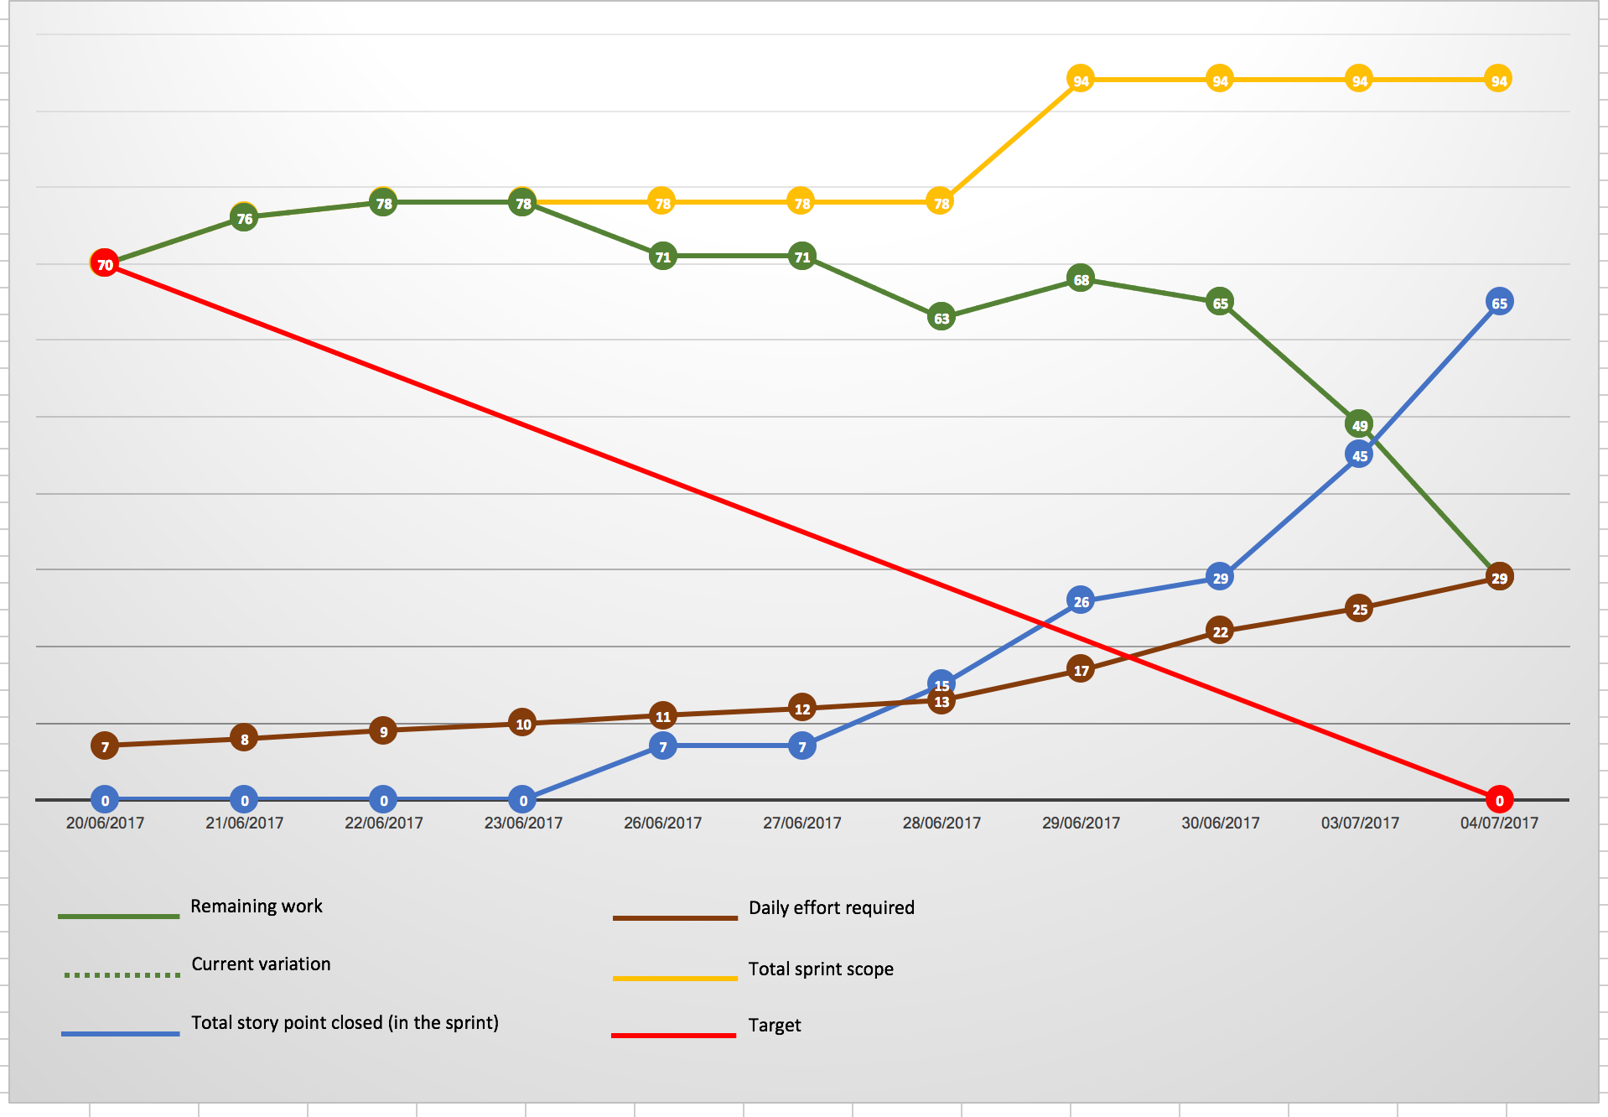
Burndown

Slide 4
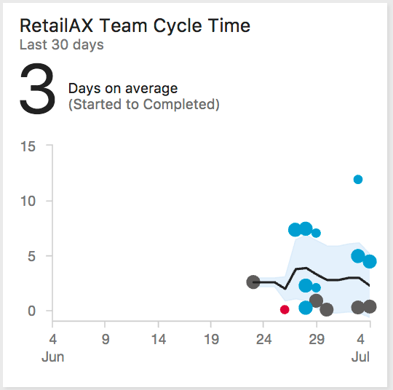
Some User Story Metrics
Planned vs. New
32 Stories
28 Planned
4 New stories added
Story quality
32 Stories
28 passed on 1st QA iteration
2 passed after 1st QA iteration
2 failed
Delivered vs. Deferred
32 Stories
26 Delivered
6 Deferred
Story Turnaround Time

Slide 5
Demo

