Slide 1
ENGR290 PDR Team 2
By
Abdullah
Omar
Jaskirat
Mohamed Mamadou Maya
March 9th, 2022

Slide 2
Specifications
 | Wish | Preferred | Demand
Autonomous |  |  | x
Succeed in first attempt |  | x
Hover gap of 3-5 mm |  |  | x
Complete the track in under 45 seconds |  | x
Complete the track in under 2 minutes |  |  | X
Minimum possible # of components |  | x
Avoid collisions |  |  | X
 |  |  | X
Able to get un-stuck |  | x

Slide 3
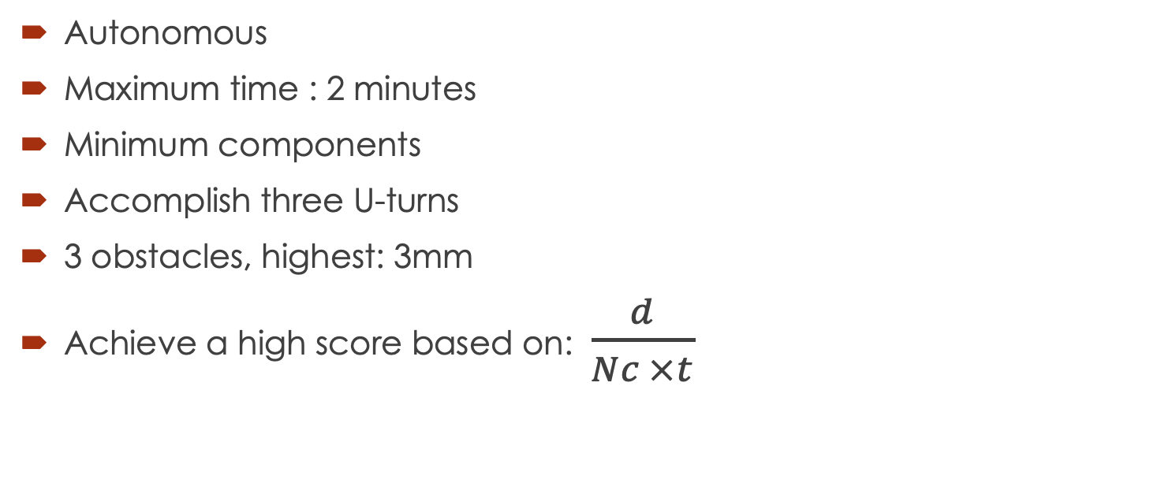
Requirements
Autonomous
Maximum time : 2 minutes
Minimum components
Accomplish three U-turns
3 obstacles, highest: 3mm
Achieve a high score based on: $\frac{d}{Nc ×t}$

Slide 4
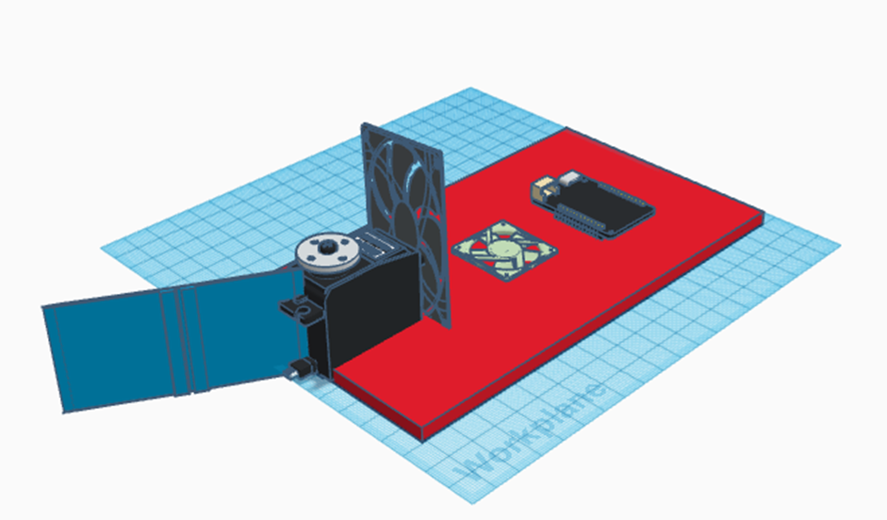
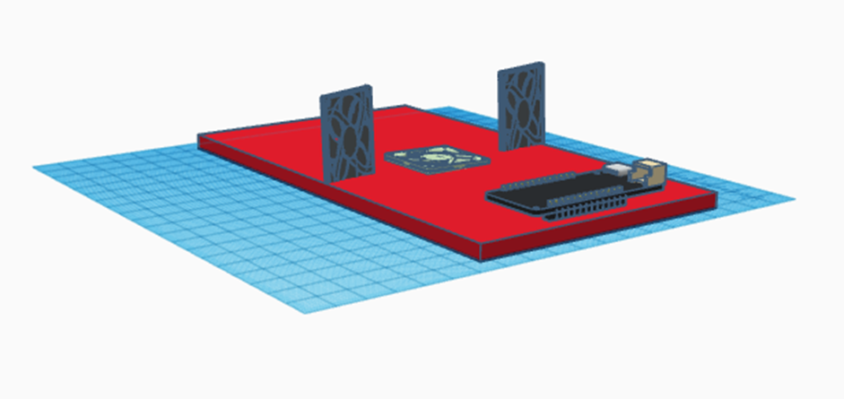
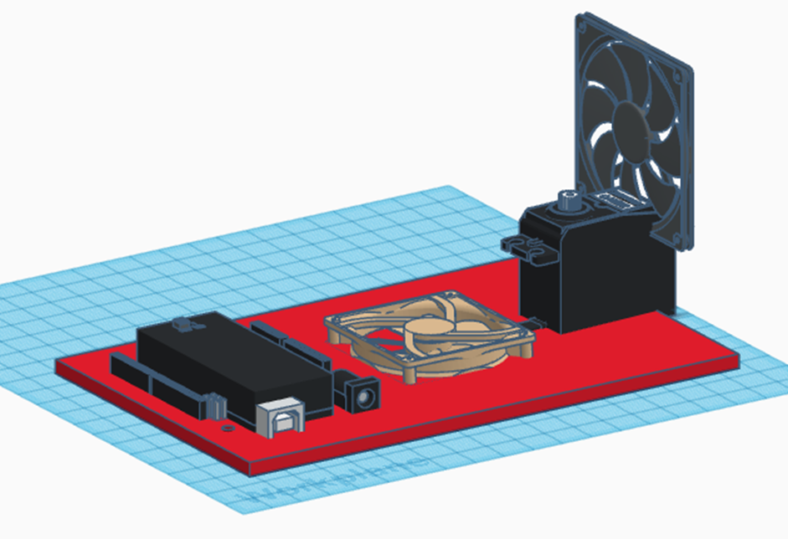
Design and Selection
Model 1
Model 2
Model 3

Slide 5
SWOT Analysis
 | Strengths | Weaknesses | Opportunities | Threats
1. 2 fans + servo + rudder | Rudder: effective and customizable Fan for thrust | 3 components | Components provided 3 attempts Access to track Competition Score Formula | 3 obstacles 3 U-turns Crashing into a wall
2. 3 fans | High Thrust Low Angular Acceleration High Moment of Inertia | 3 components Heavy Adjust center of mass
3. 2 fans + servo | Back up Fan for thrust | Sharp unstable turns Challenging implementation 3 components

Slide 6
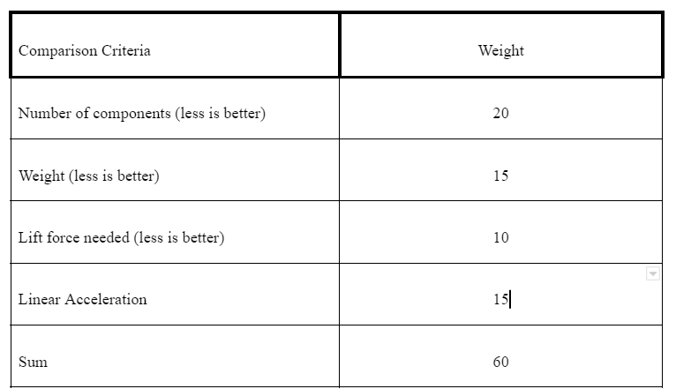
WOT Analysis

Slide 7
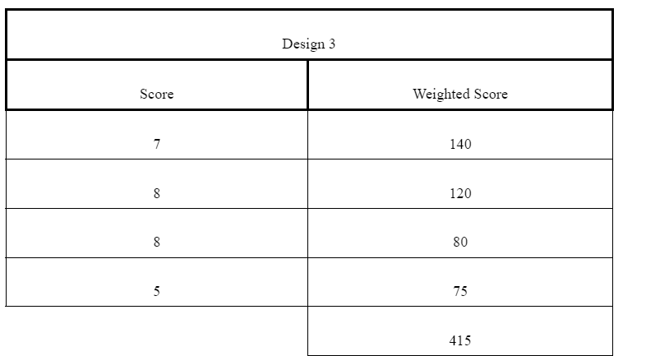
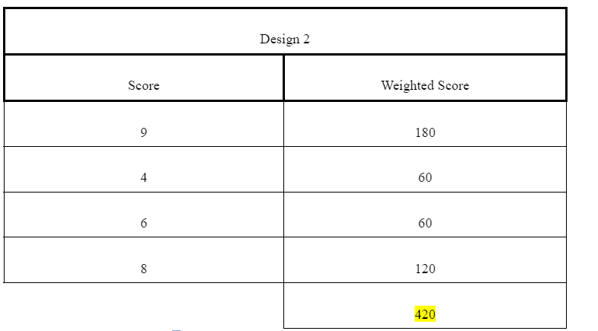
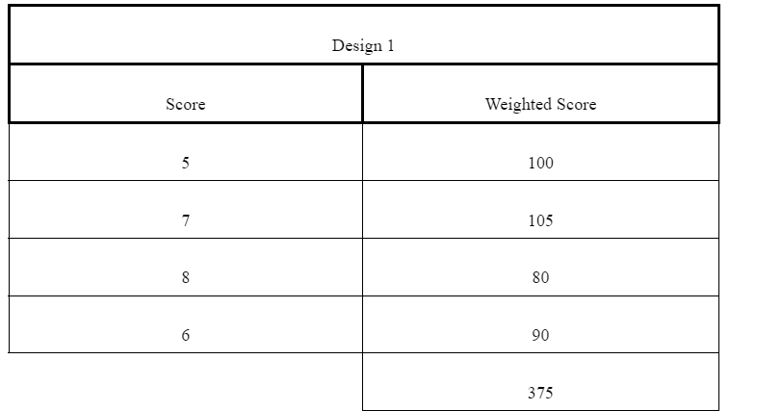

Slide 8
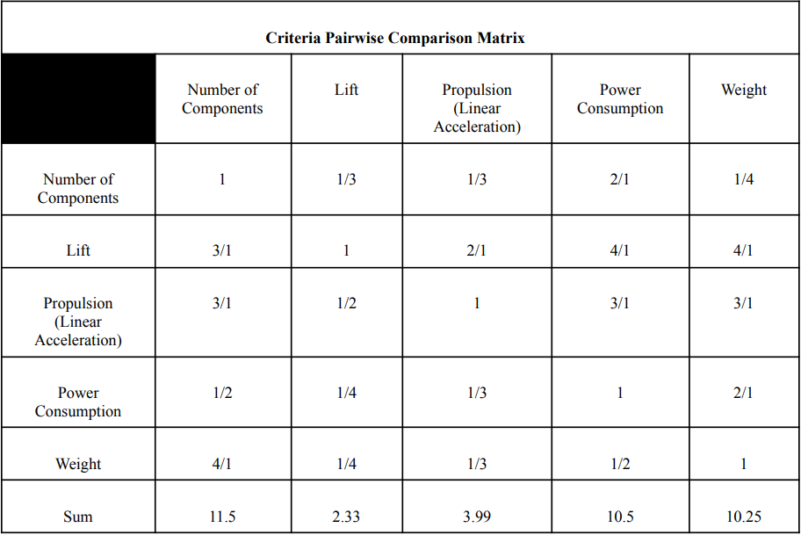
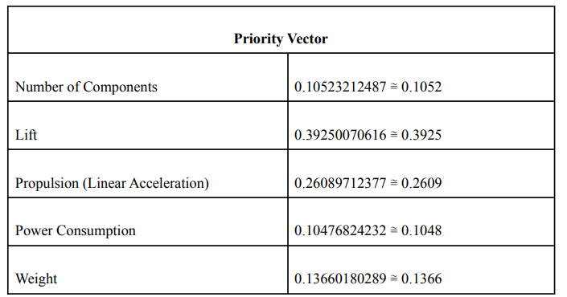
AHP

Slide 9
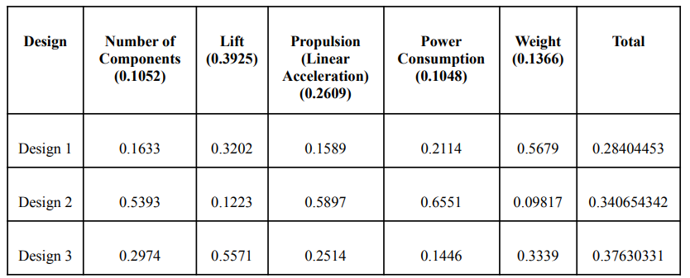
Final Decision

Slide 10
Progress
1. Define Problem ✔
2. Brainstorm ✔
3. Research & Ideas ✔
4. Identify Criteria ✔
5. Explore Possibilities ✔
6. Select Approach ✔
7. Develop a Design Proposal ✔
To do: 8. Make Prototype
9. Test and Evaluate
10. Refine
11. Final Design
12. Communicate Results

Slide 11
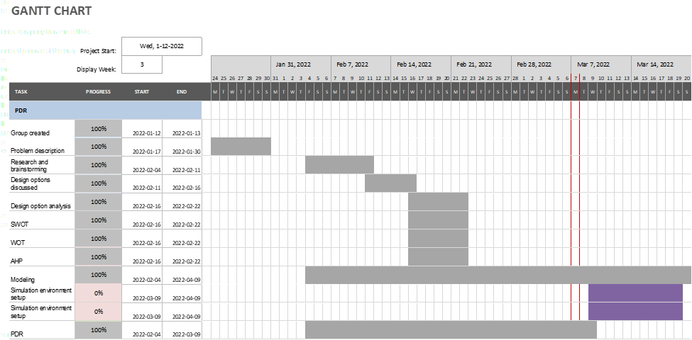
Schedule
Gantt Chart

Slide 12
THANK YOU

