Slide 2
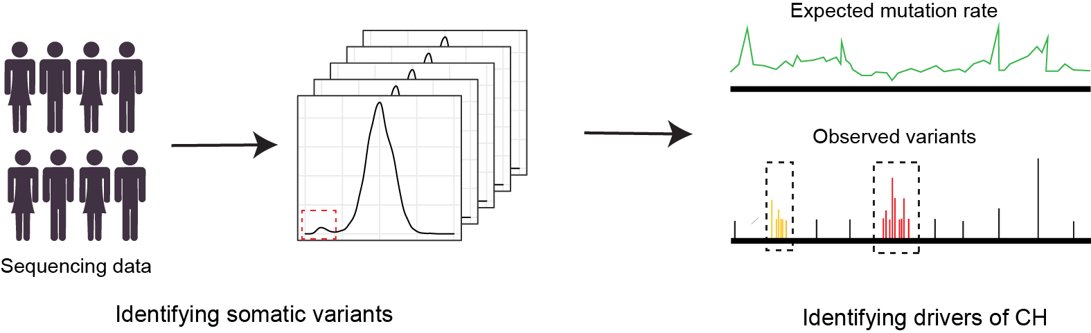
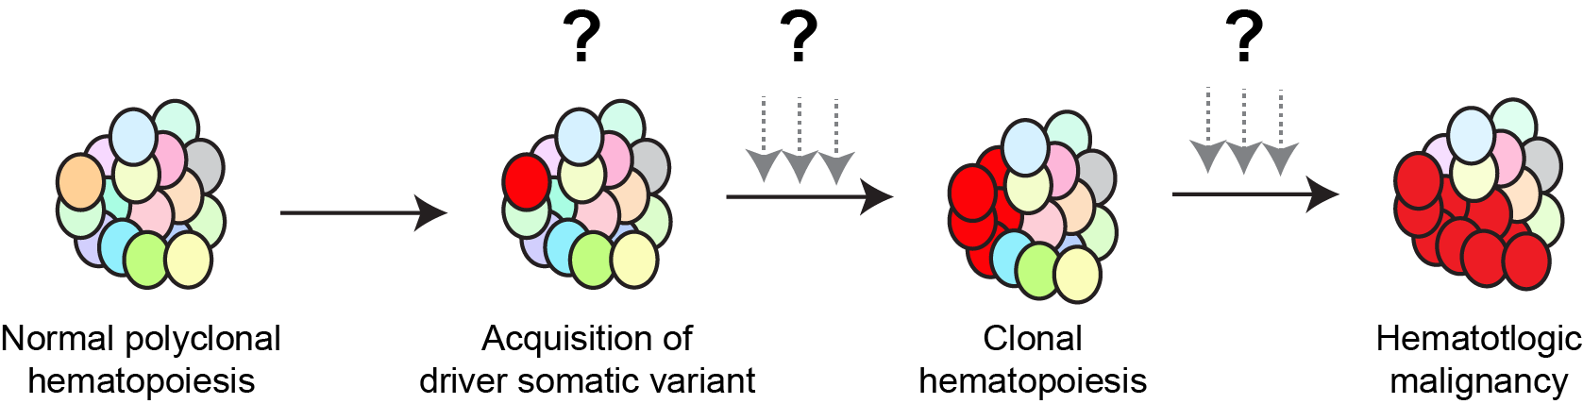
Age
Outline showing CH initiation, development, and its impact on health. Normal hematopoiesis is polyclonal. Acquisition of a driver genetic variant provides fitness advantage to the cells, potentially initiating clonal hematopoiesis. Expanded CH clones may increase risk of diverse diseases.

Slide 3
Age
Outline showing CH initiation, development, and its impact on health. Normal hematopoiesis is polyclonal. Acquisition of a driver genetic variant provides fitness advantage to the cells, potentially initiating clonal hematopoiesis. Expanded CH clones may increase risk of diverse diseases.

Slide 4
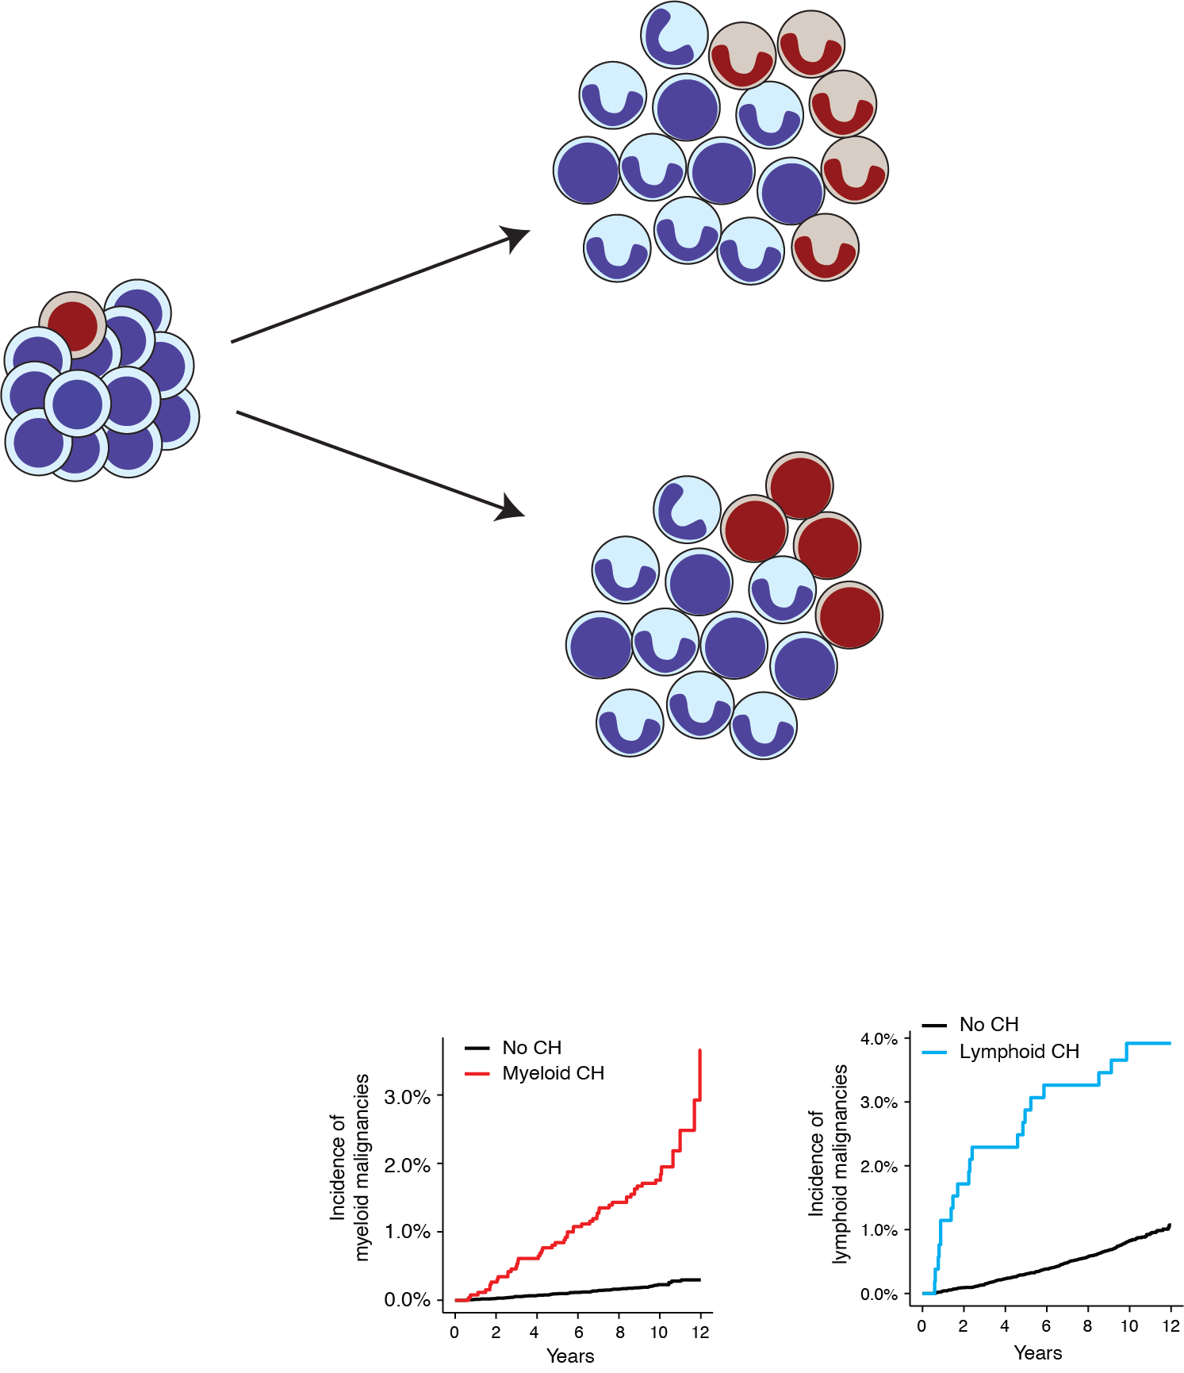
CH lineage stratifies risk of malignancies
Incidence of
myeloid malignancies
Myeloid CH
Acquisition of
a driver
genetic variant
Incidence of
lymphoid malignancies
Lymphoid CH
Myeloid and lymphoid clonal hematopoiesis are associated with higher risk of lineage-specific malignancies.

Slide 5
Start cytotoxic therapy
Therapy-related myeloid neoplasm (tMN)
Additional mutations
& clonal expansion

Slide 6
Age

Slide 7
CH lineage stratifies risk of malignancies

