Slide 1

MediConnect Plus
Group Member:
Md Tanzimul Hasan (011202151)
Md Kabirul Hossain (011202026)
Md Umar Farooq (011202200)
Md Abdul Kader (011202244)
Sheikh Rakin (011202006)

Slide 2

Description:
MediConnect Plus is a user-Friendly website designed to provide a Comprehensive range
of medical assistance and services. The platform aims to connect individuals need with
potential blood donors, heart donors, and kidney donors through an easy-to-use registration
system. Users can also search for nearby medical shops, explore medicine details, availability,
and pricing, making it effortless to find the medications they require. The website also offers
a hospital seat booking system, finding available doctor, quickly book ambulance and oxygen
cylinder

Slide 3

Motivation:
Accessibility: The system aims to improve accessibility to vital medical services by providing a centralized platform for various healthcare needs.
Convenience: Users can easily find and connect with blood donors, heart donors, kidney donors, medical shops, doctors, and emergency services through a user-friendly interface.
Saving Lives: By facilitating efficient blood, heart, and kidney donor matching, the system has the potential to save lives by connecting individuals in need with suitable donors.
Time-saving: By providing a comprehensive range of medical services in one place, the system saves users time and effort in searching for different services individually.
Contributing to Community Health: By connecting individuals with vital medical resources and services, the system plays a role in promoting the well-being and health of the community.

Slide 4





1
Login, sign up
Blood Donor
2
Organ Donor
3
Pharmacy
4
5
Medicine Search
MediConnect
Plus
Hospital seat Booking
6
7
Doctor Search
Key features
Appointment
8
Ambulance booking
9
Oxygen Cylinder
10
User Feedback
11
12
Article

Slide 5
Scope:
● Target Customers – Every type of people can use this system to get their necessary help.
● Average Updates - Depends on changes in medical shop listings, updates to doctor availability, and user feedback.
●MediConnect Plus website is to provide a user-friendly platform that connects individuals with various medical assistance services. The website aims to enhance accessibility, convenience, and efficiency in accessing vital medical resources and services, ultimately improving the overall healthcare experience for users.

Slide 6
Benchmark Analysis:
Features | Zocdoc | Vitalant | Teladoc | Donate life | Medisafe | Mero Doctor | MediCon-nect Plus
User registration | Yes | Yes | Yes | Yes | Yes | Yes | Yes
Blood Donor Matching | No | Yes | No | Yes | No | No | Yes
Organ Donor Matching | No | No | No | Yes | No | No | Yes
Medical Shop Listings | No | No | No | No | Yes | Yes | Yes
Medicine Search | No | No | No | No | Yes | Yes | Yes
Hospital Seat Booking | No | No | No | No | No | Yes | Yes
Doctor Search | Yes | No | Yes | No | No | Yes | Yes
Make Appointment | Yes | Yes | Yes | No | No | Yes | Yes
Emergency Ambulance Booking | No | No | Yes | No | No | No | Yes
Oxygen Cylinder Booking | No | No | No | No | Yes | Yes | Yes
User Feedback and Ratings | Yes | Yes | Yes | Yes | Yes | Yes | Yes
Medical Article | Yes | Yes | No | Yes | No | No | Yes
Mobile App Support | Yes | No | Yes | Yes | Yes | No | No

Slide 7

Language To Be Used:
PHP
JavaScript
MySQL
HTML
CSS

Slide 8
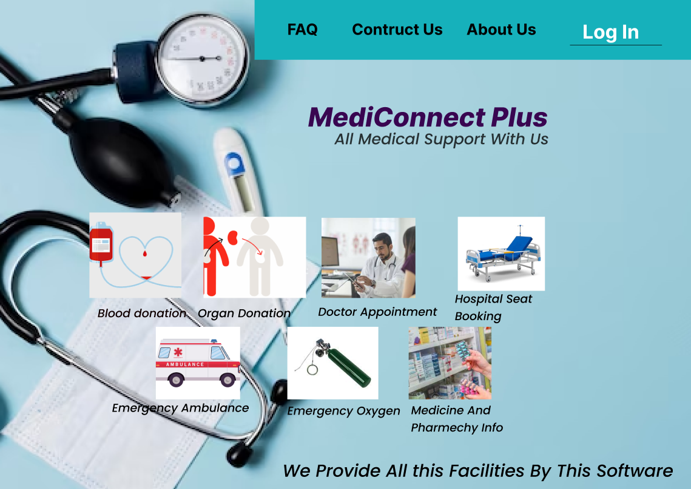
Demo Prototype:
Landing page

Slide 9
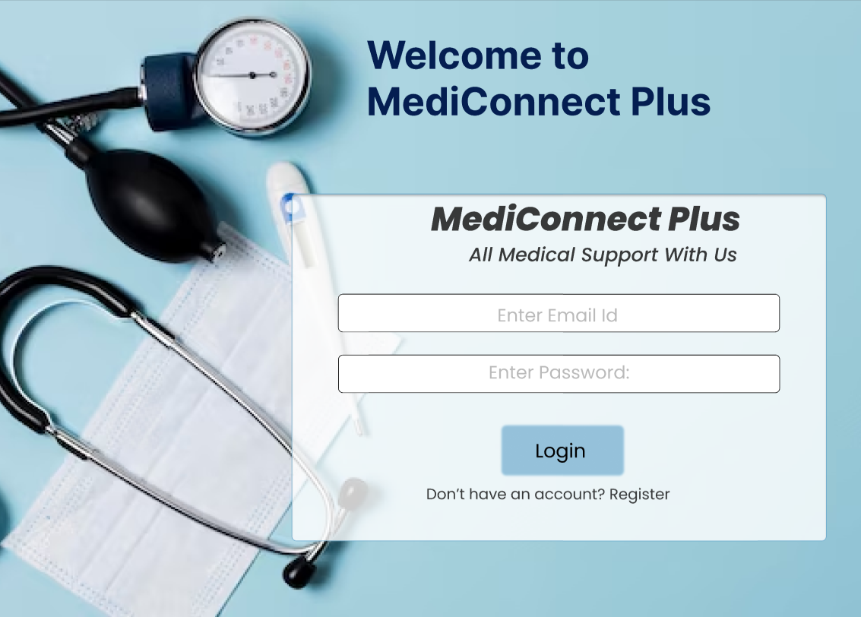
Log in Page

Slide 10
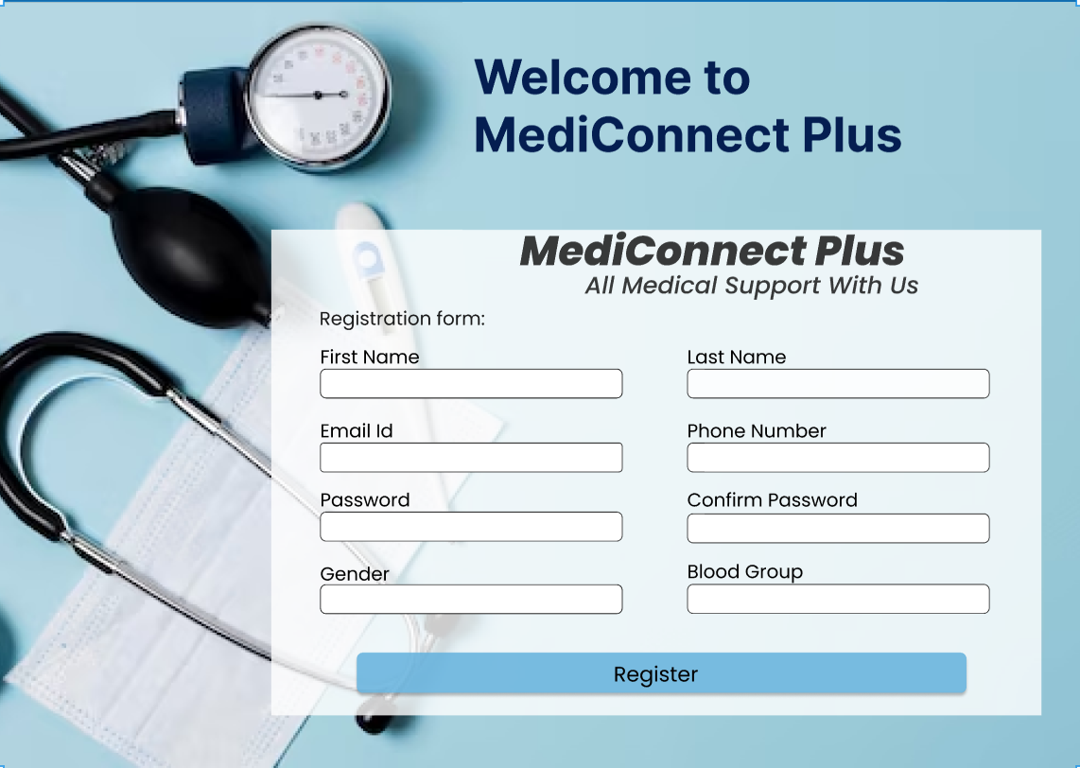
Registration Page

Slide 11
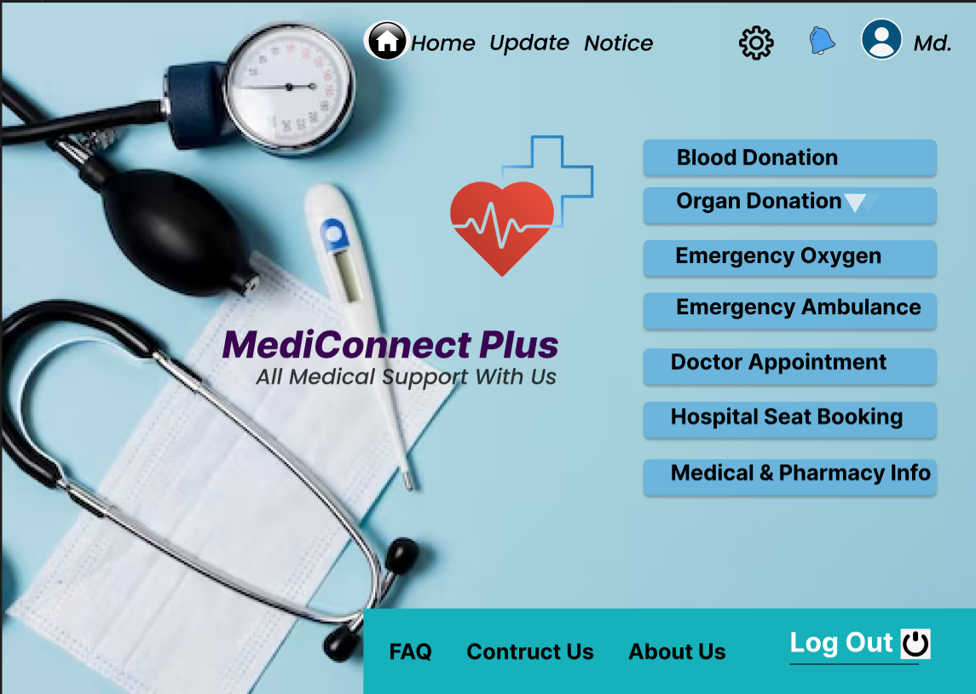
Home page

Slide 12
Thanks

