Slide 1
Decoding Cancer: Multiple Cancer Classification using RNA Gene Expression and Machine Learning

Slide 2
Name ID Nur Mohammad Fahad 011191040 Mehbubur Rahman 011191107 Md. Abdur Rahman 011202260 Md. Kabirul Hossain 011202026 Sheikh Rakin 011202006

Slide 3
Content
Introduction
Background
Methodology
Dataset Description
Expected Outcomes
Conclusion

Slide 4

Introduction
Welcome to the presentation on our bioinformatics project, titled 'Multi Cancer Classification Using RNA Gene Expression and Machine Learning'. In this presentation, we will provide an overview of the project proposal and its significance in cancer research.
Cancer is a complex disease that requires accurate diagnosis and treatment. However, current methods of cancer classification have limitations in accurately identifying different types of cancer. Our project aims to develop a multi-cancer classification model using RNA gene expression and machine learning, which will improve the accuracy of cancer diagnosis and treatment.

Slide 5
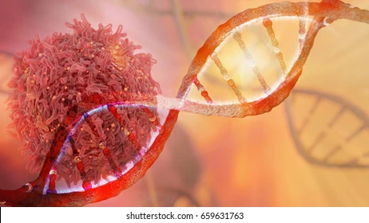
Background
Importance of Cancer research:
-for large amounts of genomic data.
-understanding the molecular basis of cancer.
Challenges:
-accurately classifying different types of cancer.
This is where RNA gene expression and machine learning come in. RNA gene expression provides information on the activity of genes in a cell, which can be used to identify different types of cancer. Machine learning algorithms mainly classification model that can accurately identify different types of cancer.

Slide 6

Objectives
The main objective of our project is to develop a multi- cancer classification model using RNA gene expression and machine learning.
This model will be able to accurately identify different types of cancer, which will improve the accuracy of cancer diagnosis and treatment.
We classify cancer using RNA gene expression data. This will aid cancer pathway research and drug development.

Slide 7
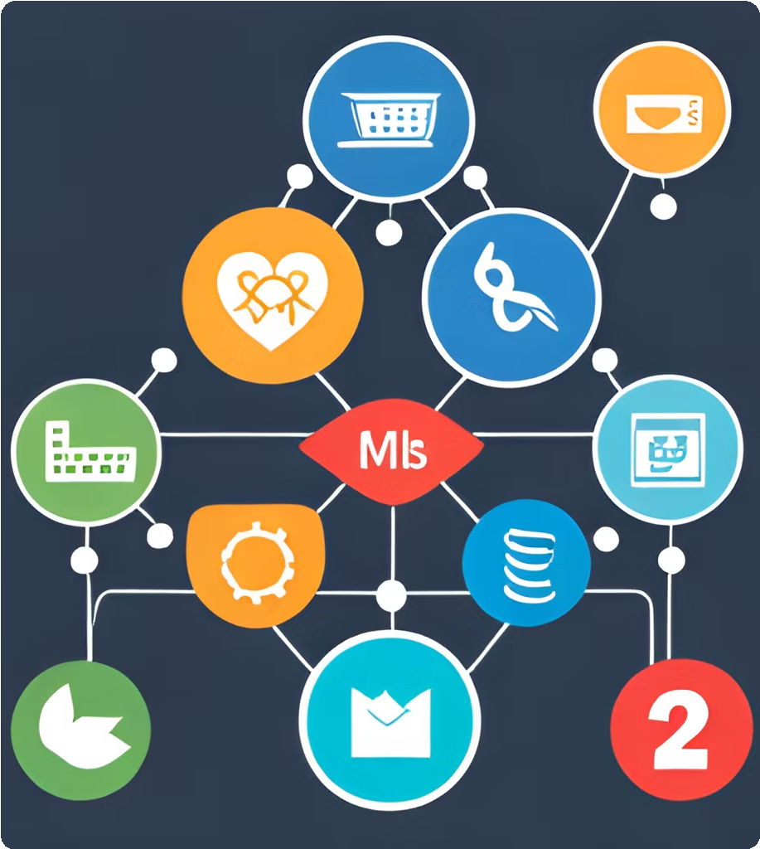
Methodology
Dataset Preprocessing
Model Training

Slide 8
Dataset Description
The dataset includes the gene expression values of five different types of cancer
Lung adenocarcinoma (LUAD),
Breast invasive carcinoma (BRCA)
Kidney renal clear cell carcinoma (KIRC)
Lung squamous cell carcinoma (LUSC), and
Uterine corpus endometrial carcinoma (UCEC)
Rows: 2086 Column: 972
- each row contains a specific sample
- each column contains the Reads Per Kilobase of transcript per Million(RPKM) RNA-Seq values of a specific gene
the last column contains the cancer categories encoded numerically: 1=BRCA , 2=KIRC, 3=LUAD, 4=LUSC, 5=UCEC
Link: Cancer Types: RNA Sequencing Values from Tumor Samples/Tissues - Mendeley Data

Slide 9
Dataset Table
 | Cancer Type | Number of Instances | Features
 | BRCA | 878 | 971
 | KIRC | 537 | 971
 | LUAD | 162 | 971
 | LUSC | 240 | 971
 | UCEC | 269 | 971

Slide 10
Model Training
Random Forest
Xgboost
Gradient Boosting
Decision Tree
ANN
1-D CNN

Slide 11

EXPECTED OUTCOMES:
> high accuracy in identifying different types of cancer
> insights into the molecular basis of cancer
> improve cancer diagnosis
> potentially leading into new treatments/therapies

Slide 12

CONCLUSION
potential to make
significant contributions
to cancer research
and treatments

Slide 13
The End

