Slide 1

Presented by:
Md. Kamran Alam
Devansh Jaiswal
Credixa
BSc CS (2026)
Under the guidance of
Raj Kumar R.

Slide 2
Problem Statement
01. Background
The Problem
Pursuing higher education puts immense financial pressure on students and their families. However, legacy banking systems rely almost entirely on historical credit scores to approve educational loans.
02. The Gap
Existing System
Millions of deserving students have "thin credit files" (meaning little to no credit history). Because of this, it is nearly impossible to secure traditional bank loans. The process is slow, opaque, and bogged down by paperwork.
03. Importance
Why It Matters
Education should be accessible to everyone. Denying credit purely due to a lack of history restricts educational opportunities and limits potential. A fairer system to assess true creditworthiness is desperately needed.

Slide 3



Objectives & Scope
01. OBJECTIVES
Project Goals
1. Provide Instant Financing: Deliver a frictionless, Buy Now Pay Later (BNPL) experience tailored specifically for the education sector.
2. Redefine Credit Scoring: Replace traditional credit scores with an AI-driven, behavioral underwriting system that evaluates non-traditional data (like academic performance and savings habits).
02. SCOPE
In-Scope Items
A lightning-fast, 5-step onboarding workflow for students and co-applicants.
Automated document digitization and OCR for bank statements and fee structures.
Real-time generation of a proprietary "Omniscore" via our AI Risk Engine.
A dedicated portal for educational institutions to monitor and verify enrollments and disbursements.

Slide 4
Existing System / Literature Review
01. APPROACH 1
Traditional Bank Loans
Heavily reliant on standard credit bureaus (like CIBIL), demanding massive amounts of paperwork, physical branch visits, and often requiring collateral.
02. APPROACH 2
Generic BNPL Services
Platforms meant for e-commerce that are not tailored for education. They lack integration with academic institutions and usually still run standard, rigid credit checks.
03. LIMITATIONS
Current Pain Points
Blanket Rejections: Students with zero credit history are automatically rejected.
Sluggish Processing: It can take weeks to get a loan approved and disbursed.
Black Box Decisions: Applicants are rarely told why they were rejected.

Slide 5
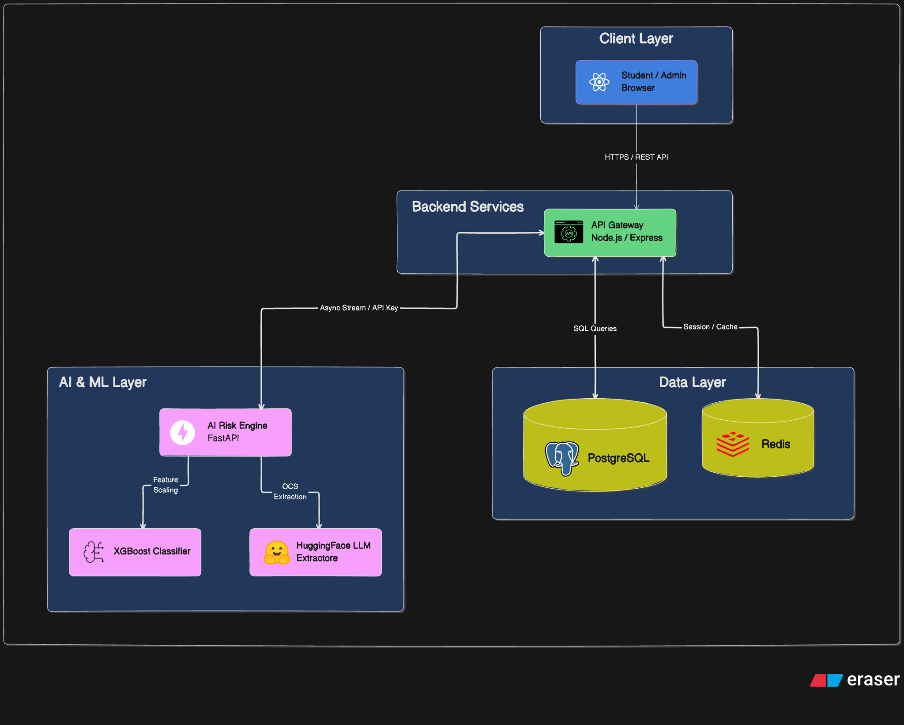


Proposed System Architecture
01. SYSTEM OVERVIEW
Architecture & Core Modules
Credixa operates on a highly scalable, 5-pillar cloud microservice architecture designed to handle real-time data processing, secure API routing, and heavy machine learning workloads seamlessly.
Frontend UI: Blazing-fast React app for a great user experience.
API Gateway: The central nervous system handling security and business logic.
AI Risk Engine: The "brain" performing OCR, parsing text, and running credit scoring models.
Database Vault & Cache: PostgreSQL for safe storage, paired with Redis for caching.
02. VISUALIZATION
Architecture Flow Diagram
Secure API Key
Features
OCR Parse

Slide 6
Tools & Technologies
01. LANGUAGES
Programming
JavaScript / TypeScript
Python
SQL
02. FRAMEWORKS
Architecture
Frontend: React 19, Vite, Tailwind CSS
Backend: Node.js, Express
AI Engine: FastAPI
03. STORAGE
Database & Cache
PostgreSQL (via Supabase)
Redis 7 (Caching)
04. ENGINEERING
Tools & ML
XGBoost (Predictive Modeling)
HuggingFace (Text Parsing)
Docker (Containerization)
Security: JWT & HMAC-SHA256

Slide 7
Implementation / Demo
01. INGESTION PIPELINE
Intelligent Document Vault
Students easily upload their fee structures and bank statements. Instead of manual review, our automated OCR pipeline instantly digitizes and reads these documents.
03. USER FLOW
System Execution Steps
1. Register: Student inputs basic details and links a co-applicant.
2. Upload: Documents are securely uploaded to the vault.
3. Analyze: The AI Risk Engine evaluates the data in real-time.
4. Disburse: An Omniscore is generated, a credit limit is set, funds are routed to the college, and a clear repayment schedule is presented.
02. DECISION CORE
Explainable AI Underwriting
The AI doesn't just output a number; it calculates the "Omniscore" and provides explicit reasoning (Pros and Cons) for its decision, ensuring complete transparency for the applicant.
🔗 Project Demo Video: [Paste your video or demo link here]

Slide 8
Results & Analysis
01. OUTPUT
Instant Underwriting
By automating the underwriting process, Credixa drastically reduces loan approval times from weeks to under 60 seconds.
02. PERFORMANCE METRICS
Accuracy & Speed
Our pipeline achieves high accuracy in text extraction from unstructured documents. The XGBoost classifier ensures highly predictive risk modeling, while our Redis cache maintains microsecond latency for session handling.
03. COMPARISON
Credixa vs. Traditional Banks
Unlike traditional banks that judge applicants based on a static, historical credit score, Credixa continuously adapts. By analyzing dynamic, real-world behavioral data—such as savings rates, debt-to-income ratios, and financial habits—we provide a much fairer and more inclusive approval rate for young students.

Slide 9
Challenges & Limitations
01. COMPUTATION & TECH
High Inference Costs
Processing unstructured text (like messy bank statements) using Large Language Models is computationally expensive and requires careful optimization.
02. DATA EXTRACTION
OCR Reliability
Dealing with low-quality, scanned, or handwritten documents can degrade text extraction accuracy, requiring robust fallback mechanisms.
03. RISK MODELING
Model Drift
The machine learning model (XGBoost) isn't "set and forget." It requires continuous retraining with fresh market data so its predictions remain accurate over time.
04. COMPLIANCE & FINANCE
Regulatory Hurdles
Navigating the financial landscape without a license means we must operate as a Technology Service Provider, requiring strategic partnerships with licensed NBFCs.

Slide 10
Conclusion & Future Work
01. CONCLUSION
Summary
Credixa successfully bridges a massive financing gap by democratizing credit for students. By leveraging AI to evaluate non-traditional data, we have built a fast, fair, and completely transparent BNPL ecosystem that empowers students while keeping institutional partners secure.
02. FUTURE WORK
Enhancements
Open Banking Integration: Moving away from PDF uploads to direct API-based Account Aggregators for real-time bank data streaming.
Mobile Expansion: Developing a native mobile application (using React Native) for iOS and Android to reach users where they are.
Automated CI/CD: Implementing robust GitHub Actions pipelines to automate testing and deployments for faster and safer rollouts.

