Slide 1
Extracting SpO₂ by pulse oximetry , X-Ray image processing, along with combining clinical symptoms and machine learning to detect pneumonia using non-invasive method
GROUP -5
ROLL: 1506129, 1506135, 1506142 ,1506143, 1506148 ,1506165

Slide 2
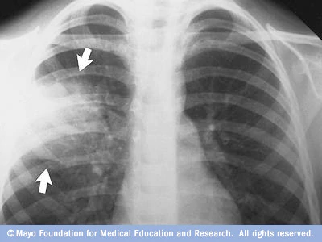


Parameters for Pneumonia Detection
X-Ray Images 2. SpO₂ 3.Symptoms

Slide 3
Paper Title: Identifying Medical Diagnoses and Treatable Diseases by Image-Based Deep Learning
Paper Link : https://www.cell.com/cell/fulltext/S0092-8674(18)30154-5
Dataset: Labeled Optical Coherence Tomography (OCT) and Chest X-Ray Images for Classification
Dataset Link : https://data.mendeley.com/datasets/rscbjbr9sj/2

Slide 4
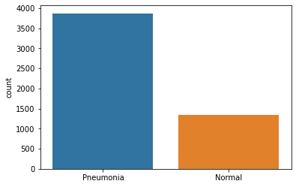
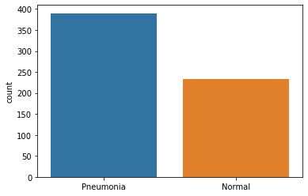
Dataset:
Train Data
Test Data
Two category :
Pneumonia (3883 images)
Normal (1349 images)
Two category :
Pneumonia (390 images)
Normal (234 images)

Slide 5
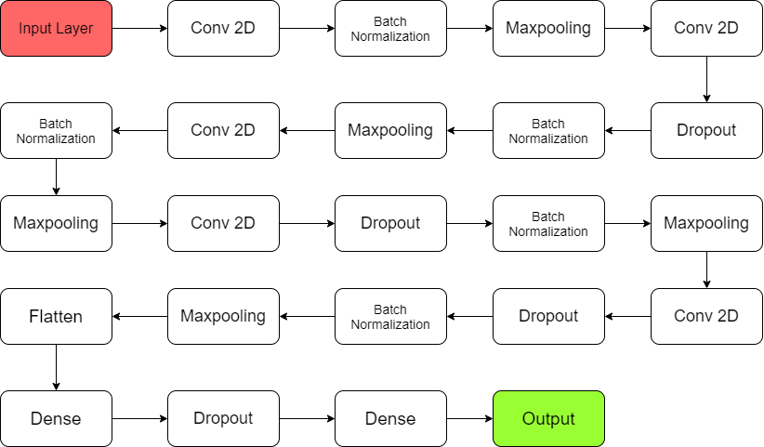
Model Architecture :

Slide 6
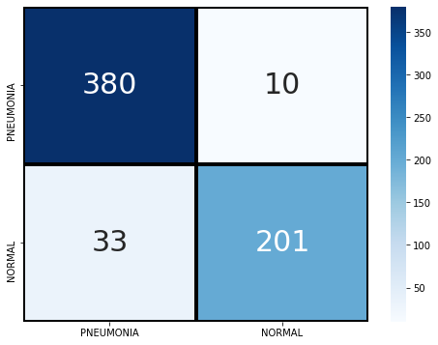
Test Data
Two category :
Pneumonia (390 images)
Normal (234 images)
Confusion Matrix

Slide 7
Result
Parameter | Reference Paper | Our Work
Accuracy | 92.8 | 93.109
Sensitivity | 93.2 | 97.436
Specificity | 90.1 | 85.897
Area Under ROC | 96.8 | 97.44

Slide 8
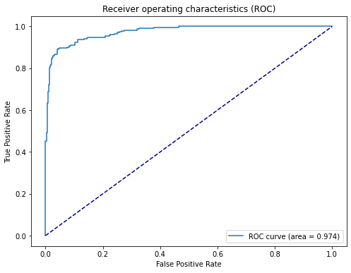
Receiver operating characteristics (ROC)
Reference Paper
Our Work

Slide 9
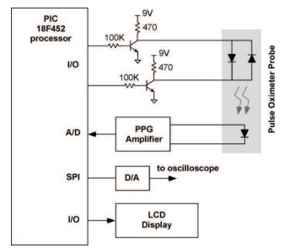
Hardware: Pulse Oximeter
Microcontroller based pulse oximeter for undergraduate capstone design.
Source: M. Tamayo, A. Westover and Y. Sun, "Microcontroller based pulse oximeter for undergraduate capstone design," Proceedings of the 2010 IEEE 36th Annual Northeast Bioengineering Conference (NEBEC), New York, NY, 2010, pp. 1-2, doi: 10.1109/NEBC.2010.5458198.

Slide 10
We want to measure the severity of the disease in a scale of 10
X-Ray Image result = 5
Comparing SpO₂ value = 3
Total 8 symptoms, each will carry 0.25 = 2

Slide 11
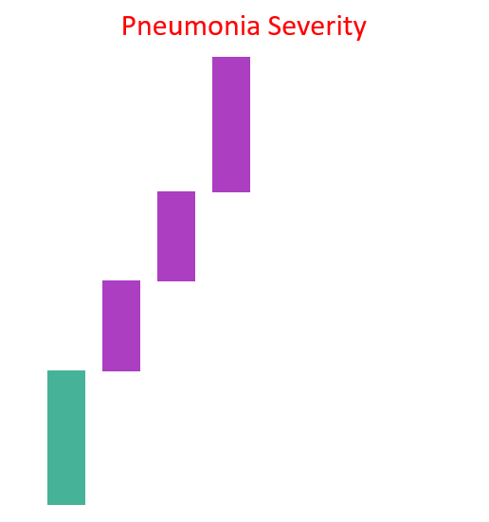
In the scale of 10
score>=7, severe pneumonia
5<=score<7, moderate pneumonia
3<=score<5, mild pneumonia.
Severe
Moderate
Mild
Negative

Slide 12
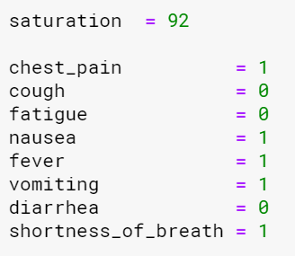
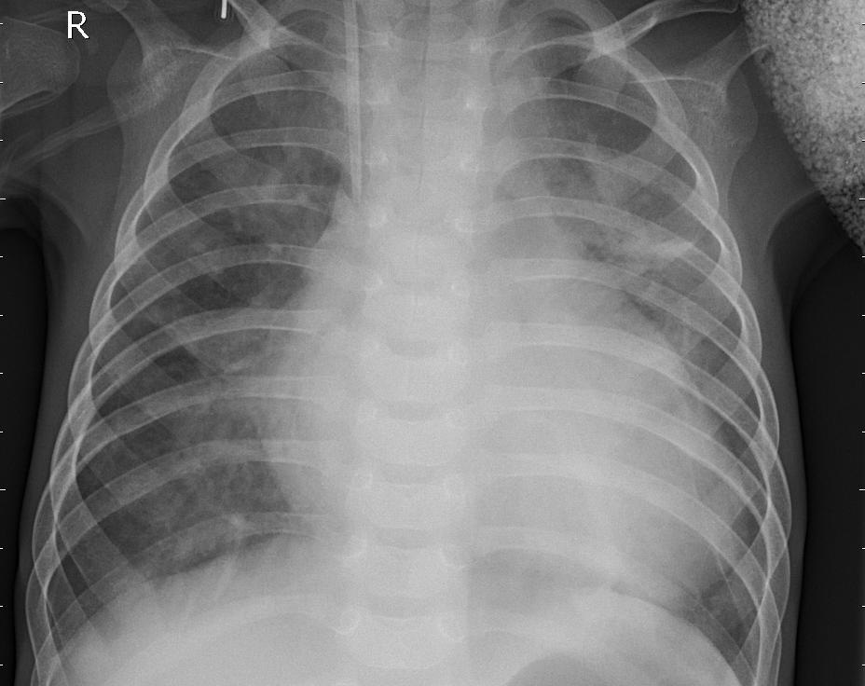
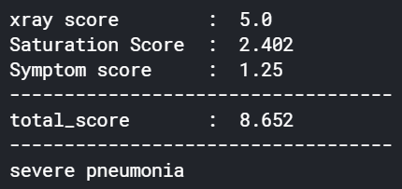
Patient-1
X-ray of Pneumonia patient

Slide 13
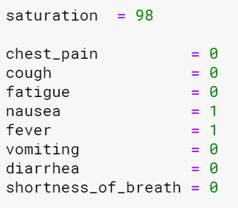
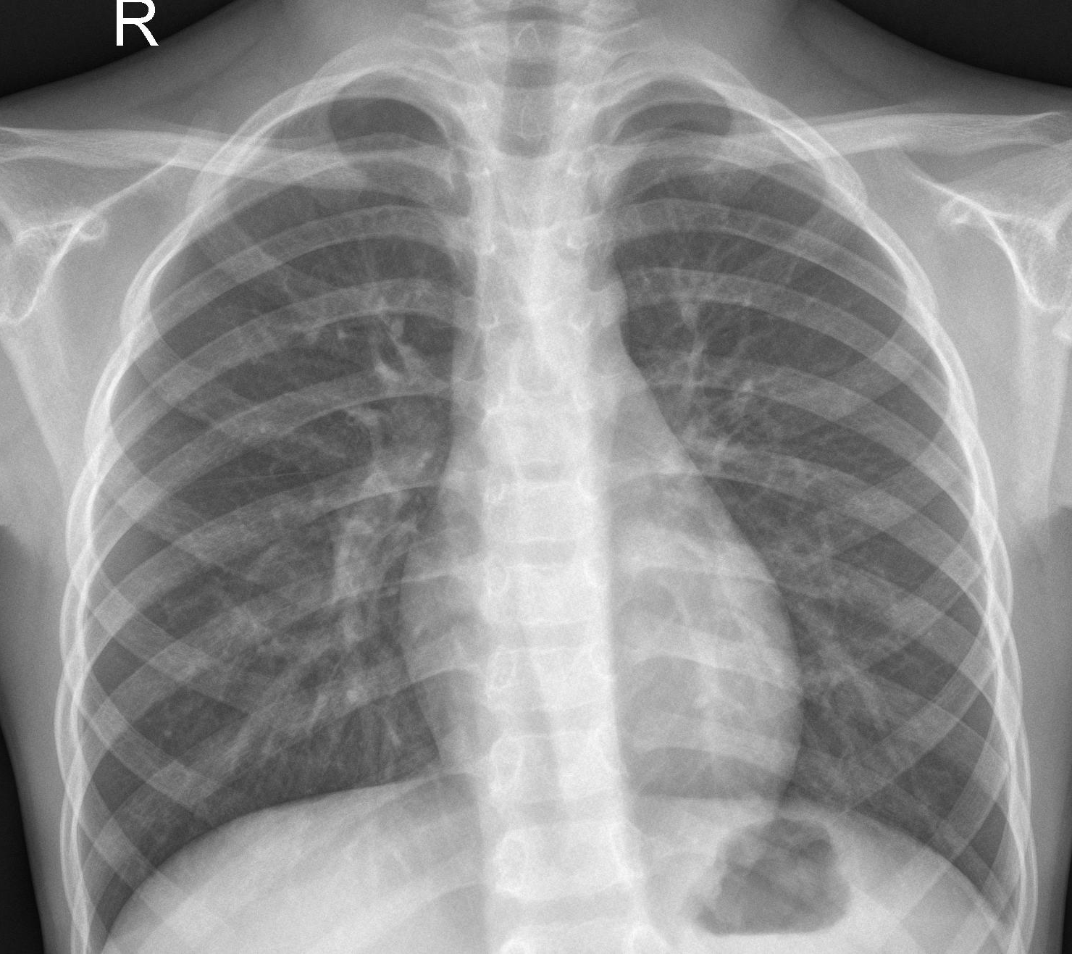
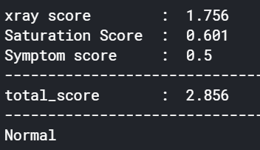
Patient-2
X-ray of Normal patient

Slide 14
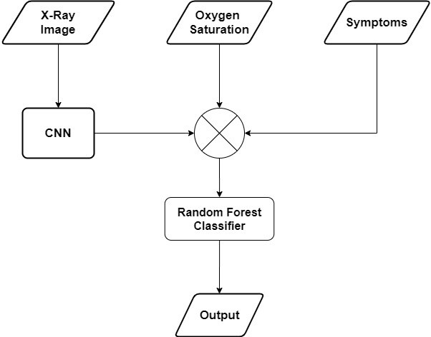
Flow chart

Slide 15
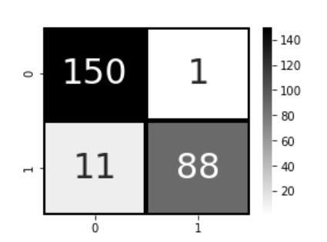
Test result
Total Test images: 624
60% Train Set (374 profiles)
40% Test Set (250 profiles)
Test accuracy: 95.20
Sensitivity: 99.3
Specificity: 88.9

