Slide 1
CIS 635 Knowledge Discovery & Data Mining
Predictive modeling: Classification

Slide 2
Regression vs Classification
Main difference is the target or response variable (y)

Slide 3
Regression vs Classification
Main difference is the target or response variable (y)
One predicts real/floating-point values whereas the other predicts categorical values (predefined set)

Slide 4
Regression vs Classification
Main difference is the target or response variable (y)
One predicts real/floating-point values whereas the other predicts categorical values (predefined set)
Regression examples:
Diabetes scores
Healthcare cost

Slide 5
Regression vs Classification
Main difference is the target or response variable (y)
One predicts real/floating-point values whereas the other predicts categorical values (predefined set)
Regression examples:
Diabetes scores
Healthcare cost
Classification examples:
Character recognition (10 classes)
Yes/No (or Binary) questions:
Accept/reject loan application
Positive vs negative sentiment
Dog vs cat (2 classes), still binary class

Slide 6
Regression vs Classification
Main difference is the target or response variable (y)
One predicts real/floating-point values whereas the other predicts categorical values (predefined set)
Regression examples:
Diabetes scores
Healthcare cost
Classification examples:
Character recognition (10 classes)
Yes/No (or Binary) questions:
Accept/reject loan application
Positive vs negative sentiment
Dog vs cat (2 classes), still binary class

Slide 7
Regression vs Classification
Main difference is the target or response variable (y)
One predicts real/floating-point values whereas the other predicts categorical values (predefined set)
Regression examples:
Diabetes scores
Healthcare cost
Classification examples:
Character recognition (10 classes)
Yes/No (or Binary) questions:
Accept/reject loan application
Positive vs negative sentiment
Dog vs cat (2 classes), still binary class

Slide 8
Regression vs Classification
Main difference is the target or response variable (y)
One predicts real/floating-point values whereas the other predicts categorical values (predefined set)
Regression examples:
Diabetes scores
Healthcare cost
We have learned about regression (not complete yet; will continue ..)
Classification examples:
Character recognition (10 classes)
Yes/No (or Binary) questions:
Accept/reject loan application
Positive vs negative sentiment
Dog vs cat (2 classes), still binary class
We will start our classification predictive modeling journey today

Slide 9
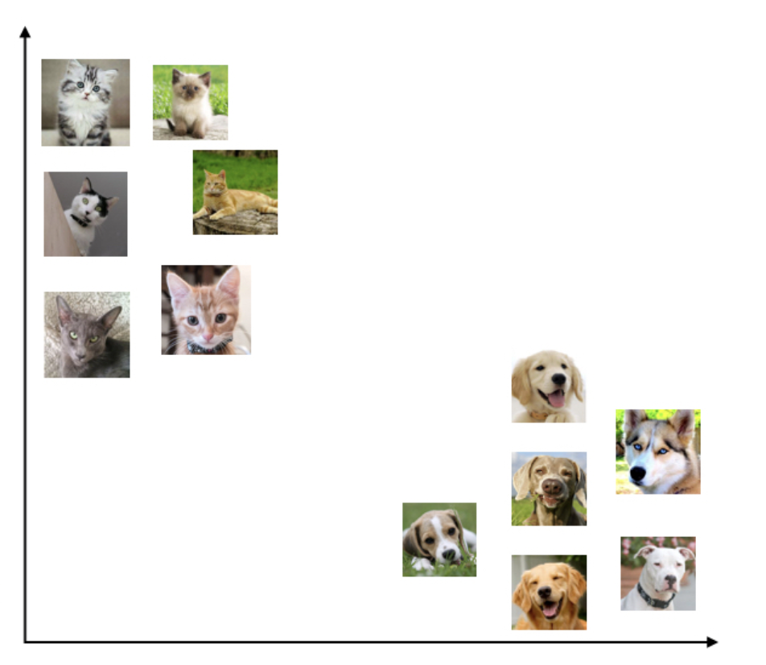
Classification
Here we are seeing some examples of Dog and Cat images

Slide 10
Classification
Here we are seeing some examples of Dog and Cat images
Both animals have features such as size, color, weight, etc.

Slide 11
Classification
Here we are seeing some examples of Dog and Cat images
Both animals have features such as size, color, weight, etc.
We are just plotting their images on 2D plane for easy understanding.

Slide 12
Classification
Here we are seeing some examples of Dog and Cat images
Both animals have features such as size, color, weight, etc.
We are just plotting their images on 2D plane for easy understanding.
We can separate the instances by simply using a liner straight line (a linear classifier):
On left top we have Cats
And right bottom we have Dogs

Slide 13


Classification
A simple Linear (2D) classifier doesn’t work for this setup

Slide 14
Classification
A simple Linear (2D) classifier doesn’t work for this setup
We require
Either go to higher dimensions, or
Chose a non-linear classifier

Slide 15
Classification
A simple Linear (2D) classifier doesn’t work for this setup
We require
Either go to higher dimensions, or
Chose a non-linear classifier

Slide 17
Classification Models
Logistic Regression
Random Forest Classifier
Support Vector Machines (SVMs)
Boosting Classifiers
Naive Bayes

Slide 18
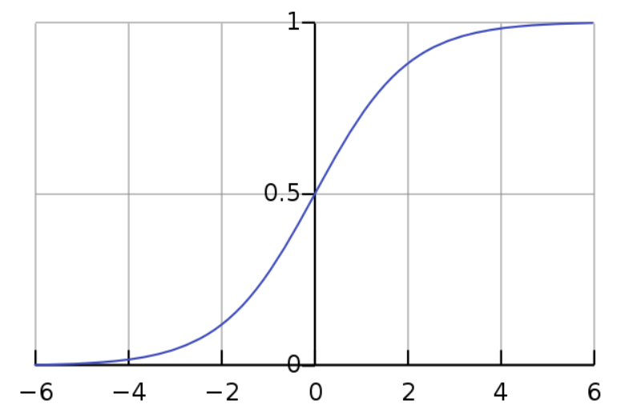
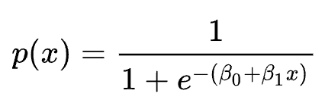
Logistic Regression
Probabilistic classifier
Sigmoid function

Slide 19
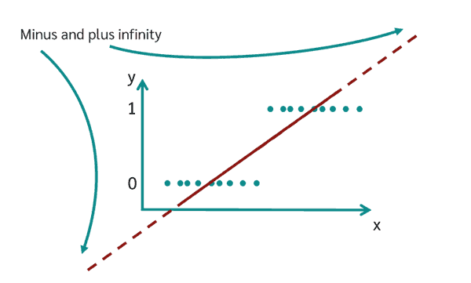
Logistic Regression
src

Slide 20
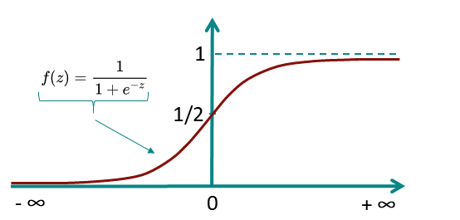
Logistic Regression
src

Slide 21
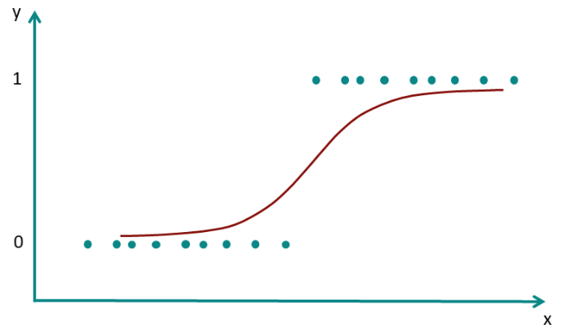
Logistic Regression
src

