Slide 1
CIS 635 - Knowledge Discovery & Data Mining
Database Table Joins

Slide 2
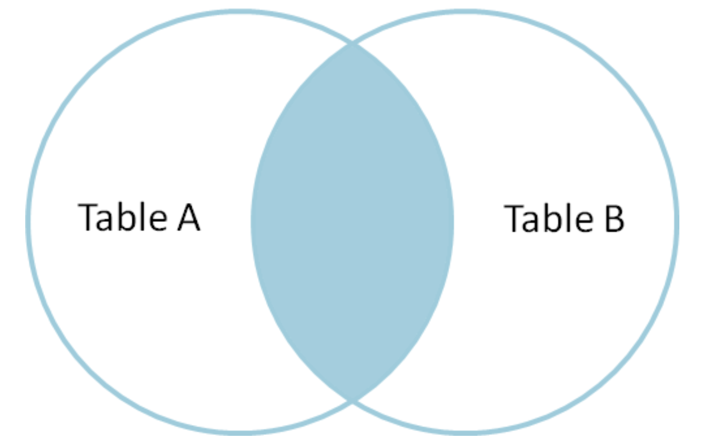
Inner join
Joins are performed through some common keys, shared across tables
Only preserve records for which data is available in both tables.

Slide 3
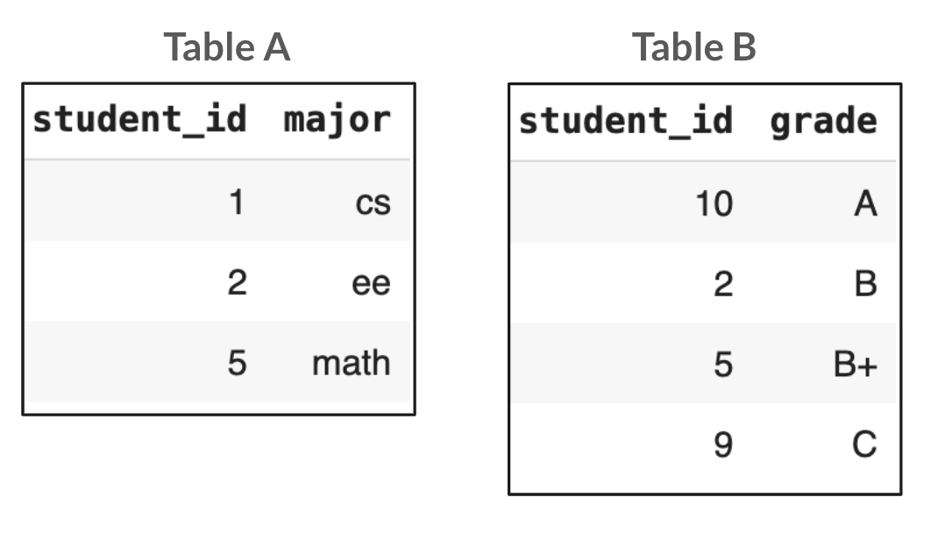
Inner join
Only preserve records for which data is available in both tables.
We see below an example with student_id be the join key.

Slide 4
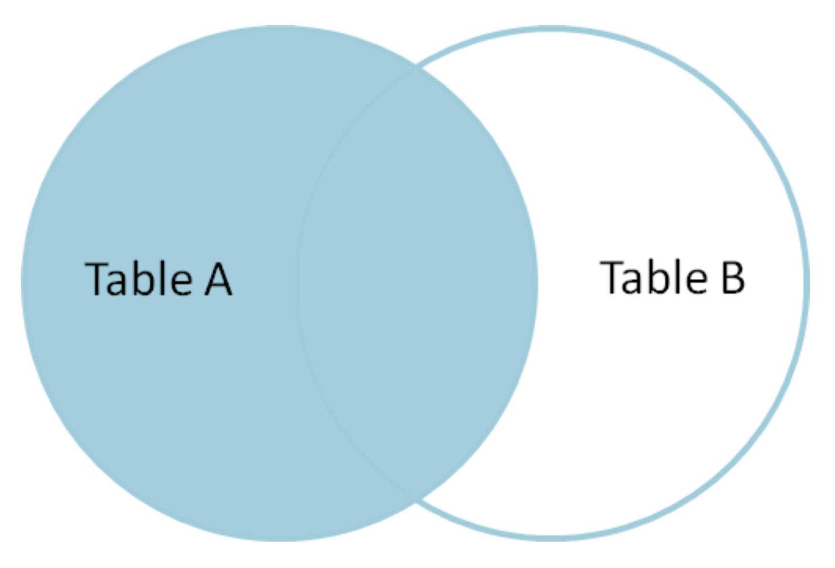
Left join
Joins are performed through some common keys, shared across tables
All records from the left table are preserved, even though no corresponding information is available in the right table

Slide 5
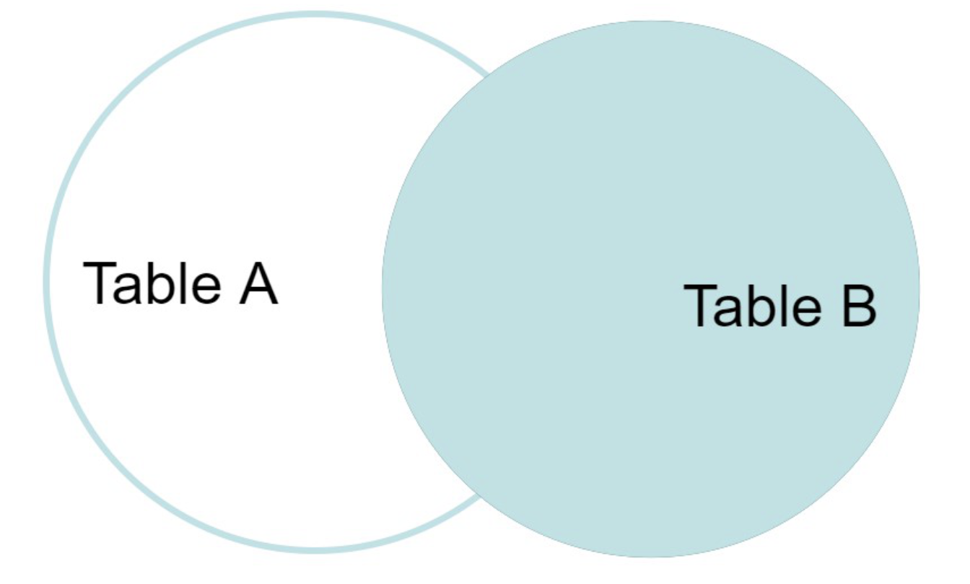
Right join
Joins are performed through some common keys, shared across tables
All records from the right table are preserved, even no corresponding information is available in the right table

Slide 6
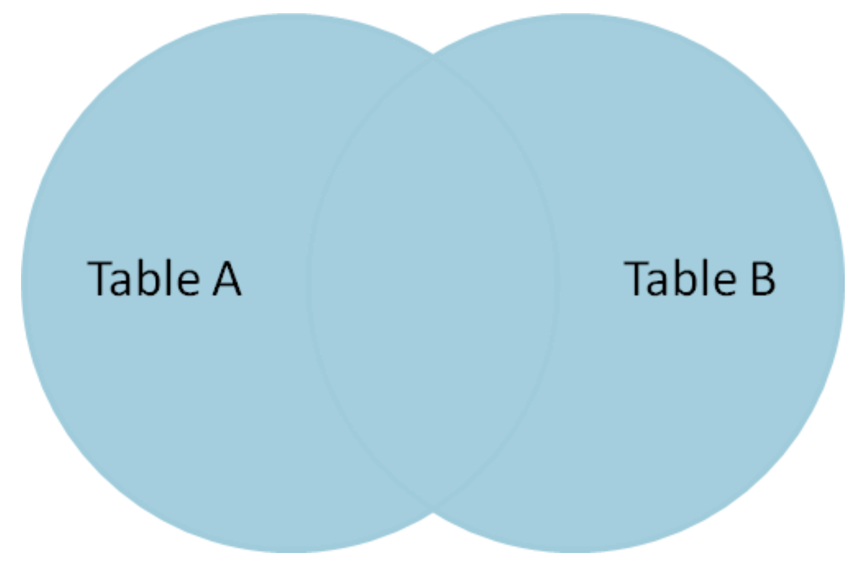
Outer/full join
Joins are performed through some common keys, shared across tables
All records from the both tables are preserved, even no corresponding information is available in the other table

