Slide 1
CIS 635 - Knowledge Discovery & Data Mining
Basics of Probability

Slide 2
Standard vs AI solutions
Find the maximum from a given list of numbers.
Whats was the recorded lowest temperature of Grand Rapids in last 20 years?

Slide 3
Standard vs AI solutions
Find the maximum from a given list of numbers.
Whats was the recorded lowest temperature of Grand Rapids in last 20 years?
Will it snow tomorrow? What are the chances?
Who is going to win in the next NFL games between Texans vs Ravens?
Translate the following into “French”:
“English and French are two European languages; they have a lot in common; however they also possess a lot of differences, especially when we talk about conjugations, contractions and gender usages.”

Slide 4
Standard vs AI solutions
Difference between a regular/standard and an AI/ML algorithm
Regular/standard algorithms (Deterministic)
AI/ML algorithms (non deterministic, lives with uncertainty)
Probability theory is the branch of Math that talks about uncertainty.

Slide 5
Standard vs AI solutions
Fill in the Gaps
I am very ……???…….

Slide 6
Standard vs AI solutions
Fill in the Gaps
It's already 7pm; I have been working since early morning, I am very ………??? ……

Slide 7
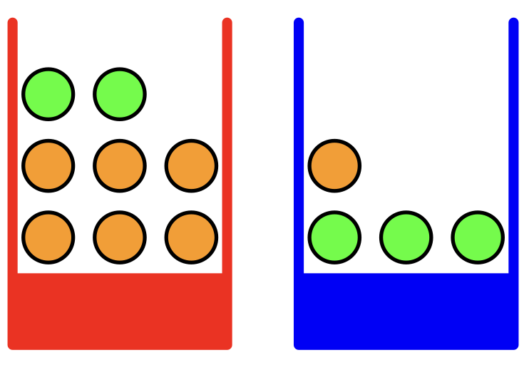
Basics of Probability
Let’s say, we have two boxes (as depicted in the right)
Notes:
Generally uniform distribution; may be biased (say color preferences of a group of people); we are biasing for the sake of discussion/understanding.

Slide 8
Basics of Probability
Let’s say, we have two boxes (as depicted in the right)
If you are asked to chose a Box (before you see what's inside) which one will you choose?
Notes:
Generally uniform distribution; may be biased (say color preferences of a group of people); we are biasing for the sake of discussion/understanding.

Slide 9
Basics of Probability
Let’s say, we have two boxes (as depicted in the right)
If you are asked to chose a Box (before you see what's inside) which one will you choose?
If you don’t have any Bias (say color, or the location of the boxes, etc), assigning a 50%-50% preference is a reasonable assumption
Notes:
Generally uniform distribution; may be biased (say color preferences of a group of people); we are biasing for the sake of discussion/understanding.

Slide 10
Basics of Probability
Let’s say, we have two boxes (as depicted in the right)
If you are asked to chose a Box (before you see what's inside) which one will you choose?
If a young kid is given this task, do you think there are any chances of gender Bias may affect the selection?
Notes:
Generally uniform distribution; may be biased (say color preferences of a group of people); we are biasing for the sake of discussion/understanding.

Slide 11

Basics of Probability
Let’s say, we have two boxes (as depicted in the right)
If you are asked to chose a Box (before you see what's inside) which one will you choose?
If a young kid is given this task, do you think there are any chances of gender Bias may affect the selection?
Notes:
Generally uniform distribution; may be biased (say color preferences of a group of people); we are biasing for the sake of discussion/understanding.

Slide 12
Basics of Probability
Let’s say, we have two boxes of mixed oranges and apples (as depicted in the right)
For some unknown reason when some people were asked to choose a fruit from one these two (2) boxes, people preferred the Blue box (60%) and the Red one (40%) of the time.
Notes:
Generally uniform distribution; may be biased (say color preferences of a group of people); we are biasing for the sake of discussion/understanding.

Slide 13
Basics of Probability
For some unknown reason when some people were asked to choose a fruit from one these two (2) boxes, people preferred the Blue box (60%) and the red one (40%) of the time.
So we have Two Random variables:
Box (B), and
Fruit (F)
Probability of choosing the Red box is, p(B=r) = 40/100 = 0.4
Probability of choosing the Blue box is, p(B=b) = 60/100 = 0.6
Notes:
Lets not worry about the term RV; Generally uniform distribution; may be biased (say color preferences of a group of people); we are biasing for the sake of discussion/understanding.

Slide 14
Basics of Probability
For some unknown reason when some people were asked to choose a fruit from one these two (2) boxes, people preferred the Blue box (60%) and the red one (40%) of the time.
So we have Two Random variables:
Box (B), and
Fruit (F)
Probability of choosing the Red box is, p(B=r) = 40/100 = 0.4
Probability of choosing the Blue box is, p(B=b) = 60/100 = 0.6
p(B=r) + p(B=b) = 1 (Summation rule)
Two boxes are completely independent and disjoint
Notes:
Lets not worry about the term RV; Generally uniform distribution; may be biased (say color preferences of a group of people); we are biasing for the sake of discussion/understanding.

Slide 15
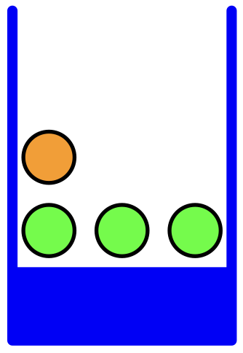
Basics of Probability
Let's open the boxes, and explore the fruits inside, and explain the content in terms of probabilities.
p(F=a|B=b) = ¾ = 0.75
p(F=o|B=b)= ¼ = 0.25
p(F=a|B=b) + p(F=o|B=b)=1
Uniform distribution assumption

Slide 16
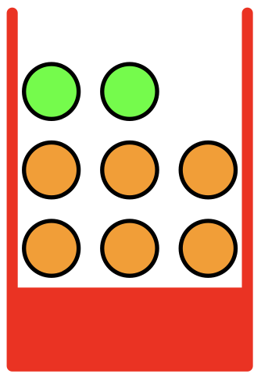
Basics of Probability
Let's open the boxes, and explore the fruits inside, and explain the content in terms of probabilities.
p(F=a|B=r) = 2/8 = 0.25
p(F=o|B=b)= 6/8 = 0.75
p(F=a|B=r) + p(F=o|B=r)=1
Uniform distribution assumption

Slide 17
Basics of Probability
Let's open the boxes, and explore the fruits inside, and explain the content in terms of probabilities.
p(F=a) = p(F=a|B=r) p(B=r) + p(F=a|B=b)p(B=b)
= 0.25*0.4 + 0.75*0.6
= 0.55
Uniform distribution assumption

Slide 18
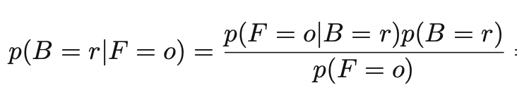
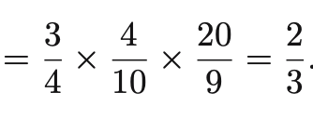
Basics of Probability
Bayes’ rule/theorem

Slide 19
What we have learned today
Differences between Standard vs AI solutions
Uncertainty is attached to AI solutions
Probability theory is to a tool to explain and manipulate Uncertainty
Some Basics of Probability theory
Summation Rule
Bayes Rule
Our Probability journey starts here

Slide 20
bk

Slide 21
Basics of Probability
Let’s say, we have two boxes of mixed oranges and apples (as depicted in the right)
Notes:
Generally uniform distribution; may be biased (say color preferences of a group of people); we are biasing for the sake of discussion/understanding.

Slide 22
Basics of Probability
Let’s say, we have two boxes of mixed oranges and apples (as depicted in the right)
If you are asked to chose a Box (before you see what's inside) which one will you choose?
Notes:
Generally uniform distribution; may be biased (say color preferences of a group of people); we are biasing for the sake of discussion/understanding.

Slide 23
Basics of Probability
Let’s say, we have two boxes of mixed oranges and apples (as depicted in the right)
If you are asked to chose a Box (before you see what's inside) which one will you choose?
If you don’t have any Bias (say color, or the location of the boxes, etc), assigning a 50%-50% preference is a reasonable assumption
Notes:
Generally uniform distribution; may be biased (say color preferences of a group of people); we are biasing for the sake of discussion/understanding.

Slide 24
Basics of Probability
Let’s say, we have two boxes of mixed oranges and apples (as depicted in the right)
If you are asked to chose a Box (before you see what's inside) which one will you choose?
If you don’t have any bias (say color, or the location of the boxes, etc), assigning a 50%-50% preference is a reasonable assumption
This is generally known as “Uniform distribution” assumption
Notes:
Generally uniform distribution; may be biased (say color preferences of a group of people); we are biasing for the sake of discussion/understanding.

