Slide 1
CIS 635 - Knowledge Discovery & Data Mining
Introduction to Data Mining

Slide 2
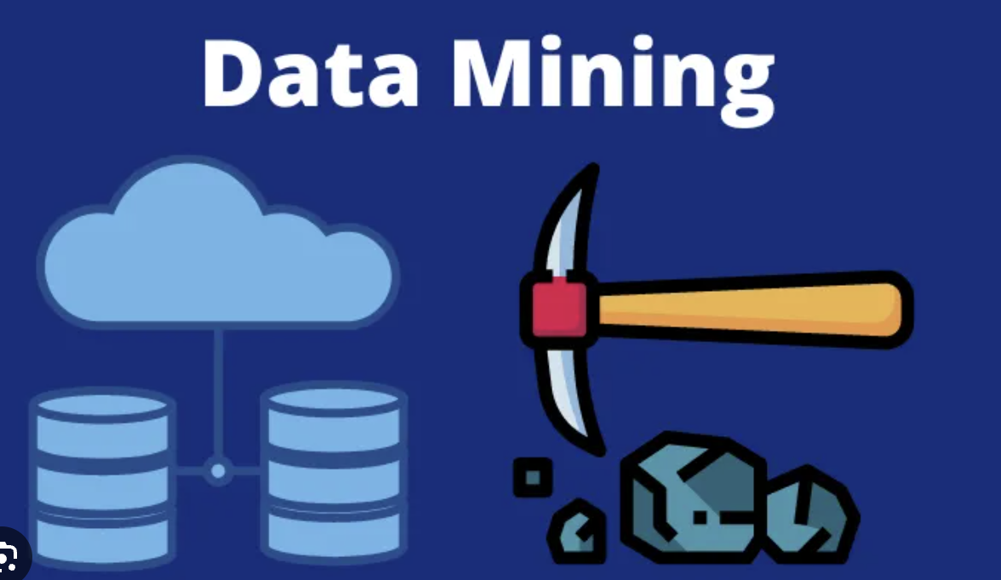
What is Data Mining?
Process of extracting and discovering patterns in large datasets
Involves methods: ML, Statistics, DBMS
Interdisciplinary field: CS, Statistics
Overall goal:
Extracting information from dataset
Transform into a comprehensive structure for further use
Data mining is the analysis step of
The KDD
Aside from raw analysis, it also involves
Database and data management aspects
Data preprocessing
Modeling and inference considerations
Evaluation and metrics
Post processing of discovered structures and visualizations
Wikipedia

Slide 3
What is Data Mining?
Process of extracting and discovering patterns in large datasets
Involves methods: ML, Statistics, DBMS
Interdisciplinary field: CS, Statistics
Overall goal:
Extracting information from dataset
Transform into a comprehensive structure for further use
Data mining is the analysis step of
The KDD
Aside from raw analysis, it also involves
Database and data management aspects
Data preprocessing
Modeling and inference considerations
Evaluation and metrics
Post processing of discovered structures and visualizations
Wikipedia

Slide 4
What is Data Mining?
Process of extracting and discovering patterns in large datasets
Involves methods: ML, Statistics, DBMS
Interdisciplinary field: CS, Statistics
Overall goal:
Extracting information from dataset
Transform into a comprehensive structure for further use
Data mining is the analysis step of
The KDD
Aside from raw analysis, it also involves
Database and data management aspects
Data preprocessing
Modeling and inference considerations
Evaluation and metrics
Post processing of discovered structures and visualizations
Wikipedia

Slide 5
What is Data Mining?
Process of extracting and discovering patterns in large datasets
Involves methods: ML, Statistics, DBMS
Interdisciplinary field: CS, Statistics
Overall goal:
Extracting information from dataset
Transform into a comprehensive structure for further use
Data mining is the analysis step of
The KDD
Aside from raw analysis, it also involves
Database and data management aspects
Data preprocessing
Modeling and inference considerations
Evaluation and metrics
Post processing of discovered structures and visualizations
Wikipedia

Slide 6
What is Data Mining?
Process of extracting and discovering patterns in large datasets
Involves methods: ML, Statistics, DBMS
Interdisciplinary field: CS, Statistics
Overall goal:
Extracting information from dataset
Transform into a comprehensive structure for further use
Data mining is the analysis step of
The KDD
Aside from raw analysis, it also involves
Database and data management aspects
Data preprocessing
Modeling and inference considerations
Evaluation and metrics
Post processing of discovered structures and visualizations
Wikipedia

Slide 7
Knowledge Discovery Process (KDP) Models
Academic Research Models
Introduced in mid 1990s
Several models available
Suggested steps are similar
9 steps: Fayyard et al KDP model:
Understanding the application domain
Creating a target dataset
Data cleaning and preprocessing
Data reduction and projection
Choosing the data mining task
Choosing the algorithm
Data mining
Interpreting mined patterns
Consolidating discovered patterns
Data Mining - A Knowledge Discovery Approach by Cis Pedrycz, and Swiniarski

Slide 8
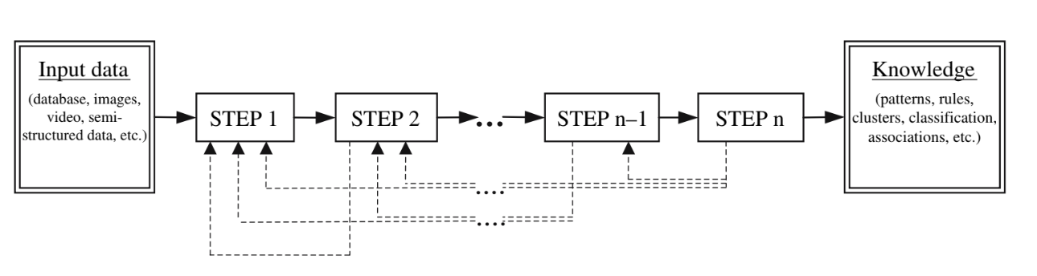
Knowledge Discovery Process (KDP) Models
Academic Research Models
Introduced in mid 1990s
Several models available
Suggested steps are similar
9 steps: Fayyard et al KDP model:
Understanding the application domain
Creating a target dataset
Data cleaning and preprocessing
Data reduction and projection
Choosing the data mining task
Choosing the algorithm
Data mining
Interpreting mined patterns
Consolidating discovered patterns

Slide 9
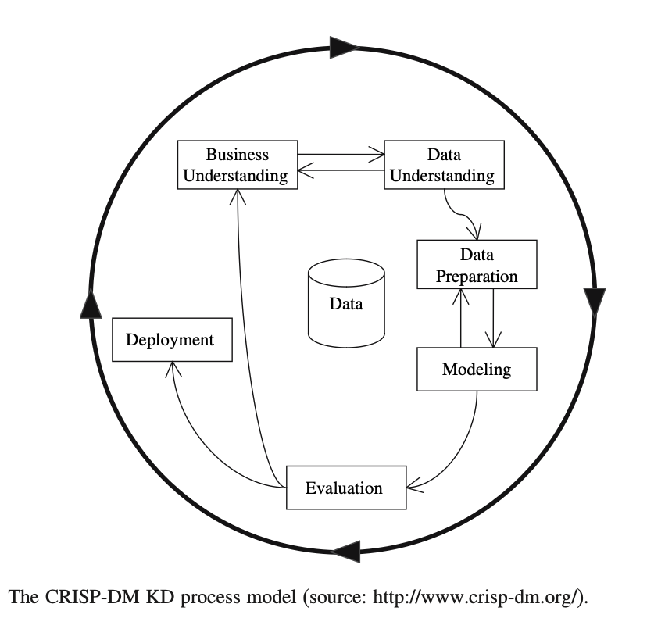
Knowledge Discovery Process (KDP) Models
Industrial Models
Business understanding
Data Understanding
Data preparation
Modeling
Evaluation
Deployment
Data Mining - A Knowledge Discovery Approach by Cis Pedrycz, and Swiniarski

Slide 10
BK

Slide 11
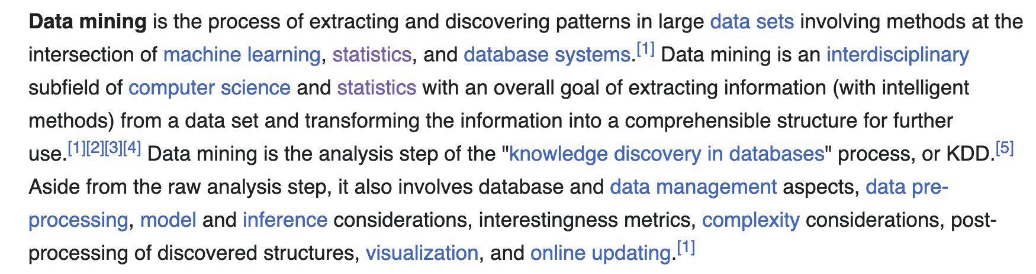
What is Data Mining
Process of extracting and discovering patterns in large datasets
Involves methods: ML, Statistics, DBMS
Interdisciplinary field: CS, Statistics
Overall goal:
Extracting information from dataset
Transform into a comprehensive structure for further use
Data mining is the analysis step of
The KDD
Aside from raw analysis, it also involves
Database and data management aspects
Data preprocessing
Modeling and inference considerations
Evaluation and metrics
Post processing of discovered structures and visualizations

