Slide 1
YOUR FIRST CHIP / START HERE
Your first Tiny Tapeout chip
Understand it.
Build it. Test it.
One real 8-bit counter, from your first bit
to a checked chip layout.
Illustrative shared chip
EE6019 • 8 October 2026 • Sources and teaching notes in PowerPoint
Open source ↗
001 / 195
Notes:
TEACHING NOTES
This course follows one genuine eight-bit counter from its specification to a checked layout. Start with the circuit concepts even if you have programmed before: Verilog describes connected hardware, and the Python test is outside the fabricated design. Each lesson gives a small piece of understanding, a worked example and a check. The practical route uses your browser and a free GitHub account, while automated tools run on standard GitHub-hosted runners. It ends with an archived source revision and verified layout files. Submission, payment and wafer fabrication are explained afterwards as separate stages. No chip was ordered or manufactured for this example. Read the full Word manual for longer explanations and use the starter ZIP to preserve source paths and indentation. The chip picture here is an editable conceptual illustration, not a photograph or physical evidence.
MANUAL REFERENCE
What you will learn and produce
SOURCES / checked 8 October 2026
https://github.com/mdkamrulislam-web/tt-sky130-counter/tree/61ef06bed008e76000f9ae46d65182e476d15dd6
https://tinytapeout.com/hdl/templates/

Slide 2
YOUR FIRST CHIP / START HERE
What you will understand and produce
1
Predict an eight-bit counter: reset, count, hold and wrap.
WORKED EXAMPLE
Explain its Verilog, fixed chip interface and Python checks.
One circuit.
0 → 1 → 2 … 255 → 0
One checked revision.
Several kinds of evidence.
2
3
Create a project and inspect the real automated results.
4
Keep the source, datasheet, waveform and checked layout together.
CHECK You can name both the circuit behaviour and the files the exercise produces.
EE6019 • 8 October 2026 • Sources and teaching notes in PowerPoint
Open source ↗
002 / 195
Notes:
TEACHING NOTES
A learning outcome is something you can explain or demonstrate. By the end you should predict the counter before running a simulator, identify which source statements implement those predictions and interpret the reported results without confusing simulation with silicon. The output package includes your saved source version, matching workflow links, XML result, actual waveform, generated datasheet, layout and check reports. A green icon alone is weaker than this connected evidence. The lesson uses a deliberately small design so arithmetic boundaries, reset priority and pin direction can be observed in detail. Bigger projects repeat the same reasoning but need additional specifications and tests. Work through the sections in order on the first pass. If a check fails, use the troubleshooting slides before moving ahead. Keep a plain-text evidence note beside the downloaded files.
MANUAL REFERENCE
What you will learn and produce
SOURCES / checked 8 October 2026
https://github.com/mdkamrulislam-web/tt-sky130-counter/tree/61ef06bed008e76000f9ae46d65182e476d15dd6
https://tinytapeout.com/hdl/templates/

Slide 3
YOUR FIRST CHIP / START HERE
Your route through the course
01 Foundations
02 Read the code
03 Browser lab
Slides 9–33
Slides 34–68
Slides 69–127
Bits, logic, stored state and clock edges
Counter, wrapper and self-checking test
Template, files, workflows and real waves
04 Physical design
05 Fabrication
06 Practise
Slides 128–151
Slides 152–161
Slides 162–195
Cells, wires, timing and layout checks
Free endpoint, later order and silicon
Optional local setup and worked exercises
EE6019 • 8 October 2026 • Sources and teaching notes in PowerPoint
Open source ↗
003 / 195
Notes:
TEACHING NOTES
The learning sequence is deliberate. Foundations make the binary output and clocked state understandable. The code lessons connect those ideas to the reusable counter, wrapper and cocotb test. The browser lab creates the repository and exposes the real results, including native captures from the actual RTL waveform. Physical design explains what the automated implementation did, which units appear in the reports and why timing, DRC, LVS and functional checks answer different questions. The fabrication lessons explain the free stopping point, dated costs and the later manufacturing chain. Optional local commands and exercises support further practice. This is a course-sized deck for study over several sessions, rather than a measured lab-duration claim. Use the contents and full manual to revisit a topic when a later result is unclear.
MANUAL REFERENCE
What you will learn and produce
SOURCES / checked 8 October 2026
https://github.com/mdkamrulislam-web/tt-sky130-counter/tree/61ef06bed008e76000f9ae46d65182e476d15dd6
https://tinytapeout.com/hdl/templates/

Slide 4
YOUR FIRST CHIP / START HERE
Get your learning workspace ready
1
Use a laptop, browser, internet access and your own GitHub account.
2
Keep counter-starter.zip and the Word manual beside this deck.
3
Create tiny-tapeout-learning and an evidence folder for downloads.
4
Use a public practice repository and standard Actions runners.
CHECK You have the ZIP, manual, account and a place to save your evidence.
EE6019 • 8 October 2026 • Sources and teaching notes in PowerPoint
Open source ↗
004 / 195
Notes:
TEACHING NOTES
The main route needs no installed physical-design tools and no development container. A GitHub account lets you create your repository, commit files and download artifacts. Standard GitHub-hosted runner compute is free for public repositories; account storage and artifact policies still apply. The starter ZIP contains seven complete example files. It is added to a repository created from the official template, whose infrastructure supplies workflows and dependencies. Use the ZIP rather than copying printed code: visual wraps in documents do not represent real source newlines. Keep separate folders for source learning files and downloaded evidence so results from an older revision are less likely to be mistaken for the newest ones. Your account name replaces YOUR_USERNAME where a later command or URL uses that placeholder. Existing institutional accounts and branch rules should be respected.
MANUAL REFERENCE
Keep these companion files together
SOURCES / checked 8 October 2026
https://github.com/mdkamrulislam-web/tt-sky130-counter/tree/61ef06bed008e76000f9ae46d65182e476d15dd6
https://tinytapeout.com/hdl/templates/

Slide 5
YOUR FIRST CHIP / START HERE
Understand the free stopping point
DO IN THIS COURSE
Write and test the circuit. Generate a layout, inspect the checks and archive matching artifacts.
LATER MANUFACTURING
Choose an approved funded route, create an order and explicitly submit an accepted revision.
CHECK A generated layout is a file; ordering and submitting for manufacture are separate actions.
EE6019 • 8 October 2026 • Sources and teaching notes in PowerPoint
Open source ↗
005 / 195
Notes:
TEACHING NOTES
Tiny Tapeout provides an open preparation flow, but manufacturing and delivery are separately costed. The file package called tt_submission is an artifact generated by Actions; its name does not mean a fabrication order has been placed. This exercise ends when the source revision, tests, datasheet, layout and relevant reports are checked and archived. The final chapters explain how an approved order and revision submission would proceed, and how combined layout data eventually becomes structures on a wafer. Do not enter payment details or start an order to complete the learning exercise. Codespaces is optional and has separate compute and storage quotas, including storage while stopped; it is not required for this browser route. The current prices in this deck are dated calculator estimates rather than quotes or guarantees.
MANUAL REFERENCE
Where the free route ends
SOURCES / checked 8 October 2026
https://github.com/mdkamrulislam-web/tt-sky130-counter/tree/61ef06bed008e76000f9ae46d65182e476d15dd6
https://tinytapeout.com/hdl/templates/

Slide 6
YOUR FIRST CHIP / START HERE
Read each step as a small experiment
1
WHY: understand what the step achieves.
2
DO: follow the action or predict the example.
3
CHECK: look for observable evidence of success.
4
If it fails, identify the first useful error before continuing.
CHECK You can explain what a step should produce before doing it.
EE6019 • 8 October 2026 • Sources and teaching notes in PowerPoint
Open source ↗
006 / 195
Notes:
TEACHING NOTES
The deck is intended to support active learning. Before clicking a button, know what it changes; before running a tool, predict the result it should produce. After the action, inspect a specific file, state or result rather than assuming success from the absence of an error dialog. The bottom check on each practical slide tells you what observation is relevant. Screenshots identify the source and the feature to look for. Some controls require a signed-in account, so those pictures come from credited official documentation and may show older example repositories. Current counter, result and waveform captures are separately identified as actual evidence. The speaker notes contain deeper teaching explanations, manual section references and source URLs. The PDF contains the slides; use the PowerPoint or Word manual for the longer notes. If an image shows the reference account, substitute your own project in your browser.
MANUAL REFERENCE
Read these conventions once
SOURCES / checked 8 October 2026
https://github.com/mdkamrulislam-web/tt-sky130-counter/tree/61ef06bed008e76000f9ae46d65182e476d15dd6
https://tinytapeout.com/hdl/templates/

Slide 7
YOUR FIRST CHIP / START HERE
Keep the example and your version distinct
REFERENCE
Repository: tt-sky130-counter
Branch: worked-example
Verified commit: 61ef06b
YOUR PROJECT
Your account and repository
Your own saved commit
Your runs must test that same commit
CHECK Each result you trust belongs to the exact source version you intend to review.
EE6019 • 8 October 2026 • Sources and teaching notes in PowerPoint
Open source ↗
007 / 195
Notes:
TEACHING NOTES
The reference counter belongs to mdkamrulislam-web and was verified at the full SHA 61ef06bed008e76000f9ae46d65182e476d15dd6. Its reviewed branch is worked-example; main may still contain the initial template until its pull request is merged. Pinned links in the notes avoid this ambiguity. Your own copy will have a different repository name and different commit IDs even if the example files are identical. A commit is a saved version of the files; a branch is a named line of those versions. The same-commit rule matters because an older successful workflow does not prove newer edits are correct. Save the exact commit and run URLs with each evidence download. The original empty-template metadata failures are real failures of project information, not deliberately generated test assertion failures.
MANUAL REFERENCE
Read these conventions once
SOURCES / checked 8 October 2026
https://github.com/mdkamrulislam-web/tt-sky130-counter/tree/61ef06bed008e76000f9ae46d65182e476d15dd6
https://tinytapeout.com/hdl/templates/

Slide 8
YOUR FIRST CHIP / START HERE
Use the seven-file starter correctly
Official template
Seven-file ZIP
Your saved project
Workflows, dependencies and process settings
Counter RTL, wrapper, test and datasheet text
A complete example on one reviewed commit
CHECK The ZIP supplements the template; preserve both the paths and template infrastructure.
EE6019 • 8 October 2026 • Sources and teaching notes in PowerPoint
Open source ↗
008 / 195
Notes:
TEACHING NOTES
First create your own repository using the official SKY Verilog template. Its remaining files provide the automatic workflows, configuration, licences and test dependencies. Then extract the seven-file starter ZIP, inspect its directory tree and upload its contents at the new repository root. There must be no extra enclosing starter-pack directory in the uploaded paths. The root info.yaml defines metadata and the design source list; src contains counter.v and project.v; test contains Makefile,tb.v and test.py; docs contains info.md. Preserve the original source notices when adapting the example. The starter checksums match the verified public counter commit byte for byte. A later slide walks through this upload with official screenshots. This overview simply establishes which part comes from the template and which part describes the lesson circuit.
MANUAL REFERENCE
Keep these companion files together
SOURCES / checked 8 October 2026
https://github.com/mdkamrulislam-web/tt-sky130-counter/tree/61ef06bed008e76000f9ae46d65182e476d15dd6
https://tinytapeout.com/hdl/templates/

Slide 9
YOUR FIRST CHIP / FOUNDATIONS
Our first chip circuit counts from 0 to 255
1
An ASIC is a chip built for a particular job.
2
Our job: remember an 8-bit count and update it on a clock edge.
3
RTL (register-transfer level) describes the registers and logic.
Reset → 0; enabled rising edges → 1, 2, 3 … 255, 0.
CHECK What must the circuit remember between clock edges? The current count.
EE6019 • 8 October 2026 • Sources and teaching notes in PowerPoint
Open source ↗
009 / 195
Notes:
TEACHING NOTES
Begin with the observable job rather than the tools. This example is an eight-bit unsigned counter, so its output represents one of 256 values. After reset, enabling the counter produces zero, one, two and eventually 255 before returning to zero. The circuit also reports terminal count through a separate flag. Students will describe this behaviour in Verilog, check it with a Python testbench, and later build a geometric layout. The layout build does not put a manufactured chip in their hands. ASIC means application-specific integrated circuit: the hardware performs the job described by the design. RTL means register-transfer level; here it describes stored count bits and the logic that chooses their next values. Ask students which part remembers the current number. The answer is the count register, not the source file or the clock itself. All examples in this section refer to the pinned worked-example revision.
MANUAL REFERENCE
1. What are we making?
SOURCES / checked 8 October 2026
https://github.com/mdkamrulislam-web/tt-sky130-counter/blob/61ef06bed008e76000f9ae46d65182e476d15dd6/src/counter.v
https://github.com/mdkamrulislam-web/tt-sky130-counter/blob/61ef06bed008e76000f9ae46d65182e476d15dd6/src/project.v

Slide 10
YOUR FIRST CHIP / FOUNDATIONS
Verilog describes connected hardware
Software instructions run on an existing processor.
An HDL (hardware description language) describes circuits that can operate together.
The clocked count and continuous wrap logic coexist.
count remembers a value; wrap continuously examines count and en.
CHECK Does the chip execute a Verilog text file? No: the file describes hardware.
EE6019 • 8 October 2026 • Sources and teaching notes in PowerPoint
Open source ↗
010 / 195
Notes:
TEACHING NOTES
A familiar program can suggest the wrong mental model for this example. The manufactured counter will not fetch the Verilog file and execute it line by line. Synthesis interprets the supported hardware description and creates a circuit made from library cells. Within that circuit, the stored count and the flag logic are connected and operate together. The order of separate module instances and continuous assignments in the file is not a schedule for a processor. There is still meaningful ordering inside a procedural block: the if and else-if express reset priority. Distinguish that local decision from the concurrency of separate hardware blocks. Use the actual counter as the example: its always block specifies when state changes, while its assign statement describes logic that responds whenever the relevant inputs change. Ask whether moving the assign statement above the always block would create a different counting sequence. It would not change these connections or their intended behaviour.
MANUAL REFERENCE
Hardware descriptions differ from software instructions
SOURCES / checked 8 October 2026
https://github.com/mdkamrulislam-web/tt-sky130-counter/blob/61ef06bed008e76000f9ae46d65182e476d15dd6/src/counter.v

Slide 11
YOUR FIRST CHIP / FOUNDATIONS
Logic calculates. A register remembers.
Combinational logic calculates from its current inputs.
A register stores a value between active clock edges.
Our count is stored; our wrap flag is calculated.
At count = 255: en changes 1 → 0; wrap becomes 0, count stays 255.
CHECK Which output can change between rising edges here? wrap.
EE6019 • 8 October 2026 • Sources and teaching notes in PowerPoint
Open source ↗
011 / 195
Notes:
TEACHING NOTES
Introduce state before showing syntax. A combinational circuit has an output determined by its current inputs after propagation delay. A register retains a value, allowing an output to depend on what happened earlier. For the counter, the current count is state. Addition calculates a possible next count, reset selects zero, and enable selects whether the stored value changes. The rising clock edge causes the selected next value to be stored. The wrap flag is different: it is calculated from the current count and enable, with no separate flag register in this design. This distinction explains why lowering enable can clear wrap immediately while count remains 255. Avoid saying that all Verilog reg declarations physically become registers; how a signal is assigned determines the inferred hardware. Ask students to describe a count held at two while the clock continues. The register remembers two because the update rule chooses to keep its existing state.
MANUAL REFERENCE
Logic calculates; stored state remembers
SOURCES / checked 8 October 2026
https://github.com/mdkamrulislam-web/tt-sky130-counter/blob/61ef06bed008e76000f9ae46d65182e476d15dd6/src/counter.v

Slide 12
YOUR FIRST CHIP / FOUNDATIONS
One bit has two logical values
0
1
Logical low
Logical high
ui_in[0] = 1 means the enable input is logically high.
A bit represents logical 0 or logical 1. • Physical pins use low and high voltage ranges. • Logical 1 does not mean exactly one volt.
CHECK Do not choose a supply voltage from the digit 1.
EE6019 • 8 October 2026 • Sources and teaching notes in PowerPoint
Open source ↗
012 / 195
Notes:
TEACHING NOTES
A bit is a binary digit, and our teaching diagrams use zero and one to describe logical values. In physical hardware those values are represented by voltage ranges accepted as low and high. The actual voltage limits depend on the process and board interface, so do not connect equipment using an assumed one-volt high level. During simulation, the testbench usually drives known binary values, although HDL signals can also expose unknown or high-impedance states. Those extra simulation states are useful warnings, not additional unsigned numbers the counter intentionally counts through. Start with one pin and then build an eight-bit bus. Explain that an illuminated LED is only a possible indicator of a pin's state; LED wiring can invert what appears illuminated. For the examples that follow, the labels show logical pin values directly. Ask students to point to bit zero rather than guessing from left-to-right drawing position.
MANUAL REFERENCE
2. Start with bits and pins
SOURCES / checked 8 October 2026
https://github.com/mdkamrulislam-web/tt-sky130-counter/blob/61ef06bed008e76000f9ae46d65182e476d15dd6/src/project.v
https://tinytapeout.com/hdl/important/

Slide 13
YOUR FIRST CHIP / FOUNDATIONS
Eight bits give 256 patterns
128
64
32
16
8
4
2
1
1
1
1
1
1
1
1
1
bit 7
bit 6
bit 5
bit 4
bit 3
bit 2
bit 1
bit 0
3 bits: 8 patterns, values 0–7. 8 bits: 256 patterns, values 0–255.
Each of eight bits has two possibilities: 2⁸ = 256. • Our unsigned values run from 0 through 255. • 00000000 is 0; 11111111 is 255.
CHECK 256 patterns does not mean the maximum count is 256.
EE6019 • 8 October 2026 • Sources and teaching notes in PowerPoint
Open source ↗
013 / 195
Notes:
TEACHING NOTES
An unsigned eight-bit quantity has 256 possible bit patterns because each of its eight positions can independently be zero or one. Numbering those patterns starts at zero, so the largest value is 255, not 256. This is a property of the representation chosen for this counter, rather than a universal limit on Verilog integers. Signed eight-bit interpretation would give a different numerical range, but this example uses unsigned count bits. Emphasise the distinction between the number of patterns and the maximum value. The all-zero pattern is already one of the 256 possibilities. This understanding prepares students for overflow: eight stored bits cannot retain a ninth carry bit when an addition produces 256. Ask them how many values a three-bit unsigned counter could represent. It has eight patterns and a maximum value of seven. Return to the eight-bit case before introducing binary weights on the next slide.
MANUAL REFERENCE
2. Start with bits and pins
SOURCES / checked 8 October 2026
https://github.com/mdkamrulislam-web/tt-sky130-counter/blob/61ef06bed008e76000f9ae46d65182e476d15dd6/src/counter.v

Slide 14
YOUR FIRST CHIP / FOUNDATIONS
Each position has a binary weight
128
64
32
16
8
4
2
1
0
0
0
0
0
1
0
1
bit 7
bit 6
bit 5
bit 4
bit 3
bit 2
bit 1
bit 0
00000101 = 4 + 1 = 5.
From bit 7 to bit 0: 128, 64, 32, 16, 8, 4, 2, 1. • Add the weights whose bits are 1. • Bit 0 is the least significant bit.
CHECK For [7:0], count both endpoints: there are eight bits.
EE6019 • 8 October 2026 • Sources and teaching notes in PowerPoint
Open source ↗
014 / 195
Notes:
TEACHING NOTES
Use the editable bit strip to associate a weight with every position. The rightmost position in the usual written notation is bit zero and has weight one. Moving left doubles the weight: two, four, eight and so on. To interpret a pattern, add only the weights under positions containing one. Zero positions contribute nothing. For the visible example, 00000101 has ones at bit two and bit zero, so its value is four plus one, or five. Do not read the text as a decimal number one hundred and one. Explain that [7:0] names positions, not a count of seven bits. The endpoints are inclusive, giving eight positions. Students will shortly use the same position labels when reading the output pins and selecting the enable input. Have a learner identify bit one in the strip, then explain why that zero contributes nothing to the value five.
MANUAL REFERENCE
Why does `00000101` mean 5?
SOURCES / checked 8 October 2026
https://github.com/mdkamrulislam-web/tt-sky130-counter/blob/61ef06bed008e76000f9ae46d65182e476d15dd6/src/project.v

Slide 15
YOUR FIRST CHIP / FOUNDATIONS
Count 5 appears on two output bits
128
64
32
16
8
4
2
1
0
0
0
0
0
1
0
1
bit 7
bit 6
bit 5
bit 4
bit 3
bit 2
bit 1
bit 0
Count 5 → uo_out = 00000101. A decimal display needs a decoder.
uo_out carries the count as eight binary output signals. • At count 5, uo_out[2] and uo_out[0] are high. • The other six output bits are low.
CHECK What is uo_out[1] at count 5? It is 0.
EE6019 • 8 October 2026 • Sources and teaching notes in PowerPoint
Open source ↗
015 / 195
Notes:
TEACHING NOTES
Connect the number representation to the actual wrapper rather than leaving binary as an abstract exercise. The counter's count port is connected directly to uo_out, so a stored value of five produces the pattern 00000101 on that bus. Bit two represents four and bit zero represents one. This is binary output, not an instruction to display the decimal character five. A seven-segment display would need additional decoding or a controller that reads and translates the binary value. An eight-bit LED strip or a controller readback is a more direct illustration of the existing design. At the simulation clock rate, a person cannot follow every increment by watching LEDs; later hardware demonstrations need a suitable slow controller-supplied or single-step clock. Keep the present drawing labelled as predicted logical pin values. Ask students which pins would be high for six: bit two and bit one.
MANUAL REFERENCE
Pin examples that catch common mistakes
SOURCES / checked 8 October 2026
https://github.com/mdkamrulislam-web/tt-sky130-counter/blob/61ef06bed008e76000f9ae46d65182e476d15dd6/src/project.v

Slide 16
YOUR FIRST CHIP / FOUNDATIONS
Try it: which pins represent 10?
TRY IT FIRST
WORKED ANSWER
Use the weights 128, 64, 32, 16, 8, 4, 2, 1.
Choose weights that add to decimal 10.
Name the output positions that are high.
What is uo_out when the unsigned count is 10?
00001010: uo_out[3] and uo_out[1] are high.
EE6019 • 8 October 2026 • Sources and teaching notes in PowerPoint
Open source ↗
016 / 195
Notes:
TEACHING NOTES
Pause before revealing the answer so students perform the conversion themselves. Ten is eight plus two, so the high positions are bit three and bit one. The complete eight-bit pattern is 00001010. Both the leading zeros and the positions matter when this value is presented on the fixed bus. Encourage learners to verify their answer by converting it back to decimal, rather than memorising a pattern. Eight plus two returns ten. A common mistake is to write 00010010, which represents sixteen plus two, or eighteen. Another is to say the third and first pins without defining whether numbering starts at zero; use the explicit names uo_out[3] and uo_out[1]. This exercise prepares students to inspect a waveform or controller readback later. It does not require running any tools. Explain that the example is a prediction from the bus mapping, not a captured physical measurement.
MANUAL REFERENCE
Mini exercise
SOURCES / checked 8 October 2026
https://github.com/mdkamrulislam-web/tt-sky130-counter/blob/61ef06bed008e76000f9ae46d65182e476d15dd6/src/project.v

Slide 17
YOUR FIRST CHIP / FOUNDATIONS
Three notations can describe the same value
8'b00000101: eight bits written in binary.
8'd5: eight bits written in decimal.
8'h05: eight bits written in hexadecimal.
8'b00000101 = 8'd5 = 8'h05; underscores do not add bits.
CHECK Read 1'b1 as a one-bit binary one, not a variable name.
EE6019 • 8 October 2026 • Sources and teaching notes in PowerPoint
Open source ↗
017 / 195
Notes:
TEACHING NOTES
Read a sized Verilog number in three parts: the size before the apostrophe, the base letter, and the digits after it. The three examples all describe the same eight-bit value five. Binary makes individual positions visible, decimal makes ordinary arithmetic familiar, and hexadecimal is a compact way to write groups of four bits. An underscore within the digits, as in 8'b0000_0001, improves readability without adding another bit. The expression 1'b1 is therefore a one-bit value of one, which appears in the counter's increment expression. Later, Python's 0xFF uses a different notation for hexadecimal 255; it is not a Verilog sized literal. Keep the two languages visibly distinct. Ask students what 7'b0 means in the wrapper. It is a seven-bit value with all seven bits zero, used to give the unused output data paths a known value.
MANUAL REFERENCE
Recognising Verilog number notation
SOURCES / checked 8 October 2026
https://github.com/mdkamrulislam-web/tt-sky130-counter/blob/61ef06bed008e76000f9ae46d65182e476d15dd6/src/counter.v
https://github.com/mdkamrulislam-web/tt-sky130-counter/blob/61ef06bed008e76000f9ae46d65182e476d15dd6/src/project.v

Slide 18
YOUR FIRST CHIP / FOUNDATIONS
Keep the Tiny Tapeout interface intact
1
ui_in: eight dedicated input signals.
2
uo_out: eight dedicated output signals.
3
uio: eight bidirectional pins with three internal paths.
4
clk, rst_n and ena are control signals.
ui_in[0] → enable; uo_out[7:0] → count; uio[0] → wrap.
CHECK The three uio buses describe eight shared pins, not 24 pins.
EE6019 • 8 October 2026 • Sources and teaching notes in PowerPoint
Open source ↗
018 / 195
Notes:
TEACHING NOTES
The shared Tiny Tapeout infrastructure expects a particular wrapper interface. Our design must fit that interface rather than adding or deleting top-level ports to make its own preferred shape. The eight dedicated inputs are named ui_in, and the eight dedicated outputs are named uo_out. The eight bidirectional pins have input, output-data and direction-control paths inside the wrapper. Those three buses describe the same eight bidirectional pins; they are not three separate sets of eight external pins. The clock, reset and project-selection indication are also provided through the interface. The counter uses only a subset of these paths, but the unused paths still need an intentional treatment. Start with the role of each bus before showing the long port declaration. Ask students where the count goes. Its entire eight-bit value goes to uo_out, while the separate terminal-count flag uses one bidirectional output path.
MANUAL REFERENCE
7.1 Understand the interface before using it
SOURCES / checked 8 October 2026
https://github.com/mdkamrulislam-web/tt-sky130-counter/blob/61ef06bed008e76000f9ae46d65182e476d15dd6/src/project.v
https://tinytapeout.com/hdl/important/

Slide 19
YOUR FIRST CHIP / FOUNDATIONS
Only input bit 0 enables this counter
128
64
32
16
8
4
2
1
1
0
0
0
0
0
0
0
bit 7
bit 6
bit 5
bit 4
bit 3
bit 2
bit 1
bit 0
ui_in = 128 → 10000000 → ui_in[0] = 0 → hold.
The wrapper connects ui_in[0] to the counter’s en input. • 00000001 enables counting; 10000000 does not. • Other ui_in bits do not change this example’s behaviour.
CHECK A nonzero input bus is not sufficient; inspect bit 0.
EE6019 • 8 October 2026 • Sources and teaching notes in PowerPoint
Open source ↗
019 / 195
Notes:
TEACHING NOTES
Students often assume that any nonzero input bus value enables counting. This wrapper makes a more specific connection: only ui_in[0] drives the counter's en port. A bus value of one has bit zero high, so counting is enabled. A bus value of 128 has bit seven high but bit zero low, so the counter holds. Values such as three also have bit zero high and would enable the hardware, although the current Python helper intentionally drives only zero or one. Keep that distinction clear when the test model is introduced: its enable argument is a Boolean-like zero or one, not an arbitrary eight-bit bus value. Use a bit strip labelled ui_in to show which position is connected. Ask students to predict ui_in equal to two. Bit one is high and bit zero is low, so the stored count does not increment on an ordinary rising edge.
MANUAL REFERENCE
Pin examples that catch common mistakes
SOURCES / checked 8 October 2026
https://github.com/mdkamrulislam-web/tt-sky130-counter/blob/61ef06bed008e76000f9ae46d65182e476d15dd6/src/project.v
https://github.com/mdkamrulislam-web/tt-sky130-counter/blob/61ef06bed008e76000f9ae46d65182e476d15dd6/test/test.py

Slide 20
YOUR FIRST CHIP / FOUNDATIONS
ena selects the project; en controls counting
ena belongs to the shared project-selection interface.
en belongs to our counter and comes from ui_in[0].
The test selects the project, then varies the counting enable.
Selected project: ena = 1. Hold counting: ui_in[0] = 0.
CHECK Do not replace the connection .en(ui_in[0]) with ena.
EE6019 • 8 October 2026 • Sources and teaching notes in PowerPoint
Open source ↗
020 / 195
Notes:
TEACHING NOTES
These similar names have different roles. ena is supplied by the Tiny Tapeout infrastructure when this project is selected. The counter's en port is our own functional input, connected to ui_in[0]. In the minimal wrapper, ena is listed among intentionally unused inputs and is not used to gate counting. The test sets ena to one so the example is exercised in its selected-project context, then changes ui_in[0] to start or hold the count. Do not suggest that lowering ena is the documented way to pause this counter; its stated counting control is ui_in[0]. Also avoid treating ena as another freely added user pin. The fixed interface and shared chip infrastructure determine its role. Ask students which signal they would set low to hold the count while keeping the project selected. The answer is ui_in[0], so the counter sees en equal to zero.
MANUAL REFERENCE
7.1 Understand the interface before using it
SOURCES / checked 8 October 2026
https://github.com/mdkamrulislam-web/tt-sky130-counter/blob/61ef06bed008e76000f9ae46d65182e476d15dd6/src/project.v
https://github.com/mdkamrulislam-web/tt-sky130-counter/blob/61ef06bed008e76000f9ae46d65182e476d15dd6/test/test.py
https://tinytapeout.com/hdl/important/

Slide 21
YOUR FIRST CHIP / FOUNDATIONS
A bidirectional pin needs a direction
1
uio_in reads the pin’s input path.
2
uio_out supplies the pin’s output data.
3
uio_oe chooses direction: 1 = output, 0 = input.
For pin uio[0]: output data = wrap; output enable = 1.
CHECK uio_out = 0 and uio_oe = 0 means an inactive output driver.
EE6019 • 8 October 2026 • Sources and teaching notes in PowerPoint
Open source ↗
021 / 195
Notes:
TEACHING NOTES
Show one bidirectional pin with three labelled internal paths. The input path reports a value entering the design. The output-data path supplies the value the design would drive. The output-enable path decides whether that output driver is active. For this interface, a one in uio_oe selects output operation for the corresponding position; zero selects input operation. A zero in uio_out alone does not force an input-configured pin low, because its driver is disabled. This distinction is essential when wiring external hardware: two devices must not intentionally drive incompatible levels onto the same pin. Our wrapper makes only uio position zero an output and uses it for wrap. The remaining bidirectional positions are inputs and are unused by the counter. Ask students to identify the direction-control bus rather than inferring direction from the words input and output in the data-path names.
MANUAL REFERENCE
7.1 Understand the interface before using it
SOURCES / checked 8 October 2026
https://github.com/mdkamrulislam-web/tt-sky130-counter/blob/61ef06bed008e76000f9ae46d65182e476d15dd6/src/project.v
https://tinytapeout.com/hdl/important/

Slide 22
YOUR FIRST CHIP / FOUNDATIONS
00000001 makes only uio[0] an output
128
64
32
16
8
4
2
1
0
0
0
0
0
0
0
1
bit 7
bit 6
bit 5
bit 4
bit 3
bit 2
bit 1
bit 0
Direction mask 00000001 → one output driver, at uio[0].
The wrapper assigns uio_oe = 8'b0000_0001. • Bit 0 is an output; bits 7 through 1 remain inputs. • The direction pattern stays constant during this test.
CHECK Does uio_oe = 1 enable every pin? No, only bit 0.
EE6019 • 8 October 2026 • Sources and teaching notes in PowerPoint
Open source ↗
022 / 195
Notes:
TEACHING NOTES
Apply the binary-weight lesson to a direction mask rather than a numerical count. The constant 00000001 has only bit zero set, so only the corresponding bidirectional pin has its output driver enabled. In this context the pattern is interpreted position by position; its decimal value of one is useful for the test assertion, but it is not a count. The wrapper sends the wrap flag to uio_out[0] and gives the seven remaining output-data paths zeros. Their direction bits remain zero, so those unused paths do not actively drive the pins. This makes the complete interface deliberate and easy to check. Later, the test verifies the whole uio_oe bus equals one, catching an accidental extra output-enable bit. Ask what 00000101 would select. It would configure positions two and zero as outputs, which would change the current design's external interface assumptions.
MANUAL REFERENCE
7.3 Drive the remaining output paths
SOURCES / checked 8 October 2026
https://github.com/mdkamrulislam-web/tt-sky130-counter/blob/61ef06bed008e76000f9ae46d65182e476d15dd6/src/project.v
https://github.com/mdkamrulislam-web/tt-sky130-counter/blob/61ef06bed008e76000f9ae46d65182e476d15dd6/test/test.py

Slide 23
YOUR FIRST CHIP / FOUNDATIONS
Write the next-state rule before the code
1
At a rising edge: reset first, then enable, then hold.
WORKED EXAMPLE
Before = 17; reset active and en = 1 → after the rising edge = 0.
2
Reset sets count to 0; enable adds 1 modulo 256.
3
With neither condition active, keep the current count.
CHECK A specification should let you predict an answer before running a tool.
EE6019 • 8 October 2026 • Sources and teaching notes in PowerPoint
Open source ↗
023 / 195
Notes:
TEACHING NOTES
A specification states the behaviour independently of how the RTL is written. For this example, evaluate the rule on every rising clock edge. If reset is active, choose zero. Otherwise, if enable is high, choose the current count plus one with eight-bit wraparound. Otherwise, choose the current count again. The order gives reset priority over enable. Distinguish the current state before an edge from the next state stored after that edge; this language will make both the RTL and the Python model easier to follow. The separate wrap output is calculated from the current count and enable, so it needs its own rule rather than being silently treated as another stored next-state value. Ask students to predict a starting count of seventeen with both reset and enable active. The next count is zero. Explain that the same prediction must hold regardless of which tools build or simulate the circuit.
MANUAL REFERENCE
The next-state rule
SOURCES / checked 8 October 2026
https://github.com/mdkamrulislam-web/tt-sky130-counter/blob/61ef06bed008e76000f9ae46d65182e476d15dd6/src/counter.v
https://github.com/mdkamrulislam-web/tt-sky130-counter/blob/61ef06bed008e76000f9ae46d65182e476d15dd6/src/project.v

Slide 24
YOUR FIRST CHIP / FOUNDATIONS
A clock edge is the update event
A rising edge is 0 → 1; a held-high clock adds no edges.
20 ns per cycle = 50 MHz in this test.
20 ns
Clock
Count
0
1
2
Enable = 1; reset released. Count changes only at ↑clk.
Predicted RTL trace — not a recorded FST screenshot
CHECK A clock held high produces no further rising edges.
EE6019 • 8 October 2026 • Sources and teaching notes in PowerPoint
Open source ↗
024 / 195
Notes:
TEACHING NOTES
Draw a clock with rising transitions clearly marked, then show that the count updates only at those transitions. The high level by itself is not a repeated request to increment. Likewise, the falling transition is not an update event for this counter. A full clock period includes a high interval and a low interval. In the actual test the period is twenty nanoseconds, so the frequency is one divided by twenty nanoseconds, or fifty megahertz. This is a simulation setting, not a measurement of the fastest frequency a manufactured circuit can achieve. Our trace diagrams are predictions derived from the RTL, not screenshots of the recorded FST. Keep count values aligned with the period after each rising edge. Ask how many updates occur during one high interval if enable stays high. There is one at its starting rising edge, not an unlimited stream of increments while the level remains high.
MANUAL REFERENCE
What is a clock edge?
SOURCES / checked 8 October 2026
https://github.com/mdkamrulislam-web/tt-sky130-counter/blob/61ef06bed008e76000f9ae46d65182e476d15dd6/src/counter.v
https://github.com/mdkamrulislam-web/tt-sky130-counter/blob/61ef06bed008e76000f9ae46d65182e476d15dd6/test/test.py

Slide 25
YOUR FIRST CHIP / FOUNDATIONS
Follow six rising edges
Edge
rst_n
enable
Before
After
wrap
1
1
1
0
1
0
2
1
1
1
2
0
3
1
0
2
2
0
4
0
1
2
0
0
5
1
1
0
1
0
6
1
1
1
2
0
Predicted sequence: 0 → 1 → 2 → 2 → 0 → 1 → 2.
CHECK Reset is demonstrated at edge 4; hold is demonstrated at edge 3.
EE6019 • 8 October 2026 • Sources and teaching notes in PowerPoint
Open source ↗
025 / 195
Notes:
TEACHING NOTES
Work through the rows slowly, asking for the next count before revealing it. The starting state is explicitly known to be zero after reset; we are not assuming that an unreset physical register powers up to zero. With reset released and enable high, the first two rising edges store one and two. The third edge has enable low and therefore retains two. At the fourth edge reset is asserted through rst_n equal to zero, so the count becomes zero even though enable is high. Releasing reset allows the fifth edge to store one; the sixth enabled edge stores two. All wrap values are zero because none of these states is 255. Each row describes the signals sampled for that rising edge and the settled result afterwards. This is a predicted teaching trace. Ask students to point out which row demonstrates reset priority and which demonstrates memory during hold.
MANUAL REFERENCE
Follow six rising edges
SOURCES / checked 8 October 2026
https://github.com/mdkamrulislam-web/tt-sky130-counter/blob/61ef06bed008e76000f9ae46d65182e476d15dd6/src/counter.v
https://github.com/mdkamrulislam-web/tt-sky130-counter/blob/61ef06bed008e76000f9ae46d65182e476d15dd6/src/project.v

Slide 26
YOUR FIRST CHIP / FOUNDATIONS
rst_n is active low; rst is active high
At the wrapper, rst_n = 0 means reset is asserted.
Inside the counter, rst = 1 means reset is asserted.
The wrapper inverts the signal: rst = ~rst_n.
rst_n 0 → rst 1 → reset requested. rst_n 1 → rst 0 → released.
CHECK A name documents intent; the inversion and clocked logic implement it.
EE6019 • 8 October 2026 • Sources and teaching notes in PowerPoint
Open source ↗
026 / 195
Notes:
TEACHING NOTES
Active low describes which logical level requests an action. The suffix _n is a common naming convention indicating an inverted or active-low signal; it is not a special Verilog keyword. The actual behaviour comes from the connections and update logic. Our wrapper receives rst_n, but the reusable counter expects an active-high rst input. The named connection .rst(~rst_n) bridges those conventions by applying bitwise inversion to a one-bit signal. When rst_n is zero, the internal rst is one. When rst_n is one, the internal rst is zero and the reset request is released. Separate polarity from timing: active low tells us the requesting level, but it does not yet say whether reset acts immediately or only at a clock edge. Ask students to fill both rows of the truth table, then explain why connecting rst_n directly to rst would invert the intended reset behaviour.
MANUAL REFERENCE
Active-low reset is a naming convention
SOURCES / checked 8 October 2026
https://github.com/mdkamrulislam-web/tt-sky130-counter/blob/61ef06bed008e76000f9ae46d65182e476d15dd6/src/counter.v
https://github.com/mdkamrulislam-web/tt-sky130-counter/blob/61ef06bed008e76000f9ae46d65182e476d15dd6/src/project.v

Slide 27
YOUR FIRST CHIP / FOUNDATIONS
This reset waits for the next rising edge
Edge
rst_n
enable
Before
After
wrap
next ↑
0
0
7
0
0
Between edges: count = 7. rst_n falls. Next ↑clk: count becomes 0.
CHECK Active-low does not automatically mean asynchronous.
EE6019 • 8 October 2026 • Sources and teaching notes in PowerPoint
Open source ↗
027 / 195
Notes:
TEACHING NOTES
Give polarity and timing separate explanations. The reset is active low at the wrapper, and it is synchronous because the counter's always block is sensitive only to posedge clk. If the count is seven and rst_n falls between rising edges, the stored count remains seven until the next rising edge evaluates the reset condition. At that edge the register stores zero. If reset is asserted and released entirely between rising edges, this counter may never sample an active reset request. There is no asynchronous reset event in the sensitivity list. Our teaching row shows the result after the next edge; a drawing before that edge should still show seven. Ask whether a stopped clock can apply this synchronous reset. It cannot update the register without an active edge. This is why later board instructions keep reset asserted while providing at least one suitable clock edge rather than relying on a brief button press alone.
MANUAL REFERENCE
Exercise 4: Reset between edges
SOURCES / checked 8 October 2026
https://github.com/mdkamrulislam-web/tt-sky130-counter/blob/61ef06bed008e76000f9ae46d65182e476d15dd6/src/counter.v
https://github.com/mdkamrulislam-web/tt-sky130-counter/blob/61ef06bed008e76000f9ae46d65182e476d15dd6/src/project.v

Slide 28
YOUR FIRST CHIP / FOUNDATIONS
Reset has priority over enable
Edge
rst_n
enable
Before
After
wrap
1
0
1
17
0
0
2
1
1
0
1
0
17 → reset + enable → 0; release reset + enable → 1.
CHECK Both controls active means reset, not reset followed by increment.
EE6019 • 8 October 2026 • Sources and teaching notes in PowerPoint
Open source ↗
028 / 195
Notes:
TEACHING NOTES
Use a nonzero starting count so the effect of reset is unmistakable. At the first visible edge, the previous count is seventeen, rst_n is zero and enable is one. The wrapper translates the low reset input into an active-high internal rst. The counter takes the first branch of its if statement and stores zero. The else-if enable branch is not also performed on that edge. After reset is released, an enabled edge stores one. This priority is part of the specification and appears independently in the Python model through its conditional expression. Explain why two independent if statements would need careful analysis: a later assignment could accidentally alter the intended priority. Students should predict the result before looking at code. The table is a predicted RTL trace, with wrap shown after each edge. None of these values reaches terminal count, so the flag remains zero throughout this particular example.
MANUAL REFERENCE
Exercise 3: Reset priority
SOURCES / checked 8 October 2026
https://github.com/mdkamrulislam-web/tt-sky130-counter/blob/61ef06bed008e76000f9ae46d65182e476d15dd6/src/counter.v
https://github.com/mdkamrulislam-web/tt-sky130-counter/blob/61ef06bed008e76000f9ae46d65182e476d15dd6/test/test.py

Slide 29
YOUR FIRST CHIP / FOUNDATIONS
Hold the value while the clock continues
Edge
rst_n
enable
Before
After
wrap
1
1
0
10
10
0
2
1
0
10
10
0
3
1
1
10
11
0
Two disabled edges hold 10; re-enable at the next edge → 11.
CHECK With en = 0, can an active reset still clear count? Yes, at ↑clk.
EE6019 • 8 October 2026 • Sources and teaching notes in PowerPoint
Open source ↗
029 / 195
Notes:
TEACHING NOTES
Holding the count and stopping the clock can look similar if only the numerical output is observed, but they are different operations. Our RTL keeps the ordinary clock running and uses enable to decide whether to update the register. When enable is zero and reset is inactive, the clocked block makes no new assignment to count, so the stored value is retained. If reset becomes active while the clock continues, the next edge can still clear the count even though enable is zero. If the clock were stopped, there would be no edge to apply that synchronous reset. Show repeated rising edges with a constant count of ten, then an enabled edge that produces eleven. This predicted trace helps students recognise the hold phase later in the real waveform. Warn against adding improvised combinational clock gating as a beginner extension; the existing functional enable already expresses the desired pause behaviour.
MANUAL REFERENCE
Why hold is different from stopping the clock
SOURCES / checked 8 October 2026
https://github.com/mdkamrulislam-web/tt-sky130-counter/blob/61ef06bed008e76000f9ae46d65182e476d15dd6/src/counter.v

Slide 30
YOUR FIRST CHIP / FOUNDATIONS
255 + 1 becomes 0 in eight stored bits
128
64
32
16
8
4
2
1
1
1
1
1
1
1
1
1
bit 7
bit 6
bit 5
bit 4
bit 3
bit 2
bit 1
bit 0
11111111 + 1 = 1_00000000 → keep eight low bits → 00000000.
11111111 + 1 produces the nine-bit result 100000000. • Only the lowest eight bits fit in count. • The stored result is 00000000: modulo-256 arithmetic.
CHECK Overflow wraps the count; it does not saturate at 255.
EE6019 • 8 October 2026 • Sources and teaching notes in PowerPoint
Open source ↗
030 / 195
Notes:
TEACHING NOTES
Show the addition with an extra position available for the carry, then show the eight positions actually stored by count. The mathematical result of 255 plus one is 256, whose binary representation needs nine bits. Assigning that result to this eight-bit unsigned register retains the lowest eight bits, which are all zero. The behaviour is therefore arithmetic modulo 256. It is intentional overflow for this example, not a simulator failure or a sign that the counter stops working. The Python model must reproduce the same width limitation because Python integers do not automatically stop at eight bits. Later it uses a bit mask for precisely this reason. Ask what follows zero when enable remains high: the next rising edge stores one. This slide illustrates representation and does not imply that the separate wrap output is high after the overflow; the flag's exact timing is introduced next.
MANUAL REFERENCE
Why does 255 become 0?
SOURCES / checked 8 October 2026
https://github.com/mdkamrulislam-web/tt-sky130-counter/blob/61ef06bed008e76000f9ae46d65182e476d15dd6/src/counter.v
https://github.com/mdkamrulislam-web/tt-sky130-counter/blob/61ef06bed008e76000f9ae46d65182e476d15dd6/test/test.py

Slide 31
YOUR FIRST CHIP / FOUNDATIONS
wrap is high at 255, before overflow
Edge
rst_n
enable
Before
After
wrap
1
1
1
253
254
0
2
1
1
254
255
1
3
1
1
255
0
0
4
1
1
0
1
0
Enabled sequence: 254 / wrap 0 → 255 / wrap 1 → 0 / wrap 0.
CHECK After the overflow edge, count = 0 and wrap = 0.
EE6019 • 8 October 2026 • Sources and teaching notes in PowerPoint
Open source ↗
031 / 195
Notes:
TEACHING NOTES
This is the most important timing distinction in the example. The flag is calculated from the current count and enable, rather than registered from the carry of an addition. With enable high, an edge that changes 254 to 255 makes the settled wrap output high. During that interval the current count is 255 and the next enabled edge will overflow. The following edge changes 255 to zero, and wrap then becomes low because the count is no longer all ones. In the table, wrap means the settled value after the named edge, with the listed enable still applied. Describe the signal as a terminal-count flag so learners do not expect a pulse after the count reaches zero. All values here are predicted from the RTL; the recorded FST is examined in the workflow chapter. Ask students which row has wrap high, and require them to explain both conditions rather than merely memorising the location.
MANUAL REFERENCE
Watch the flag at the same time
SOURCES / checked 8 October 2026
https://github.com/mdkamrulislam-web/tt-sky130-counter/blob/61ef06bed008e76000f9ae46d65182e476d15dd6/src/counter.v
https://github.com/mdkamrulislam-web/tt-sky130-counter/blob/61ef06bed008e76000f9ae46d65182e476d15dd6/test/test.py

Slide 32
YOUR FIRST CHIP / FOUNDATIONS
Disabling at 255 suppresses wrap
Edge
rst_n
enable
Before
After
wrap
1
1
0
255
255
0
2
1
0
255
255
0
3
1
1
255
0
0
At 255: en 1 → 0 clears wrap without changing the stored count.
CHECK Rows show wrap after each edge; re-enabling makes it high before overflow.
EE6019 • 8 October 2026 • Sources and teaching notes in PowerPoint
Open source ↗
032 / 195
Notes:
TEACHING NOTES
Separate the between-edge flag response from the register's edge-triggered update. Suppose the counter has reached 255 with enable high. Lowering enable makes wrap low through the combinational expression even before another clock edge occurs. With reset inactive, subsequent rising edges retain 255 because counting is disabled. Raising enable again makes wrap high while the current count is still 255. At the following rising edge the count overflows to zero, and the settled flag becomes low again. The final row in this predicted table therefore has wrap zero after the re-enabled edge; it must not erase the explanation that wrap was high immediately before that edge. The actual test includes a dedicated phase for disabled terminal count. Ask why a flag defined only as all count bits high would be wrong for the current specification. It would remain high during the disabled hold, violating the enable mask.
MANUAL REFERENCE
What happens if you disable at 255?
SOURCES / checked 8 October 2026
https://github.com/mdkamrulislam-web/tt-sky130-counter/blob/61ef06bed008e76000f9ae46d65182e476d15dd6/src/counter.v
https://github.com/mdkamrulislam-web/tt-sky130-counter/blob/61ef06bed008e76000f9ae46d65182e476d15dd6/test/test.py

Slide 33
YOUR FIRST CHIP / FOUNDATIONS
Reset does not directly mask the flag
The wrap expression uses en and count, not reset.
At count 255 with en = 1, lowering rst_n can leave wrap high.
At the next rising edge, reset stores 0 and wrap falls.
Before ↑clk: count 255, en 1, rst_n 0 → wrap may still be 1.
CHECK After that reset edge: count 0 and wrap 0. Polarity alone is insufficient.
EE6019 • 8 October 2026 • Sources and teaching notes in PowerPoint
Open source ↗
033 / 195
Notes:
TEACHING NOTES
Use this nuance to test whether learners truly distinguish state from combinational outputs. Reset is synchronous for count, and the flag expression does not include a reset term. If count is 255 and enable remains high, asserting rst_n low between edges does not immediately alter count. Because wrap still sees all count bits high and enable high, it may remain high until the next rising edge clears count. After that edge, the settled count is zero and wrap is low. The specification does not promise a separately reset-masked flag before the edge. A designer could choose that alternative behaviour, but doing so would be a deliberate specification, RTL and test change. Do not silently add it to this example. Ask whether the ordinary reset demonstrations at low count expose this nuance. They do not, because wrap is already zero. This is why boundary conditions deserve focused teaching examples rather than only a short sequence beginning at zero.
MANUAL REFERENCE
Watch the flag at the same time
SOURCES / checked 8 October 2026
https://github.com/mdkamrulislam-web/tt-sky130-counter/blob/61ef06bed008e76000f9ae46d65182e476d15dd6/src/counter.v
https://github.com/mdkamrulislam-web/tt-sky130-counter/blob/61ef06bed008e76000f9ae46d65182e476d15dd6/src/project.v

Slide 34
YOUR FIRST CHIP / COUNTER RTL
A file, a module and an instance are different
1
src/counter.v is a file containing module counter.
2
src/project.v contains the Tiny Tapeout wrapper module.
3
counter_inst is one instance of counter inside that wrapper.
File project.v → module tt_um_mdkamrulislam_counter → instance counter_inst.
CHECK The top module is not named project merely because its file is project.v.
EE6019 • 8 October 2026 • Sources and teaching notes in PowerPoint
Open source ↗
034 / 195
Notes:
TEACHING NOTES
Treat a module as a reusable circuit definition with named connections. A file is a container for source text and need not share the module's name. An instance is a particular use of a module within another module. In this project, the file counter.v defines module counter. The file project.v defines module tt_um_mdkamrulislam_counter, which creates an instance named counter_inst. Synthesis uses this hierarchy to connect the reusable counter to the fixed wrapper interface. The file names and instance name are therefore not substitutes for the top-module name in configuration. Explain the hierarchy as wrapper containing counter rather than a sequence of files that run one after another. Later, the simulator adds a surrounding tb module and a wrapper instance named user_project. Ask students to identify counter_inst in the source and say whether it is a filename, a definition or a particular instance. It is the particular counter instance inside the wrapper.
MANUAL REFERENCE
A module, an instance and a file are different things
SOURCES / checked 8 October 2026
https://github.com/mdkamrulislam-web/tt-sky130-counter/blob/61ef06bed008e76000f9ae46d65182e476d15dd6/src/counter.v
https://github.com/mdkamrulislam-web/tt-sky130-counter/blob/61ef06bed008e76000f9ae46d65182e476d15dd6/src/project.v
https://github.com/mdkamrulislam-web/tt-sky130-counter/blob/61ef06bed008e76000f9ae46d65182e476d15dd6/test/tb.v

Slide 35
YOUR FIRST CHIP / COUNTER RTL
The top-module name must agree in three places
1
src/project.v: the module declaration.
2
info.yaml: project.top_module.
3
test/tb.v: the instantiated module type.
Exact shared name: tt_um_mdkamrulislam_counter.
CHECK Compare spelling and case in all three locations before committing.
EE6019 • 8 October 2026 • Sources and teaching notes in PowerPoint
Open source ↗
035 / 195
Notes:
TEACHING NOTES
The build and simulator must locate the same wrapper circuit. The first location is the declaration in src/project.v. The second is top_module inside the project mapping in info.yaml, which tells the layout tooling which module is the design's top. The third is the module type instantiated as user_project in test/tb.v. In the worked example all three use tt_um_mdkamrulislam_counter. The instance name user_project remains a separate identifier, so it does not need to match the module type. A spelling mismatch can prevent elaboration or make the build look for a module that does not exist. This is a preventive check, not a claim that such an error occurred in the verified run. Ask students to search for the exact full name and compare all three locations before relying on green workflow icons. A name change needs a coordinated edit across these locations, not only a renamed Verilog file.
MANUAL REFERENCE
Check the three places that must agree
SOURCES / checked 8 October 2026
https://github.com/mdkamrulislam-web/tt-sky130-counter/blob/61ef06bed008e76000f9ae46d65182e476d15dd6/src/project.v
https://github.com/mdkamrulislam-web/tt-sky130-counter/blob/61ef06bed008e76000f9ae46d65182e476d15dd6/info.yaml
https://github.com/mdkamrulislam-web/tt-sky130-counter/blob/61ef06bed008e76000f9ae46d65182e476d15dd6/test/tb.v
https://tinytapeout.com/hdl/important/

Slide 36
YOUR FIRST CHIP / COUNTER RTL
Both build routes need both source files
1
info.yaml lists the files for the layout build.
# info.yaml excerpt
project:
source_files:
- "project.v"
- "counter.v"
# test/Makefile excerpt
PROJECT_SOURCES = project.v counter.v
2
test/Makefile lists the files for RTL simulation.
3
Both must include project.v and counter.v.
CHECK A new RTL file needs consideration in both source lists.
EE6019 • 8 October 2026 • Sources and teaching notes in PowerPoint
Open source ↗
036 / 195
Notes:
TEACHING NOTES
The wrapper uses the reusable counter module, so compiling only the wrapper file is not sufficient. Two independent source lists need to include both files. In info.yaml, source_files lives inside the project mapping and uses names relative to the src directory expected by the template. The simulation Makefile has PROJECT_SOURCES equal to project.v counter.v and adds its own src-directory prefix. Do not replace these entries with the complete machine-specific Windows paths. The slide shows two labelled excerpts rather than one combined runnable configuration file. Explain why one workflow could succeed while another fails if only one list were updated: they do not automatically read the same source-list variable. No such failure is fabricated here; the verified worked example already has both entries in both locations. Ask what happens when students add another reusable module file later. They should check both lists as part of that design change.
MANUAL REFERENCE
Step 7 — Check the two source lists and the three module-name locations
SOURCES / checked 8 October 2026
https://github.com/mdkamrulislam-web/tt-sky130-counter/blob/61ef06bed008e76000f9ae46d65182e476d15dd6/info.yaml
https://github.com/mdkamrulislam-web/tt-sky130-counter/blob/61ef06bed008e76000f9ae46d65182e476d15dd6/test/Makefile

Slide 37
YOUR FIRST CHIP / COUNTER RTL
File directives prevent hidden assumptions
1
timescale gives simulation time units and precision.
`timescale 1ns / 1ps
`default_nettype none
// End of the counter file:
`default_nettype wire
2
default_nettype none prevents accidental implicit wires.
3
The file restores default_nettype wire at its end.
CHECK timescale is a simulation convention, not a hardware clock source.
EE6019 • 8 October 2026 • Sources and teaching notes in PowerPoint
Open source ↗
037 / 195
Notes:
TEACHING NOTES
These backtick directives are instructions to the Verilog tools rather than ports or stored values in the counter. In counter.v, timescale 1ns / 1ps gives a one-nanosecond time unit and one-picosecond precision for delays interpreted in that module's simulation context. It does not create a physical clock, force the counter to run at one gigahertz, or define a manufactured delay element. The actual clock used by our test is generated by cocotb. default_nettype none asks the tools to reject undeclared implicit nets, helping catch a misspelled connection rather than silently creating a new one-bit wire. At the file's end, default_nettype wire restores the usual default for later source text. The project wrapper uses the net-type directives too. Ask which directive would help detect an undeclared typo. The answer is default_nettype none. Keep the displayed first and last lines labelled as separated excerpts, not a complete module.
MANUAL REFERENCE
6.1 File directives and module declaration
SOURCES / checked 8 October 2026
https://github.com/mdkamrulislam-web/tt-sky130-counter/blob/61ef06bed008e76000f9ae46d65182e476d15dd6/src/counter.v
https://github.com/mdkamrulislam-web/tt-sky130-counter/blob/61ef06bed008e76000f9ae46d65182e476d15dd6/src/project.v

Slide 38
YOUR FIRST CHIP / COUNTER RTL
WIDTH makes the counter reusable
1
parameter WIDTH = 8 supplies the default width.
module counter #(
parameter WIDTH = 8
) (
2
The wrapper explicitly chooses WIDTH = 8.
3
[WIDTH-1:0] becomes [7:0] for this instance.
WIDTH = 8 → [WIDTH-1:0] = [7:0] → eight positions.
CHECK This is a declaration excerpt; the ports follow in the real file.
EE6019 • 8 October 2026 • Sources and teaching notes in PowerPoint
Open source ↗
038 / 195
Notes:
TEACHING NOTES
A parameter is a configuration value used when a module instance is elaborated. It is not a signal that changes on every clock edge. This counter definition gives WIDTH a default of eight, and the wrapper explicitly sets that parameter to eight for its instance. The range [WIDTH-1:0] therefore becomes [7:0], providing eight stored bits. A different width would change the representable range and the replication used by reset, while the reduction expression would still examine all count bits. However, our wrapper ports and Python model are deliberately fixed at eight bits. Changing WIDTH alone would not produce a fully consistent wider Tiny Tapeout design; the external interface and tests would need a reviewed adaptation. Ask students to substitute WIDTH equal to four into the range. They obtain [3:0], which is four positions and values zero through fifteen for an unsigned counter. Return to WIDTH equal to eight for all following worked examples.
MANUAL REFERENCE
6.1 File directives and module declaration
SOURCES / checked 8 October 2026
https://github.com/mdkamrulislam-web/tt-sky130-counter/blob/61ef06bed008e76000f9ae46d65182e476d15dd6/src/counter.v
https://github.com/mdkamrulislam-web/tt-sky130-counter/blob/61ef06bed008e76000f9ae46d65182e476d15dd6/src/project.v
https://github.com/mdkamrulislam-web/tt-sky130-counter/blob/61ef06bed008e76000f9ae46d65182e476d15dd6/test/test.py

Slide 39
YOUR FIRST CHIP / COUNTER RTL
Read each counter port by direction and width
1
clk, rst and en are one-bit input connections.
input wire clk,
input wire rst,
input wire en,
output reg [WIDTH-1:0] count,
output wire wrap
2
count has WIDTH bits and is assigned in a clocked block.
3
wrap is a one-bit output driven by continuous logic.
CHECK reg is a procedural type; the clocked assignment establishes stored state.
EE6019 • 8 October 2026 • Sources and teaching notes in PowerPoint
Open source ↗
039 / 195
Notes:
TEACHING NOTES
Read each declaration from left to right. input or output gives the direction relative to module counter, not relative to the person holding a board. A range specifies multiple bit positions; without a range these ports are one bit wide. In this Verilog style, wire denotes a net driven by a connection or continuous assignment, whereas reg permits procedural assignment. The word reg alone is not a guarantee of a physical register: the way it is assigned determines the inferred hardware. Here count is assigned in an always block triggered by the rising clock edge, so it represents stored state. wrap is assigned continuously from count and enable and is combinational. The abbreviated declarations omit source comments for readability but retain the actual types and widths. Ask students which inputs the counter itself calls active high. Its rst and en inputs are high-active; the wrapper handles the external reset inversion.
MANUAL REFERENCE
6.2 Inputs and outputs
SOURCES / checked 8 October 2026
https://github.com/mdkamrulislam-web/tt-sky130-counter/blob/61ef06bed008e76000f9ae46d65182e476d15dd6/src/counter.v

Slide 40
YOUR FIRST CHIP / COUNTER RTL
posedge clk tells us when to update
1
always starts a hardware process.
always @(posedge clk) begin
if (rst)
count <= {WIDTH{1'b0}};
else if (en)
count <= count + 1'b1;
end
2
@(posedge clk) waits for a rising clock transition.
3
begin and end group the statements in this process.
CHECK The event control contains clk only: reset is synchronous.
EE6019 • 8 October 2026 • Sources and teaching notes in PowerPoint
Open source ↗
040 / 195
Notes:
TEACHING NOTES
The event control specifies when the counter process evaluates its decisions. posedge clk means a rising transition of the clock signal, which is why a high level held indefinitely produces no extra increments. The begin and end keywords group the reset and enable decisions into the same process. This block describes edge-triggered state updates, not a Python loop that waits a chosen wall-clock interval. The absence of reset from the sensitivity expression confirms that reset is synchronous in this implementation. Present the complete short block so students can relate the event control to the earlier trace. On each active edge, the code chooses one branch using the sampled control values. The register updates use nonblocking assignments, explained separately next. Ask whether a falling clock edge enters this block. It does not for the ordinary zero-to-one clock used here, because the event control requests a positive edge.
MANUAL REFERENCE
6.3 The update rule
SOURCES / checked 8 October 2026
https://github.com/mdkamrulislam-web/tt-sky130-counter/blob/61ef06bed008e76000f9ae46d65182e476d15dd6/src/counter.v

Slide 41
YOUR FIRST CHIP / COUNTER RTL
Reset writes WIDTH zeros into the register
1
1'b0 is a one-bit binary zero.
if (rst)
count <= {WIDTH{1'b0}};
2
{WIDTH{1'b0}} repeats that zero WIDTH times.
3
<= schedules the register update; it is an assignment here.
WIDTH = 8 → {WIDTH{1'b0}} = 00000000.
CHECK The if condition uses internal active-high rst, not external rst_n.
EE6019 • 8 October 2026 • Sources and teaching notes in PowerPoint
Open source ↗
041 / 195
Notes:
TEACHING NOTES
Explain the nested braces before treating the line as obvious. The inner expression is one binary zero, and the outer replication creates WIDTH copies of it. At WIDTH equal to eight, the value is 00000000. This width-aware form works with the reusable module's parameter instead of assuming a particular number of digits. The nonblocking assignment symbol <= is used inside the clocked process to schedule the new value of count. In this context it is an assignment, not the less-than-or-equal comparison students may know from other languages. The right-hand value is evaluated for the active edge, and the simulator applies the scheduled update as part of processing that edge. This scheduling is one reason the Python test does not assume that merely receiving a RisingEdge trigger means all downstream outputs have settled. Ask students to expand the replication for WIDTH equal to three. It yields the three-bit pattern 000.
MANUAL REFERENCE
6.3 The update rule
SOURCES / checked 8 October 2026
https://github.com/mdkamrulislam-web/tt-sky130-counter/blob/61ef06bed008e76000f9ae46d65182e476d15dd6/src/counter.v
https://github.com/mdkamrulislam-web/tt-sky130-counter/blob/61ef06bed008e76000f9ae46d65182e476d15dd6/test/test.py

Slide 42
YOUR FIRST CHIP / COUNTER RTL
Enable adds one; no assignment means hold
1
else if makes this branch conditional on reset being inactive.
else if (en)
count <= count + 1'b1;
2
count + 1'b1 calculates the next unsigned count.
3
If en is 0, this clocked block retains the stored value.
Before = 2. en 1 → after = 3. en 0 → after = 2.
CHECK Holding the register is not the same as assigning it zero.
EE6019 • 8 October 2026 • Sources and teaching notes in PowerPoint
Open source ↗
042 / 195
Notes:
TEACHING NOTES
The else-if branch expresses two conditions together: reset was not taken, and enable is high. The right-hand count refers to the existing stored value used to calculate its successor. Adding one produces the next count, and assignment to the fixed-width destination gives the already discussed overflow behaviour. There is no final else statement. In this edge-triggered process, a path with no assignment retains the register's existing value, which implements hold. Do not generalise that omission to every always block: incomplete assignments in a process intended to describe combinational logic can infer unwanted storage. This slide concerns the specific posedge block in counter.v. Ask students to substitute count equal to two with reset inactive. If enable is one, the next count is three; if enable is zero, the next count remains two. The same decision must be reflected in the independent Python model rather than inferred from observed outputs.
MANUAL REFERENCE
6.3 The update rule
SOURCES / checked 8 October 2026
https://github.com/mdkamrulislam-web/tt-sky130-counter/blob/61ef06bed008e76000f9ae46d65182e476d15dd6/src/counter.v

Slide 43
YOUR FIRST CHIP / COUNTER RTL
Predict the branch before running anything
TRY IT FIRST
WORKED ANSWER
Begin at count 9; evaluate each rising edge in order.
A: reset off, enable on. B: reset off, enable off.
C: reset on, enable on. D: reset off, enable on.
Starting at 9, what values follow edges A, B, C and D?
10, 10, 0, 1. Reset wins at C; the disabled B edge holds 10.
EE6019 • 8 October 2026 • Sources and teaching notes in PowerPoint
Open source ↗
043 / 195
Notes:
TEACHING NOTES
This exercise checks the whole update rule rather than another isolated definition. Starting at nine, the enabled first edge stores ten. The disabled second edge keeps ten. The third edge has active internal reset and enable together, so the reset branch stores zero. With reset released, the fourth enabled edge stores one. The expected sequence is ten, ten, zero, one. Keep the visible reset terminology internal active-high rst for this RTL exercise, and remind students that external rst_n has the opposite polarity. Ask a learner to identify the exact source line responsible for each result. If they predict eleven during hold, return to the missing-assignment explanation. If they predict one during the reset edge, return to branch priority. These are teaching predictions, not reports of a failed test run. Students should be able to explain each value in plain language before using the browser workflow to check the real example.
MANUAL REFERENCE
Check before moving on
SOURCES / checked 8 October 2026
https://github.com/mdkamrulislam-web/tt-sky130-counter/blob/61ef06bed008e76000f9ae46d65182e476d15dd6/src/counter.v
https://github.com/mdkamrulislam-web/tt-sky130-counter/blob/61ef06bed008e76000f9ae46d65182e476d15dd6/src/project.v

Slide 44
YOUR FIRST CHIP / COUNTER RTL
Reduction AND detects all count bits high
1
&count reduces eight bits to one result.
assign wrap = en & (&count);
2
That result is 1 only when every count bit is 1.
3
The outer AND also requires en = 1.
254, en 1 → 0. 255, en 0 → 0. 255, en 1 → 1.
CHECK assign is continuous logic; wrap is not assigned inside the clocked block.
EE6019 • 8 October 2026 • Sources and teaching notes in PowerPoint
Open source ↗
044 / 195
Notes:
TEACHING NOTES
The two ampersands in this expression perform related but different roles. The inner &count is a reduction AND: it combines all positions of the count bus into a single result. For known binary values and WIDTH equal to eight, that result is one only for 11111111, or 255. The outer en & (...) combines that one-bit result with the one-bit enable. Both must be high for wrap to be high. The assign keyword describes a continuous connection through combinational logic, so the expression responds when count or enable changes rather than waiting for a dedicated flag clock edge. It does not add a separate wrap register. Ask students to evaluate the expression for count equal to 254 with enable one, then count 255 with enable zero. Both give zero for different reasons. Finish with count 255 and enable one, which gives one before the next enabled overflow edge.
MANUAL REFERENCE
6.4 The terminal-count flag
SOURCES / checked 8 October 2026
https://github.com/mdkamrulislam-web/tt-sky130-counter/blob/61ef06bed008e76000f9ae46d65182e476d15dd6/src/counter.v

Slide 45
YOUR FIRST CHIP / COUNTER RTL
The wrapper declares the fixed external ports
1
This is the actual Tiny Tapeout top-module declaration.
module tt_um_mdkamrulislam_counter (
input wire [7:0] ui_in,
output wire [7:0] uo_out,
input wire [7:0] uio_in,
output wire [7:0] uio_out,
output wire [7:0] uio_oe,
input wire ena,
input wire clk,
input wire rst_n
);
2
The counter’s own ports are connected inside this boundary.
3
Keep these external names, directions and widths unchanged.
CHECK Do not add a counter en port at this external boundary; use ui_in[0].
EE6019 • 8 October 2026 • Sources and teaching notes in PowerPoint
Open source ↗
045 / 195
Notes:
TEACHING NOTES
Now show the complete wrapper port list after students have learned the role of each connection. The long module name is the one that must agree with configuration and the simulation instance. Inputs bring ui_in, uio_in and control values into this wrapper. Outputs send the count bus, bidirectional output data and direction mask to the shared interface. The reusable counter is inside this boundary and has a simpler set of ports. Keeping the external port definition fixed lets the shared infrastructure connect many projects consistently. It does not prevent students from building a different internal circuit later, as long as that circuit is mapped to this interface and checked appropriately. The displayed declaration omits comments but preserves the actual signal names and types. Ask students to identify which bus controls bidirectional direction and which port carries active-low reset. The answers are uio_oe and rst_n; the reusable counter's rst appears only inside the wrapper.
MANUAL REFERENCE
7.1 Understand the interface before using it
SOURCES / checked 8 October 2026
https://github.com/mdkamrulislam-web/tt-sky130-counter/blob/61ef06bed008e76000f9ae46d65182e476d15dd6/src/project.v
https://tinytapeout.com/hdl/important/

Slide 46
YOUR FIRST CHIP / COUNTER RTL
Named connections make the adapter readable
1
counter_inst instantiates counter with WIDTH set to 8.
counter #(.WIDTH(8)) counter_inst (
.clk(clk), .rst(~rst_n), .en(ui_in[0]),
.count(uo_out), .wrap(uio_out[0])
);
2
.port(signal) names the counter port on the left.
3
clk passes through; rst_n is inverted; ui_in[0] enables counting.
CHECK The dot-name is the counter port; parentheses hold the wrapper expression.
EE6019 • 8 October 2026 • Sources and teaching notes in PowerPoint
Open source ↗
046 / 195
Notes:
TEACHING NOTES
Read the first line as an instance of module counter, with parameter WIDTH explicitly set to eight and instance name counter_inst. In a named connection, the identifier after the dot is the port of the instantiated counter. The expression inside parentheses belongs to the surrounding wrapper. Thus .clk(clk) connects the counter clock to the wrapper clock; the identical spelling here does not mean the two roles are interchangeable everywhere. .rst(~rst_n) inverts the wrapper's active-low reset for the counter's active-high reset input. .en(ui_in[0]) selects exactly one input-bus position. The remaining connections carry the count and flag outward and are examined separately next. Named connections make the circuit easier to audit than a positional list whose meaning depends on declaration order. Ask learners to read .en(ui_in[0]) aloud as a complete sentence. It connects the counter's enable input to bit zero of the wrapper's dedicated input bus.
MANUAL REFERENCE
7.2 The actual instance and connections
SOURCES / checked 8 October 2026
https://github.com/mdkamrulislam-web/tt-sky130-counter/blob/61ef06bed008e76000f9ae46d65182e476d15dd6/src/project.v
https://github.com/mdkamrulislam-web/tt-sky130-counter/blob/61ef06bed008e76000f9ae46d65182e476d15dd6/src/counter.v

Slide 47
YOUR FIRST CHIP / COUNTER RTL
Route eight count bits and one flag outward
1
.count(uo_out) connects the whole eight-bit count bus.
2
.wrap(uio_out[0]) connects one flag bit.
3
The remaining uio output data and direction are assigned separately.
Count 5 → uo_out 00000101; wrap 0 → uio_out[0] 0.
CHECK A connected uio_out bit still needs its corresponding uio_oe bit set.
EE6019 • 8 October 2026 • Sources and teaching notes in PowerPoint
Open source ↗
047 / 195
Notes:
TEACHING NOTES
Use an editable connection diagram with a thick eight-bit path for count and a thin one-bit path for wrap. The count output connects to the complete uo_out bus, preserving bit positions: count bit zero reaches uo_out[0], and count bit seven reaches uo_out[7]. The wrap output connects only to uio_out[0], the output-data path of one bidirectional position. This data connection alone does not enable the pin driver; the wrapper also needs a matching uio_oe bit. Students should distinguish bus width from numerical interpretation. Count five means bits two and zero of uo_out are high, while the flag remains low because five is not terminal count. At count 255 with enable high, all count-output bits are high and the separate flag output is high. Ask whether the wrapper compresses the number into a single output pin. It does not; the entire binary count remains available on eight dedicated outputs.
MANUAL REFERENCE
7.2 The actual instance and connections
SOURCES / checked 8 October 2026
https://github.com/mdkamrulislam-web/tt-sky130-counter/blob/61ef06bed008e76000f9ae46d65182e476d15dd6/src/project.v

Slide 48
YOUR FIRST CHIP / COUNTER RTL
Make every remaining output intentional
1
uio_out[7:1] gets seven known zero data bits.
assign uio_out[7:1] = 7'b0;
assign uio_oe = 8'b0000_0001;
2
uio_oe enables only position 0 as an output.
3
Unused output data does not leave the other pins actively driven.
CHECK Known output data and pin direction are separate decisions.
EE6019 • 8 October 2026 • Sources and teaching notes in PowerPoint
Open source ↗
048 / 195
Notes:
TEACHING NOTES
The count instance drives the complete uo_out bus and uio_out[0]. The wrapper then gives the seven remaining uio_out positions known zeros, so every output-data path has a defined source. The literal 7'b0 supplies seven zero bits to the inclusive range [7:1]. The direction constant 8'b0000_0001 enables only position zero. This pairing is important: assigning zero output data at positions one through seven does not make those externally input-configured pins drive low. Explain that known values help both tools and tests distinguish deliberate unused paths from missing connections. The Python test checks the whole uio_out bus, not only bit zero, so accidentally changing a supposedly unused output-data bit would be detected. It also checks the whole direction mask. Ask students to name the two distinct questions these assignments answer. They specify what output data is present and whether each bidirectional output driver is enabled.
MANUAL REFERENCE
7.3 Drive the remaining output paths
SOURCES / checked 8 October 2026
https://github.com/mdkamrulislam-web/tt-sky130-counter/blob/61ef06bed008e76000f9ae46d65182e476d15dd6/src/project.v
https://github.com/mdkamrulislam-web/tt-sky130-counter/blob/61ef06bed008e76000f9ae46d65182e476d15dd6/test/test.py

Slide 49
YOUR FIRST CHIP / COUNTER RTL
The unused-input line does not add behaviour
1
This wrapper ignores ena and unused input bits.
wire _unused = &{ena, ui_in[7:1], uio_in, 1'b0};
2
{...} concatenates those signals; & reduces them.
3
The included 1'b0 makes _unused zero for known inputs.
CHECK Do not interpret _unused as a feature or a physical output.
EE6019 • 8 October 2026 • Sources and teaching notes in PowerPoint
Open source ↗
049 / 195
Notes:
TEACHING NOTES
The fixed interface contains inputs that this small design does not need. The _unused wire lists those inputs in a common template idiom to document their intentional non-use and reduce certain unused-input warnings. Braces concatenate the listed signals into one collection of bits, then the leading ampersand reduces them with AND. Including a constant zero means the result is zero for ordinary known inputs, and nothing in the counter's behaviour depends on this wire. It is not a hidden second enable, a reset, or an output that students must connect to the board. Distinguish concatenation here from the replication used in reset: both use braces, but their structure and purpose differ. Tools may optimise away this unused expression as they build the real circuit. Ask which input actually affects counting. ui_in[0] does, because it is connected to en; ui_in[7:1], uio_in and ena do not control the minimal counter logic.
MANUAL REFERENCE
7.3 Drive the remaining output paths
SOURCES / checked 8 October 2026
https://github.com/mdkamrulislam-web/tt-sky130-counter/blob/61ef06bed008e76000f9ae46d65182e476d15dd6/src/project.v

Slide 50
YOUR FIRST CHIP / COUNTER RTL
A physical switch needs more than a wire
1
The minimal counter assumes enable is synchronous to its clock.
WORKED EXAMPLE
Real switch → synchronise and debounce.
Controller → synchronous inputs.
2
A real asynchronous switch needs synchronisation and debouncing.
3
Use a suitable controller clock; do not clock it from a raw bouncing button.
CHECK Synchronise and debounce real switches; use a controlled clock.
EE6019 • 8 October 2026 • Sources and teaching notes in PowerPoint
Open source ↗
050 / 195
Notes:
TEACHING NOTES
The simulator drives precise logical values at controlled times, so its successful test does not automatically make a raw switch safe to connect. A physical switch can change close to a sampling edge and can bounce through several transitions. Synchronisation reduces the risk that an asynchronous transition produces metastability in logic using that signal; it is not a promise that risk becomes mathematically zero. Debouncing handles repeated mechanical transitions and is a separate task. Our minimal example deliberately assumes a synchronous enable and does not contain those input-conditioning circuits. The same caution applies to using a button as a clock: bouncing can generate unwanted edges. For human observation, later demonstrations can use a suitable slow controller-supplied or single-step clock. Ask students whether a green simulation result proves a raw button connection is safe. It does not, because the test checks controlled inputs under a stated interface assumption rather than that uncontrolled physical setup.
MANUAL REFERENCE
Why physical switches need more care than simulator values
SOURCES / checked 8 October 2026
https://github.com/mdkamrulislam-web/tt-sky130-counter/blob/61ef06bed008e76000f9ae46d65182e476d15dd6/src/project.v
https://github.com/mdkamrulislam-web/tt-sky130-counter/blob/61ef06bed008e76000f9ae46d65182e476d15dd6/test/test.py
https://github.com/mdkamrulislam-web/tt-sky130-counter/blob/61ef06bed008e76000f9ae46d65182e476d15dd6/docs/info.md

Slide 51
YOUR FIRST CHIP / VERIFICATION
The simulator surrounds our circuit with tb
1
test/tb.v contains the simulation top module tb.
2
tb instantiates the wrapper as user_project.
3
cocotb receives tb as dut and drives its exposed signals.
Simulation hierarchy: tb → user_project → counter_inst in RTL.
CHECK dut is a simulator handle, not another hardware module declaration.
EE6019 • 8 October 2026 • Sources and teaching notes in PowerPoint
Open source ↗
051 / 195
Notes:
TEACHING NOTES
A testbench is a surrounding simulation environment that supplies inputs and checks outputs. It is not part of the counter submitted for manufacture. In this project the Verilog module tb surrounds an instance of the wrapper named user_project. The Makefile sets TOPLEVEL equal to tb and names the Python test module as test, meaning test.py without the file extension. Consequently the dut handle passed into the Python test refers to the simulation top, not directly to the wrapper's internal counter instance. Shared signals in tb are connected to the wrapper's ports, so dut.uo_out exposes the observed count at that boundary. The test deliberately uses these shared top-level signals rather than reaching into counter_inst. That makes it easier to reuse the same checks with a generated gate-level circuit whose internal hierarchy may differ. Ask students to distinguish the two top levels: the design top is the wrapper; the simulation top is tb.
MANUAL REFERENCE
8.1 What `tb.v` does
SOURCES / checked 8 October 2026
https://github.com/mdkamrulislam-web/tt-sky130-counter/blob/61ef06bed008e76000f9ae46d65182e476d15dd6/test/tb.v
https://github.com/mdkamrulislam-web/tt-sky130-counter/blob/61ef06bed008e76000f9ae46d65182e476d15dd6/test/Makefile
https://github.com/mdkamrulislam-web/tt-sky130-counter/blob/61ef06bed008e76000f9ae46d65182e476d15dd6/test/test.py

Slide 52
YOUR FIRST CHIP / VERIFICATION
tb connects the signals Python will drive
1
tb declares input-driving variables and output-observation wires.
tt_um_mdkamrulislam_counter user_project (
.ui_in(ui_in), .uo_out(uo_out),
.uio_in(uio_in), .uio_out(uio_out),
.uio_oe(uio_oe), .ena(ena),
.clk(clk), .rst_n(rst_n)
);
2
The named connections link those signals to the wrapper.
3
The Python test reads and writes them through dut.
CHECK This is the RTL connection excerpt, not a complete standalone tb.v file.
EE6019 • 8 October 2026 • Sources and teaching notes in PowerPoint
Open source ↗
052 / 195
Notes:
TEACHING NOTES
The testbench declares reg variables for clk, rst_n, ena, ui_in and uio_in because they are driven procedurally by the simulation environment. It declares wires for uo_out, uio_out and uio_oe because the instantiated design drives those observations. These simulation reg declarations do not create manufactured registers in the counter; tb is simulation infrastructure. The displayed excerpt groups the actual named connections for readability and shows the ordinary RTL-mode interface. The generated gate-level variant also uses conditional power connections, explained next. Inputs written by cocotb travel through these shared signals to the wrapper. Outputs calculated by the wrapper appear on the corresponding observation wires. This is why dut.ui_in.value can supply enable and dut.uo_out.value can read count without knowing the internal counter hierarchy. Ask students to trace a value of one from the Python ui_in write through the wrapper to en, then trace count back through uo_out.
MANUAL REFERENCE
8.1 What `tb.v` does
SOURCES / checked 8 October 2026
https://github.com/mdkamrulislam-web/tt-sky130-counter/blob/61ef06bed008e76000f9ae46d65182e476d15dd6/test/tb.v
https://github.com/mdkamrulislam-web/tt-sky130-counter/blob/61ef06bed008e76000f9ae46d65182e476d15dd6/src/project.v
https://github.com/mdkamrulislam-web/tt-sky130-counter/blob/61ef06bed008e76000f9ae46d65182e476d15dd6/test/test.py

Slide 53
YOUR FIRST CHIP / VERIFICATION
The dump block records simulated signal history
initial begin
$dumpfile("tb.fst");
$dumpvars(0, tb);
#1;
end
$dumpfile names the recorded file tb.fst. • $dumpvars selects signals to record under tb. • initial runs once in simulation; it is not the counter’s reset circuit. • #1 advances simulated time; it does not create a hardware delay.
CHECK A waveform is evidence of simulated values; assertions judge expected behaviour.
EE6019 • 8 October 2026 • Sources and teaching notes in PowerPoint
Open source ↗
053 / 195
Notes:
TEACHING NOTES
This initial block sets up recording for the simulation rather than changing the counter's functional update rule. It runs once, selects the filename tb.fst and asks the simulator to dump signal activity in the tb hierarchy. FST is the waveform format used by the current test configuration. The small #1 delay uses tb's simulation timescale; it is not a manufactured delay element or a source of the repeating clock. The clock comes from the Python Clock task. The resulting file records observed simulation activity and can later be opened with a waveform viewer. Keep that genuine recording distinct from the native trace drawings in this lecture, which are predictions derived from the RTL. Ask whether a generated FST file by itself means every assertion passed. It does not: the recording and the checked test result are different artifacts. The workflow chapter will inspect both the real waveform and the actual result for the same saved revision.
MANUAL REFERENCE
8.1 What `tb.v` does
SOURCES / checked 8 October 2026
https://github.com/mdkamrulislam-web/tt-sky130-counter/blob/61ef06bed008e76000f9ae46d65182e476d15dd6/test/tb.v
https://github.com/mdkamrulislam-web/tt-sky130-counter/blob/61ef06bed008e76000f9ae46d65182e476d15dd6/test/Makefile

Slide 54
YOUR FIRST CHIP / VERIFICATION
Gate-level mode adds simulation power connections
1
GL_TEST adds extra netlist connections.
`ifdef GL_TEST
wire VPWR = 1'b1;
wire VGND = 1'b0;
`endif
// Inside the user_project instance:
`ifdef GL_TEST
.VPWR(VPWR),
.VGND(VGND),
`endif
2
VPWR and VGND supply logical simulation power values.
3
The original RTL wrapper keeps its fixed Tiny Tapeout interface.
CHECK Logical model power values are not board-voltage specifications.
EE6019 • 8 October 2026 • Sources and teaching notes in PowerPoint
Open source ↗
054 / 195
Notes:
TEACHING NOTES
The conditional code allows tb to connect either the ordinary RTL wrapper or the generated gate-level netlist. When the Makefile selects gate-level mode, it defines GL_TEST and includes the power-aware cell models and generated circuit. The tb source then declares VPWR and VGND simulation wires and supplies those connections to the generated wrapper. The one and zero on these wires are logical model values, not instructions to connect a one-volt supply to a physical board. Do not add these power ports manually to the original fixed RTL interface as a response to this slide. The displayed lines are separated excerpts from tb.v, with the connection excerpt belonging inside user_project's instance. A local gate-level run also requires the generated gate_level_netlist.v and the matching PDK models; the browser workflow provides its own configured environment. Ask why top-level Python checks are helpful here. They can verify the same external behaviour without assuming internal register names survived synthesis.
MANUAL REFERENCE
Gate-level reuse: why top-level checks help
SOURCES / checked 8 October 2026
https://github.com/mdkamrulislam-web/tt-sky130-counter/blob/61ef06bed008e76000f9ae46d65182e476d15dd6/test/tb.v
https://github.com/mdkamrulislam-web/tt-sky130-counter/blob/61ef06bed008e76000f9ae46d65182e476d15dd6/test/Makefile
https://github.com/mdkamrulislam-web/tt-sky130-counter/blob/61ef06bed008e76000f9ae46d65182e476d15dd6/src/project.v

Slide 55
YOUR FIRST CHIP / VERIFICATION
The Python test imports simulation tools
import cocotb
from cocotb.clock import Clock
from cocotb.triggers import FallingEdge, RisingEdge, Timer
@cocotb.test()
async def test_project(dut):
Clock generates a repeating simulated clock. • Edge triggers and Timer let the test wait for specific moments. • @cocotb.test() registers an async test with a dut handle. • async / await let this test wait while simulation continues.
CHECK This opening is an excerpt; its indented test body follows in test.py.
EE6019 • 8 October 2026 • Sources and teaching notes in PowerPoint
Open source ↗
055 / 195
Notes:
TEACHING NOTES
Read the Python opening as setup for a simulation test, not logic intended for the manufactured chip. import cocotb provides the test framework. Clock is a helper for generating a repetitive clock signal. FallingEdge, RisingEdge and Timer are triggers that let the coroutine pause until an event or interval occurs in simulated time. The decorator @cocotb.test() makes the following function a test the framework can discover and report. async def defines a coroutine, which can suspend with await while the simulator and other tasks continue. The dut argument is the handle to tb established by the build configuration. Students do not need to master every Python language feature before using the browser example, but they should understand why waiting does not freeze the hardware model. Ask which imported trigger waits for the counter's update edge. RisingEdge identifies that edge; the later settling wait still matters before reading outputs.
MANUAL REFERENCE
9.1 Imports, test declaration and initial conditions
SOURCES / checked 8 October 2026
https://github.com/mdkamrulislam-web/tt-sky130-counter/blob/61ef06bed008e76000f9ae46d65182e476d15dd6/test/test.py
https://docs.cocotb.org/en/stable/writing_testbenches.html

Slide 56
YOUR FIRST CHIP / VERIFICATION
Initial inputs establish a controlled starting condition
1
Select the project, disable counting and assert reset.
dut.ena.value = 1
dut.ui_in.value = 0
dut.uio_in.value = 0
dut.rst_n.value = 0
clock = Clock(
dut.clk, 20, unit="ns"
)
cocotb.start_soon(clock.start())
model = 0
2
start_soon runs the clock alongside the rest of the test.
3
model = 0 sets the expected value; real reset edges are still tested.
CHECK The model is Python bookkeeping; count is hardware state.
EE6019 • 8 October 2026 • Sources and teaching notes in PowerPoint
Open source ↗
056 / 195
Notes:
TEACHING NOTES
The test first writes known values to the shared signals. ena is one for the selected-project context. ui_in is zero so enable is low, and uio_in is zero because those input paths are unused by the example. rst_n is zero, requesting the active-low reset. A separate Clock task is started with a twenty-nanosecond period and continues while the test waits and performs checks. start_soon schedules that task instead of awaiting its never-ending clock loop directly. Finally model is set to zero in Python. That assignment does not drive the hardware count register and does not replace verification of reset. The following helper calls supply actual rising edges with reset active and then inspect the design's result. Ask what would happen if a physical or simulated counter had an unknown initial state but never received a reset edge. Writing the Python model alone would not establish the circuit's state or prove it matched zero.
MANUAL REFERENCE
9.1 Imports, test declaration and initial conditions
SOURCES / checked 8 October 2026
https://github.com/mdkamrulislam-web/tt-sky130-counter/blob/61ef06bed008e76000f9ae46d65182e476d15dd6/test/test.py
https://github.com/mdkamrulislam-web/tt-sky130-counter/blob/61ef06bed008e76000f9ae46d65182e476d15dd6/src/counter.v

Slide 57
YOUR FIRST CHIP / VERIFICATION
step describes one controlled test cycle
1
enable defaults to 0; reset defaults to False.
async def step(enable=0, reset=False):
nonlocal model
2
nonlocal model updates the enclosing test’s expected state.
3
Each call drives inputs, advances one edge and checks outputs.
step(): hold. step(enable=1): count. step(reset=True): reset.
CHECK Every step is checked; repeated calls share the same expected-state model.
EE6019 • 8 October 2026 • Sources and teaching notes in PowerPoint
Open source ↗
057 / 195
Notes:
TEACHING NOTES
The nested step helper packages the repeated actions needed for one checked cycle. Its defaults make await step() a hold operation with reset inactive. await step(enable=1) requests an increment, while await step(reset=True) requests reset and leaves enable at its default zero. Supplying both enable one and reset true checks reset priority. nonlocal model tells Python that assignments inside this helper refer to the model variable in the enclosing test, so the expected state persists across calls. Without that declaration, the intended state update would not behave as this test requires. This helper accepts the zero-or-one enable values used by the test; it is not a general model for arbitrary ui_in bus values. Its actual pin write uses enable as the whole bus value, deliberately selecting bit zero. Ask learners what await step() means when the previous model value is ten. It performs another clock step, checks that count remains ten, and checks the flag and direction mask too.
MANUAL REFERENCE
9.2 A helper performs one controlled clock step
SOURCES / checked 8 October 2026
https://github.com/mdkamrulislam-web/tt-sky130-counter/blob/61ef06bed008e76000f9ae46d65182e476d15dd6/test/test.py

Slide 58
YOUR FIRST CHIP / VERIFICATION
Drive inputs at the falling edge
1
Wait for FallingEdge before changing enable and reset.
await FallingEdge(dut.clk)
dut.ui_in.value = enable
dut.rst_n.value = int(not reset)
2
int(not reset) converts the reset request to active-low rst_n.
3
The next rising edge is 10 ns later in this 20 ns clock.
reset = True → not reset = False → rst_n = 0.
CHECK Drive before the sampling edge; do not infer hardware timing sign-off from this wait.
EE6019 • 8 October 2026 • Sources and teaching notes in PowerPoint
Open source ↗
058 / 195
Notes:
TEACHING NOTES
The helper deliberately avoids changing inputs at the same instant as the rising edge used by the counter. It waits for FallingEdge, then writes the enable bus and reset signal. With the actual twenty-nanosecond clock and its ordinary half-period duty cycle, the next rising edge occurs ten nanoseconds later. This supplies a controlled lead time in simulation and reduces ambiguity about which edge samples the new inputs. It is not a replacement for timing analysis of the manufactured circuit. The expression int(not reset) maps a Python request into the wrapper polarity: reset true produces integer zero, and reset false produces integer one. The enable values used here are zero and one, so writing the whole ui_in bus sets or clears its bit zero. Ask students to evaluate the two reset cases aloud. Remind them that the active-high internal rst is created by inversion in the wrapper after this external rst_n write.
MANUAL REFERENCE
9.2 A helper performs one controlled clock step
SOURCES / checked 8 October 2026
https://github.com/mdkamrulislam-web/tt-sky130-counter/blob/61ef06bed008e76000f9ae46d65182e476d15dd6/test/test.py
https://github.com/mdkamrulislam-web/tt-sky130-counter/blob/61ef06bed008e76000f9ae46d65182e476d15dd6/src/project.v

Slide 59
YOUR FIRST CHIP / VERIFICATION
Observe the edge, then allow outputs to settle
1
RisingEdge reaches the counter’s update event.
await RisingEdge(dut.clk)
model = 0 if reset else ((model + enable) & 0xFF)
await Timer(8, unit="ns")
2
The simulator still has scheduled HDL updates to process.
3
This helper samples after Timer(8 ns), before the next falling edge.
Relative timing: drive at −10 ns; rising edge at 0; sample at +8 ns.
CHECK These timings explain this test; they do not establish maximum silicon frequency.
EE6019 • 8 October 2026 • Sources and teaching notes in PowerPoint
Open source ↗
059 / 195
Notes:
TEACHING NOTES
Receiving the rising-edge trigger means the clock transitioned; it does not automatically mean every downstream HDL assignment and output has already finished updating. The actual helper first waits for RisingEdge, calculates the expected model result, and then waits eight nanoseconds before its assertions read outputs. At the twenty-nanosecond test period, the following falling edge is ten nanoseconds after the rising edge, so the sample is two nanoseconds before it. The comment in the source states that this wait allows gate-level outputs to settle. It is a testbench sampling choice, not a proof that the circuit's physical worst-case delay is eight nanoseconds or that it can run at any arbitrary frequency. The excerpt marks where the independently calculated model update occurs; that update is shown fully on the next slide. Ask students why reading immediately after an edge could see a stale value even with correct RTL. Simulator scheduling can precede the register's scheduled update.
MANUAL REFERENCE
9.2 A helper performs one controlled clock step
SOURCES / checked 8 October 2026
https://github.com/mdkamrulislam-web/tt-sky130-counter/blob/61ef06bed008e76000f9ae46d65182e476d15dd6/test/test.py
https://docs.cocotb.org/en/stable/timing_model.html

Slide 60
YOUR FIRST CHIP / VERIFICATION
The model predicts; it does not copy count
1
If reset is True, predict 0 regardless of enable.
model = 0 if reset else ((model + enable) & 0xFF)
2
Otherwise add the 0-or-1 enable to the previous model.
3
Mask with 0xFF to keep only eight bits.
(255 + 1) & 0xFF = 256 & 255 = 0.
CHECK Do not replace the model calculation with model = int(dut.uo_out.value).
EE6019 • 8 October 2026 • Sources and teaching notes in PowerPoint
Open source ↗
060 / 195
Notes:
TEACHING NOTES
An independent model computes the expected answer from the specification and previous expected state. It must not simply read the design output and call that the expectation. This expression first gives reset priority, selecting zero when reset is true. Otherwise it adds enable, which is deliberately zero or one in this test. Adding zero models hold; adding one models an increment. Python integers are not automatically limited to eight bits, so the bitwise AND with hexadecimal 0xFF retains the lowest eight positions. For a binary sum of 256, masking with 255 yields zero, reproducing unsigned modulo-256 storage. The Python ampersand here is a two-operand bitwise operation, unlike the unary reduction AND in Verilog &count. Ask students to calculate a previous model of 255 with enable one and reset false. They should show the intermediate 256 and masked result zero, then separately explain reset true producing zero without any increment.
MANUAL REFERENCE
9.3 Calculate the expected answer independently
SOURCES / checked 8 October 2026
https://github.com/mdkamrulislam-web/tt-sky130-counter/blob/61ef06bed008e76000f9ae46d65182e476d15dd6/test/test.py
https://github.com/mdkamrulislam-web/tt-sky130-counter/blob/61ef06bed008e76000f9ae46d65182e476d15dd6/src/counter.v

Slide 61
YOUR FIRST CHIP / VERIFICATION
An assertion compares observed and expected values
assert int(dut.uo_out.value) == model, f"count: expected {model}"
Read uo_out after the settling wait. • Convert the bus to an integer and compare it with model. • A mismatch fails the test instead of silently continuing. • EXAMPLE: Hypothetical: expected 2, observed 1 → investigate the first mismatching step.
CHECK The real worked-example test passed; this mismatch is a teaching scenario.
EE6019 • 8 October 2026 • Sources and teaching notes in PowerPoint
Open source ↗
061 / 195
Notes:
TEACHING NOTES
The assertion is where the predicted model meets the observed design. int(dut.uo_out.value) converts the simulated output bus into an integer that can be compared with the expected unsigned count. Equality must hold after every helper step. If it does not, the assertion reports failure, with the message providing the expected count. This is different from printing the observed value and asking a human to notice a mistake. A meaningful test has a reasoned expectation and makes mismatches visible. The comparison checks the fixed external bus, so it can be reused when synthesis changes the internal implementation. Unknown or unresolved values can also prevent an ordinary integer observation, exposing an issue that should not be ignored. Use a hypothetical mismatch only as an exercise: expected two but observed one would warrant checking reset, enable, timing and connections. The verified worked-example test passed; no genuine failing counter assertion is invented for this lesson.
MANUAL REFERENCE
9.3 Calculate the expected answer independently
SOURCES / checked 8 October 2026
https://github.com/mdkamrulislam-web/tt-sky130-counter/blob/61ef06bed008e76000f9ae46d65182e476d15dd6/test/test.py

Slide 62
YOUR FIRST CHIP / VERIFICATION
Check the flag, unused data and direction too
expected_wrap = int(bool(enable) and model == 255)
assert int(dut.uio_out.value) == expected_wrap, (
"wrap or unused output"
)
assert int(dut.uio_oe.value) == 1, (
"only uio[0] should drive an output"
)
return expected_wrap
Expected wrap is 1 only if enable is nonzero and the updated model is 255. • The whole uio_out bus must equal 0 or 1. • The whole uio_oe bus must equal 1: only bit 0 drives. • Return the flag only after its observed value passes the check.
CHECK The flag is checked after the edge; wrap at newly reached 255 is 1 if enabled.
EE6019 • 8 October 2026 • Sources and teaching notes in PowerPoint
Open source ↗
062 / 195
Notes:
TEACHING NOTES
The test checks more than the numerical count. expected_wrap is one only when enable is truthy and the updated model is 255. Because the checks occur after the rising edge, it predicts the settled flag for the new current count, not a flag attached to the previous count. Comparing the whole uio_out bus with zero or one also verifies that the seven unused output-data bits remain zero. The direction assertion compares the whole uio_oe bus with one, catching an accidentally enabled extra output driver. The helper returns expected_wrap only after the observed flag has matched it. Later, summing those returns is meaningful because every returned value has already been verified against the design. The displayed assertion messages are wrapped across lines for readability without changing their meaning. Ask why checking only uio_out[0] would be weaker. It could miss unintended nonzero data on the other seven output paths.
MANUAL REFERENCE
9.4 Check wrap and pin direction as well
SOURCES / checked 8 October 2026
https://github.com/mdkamrulislam-web/tt-sky130-counter/blob/61ef06bed008e76000f9ae46d65182e476d15dd6/test/test.py
https://github.com/mdkamrulislam-web/tt-sky130-counter/blob/61ef06bed008e76000f9ae46d65182e476d15dd6/src/project.v

Slide 63
YOUR FIRST CHIP / VERIFICATION
Phase 1 checks reset, then hold at zero
for _ in range(3):
await step(reset=True)
for _ in range(5):
await step()
Three steps keep reset active and check count = 0. • Five default steps release reset and hold count = 0. • Every step also checks wrap = 0 and the direction mask. • range(3) repeats three times; _ ignores the loop index. • EXAMPLE: After this phase: known count 0, wrap 0, reset released, enable low.
CHECK A default step is an actively checked hold cycle, not an omitted test.
EE6019 • 8 October 2026 • Sources and teaching notes in PowerPoint
Open source ↗
063 / 195
Notes:
TEACHING NOTES
The first loops establish and verify a known state before longer counting sequences. Calling step with reset true keeps rst_n low through the rising edge and predicts zero, regardless of the unknown initial state the design might otherwise have had. Repeating that operation three times checks sustained reset operation. The next five calls use the helper's defaults: enable zero and reset false. The helper releases reset at the falling edge, then checks that the following rising edge retains zero. This distinction matters because holding a signal low in initial setup alone is not the same as verifying the counter received an active reset edge. Each helper call includes all assertions, so these loops also confirm the flag is low and uio_oe has the expected direction pattern. Ask students whether the five default steps stop the simulated clock. They do not; each waits through another ordinary rising edge while the count remains zero.
MANUAL REFERENCE
9.5 Understand every tested phase
SOURCES / checked 8 October 2026
https://github.com/mdkamrulislam-web/tt-sky130-counter/blob/61ef06bed008e76000f9ae46d65182e476d15dd6/test/test.py
https://github.com/mdkamrulislam-web/tt-sky130-counter/blob/61ef06bed008e76000f9ae46d65182e476d15dd6/src/counter.v

Slide 64
YOUR FIRST CHIP / VERIFICATION
Phase 2 crosses overflow, holds, then resumes
wraps = 0
for _ in range(266):
wraps += await step(enable=1)
assert wraps == 1, f"expected one wrap indication, saw {wraps}"
for _ in range(20):
await step()
for _ in range(7):
await step(enable=1)
266 increments from 0 end at 10 and check one high flag sample. • 20 disabled steps hold 10 while the clock runs. • 7 more enabled steps end at 17. • wraps += adds each checked flag sample; its total must be 1. • EXAMPLE: 0 + 266 modulo 256 = 10; hold 10; 10 + 7 = 17.
CHECK A single reported test can include hundreds of checked cycles.
EE6019 • 8 October 2026 • Sources and teaching notes in PowerPoint
Open source ↗
064 / 195
Notes:
TEACHING NOTES
The long enabled sequence goes beyond one full eight-bit cycle rather than stopping at a small count. Starting from zero, 266 increments equal one cycle of 256 plus ten, so the final count is ten. Among the settled post-edge samples, count reaches 255 once with enable high, so exactly one checked terminal-flag sample is summed into wraps. Every returned flag was already compared with the observed uio_out bus inside step. This is not a separate registered pulse after overflow. The following twenty disabled steps leave the count at ten and suppress the flag, confirming hold while clock activity continues. Seven more enabled steps then reach seventeen, confirming that counting resumes from the retained value rather than restarting. Ask students to calculate the endpoint before reading the answer. Using modulo arithmetic is clearer than manually listing 266 values. The code shown is a contiguous actual phase excerpt; the opening reset and hold loops were taught on the previous slide.
MANUAL REFERENCE
9.5 Understand every tested phase
SOURCES / checked 8 October 2026
https://github.com/mdkamrulislam-web/tt-sky130-counter/blob/61ef06bed008e76000f9ae46d65182e476d15dd6/test/test.py

Slide 65
YOUR FIRST CHIP / VERIFICATION
Phase 3 resets a running nonzero counter
1
Starting at 17, request reset and enable together.
await step(enable=1, reset=True)
await step()
for _ in range(5):
await step(enable=1)
2
The next count must be 0: reset has priority.
3
Hold once, then five enabled steps must reach 5.
Phase entry 17 → reset + enable: 0 → hold: 0 → five counts: 5.
CHECK Reset should work after counting, not only before the first increment.
EE6019 • 8 October 2026 • Sources and teaching notes in PowerPoint
Open source ↗
065 / 195
Notes:
TEACHING NOTES
Testing reset only at startup would leave an important behaviour less clearly exercised. This phase starts from the nonzero value seventeen reached by the previous sequence and requests both enable and reset. The helper drives those inputs before the next rising edge, and the independent model chooses zero because reset has priority. The count assertion then verifies the design agrees. A following default step releases reset and holds the count at zero. Five enabled steps produce one through five, confirming that normal counting resumes after the reset. All those values are below terminal count, so the flag checks remain zero. Ask learners what result would reveal an incorrect increment-after-reset interpretation at the simultaneous-control edge. One would contradict the specified priority, while eighteen would show reset was ignored. These are hypothetical diagnoses, not actual failures in the green worked-example run. The meaningful outcome is a checked transition from a running nonzero state back to zero and onward.
MANUAL REFERENCE
9.5 Understand every tested phase
SOURCES / checked 8 October 2026
https://github.com/mdkamrulislam-web/tt-sky130-counter/blob/61ef06bed008e76000f9ae46d65182e476d15dd6/test/test.py
https://github.com/mdkamrulislam-web/tt-sky130-counter/blob/61ef06bed008e76000f9ae46d65182e476d15dd6/src/counter.v

Slide 66
YOUR FIRST CHIP / VERIFICATION
Phase 4 holds at terminal count and suppresses wrap
1
Reset, then 255 enabled steps reach count 255 with wrap high.
await step(reset=True)
for _ in range(255):
await step(enable=1)
for _ in range(3):
await step()
await step(enable=1)
assert model == 0
2
Three disabled steps retain 255 but require wrap = 0.
3
The next enabled step overflows to 0; model must finish at 0.
CHECK Do not call wrap an after-overflow pulse; the final settled wrap is 0.
EE6019 • 8 October 2026 • Sources and teaching notes in PowerPoint
Open source ↗
066 / 195
Notes:
TEACHING NOTES
This phase targets the subtle enable mask at terminal count. It first resets the model and design, then performs 255 enabled increments to reach 255. The last enabled step checks the high terminal flag. Three default helper calls then set enable low, retain 255 at each rising edge and require the flag to be low. These calls distinguish the actual expression en AND all-count-bits from an incorrect flag that ignores enable. The final enabled step makes the flag high before the edge while count is still 255, then overflows to zero; the helper checks the settled post-edge flag as zero. The final assertion confirms the model ended at zero, but the per-step count assertions already checked the observed design throughout. Ask students why the three disabled steps are useful even though the count never changes. They verify a combinational output requirement and the persistence of stored state under the same controlled conditions.
MANUAL REFERENCE
9.5 Understand every tested phase
SOURCES / checked 8 October 2026
https://github.com/mdkamrulislam-web/tt-sky130-counter/blob/61ef06bed008e76000f9ae46d65182e476d15dd6/test/test.py
https://github.com/mdkamrulislam-web/tt-sky130-counter/blob/61ef06bed008e76000f9ae46d65182e476d15dd6/src/counter.v

Slide 67
YOUR FIRST CHIP / VERIFICATION
One test function checks many phases
One reported test includes reset, hold, count, overflow and flag masking.
A passing result supports the behaviours actually driven and asserted.
It does not prove every possible input timing or physical behaviour.
1 test function ≠ 1 input case. Read the loops and assertions.
CHECK Inspect the reported result for the intended commit, not just a green icon.
EE6019 • 8 October 2026 • Sources and teaching notes in PowerPoint
Open source ↗
067 / 195
Notes:
TEACHING NOTES
The test runner reports one test because test_project is one decorated function, not because the circuit was checked only once. Inside that function, many helper calls drive different conditions and compare all three output buses with expectations. The loops and boundary phases therefore matter more than the test-count number alone. A pass supports the reset, counting, hold, overflow, flag and direction behaviours exercised by this exact source and configuration. It does not exhaust all possible input combinations or arrival times, prove safe handling of raw physical switches, measure silicon frequency, or replace geometric and timing checks. It also does not directly test every reset-at-terminal-count timing nuance discussed earlier. The next workflow chapter checks the real result for the saved commit and opens the genuine recorded waveform. Ask students what evidence would justify claiming an untested feature works. They would need an explicit requirement, suitable stimulus and an observation checked against a reasoned expectation, followed by the relevant implementation checks.
MANUAL REFERENCE
9.6 What the test does not claim
SOURCES / checked 8 October 2026
https://github.com/mdkamrulislam-web/tt-sky130-counter/blob/61ef06bed008e76000f9ae46d65182e476d15dd6/test/test.py
https://github.com/mdkamrulislam-web/tt-sky130-counter/blob/61ef06bed008e76000f9ae46d65182e476d15dd6/test/tb.v
https://github.com/mdkamrulislam-web/tt-sky130-counter/blob/61ef06bed008e76000f9ae46d65182e476d15dd6/.github/workflows/test.yaml

Slide 68
YOUR FIRST CHIP / VERIFICATION
Final exercise: predict count, wrap and direction
TRY IT FIRST
WORKED ANSWER
Start at count 254, with reset released.
Take edges: enabled, disabled, re-enabled.
Predict count, wrap and uio_oe after each edge.
Count/wrap: 255/1, 255/0, 0/0. uio_oe stays 00000001 throughout.
EE6019 • 8 October 2026 • Sources and teaching notes in PowerPoint
Open source ↗
068 / 195
Notes:
TEACHING NOTES
Use this exercise as the bridge to the browser practical work. Starting at 254, an enabled rising edge stores 255 and leaves the settled terminal flag high. The disabled edge retains 255 but makes wrap low because enable is part of the expression. Re-enabling makes wrap high before the next edge; that edge stores zero, so the settled flag is low again. The direction mask remains one throughout because it is a constant wrapper assignment, independent of count and enable. Encourage students to state which values are observed after an edge and which change between edges, rather than blending those moments. All answers are predictions derived from the verified source, not a fabricated waveform capture. Students are ready to continue when they can explain these results, find both source lists, identify the wrapper name in three locations, and describe what the test checks. They do not need to install local simulation tools first; the practical guide begins with browser-based workflows.
MANUAL REFERENCE
13. A readiness check before the workflow chapters
SOURCES / checked 8 October 2026
https://github.com/mdkamrulislam-web/tt-sky130-counter/blob/61ef06bed008e76000f9ae46d65182e476d15dd6/src/counter.v
https://github.com/mdkamrulislam-web/tt-sky130-counter/blob/61ef06bed008e76000f9ae46d65182e476d15dd6/src/project.v
https://github.com/mdkamrulislam-web/tt-sky130-counter/blob/61ef06bed008e76000f9ae46d65182e476d15dd6/test/test.py

Slide 69
YOUR FIRST CHIP / BROWSER LAB
Your browser lab: from files to checked layout
1
Start with a browser, a free GitHub account and the starter ZIP.
2
Copy the SKY template → add seven files → test → build layout.
3
Read the waveform, datasheet and reports; archive one revision.
CHECK Success means checked, archived design files; fabrication is a separate decision.
EE6019 • 8 October 2026 • Sources and teaching notes in PowerPoint
Open source ↗
069 / 195
Notes:
TEACHING NOTES
Introduce the practical destination before asking students to click anything. By the end they should have an online design repository, passing simulation results, a generated datasheet and a physical layout with its checks and reports. The circuit is still a design represented by files. It has not been manufactured. The main route runs the simulators and physical-design tools on GitHub's standard hosted runners, so a student does not need to install a chip-design suite to begin. Public-repository standard runner compute is free; artifact storage still follows GitHub's allowances and retention settings. The supplied ZIP adds a complete teaching example to the official template. Students should keep the manual open beside the slides and pause at each checkpoint. Explain that their account, repository name, commit identifier and run numbers will differ from the author's reference example.
MANUAL REFERENCE
Part 2 — Build and test your first counter, step by step
SOURCES / checked 8 October 2026
https://docs.github.com/en/billing/concepts/product-billing/github-actions
https://tinytapeout.com/hdl/templates/

Slide 70
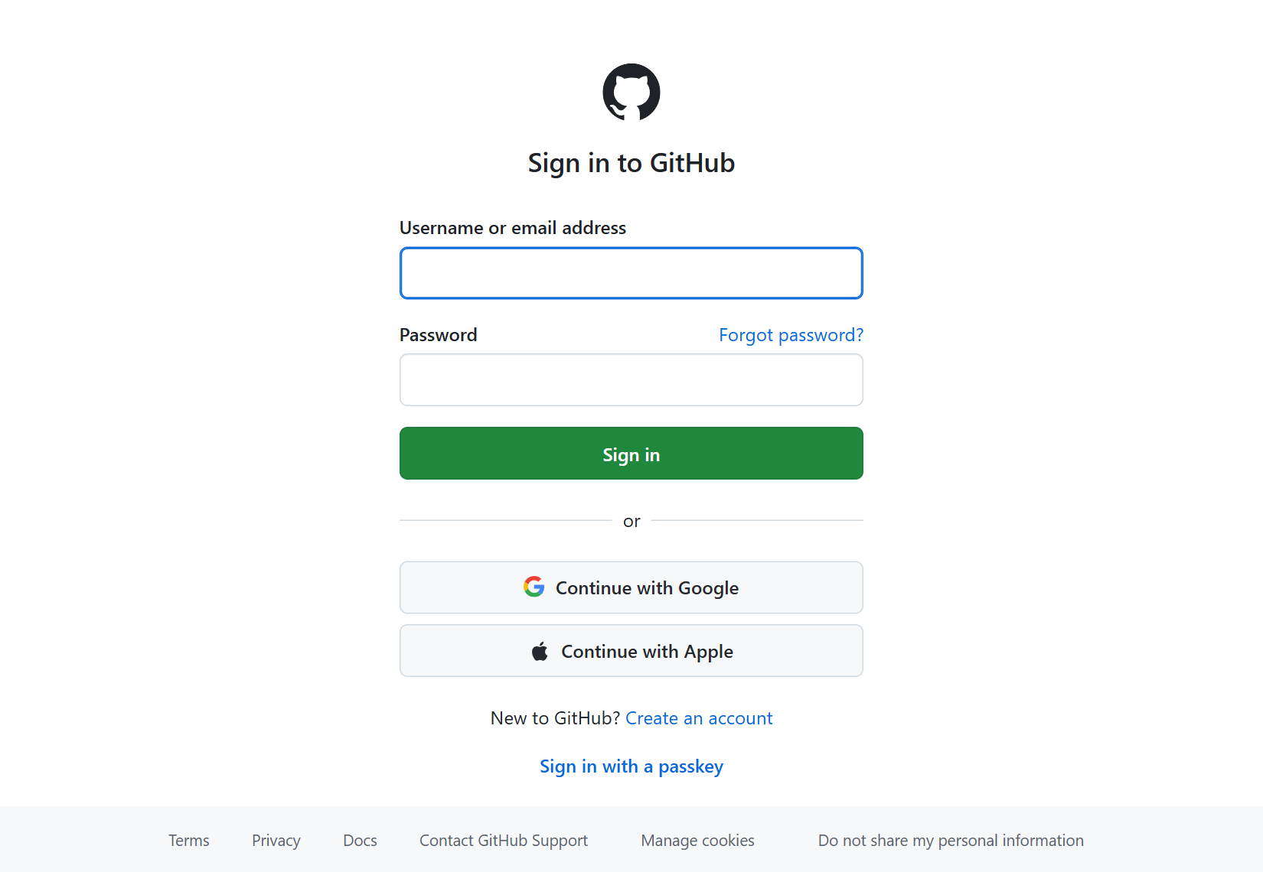
YOUR FIRST CHIP / BROWSER LAB
Step 0: sign in to your own GitHub account
1
Open github.com and sign in; new users choose Create an account.
2
Use a free personal account and complete email verification.
3
Check the account menu shows your username.
Actual public GitHub sign-in screen, 8 October 2026; enter your own details.
CHECK You can identify your signed-in account before creating a repository.
EE6019 • 8 October 2026 • Sources and teaching notes in PowerPoint
Open source ↗
070 / 195
Notes:
TEACHING NOTES
GitHub is both the online project folder and the service that starts the automated recipes. Signing in is necessary to create a repository, save changes and download workflow artifacts. Someone can read the public teaching example without signing in, but reading it does not give them permission to change its files. If students already have an institutional GitHub account, use that account and follow its repository rules. New users should enter their own details in their own browser, complete the prompted verification and confirm their email. The screenshot is a genuine public sign-in page captured on 8 October 2026, not evidence that a learner account was created for them. No paid GitHub plan or Codespace is needed for this lesson. Ask students to record their username because it becomes part of their repository and Pages addresses.
MANUAL REFERENCE
Step 0 — Get your free GitHub account ready
SOURCES / checked 8 October 2026
https://github.com/signup
https://github.com/login
IMAGE PROVENANCE
{
"file": "img/12-signin.png",
"url": "https://github.com/login",
"title": "Sign in to GitHub · GitHub",
"date": "2026-10-08",
"type": "Actual public browser capture",
"sha256": "73444bf28f9f666f22774668f28f9514f4740ddba1ee14f2dcd855e39c812480"
}

Slide 71
YOUR FIRST CHIP / BROWSER LAB
Step 1: predict the counter at a clock edge
1
rst_n=0: reset on the next rising edge.
WORKED EXAMPLE
Reset released, ui_in[0]=1: increment on that edge.
After reset: enabled edge → 1; disabled edge → 1; reset edge → 0.
2
3
Reset released, ui_in[0]=0: hold on that edge.
4
uo_out[7:0] carries the binary count.
CHECK Say when the value changes, rather than only naming its next value.
EE6019 • 8 October 2026 • Sources and teaching notes in PowerPoint
Open source ↗
071 / 195
Notes:
TEACHING NOTES
Return briefly to the specification before students edit hardware files. This counter stores an eight-bit unsigned count, representing values from zero through 255. Its state changes only at a rising clock edge. Reset is active low at the Tiny Tapeout wrapper and synchronous: setting rst_n low between edges does not immediately clear the stored count. Reset takes priority over enable when the next rising edge arrives. Enable is the least-significant input bit, ui_in[0]. The separate ena input selects the Tiny Tapeout project and is not this counter's increment enable. Ask students to predict three successive observations after a reset edge: enabled gives one, disabled holds one, and reset returns zero. The output bus is binary; no decimal seven-segment decoder exists in this design. The example's enable is a stable, synchronous testbench or controller signal.
MANUAL REFERENCE
Step 1 — Understand the circuit before editing files
SOURCES / checked 8 October 2026
https://github.com/mdkamrulislam-web/tt-sky130-counter/blob/61ef06bed008e76000f9ae46d65182e476d15dd6/src/counter.v
https://github.com/mdkamrulislam-web/tt-sky130-counter/blob/61ef06bed008e76000f9ae46d65182e476d15dd6/src/project.v

Slide 72
YOUR FIRST CHIP / BROWSER LAB
Step 1: watch the flag before overflow
Enabled count 254 → 255 → 0 on successive rising edges.
wrap = 1 while count is 255 and enable is 1.
Disable at 255: count holds at 255; wrap becomes 0.
count=255, enable=0 → uo_out=11111111, wrap=0.
CHECK Predict both count and wrap; they follow different update rules.
EE6019 • 8 October 2026 • Sources and teaching notes in PowerPoint
Open source ↗
072 / 195
Notes:
TEACHING NOTES
Students often assume that a signal called wrap must be a registered pulse after the arithmetic overflows. Read the actual assignment instead: wrap is enable AND all count bits. With enable high, all eight bits become one when count reaches 255, so the flag becomes high before the next enabled edge takes count to zero. Once count is zero, the flag is low again. Disabling enable at terminal count leaves the register unchanged but makes the combinational flag low. Reset does not directly gate the wrap expression. If reset is asserted while count is 255 and enable remains high, wrap can remain high until a rising edge applies reset and clears the count. Use this distinction when reading the real waveform later. This is a prediction exercise grounded in the actual reference source, not a screenshot of a deliberately broken test.
MANUAL REFERENCE
Step 1 — Understand the circuit before editing files
SOURCES / checked 8 October 2026
https://github.com/mdkamrulislam-web/tt-sky130-counter/blob/61ef06bed008e76000f9ae46d65182e476d15dd6/src/counter.v

Slide 73
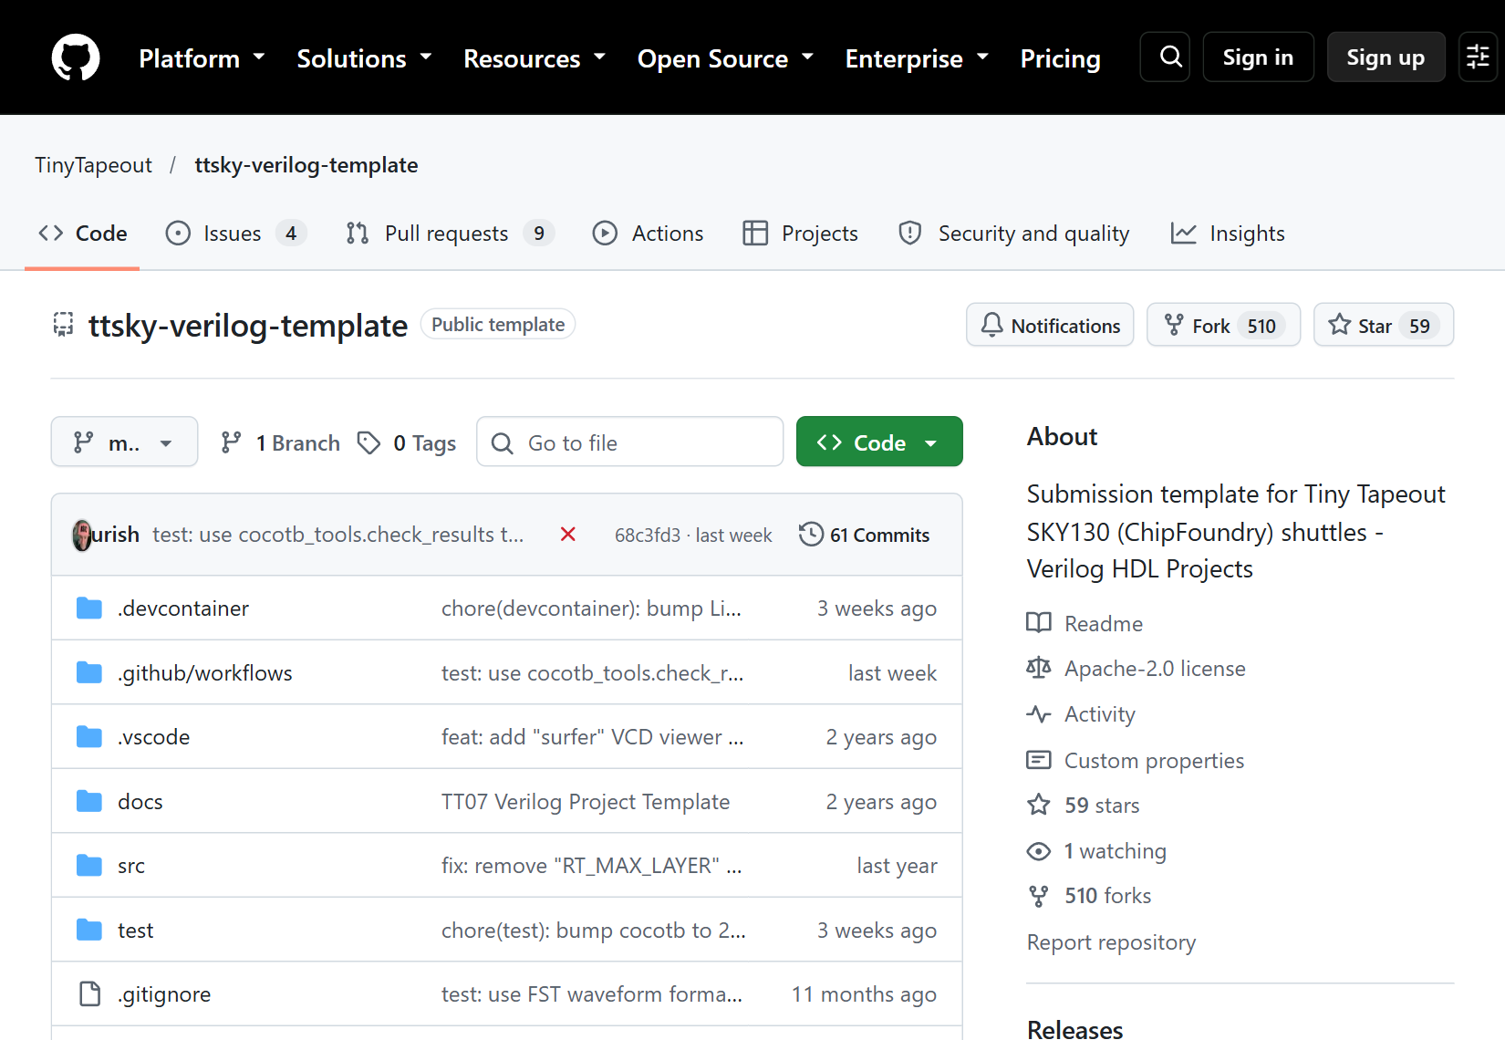
YOUR FIRST CHIP / BROWSER LAB
Step 2: open the official SKY template
1
Open tinytapeout.com/hdl/templates/.
2
Choose the SKY Verilog template.
3
Confirm TinyTapeout / ttsky-verilog-template in the header.
Actual official SKY template page, captured 8 October 2026.
CHECK You have opened the SKY Verilog template, before making your own copy.
EE6019 • 8 October 2026 • Sources and teaching notes in PowerPoint
Open source ↗
073 / 195
Notes:
TEACHING NOTES
A template is an existing repository arranged so that learners can start with the required folders, interface and automated recipes. Open the official Tiny Tapeout template selector and choose the Verilog template for SKY. The current repository is TinyTapeout/ttsky-verilog-template. Verify its owner and name rather than choosing an unrelated counter repository from search results. The page should contain src, test, docs and info.yaml. The template's physical build uses the sky130A process through its published Tiny Tapeout action. IHP and GF have separate templates; they are not interchangeable process selections inside this exercise. The genuine screenshot shows the official SKY template on 8 October 2026. For the first reproduction, keep the supplied workflows and process configuration. The lesson changes the seven teaching-example files, not the integration infrastructure that the template already provides.
MANUAL REFERENCE
Step 2 — Open the official SKY template
SOURCES / checked 8 October 2026
https://tinytapeout.com/hdl/templates/
https://github.com/TinyTapeout/ttsky-verilog-template
https://github.com/TinyTapeout/ttsky-verilog-template/blob/main/.github/workflows/gds.yaml
IMAGE PROVENANCE
{
"file": "img/01-template.png",
"url": "https://github.com/TinyTapeout/ttsky-verilog-template",
"title": "GitHub - TinyTapeout/ttsky-verilog-template: Submission template for Tiny Tapeout SKY130 (ChipFoundry) shuttles - Verilog HDL Projects · GitHub",
"date": "2026-10-08",
"type": "Actual public browser capture",
"sha256": "4a5ee6cd76b1e17464d0acb1bace4f17788174a47e77092353fff94f5cfa766d"
}

Slide 74
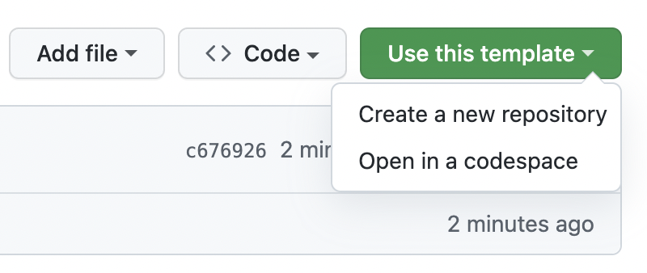
YOUR FIRST CHIP / BROWSER LAB
Step 3: create a repository from the template
1
While signed in, select Use this template.
2
Choose Create a new repository.
3
Continue to the owner, name and visibility form.
Official GitHub Docs image: template-copy menu; instructional account-only example.
CHECK The creation form will make a copy under your account.
EE6019 • 8 October 2026 • Sources and teaching notes in PowerPoint
Open source ↗
074 / 195
Notes:
TEACHING NOTES
The template remains the official shared starting point. Students create their own repository from it so they can save a design and run workflows without changing the upstream project. The signed-in page exposes Use this template, then Create a new repository. A template copy is the intended route here; downloading an isolated Verilog file would omit the workflows, testing environment, documentation rules and fixed interface. The screenshot comes from GitHub's official documentation and demonstrates the account-only control. It is not a capture of the author operating that account screen. Explain the difference between reading the template, copying it and editing the resulting personal repository. If a student cannot see the control, first confirm they are signed in and viewing the official template page. The next slide covers the choices in the creation form and the ownership checkpoint.
MANUAL REFERENCE
Step 3 — Make your own repository
SOURCES / checked 8 October 2026
https://docs.github.com/en/repositories/creating-and-managing-repositories/creating-a-repository-from-a-template
https://github.com/TinyTapeout/ttsky-verilog-template
https://docs.github.com/assets/images/help/repository/use-this-template-button.png
IMAGE PROVENANCE
{
"file": "img/official-template-menu.png",
"asset_url": "https://docs.github.com/assets/images/help/repository/use-this-template-button.png",
"source_page": "https://docs.github.com/en/repositories/creating-and-managing-repositories/creating-a-repository-from-a-template",
"caption": "GitHub Docs: Use this template menu",
"kind": "Official documentation screenshot; not our account capture",
"retrieved": "2026-10-08",
"bytes": 76823,
"sha256": "02c6f81a946c6e834f8e3372aaea5a3b3b98e37a684a3c0caed6c5346ce08d02",
"content_type": "image/png"
}

Slide 75
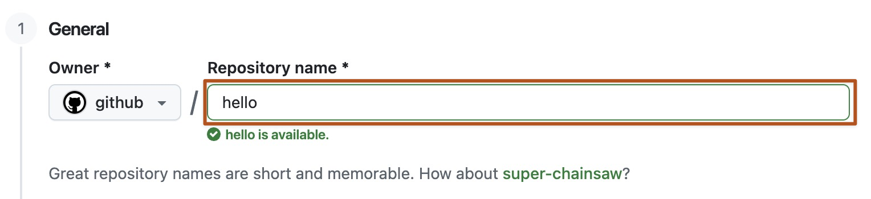
YOUR FIRST CHIP / BROWSER LAB
Step 3: choose your owner, name and Public
Owner: your account. Name: for example tt-counter-lesson. • Select Public; the default branch alone is sufficient. • Create the repository; confirm your username in its header.
Official GitHub Docs image: repository-name field; use your own account and name.
CHECK The URL is github.com/YOUR-USERNAME/YOUR-REPOSITORY.
EE6019 • 8 October 2026 • Sources and teaching notes in PowerPoint
Open source ↗
075 / 195
Notes:
TEACHING NOTES
In the creation form, choose the student's own account as Owner, then enter an available repository name such as tt-counter-lesson. Select Public for this route: the lesson uses standard hosted Actions compute available freely for public repositories. The default branch is sufficient, so copying every upstream branch is unnecessary. Complete the form and inspect the resulting header and address. It should begin with the student's username, not TinyTapeout. Subsequent edits belong in this new copy. The official screenshot illustrates the repository-name field only; the visible instructions also cover owner and visibility, which may appear elsewhere in the actual form. If the name is unavailable, choose another meaningful name and use it consistently in later links. A managed institutional repository may apply its own creation or branch rules. Creating this GitHub repository is separate from creating a fabrication order.
MANUAL REFERENCE
Step 3 — Make your own repository
SOURCES / checked 8 October 2026
https://docs.github.com/en/repositories/creating-and-managing-repositories/creating-a-repository-from-a-template
https://docs.github.com/en/billing/concepts/product-billing/github-actions
https://docs.github.com/assets/images/help/repository/create-repository-name.png
IMAGE PROVENANCE
{
"file": "img/official-repository-name.png",
"asset_url": "https://docs.github.com/assets/images/help/repository/create-repository-name.png",
"source_page": "https://docs.github.com/en/repositories/creating-and-managing-repositories/creating-a-repository-from-a-template",
"caption": "GitHub Docs: repository name field",
"kind": "Official documentation screenshot; not our account capture",
"retrieved": "2026-10-08",
"bytes": 89988,
"sha256": "7c903455267a7e9127c963cedac1ca90e2d3debaa58c0057c5bf4d2cae784a7c",
"content_type": "image/png"
}

Slide 76
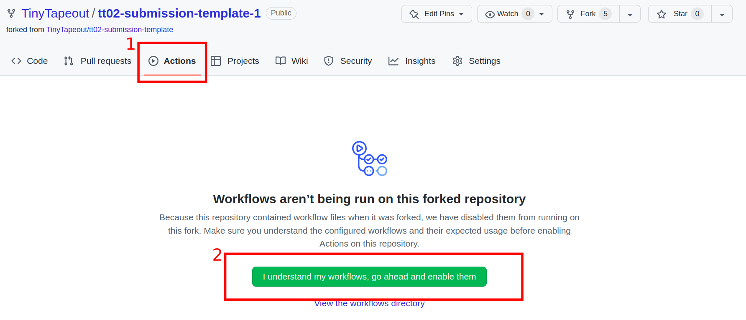
YOUR FIRST CHIP / BROWSER LAB
Step 4: make sure Actions is enabled
1
Open the Actions tab in your new repository.
2
If an enablement banner appears, enable the workflows.
3
If workflows are already available, continue to Pages.
Official Tiny Tapeout FAQ image: Actions enablement in an older example repository.
CHECK The repository can run its template workflows.
EE6019 • 8 October 2026 • Sources and teaching notes in PowerPoint
Open source ↗
076 / 195
Notes:
TEACHING NOTES
Actions runs the automated recipes stored in the template. A copied repository may already have them enabled, so learners should inspect the page rather than look for a banner that must always be present. If GitHub displays an enablement prompt, accept it within the student's own repository. Do not change workflow files just because the first blank-template run has failed. That run can start before the teaching files and metadata have been supplied. The Tiny Tapeout FAQ screenshot is a genuine official instructional image showing the enablement control in an older example repository. It does not show the current student account or prove that the counter has passed. Explain that a workflow is the full recipe, while a job is one part of it. Next configure the Pages publishing source, which allows the eventual layout viewer to be deployed.
MANUAL REFERENCE
Step 4 — Enable Actions and the layout results page
SOURCES / checked 8 October 2026
https://tinytapeout.com/faq/#when-i-commit-my-change-the-gds-action-isnt-running
https://tinytapeout.com/images/faq/enable_action.png
IMAGE PROVENANCE
{
"file": "img/official-enable-actions.png",
"asset_url": "https://tinytapeout.com/images/faq/enable_action.png",
"source_page": "https://tinytapeout.com/faq/#when-i-commit-my-change-the-gds-action-isnt-running",
"caption": "Tiny Tapeout FAQ: enabling Actions",
"kind": "Official documentation screenshot; not our account capture",
"retrieved": "2026-10-08",
"bytes": 117250,
"sha256": "a63cf1abe62d45571d7095fa43e4f1789ae96cd053c41558f15f004d7d26597e",
"content_type": "image/png"
}

Slide 77
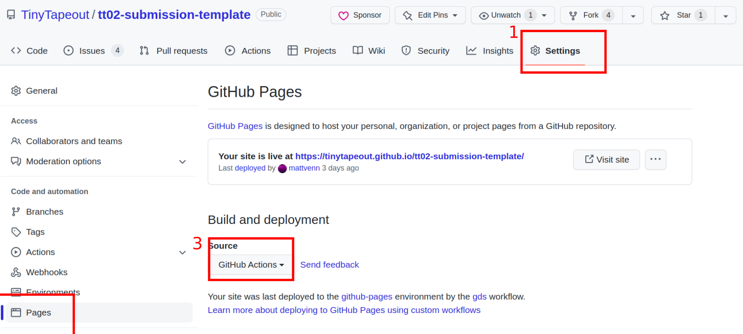
YOUR FIRST CHIP / BROWSER LAB
Step 4: set Pages Source to GitHub Actions
1
Open Settings → Pages.
2
Under Build and deployment, set Source to GitHub Actions.
3
Use the template publishing workflow already provided.
Official Tiny Tapeout FAQ image: Pages Source = GitHub Actions; older repository shown.
CHECK Source displays GitHub Actions before the complete GDS build.
EE6019 • 8 October 2026 • Sources and teaching notes in PowerPoint
Open source ↗
077 / 195
Notes:
TEACHING NOTES
Pages hosts the generated browser layout viewer. Open the repository Settings tab, find Pages in the sidebar, and set the Source control under Build and deployment to GitHub Actions. The template already supplies the recipe that publishes the viewer; learners do not need to add a second generic Pages workflow. Setting this before the physical build prevents an avoidable downstream deployment error. The official Tiny Tapeout image shows the older tt02-submission-template, so its repository name is historical while the Settings, Pages and Source controls illustrate the current route. A learner needs permission to change settings in their own copy; anonymous public readers cannot see the account-only settings screen. The success check at this stage is simply that Source reads GitHub Actions. A site may not yet exist because no complete layout build has published it. Publishing the viewer is separate from sending a chip design for manufacture.
MANUAL REFERENCE
Step 4 — Enable Actions and the layout results page
SOURCES / checked 8 October 2026
https://tinytapeout.com/faq/#my-github-action-is-failing-on-the-pages-part
https://docs.github.com/en/pages/getting-started-with-github-pages/configuring-a-publishing-source-for-your-github-pages-site
https://tinytapeout.com/images/faq/action_pages.png
IMAGE PROVENANCE
{
"file": "img/official-pages-actions.png",
"asset_url": "https://tinytapeout.com/images/faq/action_pages.png",
"source_page": "https://tinytapeout.com/faq/#my-github-action-is-failing-on-the-pages-part",
"caption": "Tiny Tapeout FAQ: Pages Source set to GitHub Actions",
"kind": "Official documentation screenshot; not our account capture",
"retrieved": "2026-10-08",
"bytes": 275746,
"sha256": "191d072f3704a6505f9cf030e4efe581b37113283309c70b3adf07843810dab5",
"content_type": "image/png"
}

Slide 78
YOUR FIRST CHIP / BROWSER LAB
Step 5: extract the starter, then open its contents
1
Download counter-starter.zip from the lesson files.
2
Extract it on your computer; open the extracted folder.
3
Find info.yaml beside src, test and docs.
4
Show filename extensions: counter.v must not be counter.v.txt.
CHECK You see the root YAML file and three folders, rather than a nested starter directory.
EE6019 • 8 October 2026 • Sources and teaching notes in PowerPoint
Open source ↗
078 / 195
Notes:
TEACHING NOTES
The ZIP is a complete seven-file teaching example, not a replacement for the whole template repository. Extract it before attempting browser upload; uploading the ZIP itself would save an archive rather than put the circuit files where the tools expect them. Open the extracted directory until info.yaml is beside the three folders src, test and docs. Some extraction tools add an outer directory named after the archive. That wrapper directory is not part of the repository path and should not be dragged into the upload page. On Windows, File Explorer's View, Show, File name extensions helps reveal accidental text-file suffixes. A file named counter.v.txt is different from counter.v to the compiler. The supplied file hashes match the reference counter commit 61ef06bed008e76000f9ae46d65182e476d15dd6. Retain the source files and checksum manifest so the example can be reproduced later.
MANUAL REFERENCE
Step 5 — Extract the seven-file starter pack
SOURCES / checked 8 October 2026
https://github.com/mdkamrulislam-web/tt-sky130-counter/tree/61ef06bed008e76000f9ae46d65182e476d15dd6

Slide 79
YOUR FIRST CHIP / BROWSER LAB
Step 5: count the seven files
1
src: counter logic and the Tiny Tapeout wrapper.
info.yaml
src/counter.v
src/project.v
test/Makefile
test/tb.v
test/test.py
docs/info.md
2
test: source list, Verilog testbench and Python assertions.
3
docs: datasheet text; info.yaml: metadata and pin labels.
CHECK Two + three + one + one = exactly seven files.
EE6019 • 8 October 2026 • Sources and teaching notes in PowerPoint
Open source ↗
079 / 195
Notes:
TEACHING NOTES
Walk through the exact file list so students can distinguish hardware, verification and documentation. The reusable counter logic is in src/counter.v. The wrapper in src/project.v connects it to Tiny Tapeout's required top-level interface. The Makefile tells the simulator which Verilog files to compile. The Verilog testbench instantiates the wrapper and exposes its ports to the Python test, which drives inputs and checks outputs. docs/info.md supplies explanatory datasheet text, and the root info.yaml supplies project metadata, source filenames and pin descriptions. There are two source files, three test files, one documentation file and one root metadata file: seven in total. The archive excludes the template's workflows, development environment, test requirements, licence and process configuration. Those remain in the repository created from the official template. Ask a learner to locate each file before uploading, rather than assume a successful extraction implies correct paths.
MANUAL REFERENCE
Step 5 — Extract the seven-file starter pack
SOURCES / checked 8 October 2026
https://github.com/mdkamrulislam-web/tt-sky130-counter/tree/61ef06bed008e76000f9ae46d65182e476d15dd6

Slide 80
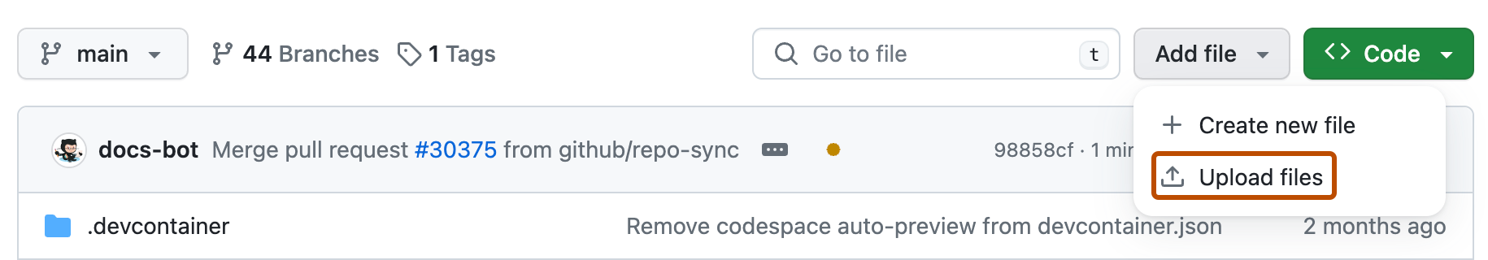
YOUR FIRST CHIP / BROWSER LAB
Step 6: open the browser upload page
In your own repository, open Code and the root file list. • Choose Add file → Upload files. • Prepare to upload the extracted contents with their folders.
Official GitHub Docs image: Add file control used to open Upload files.
CHECK The upload page belongs to your copy and its root directory.
EE6019 • 8 October 2026 • Sources and teaching notes in PowerPoint
Open source ↗
080 / 195
Notes:
TEACHING NOTES
Return to the personal copy's Code tab before making the upload. The root is the directory containing info.yaml, src, test and docs. Opening Upload files from inside src would put the wrong items in the wrong directory, so verify the current location first. Select Add file, then Upload files. The screenshot is GitHub's official documentation image for the add-file control. It demonstrates the account-only action rather than claiming the author's public screenshot exposed write controls. The folder-preserving upload route is convenient because the seven related files can be saved together as one coherent commit. The template already has six of these paths; the upload replaces their example content and adds src/counter.v. The next slide covers exactly what to drag and how to inspect the listed paths before saving. Nothing has changed remotely until the upload is committed.
MANUAL REFERENCE
Step 6 — Upload the complete example in one browser commit
SOURCES / checked 8 October 2026
https://docs.github.com/en/repositories/working-with-files/managing-files/adding-a-file-to-a-repository
https://docs.github.com/assets/images/help/repository/upload-files-button.png
IMAGE PROVENANCE
{
"file": "img/official-upload-files.png",
"asset_url": "https://docs.github.com/assets/images/help/repository/upload-files-button.png",
"source_page": "https://docs.github.com/en/repositories/working-with-files/managing-files/adding-a-file-to-a-repository",
"caption": "GitHub Docs: Add file control",
"kind": "Official documentation screenshot; not our account capture",
"retrieved": "2026-10-08",
"bytes": 54037,
"sha256": "5f40b799646d8f239aa2da3b6bba6f5b2d9f628369c40501c0eebd1ed656cdc7",
"content_type": "image/png"
}

Slide 81
YOUR FIRST CHIP / BROWSER LAB
Step 6: drag the contents, preserving folders
1
Drag info.yaml plus the src, test and docs folders.
info.yaml
src/counter.v
src/project.v
test/Makefile
test/tb.v
test/test.py
docs/info.md
2
Inspect every displayed upload path before saving.
3
Remove an unwanted outer starter-folder prefix.
CHECK All seven listed paths match before you commit.
EE6019 • 8 October 2026 • Sources and teaching notes in PowerPoint
Open source ↗
081 / 195
Notes:
TEACHING NOTES
Drag the root info.yaml and the three folders from inside the extracted starter directory onto GitHub's upload page. Dragging folders preserves relative paths, unlike flattening every contained file into the root. Check that the displayed upload list matches the seven paths shown on this slide. It must say src/counter.v, not just counter.v, and info.yaml must remain at the root. If every path begins with an archive-wrapper directory, remove that upload selection and drag the contents from one level deeper. If a browser or file manager does not preserve folder upload correctly, use the alternative per-file editor route covered shortly. Do not create a second src directory inside src or a second metadata file inside a folder. Uploading the complete set together gives the first meaningful counter build a consistent source, test and documentation version. The original template infrastructure should still be present after this replacement.
MANUAL REFERENCE
Step 6 — Upload the complete example in one browser commit
SOURCES / checked 8 October 2026
https://docs.github.com/en/repositories/working-with-files/managing-files/adding-a-file-to-a-repository
https://github.com/mdkamrulislam-web/tt-sky130-counter/tree/61ef06bed008e76000f9ae46d65182e476d15dd6

Slide 82
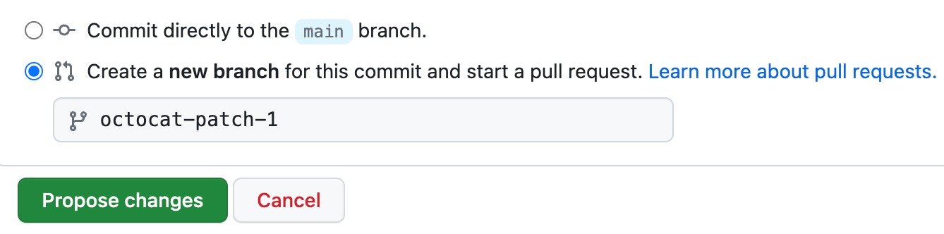
YOUR FIRST CHIP / BROWSER LAB
Step 6: save one complete counter commit
Message: Add eight-bit counter lesson. • For your personal lab, choose Commit directly to main. • Save the changes; follow a required PR route if branch rules apply.
Official GitHub Docs branch-choice example; new branch shown selected. Use your lab's required branch route.
CHECK The Code file list shows the new commit containing all seven files.
EE6019 • 8 October 2026 • Sources and teaching notes in PowerPoint
Open source ↗
082 / 195
Notes:
TEACHING NOTES
A commit is a saved version of the repository, with an identifier that later connects the source files to their test and layout results. Enter a useful message describing the complete example, then choose the intended branch and save. In a simple personal teaching repository, committing directly to main is the guide's route. If repository rules require a new branch and pull request, follow those rules to place the complete change on the intended branch. The official GitHub image shows a branch-choice control with the new-branch option selected; students should read the visible instruction rather than copy that selected state automatically. After saving, the Code file list should show a new commit and the Actions recipes begin for that version. A browser editor buffer or pending upload is not a saved remote version. Record the commit identifier so later checkpoints can distinguish this complete counter from an earlier blank template run.
MANUAL REFERENCE
Step 6 — Upload the complete example in one browser commit
SOURCES / checked 8 October 2026
https://docs.github.com/en/repositories/working-with-files/managing-files/editing-files
https://docs.github.com/en/repositories/working-with-files/managing-files/adding-a-file-to-a-repository
https://docs.github.com/assets/images/help/repository/choose-commit-branch.png
IMAGE PROVENANCE
{
"file": "img/official-commit-branch.png",
"asset_url": "https://docs.github.com/assets/images/help/repository/choose-commit-branch.png",
"source_page": "https://docs.github.com/en/repositories/working-with-files/managing-files/editing-files",
"caption": "GitHub Docs: commit branch choice",
"kind": "Official documentation screenshot; not our account capture",
"retrieved": "2026-10-08",
"bytes": 27122,
"sha256": "b1d3fc781042da16d56395da3e57697f03bbf2a63f1484ce2d3b249d22edd99b",
"content_type": "image/png"
}

Slide 83
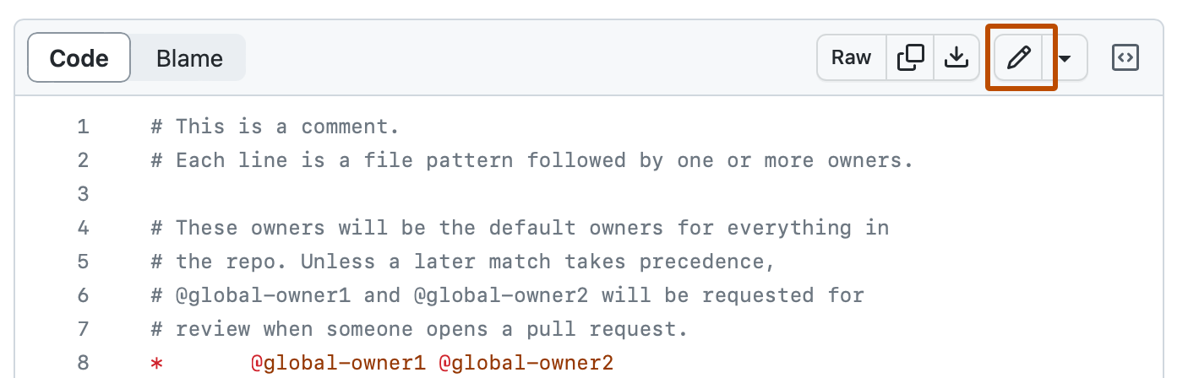
YOUR FIRST CHIP / BROWSER LAB
Alternative: replace an existing file in the editor
Open a file and select its pencil / Edit file control. • Paste that file's complete Appendix A source. • Commit changes… with a message to the intended branch.
Official GitHub Docs image: edit-file pencil; instructional account-only example.
CHECK Saved contents match the complete appendix file, not a slide excerpt.
EE6019 • 8 October 2026 • Sources and teaching notes in PowerPoint
Open source ↗
083 / 195
Notes:
TEACHING NOTES
This route is useful when a browser cannot preserve folder upload or when a student wants to study one file at a time. Six of the seven starter paths already exist in the template. Open each existing path in the personal repository, use its pencil or Edit file control, replace the complete contents with the corresponding Appendix A source, then save through Commit changes. Avoid copying a short teaching excerpt in place of the complete file. A module declaration without its ports or an incomplete test is not a runnable reproduction. The screenshot is an official GitHub Docs image demonstrating the edit control. Editing several files creates several commits and may start temporary failing builds while the set is incomplete. Keep moving through the supplied seven-file list, then evaluate the runs belonging to the final complete commit. The new counter module needs a new-file action, covered next.
MANUAL REFERENCE
Alternative: enter or replace each file in the browser editor
SOURCES / checked 8 October 2026
https://docs.github.com/en/repositories/working-with-files/managing-files/editing-files
https://docs.github.com/assets/images/help/repository/edit-file-edit-button.png
IMAGE PROVENANCE
{
"file": "img/official-edit-pencil.png",
"asset_url": "https://docs.github.com/assets/images/help/repository/edit-file-edit-button.png",
"source_page": "https://docs.github.com/en/repositories/working-with-files/managing-files/editing-files",
"caption": "GitHub Docs: edit file pencil",
"kind": "Official documentation screenshot; not our account capture",
"retrieved": "2026-10-08",
"bytes": 47646,
"sha256": "694ef02b7f50736e518df67b5389560bd5db92ba599697bb2b729e907b98e3bd",
"content_type": "image/png"
}

Slide 84
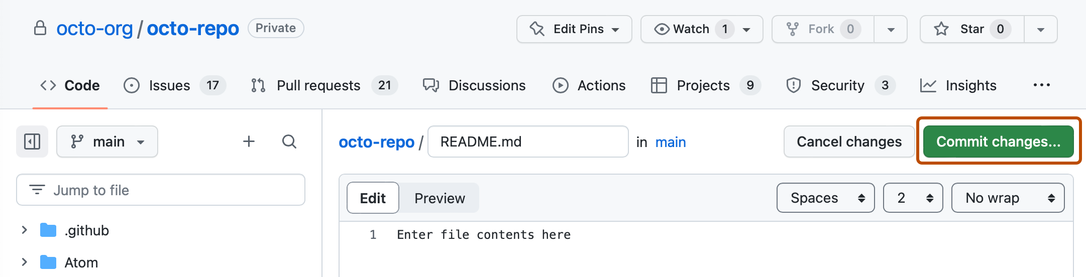
YOUR FIRST CHIP / BROWSER LAB
Alternative: add the new counter module
Open src → Add file → Create new file. • Name it counter.v; paste the complete Appendix A.2 source. • Select Commit changes… and save; complete the other six files too.
Official GitHub Docs image: Commit changes button opens the form; example is not our counter account.
CHECK src contains both counter.v and project.v.
EE6019 • 8 October 2026 • Sources and teaching notes in PowerPoint
Open source ↗
084 / 195
Notes:
TEACHING NOTES
The reusable counter module is the one new source path added by this worked example. When creating it inside src, enter counter.v as the filename. If creating it from the repository root instead, enter src/counter.v so it lands in the correct folder. Paste the complete source from Appendix A.2, including the module declaration, ports, update rule, wrap assignment and endmodule. Click Commit changes to open the commit form, give the change a meaningful message and save it to the intended branch. The official GitHub image shows the button that opens that form, rather than a completed counter commit or the whole dialog. Afterwards verify src/counter.v appears beside src/project.v. A file saved elsewhere will not be found by the supplied source lists. Continue until all seven files are complete, then inspect the final commit's workflows rather than an intermediate save.
MANUAL REFERENCE
Alternative: enter or replace each file in the browser editor
SOURCES / checked 8 October 2026
https://docs.github.com/en/repositories/working-with-files/managing-files/creating-new-files
https://github.com/mdkamrulislam-web/tt-sky130-counter/blob/61ef06bed008e76000f9ae46d65182e476d15dd6/src/counter.v
https://docs.github.com/assets/images/help/repository/start-commit-commit-new-file.png
IMAGE PROVENANCE
{
"file": "img/official-commit-dialog.png",
"asset_url": "https://docs.github.com/assets/images/help/repository/start-commit-commit-new-file.png",
"source_page": "https://docs.github.com/en/repositories/working-with-files/managing-files/creating-new-files",
"caption": "GitHub Docs: committing a new file",
"kind": "Official documentation screenshot; not our account capture",
"retrieved": "2026-10-08",
"bytes": 72018,
"sha256": "15119704d95c0a4783ed2fea541c635e80ead68b9a2203978bbdd40d8e69d4b5",
"content_type": "image/png"
}

Slide 85
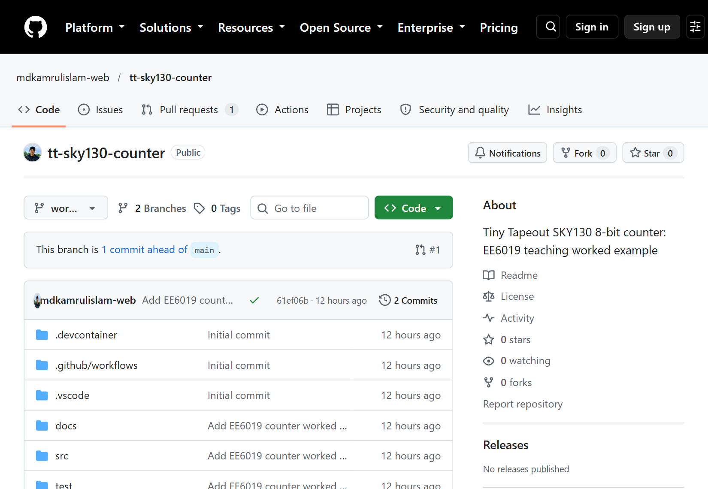
YOUR FIRST CHIP / BROWSER LAB
Step 6 checkpoint: inspect your final tree and version
1
Open Code: verify src, test, docs and root info.yaml.
2
Confirm counter.v and project.v are both inside src.
3
Record the final branch and commit identifier.
Actual reference tree on worked-example at 61ef06b; your copy has its own owner, branch and commit.
CHECK One final saved version contains all seven example files.
EE6019 • 8 October 2026 • Sources and teaching notes in PowerPoint
Open source ↗
085 / 195
Notes:
TEACHING NOTES
A successful upload or save is not enough; inspect the resulting repository tree before relying on its builds. The relevant structure should match the reference example, while the owner and repository name belong to the student. The original template infrastructure, including .github/workflows, test/requirements.txt and process configuration, should remain. The actual screenshot shows the public counter's worked-example branch at reference commit 61ef06bed008e76000f9ae46d65182e476d15dd6. Students may use main or another intended branch, so do not copy the reference branch name blindly. A commit identifies the exact saved set of files. Record the final complete version after all browser edits, then use that identifier when opening the test, docs and gds runs. An earlier green template test or a later unrelated run cannot establish what this version did. This checkpoint is also the quickest place to spot an unwanted outer upload folder.
MANUAL REFERENCE
Step 6 — Upload the complete example in one browser commit
SOURCES / checked 8 October 2026
https://github.com/mdkamrulislam-web/tt-sky130-counter/tree/61ef06bed008e76000f9ae46d65182e476d15dd6
https://github.com/mdkamrulislam-web/tt-sky130-counter/tree/worked-example
IMAGE PROVENANCE
{
"file": "img/02-example-tree.png",
"url": "https://github.com/mdkamrulislam-web/tt-sky130-counter/tree/worked-example",
"title": "GitHub - mdkamrulislam-web/tt-sky130-counter at worked-example · GitHub",
"date": "2026-10-08",
"type": "Actual public browser capture",
"sha256": "51c9f19f449035454b9b7cad1bd2a1a2dce51052596808d19be991f8dd588787"
}

Slide 86
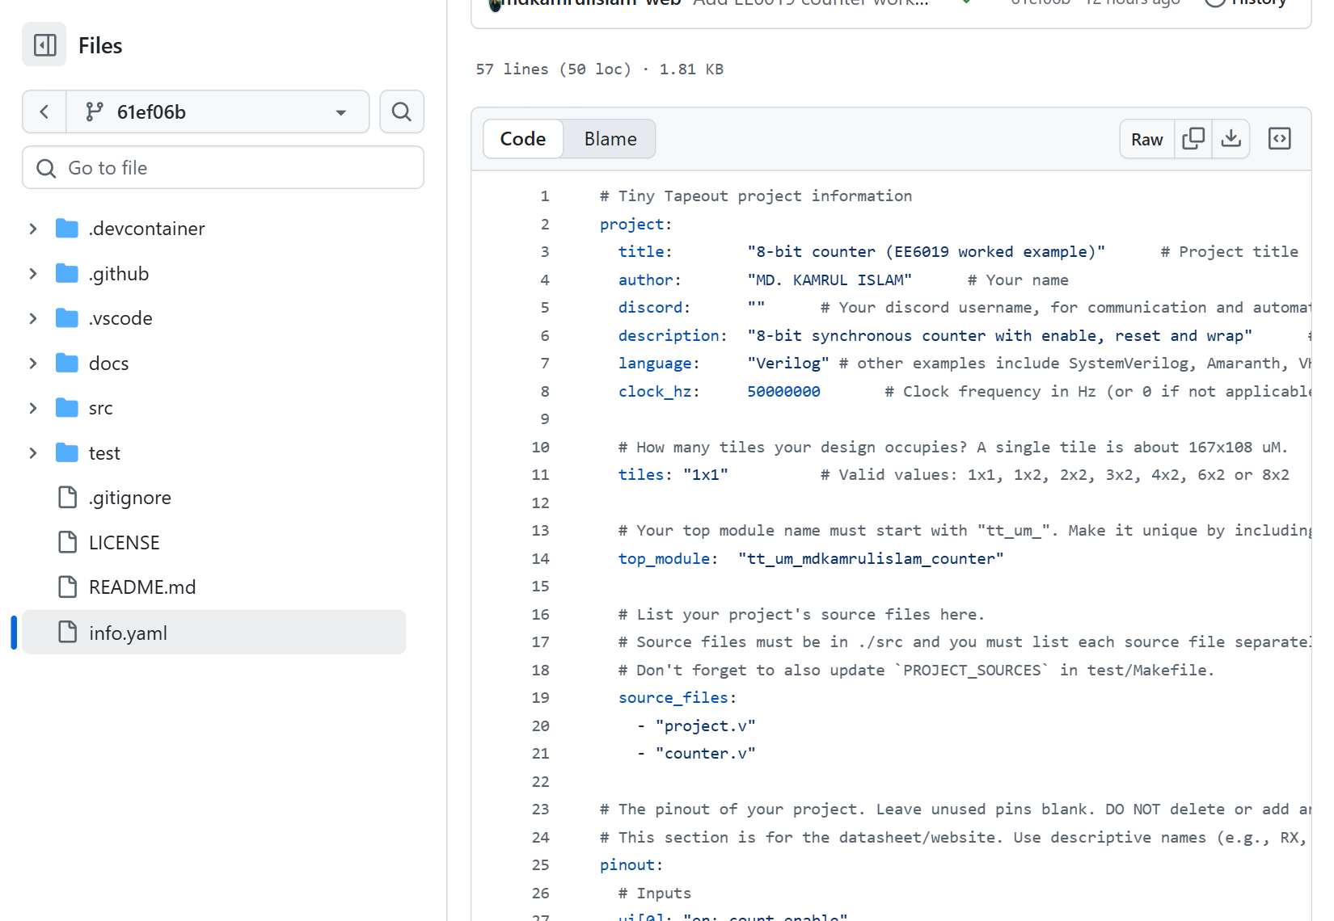
YOUR FIRST CHIP / BROWSER LAB
Step 7: read title, author and description
These fields identify the circuit and credit its author. • Describe the implemented behaviour; keep the supplied YAML indentation.
Native detail from the actual counter info.yaml at 61ef06b: title, author and description.
CHECK Metadata is meaningful and agrees with the reference circuit and clock target.
EE6019 • 8 October 2026 • Sources and teaching notes in PowerPoint
Open source ↗
086 / 195
Notes:
TEACHING NOTES
Metadata gives the tools and datasheet important information about the design. It is structured YAML, where indentation groups related values and each key is followed by a colon. Keep spaces and the supplied nesting; tabs or misplaced lists can break validation. The reference has a meaningful title, author and description, language Verilog, clock_hz 50000000 and tiles 1x1. Fifty million cycles per second corresponds to a twenty-nanosecond period. That agrees with the reference's simulation clock and the template's physical clock constraint. These are separate representations, so changing a metadata label alone would not update a future test or timing constraint. For exact reproduction, retain the supplied coherent settings. If personalising an adaptation, credit authors accurately and keep descriptions consistent with the circuit. The actual metadata screenshot belongs to counter commit 61ef06bed008e76000f9ae46d65182e476d15dd6. Next check the filenames and module names that connect metadata to real hardware.
MANUAL REFERENCE
Step 7 — Check the two source lists and the three module-name locations
SOURCES / checked 8 October 2026
https://github.com/mdkamrulislam-web/tt-sky130-counter/blob/61ef06bed008e76000f9ae46d65182e476d15dd6/info.yaml
https://github.com/TinyTapeout/ttsky-verilog-template/blob/main/src/config.json
IMAGE PROVENANCE
{
"file": "img/05-metadata.png",
"url": "https://github.com/mdkamrulislam-web/tt-sky130-counter/blob/61ef06bed008e76000f9ae46d65182e476d15dd6/info.yaml",
"title": "tt-sky130-counter/info.yaml at 61ef06bed008e76000f9ae46d65182e476d15dd6 · mdkamrulislam-web/tt-sky130-counter · GitHub",
"date": "2026-10-08",
"type": "Actual public browser capture",
"sha256": "3a1e1a08f09c2e4aabe5ca562b5c0564a6031ccd6f2e0a6253bfe818dbb72293"
}

Slide 87
YOUR FIRST CHIP / BROWSER LAB
Step 7: confirm the clock target and tile size
clock_hz = 50000000 means 50 MHz, or a 20 ns cycle. • tiles = 1x1 sets one layout tile for this example. • Keep the clock metadata, test clock and timing constraints consistent.
Native detail from the actual counter info.yaml at 61ef06b: clock_hz and tiles.
CHECK Metadata is meaningful and agrees with the reference circuit and clock target.
EE6019 • 8 October 2026 • Sources and teaching notes in PowerPoint
Open source ↗
087 / 195
Notes:
TEACHING NOTES
Metadata gives the tools and datasheet important information about the design. It is structured YAML, where indentation groups related values and each key is followed by a colon. Keep spaces and the supplied nesting; tabs or misplaced lists can break validation. The reference has a meaningful title, author and description, language Verilog, clock_hz 50000000 and tiles 1x1. Fifty million cycles per second corresponds to a twenty-nanosecond period. That agrees with the reference's simulation clock and the template's physical clock constraint. These are separate representations, so changing a metadata label alone would not update a future test or timing constraint. For exact reproduction, retain the supplied coherent settings. If personalising an adaptation, credit authors accurately and keep descriptions consistent with the circuit. The actual metadata screenshot belongs to counter commit 61ef06bed008e76000f9ae46d65182e476d15dd6. Next check the filenames and module names that connect metadata to real hardware.
MANUAL REFERENCE
Step 7 — Check the two source lists and the three module-name locations
SOURCES / checked 8 October 2026
https://github.com/mdkamrulislam-web/tt-sky130-counter/blob/61ef06bed008e76000f9ae46d65182e476d15dd6/info.yaml
https://github.com/TinyTapeout/ttsky-verilog-template/blob/main/src/config.json
IMAGE PROVENANCE
{
"file": "img/05-metadata.png",
"url": "https://github.com/mdkamrulislam-web/tt-sky130-counter/blob/61ef06bed008e76000f9ae46d65182e476d15dd6/info.yaml",
"title": "tt-sky130-counter/info.yaml at 61ef06bed008e76000f9ae46d65182e476d15dd6 · mdkamrulislam-web/tt-sky130-counter · GitHub",
"date": "2026-10-08",
"type": "Actual public browser capture",
"sha256": "3a1e1a08f09c2e4aabe5ca562b5c0564a6031ccd6f2e0a6253bfe818dbb72293"
}

Slide 88
YOUR FIRST CHIP / BROWSER LAB
Step 7: check both source-file lists
1
In info.yaml, list both Verilog files under project.source_files.
# info.yaml excerpt
project:
source_files:
- "project.v"
- "counter.v"
# test/Makefile excerpt
PROJECT_SOURCES = project.v counter.v
2
In test/Makefile, include both in PROJECT_SOURCES.
3
These entries are filenames for files already inside src.
CHECK Both lists name project.v and counter.v, and both files exist.
EE6019 • 8 October 2026 • Sources and teaching notes in PowerPoint
Open source ↗
088 / 195
Notes:
TEACHING NOTES
Two different tool routes need to know which source files to compile. The physical layout build reads project.source_files in info.yaml. RTL simulation reads PROJECT_SOURCES in test/Makefile. Both must include project.v and counter.v. The wrapper depends on the counter module, so adding the file to the repository without adding it to a compile list can still produce an unknown-module failure. The excerpts shown here belong to two named files; they are lookup examples rather than a combined replacement file. Use the complete appendix contents for reproduction. The source list in metadata uses filenames relative to src, not src-prefixed paths in this reference template. Compare both lists against the actual repository tree. If a future extension adds another hardware source, deliberately update both lists and test the new saved version. Keep the current template's variable name PROJECT_SOURCES rather than copying obsolete instructions using another source-list variable.
MANUAL REFERENCE
Step 7 — Check the two source lists and the three module-name locations
SOURCES / checked 8 October 2026
https://github.com/mdkamrulislam-web/tt-sky130-counter/blob/61ef06bed008e76000f9ae46d65182e476d15dd6/info.yaml
https://github.com/mdkamrulislam-web/tt-sky130-counter/blob/61ef06bed008e76000f9ae46d65182e476d15dd6/test/Makefile

Slide 89
YOUR FIRST CHIP / BROWSER LAB
Step 7: match the top name in three places
info.yaml: project.top_module.
src/project.v: the wrapper's module declaration.
test/tb.v: the module instantiated as user_project.
All three use tt_um_mdkamrulislam_counter; the inner module is counter.
CHECK Compare the exact spelling in all three locations.
EE6019 • 8 October 2026 • Sources and teaching notes in PowerPoint
Open source ↗
089 / 195
Notes:
TEACHING NOTES
The top module is the outside boundary of this project. Tools and tests must agree on its name, even though the reusable inner module has a different name. The supplied reference uses tt_um_mdkamrulislam_counter in project.top_module, in the declaration inside src/project.v, and in the testbench instance named user_project. Inspect all three places rather than rename one casually. The file project.v can contain a module whose name is much longer than the filename; filenames, module types and instance names are different concepts. The inner module in counter.v remains counter. For exact reproduction, keep the matching supplied names. For an original extension, choose a unique Verilog-safe name beginning tt_um_ and update all three locations together. Letters, digits and underscores are appropriate. The fixed top-level port names, widths and directions still need to remain compatible with the Tiny Tapeout interface. A mismatched name is a compilation problem, not evidence of an arithmetic error.
MANUAL REFERENCE
Step 7 — Check the two source lists and the three module-name locations
SOURCES / checked 8 October 2026
https://github.com/mdkamrulislam-web/tt-sky130-counter/blob/61ef06bed008e76000f9ae46d65182e476d15dd6/info.yaml
https://github.com/mdkamrulislam-web/tt-sky130-counter/blob/61ef06bed008e76000f9ae46d65182e476d15dd6/src/project.v
https://github.com/mdkamrulislam-web/tt-sky130-counter/blob/61ef06bed008e76000f9ae46d65182e476d15dd6/test/tb.v

Slide 90
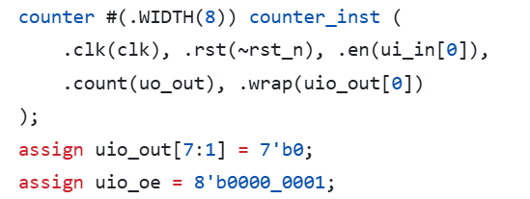
YOUR FIRST CHIP / BROWSER LAB
Step 7: confirm the wrapper's pin mapping
Keep ui_in, uo_out, uio_in, uio_out, uio_oe, ena, clk, rst_n. • ui_in[0] enables counting; ena selects the project. • uo_out carries count; uio_out[0] carries wrap; uio_oe = 01.
Actual counter wrapper at 61ef06b; inspect connections and the output-enable mask.
CHECK Enable, count, wrap and pin directions agree with the specification.
EE6019 • 8 October 2026 • Sources and teaching notes in PowerPoint
Open source ↗
090 / 195
Notes:
TEACHING NOTES
The wrapper connects the reusable counter to Tiny Tapeout's fixed eight-port interface. Inspect src/project.v after checking its name. The counter receives clk, inverted rst_n and ui_in[0], then drives uo_out and uio_out[0]. The inversion turns the external active-low reset into the counter module's active-high reset input; its effect remains synchronous because the register update is clocked. The wrapper sets uio_oe to binary 00000001, so only bidirectional pin zero is an output, and drives the unused output bits to zero. The actual screenshot belongs to reference commit 61ef06bed008e76000f9ae46d65182e476d15dd6. Pin labels in YAML merely describe these connections; they do not create them. Keep the required ports and widths for integration. A physical button connected as enable would require synchronisation and debouncing, while the supplied simulation assumes a controlled stable input. The binary output would need separate decoding for a decimal display.
MANUAL REFERENCE
Step 7 — Check the two source lists and the three module-name locations
SOURCES / checked 8 October 2026
https://github.com/mdkamrulislam-web/tt-sky130-counter/blob/61ef06bed008e76000f9ae46d65182e476d15dd6/src/project.v
https://tinytapeout.com/hdl/important/
IMAGE PROVENANCE
{
"file": "img/04-wrapper-code.png",
"url": "https://github.com/mdkamrulislam-web/tt-sky130-counter/blob/61ef06bed008e76000f9ae46d65182e476d15dd6/src/project.v",
"title": "tt-sky130-counter/src/project.v at 61ef06bed008e76000f9ae46d65182e476d15dd6 · mdkamrulislam-web/tt-sky130-counter · GitHub",
"date": "2026-10-08",
"type": "Actual public browser capture",
"sha256": "68dbbb37583184c41faeaa51d1dc59c052d6363dee07d15e45d652b2a5ea3a8d"
}

Slide 91
YOUR FIRST CHIP / BROWSER LAB
Step 7: write a datasheet someone can use
1
Open docs/info.md.
WORKED EXAMPLE
How it works: synchronous active-low reset, count, hold and wrap.
“After a reset edge, ui_in[0]=1 increments; ui_in[0]=0 holds.”
2
3
How to test: drive pins and predict outputs.
4
External hardware: simulation needs none; later switches need care.
CHECK A reader can drive the named pins and predict an observable value.
EE6019 • 8 October 2026 • Sources and teaching notes in PowerPoint
Open source ↗
091 / 195
Notes:
TEACHING NOTES
The datasheet is a set of usable instructions, not a title pasted above the circuit. Open docs/info.md and retain the required How it works, How to test and External hardware headings. Describe reset timing explicitly: rst_n low resets the counter at the next rising edge. Explain ui_in[0] as enable and identify uo_out as the binary count and uio_out[0] as the terminal-count flag. A useful test procedure predicts observations after a reset edge, enabled edge and disabled edge. State that no external hardware is needed for simulation. A later board experiment needs a controlled clock and suitable input handling; a raw bouncing switch is not an appropriate clock source. Compare the pin labels in info.yaml to the assignments in project.v. Updating a label does not change a port's direction or add hardware. This documentation is later combined with metadata into the generated PDF, which should agree with the implemented circuit.
MANUAL REFERENCE
Give the datasheet enough information to use the circuit
SOURCES / checked 8 October 2026
https://github.com/mdkamrulislam-web/tt-sky130-counter/blob/61ef06bed008e76000f9ae46d65182e476d15dd6/docs/info.md
https://github.com/mdkamrulislam-web/tt-sky130-counter/blob/61ef06bed008e76000f9ae46d65182e476d15dd6/info.yaml

Slide 92
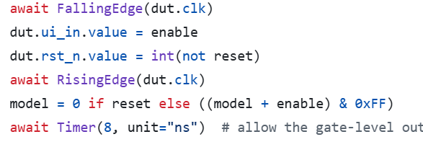
YOUR FIRST CHIP / BROWSER LAB
Step 8: read how the test drives and samples
Open test/test.py; find the step() helper. • Inputs change at a falling edge; state updates at the rising edge. • The checker waits 8 ns, then compares outputs with its model.
Actual reference Python test at 61ef06b; read drive/edge/settle/check order.
CHECK You can explain why driving and sampling occur at different times.
EE6019 • 8 October 2026 • Sources and teaching notes in PowerPoint
Open source ↗
092 / 195
Notes:
TEACHING NOTES
A green icon becomes more meaningful when students know what the test actually does. Open test/test.py and find the helper that performs one controlled clock step. The test starts a twenty-nanosecond clock, matching fifty megahertz. It waits for a falling edge, sets enable and reset, waits for the following rising edge, then allows eight nanoseconds for outputs to settle before comparison. This separates input changes from the active state-update edge and supports reuse of the top-level checks with the mapped cell netlist. The Python model calculates expected behaviour independently, rather than simply reading the internal count register and declaring it correct. The screenshot is actual reference test code at commit 61ef06bed008e76000f9ae46d65182e476d15dd6. Ask students to connect the helper to their earlier edge predictions. Sample timing matters when investigating a failure; removing an assertion or comparing before outputs settle would weaken the evidence rather than fix the circuit.
MANUAL REFERENCE
Step 8 — Read the test before relying on a green icon
SOURCES / checked 8 October 2026
https://github.com/mdkamrulislam-web/tt-sky130-counter/blob/61ef06bed008e76000f9ae46d65182e476d15dd6/test/test.py
IMAGE PROVENANCE
{
"file": "img/23-real-test-code.png",
"url": "https://github.com/mdkamrulislam-web/tt-sky130-counter/blob/61ef06bed008e76000f9ae46d65182e476d15dd6/test/test.py",
"type": "Actual pinned source file browser capture",
"date": "2026-10-08",
"sha256": "1c1f6f1d19a80545f626ce0bfff5b52acc5f5244213a6b79761bddd82096964b"
}

Slide 93
YOUR FIRST CHIP / BROWSER LAB
Step 8: know what the assertions cover
1
Check reset, enabled counting, hold and reset priority.
WORKED EXAMPLE
After 266 enabled edges from 0, count is 10.
20 disabled edges at count 10 must leave count at 10.
2
3
At 255, disable → hold/flag 0; enable → overflow to 0.
4
Also check unused output bits and uio_oe.
CHECK Explain a checked boundary case, not merely “the test passed”.
EE6019 • 8 October 2026 • Sources and teaching notes in PowerPoint
Open source ↗
093 / 195
Notes:
TEACHING NOTES
The single test case contains several phases and many assertions. It begins with reset and hold, counts through 266 enabled edges to reach ten after one complete 256-value wrap, holds ten, then counts seven more edges to seventeen. A later reset returns zero, and another enabled section reaches five. The final boundary sequence resets again, reaches 255, holds that value for disabled edges with wrap low, then enables one edge to reach zero. Reset is also tested while enable is high to establish priority. The checker compares count, wrap, the other bidirectional output bits and the output-enable mask, not just the arithmetic output. These are the actual reference phases at commit 61ef06bed008e76000f9ae46d65182e476d15dd6. They establish the observed specified behaviours for these cases. They do not prove every possible input sequence, physical switch behaviour or manufactured-chip operation. Ask students to predict one phase before opening the recorded waveform.
MANUAL REFERENCE
Step 8 — Read the test before relying on a green icon
SOURCES / checked 8 October 2026
https://github.com/mdkamrulislam-web/tt-sky130-counter/blob/61ef06bed008e76000f9ae46d65182e476d15dd6/test/test.py

Slide 94
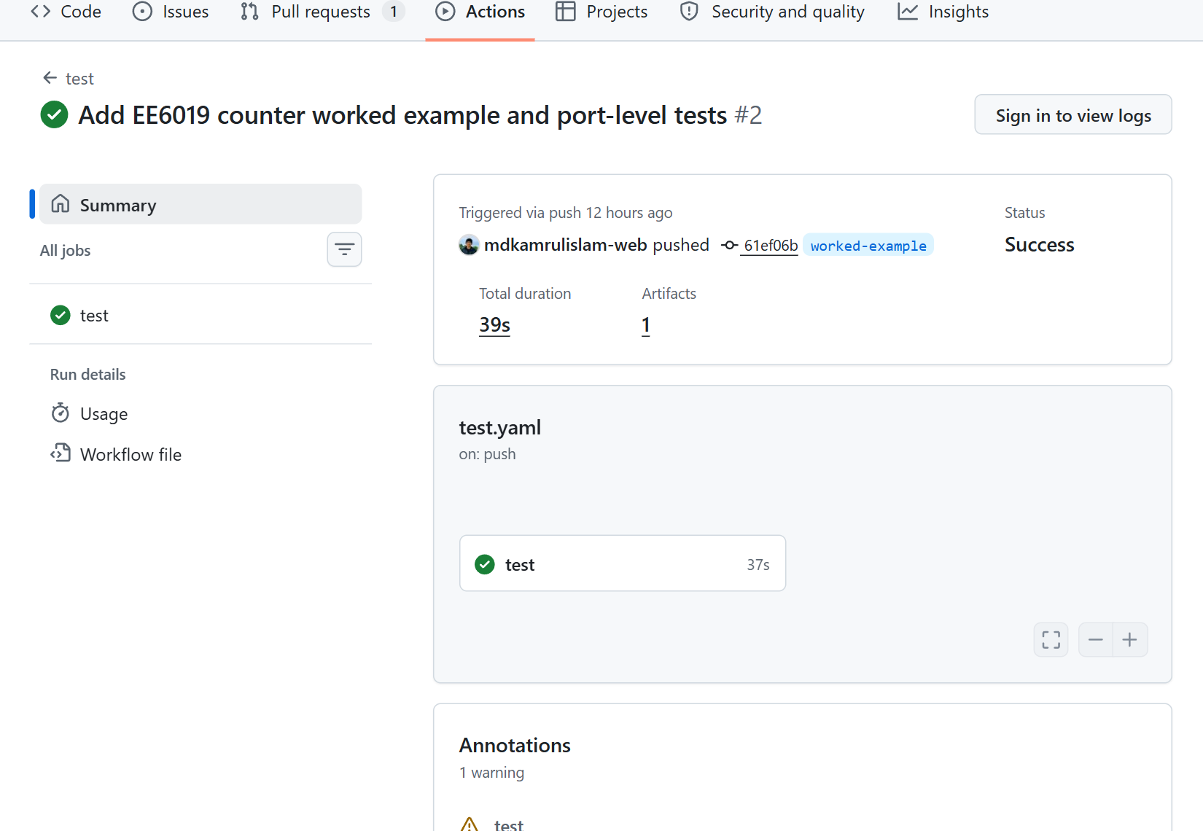
YOUR FIRST CHIP / BROWSER LAB
Step 9: open the test run for your final commit
1
Actions → test → run for the complete seven-file commit.
2
Check the branch and commit identifier.
3
Open the test job; expand Run tests.
Actual successful RTL run 37693100752 at 61ef06b; open its test job to inspect logs.
CHECK The complete counter commit has a completed successful test run.
EE6019 • 8 October 2026 • Sources and teaching notes in PowerPoint
Open source ↗
094 / 195
Notes:
TEACHING NOTES
Actions may show several runs because repository creation and each browser save can start another recipe. Choose the test workflow and open the run corresponding to the complete counter commit. Match both branch and commit identifier to the Code page. A green result from an earlier adder template or another branch is not evidence for the current counter. Open its test job and expand Run tests to inspect the simulator output. The genuine reference screenshot shows successful RTL run 37693100752 at commit 61ef06bed008e76000f9ae46d65182e476d15dd6. The unchanged example reported one test, zero failures and zero errors, with 11,368 nanoseconds of simulated time. That simulated duration is different from how long GitHub's job took in wall-clock time. Students' own runs have different IDs. Keep the matching run URL with the commit so source, assertions and artifact can be traced to one saved version.
MANUAL REFERENCE
Step 9 — Check the `test` workflow for your final commit
SOURCES / checked 8 October 2026
https://github.com/mdkamrulislam-web/tt-sky130-counter/actions/runs/37693100752
https://github.com/TinyTapeout/ttsky-verilog-template/blob/main/.github/workflows/test.yaml
IMAGE PROVENANCE
{
"file": "img/07-rtl-run.png",
"url": "https://github.com/mdkamrulislam-web/tt-sky130-counter/actions/runs/37693100752",
"title": "Add EE6019 counter worked example and port-level tests · mdkamrulislam-web/tt-sky130-counter@61ef06b · GitHub",
"date": "2026-10-08",
"type": "Actual public browser capture",
"sha256": "ff7585bdde5402b855d6ecd7118271cda4566ad9b7b517238f89f343d0d2c601"
}

Slide 95
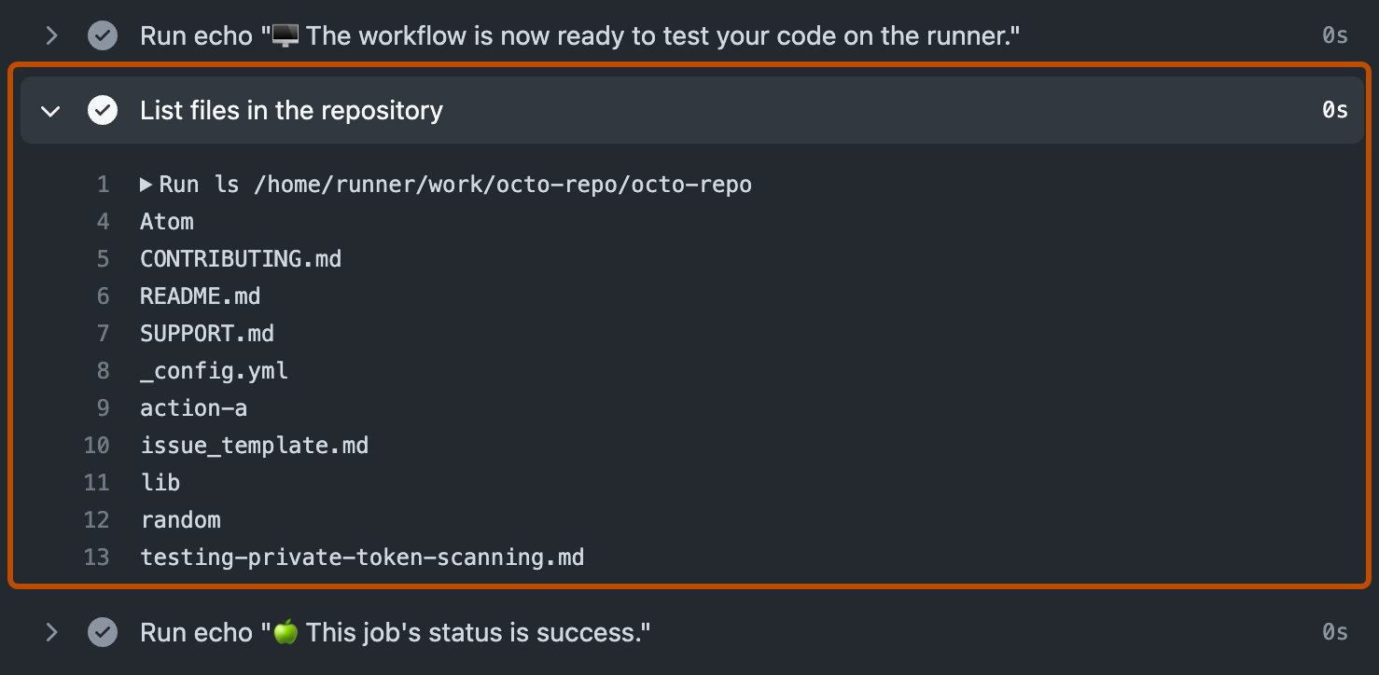
YOUR FIRST CHIP / BROWSER LAB
Step 9: read the job log, not only the icon
1
Select the test job in the run's sidebar.
2
Expand Run tests and read the pass/fail summary.
3
If red, find the first useful compiler or assertion error.
Official GitHub Docs image: expanded job log; generic workflow, not a counter failure.
CHECK You can locate the test summary or the first specific failure message.
EE6019 • 8 October 2026 • Sources and teaching notes in PowerPoint
Open source ↗
095 / 195
Notes:
TEACHING NOTES
A workflow summary tells students which job succeeded or failed. The expanded job step reveals why. Select the job in the left sidebar, then expand Run tests and find the simulator summary or earliest useful error. A missing module, a Python import failure and a count assertion mismatch require different fixes. Later cleanup or upload messages can be secondary consequences, so begin with the substantive compilation or test error. The screenshot is GitHub's official generic log-viewing example, not an actual counter failure. It illustrates the expand-step control; the student's test recipe has its own named steps. In the reference counter run 37693100752 at commit 61ef06bed008e76000f9ae46d65182e476d15dd6, the functional test passed. Preserve assertions when troubleshooting. The current template also explicitly checks results.xml after make, because successful make completion by itself can be insufficient to catch a failed cocotb result.
MANUAL REFERENCE
Step 9 — Check the `test` workflow for your final commit
SOURCES / checked 8 October 2026
https://docs.github.com/en/actions/get-started/quickstart
https://github.com/mdkamrulislam-web/tt-sky130-counter/actions/runs/37693100752
https://github.com/TinyTapeout/ttsky-verilog-template/blob/main/.github/workflows/test.yaml
https://docs.github.com/assets/images/help/repository/actions-quickstart-log-detail.png
IMAGE PROVENANCE
{
"file": "img/official-actions-log.png",
"asset_url": "https://docs.github.com/assets/images/help/repository/actions-quickstart-log-detail.png",
"source_page": "https://docs.github.com/en/actions/get-started/quickstart",
"caption": "GitHub Docs: expanded job log",
"kind": "Official documentation screenshot; not our account capture",
"retrieved": "2026-10-08",
"bytes": 53977,
"sha256": "cb3984b91bda6f4ad95c3210b371883cbf46e543d81853420ca625cb68fb892a",
"content_type": "image/png"
}

Slide 96
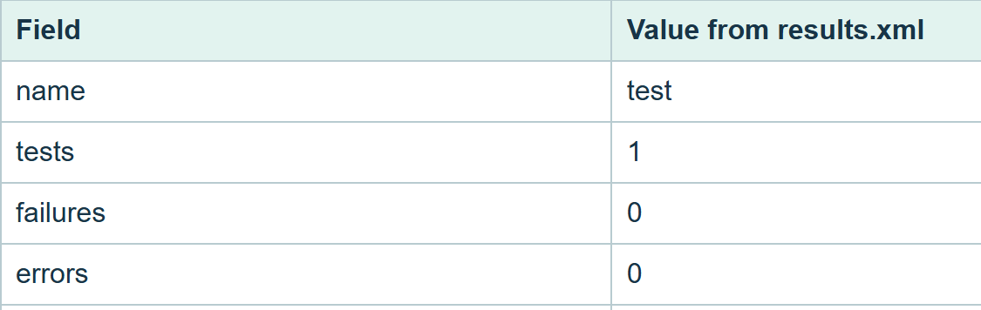
YOUR FIRST CHIP / BROWSER LAB
Step 9: keep and read results.xml
From Summary → Artifacts, download test-results and extract it. • Read results.xml: reference = 1 test, 0 failures, 0 errors. • Keep XML with tb.fst, the commit and run URL.
Local HTML view of unchanged results.xml from RTL run 37693100752, 61ef06b; not GitHub UI.
CHECK The XML belongs to the same successful RTL run as your saved source.
EE6019 • 8 October 2026 • Sources and teaching notes in PowerPoint
Open source ↗
096 / 195
Notes:
TEACHING NOTES
The XML file is structured evidence produced by the test framework. Download the test-results artifact from the completed RTL run while signed in, extract it, and locate results.xml beside tb.fst. One reported test case can contain many phases and assertions, as this counter's test does. Zero failures and errors supports the observed functional result; it does not turn one case into exhaustive verification. The screenshot presents the unchanged downloaded reference XML in a local browser HTML view. It is not a GitHub-generated results page and is not a fabricated success interface. Its data comes from RTL run 37693100752 at commit 61ef06bed008e76000f9ae46d65182e476d15dd6. Preserve the original XML as well as any explanatory screenshot. The local command used later, python -m cocotb_tools.check_results results.xml, reads this result file and returns failure when a test failed. Next use the FST to inspect the signal transitions behind the assertions.
MANUAL REFERENCE
Step 9 — Check the `test` workflow for your final commit
SOURCES / checked 8 October 2026
https://github.com/mdkamrulislam-web/tt-sky130-counter/actions/runs/37693100752
https://docs.github.com/en/actions/how-tos/manage-workflow-runs/download-workflow-artifacts
IMAGE PROVENANCE
{
"file": "img/21-real-test-results.png",
"url": "https://github.com/mdkamrulislam-web/tt-sky130-counter/actions/runs/37693100752",
"type": "Local browser view of unchanged downloaded results.xml",
"date": "2026-10-08",
"sha256": "3ab9ee863d5996c6c8855ab796233a6bea17e054756093ddbb720b23aec9650e"
}

Slide 97
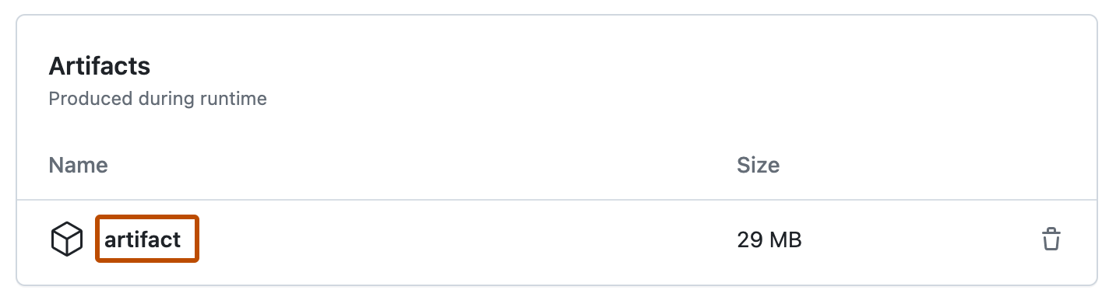
YOUR FIRST CHIP / BROWSER LAB
Waveform: download and extract test-results
Open the successful test run → Summary → Artifacts. • Click test-results while signed in; extract the ZIP. • Find tb.fst and results.xml; keep the originals.
Official GitHub Docs artifact-list image; choose test-results in your actual RTL run.
CHECK You have extracted tb.fst, not just downloaded an unopened ZIP.
EE6019 • 8 October 2026 • Sources and teaching notes in PowerPoint
Open source ↗
097 / 195
Notes:
TEACHING NOTES
A waveform records signal values over simulated time. It provides the time-based picture behind the pass/fail assertions. Return to the successful RTL test run's Summary and scroll to its Artifacts section. Download test-results while signed in, extract the ZIP and locate tb.fst and results.xml. The FST is the waveform data; the XML is the test result. Uploading the ZIP or XML into a waveform viewer will not open the expected trace. The screenshot is GitHub's official generic artifact-list example, whose item is called artifact. The counter run uses test-results instead. Our genuine RTL waveform comes from run 37693100752 at commit 61ef06bed008e76000f9ae46d65182e476d15dd6. Students should download the matching artifact from their own final run. Preserve its original files together with the source commit and run link, because a screenshot alone cannot retain all signals and time ranges for later investigation.
MANUAL REFERENCE
Practical step: open and read your real waveform
SOURCES / checked 8 October 2026
https://docs.github.com/en/actions/how-tos/manage-workflow-runs/download-workflow-artifacts
https://github.com/mdkamrulislam-web/tt-sky130-counter/actions/runs/37693100752
https://docs.github.com/assets/images/help/repository/artifact-drop-down-updated.png
IMAGE PROVENANCE
{
"file": "img/official-artifact-list.png",
"asset_url": "https://docs.github.com/assets/images/help/repository/artifact-drop-down-updated.png",
"source_page": "https://docs.github.com/en/actions/how-tos/manage-workflow-runs/download-workflow-artifacts",
"caption": "GitHub Docs: workflow artifact list",
"kind": "Official documentation screenshot; not our account capture",
"retrieved": "2026-10-08",
"bytes": 13990,
"sha256": "d8312994708b7b46b8d35404c2b0181100987daf095b2a90362312cd4756efef",
"content_type": "image/png"
}

Slide 98
YOUR FIRST CHIP / BROWSER LAB
Waveform: open Surfer and drop the FST
1
Open app.surfer-project.org in your browser.
2
Drag the extracted tb.fst onto the viewer canvas.
3
Wait for loading; look for tb scope and the loaded filename.
CHECK The filename is loaded and tb appears; next add signals to the wave area.
EE6019 • 8 October 2026 • Sources and teaching notes in PowerPoint
Open source ↗
098 / 195
Notes:
TEACHING NOTES
Surfer's web viewer allows learners to inspect the real FST without installing a native waveform application. Open the official app address and drag the extracted tb.fst from the file manager onto the canvas. Wait for loading to finish. The testbench scope named tb and the filename in the status area indicate that the data has loaded. An empty wave area at this point may simply mean no signals have been added; it does not establish that the simulation produced no data. Browser file access uses drag and drop here. The web version's load_file command cannot accept an arbitrary local filesystem path as if it were a native desktop application. This stage uses the actual artifact from reference RTL run 37693100752 at commit 61ef06bed008e76000f9ae46d65182e476d15dd6, or the learner's corresponding file. The next slide adds top-level signals and fits the full time range.
MANUAL REFERENCE
Practical step: open and read your real waveform
SOURCES / checked 8 October 2026
https://app.surfer-project.org/
https://surfer-project.org/
https://docs.surfer-project.org/book/commands/index.html
https://github.com/mdkamrulislam-web/tt-sky130-counter/actions/runs/37693100752

Slide 99
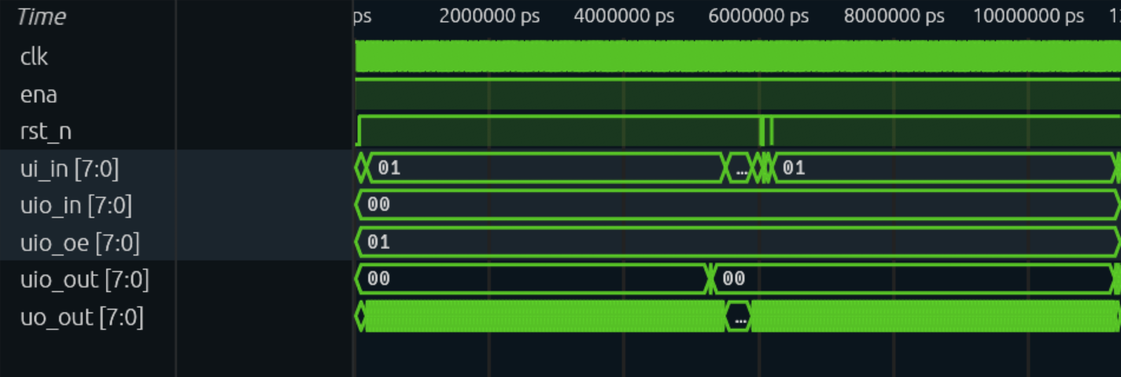
YOUR FIRST CHIP / BROWSER LAB
Waveform: add tb signals and fit the whole test
Space → type scope_add tb → Enter. • Space → type zoom_fit → Enter. • Find clk, rst_n, ui_in, uo_out, uio_out and uio_oe.
Native Surfer capture of genuine RTL tb.fst, run 37693100752, 61ef06b; full 11,368 ns test.
CHECK The wave area contains signals; a dense full view is ready to zoom.
EE6019 • 8 October 2026 • Sources and teaching notes in PowerPoint
Open source ↗
099 / 195
Notes:
TEACHING NOTES
Surfer's command palette opens with Space. Enter scope_add tb to add the top-level testbench signals, then reopen the palette and enter zoom_fit to show the full recorded time span. Students can also expand the tb scope and add individual signals. The key signals are clock, active-low reset, enable input bus, count output bus, wrap output bus and output-enable mask. ena should be high because the testbench selects the project. The actual screenshot is a native capture of the waveform area, read from test-results/tb.fst in RTL run 37693100752 at commit 61ef06bed008e76000f9ae46d65182e476d15dd6. The complete test lasts 11,368 nanoseconds. At this wide scale, many individual clock edges appear compressed. That is normal: a full-range view helps find phases, while smaller zoom windows let students inspect individual updates. The following slides use real reference windows for reset, overflow and hold.
MANUAL REFERENCE
Practical step: open and read your real waveform
SOURCES / checked 8 October 2026
https://app.surfer-project.org/
https://docs.surfer-project.org/book/commands/index.html
https://github.com/mdkamrulislam-web/tt-sky130-counter/actions/runs/37693100752
IMAGE PROVENANCE
{
"file": "img/13-real-waveform-full.png",
"url": "https://app.surfer-project.org/",
"artifact_run": "https://github.com/mdkamrulislam-web/tt-sky130-counter/actions/runs/37693100752",
"artifact": "test-results/tb.fst",
"commit": "61ef06bed008e76000f9ae46d65182e476d15dd6",
"type": "Native Surfer waveform-area browser capture of actual FST; no redrawn trace",
"date": "2026-10-08",
"sha256": "f35146cc028c3d7bd47a3486080ff40cc71804ef19cac86fb3e0656c3b936ace"
}

Slide 100
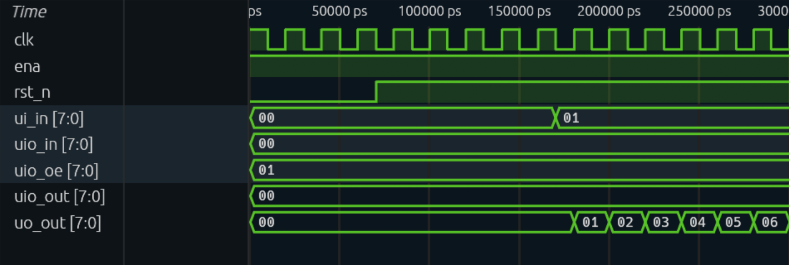
YOUR FIRST CHIP / BROWSER LAB
Waveform: inspect reset and first increments
Space → enter zoom_to 0ns 300ns → Enter. • rst_n = 0: count becomes 00 at rising clock edges. • Enable 0 holds at 00; enable 1 starts increments.
Actual reset/start trace from RTL run 37693100752 at 61ef06b; buses shown in hexadecimal.
CHECK Reset clears on an edge; enabled counting begins only after reset is released.
EE6019 • 8 October 2026 • Sources and teaching notes in PowerPoint
Open source ↗
100 / 195
Notes:
TEACHING NOTES
Zoom to the first three hundred nanoseconds of the unchanged reference test. The command is entered in Surfer's palette, not a shell terminal. Find clk, rst_n, ui_in and uo_out. The initial unknown count is not a known reset state until a rising edge has applied reset. With rst_n low, the counter becomes zero at its clocked update. Later, reset is released while enable remains low, so the count stays at zero. Once enable is asserted, each rising edge increments. The test changes input values on falling edges, leaving a clear interval before the next active edge. The screenshot is genuine native waveform output from RTL run 37693100752 at commit 61ef06bed008e76000f9ae46d65182e476d15dd6. The buses are displayed in hexadecimal, where 00 is zero and 01 is one. Ask students to locate an individual rising edge and predict the value immediately after it.
MANUAL REFERENCE
Observe reset and the first increments
SOURCES / checked 8 October 2026
https://docs.surfer-project.org/book/commands/index.html
https://github.com/mdkamrulislam-web/tt-sky130-counter/actions/runs/37693100752
https://github.com/mdkamrulislam-web/tt-sky130-counter/blob/61ef06bed008e76000f9ae46d65182e476d15dd6/test/test.py
https://app.surfer-project.org/
IMAGE PROVENANCE
{
"file": "img/14-real-waveform-reset.png",
"url": "https://app.surfer-project.org/",
"artifact_run": "https://github.com/mdkamrulislam-web/tt-sky130-counter/actions/runs/37693100752",
"artifact": "test-results/tb.fst",
"commit": "61ef06bed008e76000f9ae46d65182e476d15dd6",
"type": "Native Surfer waveform-area browser capture of actual FST; no redrawn trace",
"date": "2026-10-08",
"sha256": "5a614fec742697f9d0f6ada40ebf2dc75f0d7f85e10e5981711349b7d8a7486b"
}

Slide 101
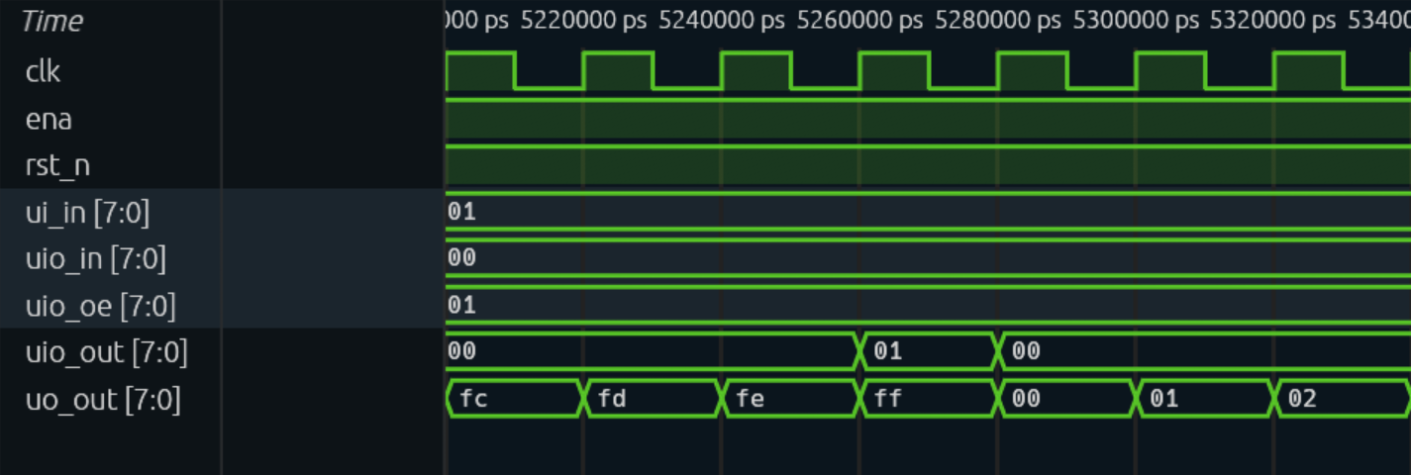
YOUR FIRST CHIP / BROWSER LAB
Waveform: inspect 254 → 255 → 0
Space → enter zoom_to 5200ns 5340ns → Enter. • uo_out: fe → ff → 00 means 254 → 255 → 0. • uio_out is 01 at enabled ff, then 00 after overflow.
Actual overflow trace from RTL run 37693100752, 61ef06b: fe/ff/00 with wrap high at ff.
CHECK Explain why the flag is high before the overflow edge.
EE6019 • 8 October 2026 • Sources and teaching notes in PowerPoint
Open source ↗
101 / 195
Notes:
TEACHING NOTES
The reference overflow is visible near 5,280 nanoseconds. Zoom to 5200 through 5340 nanoseconds and read the count bus. Hexadecimal fe means 254, ff means 255, and 00 means zero. The count reaches ff on an enabled rising edge and becomes zero on the following enabled edge. Meanwhile uio_out is 01 while count is ff and enable is 01, because its least-significant bit carries wrap. The flag is a combinational terminal-count indication before overflow, not a registered pulse after overflow. uio_oe is also 01, enabling only bidirectional pin zero as an output. This is a genuine native capture from test-results/tb.fst, RTL run 37693100752, commit 61ef06bed008e76000f9ae46d65182e476d15dd6. If students modify the test, these exact times may move. Search for the same signal transition rather than treating the reference time coordinates as a fixed specification.
MANUAL REFERENCE
Observe 254 → 255 → 0
SOURCES / checked 8 October 2026
https://docs.surfer-project.org/book/commands/index.html
https://github.com/mdkamrulislam-web/tt-sky130-counter/actions/runs/37693100752
https://github.com/mdkamrulislam-web/tt-sky130-counter/blob/61ef06bed008e76000f9ae46d65182e476d15dd6/src/counter.v
https://app.surfer-project.org/
IMAGE PROVENANCE
{
"file": "img/15-real-waveform-wrap.png",
"url": "https://app.surfer-project.org/",
"artifact_run": "https://github.com/mdkamrulislam-web/tt-sky130-counter/actions/runs/37693100752",
"artifact": "test-results/tb.fst",
"commit": "61ef06bed008e76000f9ae46d65182e476d15dd6",
"type": "Native Surfer waveform-area browser capture of actual FST; no redrawn trace",
"date": "2026-10-08",
"sha256": "ce61428b17e03fd11d6c9cc29e44b64e64bdee447365450784dfeda8fd4581e1"
}

Slide 102
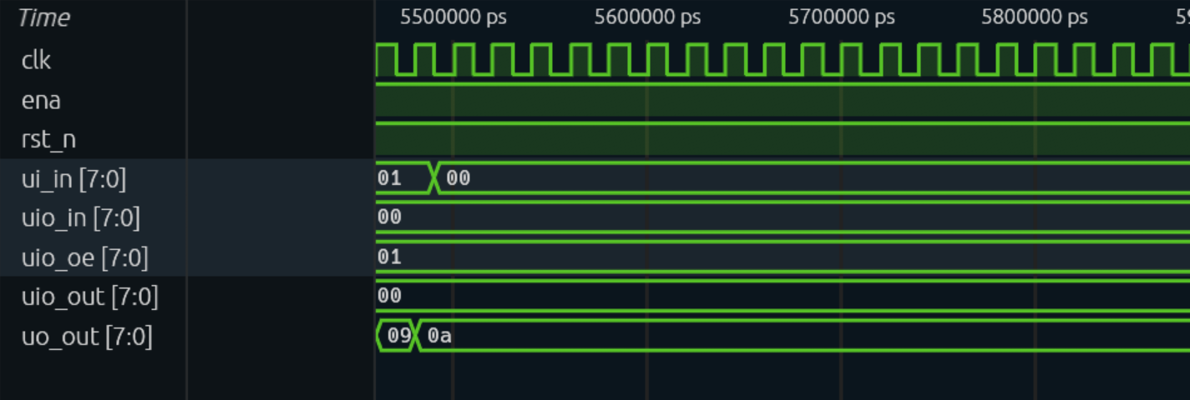
YOUR FIRST CHIP / BROWSER LAB
Waveform: inspect hold while the clock runs
Space → enter zoom_to 5460ns 5880ns → Enter. • ui_in changes from 01 to 00: counting becomes disabled. • uo_out stays at 0a, decimal 10, while clk keeps toggling.
Actual hold trace from RTL run 37693100752 at 61ef06b; 0a means decimal 10.
CHECK Clock edges continue, but the disabled register holds 10.
EE6019 • 8 October 2026 • Sources and teaching notes in PowerPoint
Open source ↗
102 / 195
Notes:
TEACHING NOTES
This zoom window shows the register holding a stored value while the clock continues. In the actual reference, the earlier 266 enabled edges leave the count at decimal ten, displayed as hexadecimal 0a. Enable changes from 01 to 00 on the input bus and the subsequent rising edges no longer increment count. The absence of an else assignment in the clocked counter block means the register retains its previous value. It does not mean the clock stopped or that the output is floating. The genuine screenshot is read from the RTL FST in run 37693100752 at commit 61ef06bed008e76000f9ae46d65182e476d15dd6. Compare clk and uo_out over several edges. Students should explain both the changing clock and unchanged count. Holding a register is a behaviour controlled by enable. For a modified test, use the transitions to locate its hold phase rather than assume the same nanosecond window remains valid.
MANUAL REFERENCE
Observe hold while the clock continues
SOURCES / checked 8 October 2026
https://docs.surfer-project.org/book/commands/index.html
https://github.com/mdkamrulislam-web/tt-sky130-counter/actions/runs/37693100752
https://github.com/mdkamrulislam-web/tt-sky130-counter/blob/61ef06bed008e76000f9ae46d65182e476d15dd6/src/counter.v
https://app.surfer-project.org/
IMAGE PROVENANCE
{
"file": "img/16-real-waveform-hold.png",
"url": "https://app.surfer-project.org/",
"artifact_run": "https://github.com/mdkamrulislam-web/tt-sky130-counter/actions/runs/37693100752",
"artifact": "test-results/tb.fst",
"commit": "61ef06bed008e76000f9ae46d65182e476d15dd6",
"type": "Native Surfer waveform-area browser capture of actual FST; no redrawn trace",
"date": "2026-10-08",
"sha256": "6363eae3aff573db56ba7482a20b589b413c2da2644ef1248ea1f4bab0e000f5"
}

Slide 103
YOUR FIRST CHIP / BROWSER LAB
Waveform: recover an empty or confusing view
1
Check tb.fst loaded; add tb signals, then use zoom_fit.
2
Hex: 0a = 10, fe = 254, ff = 255; change radix if useful.
3
Use explicit ns in zoom_to: 1 ns = 1,000 ps.
4
For modified tests, find events rather than copy reference times.
CHECK You can see the loaded signals and recognise one reset, count or hold event.
EE6019 • 8 October 2026 • Sources and teaching notes in PowerPoint
Open source ↗
103 / 195
Notes:
TEACHING NOTES
Separate a loading problem from a display problem. If the viewer is blank, confirm that the extracted FST, rather than a ZIP or XML file, was dropped onto the canvas. Wait for loading, add the tb signals and use zoom_fit to restore the full range. A loaded file with no added signals can legitimately show an empty wave area. A wide view can compress values, so zoom in before deciding data is absent. The reference buses use hexadecimal; changing the display radix changes presentation, not stored simulation data. The reference file's base time unit is picoseconds, and one nanosecond is one thousand picoseconds. Explicit ns in zoom_to avoids a thousand-fold time-window mistake. Reference coordinates belong to RTL run 37693100752 at commit 61ef06bed008e76000f9ae46d65182e476d15dd6. The student's modified test may have different event times. Use drag and drop for local browser files rather than a filesystem path in load_file.
MANUAL REFERENCE
If the waveform does not appear
SOURCES / checked 8 October 2026
https://docs.surfer-project.org/book/commands/index.html
https://app.surfer-project.org/
https://github.com/mdkamrulislam-web/tt-sky130-counter/actions/runs/37693100752

Slide 104
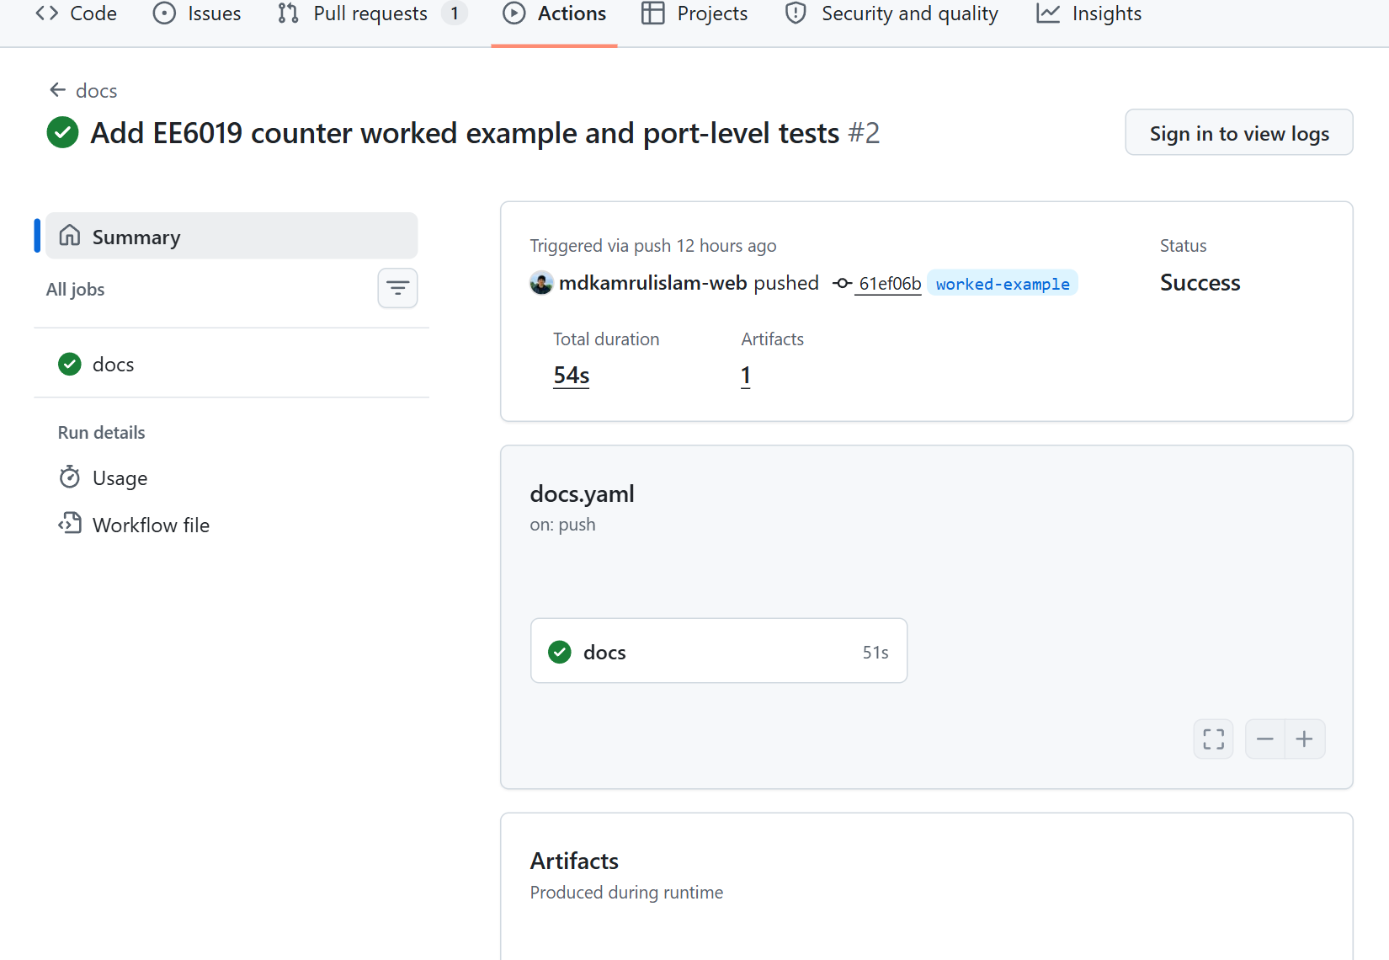
YOUR FIRST CHIP / BROWSER LAB
Step 10: build and download the datasheet
1
Actions → docs → run for your final commit.
2
Wait for success; Summary → Artifacts → PDF.
3
Extract the download and open datasheet.pdf.
Actual successful docs run 37693100755 at 61ef06b; its PDF artifact contains a two-page datasheet.
CHECK Your final commit has a generated datasheet you can open.
EE6019 • 8 October 2026 • Sources and teaching notes in PowerPoint
Open source ↗
104 / 195
Notes:
TEACHING NOTES
The documentation recipe combines project metadata and docs/info.md into a printable datasheet. Open Actions, choose docs and select the run matching the complete counter commit. Wait for the job to finish, return to Summary and download the PDF artifact while signed in. Extract the archive and open datasheet.pdf. The genuine reference run is 37693100755 at commit 61ef06bed008e76000f9ae46d65182e476d15dd6, and it produced a two-page PDF. This is a separate workflow from functional testing and physical implementation. A successful docs run means its document generation and validation completed; it does not establish correct circuit behaviour by itself. If it fails, inspect meaningful project metadata, pin labels and the required documentation sections. Students should preserve the original generated PDF with their run link and commit, rather than only screenshot the Actions icon. The next checkpoint is to read the document and compare it with the implemented pins and timing.
MANUAL REFERENCE
Step 10 — Check the documentation and download the datasheet
SOURCES / checked 8 October 2026
https://github.com/mdkamrulislam-web/tt-sky130-counter/actions/runs/37693100755
https://docs.github.com/en/actions/how-tos/manage-workflow-runs/download-workflow-artifacts
https://github.com/mdkamrulislam-web/tt-sky130-counter/blob/61ef06bed008e76000f9ae46d65182e476d15dd6/docs/info.md
IMAGE PROVENANCE
{
"file": "img/09-docs-run.png",
"url": "https://github.com/mdkamrulislam-web/tt-sky130-counter/actions/runs/37693100755",
"title": "Add EE6019 counter worked example and port-level tests · mdkamrulislam-web/tt-sky130-counter@61ef06b · GitHub",
"date": "2026-10-08",
"type": "Actual public browser capture",
"sha256": "784ccd82a705f333ae3fd47211384d57be618d621fc6538449914d53cc69f169"
}

Slide 105
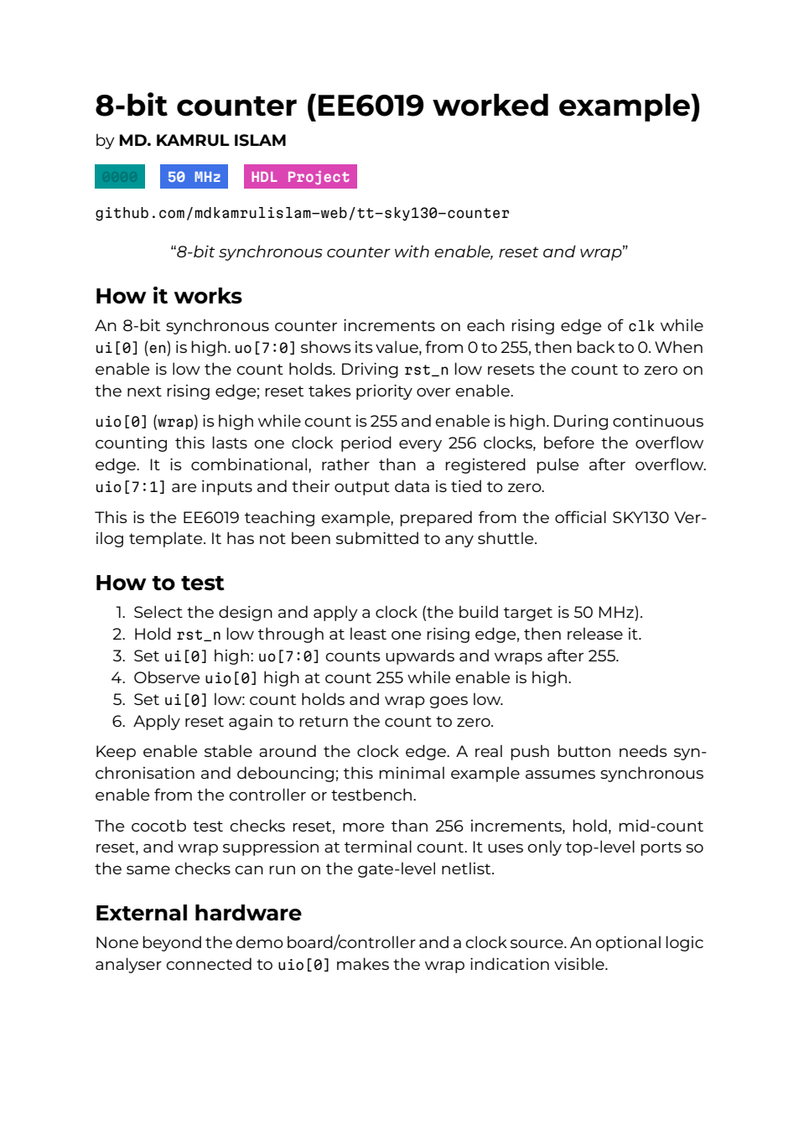
YOUR FIRST CHIP / BROWSER LAB
Step 10: read reset and enable in the datasheet
Read how reset and enable affect count at a rising edge. • Compare these words with the RTL and the top-level pin names.
Native crop of the actual generated datasheet, page 1; reference docs run 37693100755.
CHECK The generated document describes the same circuit that passed the test.
EE6019 • 8 October 2026 • Sources and teaching notes in PowerPoint
Open source ↗
105 / 195
Notes:
TEACHING NOTES
The PDF is useful only if its instructions agree with the circuit. Read the title and author, then inspect the pin descriptions and operating explanation. Reset should be described as active low at the wrapper and synchronous at the next rising clock edge. Enable should be ui_in[0], count should be the eight uo_out bits, and the flag should be high at enabled count 255 before the next edge overflows. Check that the proposed test procedure predicts concrete values a reader can observe. Pin labels do not make electrical connections, so compare them with project.v rather than infer hardware from prose alone. The screenshot is a genuine rendered page one of the reference's two-page generated datasheet, produced by docs run 37693100755 at commit 61ef06bed008e76000f9ae46d65182e476d15dd6. It is different from the source Markdown capture. Ask students to identify one sentence in the PDF that can be checked against the source or waveform.
MANUAL REFERENCE
Step 10 — Check the documentation and download the datasheet
SOURCES / checked 8 October 2026
https://github.com/mdkamrulislam-web/tt-sky130-counter/actions/runs/37693100755
https://github.com/mdkamrulislam-web/tt-sky130-counter/blob/61ef06bed008e76000f9ae46d65182e476d15dd6/docs/info.md
https://github.com/mdkamrulislam-web/tt-sky130-counter/blob/61ef06bed008e76000f9ae46d65182e476d15dd6/src/project.v
IMAGE PROVENANCE
{
"file": "img/24-real-datasheet.png",
"url": "https://github.com/mdkamrulislam-web/tt-sky130-counter/actions/runs/37693100755",
"type": "Actual rendered page1 of generated two-page datasheet",
"date": "2026-10-08",
"sha256": "a10e980eef9661e5794dce7ceb7bfa16a833f1d78807373688253e1314c9bec8"
}

Slide 106
YOUR FIRST CHIP / BROWSER LAB
Step 10: check the flag description against the code
The flag is high at count 255 while enable is high, before the overflow edge. • Its combinational behaviour must agree with both the RTL and your test.
Native crop of the actual generated datasheet, page 1; reference docs run 37693100755.
CHECK Documentation explains the circuit; passing simulation verifies the tested behaviour.
EE6019 • 8 October 2026 • Sources and teaching notes in PowerPoint
Open source ↗
106 / 195
Notes:
TEACHING NOTES
The PDF is useful only if its instructions agree with the circuit. Read the title and author, then inspect the pin descriptions and operating explanation. Reset should be described as active low at the wrapper and synchronous at the next rising clock edge. Enable should be ui_in[0], count should be the eight uo_out bits, and the flag should be high at enabled count 255 before the next edge overflows. Check that the proposed test procedure predicts concrete values a reader can observe. Pin labels do not make electrical connections, so compare them with project.v rather than infer hardware from prose alone. The screenshot is a genuine rendered page one of the reference's two-page generated datasheet, produced by docs run 37693100755 at commit 61ef06bed008e76000f9ae46d65182e476d15dd6. It is different from the source Markdown capture. Ask students to identify one sentence in the PDF that can be checked against the source or waveform.
MANUAL REFERENCE
Step 10 — Check the documentation and download the datasheet
SOURCES / checked 8 October 2026
https://github.com/mdkamrulislam-web/tt-sky130-counter/actions/runs/37693100755
https://github.com/mdkamrulislam-web/tt-sky130-counter/blob/61ef06bed008e76000f9ae46d65182e476d15dd6/docs/info.md
https://github.com/mdkamrulislam-web/tt-sky130-counter/blob/61ef06bed008e76000f9ae46d65182e476d15dd6/src/project.v
IMAGE PROVENANCE
{
"file": "img/24-real-datasheet.png",
"url": "https://github.com/mdkamrulislam-web/tt-sky130-counter/actions/runs/37693100755",
"type": "Actual rendered page1 of generated two-page datasheet",
"date": "2026-10-08",
"sha256": "a10e980eef9661e5794dce7ceb7bfa16a833f1d78807373688253e1314c9bec8"
}

Slide 107
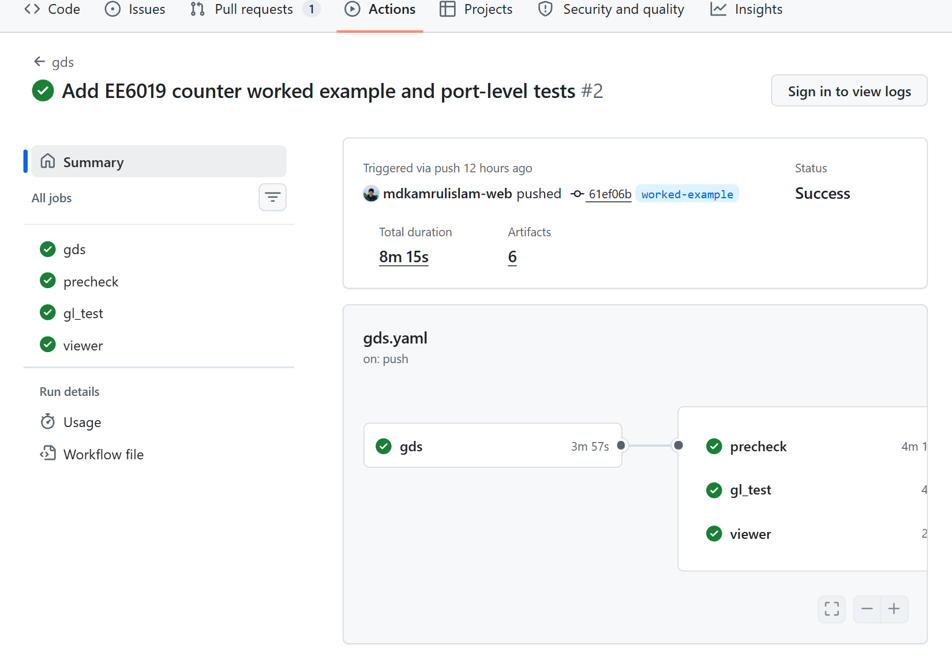
YOUR FIRST CHIP / BROWSER LAB
Step 11: wait for all four GDS jobs
1
Actions → gds → run for your final commit.
2
Wait for gds, gl_test, precheck and viewer to finish.
3
All four must pass; queued or running is still in progress.
Actual GDS run 37693100748 at 61ef06b: gds, gl_test, precheck, viewer all successful.
CHECK All four jobs passed for the same complete counter version.
EE6019 • 8 October 2026 • Sources and teaching notes in PowerPoint
Open source ↗
107 / 195
Notes:
TEACHING NOTES
The gds workflow is the complete physical-build recipe, with several jobs establishing different properties. Select it in Actions and open the run for the same final commit already checked in test and docs. The reference run 37693100748 passed gds, gl_test, precheck and viewer at commit 61ef06bed008e76000f9ae46d65182e476d15dd6. A queued or running state is not a failure or a success; let it complete. If gds fails, later jobs may be skipped because their required layout or netlist does not exist. Inspect the earlier substantive error before investigating a downstream skip. Open individual jobs and expand steps to read logs. The actual screenshot shows all four reference jobs green. Students' job durations and run IDs will differ. A separate optional FPGA workflow is not part of this chip-layout checkpoint. The next slide explains what each of the four required jobs contributes to the result.
MANUAL REFERENCE
Step 11 — Wait for all four jobs in the `gds` workflow
SOURCES / checked 8 October 2026
https://github.com/mdkamrulislam-web/tt-sky130-counter/actions/runs/37693100748
https://github.com/TinyTapeout/ttsky-verilog-template/blob/main/.github/workflows/gds.yaml
IMAGE PROVENANCE
{
"file": "img/08-gds-run.png",
"url": "https://github.com/mdkamrulislam-web/tt-sky130-counter/actions/runs/37693100748",
"title": "Add EE6019 counter worked example and port-level tests · mdkamrulislam-web/tt-sky130-counter@61ef06b · GitHub",
"date": "2026-10-08",
"type": "Actual public browser capture",
"sha256": "92e0190a86b6160d71d01cbb4cfdc11b2912d9d01e547517e388ffdc5f58dc16"
}

Slide 108
YOUR FIRST CHIP / BROWSER LAB
Step 11: four jobs, four different questions
gds: did the tools produce the placed and wired layout?
gl_test: did the built cell connections pass the functional test?
precheck: did Tiny Tapeout's required checks pass?
viewer: were the layout-viewer files published?
CHECK Name the job that checks behaviour and the job that publishes the viewer.
EE6019 • 8 October 2026 • Sources and teaching notes in PowerPoint
Open source ↗
108 / 195
Notes:
TEACHING NOTES
A single green recipe contains several kinds of evidence. The gds job creates the physical implementation and reports. The gl_test job reruns the functional test against the generated standard-cell netlist, using cell models and unit delays. It checks the specified input/output behaviour after mapping, but it is not an SDF-annotated timing simulation. The hardening reports contain separate static timing analysis. Precheck applies Tiny Tapeout's checks to the generated design and submission bundle; the reference passed all fifteen. Viewer publishes the browser files through Pages. A published picture alone cannot establish correct arithmetic, timing or connectivity. Conversely, a good functional test does not show that a layout was published. The actual reference for these claims is GDS run 37693100748 at commit 61ef06bed008e76000f9ae46d65182e476d15dd6. Students should explain which job answers a question instead of treating every success icon as interchangeable proof.
MANUAL REFERENCE
Step 11 — Wait for all four jobs in the `gds` workflow
SOURCES / checked 8 October 2026
https://github.com/mdkamrulislam-web/tt-sky130-counter/actions/runs/37693100748
https://tinytapeout.com/guides/precheck/

Slide 109
YOUR FIRST CHIP / BROWSER LAB
Step 12: open your published layout site
After viewer passes: Settings → Pages → Visit site. • Or open the published project URL shown in Pages. • Allow loading; confirm your top-module name and a visible layout.
Official GitHub Docs image: repository Settings tab; then choose Pages and Visit site in your copy.
CHECK A loaded layout appears under your project's top-module name.
EE6019 • 8 October 2026 • Sources and teaching notes in PowerPoint
Open source ↗
109 / 195
Notes:
TEACHING NOTES
The successful viewer job publishes a Pages site for the generated layout. Open Settings, Pages and Visit site, or use the address shown there. A normal project site has a username.github.io/repository address. The reference lives at https://mdkamrulislam-web.github.io/tt-sky130-counter/. Students should open their own published address for their own evidence. The screenshot is GitHub's official documentation image locating the Settings tab; it is not a capture of an account-only settings operation performed by the author. If the site has not been published yet, check viewer completion and the Pages Source setting rather than add a new unrelated workflow. Let the layout data load before deciding the browser is blank. The viewer should identify the top module and display geometry from the generated design. This is a view of layout layers, not a photograph of a manufactured chip. The next slide explores its native controls.
MANUAL REFERENCE
Step 12 — Open and explore the layout
SOURCES / checked 8 October 2026
https://mdkamrulislam-web.github.io/tt-sky130-counter/
https://docs.github.com/en/pages/getting-started-with-github-pages/configuring-a-publishing-source-for-your-github-pages-site
https://github.com/mdkamrulislam-web/tt-sky130-counter/actions/runs/37693100748
https://docs.github.com/assets/images/help/repository/repo-actions-settings.png
IMAGE PROVENANCE
{
"file": "img/official-repository-settings.png",
"asset_url": "https://docs.github.com/assets/images/help/repository/repo-actions-settings.png",
"source_page": "https://docs.github.com/en/pages/getting-started-with-github-pages/configuring-a-publishing-source-for-your-github-pages-site",
"caption": "GitHub Docs: repository Settings tab",
"kind": "Official documentation screenshot; not our account capture",
"retrieved": "2026-10-08",
"bytes": 28260,
"sha256": "55780efaf6bbcdb662727f6d6bf8381e2bb7769937bc080570c856e0c42e7468",
"content_type": "image/png"
}

Slide 110
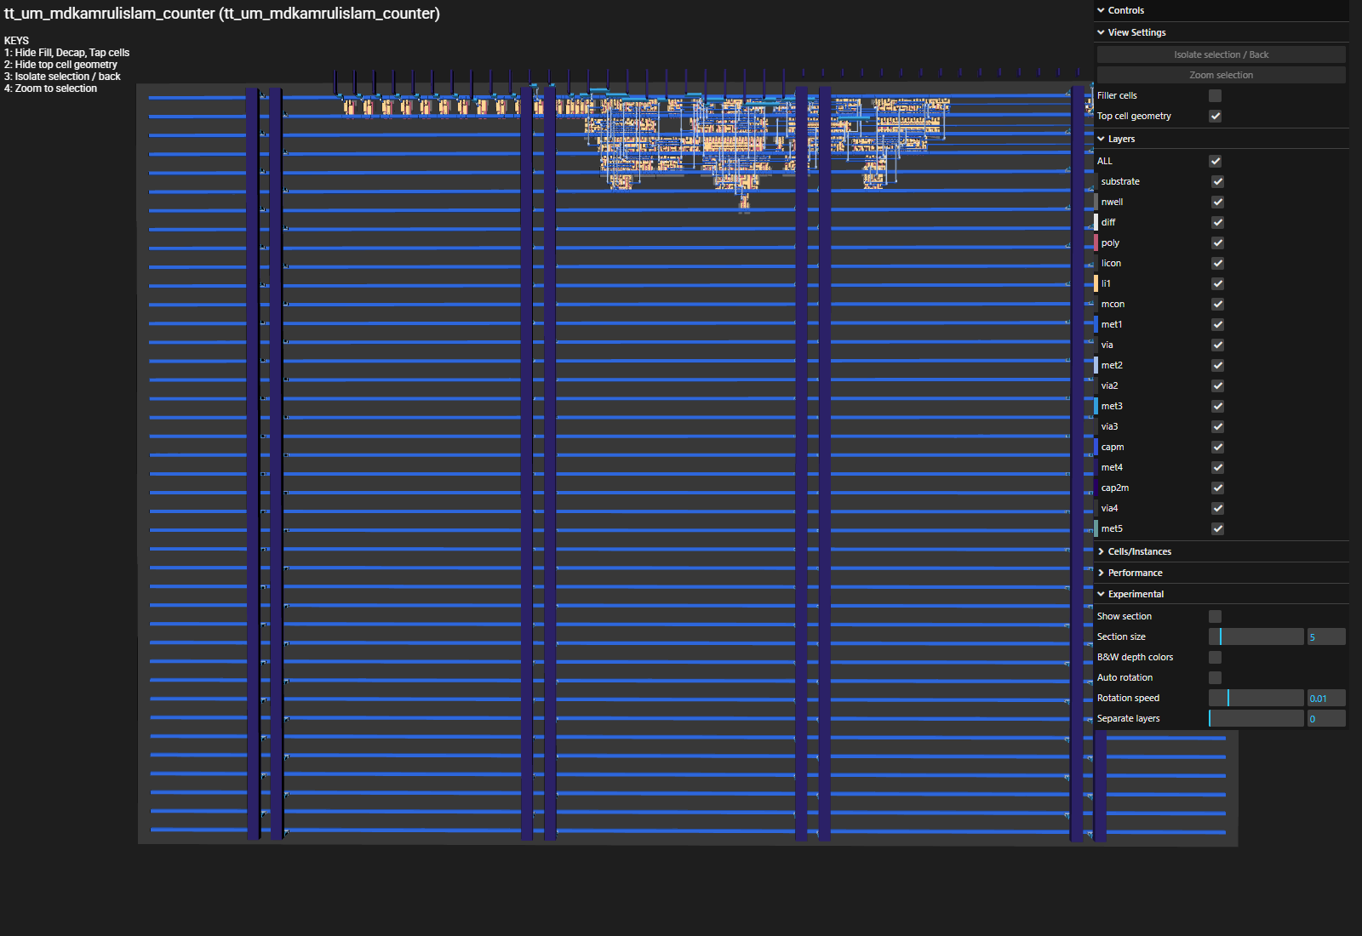
YOUR FIRST CHIP / BROWSER LAB
Step 12: explore layers and hide filler cells
1
Use the viewer's KEYS panel for pan, rotate and zoom.
2
Controls → View Settings → Filler cells: hide them to see logic.
3
Explore layer controls; compare the view with the build reports.
Actual native layout-viewer capture from 61ef06b; filler, decap, tap hidden using its own control.
CHECK You can distinguish visible geometry from claims made by tests and reports.
EE6019 • 8 October 2026 • Sources and teaching notes in PowerPoint
Open source ↗
110 / 195
Notes:
TEACHING NOTES
The layout viewer lets students examine geometric layers from the generated design. Use the visible KEYS instructions rather than assume every viewer has the same mouse gestures. Pan, rotate and zoom, then use Controls, View Settings and the Filler cells checkbox to reduce physical support-cell clutter. In the actual captured view, filler, decap and tap cells were hidden by the native control. This is a display choice; it does not remove them from the design or reduce the measured instance count. The reference's active logic is clustered near the top, with power rails across the tile. The genuine native browser capture comes from the layout published by GDS run 37693100748 at commit 61ef06bed008e76000f9ae46d65182e476d15dd6. The picture helps explain placement and wiring, while test and signoff reports establish other checked properties. If WebGL is unavailable, inspect the downloaded gds_render image while resolving the browser view.
MANUAL REFERENCE
Step 12 — Open and explore the layout
SOURCES / checked 8 October 2026
https://mdkamrulislam-web.github.io/tt-sky130-counter/
https://github.com/mdkamrulislam-web/tt-sky130-counter/actions/runs/37693100748
https://gds-viewer.tinytapeout.com/?pdk=sky130A&model=https%3A%2F%2Fmdkamrulislam-web.github.io%2Ftt-sky130-counter%2Ftinytapeout.oas
IMAGE PROVENANCE
{
"file": "img/18-real-layout.png",
"url": "https://gds-viewer.tinytapeout.com/?pdk=sky130A&model=https%3A%2F%2Fmdkamrulislam-web.github.io%2Ftt-sky130-counter%2Ftinytapeout.oas",
"type": "Actual native 3D layout viewer capture, fill/decap/tap hidden",
"date": "2026-10-08",
"sha256": "80d144f72e9ecd4706e13808379b7c6ac5ecff0a0087075201edb9804a550359"
}

Slide 111
YOUR FIRST CHIP / BROWSER LAB
Step 12: read the viewer’s keyboard controls
Read the actual KEYS panel: 1 hides fill, decap and tap cells. • The other keys hide top geometry, isolate a selection or zoom to it.
Native crop of the actual viewer’s KEYS panel; display choices do not change the layout file.
CHECK You can distinguish visible geometry from claims made by tests and reports.
EE6019 • 8 October 2026 • Sources and teaching notes in PowerPoint
Open source ↗
111 / 195
Notes:
TEACHING NOTES
The layout viewer lets students examine geometric layers from the generated design. Use the visible KEYS instructions rather than assume every viewer has the same mouse gestures. Pan, rotate and zoom, then use Controls, View Settings and the Filler cells checkbox to reduce physical support-cell clutter. In the actual captured view, filler, decap and tap cells were hidden by the native control. This is a display choice; it does not remove them from the design or reduce the measured instance count. The reference's active logic is clustered near the top, with power rails across the tile. The genuine native browser capture comes from the layout published by GDS run 37693100748 at commit 61ef06bed008e76000f9ae46d65182e476d15dd6. The picture helps explain placement and wiring, while test and signoff reports establish other checked properties. If WebGL is unavailable, inspect the downloaded gds_render image while resolving the browser view.
MANUAL REFERENCE
Step 12 — Open and explore the layout
SOURCES / checked 8 October 2026
https://mdkamrulislam-web.github.io/tt-sky130-counter/
https://github.com/mdkamrulislam-web/tt-sky130-counter/actions/runs/37693100748
https://gds-viewer.tinytapeout.com/?pdk=sky130A&model=https%3A%2F%2Fmdkamrulislam-web.github.io%2Ftt-sky130-counter%2Ftinytapeout.oas
IMAGE PROVENANCE
{
"file": "img/18-real-layout.png",
"url": "https://gds-viewer.tinytapeout.com/?pdk=sky130A&model=https%3A%2F%2Fmdkamrulislam-web.github.io%2Ftt-sky130-counter%2Ftinytapeout.oas",
"type": "Actual native 3D layout viewer capture, fill/decap/tap hidden",
"date": "2026-10-08",
"sha256": "80d144f72e9ecd4706e13808379b7c6ac5ecff0a0087075201edb9804a550359"
}

Slide 112
YOUR FIRST CHIP / BROWSER LAB
Step 12: find the Filler cells checkbox
1
Expand Controls, then View Settings.
2
Uncheck Filler cells to inspect the logic with the grouped support cells hidden.
3
The checked Top cell geometry control keeps the top-level shape visible.
Native crop of the actual viewer’s View Settings; the unchecked Filler cells control is visible.
CHECK You can distinguish visible geometry from claims made by tests and reports.
EE6019 • 8 October 2026 • Sources and teaching notes in PowerPoint
Open source ↗
112 / 195
Notes:
TEACHING NOTES
The layout viewer lets students examine geometric layers from the generated design. Use the visible KEYS instructions rather than assume every viewer has the same mouse gestures. Pan, rotate and zoom, then use Controls, View Settings and the Filler cells checkbox to reduce physical support-cell clutter. In the actual captured view, filler, decap and tap cells were hidden by the native control. This is a display choice; it does not remove them from the design or reduce the measured instance count. The reference's active logic is clustered near the top, with power rails across the tile. The genuine native browser capture comes from the layout published by GDS run 37693100748 at commit 61ef06bed008e76000f9ae46d65182e476d15dd6. The picture helps explain placement and wiring, while test and signoff reports establish other checked properties. If WebGL is unavailable, inspect the downloaded gds_render image while resolving the browser view.
MANUAL REFERENCE
Step 12 — Open and explore the layout
SOURCES / checked 8 October 2026
https://mdkamrulislam-web.github.io/tt-sky130-counter/
https://github.com/mdkamrulislam-web/tt-sky130-counter/actions/runs/37693100748
https://gds-viewer.tinytapeout.com/?pdk=sky130A&model=https%3A%2F%2Fmdkamrulislam-web.github.io%2Ftt-sky130-counter%2Ftinytapeout.oas
IMAGE PROVENANCE
{
"file": "img/18-real-layout.png",
"url": "https://gds-viewer.tinytapeout.com/?pdk=sky130A&model=https%3A%2F%2Fmdkamrulislam-web.github.io%2Ftt-sky130-counter%2Ftinytapeout.oas",
"type": "Actual native 3D layout viewer capture, fill/decap/tap hidden",
"date": "2026-10-08",
"sha256": "80d144f72e9ecd4706e13808379b7c6ac5ecff0a0087075201edb9804a550359"
}

Slide 113
YOUR FIRST CHIP / BROWSER LAB
Step 13: download layout, image and build logs
Completed gds run → Summary → Artifacts. • gds_render: the generated 2D layout PNG. • tt_submission: layout, netlist, identity and statistics. • GDS_logs: detailed build logs and reports.
Official GitHub Docs download-control example; the actual GDS run has the artifact names listed here.
CHECK Downloaded ZIPs are extracted and labelled with their source run.
EE6019 • 8 October 2026 • Sources and teaching notes in PowerPoint
Open source ↗
113 / 195
Notes:
TEACHING NOTES
A screenshot records only one view. The artifacts retain the design and evidence that allow later inspection. In the completed gds run, return to Summary and scroll to Artifacts. Download gds_render for the generated two-dimensional image, tt_submission for the layout and associated implementation data, and GDS_logs for detailed build information. Click each artifact name and extract the ZIP while signed in. The official GitHub image illustrates the download control with a generic artifact name; the actual Tiny Tapeout names are shown in the slide body. Reference artifacts come from run 37693100748 at commit 61ef06bed008e76000f9ae46d65182e476d15dd6. Students must use the matching run for their own source version. A generated rendering is different from the native interactive viewer, and both are different from a fabricated-chip photograph. Keep the files before their retention window expires, with the run link and commit saved alongside them.
MANUAL REFERENCE
Step 13 — Download the evidence, not just a screenshot
SOURCES / checked 8 October 2026
https://docs.github.com/en/actions/how-tos/manage-workflow-runs/download-workflow-artifacts
https://github.com/mdkamrulislam-web/tt-sky130-counter/actions/runs/37693100748
https://docs.github.com/assets/images/help/repository/artifact-drop-down-updated.png
IMAGE PROVENANCE
{
"file": "img/official-artifact-list.png",
"asset_url": "https://docs.github.com/assets/images/help/repository/artifact-drop-down-updated.png",
"source_page": "https://docs.github.com/en/actions/how-tos/manage-workflow-runs/download-workflow-artifacts",
"caption": "GitHub Docs: workflow artifact list",
"kind": "Official documentation screenshot; not our account capture",
"retrieved": "2026-10-08",
"bytes": 13990,
"sha256": "d8312994708b7b46b8d35404c2b0181100987daf095b2a90362312cd4756efef",
"content_type": "image/png"
}

Slide 114
YOUR FIRST CHIP / BROWSER LAB
Step 13: keep the verification artifacts too
1
gatelevel_test_results: mapped-design XML and waveform.
2
precheck_reports: Tiny Tapeout check results.
3
github-pages: packaged viewer files.
4
Also keep test → test-results and docs → PDF.
CHECK RTL, gate-level, precheck, documentation and viewer files remain distinguishable.
EE6019 • 8 October 2026 • Sources and teaching notes in PowerPoint
Open source ↗
114 / 195
Notes:
TEACHING NOTES
The physical workflow produces evidence beyond the layout. gatelevel_test_results contains the test results and waveform from checking the generated cell netlist. precheck_reports contains the Tiny Tapeout check results, including the fifteen passing reference checks. github-pages contains the files used for the published browser viewer. These are distinct artifacts from the separate RTL test workflow's test-results and the documentation workflow's PDF. Download from each corresponding run rather than look for every artifact in one workflow. The verified reference has GDS run 37693100748, RTL run 37693100752 and docs run 37693100755, all at commit 61ef06bed008e76000f9ae46d65182e476d15dd6. Name folders or save a small evidence index so a later reader can tell RTL from gate-level data. GitHub artifact retention can expire a download link. Keeping originals locally, together with their source identity, is a more useful archive than a collection of success screenshots alone.
MANUAL REFERENCE
Step 13 — Download the evidence, not just a screenshot
SOURCES / checked 8 October 2026
https://github.com/mdkamrulislam-web/tt-sky130-counter/actions/runs/37693100748
https://github.com/mdkamrulislam-web/tt-sky130-counter/actions/runs/37693100752
https://github.com/mdkamrulislam-web/tt-sky130-counter/actions/runs/37693100755
https://docs.github.com/en/actions/how-tos/manage-workflow-runs/download-workflow-artifacts

Slide 115
YOUR FIRST CHIP / BROWSER LAB
Step 13: inspect the submission bundle's identity
1
Extract tt_submission; find its contained tt_submission folder.
tt_submission/
tt_um_mdkamrulislam_counter.gds
tt_um_mdkamrulislam_counter.oas
tt_um_mdkamrulislam_counter.v
commit_id.json
pdk.json
stats/metrics.csv
stats/synthesis-stats.txt
2
Compare commit_id.json with the source/run commit.
3
Read pdk.json; keep layout, mapped Verilog and statistics together.
CHECK The bundle's identity matches the revision you tested and built.
EE6019 • 8 October 2026 • Sources and teaching notes in PowerPoint
Open source ↗
115 / 195
Notes:
TEACHING NOTES
Open the extracted tt_submission archive and follow its contained folder tree. Download or extraction tools may add a wrapper directory, so locate the inner tt_submission folder rather than assume a fixed number of outer levels. It contains the design's GDS and OAS layout files, mapped Verilog, other implementation files and metadata such as commit_id.json and pdk.json. The stats directory contains metrics.csv and synthesis-stats.txt. GDS and OAS describe physical layers; the Verilog file describes connected cells after mapping. The process metadata helps establish which PDK produced them. Compare the recorded commit with the workflow and source version before calling the bundle evidence for a design. The reference bundle belongs to GDS run 37693100748 at commit 61ef06bed008e76000f9ae46d65182e476d15dd6 and uses sky130A. The bundle's name does not mean it has been uploaded to a fabrication portal: downloading it is still within the free design exercise.
MANUAL REFERENCE
Step 13 — Download the evidence, not just a screenshot
SOURCES / checked 8 October 2026
https://github.com/mdkamrulislam-web/tt-sky130-counter/actions/runs/37693100748

Slide 116
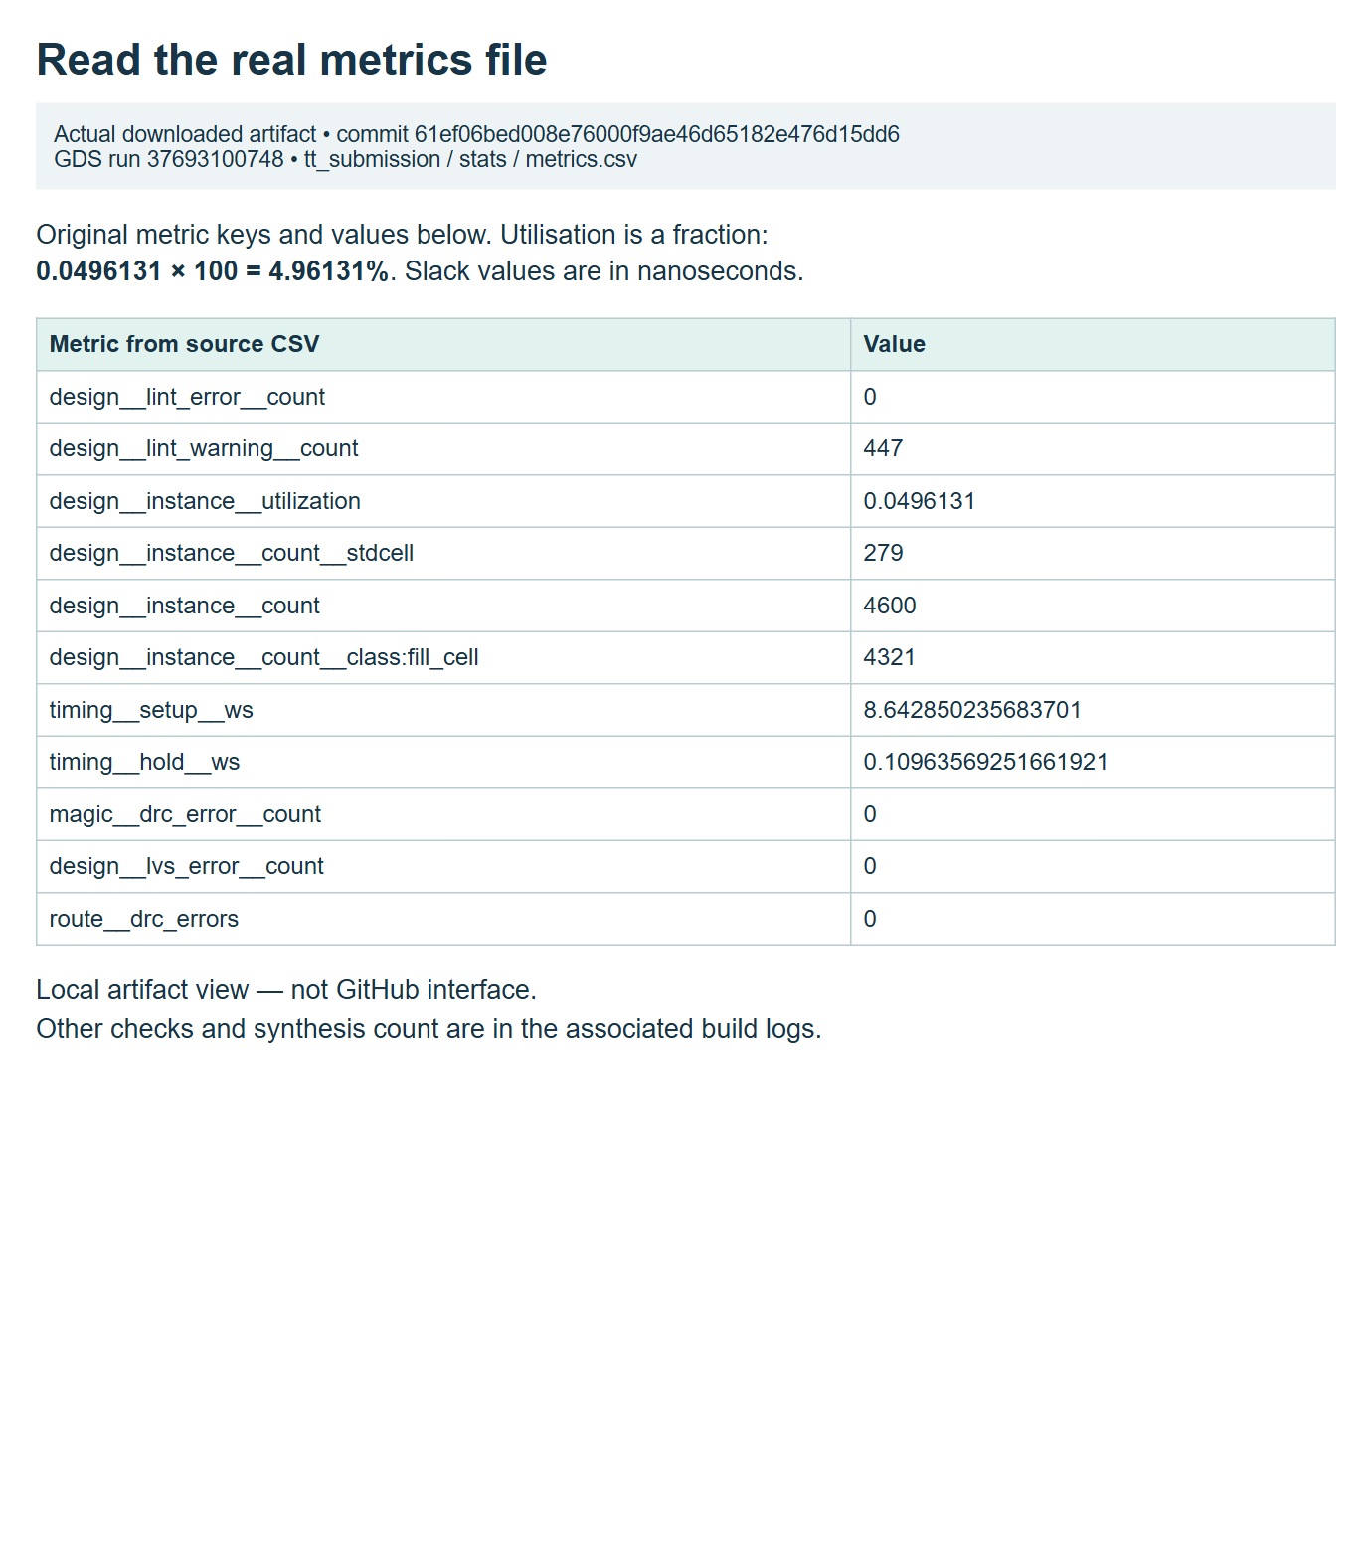
YOUR FIRST CHIP / BROWSER LAB
Step 14: read counts with their stage and category
47 cells after synthesis. • 279 final non-fill standard-cell instances, including 225 taps. • 4,600 total instances, including 4,321 filler cells. • Core utilisation: 0.0496131 × 100 ≈ 4.96%.
Local HTML view of unchanged metrics.csv from GDS run 37693100748, 61ef06b; not GitHub UI.
CHECK Every quoted count includes its build stage and what was counted.
EE6019 • 8 October 2026 • Sources and teaching notes in PowerPoint
Open source ↗
116 / 195
Notes:
TEACHING NOTES
These measurements describe the genuine reference implementation, not guaranteed results for every counter or future tool version. Synthesis reported forty-seven cells. The final physical implementation reported 279 non-fill standard-cell instances, including 225 tap cells, and 4,600 total instances including 4,321 fillers. Physical support cells appear during implementation, so the totals refer to different stages and categories. None should casually be called a number of logic gates. Core utilisation is reported non-fill cell area divided by available core area, approximately 4.96131 percent for this design. Hiding filler cells in the viewer does not change that report. The screenshot is a local HTML presentation of the unchanged downloaded metrics.csv, not a GitHub-generated metrics interface. Its source is GDS run 37693100748 at commit 61ef06bed008e76000f9ae46d65182e476d15dd6. Compare synthesis-stats.txt and metrics.csv from your own matching run when studying an extension.
MANUAL REFERENCE
Step 14 — Interpret the real counter's measurements
SOURCES / checked 8 October 2026
https://github.com/mdkamrulislam-web/tt-sky130-counter/actions/runs/37693100748
IMAGE PROVENANCE
{
"file": "img/17-real-metrics.png",
"url": "https://github.com/mdkamrulislam-web/tt-sky130-counter/actions/runs/37693100748",
"type": "Local browser view of unchanged downloaded metrics.csv",
"date": "2026-10-08",
"sha256": "7fecf97d5c2c344e7c8c75e41ba86fd68e1254a796cb53a3d45a7a7eee556eea"
}

Slide 117
YOUR FIRST CHIP / BROWSER LAB
Step 14: read timing, geometry and warnings
50 MHz target: setup/hold slack +8.64285/+0.109636 ns.
Reported setup/hold violations: 0/0; Magic DRC/LVS errors: 0/0.
Precheck: all 15 passed; review warnings separately.
CHECK Quote units and checked conditions; distinguish warnings from failures.
EE6019 • 8 October 2026 • Sources and teaching notes in PowerPoint
Open source ↗
117 / 195
Notes:
TEACHING NOTES
Timing and layout checks answer different questions. Setup and hold slack report margins against the timing constraints and models used for this implementation. The reference worst margins are positive: approximately 8.64285 nanoseconds for setup and 0.109636 nanoseconds for hold, with zero reported violations. Magic DRC reports geometry checks against manufacturing rules, while LVS compares the layout's extracted connections to the intended circuit. Both reported zero errors in this run. Tiny Tapeout precheck passed all fifteen checks. These statements belong to GDS run 37693100748 at commit 61ef06bed008e76000f9ae46d65182e476d15dd6 and should be quoted with that context. The lint report also had zero errors and 447 TIMESCALEMOD warnings from inherited timescale and generated cell modules. A green result does not mean every warning count is zero. Read and classify warnings rather than hide them. These checks support a design result under the recorded conditions; they are separate from testing a manufactured chip.
MANUAL REFERENCE
Step 14 — Interpret the real counter's measurements
SOURCES / checked 8 October 2026
https://github.com/mdkamrulislam-web/tt-sky130-counter/actions/runs/37693100748

Slide 118
YOUR FIRST CHIP / BROWSER LAB
Step 15: start with the first useful error
1
Open the failed job and expand its first failing step.
2
Our first blank-template failure was empty metadata.
3
Finish the seven files; inspect the complete final commit.
4
Fix the cause before reading downstream skipped jobs.
CHECK Explain the error and the revision it belongs to before changing a file.
EE6019 • 8 October 2026 • Sources and teaching notes in PowerPoint
Open source ↗
118 / 195
Notes:
TEACHING NOTES
Failures are useful when they are tied to a concrete stage and saved version. The genuine initial blank-template GDS run 37693066241 failed metadata validation because title, author and description were empty. Initial docs run 37693066333 also needed meaningful pin descriptions and documentation content. Those runs belonged to blank main commit 799863810d7ef1761fb9f5b8241fbb386223a2c7, before the complete counter was saved. They are not failed assertions in the finished counter. The final counter commit 61ef06bed008e76000f9ae46d65182e476d15dd6 passed its workflows. Students should open the failing job, find the first useful message and identify whether the issue is validation, compilation, testing, physical implementation or deployment. A later missing log or skipped job may simply follow an earlier failure. Completing all seven files and checking the new final run resolves an incomplete template state. Repeating an unchanged deterministic failure does not supply missing metadata or correct a source error.
MANUAL REFERENCE
Step 15 — Troubleshoot one cause at a time
SOURCES / checked 8 October 2026
https://github.com/mdkamrulislam-web/tt-sky130-counter/actions/runs/37693066241
https://github.com/mdkamrulislam-web/tt-sky130-counter/actions/runs/37693066333
https://github.com/mdkamrulislam-web/tt-sky130-counter/actions/runs/37693100748

Slide 119
YOUR FIRST CHIP / BROWSER LAB
Step 15: match the symptom to its cause
Unknown module: check both source lists and all three top names.
Docs validation: check metadata, pin labels and required sections.
Count mismatch: predict reset/enable behaviour at the sampled edge.
Commit the fix; keep the assertion and inspect the new run.
CHECK One justified fix creates one new version whose results can be evaluated.
EE6019 • 8 October 2026 • Sources and teaching notes in PowerPoint
Open source ↗
119 / 195
Notes:
TEACHING NOTES
These are conditional troubleshooting routes, not fabricated failures in the verified counter. An unknown-module or missing-file message usually calls for checking compile lists, filenames and the matching top declaration and testbench instance. A documentation validation message calls for checking title, author, description, pin keys and the required Markdown sections. A count assertion mismatch requires reading the expected and observed values and tracing reset and enable at the relevant clock edge. In the supplied test, inputs are driven at a falling edge and outputs sampled after the rising edge plus settling time. If RTL passes but the mapped-cell test fails, examine those timing assumptions and top-level checks rather than immediately weakening the test. Preserve the assertion while fixing the source or test-model cause. The unchanged reference passed RTL run 37693100752 and GDS run 37693100748 at commit 61ef06bed008e76000f9ae46d65182e476d15dd6. Record a real future failure accurately if an extension exposes one.
MANUAL REFERENCE
Step 15 — Troubleshoot one cause at a time
SOURCES / checked 8 October 2026
https://github.com/mdkamrulislam-web/tt-sky130-counter/actions/runs/37693100752
https://github.com/mdkamrulislam-web/tt-sky130-counter/actions/runs/37693100748
https://github.com/mdkamrulislam-web/tt-sky130-counter/blob/61ef06bed008e76000f9ae46d65182e476d15dd6/test/test.py

Slide 120
YOUR FIRST CHIP / BROWSER LAB
Step 15: fix Pages or a blank viewer
1
Deployment failure: confirm Pages Source = GitHub Actions.
2
Multiple github-pages artifacts after a viewer rerun: start a fresh full GDS run.
3
Blank WebGL view: wait, check viewer success, then try another browser.
4
Use the downloaded gds_render PNG while investigating.
CHECK Identify deployment or rendering first, then use the matching remedy.
EE6019 • 8 October 2026 • Sources and teaching notes in PowerPoint
Open source ↗
120 / 195
Notes:
TEACHING NOTES
Separate a publishing failure from a browser rendering failure. If the viewer job failed, inspect its first deployment error and verify Settings, Pages, Source is GitHub Actions. Tiny Tapeout documents a particular problem after enabling Pages and rerunning only viewer on an existing GDS workflow: multiple github-pages artifacts may conflict. In that case use a fresh complete workflow run after correcting the setting, rather than repeatedly rerun the old viewer job. A successful deployment with a blank browser canvas is a different issue. Wait for loading, check WebGL support and try a suitable browser. Downloaded gds_render provides a genuine static layout image while investigating interactive rendering. These are troubleshooting instructions; no new failure was manufactured for a screenshot. The reference viewer was successfully published by GDS run 37693100748 at commit 61ef06bed008e76000f9ae46d65182e476d15dd6. The next slide shows how to deliberately start the complete workflow on the intended branch.
MANUAL REFERENCE
Step 15 — Troubleshoot one cause at a time
SOURCES / checked 8 October 2026
https://tinytapeout.com/faq/#my-github-action-is-failing-on-the-pages-part
https://tinytapeout.com/faq/#my-viewer-job-fails-after-enabling-github-pages-and-rerunning-it-on-an-existing-gds-action
https://github.com/mdkamrulislam-web/tt-sky130-counter/actions/runs/37693100748

Slide 121
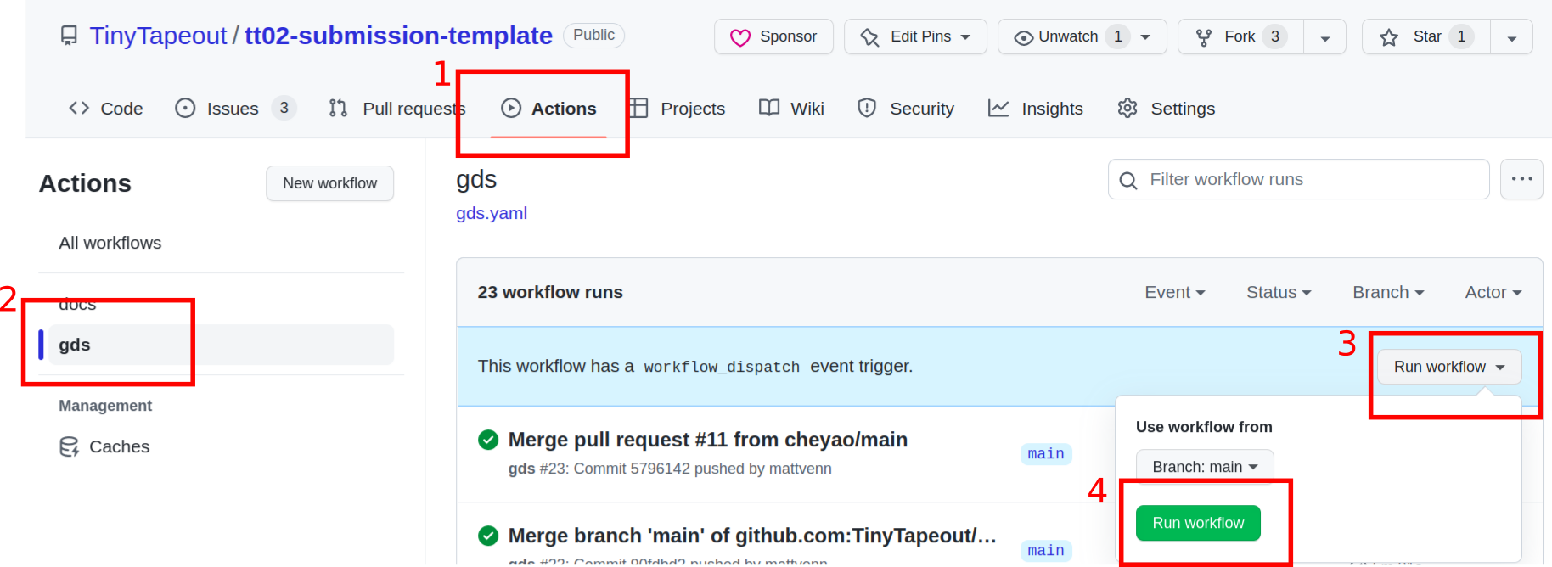
YOUR FIRST CHIP / BROWSER LAB
Step 15: deliberately start a fresh complete run
Actions → choose gds in the workflow list. • Select Run workflow; choose the intended branch. • Select Run workflow in that menu. • Check the new run uses your intended saved commit.
Official Tiny Tapeout FAQ image: Run workflow controls in an older example repository.
CHECK The fresh run belongs to the branch and complete saved version you intended.
EE6019 • 8 October 2026 • Sources and teaching notes in PowerPoint
Open source ↗
121 / 195
Notes:
TEACHING NOTES
Manual workflow dispatch is useful after a relevant settings fix or when a fresh full run is specifically needed. Open Actions, select gds in the left workflow list, then use Run workflow. Choose the intended branch and click Run workflow in the menu. This needs write permission and starts the recipe using current saved files on that branch. It does not save an unsaved editor buffer or select the author's historical commit automatically. The official Tiny Tapeout FAQ image illustrates the control in an older example repository. It is not a capture of a new paid or fabrication operation, and it does not represent another run performed for the reference evidence. For a source change, saving a new commit normally starts the template workflows already. Repeatedly rerunning unchanged source is not a solution to a deterministic compile or assertion error. After dispatch, open the newly created run and verify its branch and commit before interpreting its result.
MANUAL REFERENCE
Step 15 — Troubleshoot one cause at a time
SOURCES / checked 8 October 2026
https://tinytapeout.com/faq/#i-updated-and-saved-my-wokwi-design-how-do-i-re-run-the-github-action-to-update-the-gds-files
https://docs.github.com/en/actions/how-tos/manage-workflow-runs/manually-running-a-workflow
https://tinytapeout.com/images/faq/rerun_actions.png
IMAGE PROVENANCE
{
"file": "img/official-run-workflow.png",
"asset_url": "https://tinytapeout.com/images/faq/rerun_actions.png",
"source_page": "https://tinytapeout.com/faq/#i-updated-and-saved-my-wokwi-design-how-do-i-re-run-the-github-action-to-update-the-gds-files",
"caption": "Tiny Tapeout FAQ: Run workflow controls",
"kind": "Official documentation screenshot; not our account capture",
"retrieved": "2026-10-08",
"bytes": 212676,
"sha256": "f2e60311a40e6a076c2e2b1efe776fc8588c9d7b40dc85d2cda9852f8021fb42",
"content_type": "image/png"
}

Slide 122
YOUR FIRST CHIP / BROWSER LAB
Step 16: optional local setup in Ubuntu or WSL
sudo apt-get update
sudo apt-get install -y git python3 python3-venv
sudo apt-get install -y python3-pip make iverilog
git clone https://github.com/YOUR_USERNAME/YOUR_REPOSITORY.git
cd YOUR_REPOSITORY
git rev-parse HEAD
Use an Ubuntu/WSL terminal; these are Linux commands. • On your own machine install prerequisites below; managed labs use supplied tools. • Replace the URL placeholders, clone your project and enter its root.
CHECK The project root contains info.yaml, src and test; record the checked-out commit.
EE6019 • 8 October 2026 • Sources and teaching notes in PowerPoint
Open source ↗
122 / 195
Notes:
TEACHING NOTES
The main browser route is already complete without local tool installation. Local simulation is optional for quicker edit and test cycles or to understand what the Actions job runs. These commands use Ubuntu, including an already configured WSL environment on Windows; they are not PowerShell commands. On a managed laboratory machine, use the supplied environment rather than changing system packages. On an owned Ubuntu machine, the shown package installation supplies Git, Python, virtual-environment support, make and Icarus Verilog. Python packages alone do not install the simulator. Replace YOUR_USERNAME and YOUR_REPOSITORY with the student's completed repository, clone it and enter its root. git rev-parse HEAD identifies the checked-out saved version. If using another branch, select it before testing. The reference CI uses Ubuntu 24.04 and Python 3.11; a different local environment is not automatically an identical reproduction. Appendix B provides the fuller tool checks and explanations.
MANUAL REFERENCE
Step 16 — Choose whether you need local simulation
SOURCES / checked 8 October 2026
https://github.com/TinyTapeout/ttsky-verilog-template/blob/68c3fd3f3ec640e5edcb6a5f74f360ebc016bb2a/.github/workflows/test.yaml
https://github.com/TinyTapeout/ttsky-verilog-template/blob/68c3fd3f3ec640e5edcb6a5f74f360ebc016bb2a/test/README.md

Slide 123
YOUR FIRST CHIP / BROWSER LAB
Step 16: run RTL, then explicitly check XML
1
From the project root, create and activate the Python environment.
python3 -m venv .venv
source .venv/bin/activate
python -m pip install -r test/requirements.txt
cd test
make -B
python -m cocotb_tools.check_results results.xml
2
Install the template test requirements; run inside test.
3
Keep results.xml and tb.fst; use Actions gl_test for the first mapped-cell result.
CHECK Inside test: results.xml and tb.fst exist; the explicit checker succeeds.
EE6019 • 8 October 2026 • Sources and teaching notes in PowerPoint
Open source ↗
123 / 195
Notes:
TEACHING NOTES
Create an isolated Python environment in the project root and activate it for the current terminal. Install the requirements from the template's test/requirements.txt rather than independently selecting a newer cocotb release. The reference pins cocotb 2.1.0 and pytest 8.4.2. Change into test, run make -B to compile and execute the test, then explicitly run the cocotb results checker. The final command reads results.xml and signals failure if a test failed; make completion alone may be insufficient. For the unchanged reference, expect one passing test, zero failures and errors, and an FST waveform, with 11,368 nanoseconds of simulated time. The same browser Surfer procedure can open the local FST. Local mapped-cell testing additionally needs the matching generated netlist and installed SKY130 cell models. The main Actions gl_test job prepares those dependencies automatically. Local runs do not upload edits: a later GitHub result needs the saved new repository version.
MANUAL REFERENCE
Step 16 — Choose whether you need local simulation
SOURCES / checked 8 October 2026
https://github.com/TinyTapeout/ttsky-verilog-template/blob/68c3fd3f3ec640e5edcb6a5f74f360ebc016bb2a/test/requirements.txt
https://github.com/mdkamrulislam-web/tt-sky130-counter/blob/61ef06bed008e76000f9ae46d65182e476d15dd6/test/Makefile
https://github.com/mdkamrulislam-web/tt-sky130-counter/actions/runs/37693100752

Slide 124
YOUR FIRST CHIP / BROWSER LAB
Step 17: specify one small extension first
1
Example: an enabled count-down counter, with 0 wrapping to 255.
WORKED EXAMPLE
Define reset priority, hold and the new terminal flag.
Proposed count-down boundary: count 0, enable 1, reset released → next count 255.
2
3
Keep the fixed Tiny Tapeout interface.
4
Predict boundary cases before editing RTL.
CHECK Your written rules specify both the stored count and the combinational flag.
EE6019 • 8 October 2026 • Sources and teaching notes in PowerPoint
Open source ↗
124 / 195
Notes:
TEACHING NOTES
An extension should start with a new specification, not a random change to an operator. For a count-down counter, define what an enabled rising edge does at zero: an eight-bit unsigned count wraps to 255. Retain explicit reset and hold behaviour, and decide what the terminal indication means for the new direction. A useful choice is a flag high at enabled zero before the edge underflows. That would require changing the old all-ones flag expression as well as the arithmetic. A parallel-load design is another possible exercise, but choose one coherent change at a time and allocate its input pins deliberately. The fixed Tiny Tapeout port interface remains. These are proposed learning extensions, not a claim that the downloaded reference already implements them. The passing evidence at commit 61ef06bed008e76000f9ae46d65182e476d15dd6 is for the original incrementing counter. Ask students to write expected values for reset, hold, a normal decrement and the zero boundary before coding.
MANUAL REFERENCE
Step 17 — Make a small extension after the example passes
SOURCES / checked 8 October 2026
https://github.com/mdkamrulislam-web/tt-sky130-counter/blob/61ef06bed008e76000f9ae46d65182e476d15dd6/src/counter.v
https://github.com/mdkamrulislam-web/tt-sky130-counter/blob/61ef06bed008e76000f9ae46d65182e476d15dd6/test/test.py

Slide 125
YOUR FIRST CHIP / BROWSER LAB
Step 17: update, commit and recheck the extension
1
Update RTL, Python model/assertions, metadata and datasheet together.
2
New files need both source lists; renamed tops need all three locations.
3
Commit; check test, docs and all four gds jobs for that version.
4
Compare its own cell counts and utilisation.
CHECK The extension has its own matching source, tests, documents and layout evidence.
EE6019 • 8 October 2026 • Sources and teaching notes in PowerPoint
Open source ↗
125 / 195
Notes:
TEACHING NOTES
A changed circuit needs changed verification and documentation. For the proposed count-down version, update the hardware and independently calculate decrementing expected values in the Python model, including the chosen terminal flag. Add assertions for normal transitions, hold, reset priority and the new boundary. If the interface mapping changes, keep YAML pin labels and docs/info.md in agreement. Additional hardware files need both source lists; a renamed top needs all three matching module-name locations. Save the complete extension as a new commit, then inspect its test and docs workflows and all four jobs in gds. Compare measurements from that same run with the original reference. Do not attach a screenshot from the original incrementing counter as proof that the extension passed. The reference comparison is commit 61ef06bed008e76000f9ae46d65182e476d15dd6 with GDS run 37693100748, RTL run 37693100752 and docs run 37693100755. Keep the two versions' evidence separate.
MANUAL REFERENCE
Step 17 — Make a small extension after the example passes
SOURCES / checked 8 October 2026
https://github.com/mdkamrulislam-web/tt-sky130-counter/blob/61ef06bed008e76000f9ae46d65182e476d15dd6/test/test.py
https://github.com/mdkamrulislam-web/tt-sky130-counter/actions/runs/37693100752
https://github.com/mdkamrulislam-web/tt-sky130-counter/actions/runs/37693100755
https://github.com/mdkamrulislam-web/tt-sky130-counter/actions/runs/37693100748

Slide 126
YOUR FIRST CHIP / BROWSER LAB
Step 18: archive one checked revision
1
Record repository, branch, full commit and the three run links.
2
Keep datasheet, XML, FST, layout/netlist, metrics and build logs.
3
Keep precheck reports and source/provenance manifests.
4
Label original-counter and extension evidence separately.
CHECK Another person can identify the version and reopen its original evidence.
EE6019 • 8 October 2026 • Sources and teaching notes in PowerPoint
Open source ↗
126 / 195
Notes:
TEACHING NOTES
The free exercise ends with an archive someone else can inspect. Save the repository URL, intended branch and full commit, then retain links to the matching test, docs and gds runs. Download the generated datasheet, RTL and mapped-cell test results and waveforms, layout and cell netlist, process and commit metadata, metrics, detailed logs and precheck reports. Keep the original source files and the starter checksum and screenshot-provenance manifests with the teaching package. Artifacts may expire, so make the archive while the downloads are available. The author's reference is commit 61ef06bed008e76000f9ae46d65182e476d15dd6, RTL run 37693100752, docs run 37693100755 and GDS run 37693100748. Student versions have different identities and should be labelled accordingly. An attractive layout screenshot is useful context but cannot replace the downloadable evidence. Technical and visual review of this teaching example has been performed; an observed beginner usability trial remains a separate evaluation.
MANUAL REFERENCE
Step 18 — Finish the free exercise here
SOURCES / checked 8 October 2026
https://github.com/mdkamrulislam-web/tt-sky130-counter/actions/runs/37693100752
https://github.com/mdkamrulislam-web/tt-sky130-counter/actions/runs/37693100755
https://github.com/mdkamrulislam-web/tt-sky130-counter/actions/runs/37693100748
https://docs.github.com/en/actions/how-tos/manage-workflow-runs/download-workflow-artifacts

Slide 127
YOUR FIRST CHIP / BROWSER LAB
Step 18: stop before fabrication actions
1
The free result is a tested, checked and archived layout.
2
Fabrication needs a separate approved order and submitted revision.
3
A later GitHub commit does not automatically replace a submitted revision.
4
Stop before payment, ordering or fabrication submission.
CHECK You can explain the completed design result and the separate fabrication boundary.
EE6019 • 8 October 2026 • Sources and teaching notes in PowerPoint
Open source ↗
127 / 195
Notes:
TEACHING NOTES
Successful GitHub recipes produce design files and evidence. They do not place an order or submit a revision to a fabrication shuttle. Standard public-repository hosted Actions compute supports the free practical route, subject to GitHub's storage allowances. The later Tiny Tapeout portal route separates project or order creation from submitting a design revision, and later source commits need an explicit new submission if the intended fabrication version changes. The manual explains that boundary for understanding, but this classroom exercise ends with the checked archive. No payment, fabrication order or fabrication submission was performed for the verified counter. The reference evidence remains commit 61ef06bed008e76000f9ae46d65182e476d15dd6 and its successful test, docs and GDS runs. Ask students to describe what they have actually produced: source, tests, documentation, physical layout and reports. Any future fabrication decision requires its own approved process and should begin by identifying the exact checked revision.
MANUAL REFERENCE
Step 18 — Finish the free exercise here
SOURCES / checked 8 October 2026
https://tinytapeout.com/guides/advanced-workshop/submit-your-design/
https://docs.github.com/en/billing/concepts/product-billing/github-actions
https://github.com/mdkamrulislam-web/tt-sky130-counter/actions/runs/37693100748

Slide 128
YOUR FIRST CHIP / PHYSICAL DESIGN
Follow one design through changing representations
RTL
Netlist
Layout
Reports
Describes state and logic
Names cells and connections
Places cells and wires
Check the implementation
The counter's specified behaviour stays the same. • Each stage produces a different kind of evidence.
CHECK Which artifact contains geometry rather than behaviour?
EE6019 • 8 October 2026 • Sources and teaching notes in PowerPoint
Open source ↗
128 / 195
Notes:
TEACHING NOTES
Begin with the familiar counter rather than with tool names. The specification says what should happen at a rising edge: reset clears the count, otherwise enable increments it, otherwise the stored value remains. RTL expresses this rule. Synthesis chooses library cells and connects them, producing a netlist. Physical tools then decide where those cells go and how their connections become wires. The layout describes manufacturing geometry. Reports and tests answer questions about that implementation. Explain that these are representations of one design, with different purposes. A netlist is not a screenshot, and a layout file is not a Python program that counts when opened. Ask students to classify counter.v, an implemented Verilog netlist, a GDS file and a timing report. The answer to the visible check is the layout artifact. Keep this distinction available throughout the following stages: a pretty layout does not replace behaviour, timing or connectivity evidence.
MANUAL REFERENCE
Part 3 — Understand what the layout build actually did
SOURCES / checked 8 October 2026
https://librelane.readthedocs.io/en/latest/glossary.html
https://github.com/mdkamrulislam-web/tt-sky130-counter/tree/61ef06bed008e76000f9ae46d65182e476d15dd6

Slide 129
YOUR FIRST CHIP / PHYSICAL DESIGN
Synthesis starts from a precise update rule
1
Eight count bits need stored state.
always @(posedge clk) begin
if (rst)
count <= {WIDTH{1'b0}};
else if (en)
count <= count + 1'b1;
end
assign wrap = en & (&count);
2
Reset and enable decide the next stored value.
3
The terminal-count expression becomes combinational logic.
CHECK At count 255 with enable low: count holds; wrap is low.
EE6019 • 8 October 2026 • Sources and teaching notes in PowerPoint
Open source ↗
129 / 195
Notes:
TEACHING NOTES
Connect the physical chapter to the RTL students already understand. The clocked block describes storage whose value changes at a rising edge. Its branches define priority: reset first, then enable. When neither branch updates count, the storage holds its value. Synthesis must preserve this behaviour while implementing it with cells available in the selected library. Do not promise that one source statement becomes exactly one gate; optimisation may combine expressions or choose a different arrangement of cells. The continuous assignment for wrap describes an output dependent on current count and enable. It is not another register. Work the visible terminal-count case: all count bits are one, but enable is zero, so the AND expression makes wrap zero while count stays at 255. Explain that synthesis needs a supported hardware description and the correct top module and source files. A syntactically valid file alone does not establish the intended circuit.
MANUAL REFERENCE
3.1 From behaviour to actual gates: synthesis
SOURCES / checked 8 October 2026
https://github.com/mdkamrulislam-web/tt-sky130-counter/blob/61ef06bed008e76000f9ae46d65182e476d15dd6/src/counter.v
https://librelane.readthedocs.io/en/latest/glossary.html

Slide 130
YOUR FIRST CHIP / PHYSICAL DESIGN
The synthesis result reports 47 cells
1
The reference synthesis report contains 47 cells.
WORKED EXAMPLE
47 synthesis cells ≠ 4,600 final physical instances.
2
Its netlist names instances and the wires connecting them.
3
Placement, clock distribution and routing still follow.
CHECK Find the synthesis summary in GDS_logs; record its commit.
EE6019 • 8 October 2026 • Sources and teaching notes in PowerPoint
Open source ↗
130 / 195
Notes:
TEACHING NOTES
Use the real result to establish the meaning of a cell count before introducing several different counts later. The synthesis report for reference commit 61ef06b contains 47 cells. This is a result of this RTL, library, tool version and configuration. It is not a measured property of a manufactured counter, and it is not a universal size for every eight-bit counter. A cell instance is one use of a library circuit; examples include storage elements and logic gates. The synthesis netlist gives names and connections but does not yet provide the completed physical positions and routed wires. Physical implementation also introduces support cells, which explains why the final instance count is much larger. Ask students to open their GDS run's synthesis logs, search for the cell statistics and associate the result with their own commit. Missing or unmapped cells and synthesis errors should be resolved before treating later output as evidence.
MANUAL REFERENCE
3.1 From behaviour to actual gates: synthesis
SOURCES / checked 8 October 2026
https://github.com/mdkamrulislam-web/tt-sky130-counter/actions/runs/37693100748
https://librelane.readthedocs.io/en/latest/reference/flows.html#classic

Slide 131
YOUR FIRST CHIP / PHYSICAL DESIGN
The PDK connects the tools to a manufacturing process
1
A PDK supplies process layers, rules, models and technology data.
WORKED EXAMPLE
Changing a filename cannot turn SKY130 geometry into IHP geometry.
2
A standard-cell library supplies reusable digital circuits.
3
This template uses SKY130 and its high-density cell library.
CHECK Record sky130A, the library and the PDK/tool versions.
EE6019 • 8 October 2026 • Sources and teaching notes in PowerPoint
Open source ↗
131 / 195
Notes:
TEACHING NOTES
Spell out process design kit before using PDK as shorthand. It contains the information tools need to represent a particular manufacturing process, including layers and rules. The standard-cell library supplies circuits characterised for that process. Synthesis can choose those circuits, while physical tools use their geometry and electrical information. This worked example uses the official SKY130 template and sky130A. Explain why the technology choice is consequential: moving to another process means using the appropriate template, libraries and configuration, then rebuilding and checking the design. Renaming an existing GDS file does none of that work. Clarify that 130 nm names a process family; it does not mean every shape in the layout is exactly 130 nm wide. Have students locate the PDK and tool information in their downloaded submission package and record it with the full commit. This makes the result reproducible and prevents unrelated runs from being compared as if their conditions were identical.
MANUAL REFERENCE
3.2 The PDK: the rules for a particular manufacturing process
SOURCES / checked 8 October 2026
https://github.com/TinyTapeout/ttsky-verilog-template/tree/68c3fd3f3ec640e5edcb6a5f74f360ebc016bb2a
https://skywater-pdk.readthedocs.io/en/main/
https://librelane.readthedocs.io/en/latest/glossary.html

Slide 132
YOUR FIRST CHIP / PHYSICAL DESIGN
Floorplanning establishes the space and interfaces
Floorplan = boundary + usable core + pins + power plan.
Tiny Tapeout provides a fixed tile within a larger shared chip.
Boundary
Limits the tile
Tile boundary
Usable core
Core / rows
Legal cell positions
Pins
External connections
Power rails
Distribute supply
Conceptual diagram — not measured geometry
CHECK A tile is one part of a shared chip.
EE6019 • 8 October 2026 • Sources and teaching notes in PowerPoint
Open source ↗
132 / 195
Notes:
TEACHING NOTES
Introduce floorplanning with the idea of planning a room before placing furniture. The boundary describes the region, the usable core provides space for cell rows, pins connect the design to its surroundings, and power needs a distribution plan. Mark this as an analogy: actual tools also obey electrical and process rules. In Tiny Tapeout, students start within a defined tile and a fixed interface, rather than drawing any outline they want. The shared chip contains other user designs and selection infrastructure as well. Therefore the reported core utilisation for the counter is not its percentage of the complete manufactured chip. Ask students to distinguish tile, core and shared chip in an illustrative diagram. Do not label that teaching diagram as the measured reference floorplan. If a design does not fit, confirm the intended design and tile configuration, then read the reported cause before changing dimensions or density settings.
MANUAL REFERENCE
3.3 Floorplanning: choose the usable space and place the interfaces
SOURCES / checked 8 October 2026
https://librelane.readthedocs.io/en/latest/glossary.html
https://tinytapeout.com/hdl/templates/
https://github.com/mdkamrulislam-web/tt-sky130-counter/actions/runs/37693100748

Slide 133
YOUR FIRST CHIP / PHYSICAL DESIGN
Placement must leave room for connections
1
Place cell instances in legal rows and positions.
WORKED EXAMPLE
A small netlist can still be awkward to place or route.
2
Keep connected cells sensibly arranged.
3
Cell area, wiring space and timing all affect the result.
CHECK Read a placement failure before changing density or tile size.
EE6019 • 8 October 2026 • Sources and teaching notes in PowerPoint
Open source ↗
133 / 195
Notes:
TEACHING NOTES
Placement decides physical positions for the cell instances. Explain legal placement as fitting cells into permitted rows without forbidden overlaps or invalid positions. Connected cells benefit from sensible separation, but minimising one wire is not the only requirement: all cells and connections must share the region, meet physical rules and support timing. A design can contain relatively little cell area yet create difficult wiring. This is why utilisation alone is not proof that an extension will succeed. Use an illustrative arrangement of a few labelled storage and logic cells to show how moving a cell changes connection lengths; do not present invented positions as the actual counter placement. For troubleshooting, first identify whether the reported failure concerns legality, congestion, dimensions or timing. Blindly changing a density value can move the failure into a later stage. Students should keep the source and configuration version associated with every placement result they discuss.
MANUAL REFERENCE
3.4 Placement: put the cells in legal positions
SOURCES / checked 8 October 2026
https://librelane.readthedocs.io/en/latest/glossary.html
https://librelane.readthedocs.io/en/latest/reference/flows.html#classic

Slide 134
YOUR FIRST CHIP / PHYSICAL DESIGN
Calculate what 4.96131% utilisation means
1
Reported core utilisation: 4.96131%.
WORKED EXAMPLE
818.285 µm² ÷ 16,493.3 µm² × 100 ≈ 4.96131%
2
Counted area includes physical support cells such as taps.
3
It is not a percentage of the entire shared chip.
CHECK The remaining 95% is not guaranteed capacity for any extension.
EE6019 • 8 October 2026 • Sources and teaching notes in PowerPoint
Open source ↗
134 / 195
Notes:
TEACHING NOTES
Work the arithmetic slowly and retain the units. The numerator is the reported non-filler standard-cell area, approximately 818.285 square micrometres. The denominator is the core area, approximately 16,493.3 square micrometres. Dividing areas and multiplying by 100 gives approximately 4.96131 percent. These are reference-run results, not a pixel measurement from a screenshot. The counted area includes physical support cells such as taps, so this figure should not be called logic-only occupancy. It also refers to the core, rather than the entire shared Tiny Tapeout chip. Explain the practical limit of the conclusion: a low utilisation figure provides useful evidence of a small implementation, but routing, pin access, clocking, power and constraints can limit an extension. Ask students to repeat the calculation from their own metrics and state both numerator and denominator. An unqualified statement that 95 percent is free for anything would overstate the evidence.
MANUAL REFERENCE
3.4 Placement: put the cells in legal positions
SOURCES / checked 8 October 2026
https://github.com/mdkamrulislam-web/tt-sky130-counter/actions/runs/37693100748
https://skywater-pdk.readthedocs.io/en/main/contents/libraries/sky130_fd_sc_hd/cells/tapvpwrvgnd/README.html

Slide 135
YOUR FIRST CHIP / PHYSICAL DESIGN
A clock tree distributes the sampling event
One clock must reach many storage elements.
Buffers distribute load; physical clock arrivals can differ.
Flip-flop 1
Buffer
Clock
Buffer
Flip-flop 2
Buffer
Flip-flop 3
Flip-flop 4
Skew = difference between clock arrival times.
Conceptual branching tree — not the reference clock network
CHECK RTL's single clock name does not imply zero physical skew.
EE6019 • 8 October 2026 • Sources and teaching notes in PowerPoint
Open source ↗
135 / 195
Notes:
TEACHING NOTES
In the RTL, all count bits refer to the same clock signal. In physical silicon, that signal travels through wires and drives electrical loads. It cannot reach every storage element at exactly the same instant. Clock-tree synthesis, shortened to CTS, builds a distribution network using buffers and routing. Define skew as the difference between arrival times at two storage elements. That difference affects the time available for data to travel and settle, so timing must be checked after implementation. Draw a simple illustrative tree with one source and two branches; label it as a teaching diagram, not a reconstruction of the actual counter tree. Clock support cells are another reason the final physical instance count differs from the synthesis count. Ask students why merely observing a perfect clock in RTL simulation does not establish physical timing. The answer is that simulation's logical clock event does not model the implemented distribution network and its delays.
MANUAL REFERENCE
3.5 Clock-tree synthesis: distribute the clock
SOURCES / checked 8 October 2026
https://librelane.readthedocs.io/en/latest/glossary.html
https://librelane.readthedocs.io/en/latest/reference/flows.html#classic

Slide 136
YOUR FIRST CHIP / PHYSICAL DESIGN
Routing turns netlist connections into wires
Routing makes physical wire paths; vias change layers.
Width, spacing and required connectivity must be checked.
Metal 3
B
Metal wires
run on a layer.
Metal 2
Vias connect
different layers.
Metal 1
A
One required net
Conceptual layer view — spacing and wire lengths are not measured
CHECK Reference: 16 unused, non-critical disconnected inputs; zero critical.
EE6019 • 8 October 2026 • Sources and teaching notes in PowerPoint
Open source ↗
136 / 195
Notes:
TEACHING NOTES
A netlist says which nodes belong together. Routing must create valid physical paths for those connections. Define a metal layer as one available wiring layer and a via as a conductive connection between layers. A line that looks connected in a small screenshot does not establish electrical connectivity or legal geometry; reports check those properties. Explain the reference disconnection count carefully. The flow records 16 disconnected pins but zero critical disconnected pins. They correspond to unused inputs: seven dedicated input bits, eight bidirectional input bits and the harness enable input that this teaching counter ignores. This is not a general instruction to ignore disconnections in another design. Required inputs and logic connections still need inspection. Antenna and routing-rule results also matter. Ask students to distinguish an intentionally unused interface input from a missing required data connection. Their own reports must support that interpretation; the reference count cannot certify a changed design.
MANUAL REFERENCE
3.6 Routing and extraction: connect the placed cells
SOURCES / checked 8 October 2026
https://github.com/mdkamrulislam-web/tt-sky130-counter/actions/runs/37693100748
https://github.com/mdkamrulislam-web/tt-sky130-counter/blob/61ef06bed008e76000f9ae46d65182e476d15dd6/src/project.v
https://librelane.readthedocs.io/en/latest/glossary.html

Slide 137
YOUR FIRST CHIP / PHYSICAL DESIGN
Extraction estimates the electrical effects of wires
1
Real wires have resistance and capacitance.
WORKED EXAMPLE
Changing a route can change delay while preserving connectivity.
2
Parasitic extraction estimates them from implemented geometry.
3
Timing analysis uses this information.
CHECK Antenna checking addresses fabrication charge, not radio reception.
EE6019 • 8 October 2026 • Sources and teaching notes in PowerPoint
Open source ↗
137 / 195
Notes:
TEACHING NOTES
Explain parasitics as electrical effects accompanying the physical implementation. The word does not mean the wires are errors. Resistance and capacitance affect how quickly a signal changes at its destination. Extraction estimates those effects from the routed geometry, supplying information for timing analysis. Two routes can connect the same logical nodes yet have different electrical behaviour. This bridges the gap between a passing functional simulation and the need for timing reports. Introduce antenna checking here because it also concerns physical conductors. During manufacturing, accumulated charge on a conductor can damage a connected transistor gate; the term antenna refers to that fabrication effect, rather than a radio receiver. The reference reports zero antenna violations under the checks used. Ask students to explain why a route that preserves the logical circuit can still change timing. Do not invent a delay value for the reference route: use the actual timing report when discussing numerical results.
MANUAL REFERENCE
3.6 Routing and extraction: connect the placed cells
SOURCES / checked 8 October 2026
https://librelane.readthedocs.io/en/latest/glossary.html
https://skywater-pdk.readthedocs.io/en/main/glossary.html#antenna-rule-violations
https://github.com/mdkamrulislam-web/tt-sky130-counter/actions/runs/37693100748

Slide 138
YOUR FIRST CHIP / PHYSICAL DESIGN
A 50 MHz target means a 20 ns clock period
1
The reference uses a 20 ns clock constraint.
period = 1 / frequency
= 1 / 50,000,000 seconds
= 20 nanoseconds
2
Its generic input and output delays are 4 ns.
3
These describe the analysed interface, not measurements of a board.
CHECK Read the SDC constraints before interpreting timing slack.
EE6019 • 8 October 2026 • Sources and teaching notes in PowerPoint
Open source ↗
138 / 195
Notes:
TEACHING NOTES
Calculate the period explicitly so students can connect clock frequency to the report. Fifty million cycles per second means one cycle lasts twenty nanoseconds. A timing-constraint file, usually called SDC, tells the analysis which clock and interface assumptions to use. The reference run uses the template's generic twenty-nanosecond clock and four-nanosecond input and output delay constraints. Those interface values are assumptions for the analysis; they are not measured delays of an attached development board. Avoid simply subtracting both four-nanosecond values from every path: different path types use different applicable constraints. Before interpreting slack, students should identify the path and the constraints that apply to it. The run also includes uncertainty and checks multiple analysis conditions. Have students locate the final SDC in their downloaded logs and record the clock target with the result. Changing a declared target changes the claim being checked, rather than fixing a broken functional specification.
MANUAL REFERENCE
3.7 Static timing analysis: will data arrive in time?
SOURCES / checked 8 October 2026
https://github.com/mdkamrulislam-web/tt-sky130-counter/actions/runs/37693100748
https://github.com/mdkamrulislam-web/tt-sky130-counter/blob/61ef06bed008e76000f9ae46d65182e476d15dd6/src/config.json
https://librelane.readthedocs.io/en/latest/usage/timing_corners.html

Slide 139
YOUR FIRST CHIP / PHYSICAL DESIGN
Setup and hold protect opposite sides of an edge
Data must be stable around the receiving clock edge.
Setup is before; hold is after. STA checks both.
SETUP
HOLD
Clock
↑ Sampling edge
Stable before
Stable after
Conceptual timing windows — widths do not represent cell requirements
CHECK A passing setup check alone does not establish a passing hold check.
EE6019 • 8 October 2026 • Sources and teaching notes in PowerPoint
Open source ↗
139 / 195
Notes:
TEACHING NOTES
Use a small teaching timeline with one rising clock edge. Mark a region immediately before the edge for setup and a region immediately after it for hold. Explain that these are requirements of the receiving storage cell, not extra lines of Verilog. Setup asks whether data can arrive and settle in time for capture. Hold asks whether it remains stable long enough after capture. Static timing analysis, shortened to STA, checks paths using cell and wire models and the supplied constraints. It does this without applying every possible simulation sequence. Both requirements matter, so a positive setup margin does not allow a student to omit hold results. Keep the timeline illustrative and avoid adding numerical setup or hold requirements that the counter reports do not provide. Then ask students to explain the two sides of the edge in their own words before showing the real reported margins on the next slide.
MANUAL REFERENCE
3.7 Static timing analysis: will data arrive in time?
SOURCES / checked 8 October 2026
https://librelane.readthedocs.io/en/latest/glossary.html
https://librelane.readthedocs.io/en/latest/usage/timing_corners.html

Slide 140
YOUR FIRST CHIP / PHYSICAL DESIGN
Read the real timing result with its conditions
1
Worst reported setup slack: +8.64285 ns.
WORKED EXAMPLE
Positive margins support the stated target under the analysed conditions.
2
Worst reported hold slack: +0.109636 ns.
3
Reported setup and hold violation counts: zero.
CHECK They do not measure a fabricated chip's maximum frequency.
EE6019 • 8 October 2026 • Sources and teaching notes in PowerPoint
Open source ↗
140 / 195
Notes:
TEACHING NOTES
Show the two actual reported margins and keep nanoseconds visible. For setup, a useful first interpretation of slack is the remaining time after accounting for the required arrival and the predicted arrival under the applied constraints. Positive slack means the reported path meets that requirement. Hold slack should be read from its own analysis, rather than treated as another setup result. The reference summary reports positive worst setup and hold margins and zero violations. A timing corner combines process, voltage and temperature models with a wire-extraction condition; the summary considers several corners. These numbers therefore belong to this implementation and its stated analysis conditions. They are not a measurement of manufactured silicon, and the worst setup slack alone is not a licence to advertise a new maximum clock frequency. Ask students to record target, worst margins, violation counts, commit and tool/PDK identity together. That makes their conclusion specific enough to assess.
MANUAL REFERENCE
3.7 Static timing analysis: will data arrive in time?
SOURCES / checked 8 October 2026
https://github.com/mdkamrulislam-web/tt-sky130-counter/actions/runs/37693100748
https://librelane.readthedocs.io/en/latest/usage/timing_corners.html

Slide 141
YOUR FIRST CHIP / PHYSICAL DESIGN
Practise interpreting a timing failure
TRY IT FIRST
WORKED ANSWER
Hypothetical teaching example; not a failure in the verified run.
Hypothetical setup slack is −0.8 ns. What does it mean, and what should you inspect first?
The path is 0.8 ns late under its stated constraints. Inspect the path and constraints.
CHECK Would slowing the clock repair an incorrect count sequence? No.
EE6019 • 8 October 2026 • Sources and teaching notes in PowerPoint
Open source ↗
141 / 195
Notes:
TEACHING NOTES
Clearly label this exercise as hypothetical. The verified counter run has positive margins; we are not claiming that an invented failure occurred. Ask what negative setup slack means. Under the reported constraints, the predicted arrival is too late by the stated amount. The next useful action is to read the failing path, identify its start and end and understand the applicable clock and interface assumptions. A change might concern the specification, RTL, implementation or justified constraints, depending on what that evidence shows. Merely making the clock slower changes the performance target. It does not repair a counter that increments incorrectly or has the wrong reset priority. Also avoid treating a setup-oriented change as a universal hold fix. Ask students to separate a behaviour failure, a setup failure and a hold failure. Each needs the relevant evidence, and none should be inferred from the colour of a layout screenshot.
MANUAL REFERENCE
3.7 Static timing analysis: will data arrive in time?
SOURCES / checked 8 October 2026
https://librelane.readthedocs.io/en/latest/glossary.html
https://librelane.readthedocs.io/en/latest/usage/timing_corners.html

Slide 142
YOUR FIRST CHIP / PHYSICAL DESIGN
DRC checks geometry against process rules
1
Design rule checking tests permitted widths, spacing and other geometry.
WORKED EXAMPLE
Illustrative error: two unrelated wires placed closer than allowed.
2
Correct logic can still have illegal physical shapes.
3
The reference reports zero Magic DRC errors.
CHECK State which checks ran and passed.
EE6019 • 8 October 2026 • Sources and teaching notes in PowerPoint
Open source ↗
142 / 195
Notes:
TEACHING NOTES
Expand design rule checking before using DRC. Rules describe permitted manufacturing geometry, including minimum wire width and spacing. Explain why behaviour alone is insufficient: the intended logic can be correct while an implemented shape violates a process rule. Draw two illustrative conductors too close together and mark the spacing problem. Keep the diagram explicitly educational; it is not a screenshot of an actual reference failure. The real reference hardening run reports zero Magic DRC errors, and Tiny Tapeout precheck also passes. This conclusion must retain the scope of the enabled checks. It does not mean every possible tool and rule deck ran. If a student gets a DRC violation, they should identify the layer, rule and geometry in the report and inspect the relevant enabled flow steps. A green simulation result cannot remove a spacing violation, and a coloured layout picture alone cannot establish that every required rule passed.
MANUAL REFERENCE
3.8 DRC: is the geometry manufacturable under the checked rules?
SOURCES / checked 8 October 2026
https://github.com/mdkamrulislam-web/tt-sky130-counter/actions/runs/37693100748
https://librelane.readthedocs.io/en/latest/glossary.html

Slide 143
YOUR FIRST CHIP / PHYSICAL DESIGN
LVS checks whether the geometry represents the circuit
DRC asks whether the shapes follow checked rules.
LVS compares extracted connectivity with the intended netlist.
The reference Netgen result matches; reported LVS errors are zero.
A legally spaced wire connected to the wrong node can fail LVS.
CHECK Passing DRC does not by itself establish passing LVS.
EE6019 • 8 October 2026 • Sources and teaching notes in PowerPoint
Open source ↗
143 / 195
Notes:
TEACHING NOTES
Expand layout versus schematic, then describe the comparison in this digital flow. The tool extracts circuit connectivity from the physical layout and compares it with the expected netlist, including relevant device information. DRC and LVS therefore ask different questions. A wire can have legal width and spacing but connect two nodes that should not be connected; the geometry may satisfy that spacing rule while failing circuit comparison. Use an illustrative wrong-node example and state that it is not an observed defect in the reference. The actual Netgen report says the circuits match uniquely, and the reference metrics report zero LVS errors. Ask students to locate their own final comparison report, rather than relying only on the workflow summary. If LVS fails, changing an expected value in the Python test does not repair the physical connection. Read the mismatch, identify the relevant nets or devices and address its actual cause.
MANUAL REFERENCE
3.9 LVS: does the geometry represent the intended circuit?
SOURCES / checked 8 October 2026
https://github.com/mdkamrulislam-web/tt-sky130-counter/actions/runs/37693100748
https://librelane.readthedocs.io/en/latest/glossary.html

Slide 144
YOUR FIRST CHIP / PHYSICAL DESIGN
Check scope: KLayout ran in precheck
Hardening: Magic DRC and Netgen LVS ran.
Hardening's KLayout DRC and XOR steps were disabled.
Separate precheck ran KLayout geometry checks, including FEOL and BEOL.
Disabled in one stage ≠ absent from every check.
CHECK FEOL: device-side rules; BEOL: interconnect-side rules.
EE6019 • 8 October 2026 • Sources and teaching notes in PowerPoint
Open source ↗
144 / 195
Notes:
TEACHING NOTES
This slide prevents a specific misreading of the reference evidence. The template disables its KLayout DRC and XOR steps within the hardening flow. Magic DRC and Netgen LVS run there. The separate Tiny Tapeout precheck job does use KLayout checks, including front-end geometry, back-end wiring, off-grid shapes and pin-label overlap. Expand FEOL as front end of line, associated with device formation, and BEOL as back end of line, associated with interconnect. The important conclusion is about where checks occurred, rather than declaring a tool universally enabled or disabled. A student's evidence record should name the enabled checks, their results and the workflow stage. Do not turn all visible jobs passed into a claim that every possible check was used. Ask students to find one disabled hardening step and one completed precheck step in the actual logs, then explain why the two observations are compatible.
MANUAL REFERENCE
3.8 DRC: is the geometry manufacturable under the checked rules?
SOURCES / checked 8 October 2026
https://github.com/mdkamrulislam-web/tt-sky130-counter/actions/runs/37693100748
https://github.com/TinyTapeout/tt-gds-action/tree/395eedb3eeec3c2f4961c3b04ff2cf87f5525636

Slide 145
YOUR FIRST CHIP / PHYSICAL DESIGN
Precheck verifies the package for integration
1
The reference precheck passed all 15 reported checks.
2
It checks integration requirements, pins, boundaries and geometry.
3
Require gds, precheck, gl_test and viewer for the same commit.
Actual reference run: four successful jobs at 61ef06b.
CHECK A successful viewer does not prove its parallel jobs passed.
EE6019 • 8 October 2026 • Sources and teaching notes in PowerPoint
Open source ↗
145 / 195
Notes:
TEACHING NOTES
Use the genuine workflow summary to locate the four jobs. The gds job implements the design, precheck tests the resulting package against Tiny Tapeout requirements, gl_test exercises the implemented netlist, and viewer publishes the layout view. In the reference run all four pass. The precheck results contain fifteen passing checks, covering topics including geometry, boundaries, pins, allowed layers, cell names and syntax. The exact list and number can change with the shuttle and action version, so students should inspect their own report rather than memorise fifteen as a permanent guarantee. Explain that downstream or parallel jobs answer different questions. A viewer can succeed even when a separate check has not passed. Have students open each job and record its conclusion for the same final source commit. The screenshot is evidence of this reference run; students still need the corresponding run results for their own repositories.
MANUAL REFERENCE
3.10 Precheck and gate-level simulation: two more kinds of evidence
SOURCES / checked 8 October 2026
https://github.com/mdkamrulislam-web/tt-sky130-counter/actions/runs/37693100748
https://github.com/TinyTapeout/tt-gds-action/tree/395eedb3eeec3c2f4961c3b04ff2cf87f5525636
IMAGE PROVENANCE
{
"file": "img/08-gds-run.png",
"url": "https://github.com/mdkamrulislam-web/tt-sky130-counter/actions/runs/37693100748",
"title": "Add EE6019 counter worked example and port-level tests · mdkamrulislam-web/tt-sky130-counter@61ef06b · GitHub",
"date": "2026-10-08",
"type": "Actual public browser capture",
"sha256": "92e0190a86b6160d71d01cbb4cfdc11b2912d9d01e547517e388ffdc5f58dc16"
}

Slide 146
YOUR FIRST CHIP / PHYSICAL DESIGN
The gate-level test checks implemented behaviour
RTL test: exercises the behavioural hardware description.
Gate-level test: exercises the implementation netlist with cell models.
This template uses functional/unit-delay settings, without extracted SDF.
Both tests check top-level pins, so renamed internal signals are unnecessary.
CHECK Gate-level functional simulation complements STA; it does not replace it.
EE6019 • 8 October 2026 • Sources and teaching notes in PowerPoint
Open source ↗
146 / 195
Notes:
TEACHING NOTES
Gate-level simulation replaces the behavioural design representation with its implemented cell netlist and the appropriate library models. The counter test deliberately uses top-level ports, allowing the same external cases to run without depending on an internal RTL name that synthesis may remove. Explain the actual simulation scope. The template's Makefile uses functional and unit-delay settings. It does not load the layout's extracted delays through SDF, meaning Standard Delay Format. Therefore this successful test supports implemented functional behaviour for the tested cases; it is not an extracted-delay timing simulation. STA remains separate timing evidence. Ask students which result answers whether reset and hold still work after mapping, and which answers whether the analysed paths meet timing requirements. The first is supported by the gate-level functional test, while the second uses STA. Neither result alone establishes the other checks, such as DRC, LVS or integration precheck.
MANUAL REFERENCE
3.10 Precheck and gate-level simulation: two more kinds of evidence
SOURCES / checked 8 October 2026
https://github.com/mdkamrulislam-web/tt-sky130-counter/blob/61ef06bed008e76000f9ae46d65182e476d15dd6/test/Makefile
https://github.com/mdkamrulislam-web/tt-sky130-counter/blob/61ef06bed008e76000f9ae46d65182e476d15dd6/test/test.py
https://github.com/mdkamrulislam-web/tt-sky130-counter/actions/runs/37693100748

Slide 147
YOUR FIRST CHIP / PHYSICAL DESIGN
Three cell counts describe different things
1
47 cells: synthesis result.
2
279 non-filler instances: includes 225 taps.
3
4,600 final instances: includes 4,321 fillers.
Actual downloaded reference metrics, opened locally.
EE6019 • 8 October 2026 • Sources and teaching notes in PowerPoint
Open source ↗
147 / 195
Notes:
TEACHING NOTES
Keep the three count categories separate. Synthesis reports forty-seven cells for its mapped circuit. The final non-filler physical count is two hundred and seventy-nine, including two hundred and twenty-five taps as well as logic and other implementation cells. Adding four thousand three hundred and twenty-one filler cells gives four thousand six hundred total physical instances. Tap cells provide electrical contacts to substrate and well regions; they support the physical circuit rather than storing count bits. Fillers occupy required physical gaps and are not thousands of additional counter operations. Do not subtract categories and assume the remainder exactly reproduces the synthesis count, because implementation can add or change cells. The screenshot is a local browser view of genuine downloaded metrics, not a recreation of GitHub's interface. Ask students to name the stage and inclusion rules whenever they quote a cell count. A remembered gates-per-tile estimate cannot replace the actual fit and timing checks.
MANUAL REFERENCE
3.11 Read the actual reports and keep the units straight
SOURCES / checked 8 October 2026
https://github.com/mdkamrulislam-web/tt-sky130-counter/actions/runs/37693100748
https://skywater-pdk.readthedocs.io/en/main/contents/libraries/sky130_fd_sc_hd/cells/tapvpwrvgnd/README.html
IMAGE PROVENANCE
{
"file": "img/17-real-metrics.png",
"url": "https://github.com/mdkamrulislam-web/tt-sky130-counter/actions/runs/37693100748",
"type": "Local browser view of unchanged downloaded metrics.csv",
"date": "2026-10-08",
"sha256": "7fecf97d5c2c344e7c8c75e41ba86fd68e1254a796cb53a3d45a7a7eee556eea"
}

Slide 148
YOUR FIRST CHIP / PHYSICAL DESIGN
A passing run can still contain warnings
1
Reference lint errors: zero.
WORKED EXAMPLE
447 warnings are not 447 failed cocotb assertions.
2
Reference timescale warnings: 447.
3
Classify a warning by its cause and effect before changing code.
CHECK Record the warning and the successful result together.
EE6019 • 8 October 2026 • Sources and teaching notes in PowerPoint
Open source ↗
148 / 195
Notes:
TEACHING NOTES
Distinguish errors, warnings and failed test assertions. The reference run completes successfully with zero lint errors but four hundred and forty-seven timescale warnings. The counter supplies a timescale, while generated or other modules do not supply one consistently. This warning count does not mean the Python test failed hundreds of assertions. It also means that passed should not be rewritten as no warnings. Ask students to read the actual warning message and identify which files and conditions produce it. A useful evidence note records the count, cause, observed effect and any remaining limitation. Do not recommend broad edits merely to make a summary look tidier: a changed source requires a new commit and a new set of checks. For another warning, the interpretation could be more serious, so the reference explanation is not permission to ignore all warnings. The disciplined habit is to investigate and classify each relevant category.
MANUAL REFERENCE
3.11 Read the actual reports and keep the units straight
SOURCES / checked 8 October 2026
https://github.com/mdkamrulislam-web/tt-sky130-counter/actions/runs/37693100748
https://github.com/mdkamrulislam-web/tt-sky130-counter/blob/61ef06bed008e76000f9ae46d65182e476d15dd6/src/counter.v

Slide 149
YOUR FIRST CHIP / PHYSICAL DESIGN
Archive files that support your conclusion
1
Download artifacts while they remain available.
evidence/
identity.txt
rtl-test/results.xml + tb.fst
layout/
build-logs/
datasheet/
observations.txt
2
GDS/OAS stores geometry.
The netlist lists connections.
3
The artifact is a file package.
Ordering is a separate action.
CHECK Record repository, full commit, run URLs and versions.
EE6019 • 8 October 2026 • Sources and teaching notes in PowerPoint
Open source ↗
149 / 195
Notes:
TEACHING NOTES
A screenshot is useful orientation, but it cannot replace the files and reports behind the conclusion. Show a simple evidence directory containing the design identity, RTL test result and FST waveform, layout files, build logs, generated datasheet and observations. The reference submission artifact contains GDS and OASIS geometry, an implemented Verilog netlist and statistics. Folder nesting can vary with future action packaging, so search by filename and extension if the first folder is not the expected one. GitHub may require sign-in to download artifacts, and retention is limited; archive evidence while it is available. Explain the misleading artifact name explicitly: downloading tt_submission does not place an order or submit a revision to a shuttle. Have students find their own full commit and run URLs before saving the package. Files from different source versions do not jointly establish a final checked revision, even if each separate screenshot shows green.
MANUAL REFERENCE
3.12 Download the artifacts and inspect the layout
SOURCES / checked 8 October 2026
https://docs.github.com/en/actions/how-tos/manage-workflow-runs/download-workflow-artifacts
https://github.com/mdkamrulislam-web/tt-sky130-counter/actions/runs/37693100748
https://tinytapeout.com/guides/advanced-workshop/submit-your-design/

Slide 150
YOUR FIRST CHIP / PHYSICAL DESIGN
Explore the real layout without overstating the picture
1
Coloured shapes represent manufacturing layers.
2
The native toggle hides filler, decap and tap cells together.
3
Rotation and zoom help locate cells and routed connections.
Actual counter viewer, with fill/decap/tap hidden.
CHECK Geometry exists; reports still establish timing and rule results.
EE6019 • 8 October 2026 • Sources and teaching notes in PowerPoint
Open source ↗
150 / 195
Notes:
TEACHING NOTES
Show the genuine loaded counter viewer and identify the module name. The coloured shapes represent manufacturing-layer geometry; viewing them does not manufacture anything. The native display control groups filler, decoupling and tap cells together. Hiding that group makes the logic and its routes easier to inspect. A decoupling cell provides capacitance associated with the supply rather than an extra count operation. The viewer may refit its camera when display options change, so two screenshots should not be compared as exact pixel-area measurements. Students should rotate and zoom their own view and write one defensible observation, such as that the intended module loaded and its layout exists. Stronger claims require corresponding reports. Also explain that the OAS file can take time to load and process; an initially empty canvas does not show that the design is empty. Use the published viewer URL for the intended revision and confirm its identity.
MANUAL REFERENCE
3.12 Download the artifacts and inspect the layout
SOURCES / checked 8 October 2026
https://mdkamrulislam-web.github.io/tt-sky130-counter/
https://gds-viewer.tinytapeout.com/?pdk=sky130A&model=https%3A%2F%2Fmdkamrulislam-web.github.io%2Ftt-sky130-counter%2Ftinytapeout.oas
https://github.com/mdkamrulislam-web/tt-sky130-counter/actions/runs/37693100748
IMAGE PROVENANCE
{
"file": "img/18-real-layout.png",
"url": "https://gds-viewer.tinytapeout.com/?pdk=sky130A&model=https%3A%2F%2Fmdkamrulislam-web.github.io%2Ftt-sky130-counter%2Ftinytapeout.oas",
"type": "Actual native 3D layout viewer capture, fill/decap/tap hidden",
"date": "2026-10-08",
"sha256": "80d144f72e9ecd4706e13808379b7c6ac5ecff0a0087075201edb9804a550359"
}

Slide 151
YOUR FIRST CHIP / PHYSICAL DESIGN
Finish the free exercise with one checked revision
1
Keep specification, source and pin mapping.
WORKED EXAMPLE
Explain reset, hold, wrap and one timing result to a demonstrator.
2
Match RTL, docs and all four GDS jobs to one commit.
3
Archive artifacts, waveform observations, metrics and limitations.
CHECK You can complete this package without buying silicon.
EE6019 • 8 October 2026 • Sources and teaching notes in PowerPoint
Open source ↗
151 / 195
Notes:
TEACHING NOTES
Use this as the assessment checkpoint, rather than treating a green icon or colourful layout as the endpoint. The student should show a clear counter specification, the complete source identity, a passing functional test, documentation that agrees with the implemented pins, and successful physical, integration and netlist checks for the same revision. The published viewer should load the intended geometry. Their evidence package should retain downloaded files and reports, three meaningful waveform observations and one correctly interpreted timing result. Ask them to explain reset priority, holding count while the clock continues, and why the terminal-count flag is high at enabled 255 before overflow. They should also identify remaining warnings and the analysed clock target. This practical package is achievable without placing an order. A later manufacturing decision belongs to the class or project owner, with its budget, chosen shuttle and review process. Changes after this checkpoint require fresh evidence for the changed source.
MANUAL REFERENCE
4.1 Your free stopping point: a checked, archived revision
SOURCES / checked 8 October 2026
https://tinytapeout.com/faq/
https://github.com/mdkamrulislam-web/tt-sky130-counter/actions/runs/37693100748
https://tinytapeout.com/guides/advanced-workshop/submit-your-design/

Slide 152
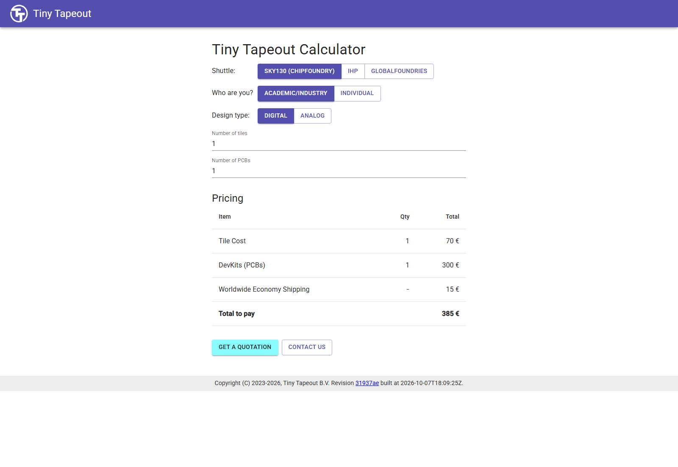
YOUR FIRST CHIP / FABRICATION
A tile and a development kit are separate purchases
1
8 October 2026 calculator: SKY130, academic/industry.
2
One digital tile €70; one kit €300; shipping €15.
3
Displayed total: €385.
Genuine dated public estimate; no quote or order was requested.
CHECK Check current terms before any approved order.
EE6019 • 8 October 2026 • Sources and teaching notes in PowerPoint
Open source ↗
152 / 195
Notes:
TEACHING NOTES
This screenshot explains the cost boundary without asking students to transact. It is a genuine public calculator view captured on 8 October 2026, with SKY130, the academic/industry category, one digital tile and one PCB selected. The displayed estimate separates tile space at seventy euros, the development kit at three hundred euros and economy shipping at fifteen euros, giving three hundred and eighty-five euros. Explain that design space and hardware for using the eventual chip are different items. These are dated values for the displayed selection, not a guaranteed quotation for a class or a later shuttle. Eligibility, taxes, delivery and current service terms must be checked at the time of an approved purchase. Do not direct students to request a quote, create an order or enter payment details as part of this exercise. The reference counter has not been ordered or submitted to a shuttle; its completed free evidence remains a valid teaching result.
MANUAL REFERENCE
4.2 See the cost boundary without placing an order
SOURCES / checked 8 October 2026
https://app.tinytapeout.com/calculator
https://tinytapeout.com/teaching/
https://tinytapeout.com/terms/
IMAGE PROVENANCE
{
"file": "img/19-cost-with-board.png",
"url": "https://app.tinytapeout.com/calculator",
"type": "Actual calculator: SKY130 academic/industry,1 tile,1 PCB,dated estimate",
"date": "2026-10-08",
"sha256": "f45fcfd0122f191cfb1b185c0ba72c4bbdb050a1e773674b6da047dbb73861f3"
}

Slide 153
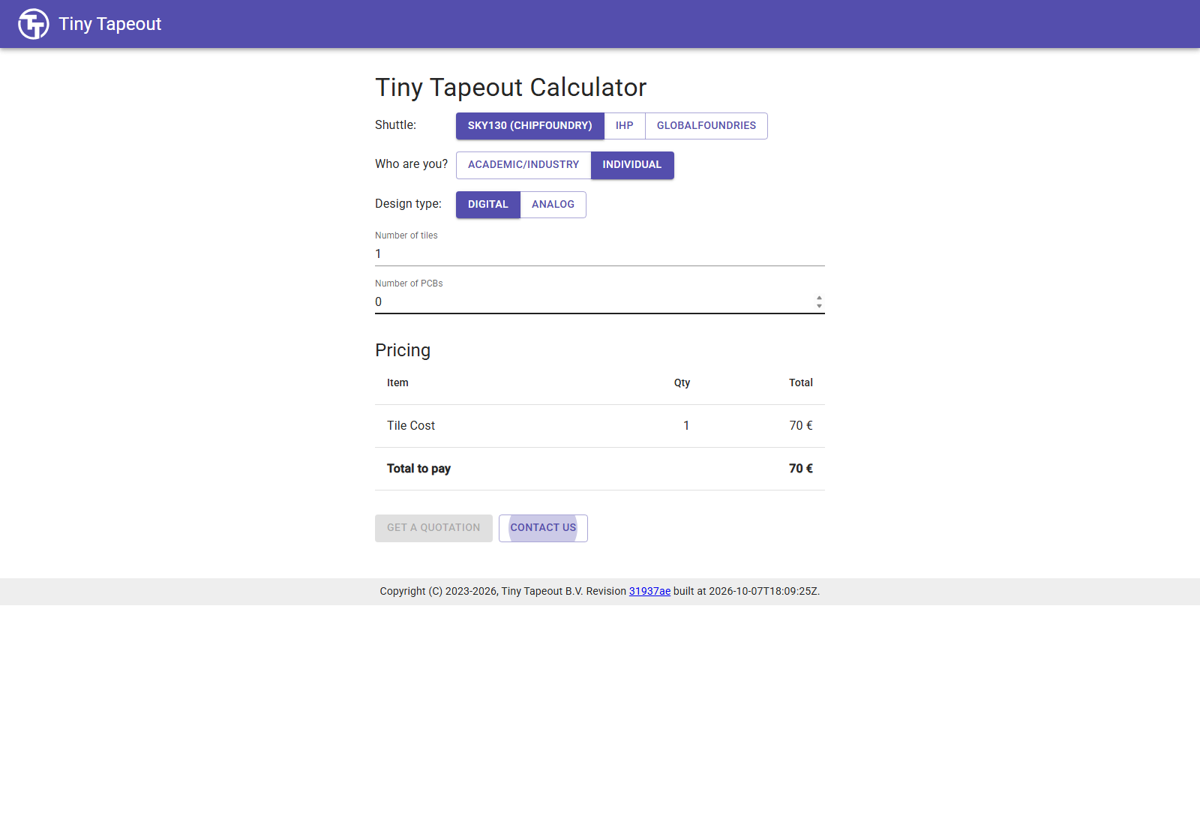
YOUR FIRST CHIP / FABRICATION
A €70 tile selection includes no development kit
1
8 October 2026 calculator: individual, one tile, zero PCBs.
2
The displayed total was €70.
3
A tile credit does not automatically include hardware.
Actual public tile-only selection; no order was placed.
CHECK Ask what is included, rather than comparing totals alone.
EE6019 • 8 October 2026 • Sources and teaching notes in PowerPoint
Open source ↗
153 / 195
Notes:
TEACHING NOTES
Compare this selection with the previous slide. Removing the PCB changes what would be purchased, not merely the price of the same delivered package. In the genuine 8 October calculator view, the individual category with one SKY130 digital tile and zero PCBs displays seventy euros. That selection includes no development kit. Explain why a tile coupon or credit cannot automatically be treated as an entitlement to hardware. Individual discounts may be limited, and institutional eligibility and current shuttle conditions must be checked separately. Do not imply that every account or class is eligible for a particular displayed category. Students should learn to distinguish tile allocation, development hardware and shipping when reading a calculator. The visible check asks them to identify the included items before comparing amounts. Reiterate that opening and changing selections in a public calculator is a learning activity; obtaining an approved order, using a coupon or submitting a revision is a later process.
MANUAL REFERENCE
4.2 See the cost boundary without placing an order
SOURCES / checked 8 October 2026
https://app.tinytapeout.com/calculator
https://tinytapeout.com/teaching/
https://tinytapeout.com/guides/advanced-workshop/submit-your-design/
IMAGE PROVENANCE
{
"file": "img/20-cost-tile-only.png",
"url": "https://app.tinytapeout.com/calculator",
"type": "Actual calculator: SKY130 individual,1 tile,0 PCB,dated estimate",
"date": "2026-10-08",
"sha256": "1126a8bc7ca1448d295528536c6bc880681126b0d5eca189bfba7da3352df82b"
}

Slide 154
YOUR FIRST CHIP / FABRICATION
Understand the later order and submission sequence
Reviewed files
Project/order
Payment or zero total
Submit revision
Passing builds
Sign in; select repository
Complete order stage
Choose the source version
Owner approval covers shuttle, budget, rights and delivery. • A zero-total order is still an order. • This explains a later process; the exercise stops earlier.
CHECK No authenticated payment screens were visited for this lesson.
EE6019 • 8 October 2026 • Sources and teaching notes in PowerPoint
Open source ↗
154 / 195
Notes:
TEACHING NOTES
Describe the sequence without performing it. Before an approved booking, the owner confirms the selected technology and shuttle, closing date, tile count, budget, rights and delivery expectations. Reviewed source and passing builds come first. The owner then signs into the Tiny Tapeout portal with GitHub and creates a project using the repository URL, reviewing any requested account authorisation. The project goes through an order stage. The current public interface uses Continue to Payment when an amount is due and Submit Project for a zero-total case. A coupon or credit can affect the total, but a zero amount does not turn the action into a practice simulation. The owner then explicitly submits a design revision. Make clear that this lesson did not visit authenticated payment-provider screens, place an order or submit the counter. Students should read the current official guide before any separately approved action, since the service interface and terms can change.
MANUAL REFERENCE
4.3 What an approved submission would do
SOURCES / checked 8 October 2026
https://tinytapeout.com/guides/advanced-workshop/submit-your-design/
https://app.tinytapeout.com/_build/assets/CreateProjectForm-CKe81cnQ.js
https://app.tinytapeout.com/_build/assets/CreateSubmission-krpe5UGC.js

Slide 155
YOUR FIRST CHIP / FABRICATION
A new GitHub commit does not replace a submitted revision
GitHub commit: saves a version and can trigger builds.
Order stage: books the selected allocation.
Submit a new revision: explicitly selects design source for integration.
After an RTL change: new passing builds → deliberate new submission.
CHECK Record the commit accepted by the submission before the deadline.
EE6019 • 8 October 2026 • Sources and teaching notes in PowerPoint
Open source ↗
155 / 195
Notes:
TEACHING NOTES
Separate three events that beginners can easily combine mentally. A commit saves source history and may trigger workflow builds. Completing an order handles the selected allocation and any payment or zero-total case. Submitting a new revision selects a particular source version for the manufacturing integration process. Creating a project or paying alone is not equivalent to submitting the final design revision. If the owner changes code before the shuttle closes, the changed revision needs passing builds and an explicit new submission. A later push or newly generated artifact does not automatically replace the version previously accepted. Have students describe what evidence would identify the submitted source: the full commit associated with the accepted revision, not merely the latest branch name. This remains a conceptual discussion in the free lesson. After manufacture has begun, editing a GitHub repository cannot alter geometry already sent to the foundry.
MANUAL REFERENCE
4.3 What an approved submission would do
SOURCES / checked 8 October 2026
https://tinytapeout.com/guides/advanced-workshop/submit-your-design/
https://app.tinytapeout.com/_build/assets/CreateSubmission-krpe5UGC.js

Slide 156
YOUR FIRST CHIP / FABRICATION
Integration creates the shared chip before tapeout
Checked tile
Shared chip
Final checks
Tapeout
One user design
Many designs and infrastructure
Integrated implementation
Manufacturing-data handover
Accepted tiles join shared selection and chip infrastructure. • The complete chip needs additional integration checks. • Tapeout hands over final manufacturing data.
CHECK Passing one standalone tile is only part of a complete chip.
EE6019 • 8 October 2026 • Sources and teaching notes in PowerPoint
Open source ↗
156 / 195
Notes:
TEACHING NOTES
Explain the transition from a student's tile to the shared physical chip. Tiny Tapeout must place accepted user designs into the complete layout and connect them to common selection and interface infrastructure. The overall chip needs checks beyond the standalone tile result. A passing tile is necessary evidence for its design, but it does not establish that the whole integration has been completed or manufactured. Define tapeout as handing over final design data for manufacturing. The historical name comes from magnetic tape, although files are now transferred electronically. It is distinct from running a local simulator or downloading an artifact called tt_submission. Draw an illustrative set of tiles within a shared chip outline and label the shared infrastructure. Do not imply that the diagram is the actual future shuttle layout. The accepted source version matters because later repository edits cannot change data already handed over for manufacture.
MANUAL REFERENCE
Integration and final preparation
SOURCES / checked 8 October 2026
https://tinytapeout.com/making_asics/
https://tinytapeout.com/guides/advanced-workshop/submit-your-design/
https://www.asml.com/en/technology/all-about-microchips/how-microchips-are-made

Slide 157
YOUR FIRST CHIP / FABRICATION
Masks and repeated process steps create wafer structures
A wafer contains repeated chip sites.
Patterns and repeated process steps form devices and interconnect.
Wafer
Layers in one illustrative chip site
Insulation
Conductive layer
Insulation
Silicon / device region
Form → pattern → modify → repeat
Conceptual wafer and layers — not a SKY130 cross-section or mask count
CHECK The fab uses manufacturing data, not a screenshot of the viewer.
EE6019 • 8 October 2026 • Sources and teaching notes in PowerPoint
Open source ↗
157 / 195
Notes:
TEACHING NOTES
Use a deliberately simplified manufacturing diagram to bridge geometry files and silicon. A wafer is a disc of semiconductor material with many repeated chip sites. Manufacturing forms devices and connections through controlled process steps: material is deposited or prepared, lithography defines a pattern, selected regions are removed or modified, and later layers repeat related operations. Doping alters semiconductor properties, insulating layers separate structures, and conductive layers provide interconnections. Masks and the process recipe correspond to different layers and operations; the foundry does not print the 3D viewer image onto silicon. Keep the illustration conceptual. Do not borrow advanced-node EUV requirements, exact layer counts or cycle times from generic sources and assign them to this SKY130 shuttle. Also repeat that 130 nm is a process-family name rather than the exact size of every feature. Ask students how a coloured shape in the viewer relates to a process layer and why the PDK's rules matter.
MANUAL REFERENCE
Layers, masks and the wafer
SOURCES / checked 8 October 2026
https://www.asml.com/en/technology/all-about-microchips/how-microchips-are-made
https://www.asml.com/en/technology/lithography-principles
https://tinytapeout.com/making_asics/

Slide 158
YOUR FIRST CHIP / FABRICATION
Transistor networks implement gates and stored state
Transistors
Library cells
Counter netlist
Physical devices
Reusable circuits
Connected instances
Transistors help control conducting paths. • CMOS uses complementary networks to implement logic. • The standard-cell library supplies the counter's gates and flip-flops. • An inverter maps logical 0 to 1, and 1 to 0.
EE6019 • 8 October 2026 • Sources and teaching notes in PowerPoint
Open source ↗
158 / 195
Notes:
TEACHING NOTES
Connect the digital abstraction to physical devices without attempting a transistor-design course. At this level, a transistor helps control whether a conducting path is available. CMOS logic uses complementary transistor networks to produce logic functions. An inverter gives a simple example: under valid supply and electrical conditions, logical zero at the input produces logical one at the output, and vice versa. Larger circuit networks implement arithmetic and storage cells. In this project, students did not draw each transistor. The standard-cell library provides the actual gate and flip-flop circuits, synthesis selects instances, and physical tools place and connect their layouts. This separation makes the flow manageable while retaining the link to manufacturing through the PDK, library models and checks. Any device-to-cell illustration should be labelled as conceptual, rather than presented as the extracted transistor schematic of the reference counter. Ask students to trace how one RTL storage requirement eventually needs a physical storage circuit.
MANUAL REFERENCE
Why transistors can implement the counter
SOURCES / checked 8 October 2026
https://skywater-pdk.readthedocs.io/en/main/contents/libraries.html
https://librelane.readthedocs.io/en/latest/glossary.html
https://www.asml.com/en/technology/all-about-microchips/how-microchips-are-made

Slide 159
YOUR FIRST CHIP / FABRICATION
Testing and assembly continue after wafer processing
Test devices; dice the wafer into dies; package for protection and connections.
Board assembly and testing prepare usable hardware.
Wafer sites
Die
Package
Conceptual separation and packaging — actual delivery depends on the service
CHECK Delivery depends on the selected service and kit; check current schedules.
EE6019 • 8 October 2026 • Sources and teaching notes in PowerPoint
Open source ↗
159 / 195
Notes:
TEACHING NOTES
A completed wafer is not yet the same thing as the development board a student uses. After processing, testing can identify devices that work or fail. Dicing separates individual dies from the wafer. Packaging provides protection and usable electrical connections, and board assembly connects the packaged device to the development hardware. The exact testing and delivery arrangement depends on the selected service and kit, so present this as a conceptual sequence rather than a promise about every shuttle. The finished chip still needs valid power, a clock, reset, design selection and appropriate I/O conditions. Manufacturing, assembly, external inputs and board handling can introduce issues outside the functional test used in this lesson. Shuttle manufacturing and delivery expectations are measured in months rather than software-build minutes. Refer students to the current service schedule and order information, and do not promise a delivery date based on an old video or this reference design's successful workflow.
MANUAL REFERENCE
Wafer testing, dicing, packaging and board testing
SOURCES / checked 8 October 2026
https://www.asml.com/en/technology/all-about-microchips/how-microchips-are-made
https://tinytapeout.com/chips/
https://tinytapeout.com/faq/
https://tinytapeout.com/terms/

Slide 160
YOUR FIRST CHIP / FABRICATION
Read the counter as binary on a board
1
Select the design and use a controlled learning clock.
WORKED EXAMPLE
Count 5 = 00000101: output bits 2 and 0 are high.
2
Hold rst_n low across a rising edge; release it, then enable ui_in[0].
3
Read uo_out[7:0]; uio[0] flags enabled count 255.
CHECK The RTL does not include a decimal-display decoder.
EE6019 • 8 October 2026 • Sources and teaching notes in PowerPoint
Open source ↗
160 / 195
Notes:
TEACHING NOTES
This is preparation for later hardware use, not a requirement to own a board now. Follow the guide for the actual board revision, since current ETR instructions differ from older board guides. Power and configure the board, select the intended design, and choose a controlled slow clock or single-step mode for learning. A fifty-megahertz analysis target does not make individual counts visually readable at fifty million updates per second. Hold reset low through a rising edge, release it, then apply the synchronous count enable on dedicated input bit zero. At count five, output bits two and zero are high, giving binary 00000101. A decimal display requires a controller or additional decoding; this RTL supplies no seven-segment decoder. Bidirectional bit zero is driven as an output and is high while count is 255 and enable is high, then low after overflow. Use the board's own GPIO specifications for valid electrical levels.
MANUAL REFERENCE
4.5 How this counter would be used on a board later
SOURCES / checked 8 October 2026
https://tinytapeout.com/guides/get-started-demoboard-etr/
https://tinytapeout.com/specs/gpio/
https://github.com/mdkamrulislam-web/tt-sky130-counter/blob/61ef06bed008e76000f9ae46d65182e476d15dd6/docs/info.md

Slide 161
YOUR FIRST CHIP / FABRICATION
A physical button is not an ideal testbench input
Synchronisation reduces risks from asynchronous sampling.
Debouncing suppresses repeated changes from switch contacts.
These solve different problems; this counter assumes synchronous enable.
One press can produce several electrical transitions near clock edges.
CHECK A simulator's logical 1 does not mean one volt.
EE6019 • 8 October 2026 • Sources and teaching notes in PowerPoint
Open source ↗
161 / 195
Notes:
TEACHING NOTES
The testbench changes inputs at controlled times away from the sampling edge. A physical switch can change near that edge, and its contacts can bounce several times during one press. These introduce separate concerns. Synchronisation reduces the risk associated with sampling an asynchronous change. Debouncing suppresses repeated apparent changes caused by contact bounce. One does not automatically solve the other, and neither is implemented by this minimal teaching counter. Its enable input is assumed to be synchronous to the clock, supplied by a suitable controller or testbench. Ask students why directly attaching a pushbutton would not reproduce the ideal simulated input. Avoid implying that a small extra gate alone guarantees safe asynchronous sampling. Also bridge logical values and electrical levels: simulated one is a logic state, not a one-volt supply specification. Use the actual board instructions and current GPIO specifications to determine permitted voltages and speed before any later hardware connection.
MANUAL REFERENCE
4.5 How this counter would be used on a board later
SOURCES / checked 8 October 2026
https://github.com/mdkamrulislam-web/tt-sky130-counter/blob/61ef06bed008e76000f9ae46d65182e476d15dd6/docs/info.md
https://tinytapeout.com/specs/gpio/
https://tinytapeout.com/guides/get-started-demoboard-etr/

Slide 162
YOUR FIRST CHIP / OPTIONAL LOCAL LAB
Local simulation is an optional faster feedback loop
Browser route: Actions supplies the simulation and physical tools.
Local RTL route: you supply Linux, Python, make and Icarus.
Use Ubuntu or a managed lab environment; these are not PowerShell commands.
CHECK Installing a full physical-design suite is unnecessary for this RTL exercise.
EE6019 • 8 October 2026 • Sources and teaching notes in PowerPoint
Open source ↗
162 / 195
Notes:
TEACHING NOTES
State the scope before installing anything. The main browser workflow already provides a route to a tested, checked and archived layout without local tool installation. Local RTL simulation is optional and can make edit/test cycles faster while teaching what the test job runs. The commands in this appendix target an Ubuntu Linux terminal, including Ubuntu inside an already configured WSL2 environment. They are not commands to paste into PowerShell. Students without a suitable Linux or managed lab environment should continue using the browser route. Installing WSL, Docker or a complete physical-design tool suite is not required for this lesson. A managed laboratory may already supply the tools, and students should follow its setup rather than change system packages. Explain that the terminal's current directory matters. Before running a command, identify whether the instructions expect the project root or its test subdirectory. Local simulation does not submit a design or order hardware.
MANUAL REFERENCE
B.1 Choose a supported environment
SOURCES / checked 8 October 2026
https://github.com/TinyTapeout/ttsky-verilog-template/blob/68c3fd3f3ec640e5edcb6a5f74f360ebc016bb2a/test/README.md
https://tinytapeout.com/guides/local-hardening/

Slide 163
YOUR FIRST CHIP / OPTIONAL LOCAL LAB
Check tools and obtain your saved source
1
On your own Ubuntu installation, install missing prerequisites.
sudo apt-get update
sudo apt-get install -y git python3 \
python3-venv python3-pip make iverilog
git --version
python3 --version
make --version
iverilog -V
2
Clone your repository or extract its complete project ZIP.
3
Test the same source version
as your saved reference run.
CHECK Project root contains info.yaml, src and test.
EE6019 • 8 October 2026 • Sources and teaching notes in PowerPoint
Open source ↗
163 / 195
Notes:
TEACHING NOTES
Explain each command rather than treating this as a universal installation recipe. On a student's own Ubuntu system, apt-get obtains packages from the configured repositories and sudo gives the installation system privileges. The listed tools supply Git, Python, virtual-environment support, make and the Icarus simulator. On a managed lab machine, use the demonstrator's environment instead of changing system packages. Each version command should identify a tool rather than report command not found. Obtain the student's saved repository using git clone or a complete project ZIP, then enter its project root. If using Git, git rev-parse HEAD records the full source identity, and a deliberately different branch must be selected before testing. The verified CI uses Python 3.11 and Ubuntu 24.04 with pinned packages; a different local tool version can be useful for learning without being an identical reproduction. The wrapped installation command uses a real backslash continuation between its two lines.
MANUAL REFERENCE
B.2 Get your own saved project files
SOURCES / checked 8 October 2026
https://github.com/TinyTapeout/ttsky-verilog-template/blob/68c3fd3f3ec640e5edcb6a5f74f360ebc016bb2a/.github/workflows/test.yaml
https://github.com/TinyTapeout/ttsky-verilog-template/blob/68c3fd3f3ec640e5edcb6a5f74f360ebc016bb2a/test/README.md

Slide 164
YOUR FIRST CHIP / OPTIONAL LOCAL LAB
Install test packages inside an isolated environment
1
Run from the project root.
python3 -m venv .venv
source .venv/bin/activate
python -m pip install -r test/requirements.txt
2
A virtual environment isolates the test's Python packages.
3
Reference requirements pin cocotb 2.1.0 and pytest 8.4.2.
CHECK Python packages do not install the Icarus Verilog executable.
EE6019 • 8 October 2026 • Sources and teaching notes in PowerPoint
Open source ↗
164 / 195
Notes:
TEACHING NOTES
A Python virtual environment keeps the test's package versions separate from unrelated system packages. The first command creates the environment in a directory named .venv within the project. The second activates it for the current terminal. The third installs the requirements supplied by the template the student actually copied. For the verified reference, those requirements pin cocotb 2.1.0 and pytest 8.4.2. Do not silently substitute the newest cocotb or instructions from an older article that expects another version. Explain the separation between the Python test and the Verilog simulator: installing cocotb does not install the Icarus executable. Both must be available. A new terminal may require the activation command again. Ask students to confirm their current directory and active environment before investigating an import failure. Their source should contain the updated counter and wrapper, while test/Makefile lists both files; environment setup alone cannot fix a missing source file.
MANUAL REFERENCE
B.3 Install the pinned Python test packages
SOURCES / checked 8 October 2026
https://github.com/TinyTapeout/ttsky-verilog-template/blob/68c3fd3f3ec640e5edcb6a5f74f360ebc016bb2a/test/requirements.txt
https://github.com/TinyTapeout/ttsky-verilog-template/blob/68c3fd3f3ec640e5edcb6a5f74f360ebc016bb2a/test/README.md

Slide 165
YOUR FIRST CHIP / OPTIONAL LOCAL LAB
Run the test, then explicitly check its XML result
1
Icarus compiles the design; cocotb drives inputs and checks assertions.
cd test
make -B
python -m cocotb_tools.check_results results.xml
2
The XML checker verifies reported failures and errors.
3
Reference result: one passing test; 11,368 ns simulated time.
CHECK Require results.xml and tb.fst; make alone can conceal a test failure.
EE6019 • 8 October 2026 • Sources and teaching notes in PowerPoint
Open source ↗
165 / 195
Notes:
TEACHING NOTES
Run these commands from the project root after activating the virtual environment. Changing into test makes the relative source paths in the Makefile resolve as intended. Make reads the compilation and simulation recipe, and its -B option asks it to rebuild rather than assume existing compiled outputs are current. Icarus compiles the Verilog source and testbench; cocotb drives the top-level signals and checks the expected model. The final command reads the XML result and signals a failure if tests failed. This explicit check matters because make alone can return a successful exit status even when cocotb reports a test failure. For the unchanged reference, look for one passing test_project, zero failures and errors, and an actual tb.fst file. Its simulated circuit time is 11,368 nanoseconds, which is different from elapsed wall-clock time. A passing result supports the tested phases; it does not prove every possible state sequence or physical check.
MANUAL REFERENCE
B.4 Compile and run, then check the results explicitly
SOURCES / checked 8 October 2026
https://github.com/TinyTapeout/ttsky-verilog-template/blob/68c3fd3f3ec640e5edcb6a5f74f360ebc016bb2a/.github/workflows/test.yaml
https://github.com/mdkamrulislam-web/tt-sky130-counter/blob/61ef06bed008e76000f9ae46d65182e476d15dd6/test/test.py
https://github.com/mdkamrulislam-web/tt-sky130-counter/actions/runs/37693100752

Slide 166
YOUR FIRST CHIP / OPTIONAL LOCAL LAB
Local gate-level testing needs matching implementation files
1
Copy the exact implementation netlist to test/gate_level_netlist.v.
export PDK_ROOT=/path/to/installed/pdk
SC="$PDK_ROOT/sky130A/libs.ref"
SC="$SC/sky130_fd_sc_hd/verilog"
test -f "$SC/primitives.v"
test -f "$SC/sky130_fd_sc_hd.v"
test -f gate_level_netlist.v
make -B GATES=yes
python -m cocotb_tools.check_results results.xml
2
PDK_ROOT names the directory containing sky130A.
3
These checks inspect existing files; they do not install a PDK.
CHECK Correct missing paths before make; use the build's pdk.json identity.
EE6019 • 8 October 2026 • Sources and teaching notes in PowerPoint
Open source ↗
166 / 195
Notes:
TEACHING NOTES
Keep this clearly optional. Local gate-level simulation requires the netlist from the exact implementation and matching installed SKY130 cell models. Copy the implemented netlist to test/gate_level_netlist.v. Set PDK_ROOT to the installed directory containing sky130A, not to sky130A itself, because the Makefile appends that component. Replace the example path with the actual installation path. The temporary SC variable only shortens the visible file checks; the Makefile continues using PDK_ROOT. Each test -f should return success. If one fails, locate the missing file and correct the path before invoking make. Record and match the PDK version using the build's pdk.json rather than substituting unrelated models. Run the commands inside test with the Python environment active. The main workflow's gl_test job obtains these prerequisites automatically, making Actions the recommended first result. This functional/unit-delay test still does not load extracted SDF delays or replace static timing analysis.
MANUAL REFERENCE
B.5 View the FST and understand gate-level dependencies
SOURCES / checked 8 October 2026
https://github.com/mdkamrulislam-web/tt-sky130-counter/blob/61ef06bed008e76000f9ae46d65182e476d15dd6/test/Makefile
https://github.com/TinyTapeout/ttsky-verilog-template/blob/68c3fd3f3ec640e5edcb6a5f74f360ebc016bb2a/test/README.md
https://tinytapeout.com/guides/local-hardening/

Slide 167
YOUR FIRST CHIP / OPTIONAL LOCAL LAB
Inspect the waveform and diagnose one cause at a time
Missing tool
Missing source
Import error
Wrong count
Check installation
Check lists and directory
Check environment
Compare specification and wave
Open tb.fst in web Surfer or an available native viewer. • Inspect clock, reset, enable, count and terminal-count output. • Read the first useful error before changing anything.
CHECK Local changes need a saved commit and fresh Actions evidence.
EE6019 • 8 October 2026 • Sources and teaching notes in PowerPoint
Open source ↗
167 / 195
Notes:
TEACHING NOTES
The local FST can be opened using the same free web Surfer procedure as the browser lesson. A native GTKWave or Surfer installation is optional. Where GTKWave is available, run gtkwave tb.fst inside test, then add the current top-level signals. A saved viewer configuration from an older adder template may refer to old signals; an empty saved view is not proof that the counter waveform is missing. For troubleshooting, confirm the test directory, active environment, installed simulator, source lists and matching top-module names. Distinguish a missing tool, missing file, Python import error and incorrect expected count, since they require different fixes. Read the first useful compiler or assertion error and compare it with the specification and wave. Running locally neither uploads changes nor orders a chip. Save an intentional change through a commit and push using the student's repository workflow, then review a complete new set of Actions results for that revision.
MANUAL REFERENCE
B.5 View the FST and understand gate-level dependencies
SOURCES / checked 8 October 2026
https://github.com/TinyTapeout/ttsky-verilog-template/blob/68c3fd3f3ec640e5edcb6a5f74f360ebc016bb2a/test/README.md
https://docs.surfer-project.org/book/commands/index.html
https://github.com/mdkamrulislam-web/tt-sky130-counter/blob/61ef06bed008e76000f9ae46d65182e476d15dd6/test/Makefile

Slide 168
YOUR FIRST CHIP / WORKED EXERCISES
Exercise 1: Binary output
1
Count is decimal 37. Write its eight-bit output and list the high pins.
WORKED EXAMPLE
Predict it first.
Then advance for the worked answer.
EE6019 • 8 October 2026 • Sources and teaching notes in PowerPoint
Open source ↗
168 / 195
Notes:
TEACHING NOTES
Try the question before advancing to its answer. Return to the earlier circuit, wrapper or verification lesson to justify each step.
QUESTION
Count is decimal 37. Write its eight-bit output and list the high pins.
WORKED ANSWER
37 = 32 + 4 + 1, so uo_out = 00100101. Bits 5, 2 and 0 are high. No decoder is needed to read those bits as a number in software; a human-facing decimal display would need decoding.
MANUAL REFERENCE
Exercise 1: Binary output
SOURCES / checked 8 October 2026
https://github.com/mdkamrulislam-web/tt-sky130-counter/tree/61ef06bed008e76000f9ae46d65182e476d15dd6

Slide 169
YOUR FIRST CHIP / WORKED EXERCISES
Answer 1: Binary output
1
37 = 32 + 4 + 1, so uo_out = 00100101. Bits 5, 2 and 0 are high. No decoder is needed to read those bits as a number in software; a human-facing decimal display would need decoding.
EE6019 • 8 October 2026 • Sources and teaching notes in PowerPoint
Open source ↗
169 / 195
Notes:
TEACHING NOTES
WORKED ANSWER
37 = 32 + 4 + 1, so uo_out = 00100101. Bits 5, 2 and 0 are high. No decoder is needed to read those bits as a number in software; a human-facing decimal display would need decoding.
Connect the answer to the specified behaviour and identify the evidence that would check it.
MANUAL REFERENCE
Exercise 1: Binary output
SOURCES / checked 8 October 2026
https://github.com/mdkamrulislam-web/tt-sky130-counter/tree/61ef06bed008e76000f9ae46d65182e476d15dd6

Slide 170
YOUR FIRST CHIP / WORKED EXERCISES
Exercise 2: The enable bit
1
Reset is inactive. Write ui_in=10000000, then apply two rising edges. The starting count is 9. What happens? What changes if ui_in=10000001 instead?
WORKED EXAMPLE
Predict it first.
Then advance for the worked answer.
EE6019 • 8 October 2026 • Sources and teaching notes in PowerPoint
Open source ↗
170 / 195
Notes:
TEACHING NOTES
Try the question before advancing to its answer. Return to the earlier circuit, wrapper or verification lesson to justify each step.
QUESTION
Reset is inactive. Write ui_in=10000000, then apply two rising edges. The starting count is 9. What happens? What changes if ui_in=10000001 instead?
WORKED ANSWER
In the first case bit 0 is zero, so count stays 9 at both edges. In the second case bit 0 is one, so the counts after the two edges are 10 and 11. Bits 7:1 do not affect this example.
MANUAL REFERENCE
Exercise 2: The enable bit
SOURCES / checked 8 October 2026
https://github.com/mdkamrulislam-web/tt-sky130-counter/tree/61ef06bed008e76000f9ae46d65182e476d15dd6

Slide 171
YOUR FIRST CHIP / WORKED EXERCISES
Answer 2: The enable bit
1
In the first case bit 0 is zero, so count stays 9 at both edges. In the second case bit 0 is one, so the counts after the two edges are 10 and 11. Bits 7:1 do not affect this example.
EE6019 • 8 October 2026 • Sources and teaching notes in PowerPoint
Open source ↗
171 / 195
Notes:
TEACHING NOTES
WORKED ANSWER
In the first case bit 0 is zero, so count stays 9 at both edges. In the second case bit 0 is one, so the counts after the two edges are 10 and 11. Bits 7:1 do not affect this example.
Connect the answer to the specified behaviour and identify the evidence that would check it.
MANUAL REFERENCE
Exercise 2: The enable bit
SOURCES / checked 8 October 2026
https://github.com/mdkamrulislam-web/tt-sky130-counter/tree/61ef06bed008e76000f9ae46d65182e476d15dd6

Slide 172
YOUR FIRST CHIP / WORKED EXERCISES
Exercise 3: Reset priority
1
Starting count is 18. Before the next rising edge set rst_n=0 and enable=1. What should count and wrap be after that edge?
WORKED EXAMPLE
Predict it first.
Then advance for the worked answer.
EE6019 • 8 October 2026 • Sources and teaching notes in PowerPoint
Open source ↗
172 / 195
Notes:
TEACHING NOTES
Try the question before advancing to its answer. Return to the earlier circuit, wrapper or verification lesson to justify each step.
QUESTION
Starting count is 18. Before the next rising edge set rst_n=0 and enable=1. What should count and wrap be after that edge?
WORKED ANSWER
Count is 0 because reset has priority. Wrap is 0 because the settled count is not 255. This is directly exercised by step(enable=1, reset=True).
MANUAL REFERENCE
Exercise 3: Reset priority
SOURCES / checked 8 October 2026
https://github.com/mdkamrulislam-web/tt-sky130-counter/tree/61ef06bed008e76000f9ae46d65182e476d15dd6

Slide 173
YOUR FIRST CHIP / WORKED EXERCISES
Answer 3: Reset priority
1
Count is 0 because reset has priority. Wrap is 0 because the settled count is not 255. This is directly exercised by step(enable=1, reset=True).
EE6019 • 8 October 2026 • Sources and teaching notes in PowerPoint
Open source ↗
173 / 195
Notes:
TEACHING NOTES
WORKED ANSWER
Count is 0 because reset has priority. Wrap is 0 because the settled count is not 255. This is directly exercised by step(enable=1, reset=True).
Connect the answer to the specified behaviour and identify the evidence that would check it.
MANUAL REFERENCE
Exercise 3: Reset priority
SOURCES / checked 8 October 2026
https://github.com/mdkamrulislam-web/tt-sky130-counter/tree/61ef06bed008e76000f9ae46d65182e476d15dd6

Slide 174
YOUR FIRST CHIP / WORKED EXERCISES
Exercise 4: Reset between edges
1
Count is 12 and enable is zero. Reset becomes active halfway between two rising edges. Does count become zero at the moment reset changes?
WORKED EXAMPLE
Predict it first.
Then advance for the worked answer.
EE6019 • 8 October 2026 • Sources and teaching notes in PowerPoint
Open source ↗
174 / 195
Notes:
TEACHING NOTES
Try the question before advancing to its answer. Return to the earlier circuit, wrapper or verification lesson to justify each step.
QUESTION
Count is 12 and enable is zero. Reset becomes active halfway between two rising edges. Does count become zero at the moment reset changes?
WORKED ANSWER
No. It remains 12 until the next rising edge, then becomes zero. Active-low polarity does not make a reset asynchronous.
MANUAL REFERENCE
Exercise 4: Reset between edges
SOURCES / checked 8 October 2026
https://github.com/mdkamrulislam-web/tt-sky130-counter/tree/61ef06bed008e76000f9ae46d65182e476d15dd6

Slide 175
YOUR FIRST CHIP / WORKED EXERCISES
Answer 4: Reset between edges
1
No. It remains 12 until the next rising edge, then becomes zero. Active-low polarity does not make a reset asynchronous.
EE6019 • 8 October 2026 • Sources and teaching notes in PowerPoint
Open source ↗
175 / 195
Notes:
TEACHING NOTES
WORKED ANSWER
No. It remains 12 until the next rising edge, then becomes zero. Active-low polarity does not make a reset asynchronous.
Connect the answer to the specified behaviour and identify the evidence that would check it.
MANUAL REFERENCE
Exercise 4: Reset between edges
SOURCES / checked 8 October 2026
https://github.com/mdkamrulislam-web/tt-sky130-counter/tree/61ef06bed008e76000f9ae46d65182e476d15dd6

Slide 176
YOUR FIRST CHIP / WORKED EXERCISES
Exercise 5: Terminal count
1
Starting count is 254, reset is inactive and enable stays high. Predict count and wrap after three rising edges.
WORKED EXAMPLE
Predict it first.
Then advance for the worked answer.
EE6019 • 8 October 2026 • Sources and teaching notes in PowerPoint
Open source ↗
176 / 195
Notes:
TEACHING NOTES
Try the question before advancing to its answer. Return to the earlier circuit, wrapper or verification lesson to justify each step.
QUESTION
Starting count is 254, reset is inactive and enable stays high. Predict count and wrap after three rising edges.
WORKED ANSWER
The pairs (count, wrap) are (255,1), (0,0) and (1,0). The flag marks the 255 state, not the zero state after overflow.
MANUAL REFERENCE
Exercise 5: Terminal count
SOURCES / checked 8 October 2026
https://github.com/mdkamrulislam-web/tt-sky130-counter/tree/61ef06bed008e76000f9ae46d65182e476d15dd6

Slide 177
YOUR FIRST CHIP / WORKED EXERCISES
Answer 5: Terminal count
1
The pairs (count, wrap) are (255,1), (0,0) and (1,0). The flag marks the 255 state, not the zero state after overflow.
EE6019 • 8 October 2026 • Sources and teaching notes in PowerPoint
Open source ↗
177 / 195
Notes:
TEACHING NOTES
WORKED ANSWER
The pairs (count, wrap) are (255,1), (0,0) and (1,0). The flag marks the 255 state, not the zero state after overflow.
Connect the answer to the specified behaviour and identify the evidence that would check it.
MANUAL REFERENCE
Exercise 5: Terminal count
SOURCES / checked 8 October 2026
https://github.com/mdkamrulislam-web/tt-sky130-counter/tree/61ef06bed008e76000f9ae46d65182e476d15dd6

Slide 178
YOUR FIRST CHIP / WORKED EXERCISES
Exercise 6: Hold at terminal count
1
Count is 255 and enable becomes zero. Predict the next two edge samples. Then enable becomes one before a third edge; predict that edge sample too.
WORKED EXAMPLE
Predict it first.
Then advance for the worked answer.
EE6019 • 8 October 2026 • Sources and teaching notes in PowerPoint
Open source ↗
178 / 195
Notes:
TEACHING NOTES
Try the question before advancing to its answer. Return to the earlier circuit, wrapper or verification lesson to justify each step.
QUESTION
Count is 255 and enable becomes zero. Predict the next two edge samples. Then enable becomes one before a third edge; predict that edge sample too.
WORKED ANSWER
The first two samples are count 255 and wrap 0. After re-enabling but before the third edge, wrap is high while count is still 255. After the third edge, count is 0 and wrap is 0.
MANUAL REFERENCE
Exercise 6: Hold at terminal count
SOURCES / checked 8 October 2026
https://github.com/mdkamrulislam-web/tt-sky130-counter/tree/61ef06bed008e76000f9ae46d65182e476d15dd6

Slide 179
YOUR FIRST CHIP / WORKED EXERCISES
Answer 6: Hold at terminal count
1
The first two samples are count 255 and wrap 0. After re-enabling but before the third edge, wrap is high while count is still 255. After the third edge, count is 0 and wrap is 0.
EE6019 • 8 October 2026 • Sources and teaching notes in PowerPoint
Open source ↗
179 / 195
Notes:
TEACHING NOTES
WORKED ANSWER
The first two samples are count 255 and wrap 0. After re-enabling but before the third edge, wrap is high while count is still 255. After the third edge, count is 0 and wrap is 0.
Connect the answer to the specified behaviour and identify the evidence that would check it.
MANUAL REFERENCE
Exercise 6: Hold at terminal count
SOURCES / checked 8 October 2026
https://github.com/mdkamrulislam-web/tt-sky130-counter/tree/61ef06bed008e76000f9ae46d65182e476d15dd6

Slide 180
YOUR FIRST CHIP / WORKED EXERCISES
Exercise 7: Width masking
1
The Python model is 255, reset is false and enable is 1. Calculate (model + enable) & 0xFF by hand.
WORKED EXAMPLE
Predict it first.
Then advance for the worked answer.
EE6019 • 8 October 2026 • Sources and teaching notes in PowerPoint
Open source ↗
180 / 195
Notes:
TEACHING NOTES
Try the question before advancing to its answer. Return to the earlier circuit, wrapper or verification lesson to justify each step.
QUESTION
The Python model is 255, reset is false and enable is 1. Calculate (model + enable) & 0xFF by hand.
WORKED ANSWER
The sum is 256, hexadecimal 0x100. Masking with 0x0FF retains the lower eight bits: 0x100 & 0x0FF = 0x000. The expected count is zero.
MANUAL REFERENCE
Exercise 7: Width masking
SOURCES / checked 8 October 2026
https://github.com/mdkamrulislam-web/tt-sky130-counter/tree/61ef06bed008e76000f9ae46d65182e476d15dd6

Slide 181
YOUR FIRST CHIP / WORKED EXERCISES
Answer 7: Width masking
1
The sum is 256, hexadecimal 0x100. Masking with 0x0FF retains the lower eight bits: 0x100 & 0x0FF = 0x000. The expected count is zero.
EE6019 • 8 October 2026 • Sources and teaching notes in PowerPoint
Open source ↗
181 / 195
Notes:
TEACHING NOTES
WORKED ANSWER
The sum is 256, hexadecimal 0x100. Masking with 0x0FF retains the lower eight bits: 0x100 & 0x0FF = 0x000. The expected count is zero.
Connect the answer to the specified behaviour and identify the evidence that would check it.
MANUAL REFERENCE
Exercise 7: Width masking
SOURCES / checked 8 October 2026
https://github.com/mdkamrulislam-web/tt-sky130-counter/tree/61ef06bed008e76000f9ae46d65182e476d15dd6

Slide 182
YOUR FIRST CHIP / WORKED EXERCISES
Exercise 8: Interpret uio direction
1
The wrapper drives uio_oe=00000001. Which uio pins are outputs? Does uio_out[7:1]=0 mean the design drives those physical pins low?
WORKED EXAMPLE
Predict it first.
Then advance for the worked answer.
EE6019 • 8 October 2026 • Sources and teaching notes in PowerPoint
Open source ↗
182 / 195
Notes:
TEACHING NOTES
Try the question before advancing to its answer. Return to the earlier circuit, wrapper or verification lesson to justify each step.
QUESTION
The wrapper drives uio_oe=00000001. Which uio pins are outputs? Does uio_out[7:1]=0 mean the design drives those physical pins low?
WORKED ANSWER
Only uio[0] is enabled as an output. Pins 7:1 have disabled output drivers and remain inputs. Their output-data values are zero, but disabled drivers do not force the external pins low.
MANUAL REFERENCE
Exercise 8: Interpret uio direction
SOURCES / checked 8 October 2026
https://github.com/mdkamrulislam-web/tt-sky130-counter/tree/61ef06bed008e76000f9ae46d65182e476d15dd6

Slide 183
YOUR FIRST CHIP / WORKED EXERCISES
Answer 8: Interpret uio direction
1
Only uio[0] is enabled as an output. Pins 7:1 have disabled output drivers and remain inputs. Their output-data values are zero, but disabled drivers do not force the external pins low.
EE6019 • 8 October 2026 • Sources and teaching notes in PowerPoint
Open source ↗
183 / 195
Notes:
TEACHING NOTES
WORKED ANSWER
Only uio[0] is enabled as an output. Pins 7:1 have disabled output drivers and remain inputs. Their output-data values are zero, but disabled drivers do not force the external pins low.
Connect the answer to the specified behaviour and identify the evidence that would check it.
MANUAL REFERENCE
Exercise 8: Interpret uio direction
SOURCES / checked 8 October 2026
https://github.com/mdkamrulislam-web/tt-sky130-counter/tree/61ef06bed008e76000f9ae46d65182e476d15dd6

Slide 184
YOUR FIRST CHIP / WORKED EXERCISES
Exercise 9: Diagnose a hypothetical mismatch
1
Imagine your modified test reports expected count 1 but observed count 0 after an enabled edge. List four things to inspect before altering the assertion.
WORKED EXAMPLE
Predict it first.
Then advance for the worked answer.
EE6019 • 8 October 2026 • Sources and teaching notes in PowerPoint
Open source ↗
184 / 195
Notes:
TEACHING NOTES
Try the question before advancing to its answer. Return to the earlier circuit, wrapper or verification lesson to justify each step.
QUESTION
Imagine your modified test reports expected count 1 but observed count 0 after an enabled edge. List four things to inspect before altering the assertion.
WORKED ANSWER
Check whether reset was still active; whether the code set ui_in[0] rather than another bit; whether the simulator compiled the intended wrapper/core files and top-module name; and whether observation waited for the appropriate settled output. Also compare the expected model with the written specification. This is a hypothetical diagnostic exercise; the reviewed worked-example test passed.
MANUAL REFERENCE
Exercise 9: Explain a hypothetical mismatch without inventing a real failure
SOURCES / checked 8 October 2026
https://github.com/mdkamrulislam-web/tt-sky130-counter/tree/61ef06bed008e76000f9ae46d65182e476d15dd6

Slide 185
YOUR FIRST CHIP / WORKED EXERCISES
Answer 9: Diagnose a hypothetical mismatch
1
Check whether reset was still active; whether the code set ui_in[0] rather than another bit; whether the simulator compiled the intended wrapper/core files and top-module name; and whether observation waited for the appropriate settled output.
2
Also compare the expected model with the written specification. This is a hypothetical diagnostic exercise; the reviewed worked-example test passed.
EE6019 • 8 October 2026 • Sources and teaching notes in PowerPoint
Open source ↗
185 / 195
Notes:
TEACHING NOTES
WORKED ANSWER
Check whether reset was still active; whether the code set ui_in[0] rather than another bit; whether the simulator compiled the intended wrapper/core files and top-module name; and whether observation waited for the appropriate settled output. Also compare the expected model with the written specification. This is a hypothetical diagnostic exercise; the reviewed worked-example test passed.
Connect the answer to the specified behaviour and identify the evidence that would check it.
MANUAL REFERENCE
Exercise 9: Explain a hypothetical mismatch without inventing a real failure
SOURCES / checked 8 October 2026
https://github.com/mdkamrulislam-web/tt-sky130-counter/tree/61ef06bed008e76000f9ae46d65182e476d15dd6

Slide 186
YOUR FIRST CHIP / WORKED EXERCISES
Exercise 10: Modify the counter to count down
1
Write the expected sequence from reset for three enabled rising edges before changing the RTL. Define what the flag should mean in a count-down design.
WORKED EXAMPLE
Predict it first.
Then advance for the worked answer.
EE6019 • 8 October 2026 • Sources and teaching notes in PowerPoint
Open source ↗
186 / 195
Notes:
TEACHING NOTES
Try the question before advancing to its answer. Return to the earlier circuit, wrapper or verification lesson to justify each step.
QUESTION
Write the expected sequence from reset for three enabled rising edges before changing the RTL. Define what the flag should mean in a count-down design.
WORKED ANSWER
With unsigned 8-bit arithmetic the sequence is 255, 254, 253 after the three edges: 0−1 wraps to 255. A reasonable terminal/underflow flag is high when count is zero and enable is high, before the next decrement wraps to 255. Specify that rule explicitly; do not retain the count-up rule “all bits high” merely because it compiles. Update the model to subtract enable modulo 256, update the flag expectation and its boundary tests, then compare results. Any modified design is a new version requiring new evidence; the public passes for the original count-up revision do not certify it.
MANUAL REFERENCE
Exercise 10: Modify the counter to count down
SOURCES / checked 8 October 2026
https://github.com/mdkamrulislam-web/tt-sky130-counter/tree/61ef06bed008e76000f9ae46d65182e476d15dd6

Slide 187
YOUR FIRST CHIP / WORKED EXERCISES
Answer 10: Modify the counter to count down
1
With unsigned 8-bit arithmetic the sequence is 255, 254, 253 after the three edges: 0−1 wraps to 255.
2
A reasonable terminal/underflow flag is high when count is zero and enable is high, before the next decrement wraps to 255.
3
Specify that rule explicitly; do not retain the count-up rule “all bits high” merely because it compiles.
EE6019 • 8 October 2026 • Sources and teaching notes in PowerPoint
Open source ↗
187 / 195
Notes:
TEACHING NOTES
WORKED ANSWER
With unsigned 8-bit arithmetic the sequence is 255, 254, 253 after the three edges: 0−1 wraps to 255. A reasonable terminal/underflow flag is high when count is zero and enable is high, before the next decrement wraps to 255. Specify that rule explicitly; do not retain the count-up rule “all bits high” merely because it compiles. Update the model to subtract enable modulo 256, update the flag expectation and its boundary tests, then compare results. Any modified design is a new version requiring new evidence; the public passes for the original count-up revision do not certify it.
Connect the answer to the specified behaviour and identify the evidence that would check it.
MANUAL REFERENCE
Exercise 10: Modify the counter to count down
SOURCES / checked 8 October 2026
https://github.com/mdkamrulislam-web/tt-sky130-counter/tree/61ef06bed008e76000f9ae46d65182e476d15dd6

Slide 188
YOUR FIRST CHIP / WORKED EXERCISES
Answer 10: Modify the counter to count down (continued)
1
Update the model to subtract enable modulo 256, update the flag expectation and its boundary tests, then compare results.
2
Any modified design is a new version requiring new evidence; the public passes for the original count-up revision do not certify it.
EE6019 • 8 October 2026 • Sources and teaching notes in PowerPoint
Open source ↗
188 / 195
Notes:
TEACHING NOTES
WORKED ANSWER
With unsigned 8-bit arithmetic the sequence is 255, 254, 253 after the three edges: 0−1 wraps to 255. A reasonable terminal/underflow flag is high when count is zero and enable is high, before the next decrement wraps to 255. Specify that rule explicitly; do not retain the count-up rule “all bits high” merely because it compiles. Update the model to subtract enable modulo 256, update the flag expectation and its boundary tests, then compare results. Any modified design is a new version requiring new evidence; the public passes for the original count-up revision do not certify it.
Connect the answer to the specified behaviour and identify the evidence that would check it.
MANUAL REFERENCE
Exercise 10: Modify the counter to count down
SOURCES / checked 8 October 2026
https://github.com/mdkamrulislam-web/tt-sky130-counter/tree/61ef06bed008e76000f9ae46d65182e476d15dd6

Slide 189
YOUR FIRST CHIP / WORKED EXERCISES
Exercise 11: Test a specification change
1
Suppose the new requirement is “generate a registered pulse after overflow.” Why is renaming wrap insufficient?
WORKED EXAMPLE
Predict it first.
Then advance for the worked answer.
EE6019 • 8 October 2026 • Sources and teaching notes in PowerPoint
Open source ↗
189 / 195
Notes:
TEACHING NOTES
Try the question before advancing to its answer. Return to the earlier circuit, wrapper or verification lesson to justify each step.
QUESTION
Suppose the new requirement is “generate a registered pulse after overflow.” Why is renaming wrap insufficient?
WORKED ANSWER
A name does not change the expression. The existing continuous assignment detects the current terminal state. A registered post-overflow pulse needs state and an edge-update rule, including what reset and disable do to it. Write that specification and test the pulse relative to count 255→0 before implementing it.
MANUAL REFERENCE
Exercise 11: Test a specification change
SOURCES / checked 8 October 2026
https://github.com/mdkamrulislam-web/tt-sky130-counter/tree/61ef06bed008e76000f9ae46d65182e476d15dd6

Slide 190
YOUR FIRST CHIP / WORKED EXERCISES
Answer 11: Test a specification change
1
A name does not change the expression. The existing continuous assignment detects the current terminal state.
2
A registered post-overflow pulse needs state and an edge-update rule, including what reset and disable do to it.
3
Write that specification and test the pulse relative to count 255→0 before implementing it.
EE6019 • 8 October 2026 • Sources and teaching notes in PowerPoint
Open source ↗
190 / 195
Notes:
TEACHING NOTES
WORKED ANSWER
A name does not change the expression. The existing continuous assignment detects the current terminal state. A registered post-overflow pulse needs state and an edge-update rule, including what reset and disable do to it. Write that specification and test the pulse relative to count 255→0 before implementing it.
Connect the answer to the specified behaviour and identify the evidence that would check it.
MANUAL REFERENCE
Exercise 11: Test a specification change
SOURCES / checked 8 October 2026
https://github.com/mdkamrulislam-web/tt-sky130-counter/tree/61ef06bed008e76000f9ae46d65182e476d15dd6

Slide 191
YOUR FIRST CHIP / WORKED EXERCISES
Exercise 12: Judge evidence
1
You have a green RTL test, a layout viewer screenshot and no timing report. Can you conclude the design meets its target clock frequency? Can you conclude a chip has been ordered?
WORKED EXAMPLE
Predict it first.
Then advance for the worked answer.
EE6019 • 8 October 2026 • Sources and teaching notes in PowerPoint
Open source ↗
191 / 195
Notes:
TEACHING NOTES
Try the question before advancing to its answer. Return to the earlier circuit, wrapper or verification lesson to justify each step.
QUESTION
You have a green RTL test, a layout viewer screenshot and no timing report. Can you conclude the design meets its target clock frequency? Can you conclude a chip has been ordered?
WORKED ANSWER
Neither conclusion follows. Functional simulation checks sampled behaviour, and the viewer shows geometry. Timing reports check the implementation against the clock constraints. A chip order additionally requires an explicit authorised shuttle booking/payment/submission process. Keep those evidence categories separate.
MANUAL REFERENCE
Exercise 12: Judge evidence
SOURCES / checked 8 October 2026
https://github.com/mdkamrulislam-web/tt-sky130-counter/tree/61ef06bed008e76000f9ae46d65182e476d15dd6

Slide 192
YOUR FIRST CHIP / WORKED EXERCISES
Answer 12: Judge evidence
1
Neither conclusion follows. Functional simulation checks sampled behaviour, and the viewer shows geometry. Timing reports check the implementation against the clock constraints.
2
A chip order additionally requires an explicit authorised shuttle booking/payment/submission process. Keep those evidence categories separate.
EE6019 • 8 October 2026 • Sources and teaching notes in PowerPoint
Open source ↗
192 / 195
Notes:
TEACHING NOTES
WORKED ANSWER
Neither conclusion follows. Functional simulation checks sampled behaviour, and the viewer shows geometry. Timing reports check the implementation against the clock constraints. A chip order additionally requires an explicit authorised shuttle booking/payment/submission process. Keep those evidence categories separate.
Connect the answer to the specified behaviour and identify the evidence that would check it.
MANUAL REFERENCE
Exercise 12: Judge evidence
SOURCES / checked 8 October 2026
https://github.com/mdkamrulislam-web/tt-sky130-counter/tree/61ef06bed008e76000f9ae46d65182e476d15dd6

Slide 193
YOUR FIRST CHIP / FINISH AND REVIEW
Explain the result before calling it finished
1
Predict reset, count, hold, overflow and the pre-overflow wrap flag.
2
Show matching source, test, documentation and layout evidence.
3
Distinguish simulation, timing analysis, layout checks and silicon tests.
4
Archive the checked revision before considering a fabrication order.
CHECK Demonstrate the circuit and explain what each form of evidence proves.
EE6019 • 8 October 2026 • Sources and teaching notes in PowerPoint
Open source ↗
193 / 195
Notes:
TEACHING NOTES
Use these outcomes as the closing discussion. The original reference has successful RTL and documentation workflows, and its GDS workflow completed gds,precheck,gl_test and viewer. Those results belong to the pinned source revision. They support a checked design package and do not represent fabricated-silicon measurements. A learner should explain the subtle terminal-count flag and the enable/reset priorities, not merely point to a green icon. The instructor should review evidence organisation and ask a learner to identify what would need to change for a modified specification. A beginner usability trial and supervisor feedback remain separate from the technical and visual review completed for this course.
MANUAL REFERENCE
4.6 Demonstrate understanding before extending the design
SOURCES / checked 8 October 2026
https://github.com/mdkamrulislam-web/tt-sky130-counter/tree/61ef06bed008e76000f9ae46d65182e476d15dd6

Slide 194
YOUR FIRST CHIP / FINISH AND REVIEW
Choose a small next design change
1
Count down: specify whether zero wraps to 255.
WORKED EXAMPLE
Parallel load: specify its pins and reset/load/enable priority.
Change the specification first.
Then change the implementation and its checks.
2
3
Update RTL, the independent model, metadata and datasheet together.
4
Inspect the new commit’s tests, checks and cell measurements.
CHECK Old screenshots do not prove a modified circuit works.
EE6019 • 8 October 2026 • Sources and teaching notes in PowerPoint
Open source ↗
194 / 195
Notes:
TEACHING NOTES
An extension is useful only if its expected behaviour is written before the code is changed. The counter is small enough for countdown or parallel-load changes, but either modification changes the model and boundary cases. For a countdown circuit, decide whether zero underflows to255 and what wrap means; do not reuse an up-counter terminal flag without evaluating the new specification. A load input needs chosen data pins and clear priority relative toreset and enable. Preserve the fixed Tiny Tapeout interface and update the unique top name in all three required locations if giving the design a new identity. After committing, inspect all relevant workflows for that new commit and archive its artifacts. The original example’s results remain the reference for the original design only.
MANUAL REFERENCE
Step 17 — Make a small extension after the example passes
SOURCES / checked 8 October 2026
https://github.com/mdkamrulislam-web/tt-sky130-counter/tree/61ef06bed008e76000f9ae46d65182e476d15dd6
https://tinytapeout.com/hdl/important/

Slide 195
YOUR FIRST CHIP / FINISH AND REVIEW
Keep the learning package together
1
PowerPoint: editable diagrams, notes and linked sources.
2
Course PDF: stable slide layout for reading and printing.
3
Word/PDF manual: deeper explanations and the complete source appendix.
4
Starter ZIP and original artifacts: exact source bytes and real evidence.
CHECK Use the full package when teaching or reproducing the lesson.
EE6019 • 8 October 2026 • Sources and teaching notes in PowerPoint
Open source ↗
195 / 195
Notes:
TEACHING NOTES
The slides form the complete teaching sequence, while the manual is the longer reference for a learner who wants additional explanation or exact source listings. Both are grounded in the same counter revision. Use the ZIP to create the files because printed code can wrap visually, and retain source notices. Keep the unchanged FST,XML and metrics CSV alongside their run identity to distinguish native observations from instructional diagrams. Per-slide source metadata records the guide section and primary URLs; each screenshot also inherits its source category,date and checksum from the guide manifest. Some account-only controls are official documentation examples rather than screenshots of this account operating them. No fabrication order,payment or submitted revision occurred. Review with an actual beginner to assess teaching usability and duration.
MANUAL REFERENCE
Keep these companion files together
SOURCES / checked 8 October 2026
https://github.com/mdkamrulislam-web/tt-sky130-counter/tree/61ef06bed008e76000f9ae46d65182e476d15dd6
https://tinytapeout.com/hdl/templates/

