Slide 1
TINY TAPEOUT FLOW • STEP BY STEP
Make your
own chip.
From an 8-bit counter
to a real ASIC.
ASIC = a chip made for a specific job.
Our job: count from 0 to 255.
ONE SHARED CHIP. YOUR OWN TILE.
0
1
2
EE6019 • Tiny Tapeout • 8 October 2026 • Sources and teaching notes in PowerPoint
01
Notes:
LECTURER NOTES
Introduce the outcome: students will prepare a tested digital project and understand how its layout is built. This version explains submission but performs no reservation, payment or submission. The HDL route is the teaching focus. Diagrams are editable; pending panels are instructions, not evidence of completed runs.
SOURCES (checked 7 October 2026)
https://tinytapeout.com/hdl/templates/

Slide 2
WHY A STUDENT CHIP IS AFFORDABLE
Many designs. One shared chip.
Select
one tile
Your
board pins
Shared fabrication
Open design tools
Open PDK:
process rules + cells
EE6019 • Tiny Tapeout • 8 October 2026 • Sources and teaching notes in PowerPoint
02
Notes:
LECTURER NOTES
A tile is an allocated rectangle of the shared ASIC. Many projects share fabrication; a multiplexer selects which project reaches the external digital pins. A PDK is the process cell library and manufacturing rulebook. This editable diagram is conceptual, not a floorplan. Ask which cost is shared: manufacture of the chip, rather than the student's design work.
SOURCES (checked 7 October 2026)
https://tinytapeout.com/faq/
https://tinytapeout.com/

Slide 3
KEEP THIS MAP BESIDE THE LAB
The path from an idea to silicon
1
2
3
4
Idea
RTL
Test
Template
Count 0–255
Verilog: registers + logic
Check its behaviour
Connect fixed pins
5
6
7
8
Actions
GDS
Fab
Board
Tools build + check
Layout geometry
Manufacture
Select + test
YOU DESIGN AND VERIFY • ACTIONS BUILD • FABRICATION FOLLOWS AN APPROVED SUBMISSION
EE6019 • Tiny Tapeout • 8 October 2026 • Sources and teaching notes in PowerPoint
03
Notes:
LECTURER NOTES
Walk left to right across each row. RTL means register-transfer level: Verilog describes stored state and logic. A testbench drives inputs and compares the result with the expected answer. Students write behaviour, tests and metadata. GitHub Actions perform implementation and checks. GDS describes the geometric layout used to make masks. Fabrication follows an approved submitted revision. Return from results to RTL when a check fails; iteration is expected.
SOURCES (checked 7 October 2026)
https://github.com/TinyTapeout/ttsky-verilog-template/blob/main/README.md
https://github.com/TinyTapeout/ttsky-verilog-template/blob/main/.github/workflows/gds.yaml
https://tinytapeout.com/guides/get-started-demoboard-etr/

Slide 4
THREE FABRICATION ROUTES
Choose the process with your template
IHP
SkyWater
GlobalFoundries
130
130
180
nm
nm
nm
SG13G2
IHP MPW
SKY130
ChipFoundry
GF180
wafer.space
Allow months for fabrication, assembly and delivery: typically 6–12 months.
EE6019 • Tiny Tapeout • 8 October 2026 • Sources and teaching notes in PowerPoint
04
Notes:
LECTURER NOTES
The shuttle schedule connects IHP runs to IHP MPW, SKY runs to ChipFoundry chipIgnite and GF runs to wafer.space. Process names come from the official templates. Historical videos mention Efabless, which shut down in 2025; use the current partner and template. Delivery estimates are shuttle-specific. The FAQ suggests allowing up to a year including assembly and fulfilment; use the schedule for a particular booking.
SOURCES (checked 7 October 2026)
https://tinytapeout.com/chips/
https://tinytapeout.com/hdl/templates/
https://tinytapeout.com/news/

Slide 5
THE FIXED TINY TAPEOUT INTERFACE
Eight bits become eight output pins
ui_in[0] → enable
clk → clock
rst_n = 0 → reset
8-bit
counter
uo_out[7:0] → count
uio[0] → wrap
uio_oe[0] = 1
EXAMPLE: COUNT = 5 → BINARY 00000101
uo[7]
uo[6]
uo[5]
uo[4]
uo[3]
uo[2]
uo[1]
uo[0]
0
0
0
0
0
1
0
1
1x1: SKY / IHP ≈ 167 × 108 µm • GF180 ≈ 340 × 160 µm
EE6019 • Tiny Tapeout • 8 October 2026 • Sources and teaching notes in PowerPoint
05
Notes:
LECTURER NOTES
Current info.yaml comments describe a 1x1 SKY and IHP tile as approximately 167 by 108 micrometres, and GF180 as approximately 340 by 160 micrometres. These are template descriptions, not a guarantee of usable routing area. The old FAQ estimate of roughly 1,000 gates belongs to TT04–TT10; do not turn it into a standard-cell-count limit for every PDK. uio has input, output and output-enable paths internally. ena is an internal selection signal, not another external pin. Internal timing and I/O speed are different limits.
BEGINNER EXAMPLE / REVIEW NOTES
Visible worked example: count 5 is binary 00000101, so uo_out[2] and uo_out[0] are high. clk and rst_n are external pins; ena is internal selection. In this actual example uio_oe[0]=1 drives wrap and the remaining uio pins are inputs. The enable input is assumed synchronous in the minimal example.
SOURCES (checked 7 October 2026)
https://github.com/TinyTapeout/ttsky-verilog-template/blob/main/info.yaml
https://github.com/TinyTapeout/ttihp-verilog-template/blob/main/info.yaml
https://github.com/TinyTapeout/ttgf-verilog-template/blob/main/info.yaml
https://tinytapeout.com/specs/gpio/
https://github.com/mdkamrulislam-web/tt-sky130-counter/blob/61ef06bed008e76000f9ae46d65182e476d15dd6/src/project.v

Slide 6
MEASURED TINY TAPEOUT RESULT
Our counter: 4.96% reported core utilisation
4.96%
Utilisation = occupied cell area
as a fraction of available core area.
47
cells after synthesis
50 MHz
clock target
+8.643 ns
worst setup slack
SKY130 • 1x1 • commit 61ef06b
EE6019 • Tiny Tapeout • 8 October 2026 • Sources and teaching notes in PowerPoint
06
Notes:
LECTURER NOTES
Start with the actual counter result, not a generic gate-capacity estimate. GDS run 37693100748 at SHA 61ef06bed008e76000f9ae46d65182e476d15dd6 used SKY130, one 1x1 tile, LibreLane 3.0.14 and a 50 MHz clock target. Reported standard-cell utilisation is 4.96131%: 818.285 / 16,493.3 square micrometres of core area, including non-fill physical cells. Synthesis produced 47 cells with area 421.6544 square micrometres. The later 279 non-fill cells include 225 taps; 4,600 total cells include 4,321 fillers. These totals are not logic-gate counts. Worst setup/hold slack is 8.64285 / 0.109636 ns, with zero violations. Timing margins do not establish measured maximum silicon frequency. All four gds jobs passed, and all 15 prechecks passed. There are 447 TIMESCALEMOD lint warnings, so do not claim zero warnings. The linked historical UART and NanoV datasheets are optional further examples, not designs shown in the visible diagram. Do not substitute the separate 150-by-150 micrometre custom-flow result.
BEGINNER EXAMPLE / REVIEW NOTES
The 10-by-10 diagram is an editable illustration of area utilisation, not a cell floorplan. Exact utilisation is 4.96131% of core area, including non-fill physical cells. All gds jobs, including precheck, passed at 61ef06b. Lint warnings are TIMESCALEMOD and are not a zero-warning result.
SOURCES (checked 7 October 2026)
https://tinytapeout.com/chips/ttihp26b/tt_um_nuatlabs_uart/
https://tinytapeout.com/chips/ttsky26c/tt_um_WaiMingLee888_nanov_1tile/
https://github.com/mdkamrulislam-web/tt-sky130-counter/actions/runs/37693100748
https://github.com/TinyTapeout/ttsky-verilog-template/blob/main/info.yaml

Slide 7
TWO WAYS INTO THE SAME FLOW
Draw gates, or write their behaviour
WOKWI • GATES IN A BROWSER
VERILOG • THIS LESSON
A picture of the circuit
A description of the circuit
A = 1
B = 0
AND
0
assign y = a & b;
An IHP Chisel template also exists.
EE6019 • Tiny Tapeout • 8 October 2026 • Sources and teaching notes in PowerPoint
07
Notes:
LECTURER NOTES
Wokwi is useful for a first gate-level exercise in a browser. The HDL route gives a version-controlled Verilog design and a Python testbench, and is the remainder of this deck. Both feed Tiny Tapeout infrastructure. The templates page also links a user-contributed IHP Chisel template. Do not introduce analogue design or an FPGA lab here; they are outside this lesson.
BEGINNER EXAMPLE / REVIEW NOTES
The visible AND example has A=1 and B=0, so its output is 0. This illustrates the same logic expressed as a gate drawing and an HDL assignment; the running counter lesson uses the HDL route.
SOURCES (checked 7 October 2026)
https://tinytapeout.com/hdl/templates/
https://tinytapeout.com/digital_design/

Slide 8
START WITH THE CORRECT FAB
01
Copy the template for your class shuttle
SKY130
ttsky-verilog-template
ttsky26d
IHP
ttihp-verilog-template
ttihp26b • closed
GF180
ttgf-verilog-template
ttgf26c
P1 • CAPTURE PENDING
P2 • CAPTURE PENDING
Use this template
Pages → GitHub Actions
Signed-in template menu capture.
Capture the repo Pages setting.
EE6019 • Tiny Tapeout • 8 October 2026 • Sources and teaching notes in PowerPoint
08
Notes:
LECTURER NOTES
Open the official templates page and match the process to the class shuttle. Use this template creates a new repository. Set Settings > Pages > Build and deployment > Source to GitHub Actions. P1 requires a signed-in template menu capture; the anonymous page does not expose that button. P2 requires the actual authorised repository Pages setting. The public worked example now exists, but these settings captures remain pending. Snapshot pins: SKY ttsky26d, IHP ttihp26b, GF ttgf26c. IHP26b is closed; its current template pin does not mean it is open. The SKY workflow action currently pins LibreLane 3.0.14, whereas IHP pins 3.0.5. Re-check template and action versions before the next class.
SOURCES (checked 7 October 2026)
https://tinytapeout.com/hdl/templates/
https://github.com/TinyTapeout/ttsky-verilog-template/blob/main/.github/workflows/gds.yaml
https://github.com/TinyTapeout/ttihp-verilog-template/blob/main/.github/workflows/gds.yaml
https://github.com/TinyTapeout/ttgf-verilog-template/blob/main/.github/workflows/gds.yaml
https://tinytapeout.com/faq/#my-github-action-is-failing-on-the-pages-part
https://raw.githubusercontent.com/TinyTapeout/tt-gds-action/ttsky26d/action.yml
https://raw.githubusercontent.com/TinyTapeout/tt-gds-action/ttihp26b/action.yml

Slide 9
YOUR PROJECT IS A SMALL SET OF FILES
02
Know which file you are changing
src/
project.v
counter.v
info.yaml
test/
test.py
tb.v
Makefile
docs/info.md
Circuit
src/: wrapper + counter RTL
Build description
info.yaml: name, sources, clock, tiles
Tests
test/: stimulus, checks and instance
Datasheet
docs/info.md: behaviour + testing
EE6019 • Tiny Tapeout • 8 October 2026 • Sources and teaching notes in PowerPoint
09
Notes:
LECTURER NOTES
Show the class the actual template tree. src/project.v is the starting RTL file; add files under src and list every one in info.yaml source_files and test/Makefile PROJECT_SOURCES. info.yaml has project title, author, language, description, clock_hz, tiles and top_module, plus all 24 pin descriptions; retain yaml_version: 6. Preserve unused pin entries and leave their descriptions blank. test/tb.v must instantiate the same top name. docs/info.md explains behaviour, tests and external hardware. Leave automation and PDK setup alone for the first exercise. P7 captures the resulting datasheet.
BEGINNER EXAMPLE / REVIEW NOTES
The actual counter has project.v plus counter.v. Both must appear in info.yaml source_files and test/Makefile PROJECT_SOURCES. The docs artifact shown on slide26 was built by docs at 61ef06b.
SOURCES (checked 7 October 2026)
https://github.com/TinyTapeout/ttsky-verilog-template/blob/main/info.yaml
https://github.com/TinyTapeout/ttsky-verilog-template/blob/main/test/README.md
https://github.com/TinyTapeout/ttsky-verilog-template/blob/main/docs/info.md
https://github.com/mdkamrulislam-web/tt-sky130-counter/tree/61ef06bed008e76000f9ae46d65182e476d15dd6

Slide 10
KEEP EVERY TEMPLATE PORT UNCHANGED
03
Connect the counter to the shared pins
The port contract
counter #(.WIDTH(8)) counter_inst (
.clk(clk), .rst(~rst_n),
.en(ui_in[0]),
.count(uo_out),
.wrap(uio_out[0])
);
assign uio_out[7:1] = 7'b0;
assign uio_oe = 8'b0000_0001;
8 inputs: ui_in
8 outputs: uo_out
8 bidirectional: uio_*
Control: ena, clk, rst_n
uio_oe: 0 = input
uio_oe: 1 = output
Same top name in RTL, info.yaml and tb.v.
EE6019 • Tiny Tapeout • 8 October 2026 • Sources and teaching notes in PowerPoint
10
Notes:
LECTURER NOTES
The visible code is an excerpt from the real working counter wrapper at 61ef06b, not a zero-output shell. It instantiates counter, connects binary count to uo_out and drives wrap through uio_out[0]. uio_oe is active high: zero selects input and one selects output. The wrapper drives unused uio_out bits low. ena is internal project selection; ui_in[0] is this counter's enable. The core reset is active high, so .rst(~rst_n) converts the shared active-low reset. Reset affects count at the next rising clock edge. Use the exact eight template ports and make the tt_um_ module name, info.yaml and test/tb.v agree. The source link supplies the complete runnable wrapper.
BEGINNER EXAMPLE / REVIEW NOTES
This visible code is the real wrapper excerpt at 61ef06b. The top name is tt_um_mdkamrulislam_counter. Ports are exactly ui_in, uo_out, uio_in, uio_out, uio_oe, ena, clk and rst_n; do not add ports. Reset is inverted because the underlying counter uses active-high rst.
SOURCES (checked 7 October 2026)
https://tinytapeout.com/hdl/important/
https://github.com/TinyTapeout/ttsky-verilog-template/blob/main/src/project.v
https://github.com/mdkamrulislam-web/tt-sky130-counter/blob/61ef06bed008e76000f9ae46d65182e476d15dd6/src/project.v

Slide 11
WRITE THE COUNTER; DEFINE RESET AND HOLD
04
Describe what happens on a clock edge
always @(posedge clk) begin
if (rst) count <= 8'b0;
else if (en) count <= count + 1'b1;
end
assign wrap = en && (&count);
rst_n = 0 → 0 at next ↑clk
Enable = 1 → increment
Enable = 0 → hold
wrap = 1 at 255, if enabled
0
1
2
…
255
0
Try it: count = 7, enable = 0. Next count? 7 — it holds.
EE6019 • Tiny Tapeout • 8 October 2026 • Sources and teaching notes in PowerPoint
11
Notes:
LECTURER NOTES
This running example uses one synchronous rising-edge clock. Count is unsigned and wraps modulo 256. rst_n=0 resets count at the next rising edge; reset wins over enable. With enable=0 the count holds. wrap is a combinational terminal-count flag: it is high only when count=255 and enable=1, before overflow to zero. Disabling while count=255 makes wrap low. The ellipsis skips many clock edges between count 2 and 255. Power-up state must not be relied upon. For physical asynchronous controls, use an appropriate synchroniser; debounce is a separate concern. The minimal teaching counter assumes synchronous enable. Avoid incomplete combinational assignments, unintended latches and derived ripple clocks.
BEGINNER EXAMPLE / REVIEW NOTES
The snippet is an 8-bit teaching form of the existing WIDTH-parameterised counter, with declarations omitted. rst is active high inside the core; the wrapper derives it from ~rst_n. Counting is modulo256. wrap is combinational: high when count255 and en1, before the overflow edge. Formative question answer: count stays7 when en0. Reset wins over enable.
SOURCES (checked 7 October 2026)
https://tinytapeout.com/hdl/important/
https://tinytapeout.com/specs/clock/
https://github.com/TinyTapeout/ttsky-verilog-template/blob/main/src/project.v
https://github.com/mdkamrulislam-web/tt-sky130-counter/blob/61ef06bed008e76000f9ae46d65182e476d15dd6/src/counter.v

Slide 12
COCOTB = PYTHON DRIVING YOUR VERILOG SIMULATOR
05
A test says what should happen
Excerpt using step() from the real test
RESET → 0
await step(reset=True)
await step(enable=1)
assert int(dut.uo_out.value) == 1
await step(enable=0)
assert int(dut.uo_out.value) == 1
COUNT → 1
HOLD → 1
Needs Python + make + Icarus Verilog
step() applies inputs
and samples after the edge.
cd test && make -B
python -m cocotb_tools.check_results results.xml
EE6019 • Tiny Tapeout • 8 October 2026 • Sources and teaching notes in PowerPoint
12
Notes:
LECTURER NOTES
Use a provisioned lab environment or an existing laptop environment with Python, make and Icarus Verilog. Installing only Python packages does not install the simulator. Install the requirements from this template to preserve its cocotb version. Rename the instance in tb.v and set PROJECT_SOURCES. A cocotb coroutine drives inputs and checks outputs with assertions; students should test reset, enable hold, increment and wrap. Explicitly run check_results because the workflow warns make may succeed even with failed tests. tb.fst is the current template waveform, not the older web guide tb.vcd. The dev container requests 10 GB; a standard Codespace has not been validated here.
BEGINNER EXAMPLE / REVIEW NOTES
The example uses the real test helper step(), which waits for the falling edge, drives inputs, waits for the rising edge, updates the model and samples outputs after8ns. The excerpt is original pedagogical code using this helper. It is not a standalone test file. Run cd test; install the pinned requirements; make -B; python -m cocotb_tools.check_results results.xml. This last check prevents make-success hiding failed tests. Waveform P8 remains pending a real GTKWave/Surfer view.
SOURCES (checked 7 October 2026)
https://github.com/TinyTapeout/ttsky-verilog-template/blob/main/test/README.md
https://github.com/TinyTapeout/ttsky-verilog-template/blob/main/.github/workflows/test.yaml
https://github.com/TinyTapeout/ttsky-verilog-template/blob/main/.devcontainer/devcontainer.json
https://tinytapeout.com/hdl/testing/
https://github.com/mdkamrulislam-web/tt-sky130-counter/blob/61ef06bed008e76000f9ae46d65182e476d15dd6/test/test.py

Slide 13
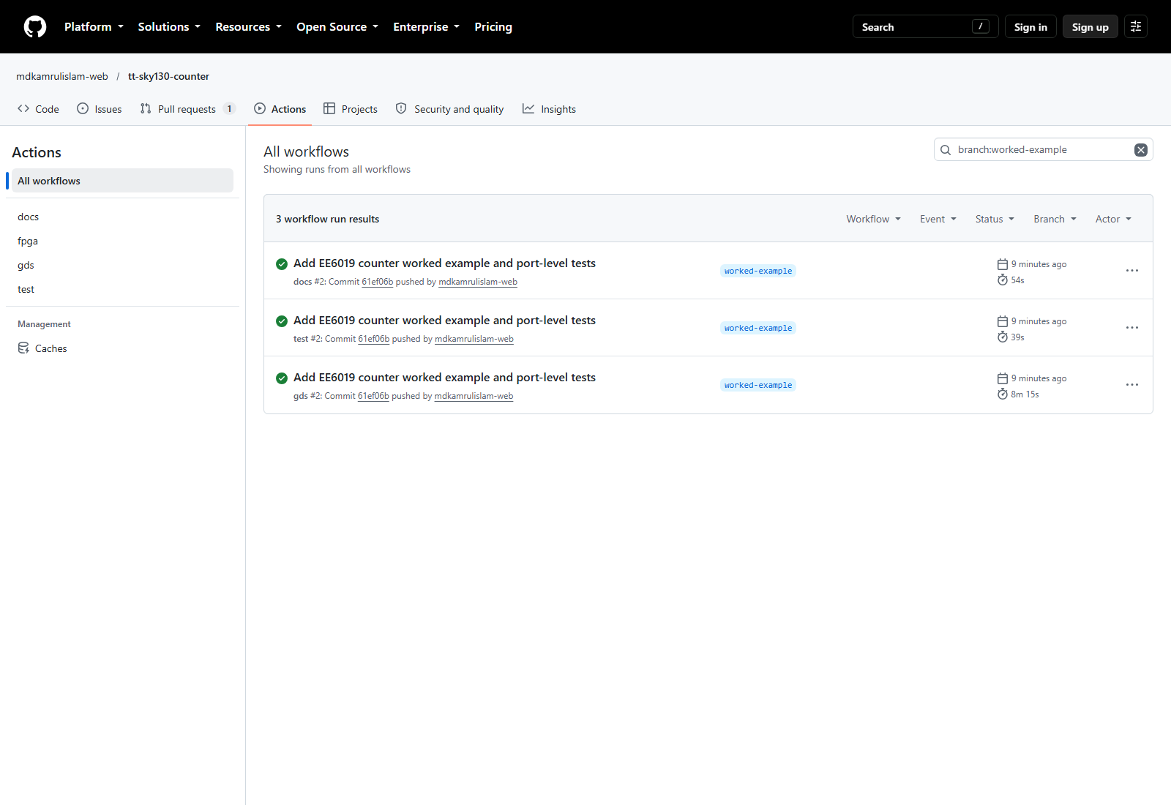
A REPRODUCIBLE RESULT ON GITHUB
06
Push once. Check three green workflows.
A commit starts three automated jobs: test checks behaviour,
gds builds and checks layout, docs writes the datasheet.
docs PASS
Datasheet generated
test PASS
Reset, count, hold, wrap
gds PASS
All four jobs succeeded
Worked example: tt-sky130-counter • commit 61ef06b
ACTUAL GITHUB EVIDENCE • FPGA IS OPTIONAL AND WAS NOT RUN
EE6019 • Tiny Tapeout • 8 October 2026 • Sources and teaching notes in PowerPoint
13
Notes:
LECTURER NOTES
A commit captures a specific version. test checks behaviour, gds builds/checks the layout and docs writes the datasheet. The actual public worked-example branch has all three workflows passing at 61ef06b. The gds workflow has gds, precheck, gl_test and viewer jobs, and every one passed in run 37693100748. Native PowerPoint crop magnifies the genuine workflow rows; the original screenshot remains in img/. Match results to the commit intended for review. fpga is optional and was not run. A passing build does not reserve or submit a tile.
BEGINNER EXAMPLE / REVIEW NOTES
P3 is captured from the real public Actions list filtered to branch worked-example. It shows docs, test and gds all successful at 61ef06b. The optional fpga workflow has not run. Native PowerPoint crop magnifies the three workflow rows, retaining the real workflow labels and commit; it does not alter the results. Each pass label describes a genuine workflow result.
SOURCES (checked 7 October 2026)
https://github.com/TinyTapeout/ttsky-verilog-template/blob/main/.github/workflows/test.yaml
https://github.com/TinyTapeout/ttsky-verilog-template/blob/main/.github/workflows/gds.yaml
https://github.com/TinyTapeout/ttsky-verilog-template/blob/main/.github/workflows/docs.yaml
https://github.com/TinyTapeout/ttsky-verilog-template/blob/main/.github/workflows/fpga.yaml
https://github.com/mdkamrulislam-web/tt-sky130-counter/actions?query=branch%3Aworked-example

Slide 14
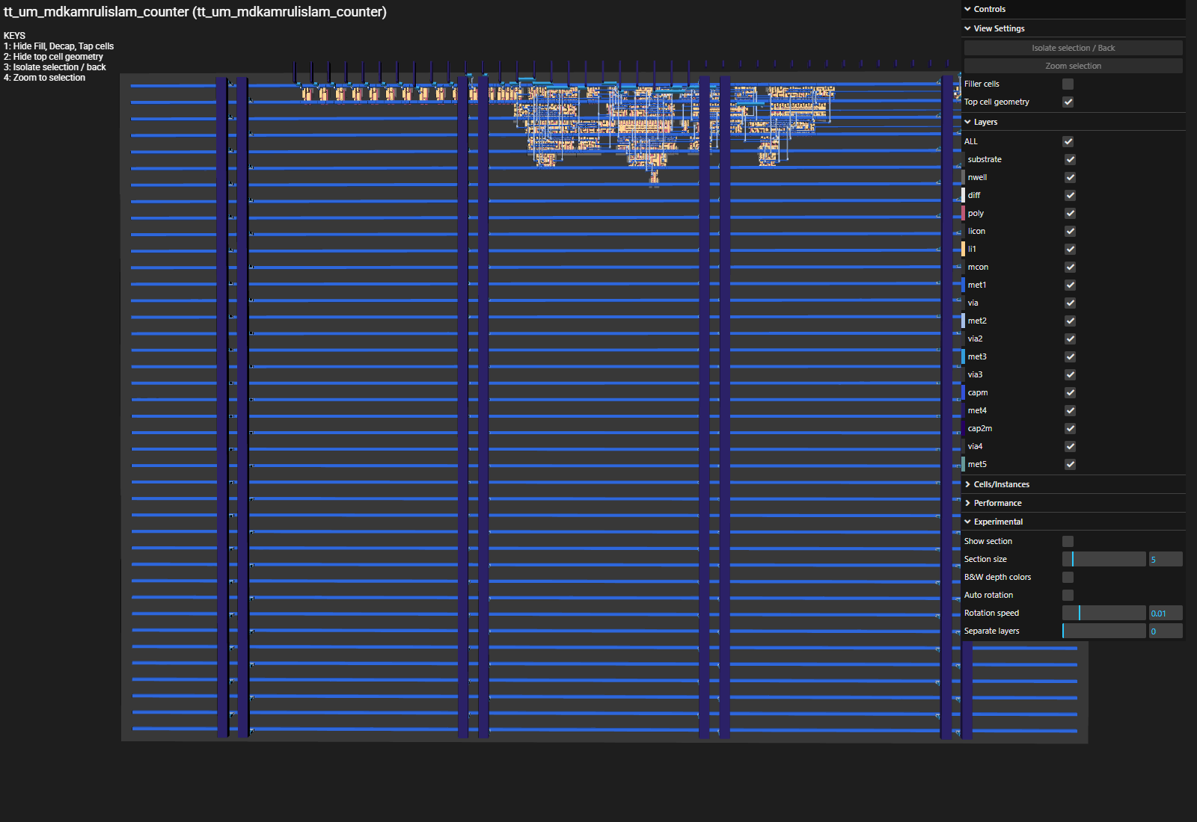
GDS = THE FILE THAT DESCRIBES THE CHIP LAYERS
07
A layout is geometry, not a photograph
Look for three things
1 Logic + wiring
2 Warnings + timing
3 Precheck + gl_test
Open the actual viewer ↗
Filler cells hidden.
P4 metrics capture pending.
EE6019 • Tiny Tapeout • 8 October 2026 • Sources and teaching notes in PowerPoint
14
Notes:
LECTURER NOTES
The visible P5 image is a genuine loaded browser 3D viewer capture of the published counter OAS, from GDS run 37693100748 at 61ef06b. The viewer's native Filler cells checkbox is off. The useful logic is clustered near the top; horizontal power rails cross the tile. Filler cells support implementation/manufacturing and are not extra logic. The viewer refits when visibility changes, so do not compare full-filler and hidden-filler pictures by pixel area. The original full viewer and 2D gds_render images remain as assets. Read actual warnings, cell taxonomy, utilisation, timing and precheck results. The run-overview screenshot is captured; P4 still needs the metrics/cell-table view. A good-looking layout and passing functional simulation do not replace timing and manufacturing checks.
BEGINNER EXAMPLE / REVIEW NOTES
All actual counter jobs passed. P5 is a genuine loaded browser 3D viewer capture of the published OAS from run 37693100748. The viewer's native Filler cells checkbox is off, so the useful logic is easier to find. The viewer refits the camera when visibility changes: do not use the screenshots as a pixel-area comparison. The original 2D gds_render and full-filler viewer capture remain as source assets. P4 still needs the metrics/cell-table view; the run summary itself has been captured.
SOURCES (checked 7 October 2026)
https://tinytapeout.com/hdl/important/#check-the-synthesis-warnings
https://github.com/mdkamrulislam-web/tt-sky130-counter/actions/runs/37693100748
https://github.com/TinyTapeout/ttsky-verilog-template/blob/main/.github/workflows/gds.yaml
https://gds-viewer.tinytapeout.com/?pdk=sky130A&model=https%3A%2F%2Fmdkamrulislam-web.github.io%2Ftt-sky130-counter%2Ftinytapeout.oas
https://mdkamrulislam-web.github.io/tt-sky130-counter/

Slide 15
INSIDE THE AUTOMATED GDS FLOW
Tools turn behaviour into cells and wires
Map logic
Place + route
Check
Timing
Before next edge?
AND
DFF
DRC
Wire spacing okay?
OR
LVS
Same connections?
Yosys + ABC
OpenROAD
Timing + DRC + LVS
EE6019 • Tiny Tapeout • 8 October 2026 • Sources and teaching notes in PowerPoint
15
Notes:
LECTURER NOTES
LibreLane orchestrates implementation. Synthesis maps Verilog into standard-cell instances; place and route chooses their locations and joins them with wires. These steps together are commonly called hardening. Timing asks whether signals reach registers before the next required edge and remain stable long enough. DRC checks physical rules such as minimum wire spacing; LVS checks that extracted circuit connections match the intended netlist. Tool roles describe the flow family, not a guarantee that each tool runs for every PDK: the IHP config disables KLayout DRC and XOR. Current workflow action versions differ by process. Commercial equivalents belong to the survey rather than this beginner diagram.
SOURCES (checked 7 October 2026)
https://librelane.readthedocs.io/en/latest/reference/flows.html
https://github.com/TinyTapeout/ttihp-verilog-template/blob/main/src/config.json
https://github.com/YosysHQ/yosys
https://github.com/The-OpenROAD-Project/OpenROAD
https://github.com/The-OpenROAD-Project/OpenSTA

Slide 16
RUN THE SAME FUNCTIONAL TESTS ON GATES
08
Check the synthesised circuit too
RTL: your Verilog description
One testbench
Same outputs
0 → 1 → hold 1 → reset 0
Gates: the mapped cell netlist
0 → 1 → hold 1 → reset 0
In test/: make -B GATES=yes • needs gate_level_netlist.v and PDK_ROOT.
EE6019 • Tiny Tapeout • 8 October 2026 • Sources and teaching notes in PowerPoint
16
Notes:
LECTURER NOTES
Repeat the behavioural checks on the synthesised cell netlist. The actual counter RTL test and gl_test passed at 61ef06b. The gl_test job sets up cell models and power connections. To run locally, harden first, copy the matching final Verilog netlist into test/gate_level_netlist.v, set PDK_ROOT to the installed matching PDK, enter test/ and run make -B GATES=yes. Then check results.xml explicitly as with RTL simulation. This deck build does not install a PDK or run hardening locally. Functional gate-level simulation does not replace static timing analysis or SDF-based timing simulation.
BEGINNER EXAMPLE / REVIEW NOTES
The actual counter RTL and gl_test both passed at61ef06b. Functional gate-level simulation uses PDK cell models and power connections. It does not replace static timing analysis or SDF timing simulation. The statement on the slide distinguishes function from speed without presenting gl_test as timing sign-off.
SOURCES (checked 7 October 2026)
https://github.com/TinyTapeout/ttsky-verilog-template/blob/main/test/README.md
https://github.com/TinyTapeout/ttsky-verilog-template/blob/main/test/Makefile
https://github.com/TinyTapeout/ttsky-verilog-template/blob/main/.github/workflows/gds.yaml
https://tinytapeout.com/hdl/testing/#gate-level-testing
https://github.com/mdkamrulislam-web/tt-sky130-counter/blob/61ef06bed008e76000f9ae46d65182e476d15dd6/test/Makefile
https://github.com/mdkamrulislam-web/tt-sky130-counter/actions/runs/37693100748

Slide 17
READ THE FIRST USEFUL ERROR
A real first failure: empty project information
BEFORE • TEMPLATE DEFAULTS
AFTER • DESCRIBE THE COUNTER
title: ""
author: ""
description: ""
title: "8-bit counter"
author: "Your name"
description: "Count, hold, reset"
YAML excerpts: these fields belong inside project:
Fix one cause → commit → rerun → read the new result.
Then check: top name • source files • assertions • tile area • timing.
No counter assertion failed; this genuine example is a metadata error.
EE6019 • Tiny Tapeout • 8 October 2026 • Sources and teaching notes in PowerPoint
17
Notes:
LECTURER NOTES
The genuine initial-template GDS run 37693066241 failed validation because project title, author and description were empty. The visible before/after YAML snippets are excerpts: the fields belong inside the parent project: mapping. The worked-example commit filled the metadata and all workflows passed. This is a setup/metadata failure, not a failed counter assertion. No counter assertion failed. P6 is optional future evidence if a real assertion fails during teaching; no failing run is required to review this deck. When debugging, read the first useful error, change one cause and rerun. For area or timing changes, seek staff guidance and compare the new reports; density and hold-margin changes are not general fixes.
BEGINNER EXAMPLE / REVIEW NOTES
The initial template gds run37693066241 genuinely failed because project title, author and description were empty. This is metadata validation, not a failed RTL assertion. The worked-example commit filled these fields and all workflows passed. P6 is optional future assertion-failure evidence; no counter assertion failed. Do not invent a failed test. The contrasting snippets are teaching excerpts of metadata, not screenshots.
SOURCES (checked 7 October 2026)
https://github.com/TinyTapeout/ttsky-verilog-template/blob/main/src/config.json
https://github.com/TinyTapeout/ttihp-verilog-template/blob/main/src/config.json
https://tinytapeout.com/faq/#my-gds-action-is-taking-much-longer-than-usual
https://github.com/TinyTapeout/ttsky-verilog-template/blob/main/.github/workflows/test.yaml
https://github.com/mdkamrulislam-web/tt-sky130-counter/actions/runs/37693066241
https://github.com/mdkamrulislam-web/tt-sky130-counter/blob/61ef06bed008e76000f9ae46d65182e476d15dd6/info.yaml

Slide 18
EXPLAINED ONLY • NO RESERVATION OR PAYMENT
09
Choose the revision for fabrication
1
2
3
4
5
Sign in
Choose shuttle
Add repo
Review price
Submit revision
GitHub account
Correct fab
Public source
Payment / coupon
Verified commit
A new GitHub push needs a new submitted revision before the deadline.
EE6019 • Tiny Tapeout • 8 October 2026 • Sources and teaching notes in PowerPoint
18
Notes:
LECTURER NOTES
Demonstrate the sequence verbally without making a submission: sign in at the app with GitHub, select the intended shuttle, supply the public repository URL, review price or class coupon, then explicitly submit a revision. A passing build does not by itself reserve a place or select a fabrication revision. A later GitHub push does not automatically update the submitted revision; submit the updated revision before the shuttle deadline. Only the course lead or supervisor should authorise the paid reservation and submission. No app action, payment or reservation was performed while building this material.
SOURCES (checked 7 October 2026)
https://tinytapeout.com/guides/advanced-workshop/submit-your-design/
https://tinytapeout.com/guides/workshop/create-your-gds/
https://tinytapeout.com/faq/#which-of-my-builds-will-be-submitted-for-fabrication
https://tinytapeout.com/chips/

Slide 19
AFTER FABRICATION • CHOOSE YOUR TILE
On the board, test the same behaviour
Select your project.
Set a slow clock.
rst_n = 0 until ↑clk:
count becomes 0.
Enable: 0 → 1 → 2.
Disable: count holds.
Controller
ASIC tile
Switch / PMOD
Inputs
Binary pins
Read back count
No seven-segment decoder is included.
Synchronous enable assumed: synchronise and debounce a real switch.
EE6019 • Tiny Tapeout • 8 October 2026 • Sources and teaching notes in PowerPoint
19
Notes:
LECTURER NOTES
This editable diagram is conceptual, not a board photograph or connector pinout. Latest ETR boards use RP2350B; older boards use RP2040. Follow the board-revision guide and configure one driver per input. The controller selects the project and supplies a slow clock or single-step clock. Assert rst_n low until a rising edge, then release it. Enable causes 0, 1, 2; disable holds count. Counter output is eight binary bits, readable with a controller or suitable bit indicators. No seven-segment decoder is included. A physical enable switch needs synchronisation and debounce; the minimal RTL assumes stable synchronous enable. Do not connect a raw bouncing button as a clock.
BEGINNER EXAMPLE / REVIEW NOTES
Begin at a slow clock or single-step while watching count. The current ETR board uses RP2350B; older boards use RP2040. Mode and pin ownership matter when using switches versus controller-driven inputs. A real switch enable needs synchronisation/debounce; the minimal worked example assumes stable synchronous enable.
SOURCES (checked 7 October 2026)
https://tinytapeout.com/guides/get-started-demoboard-etr/
https://tinytapeout.com/specs/pcb-etr/
https://commander.tinytapeout.com/

Slide 20
YOUR SIX CHECKPOINTS
Show your evidence before a submission review
Behaviour and pins are written down.
RTL, metadata and test setup agree.
Reset, count, hold and wrap tests pass.
test, gds and docs pass at one commit.
Area, timing, warnings and datasheet are reviewed.
Teacher approves shuttle, terms, budget and revision.
EE6019 • Tiny Tapeout • 8 October 2026 • Sources and teaching notes in PowerPoint
20
Notes:
LECTURER NOTES
Ask students to attach evidence to each line: specification, file review, local results, commit-specific workflow URLs, metrics and datasheet. The FPGA workflow is optional. Students should be able to explain one failure and the fix; a green badge without that explanation is insufficient. Submission approval is an explicit staff checkpoint, not an invitation to pay during the lab.
SOURCES (checked 7 October 2026)
https://github.com/TinyTapeout/ttsky-verilog-template/blob/main/README.md
https://github.com/TinyTapeout/ttsky-verilog-template/blob/main/.github/workflows/gds.yaml
https://tinytapeout.com/guides/advanced-workshop/submit-your-design/

Slide 21
PREDICT THE OUTPUT BEFORE YOU CHANGE THE RTL
Lab: make the counter count down
EXPECTED COUNT-DOWN SEQUENCE
0
255
254
count <= count - 1'b1;
1 Define the new wrap / underflow rule.
2 Change RTL + expected test values.
3 Push; compare area and timing.
Unsigned 8-bit count:
what is 0 − 1?
255 (it wraps).
Submit a commit with evidence; no shuttle booking during this exercise.
EE6019 • Tiny Tapeout • 8 October 2026 • Sources and teaching notes in PowerPoint
21
Notes:
LECTURER NOTES
Students can start from the public worked-example branch, define count-down behaviour and write expected tests before editing RTL. Unsigned 8-bit subtraction is modulo 256: 0-1 gives 255, then 254. Define the terminal-count/underflow flag afresh: existing wrap detects count=255 while enabled for count-up; a count-down underflow flag would commonly detect count=0 while enabled. Specify and test that choice. Keep the fixed top interface. Produce test, gds and docs passes at one commit; compare synthesis cell count and reported utilisation. FPGA is optional. No class booking or paid submission occurs in this exercise.
BEGINNER EXAMPLE / REVIEW NOTES
At reset the8-bit counter is0. A modulo256 count-down counter goes0,255,254 when enabled. Its terminal flag must be defined afresh: the existing wrap indicates count255 with enable1 for count-up. For count-down a logical underflow condition would usually be count0 with enable1. Students must specify and test this choice, not merely swap plus for minus. Expected quiz answer:0−1 modulo256 is255.
SOURCES (checked 7 October 2026)
https://github.com/mdkamrulislam-web/tt-sky130-counter/tree/worked-example
https://github.com/TinyTapeout/ttsky-verilog-template/blob/main/test/README.md
https://github.com/TinyTapeout/ttsky-verilog-template/blob/main/info.yaml
https://github.com/TinyTapeout/ttsky-verilog-template/blob/main/.github/workflows/gds.yaml
https://github.com/mdkamrulislam-web/tt-sky130-counter/blob/61ef06bed008e76000f9ae46d65182e476d15dd6/src/counter.v
https://github.com/mdkamrulislam-web/tt-sky130-counter/blob/61ef06bed008e76000f9ae46d65182e476d15dd6/test/test.py

Slide 22
OFFICIAL REFERENCES TO KEEP OPEN
Learn one layer deeper
Start
Templates ↗
Connect
HDL interface rules ↗
Verify
Testing guide ↗
Understand
Making ASICs + factory tour ↗
Check limits
Technical specs ↗
Plan
Shuttles + FAQ ↗
EE6019 • Tiny Tapeout • 8 October 2026 • Sources and teaching notes in PowerPoint
22
Notes:
LECTURER NOTES
Use these links in order: the template, interface rules, test setup, process and I/O constraints, schedule and help. All cards are hyperlinks. Older videos remain useful for the concepts but their store, fabrication partner, config.tcl and waveform names can differ from current templates. Prefer the actual current repo file when a guide is outdated. Suggested videos: idea-to-chip https://www.youtube.com/watch?v=qVWq_XZko-M ; HDL https://www.youtube.com/watch?v=KbWb6xd9jFE ; submission https://www.youtube.com/watch?v=fCGPKdmM3Dc ; physical design and manufacturing videos are embedded at making_asics. Watching them remains a lecturer preparation task, not a completed claim.
SOURCES (checked 7 October 2026)
https://tinytapeout.com/hdl/templates/
https://tinytapeout.com/hdl/important/
https://tinytapeout.com/hdl/testing/
https://tinytapeout.com/specs/
https://tinytapeout.com/chips/
https://tinytapeout.com/faq/
https://tinytapeout.com/making_asics/

Slide 23
APPENDIX A • STARTING PRICES, NOT A QUOTE
Staff: budget projects and shared hardware
5
25
75
projects, up to
projects, up to
projects, up to
1 PCB kit
3 PCB kits
5 PCB kits
€565
€2,195
€5,325
75 one-tile projects can cover a class of about 70; five kits are shared.
EE6019 • Tiny Tapeout • 8 October 2026 • Sources and teaching notes in PowerPoint
23
Notes:
LECTURER NOTES
The official teaching page lists starting prices, not a quotation: up to 5 one-tile projects and one PCB kit for EUR565; up to 25 and three kits for EUR2195; up to 75 and five kits for EUR5325. A kit has a chip with all shuttle projects. A 75-project bundle could cover roughly 70 one-tile student projects, but not one board per student. Larger or analogue projects reduce project count. Obtain an institutional quote and confirm current taxes, shipping, ownership terms and availability before a commitment.
SOURCES (checked 7 October 2026)
https://tinytapeout.com/teaching/
https://tinytapeout.com/terms/

Slide 24
APPENDIX B • 7 OCTOBER 2026 SNAPSHOT
Staff: a template pin is not an open booking
TEMPLATE
ACTION PIN
SUBMISSION DEADLINE
SKY
ttsky26d
30 Nov 2026
GF
ttgf26c
7 Dec 2026
IHP
ttihp26b
Closed 21 Sep 2026
Next IHP: March 2027 planned; exact day unpublished.
Estimated shipping: Q1 2028. Re-check before committing.
EE6019 • Tiny Tapeout • 8 October 2026 • Sources and teaching notes in PowerPoint
24
Notes:
LECTURER NOTES
The SKY template pins ttsky26d and the schedule closes that shuttle on 30 November 2026. The GF template pins ttgf26c, closing on 7 December 2026. The IHP template still pins ttihp26b, which closed on 21 September 2026. TTIHP27a is planned for March 2027; no day is listed, and estimated shipping is Q1 2028. Other future schedule rows are estimates: GF27a April 2027 and SKY27a May 2027. Never interpret an action tag as evidence of currently open space. Refresh tags, deadlines, availability and shipping estimates before using this appendix for a course.
SOURCES (checked 7 October 2026)
https://tinytapeout.com/chips/
https://github.com/TinyTapeout/ttsky-verilog-template/blob/main/.github/workflows/gds.yaml
https://github.com/TinyTapeout/ttihp-verilog-template/blob/main/.github/workflows/gds.yaml
https://github.com/TinyTapeout/ttgf-verilog-template/blob/main/.github/workflows/gds.yaml

Slide 25
APPENDIX C • CURRENT SHUTTLE TERMS STILL REQUIRED
Staff: verify the exact IHP loan agreement
REPORTED IN PRIOR PROGRAMME MATERIAL
CONFIRM FOR THE CHOSEN SHUTTLE
IHP retains chip ownership.
Default loan: two years.
No resale or transfer.
EU + Switzerland shipping.
Read the current agreement.
Check student ownership.
Check duration and returns.
Record terms before payment.
These historical restrictions need official confirmation for the selected run.
EE6019 • Tiny Tapeout • 8 October 2026 • Sources and teaching notes in PowerPoint
25
Notes:
LECTURER NOTES
The supplied project background reports two-year loans of IHP-owned chips, no resale and shipping only to the EU and Switzerland, referring to the IHP25b programme. The general Tiny Tapeout terms and current static schedule were read, but a current official shuttle-specific loan agreement could not be retrieved from the JavaScript submission app. Therefore this slide deliberately identifies the reported restrictions as requiring confirmation, not as verified 2027 terms. Before procurement, the course lead must read the exact agreement shown for the chosen shuttle and record ownership, permitted transfer, loan duration, geography and return obligations. Do not assume a student can keep the chip forever or that SKY/GF have identical terms.
SOURCES (checked 7 October 2026)
https://tinytapeout.com/terms/
https://app.tinytapeout.com/shuttles/ttihp26b
https://tinytapeout.com/chips/

Slide 26
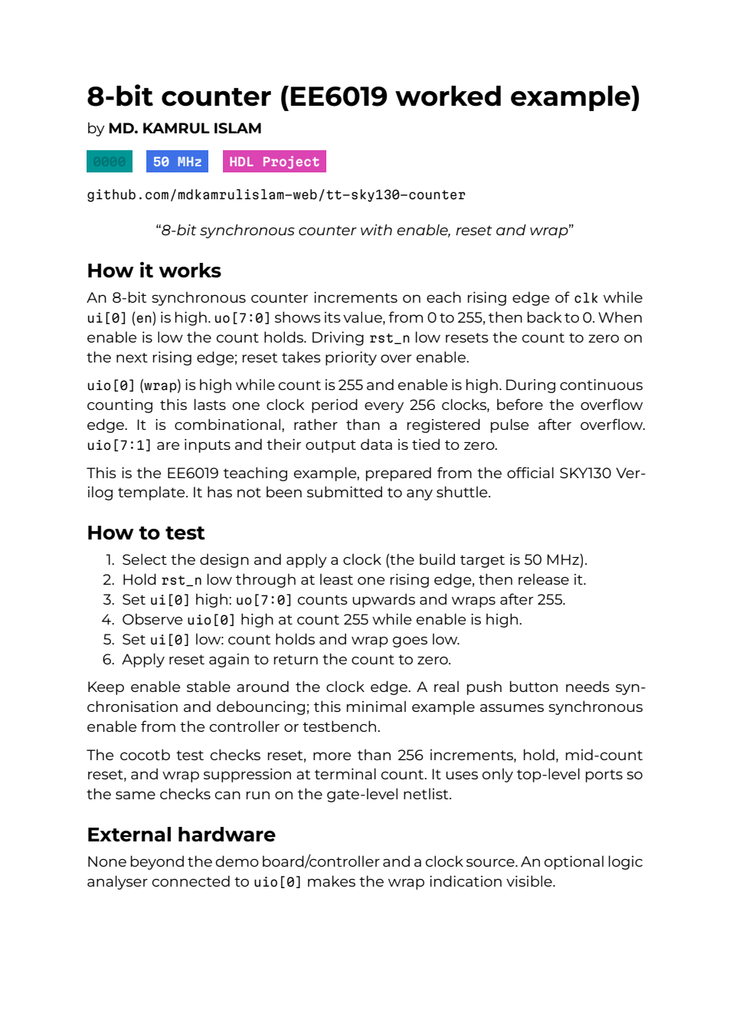
APPENDIX D • ACTUAL ARTIFACTS AND REMAINING CAPTURES
Staff: finish the evidence pack
Captured: Actions, datasheet,
GDS render and real 3D viewer.
P1 Signed-in template menu
P2 Pages source setting
P4 gds metrics + cell table
P8 Reset / count / hold / wrap waveform
P6 Optional future assertion-failure example
Capture instructions: docs/slides/README.md
EE6019 • Tiny Tapeout • 8 October 2026 • Sources and teaching notes in PowerPoint
26
Notes:
LECTURER NOTES
Captured evidence: P3 actual Actions list, P5 genuine loaded 3D viewer and P7 generated datasheet. A real GDS render and all-four-jobs overview are also retained. Remaining captures are P1 signed-in template menu; P2 Pages source setting; P4 metrics/cell table from run 37693100748; P6 an optional future assertion failure and its correction; P8 the actual tb.fst waveform showing reset, count, hold and terminal-count/wrap. The old 150-by-150 micrometre custom LibreLane layout is retained only as provenance and is not Tiny Tapeout evidence. The README contains exact routes, run/commit identity, dependencies and reproduction instructions. No paid submission was performed.
BEGINNER EXAMPLE / REVIEW NOTES
P3, P5 and P7 are captured from genuine public CI/browser artifacts. P4 run overview is captured but its metrics/cell table remains pending. The old 150-by-150 µm custom LibreLane render remains in img/counter-sky130-background.png for provenance only and is not used as Tiny Tapeout evidence. Pending P1 requires signed-in template menu; P2 requires repo settings; P4 is the metrics/cell table; P6 is optional future assertion-failure evidence; P8 is the real FST waveform view. README gives exact routes.
SOURCES (checked 7 October 2026)
https://github.com/mdkamrulislam-web/tt-sky130-counter
https://github.com/mdkamrulislam-web/tt-sky130-counter/actions/runs/37693100748
https://github.com/mdkamrulislam-web/tt-sky130-counter/actions/runs/37693100755
https://tinytapeout.com/hdl/templates/

