Slide 1
Monitoring Jobs and Inflation
Professor Syed A. Mamun, PhD, FCMA

Slide 2

Learning Objectives
Explain why unemployment is an important macroeconomic problem.
Define and measure employment, unemployment, and labor force participation.
Distinguish among frictional, structural, and cyclical unemployment.
Explain the concept of full employment and the natural unemployment rate.
Understand inflation and its economic costs.
Measure inflation using the Consumer Price Index (CPI).
Identify biases in CPI measurement. Interpret labor market and inflation statistics for policy analysis.

Slide 3
Why Unemployment Matters
Unemployment is one of the most closely watched economic indicators because it creates:
Lost Income and Production
  Workers lose wages.
  Firms produce less output.
  National income declines.
  Economic growth slows.
Loss of Human Capital
  Human capital refers to workers' skills, knowledge, and experience.
  Long-term unemployment can:
  Reduce skills
  Lower future earnings
  Make workers less employable

Slide 4

Measuring Employment and Unemployment
Working-Age Population
The working-age population includes people legally eligible to work.
It excludes children and some institutionalized individuals.
Combination of Labor Force and Not in Labor Force
Labor Force
Labor Force = Employed + Unemployed
People are in the labor force if they:
Have a job, or
Are actively looking for work
Not in workforce
Full-time students not seeking jobs
Retirees
Homemakers
Discouraged workers

Slide 5

Employed vs Unemployed Person
Who Is Employed?
A person is employed if:
Works full-time or part-time
Is temporarily absent from work
Is self-employed
Who Is Unemployed?
A person is unemployed if:
Has no job
Is available for work
Has actively searched recently
Waiting to be recalled after a layoff
Waiting to start a new job soon

Slide 6
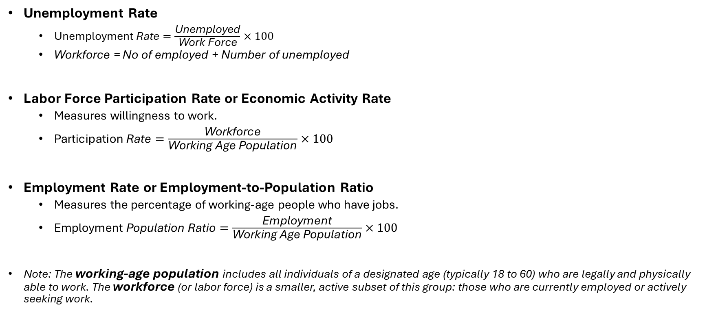
Key Labor Market Indicators
Unemployment Rate
  $\text{Unemployment} \text{Rate}=\frac{\text{Unemployed}}{\text{Work} \text{Force}}×100$
  Workforce = No of employed + Number of unemployed
Labor Force Participation Rate or Economic Activity Rate
  Measures willingness to work.
  $\text{Participation} \text{Rate}=\frac{\text{Workf}\text{orce}}{\text{Working} \text{Age} \text{Population}}×100$
Employment Rate or Employment-to-Population Ratio
  Measures the percentage of working-age people who have jobs.
  $\text{Employment} \text{Population} \text{Ratio}=\frac{\text{Employment}}{\text{Working} \text{Age} \text{Population}}×100$
Note: The working-age population includes all individuals of a designated age (typically 18 to 60) who are legally and physically able to work. The workforce (or labor force) is a smaller, active subset of this group: those who are currently employed or actively seeking work.

Slide 7

Why Unemployment Rate Is Imperfect
The unemployment rate does not capture all labor market problems.
Discouraged Workers
People who want jobs but stopped searching
As they are not counted as unemployed, unemployment may be understated.
Underemployment
People who are Working part-time and want full-time jobs
Counted as employed although labor is underutilized.
Marginally Attached Workers
People who Want jobs and Occasionally search
Not counted in official unemployment statistics.

Slide 8
Unemployment and Full Employment
Frictional Unemployment
  Occurs when workers are temporarily between jobs, looking for their first role, or re-entering the workforce.
Structural Unemployment
  Changes of technology and competition cause unemployment
  A long-term mismatch between the skills workers possess and the skills demanded by the job market.
Cyclical Unemployment
  Joblessness that fluctuates directly with the business cycle, rising during recessions and falling during economic expansions.
Natural Unemployment
  When all unemployment is fractional and structural
  Full employment is the context when unemployment is equal to Natural Unemployment.
Type | Cause | Example
Frictional | Job search | New graduate
Structural | Skills mismatch | Worker replaced by automation
Cyclical | Recession | Factory layoffs

Slide 9
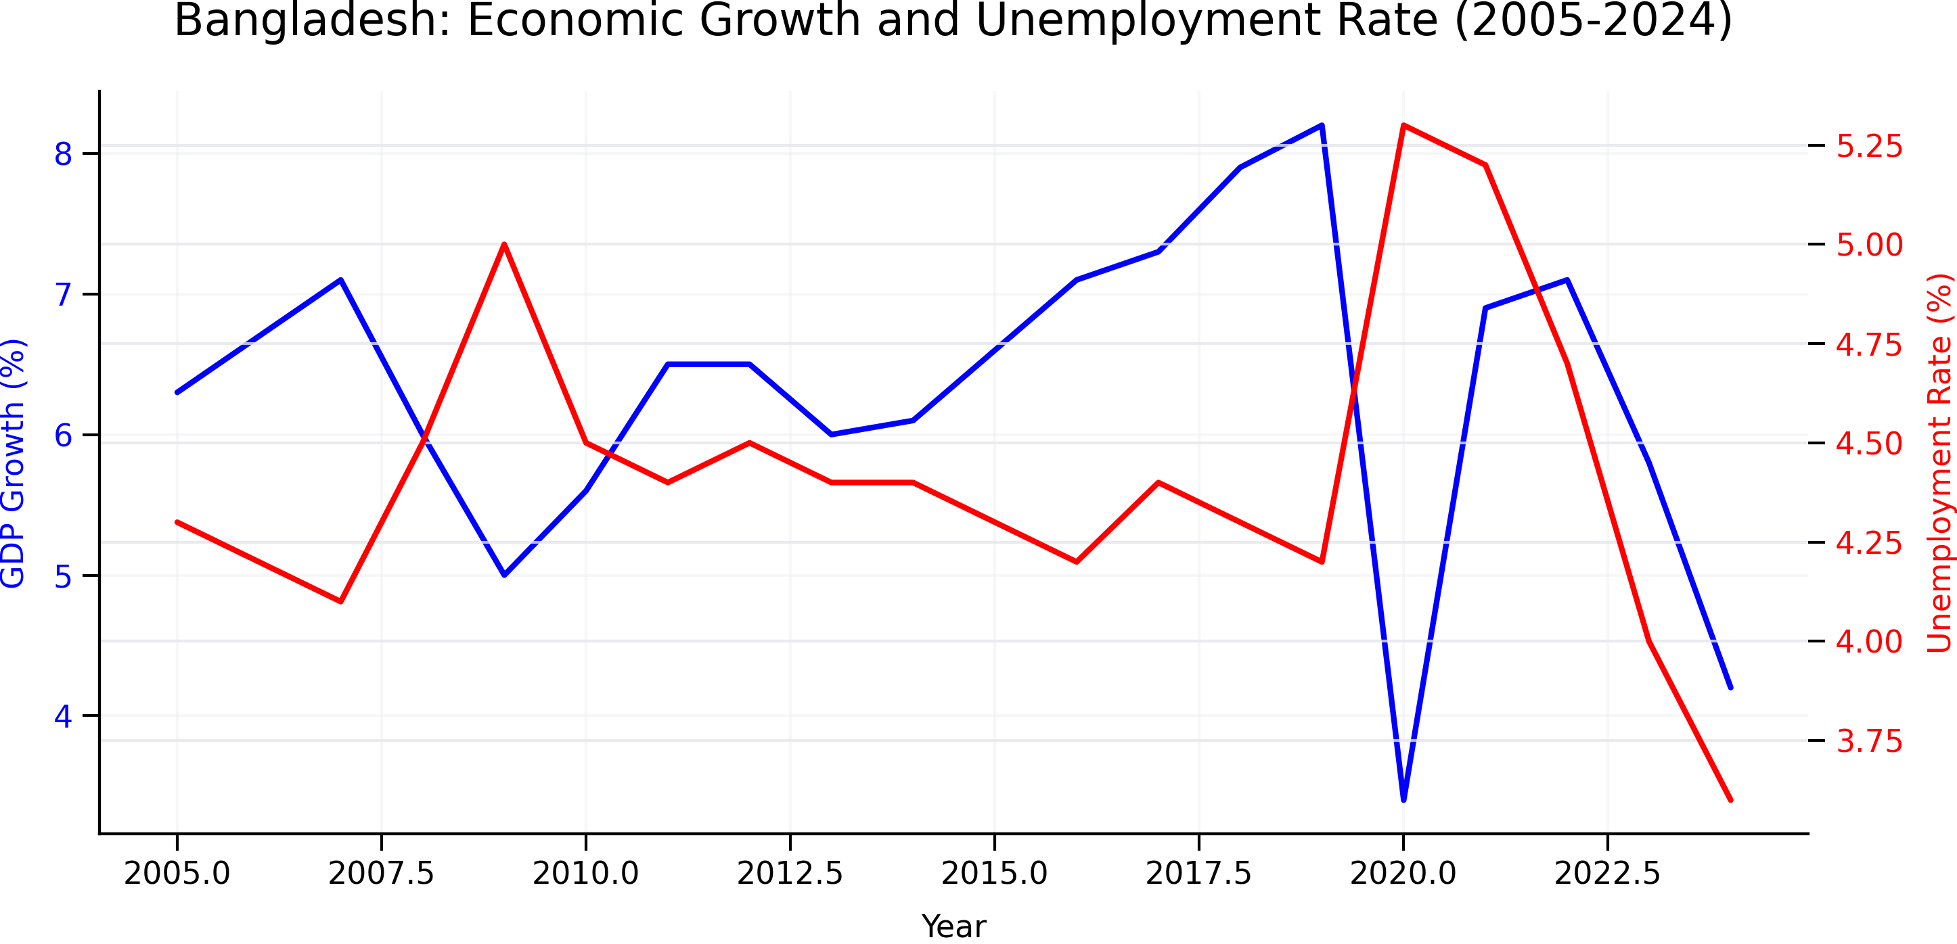

Slide 10

Full Employment
Full employment does NOT mean zero unemployment.
Even in a healthy economy
Some workers change jobs
Some industries evolve
Therefore
Full Employment Exists When Only
Frictional unemployment
Structural unemployment remain.

Slide 11

Natural Unemployment Rate
The unemployment rate that exists at full employment.
$\text{Natural} \text{Rate}=\text{Frictional}+\text{Structural}$
It does not include Cyclical Unemployment

Slide 12
Factors affect Natural Unemployment
The age distribution of the population
The scale of structural change
The real wage rate
Unemployment benefits

Slide 13
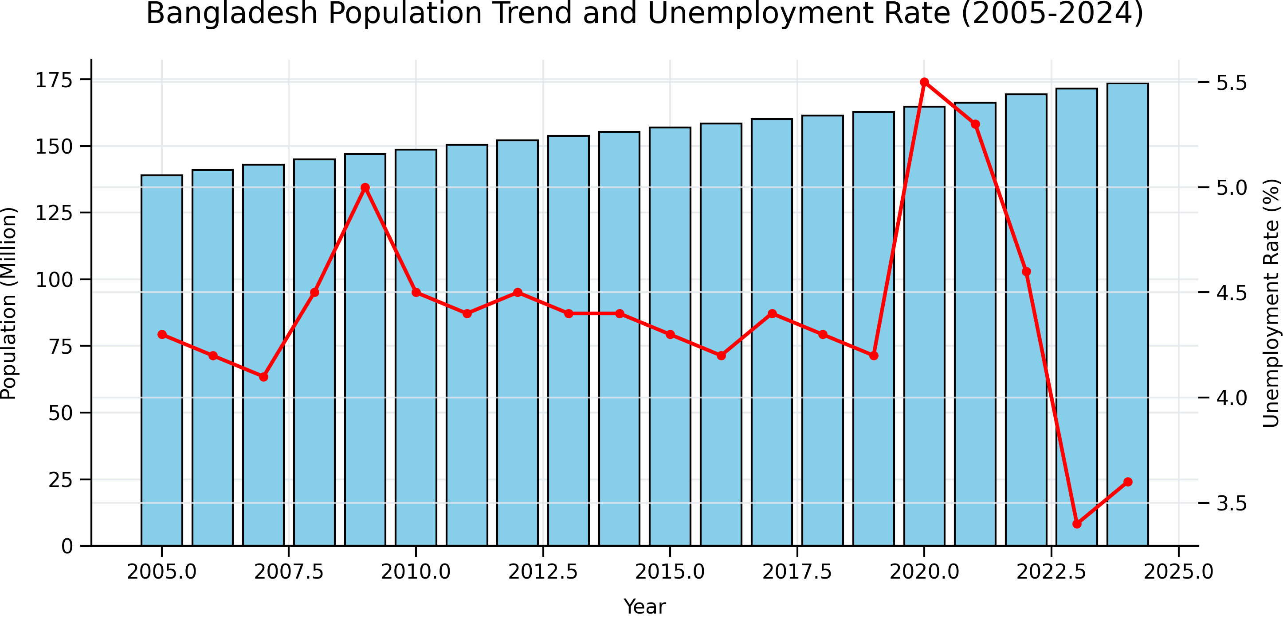

Slide 14
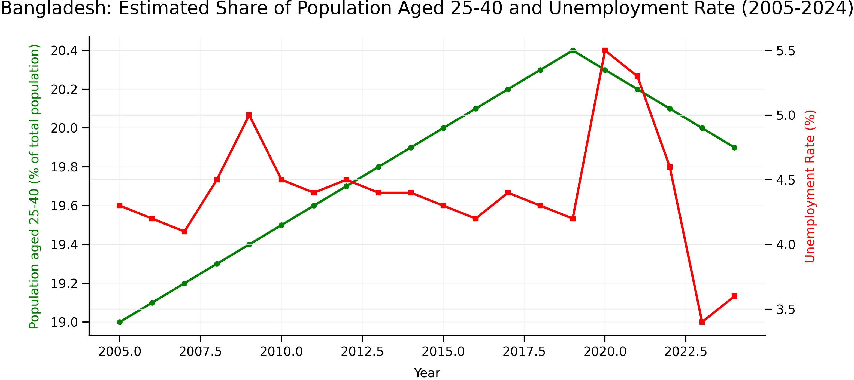

Slide 15
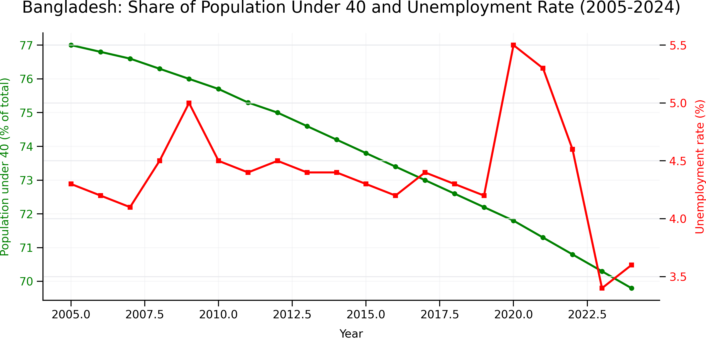

Slide 16
Inflation

Slide 17
Price level
Price Level
  The price level is the average level of prices of all goods and services in an economy at a particular time.
  It tells us:
    Whether goods are becoming more expensive.
    Whether purchasing power is rising or falling.
    Whether inflation exists.
Why Price Level Matters
  Price level affects
  Household purchasing power
  Business investment
  Interest rates
  Wage negotiations
  Government policies
  International competitiveness

Slide 18
Changes of Price level
Product | 2024 Price (Tk.) | 2025 Price (Tk.)
Rice | 70 | 80
Fish | 400 | 460
Milk | 90 | 100
Bus Fare | 20 | 25

Slide 19

Consumer Price Index (CPI)
The Consumer Price Index (CPI) measures the average price of a fixed basket of goods and services purchased by a typical household.
$CPI=\frac{\text{Cost} \text{of} \text{Basket} \text{in} \text{Current} \text{Year}}{\text{Cost} \text{of} \text{Basket} \text{in} \text{Base} \text{Year}}×100$
Example
  Base Year Basket Cost = Tk. 4,000
  Current Basket Cost = Tk. 5,200
  $CPI=\frac{5200}{4000}×100=130$
Prices are 30% higher than in the base year.

Slide 20
Inflation
Inflation is a persistent increase in the general price level over time.
It reduces the purchasing power of money.
Purchasing Power
  Suppose Tk.100 buys 2 kg rice today
  Next year Tk.100 buys 1.7 kg rice
  Money buys fewer goods.
  Purchasing power decreases.

Slide 21
Deflation
Deflation is a persistent decrease in the general price level.
Goods become cheaper.
Money gains purchasing power.
Inflation | Deflation
Prices increase | Prices decrease
Money loses value | Money gains value
Purchasing power falls | Purchasing power rises
Usually caused by excess demand | Usually caused by weak demand

Slide 22

Measuring Inflation Rate
$\text{Inflation} \text{Rate}=\frac{CPI_{t}−CPI_{t−1}}{CPI_{t−1}}×100$
Example
  CPI 2024 = 120
  CPI 2025 = 132
  $Inflation=\frac{132−120}{120}×100=10\%$
  Inflation Rate = 10%
Deflation Example
  CPI 2024 = 120
  CPI 2025 = 114
  $Deflation=\frac{114−120}{120}×100=−5\%$

