Slide 1
Email pattern matching by using antlr
Group members:
1.Khairul Hasib ID:2015-2-60-105
2.Fahmida Hassan ID:2015-2-60-114
3.Salma Rahman ID:2015-2-60-088

Slide 2
Overview
ANTLR tool
Context Free Grammar
Generating parse tree
Detecting Email
Examples

Slide 3
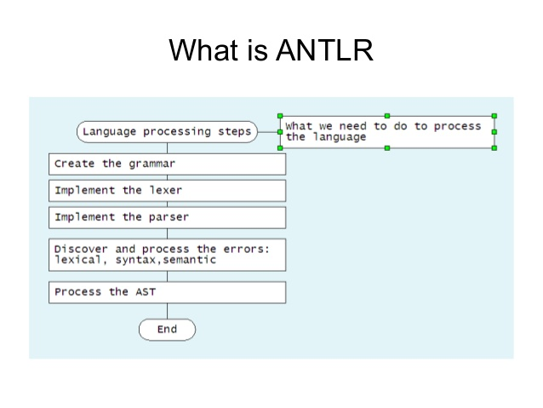

Slide 4
Why use ANTLR
A powerful parser generator
Can generates Java ,C#, C++ and Python
Flexible and decent error handling

Slide 5
Grammar Experiment
Prog:(em NEWLINE)*;
Em :exf (‘@’) exl;
Exf:ex|ex fex*;
Fex:(‘.’)ex;
Exl:ex fex*;
Ex:LE+
NEWLINE:[\r\n]+
LE:[a-z]+[0-9];

Slide 6
Examples:
Username123 @ mail .com
Compilerproject @ gmail. com
Antlr.ewu.bd
Ewu.edu.bd

Slide 7
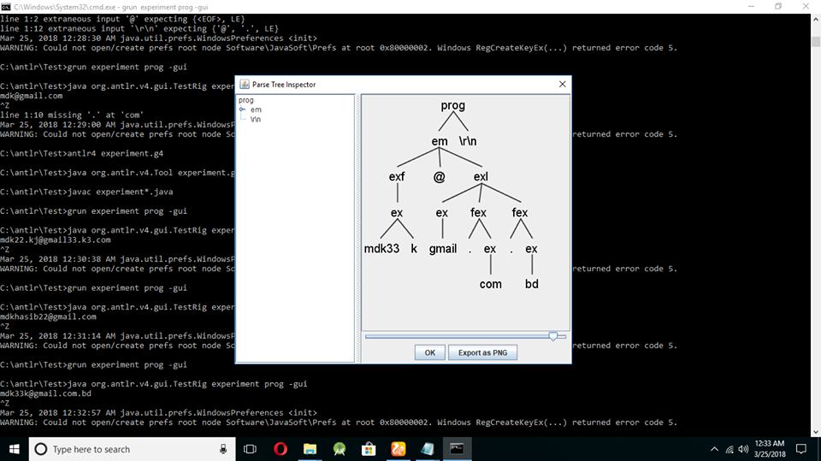
Parse Tree

Slide 8


Slide 9


