Slide 1
TCP Congestion Control TCP Simulator
By Vishal Boga & Mayunk Kulkarni

Slide 2
Introduction
Lots of students had expressed an inability to visualize and understand the various congestion algorithms in the TCP connection. As teachers did not have a proper simulator software to visualize and graph the packets being sent between two nodes in a TCP connection; this inspired us to work in understanding the various methods in congestion control in a TCP connection and making a user friendly interface to give a certain set of values to simulate the connection and returning results such as graphs and critical values.

Slide 3
Congestion Control Methods
Tahoe
Reno
New Reno

Slide 4
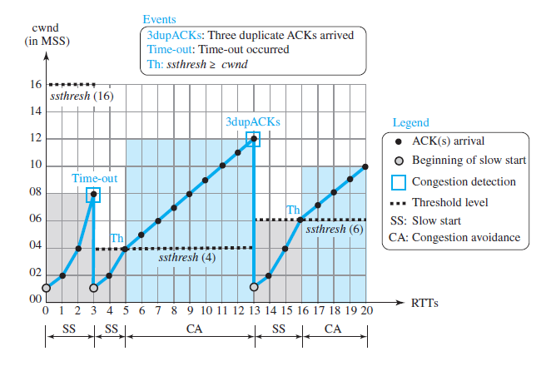
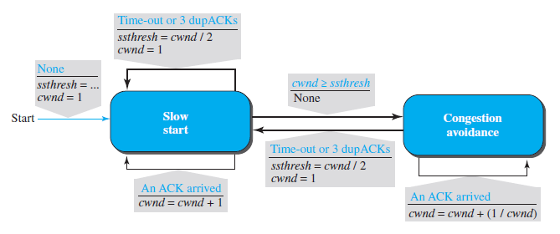
Tahoe

Slide 5
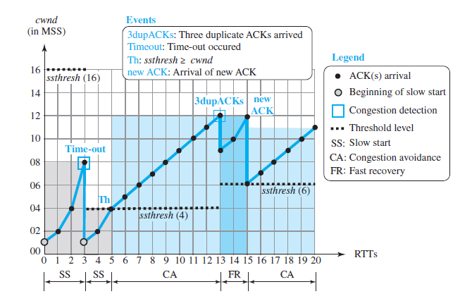
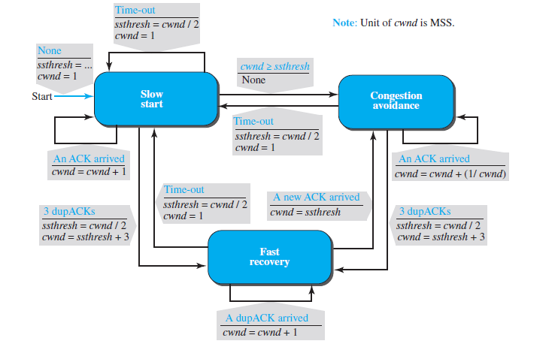
Reno

Slide 6
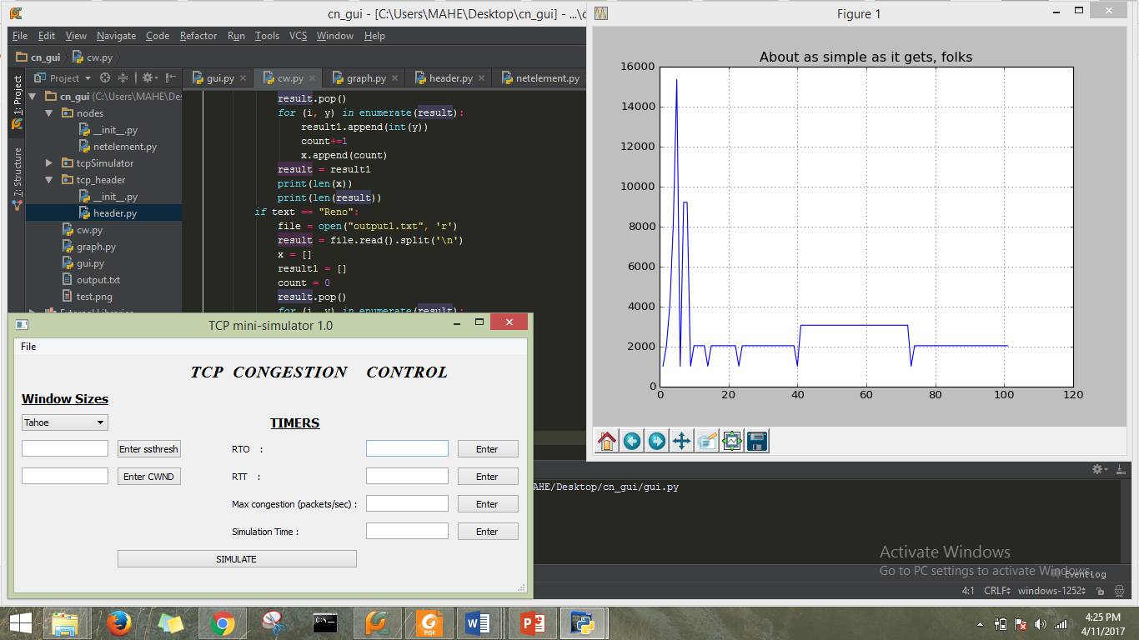

Slide 7
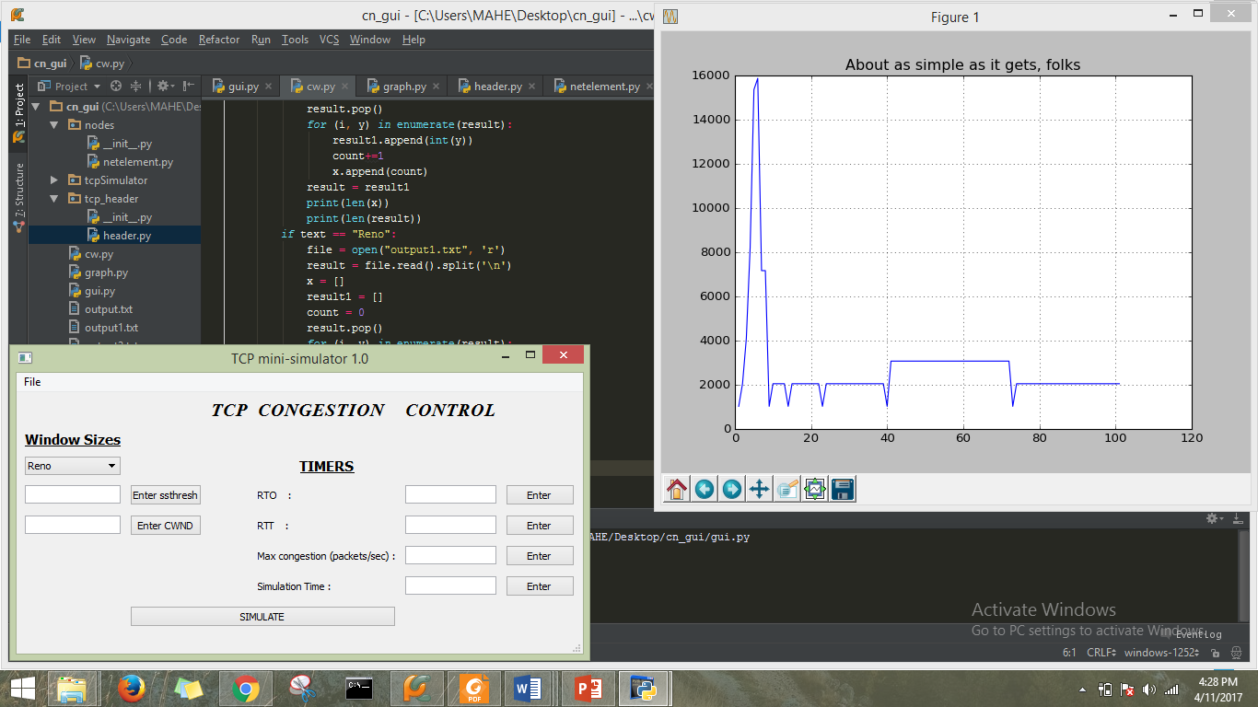

Slide 8
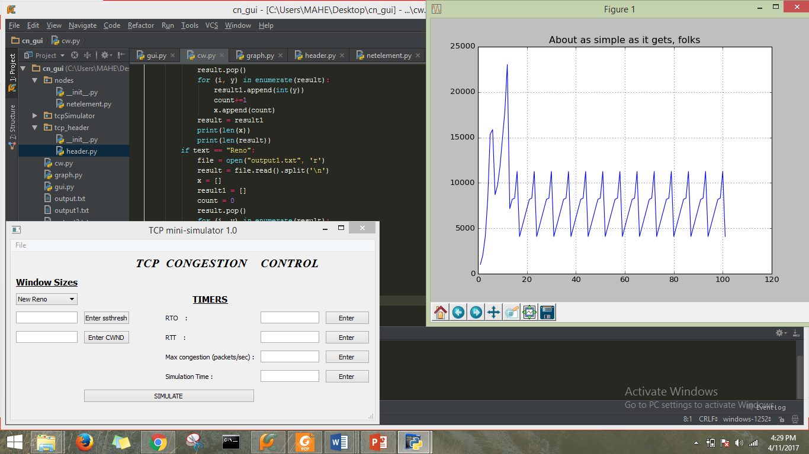

Slide 9
Result
(For 100 iterations)
Tahoe utilization: 4%
Reno utilization: 4%
New Reno utilization: 78%
(For 10 iterations)
Tahoe utilization: 32%
Reno utilization: 32%
New Reno utilization: 38%

