Slide 1
GraphSAGE explained
Jian

Slide 2
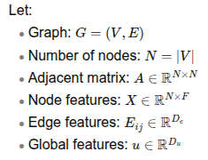




What if a graph becomes exceedingly large?
General framework of GNNs:
The issue of "Neighbor explosion"
Simple math:
A graph has nodes with an average "degree" (connections/neighbors) of 20; (d = 20)
It has a "fanout" of three layers; (L=3)
For one node, it will have 20^3=8000 neighbors involved in its message passing/aggregation calculation.
Complexity for one node: d^L

Slide 3
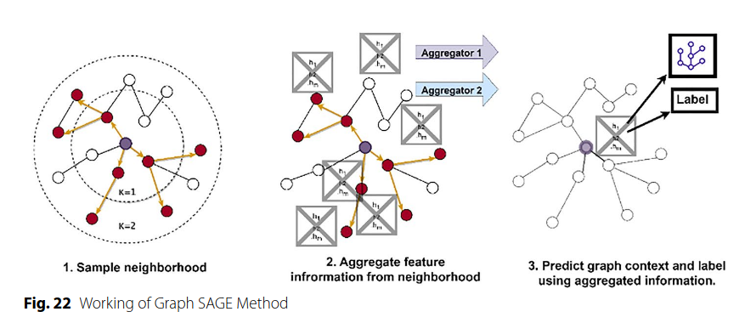
GraphSAGE
Main innovation: Stochastic sampling neighbors during training
Intuition:
Monte Carlo estimation ~ estimate for average
Stochastic gradient descent; mini-batch (in the graph level); drop out ~ regularization
Some neighbors matter more:
I may ask David for how to cook; Kairong for how to knit; Shrishti for how to make macha...
Khemani et al. Journal of Big Data 11, no. 1 (2024): 18.

Slide 4



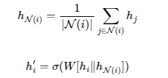

Mathematic formulation
AGG function could be:
Mean
Max-pooling
Others
General GNNs

Slide 5
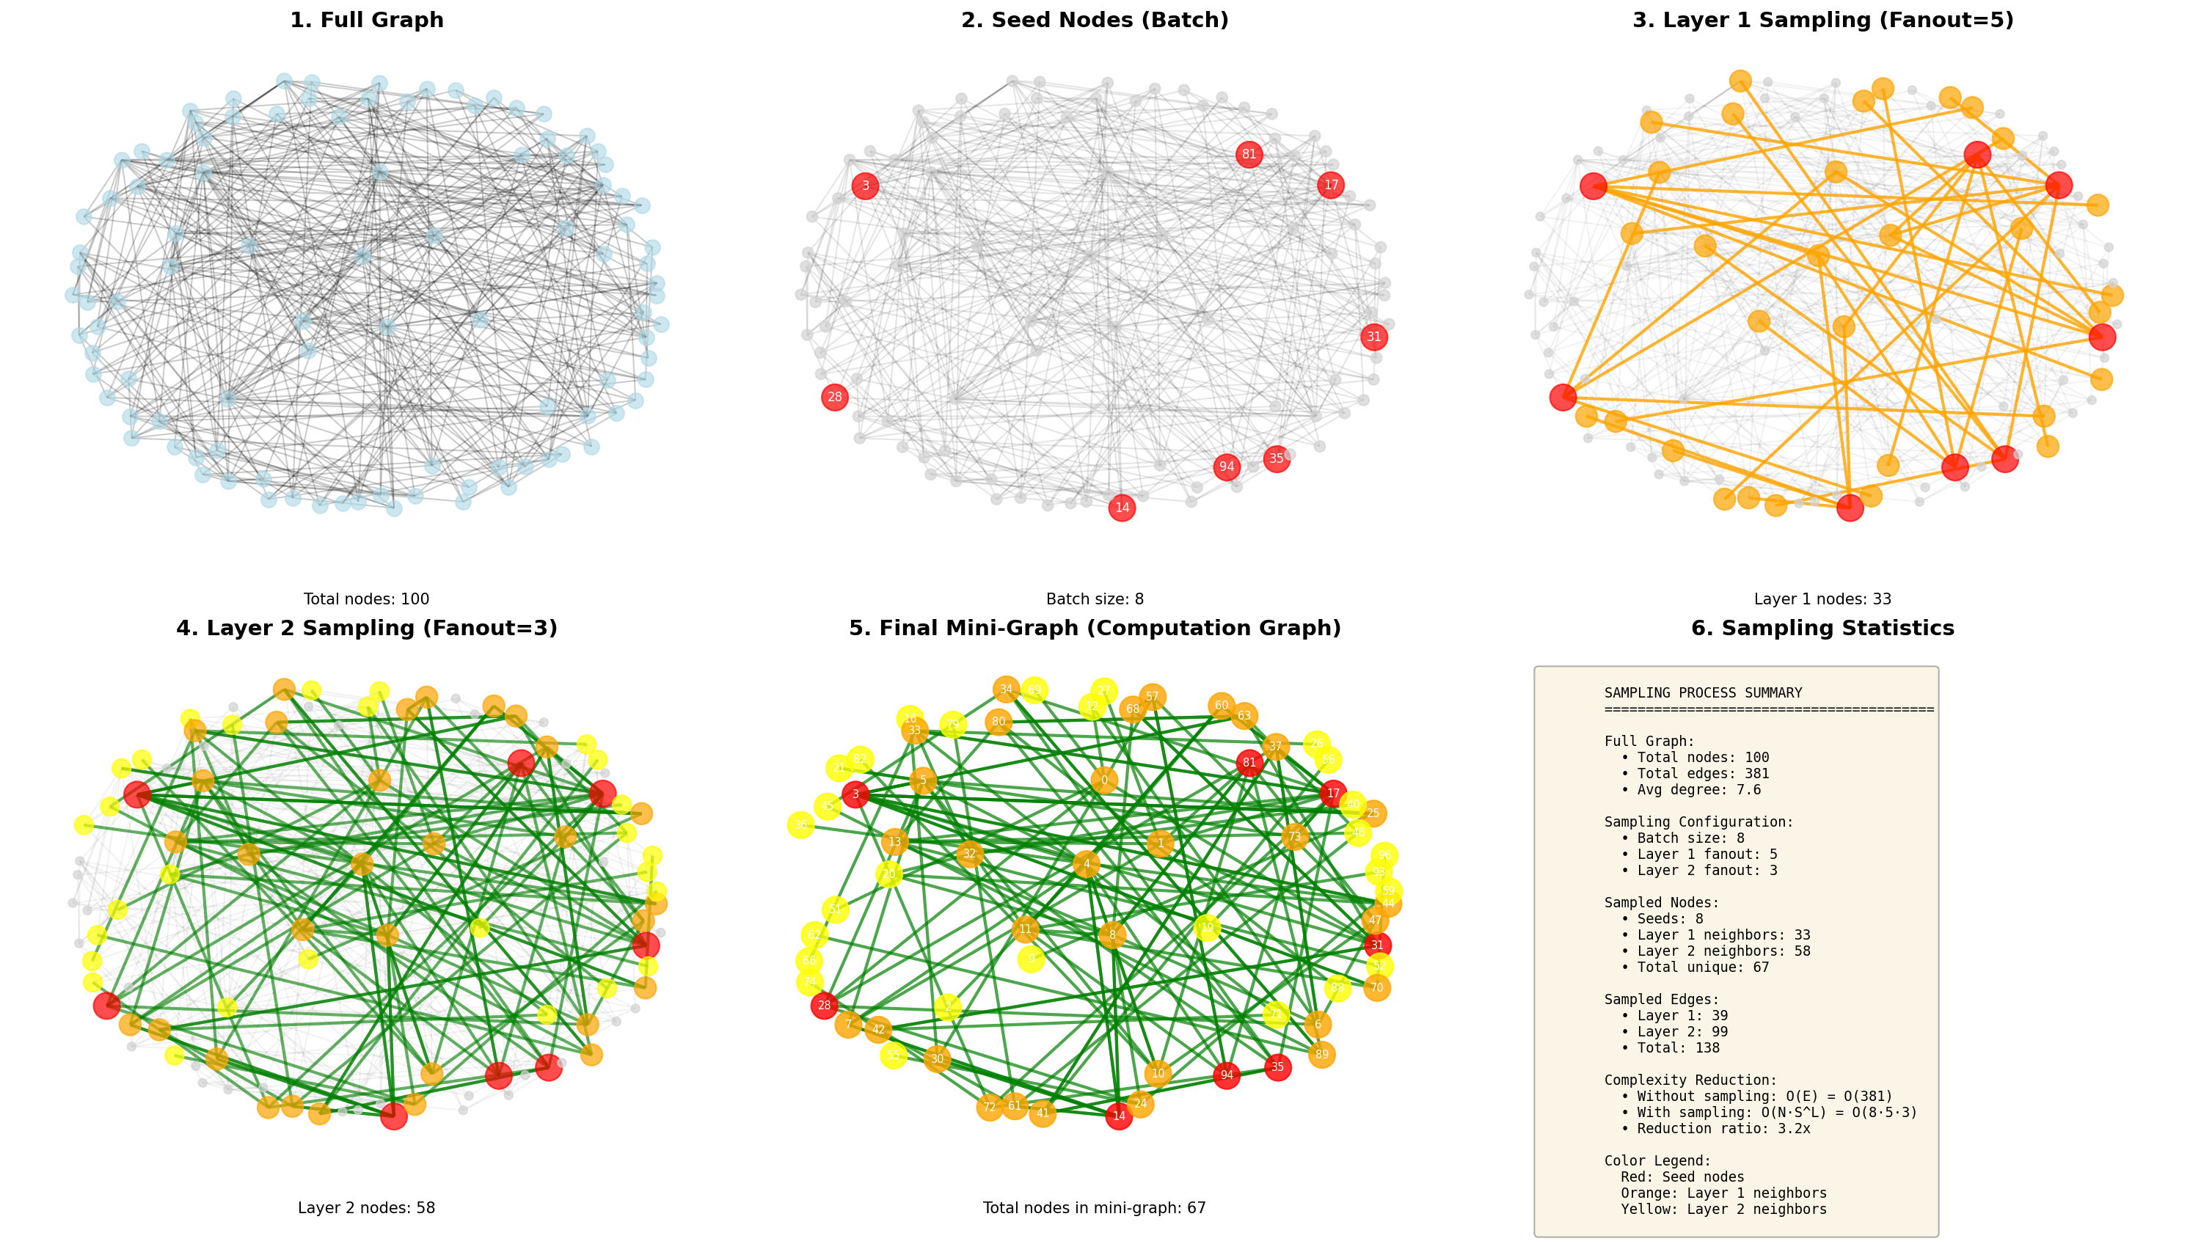
In practice
sampling is done per node, per layer, and re-randomized every batch

Slide 6
In practice
Question: what is the complexity of this architecture?
O(N*S^L) ; S=sample numbers; N: batch size; L: layers
Recall: drop-out; mini-batch?
One sentence: it allows flexibility of aggregating message from different neighbors

