Slide 1
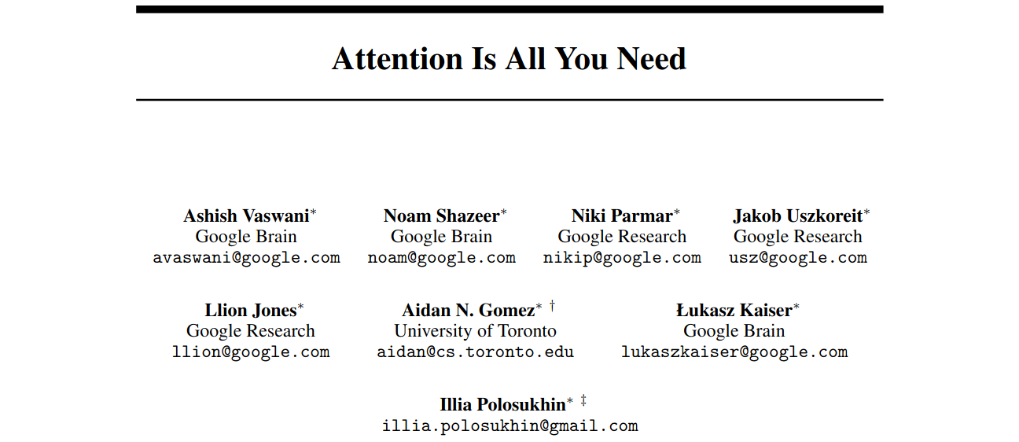
12/19/2025

Slide 2
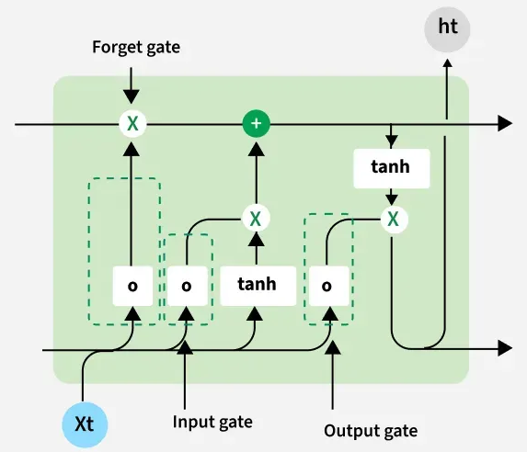
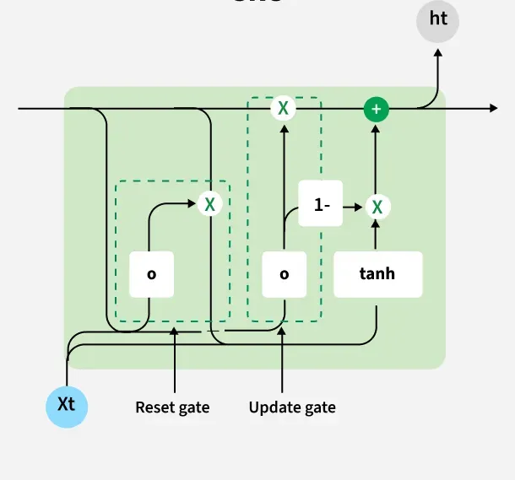
Limitations of RNN-based models
The main limitation of RNNs is the vanishing gradient problem.
Sequential data processing is inherently serialized: → they ingest the elements of an input sequence one at a time and in a specific order.
Sequential nature also limits the ability to process data in parallel which slows down training.
Linear interaction distance → Long sequences make it difficult for the model to recall earlier words and capture long-range dependencies.
Parallelization issue with dependence on the sequence index.
What if we remove this linear dependencies?
Any word can directly attend to any other word
No need to pass information sequentially
Self-Attention!

Slide 3
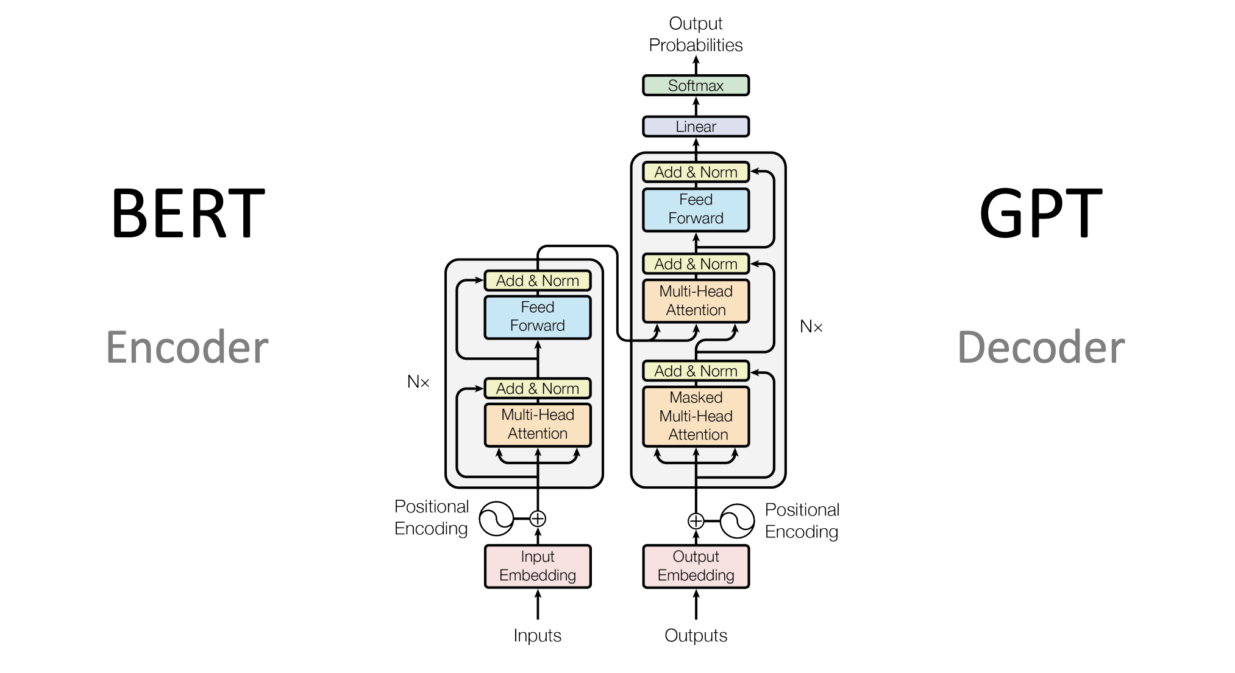

Slide 4
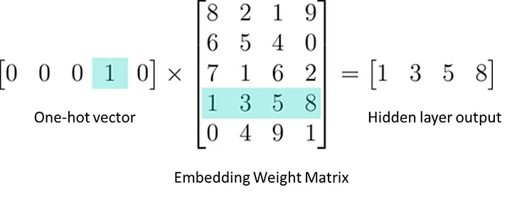
Embedding
Bag of words → dimension of vector = vocabulary of the document
Aims to create a vector representation with a lower dimensional space while preserves the contextual similarity of words.
2 advantages: Dimensionality reduction and contextual similarity
Input text → tokens → Embedding
It is similar to linear layer but a lookup instead of matrix multiplication
https://medium.com/@gautam.e/what-is-nn-embedding-really-de038baadd24

Slide 5
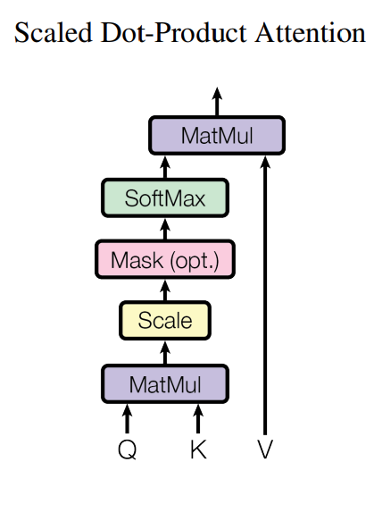
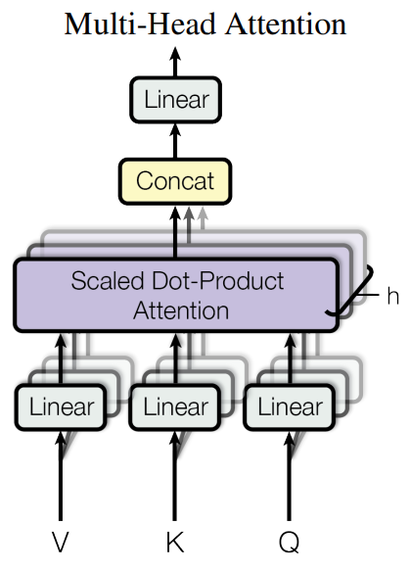
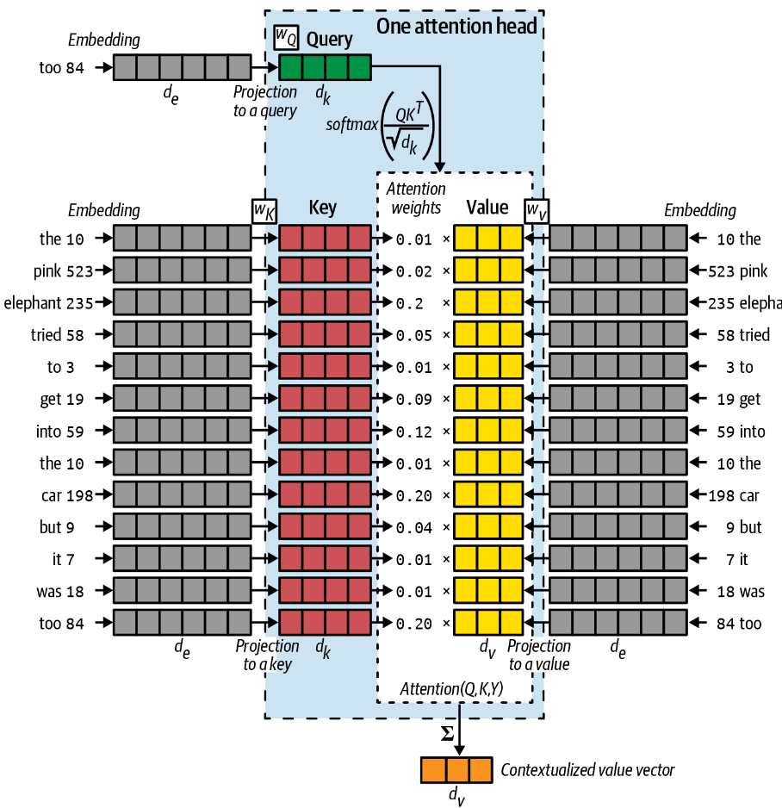
Self-attention
An attention mechanism relating different positions of a single sequence in order to compute a representation of the sequence.
Q: representation of current task at hand
K: representations of each word in the sentence
V: representations of the words in the sentence

Slide 6
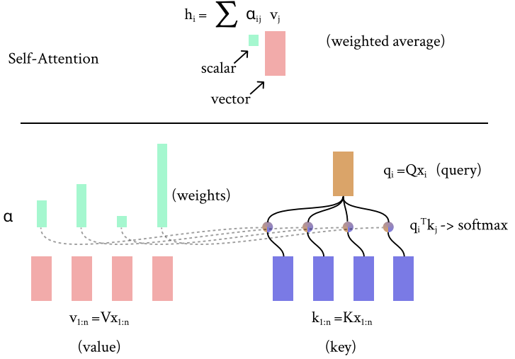
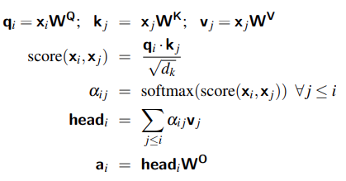
Self-attention
3 vectors from embedding: Query, keys, and values. Multiply each with weight matrices
Calculating self-attention score: → dot product of Q and K
Division of scores by √d_{k}, for stable gradients → dot product can result in large values
Pass through a softmax operation → to keep variance sum stable (equal to 1).
Multiplication of value with softmax scores → drown-out irrelevant words.
Sum up the weighted value vectors.
https://web.stanford.edu/class/cs224n/readings/cs224n-self-attention-transformers-2023_draft.pdf
https://web.stanford.edu/~jurafsky/slp3/8.pdf

Slide 7
Kairong
David
Jian
Jessica

Slide 8
