Slide 1

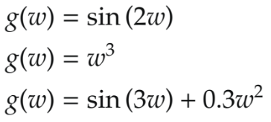
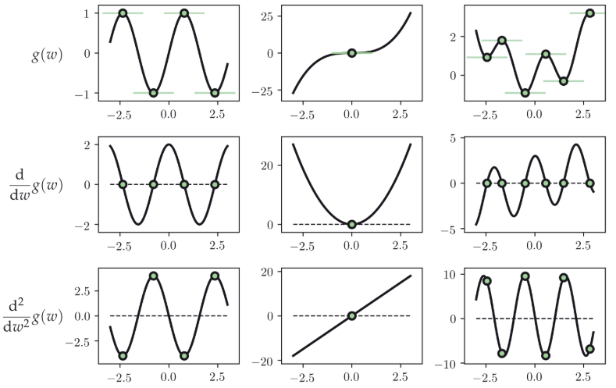
Second-order optimization
Both maxima and minima have zero derivative.
What about derivative of the derivative of the curve?
A single input function is convex or concave at point v can be determined:
A multi input function: if Hessian matrix at a point v has all nonnegative or nonpositive values.
A local or global minimum if convex (if all the eigenvalues are positive)
A local or global maximum if concave (if eigenvalues are -ve)
A saddle point if its 0 (if eigenvalues are mixed)
If eigenvalues are 0, reduces to linear function.
https://github.com/neonwatty/machine-learning-refined/tree/main/chapter_pdfs

Slide 2
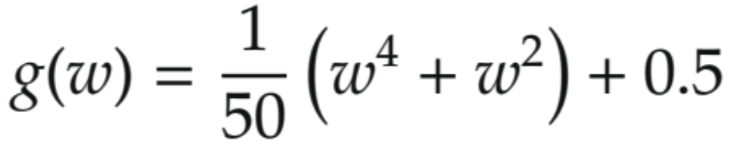
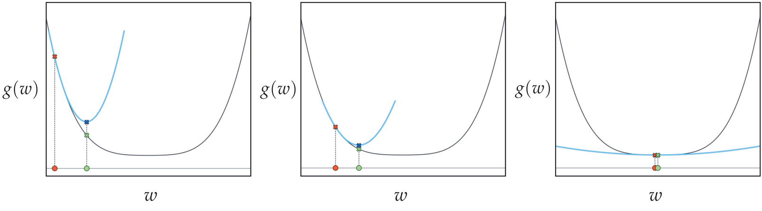
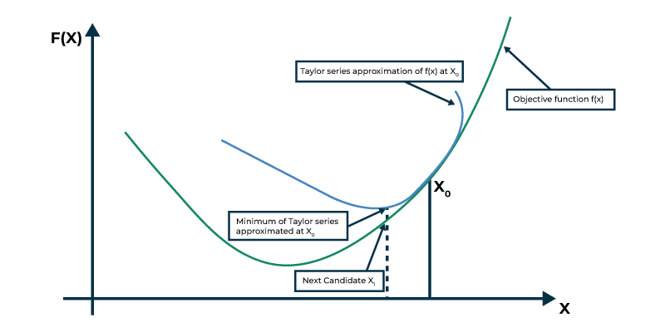
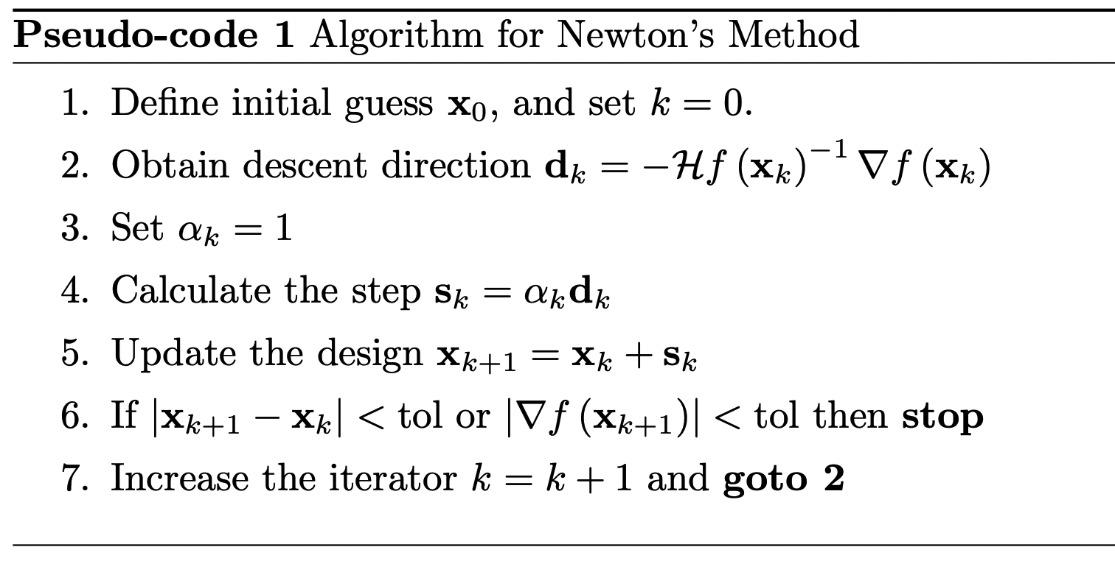
Second-order optimization
Function:
Second-order Taylor series approximations is done → quadratic functions.
Constant controls the convexity (if +ve) or concavity (if -ve) or linear (if 0) of the function.
Point of expansion → o and its evaluation by the function → x
Stationary point w* of the second-order Taylor series → o
Evaluations of both the quadratic approximation (x) and the function itself at w* (x)
Function g is convex everywhere → quadratic approximation is always convex and its stationary point is always minimum.
https://github.com/neonwatty/machine-learning-refined/tree/main/chapter_pdfs

Slide 3
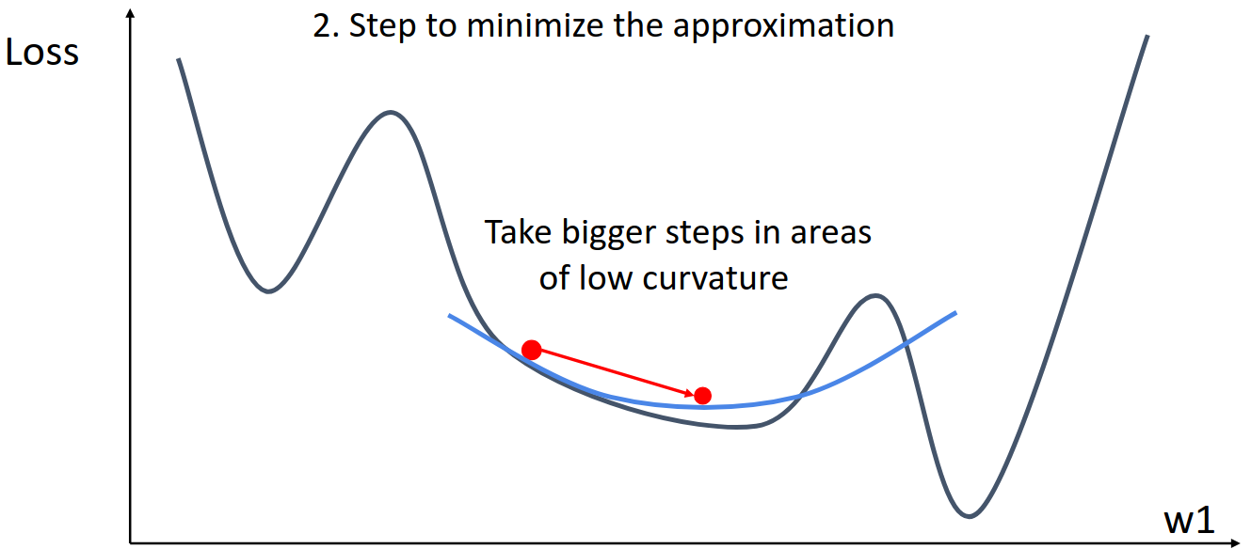
Second-order optimization
Advantages
Adapt step size automatically to the curvature of the function.
ill -conditioned function.
More precise parameter updates.
Less tuning needed
Disadvantages
Computing inverse Hessian explicitly is too expensive
Requires careful tuning.
Many saddle points can be problematic.
Requires handling Hessian approximations, regularization (damping), and numerical stability issues

