Slide 1
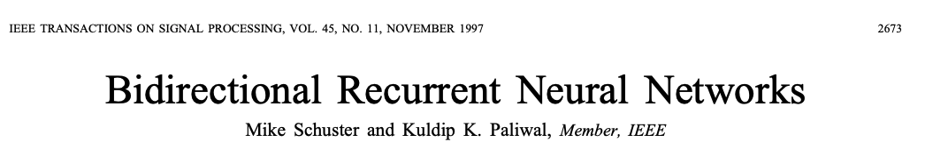
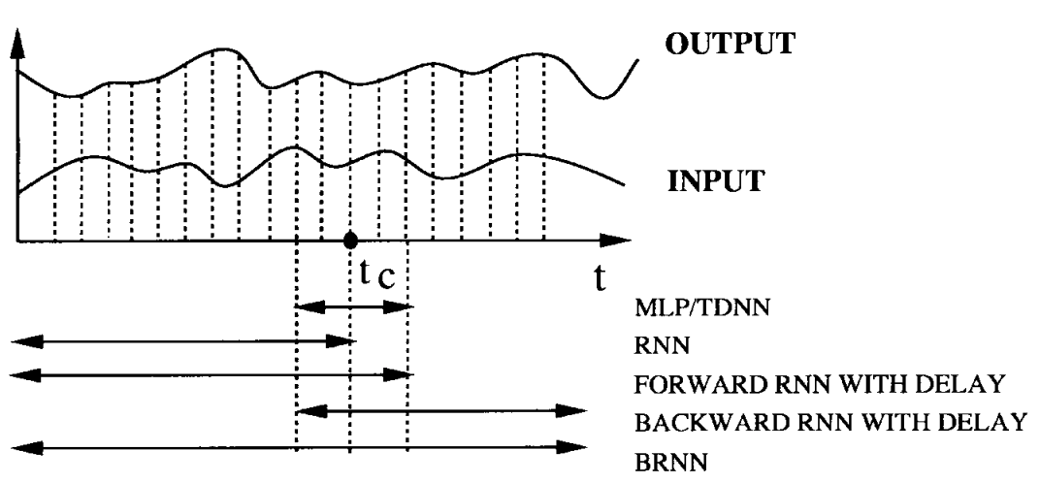
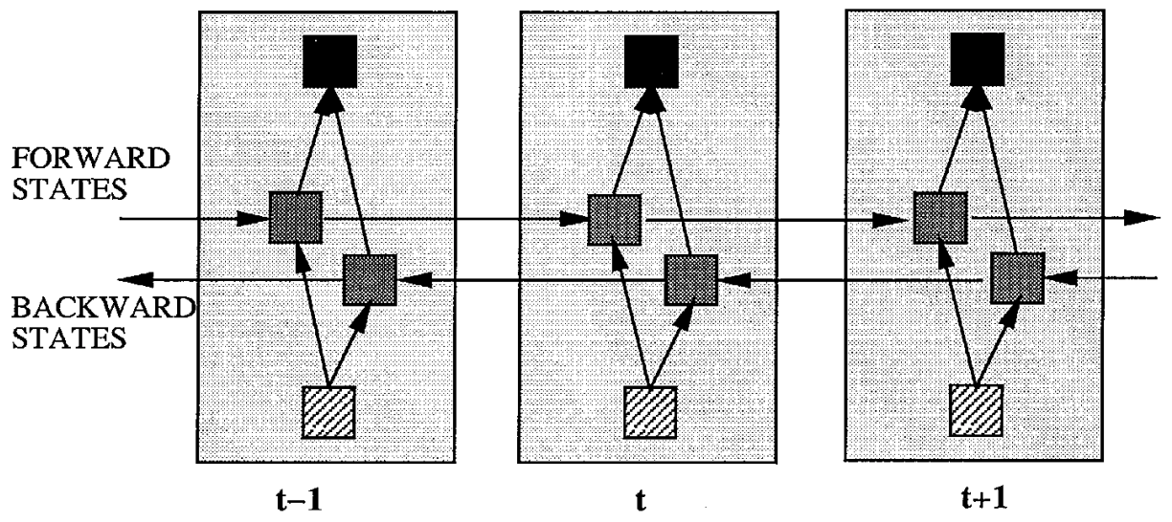
Trained using all available input information in the past and future of a specific time frame.
This is accomplished by training it simultaneously in positive (forward) and negative (backward) time direction.
Structure:
Idea is to split the state neurons of RNN part responsible for forward and backward direction.
Outputs from forward states are not connected to inputs of backward states.
Forward: Processes the input sequence from t=1 to t=T.
Backward: Processes the input sequence from t=T to t=1.
Concatenation: The outputs from the forward and backward are concatenated to form the final output at each time step.

Slide 2
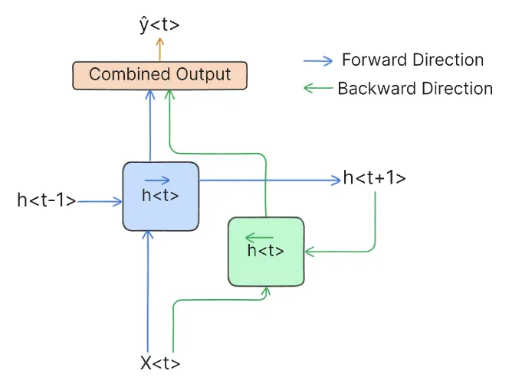
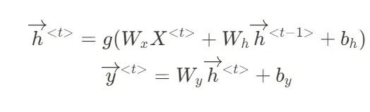
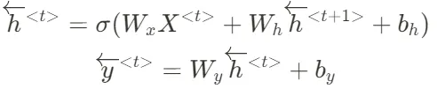
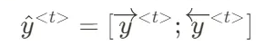
Forward:
Backward:
Combined:
Pros of BRNN
1. Better Understanding: They look at data from both the past and the future
2. More Accurate: They consider more information, leading to better predictions
3. Handles Ambiguity: They use context from both directions to clear up confusion
Cons of BRNN
1. Slower to Compute: They process the data twice, once forward and once backward (still efficient than LSTM)
2. Uses More Memory: Storing hidden states in both directions uses more memory
3. More Complex to Build: They need careful handling of both forward and backward passes
4. Delay in Real-Time: They need to see the whole sequence before making a decision

