Slide 1
Gradient Descent Algorithms

Slide 2
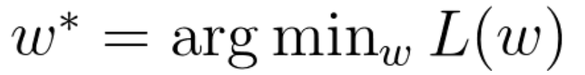
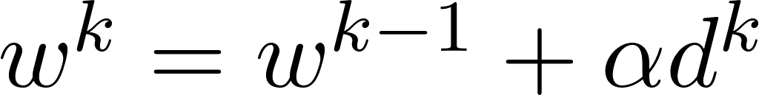
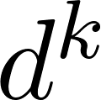

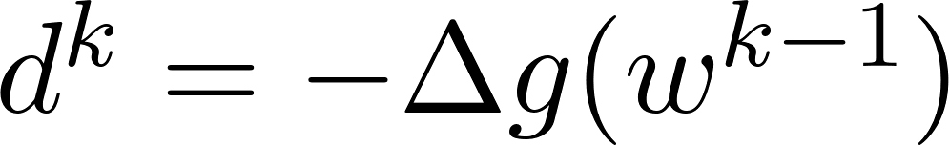
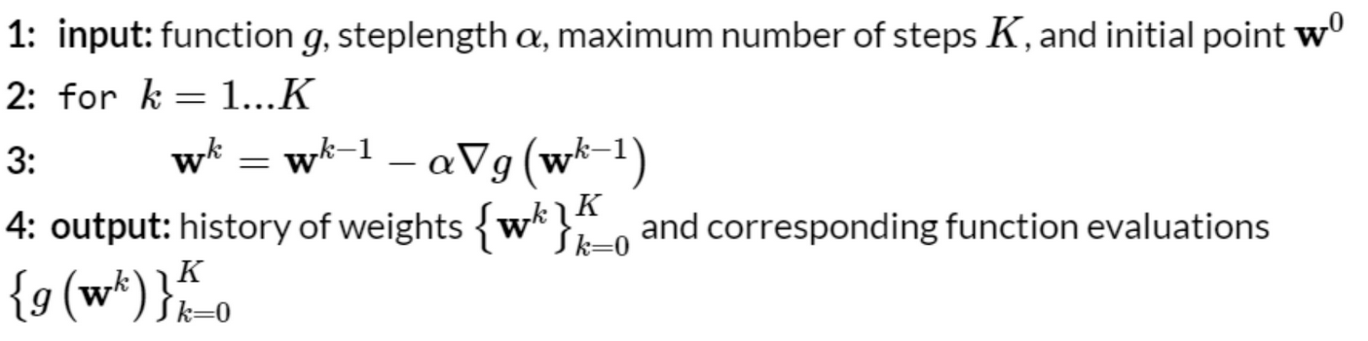
Basic
Gradient Descent is an iterative method used to adjust parameters in order to minimize a cost function.
Minimization of cost function, loss function or error function.
Randomly initialize parameters, then gradually improve them in small steps to reduce the cost function until reaching a minimum.
A general local optimization method:
are the descent direction vectors and is called the steplength/learning rate parameter.
Gradient descent algorithm

Slide 3
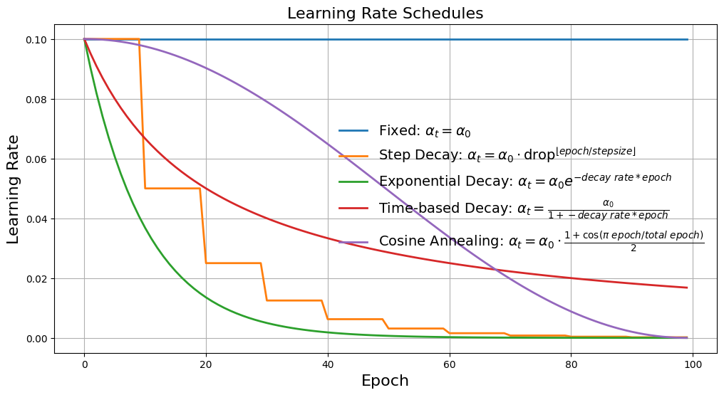
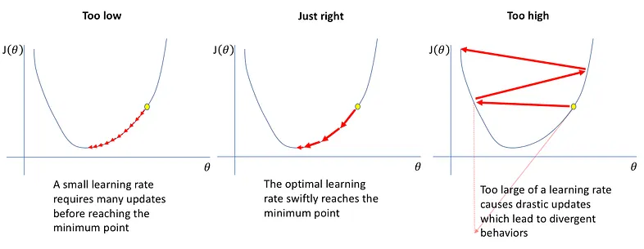
Learning rate parameter
Determines how quickly the model updates its parameters based on the input data.
A learning rate → a trade-off between the rate of convergence and overshooting.
High → overshoot minima, instability or divergence of the loss function.
Low → slow convergence, require more steps, increase computation time.
Optimal → Balances training speed and model accuracy, ensure convergence.
Learning rate include:
Fixed learning rate.
Learning rate schedules.
Adaptive learning rate: learning rate of an algorithm adjusts dynamically during training based on previous iterations.
https://neptune.ai/blog/how-to-choose-a-learning-rate-scheduler

Slide 4
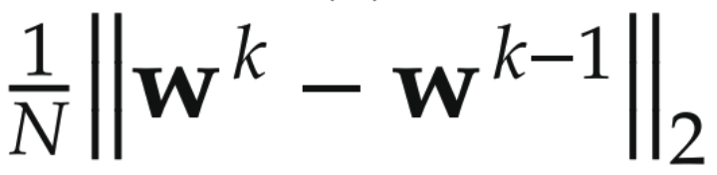
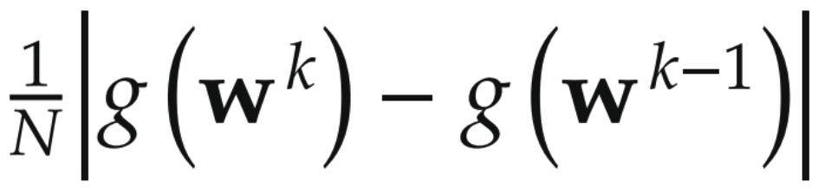
Convergence Criteria
Halting when steps no longer make sufficient progress.
When corresponding evaluations no longer differ substantially.
Simply run the algorithm for a fixed number of maximum iterations.

Slide 5
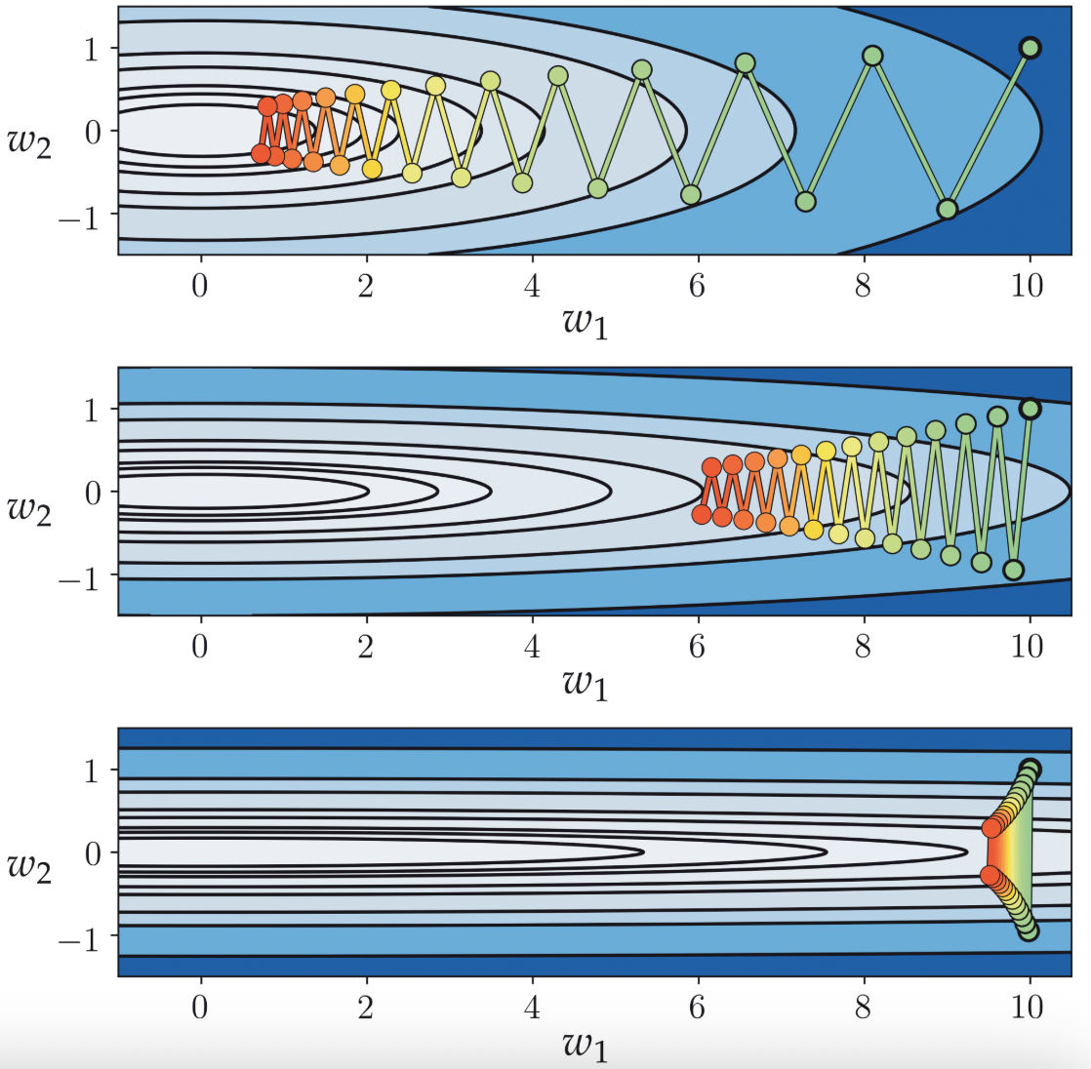
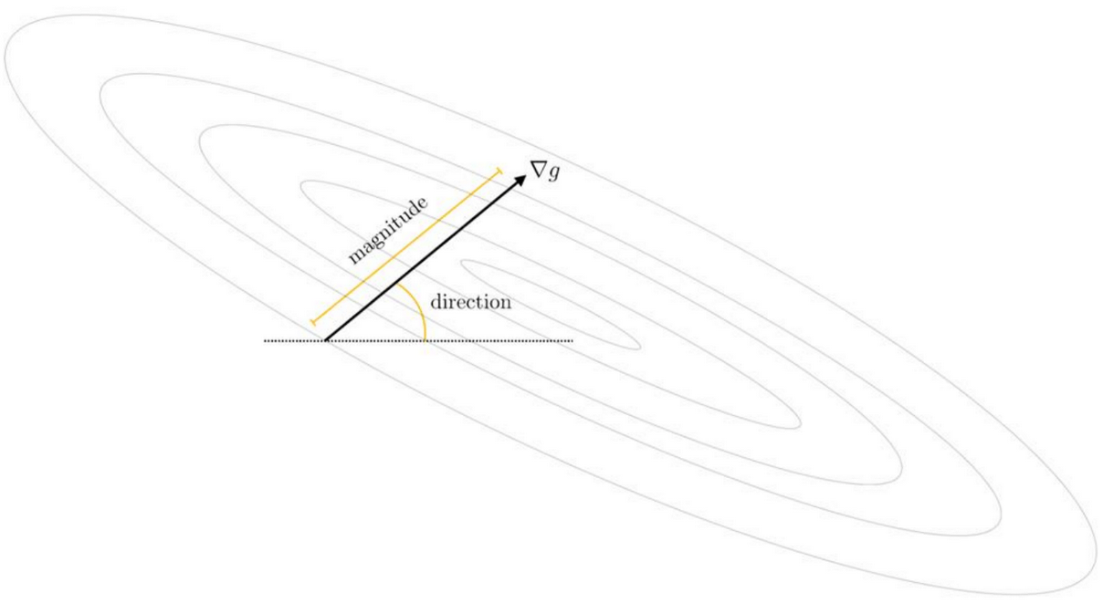
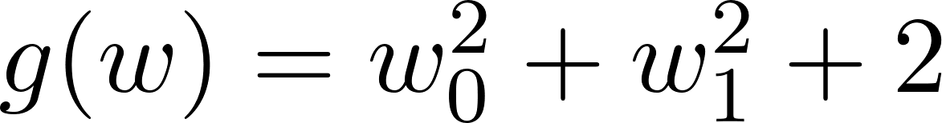
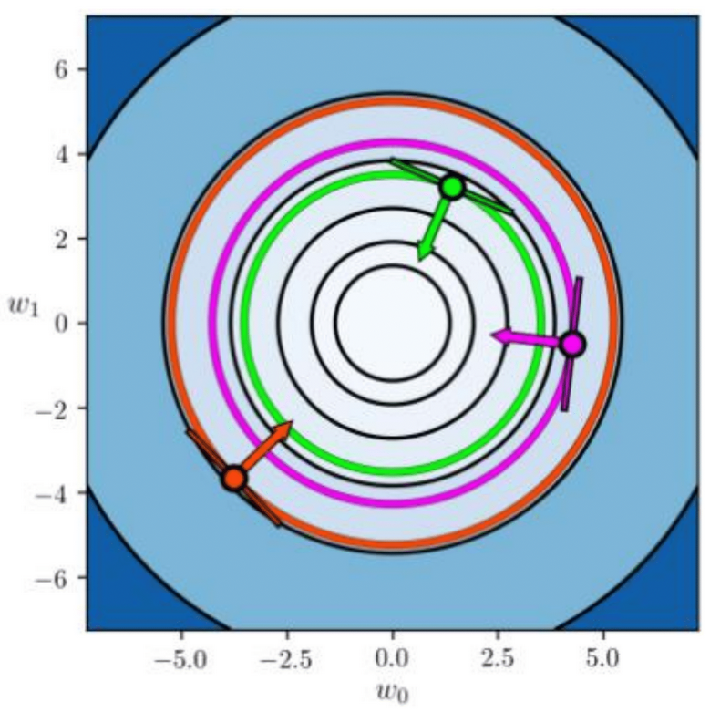
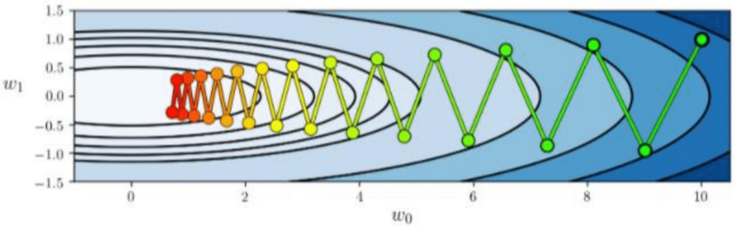
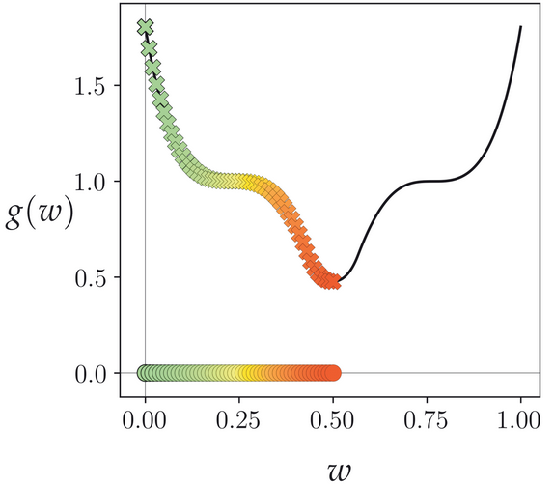
Natural Weaknesses of Gradient Descent
Direction: can rapidly oscillate or zig-zag during a run of gradient descent, producing zig-zagging steps that take time to reach a near minimum point → slows minimization progress.
Reasons → The (negative) gradient direction points perpendicular to the contours of any function.
Magnitude: can vanish rapidly near stationary points, leading gradient descent to slowly crawl near minima and saddle points. Reason → distance traveled during each step of gradient descent is not completely determined by the steplength.

Slide 6

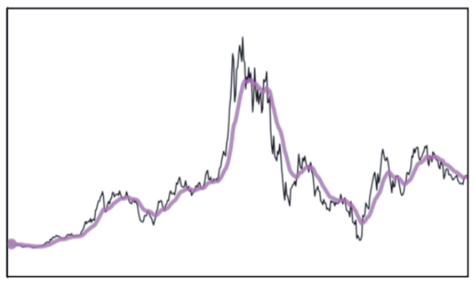


Exponential average
Core idea → time series and smoothing tool exponential average
Cumulative:
Cumulative average by expressing h^{k} in a recursive manner involving only its preceding cumulative average h^{k-1}
Coefficients on h and w sum to 1
With the exponential average → freeze coefficients
Small 𝜷 → approx. raw time (zig-zagging) series
Larger → subsequent average looks like its predecessor (smoother curve)

Slide 7
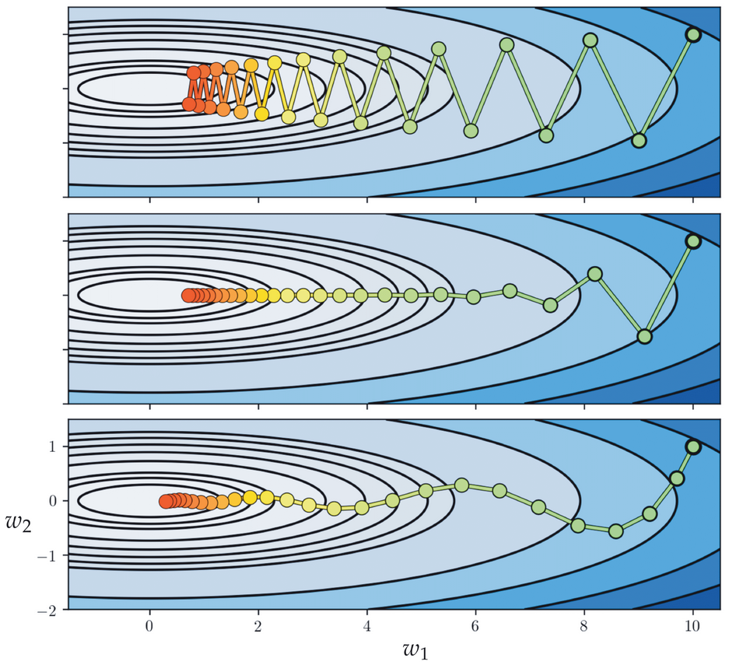


Momentum-accelerated GD
A sequence of gradient descent steps → a time series.
To ameliorate zig-zagging behavior of gradient descent steps → compute their exponential average.
Smooth the steps as they are created → by smoothing the descent directions.
Initialize: d⁰ = -▽g(w⁰)
Then the exponential averaged descent direction d^{k-1}
Momentum refers to the new exponentially averaged descent direction d^{k-1} by definition is a function of every negative gradient which precedes it.
d^{k-1} captures the average or momentum of the directions preceding it.

Slide 8
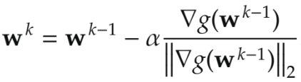
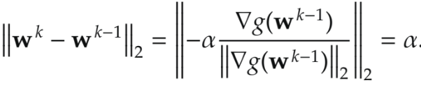
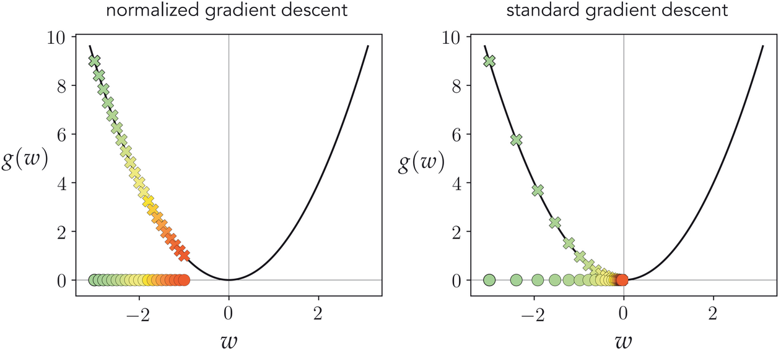

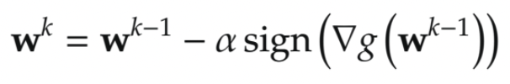
Normalized GD
Magnitude of -ve gradient vanishes near stationary points causing gradient to slow crawl.
Core idea → what happens if we simply ignore the magnitude at each step by normalizing it out?
Length of a standard gradient descent step is proportional to the magnitude of the gradient: 𝛼||▽g(w^{k-1})||₂
Normalize a (gradient) descent direction is via dividing it by its magnitude.
Steplength value adjusts itself at each step is precisely 𝛼 Normalize out the magnitude of the gradient component-wise.

Slide 9
Advanced Gradient-Based Methods
Batch Gradient Descent: uses the whole training set to compute the gradients at every step.
Stochastic gradient descent (SGD): At each step, it picks a random training instance and computes gradients using only that one.
Mini-batch Gradient Descent: computes the gradients on small random sets of instances called minibatches.
Jessica
Adaptive Gradient (AdaGrad) → Added element-wise scaling of the gradient based on the historical sum of squares in each dimension and adaptive learning rate.
Kairong
Root Mean Squared Propagation (RMSProp) → a variant of the component-wise normalized step where – instead of normalizing each component of the gradient by its magnitude – each component is normalized by the exponential average of the component-wise magnitudes of previous gradient directions.
Harsha
Adaptive Moment Estimation (Adam) → is a component-wise normalized gradient step employing independently-calculated exponential averages for both the descent direction and its magnitude.
David
Notes:
https://web.eecs.umich.edu/~justincj/slides/eecs498/498_FA2019_lecture04.pdf

Slide 10
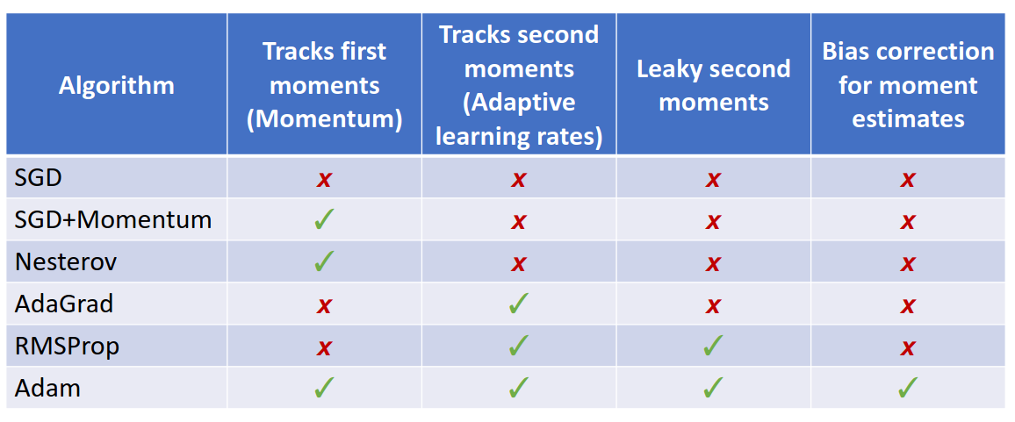
Advanced Gradient-Based Methods

