Slide 1
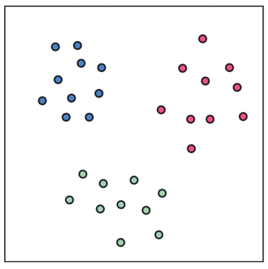
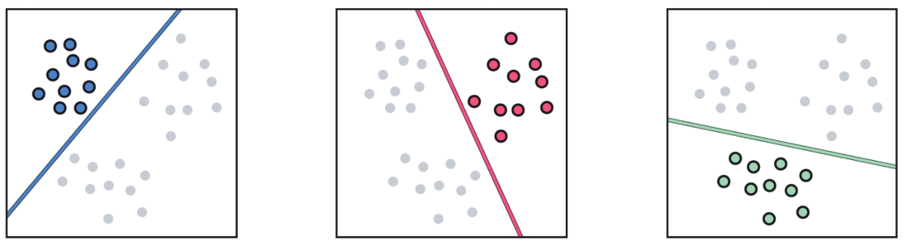
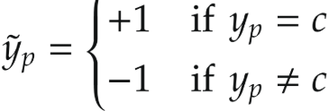
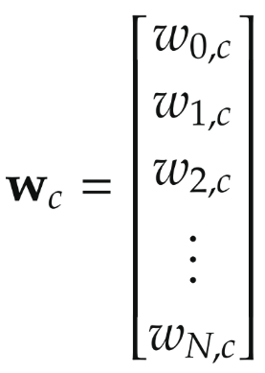
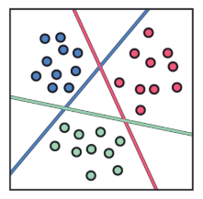

One-versus-all multi-class classification
A multiclass dataset consist of C different classes of data.
Temporary labels
Is it possible to use 2-class classification model for this problem?
Run 2 class classification.
Decision boundary associated with 2-class classification:
Is it possible to combine all 3 classifiers?
points that lie on the positive side of a single two-class classifier
points that lie on the positive side of more than one classifier
points that lie on the positive side of none of the classifiers.

Slide 2
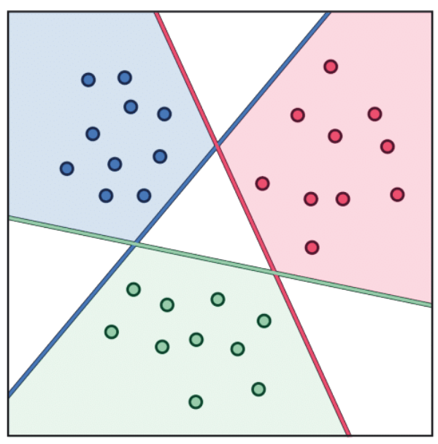
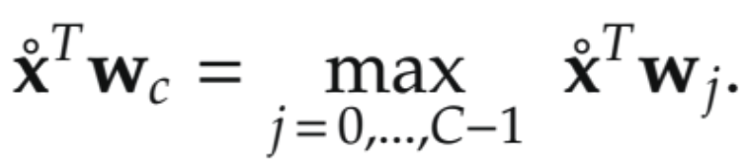
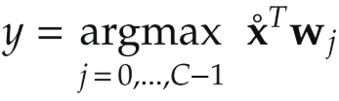
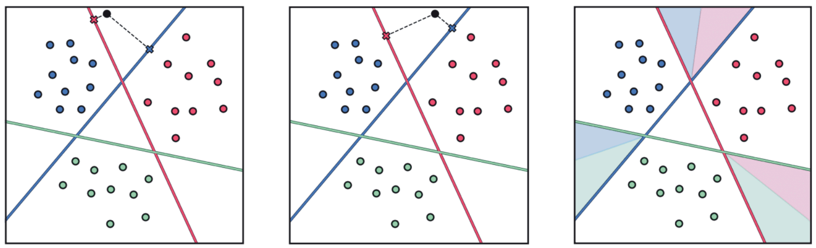
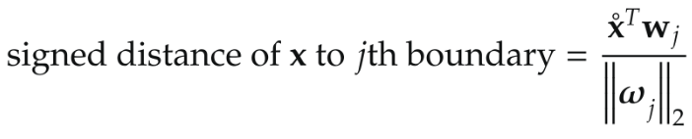
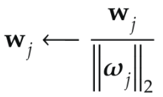
Case 1. Labeling points on the positive side of a single classifier
The points that lie solely on the positive side of the j^{th} classifier only should clearly belong to the j^{th} class.
Case 2. Labeling points on the positive side of more than one classifier
Classification rule: assign each point to the class whose boundary is at the largest non-negative distance from it.
Normalize the weights of each linear classifier by the length of its normal vector as
then this distance is simply written as the raw evaluation of the point via the decision boundary as
To assign a point in one of our current regions we seek out the classifier which maximizes this quantity.

Slide 3
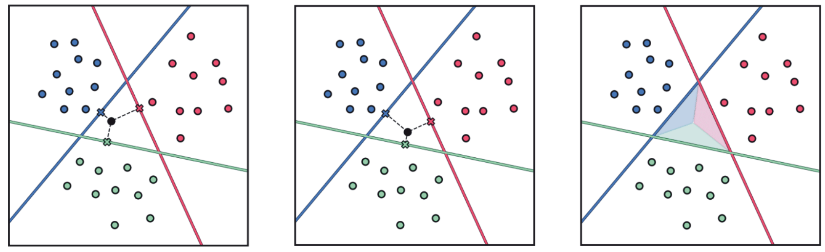
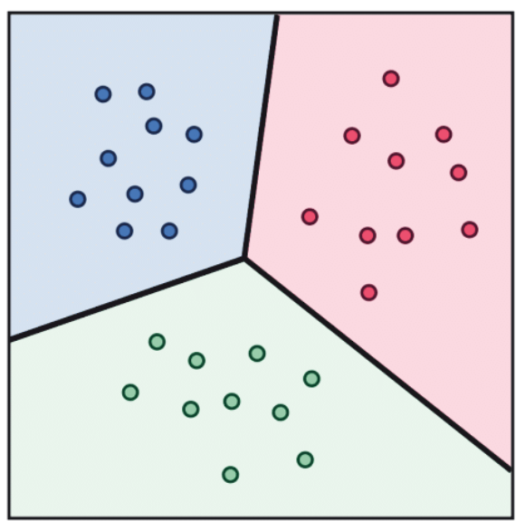
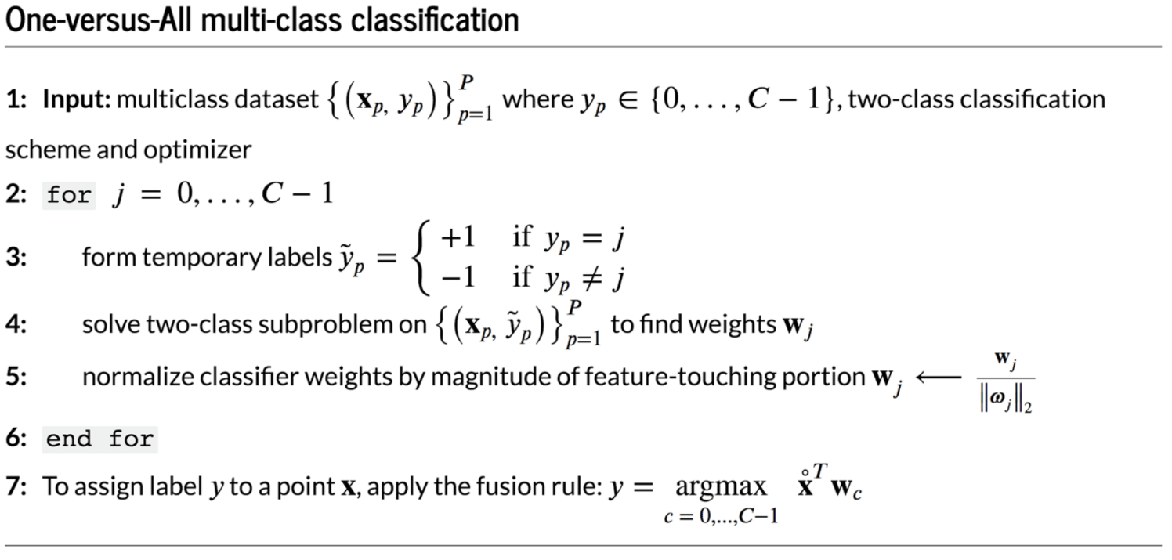
Case 3. Labeling points on the positive side of no classifier
Cannot find that one classifier is more confident in the class identity of such points.
Look at the least sure → closet decision boundary
Combining all 3 cases together
The single rule for assigning a label y to a point x:
Fusion rule: assigns the label based on the maximum signed distance of this point to each classifier.

Slide 4
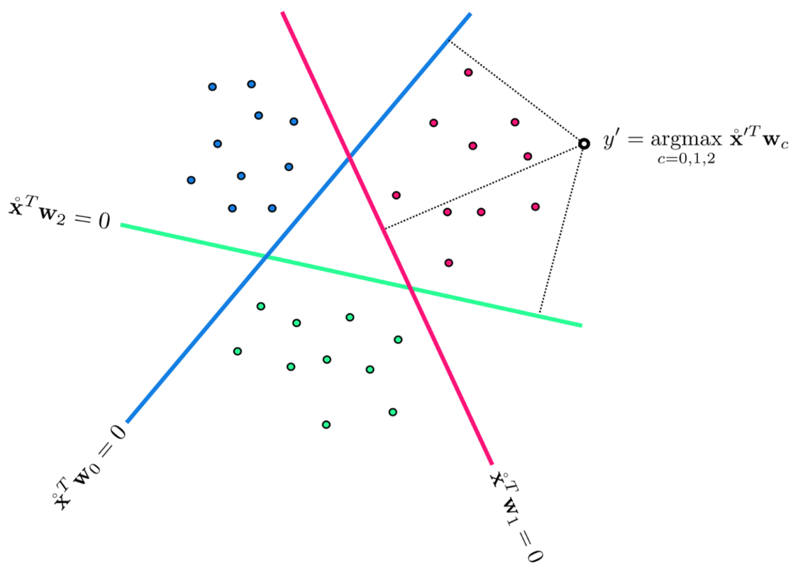
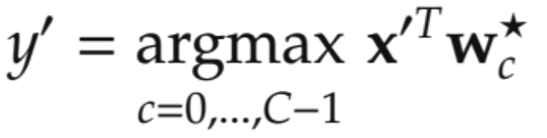
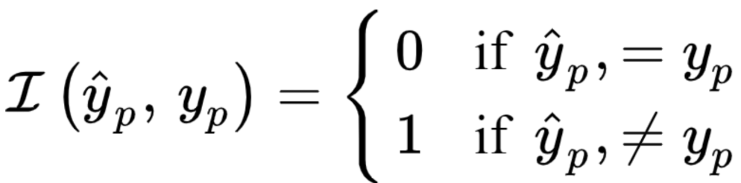
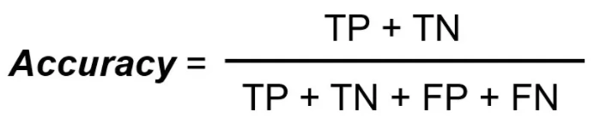
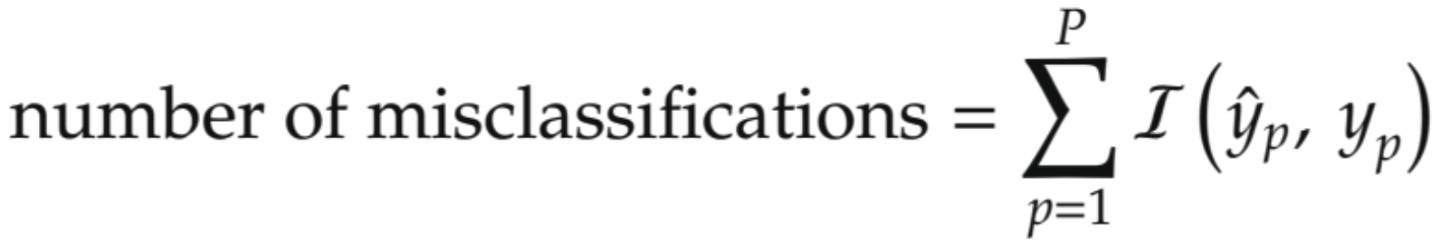
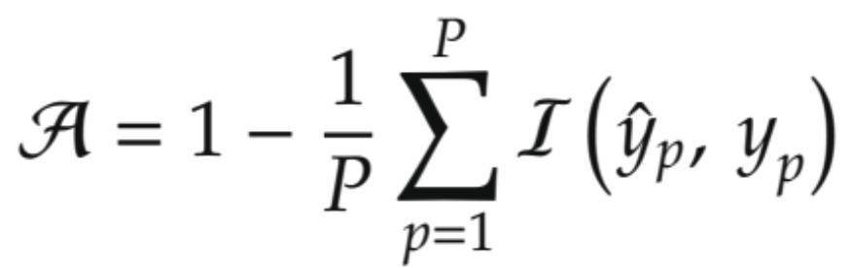
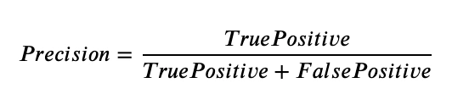
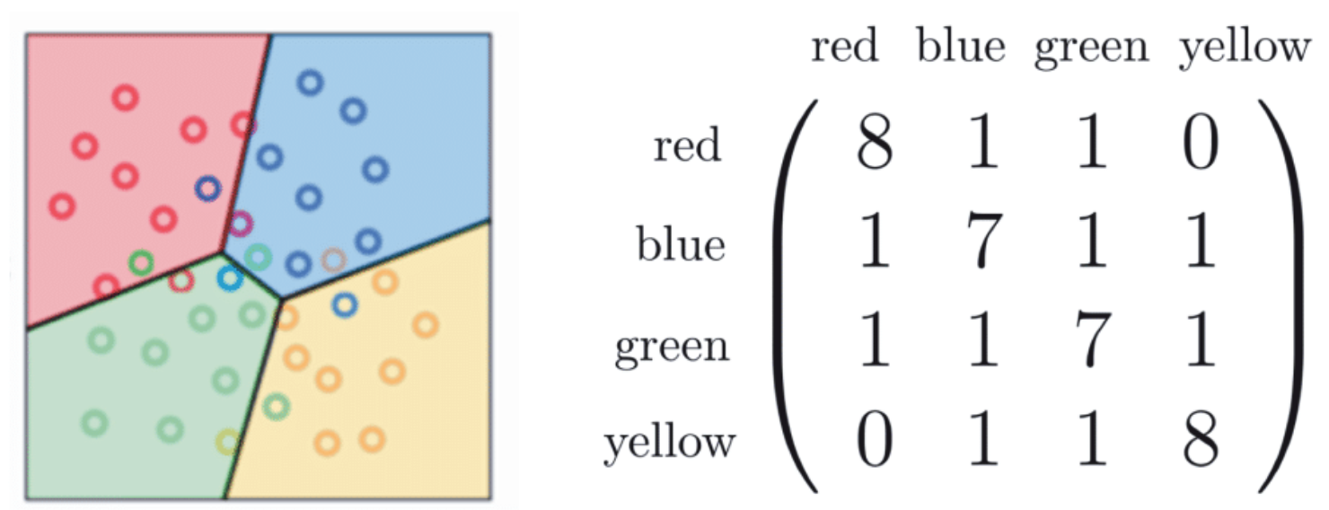
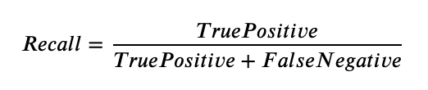

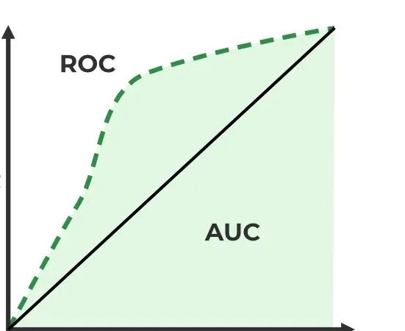
Classification Evaluation Metrics
Predict the label y of an input x, fusion rule:
Points on the decision boundary should be assigned a label randomly, based on the classifiers with the highest evaluation scores.
Accuracy:
→ Can be misleading if classes are unbalanced.
Confusion matrix:
FP
Useful in cases where FP are costly.
Useful in cases where FN is of higher concern than FP.
FN
Useful When you want a balance between precision and recall.
Shows how good the model is at telling the difference between the two classes by plotting.
Receiver Operating Characteristics Curve: Plots TPR vs. FPR across thresholds, showing the trade-off between sensitivity (recall) and specificity (TN/(TN+FP)). FPR=(1-specificity)
Area Under the Curve: Higher AUC indicates better class separation; 1.0 is perfect, 0.5 is random guessing.
TPR = TP/(TP+FN)
FPR=FP/(FP+TN)
https://www.geeksforgeeks.org/machine-learning/auc-roc-curve/

