Slide 1

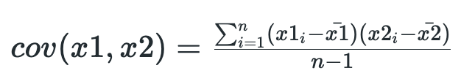

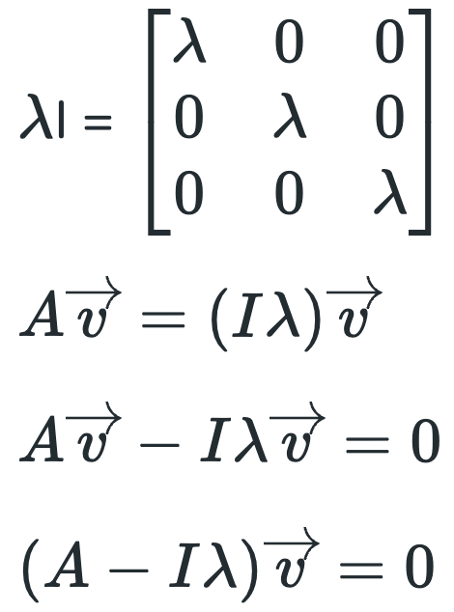



Principal component analysis
Step 1: Standardization and Centering Data:
Standardize the range of the continuous initial variables so that each one of them contributes equally to the analysis.
Step 2: Covariance Matrix Computation:
The aim of this step is to understand how the variables of the input data set are varying from the mean with respect to each other
If positive then: the two variables increase or decrease together (correlated)
If negative then: one increases when the other decreases (Inversely correlated)
Step 3: Eigen Decomposition and Identifying Principal Components:
Eigenvectors of the Covariance matrix are the directions of the axes where there is the most variance
Eigenvalues are the coefficients of eigenvectors, which give the amount of variance carried in each Principal Component.
By ranking your eigenvectors in order of their eigenvalues, highest to lowest → get the principal components in order of significance.

Slide 2
Step 4: Pick the Top Directions & Transform Data
Select the top k components that capture most of the variance like 95%.
Transform the original dataset by projecting it onto these top components. → Transformed data = FeatureVector x StandardizedOriginalData
Applications of Principal Component Analysis
Data Visualization
Multicollinearity Handling: Creates new, uncorrelated variables to address issues when original features are highly correlated.
Noise Reduction: Eliminates components with low variance enhance data clarity.
Data Compression: Represents data with fewer components reduce storage needs and speeding up processing.
Outlier Detection: Identifies unusual data points by showing which ones deviate significantly in the reduced space.
Interpretation Challenges
Information Loss: Reducing dimensions may lose some important information if too few components are kept.
Assumption of Linearity
Risk of Overfitting: Using too many components or working with a small dataset might lead to models that don't generalize well.

