Slide 1
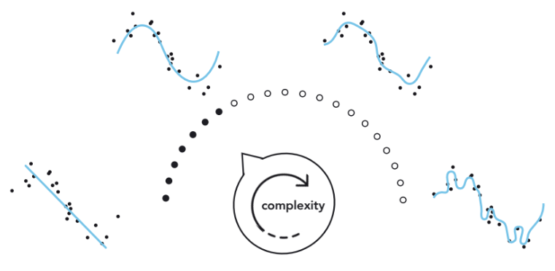
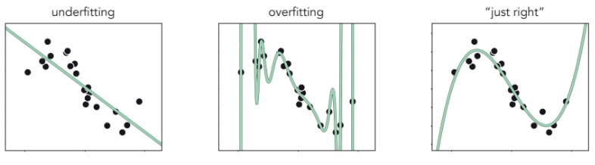
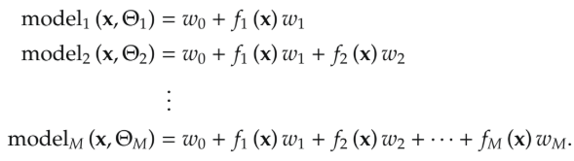
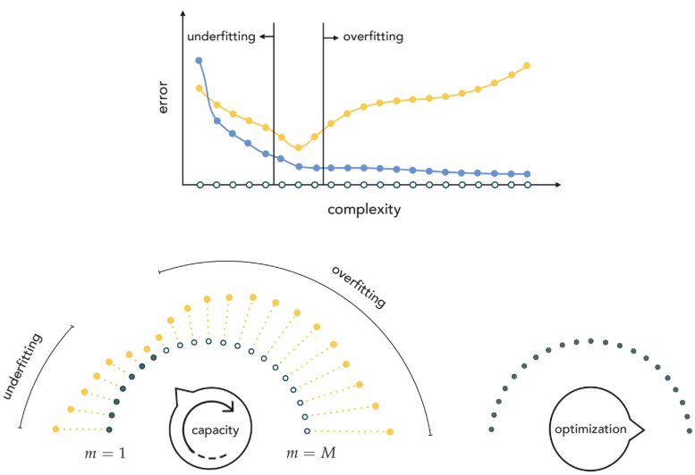
How to optimize dial?
Find right amount of complexity.
Validation error → Validation set (randomly divide the dataset) → 1/10 to 1/3 of data. → best model with lower validation error. → Cross-validation (or model search/selection)
?
Naive cross-validation: → split data randomly → optimize every model completion → measure error on M fully trained models on each portion of the data → Final model based on lowest validation.
Bias-variance tradeoff: Determining a model which neither underfits(high bias) nor overfits (high variance)
Computationally very expensive
Coarse model search that can miss (or ”skip over”) the ideal amount of complexity desired for a given dataset

Slide 2
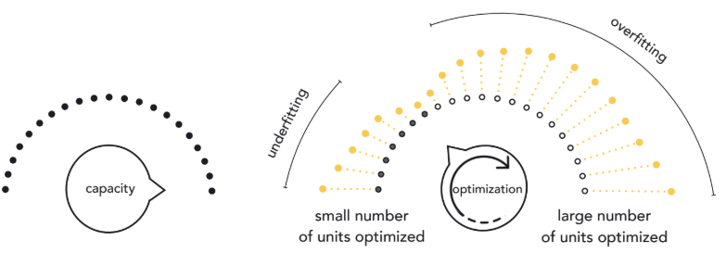


Efficient Cross-Validation via Boosting
Build a high capacity model one-unit at a time.
M rounds → model_{m} → best training loss → validation loss
Optimizing the parameters of each unit, one at a time.
Boosting tends to provide a computationally efficient fine-resolution form of model search
Round 0 of boosting: → Tuning , by minimizing the cost function.
Round 1 of boosting: → → Only need tune the weight w₁ as well as the parameters internal to the nonlinear unit f_{s1}.
Round m > 1 of boosting: → → m^{th} round of boosting:
M tuned models (without 0) → choose the model with lowest validation loss.
Early stopping → halt the procedure when the validation error first starts to increase.
Add additional bias at m^{th} round → offers more flexibility and better performance with one extra variable per round.
Performance by allowing units to be adjusted 'vertically' at each round.

Slide 3
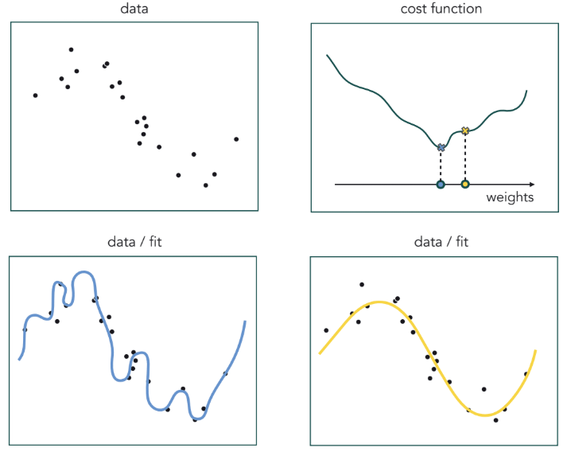
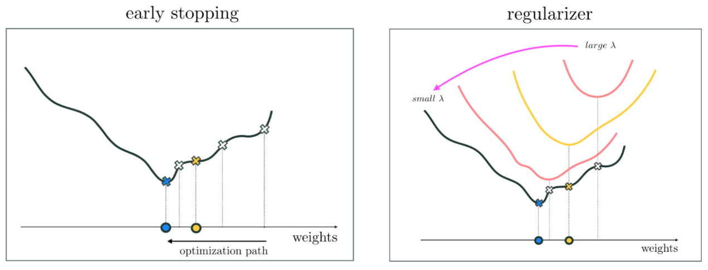
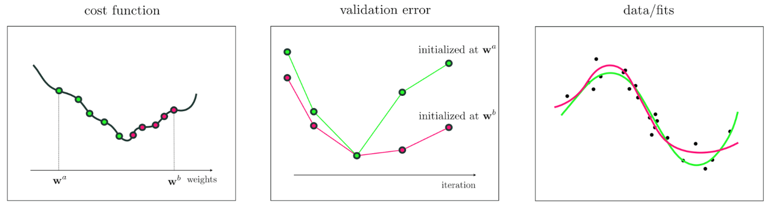

Efficient Cross-Validation via Regularization
Overfitting → capacity of model is too high and cost function is optimized too well.
Model parameters purposefully away from the global minimum → validation is lowest.
Early stopping based regularization:
Properly tune high-capacity model by making a local optimization → using set of weights when model achieves minimum validation.
Different optimization → different tuned models → different initializations → different trajectories → different minima, produce different validation-error minimizing.
How high should capacity be set? set high enough such that if model completely optimize it overfits.
Regularizer based methods
A regularizer is a simple function that can be added to a cost.
Cost function g and regularizer h, then regularized cost is
The regularization parameter: is non-negative, control mixture of cost and regularizer. → Bias weights are often not included in the regularizer.

Slide 4

Testing data
It is possible for a properly cross-validated model to overfit validation data.
Therefore, we need test set → testing error gives an unbiased estimate of the cross-validated model’s performance.
K-Fold Cross-Validation
Choose a single model that has minimum average validation error over all splits.

