Slide 1
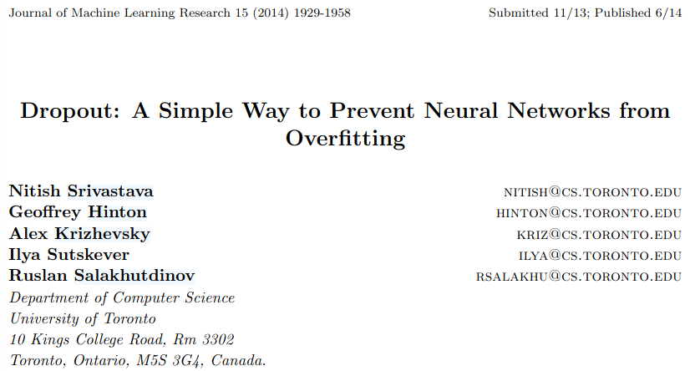
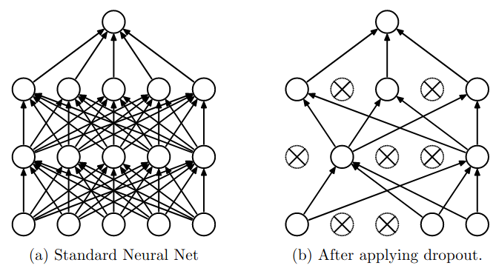
Prevents overfitting and approximately combining exponentially many neural network architectures efficiently.
Randomly dropping out units (neurons) from input and hidden layers.
Each unit is retained with a fixed probability p (hyperparameter) independent of other units.
Neurons trained with dropout cannot co-adapt with their neighboring neurons; they have to be as useful as possible on their own.
Applying dropout = sampling a “thinned” network
Thinned network includes only the units that survive dropout. 2^{n} possible thinned NN.
All thinned networks share weights and each individual network is trained rarely (if at all).

Slide 2
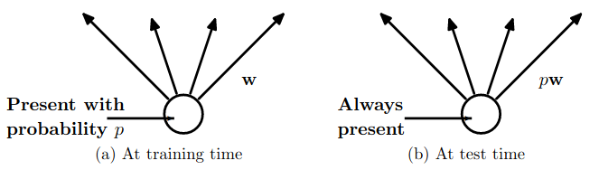
Explicitly averaging 2^{n} thinned networks is infeasible
Approximate averaging: use a single network without dropout
Scale weights:
If a unit is retained with probability 𝑝 during training
Multiply its outgoing weights by 𝑝 at test time
This maintains the expected activation of each unit
Combines all thinned networks into one effective model
Result: Lower generalization error vs. other regularization methods
Additionally the thinned network can be combined with other regularization networks.
Slow down convergence, but result in better model.

