Slide 1
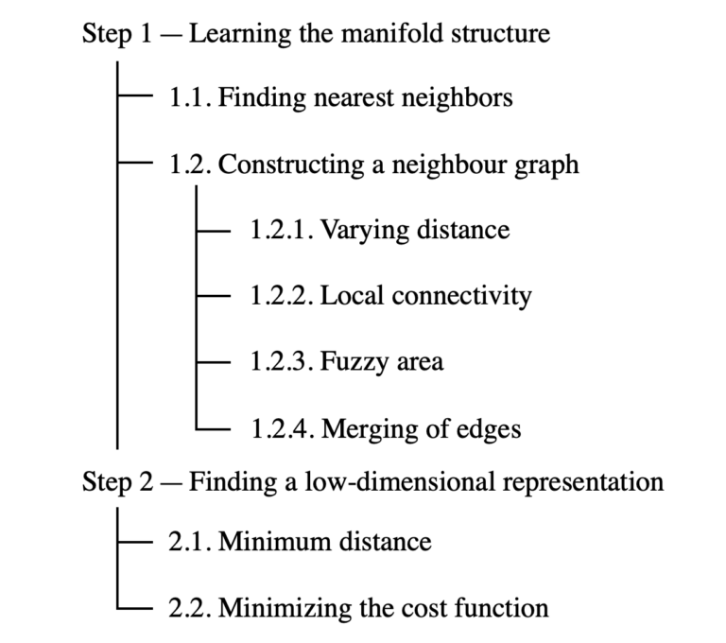
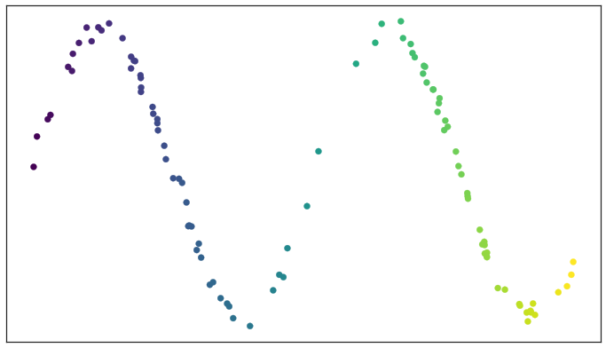
UMAP: Uniform Manifold Approximation and Projection
Aims to reduce the dimensionality of data while preserving its topological structure.
Assumes data samples are uniformly distributed across a topological space (manifold).
The manifold can be approximated from the finite data samples.
The data are then mapped (projected) onto a lower-dimensional space.
Step 1 - Learning the manifold
Finding nearest neighbors: Efficient K-Nearest Neighbor Graph Construction for Generic Similarity Measures.
For each observation, compute d_{𝑖,𝑗} using a chosen metric and identify its k nearest neighbors (smallest distances).
Small no. of neighbors → very local interpretation that accurately captures the fine detail of the structure.
https://towardsdatascience.com/
https://umap-learn.readthedocs.io/en/latest/how_umap_works.html

Slide 2
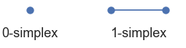
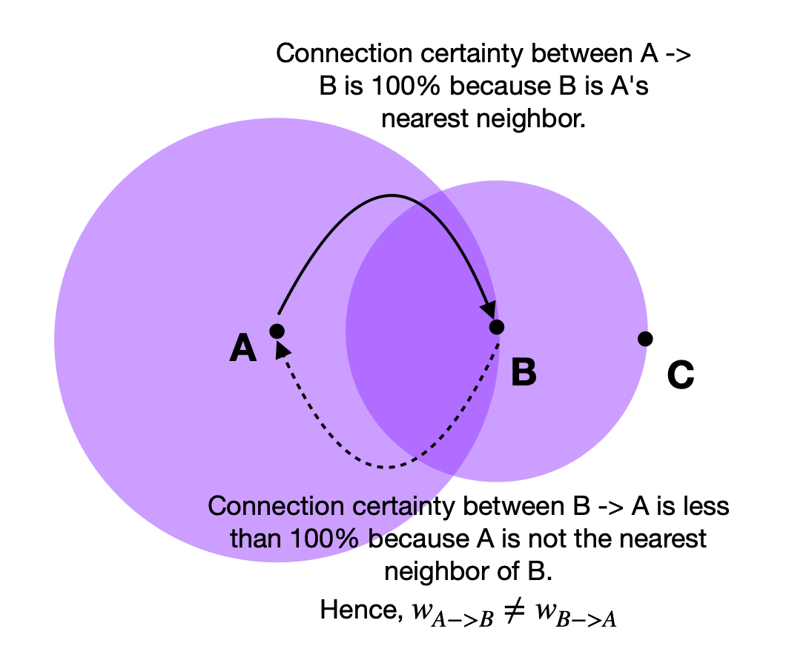
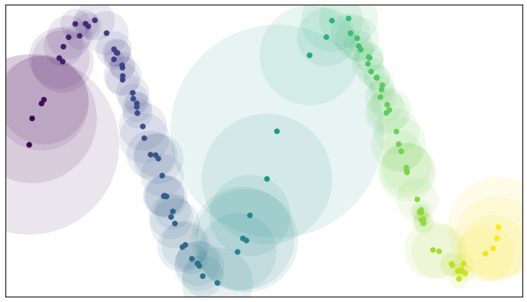
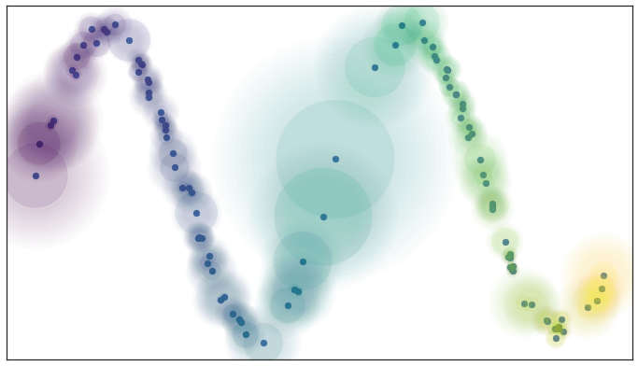
UMAP: Uniform Manifold Approximation and Projection
Constructing a graph: construct a graph by connecting the previously identified nearest neighbors.
Varying distance: Points are assumed uniformly spread across the manifold.
Distances stretch or shrink in sparse/dense regions → distance metric varies locally.
Local connectivity hyperparameter (default = 1): Ensures no isolated points in the manifold.
Each point connects to at least one neighbor.
Fuzzy area: Connection certainty decreases with distance from a point of interest.
Merging of edges: understand that the connection certainty through edge weights (w).
Cases where edge weights do not align when viewed from the perspective of each point → take a union of the two edges.
The weights are effectively the probabilities that an edge (1-simplex) exists.

Slide 3
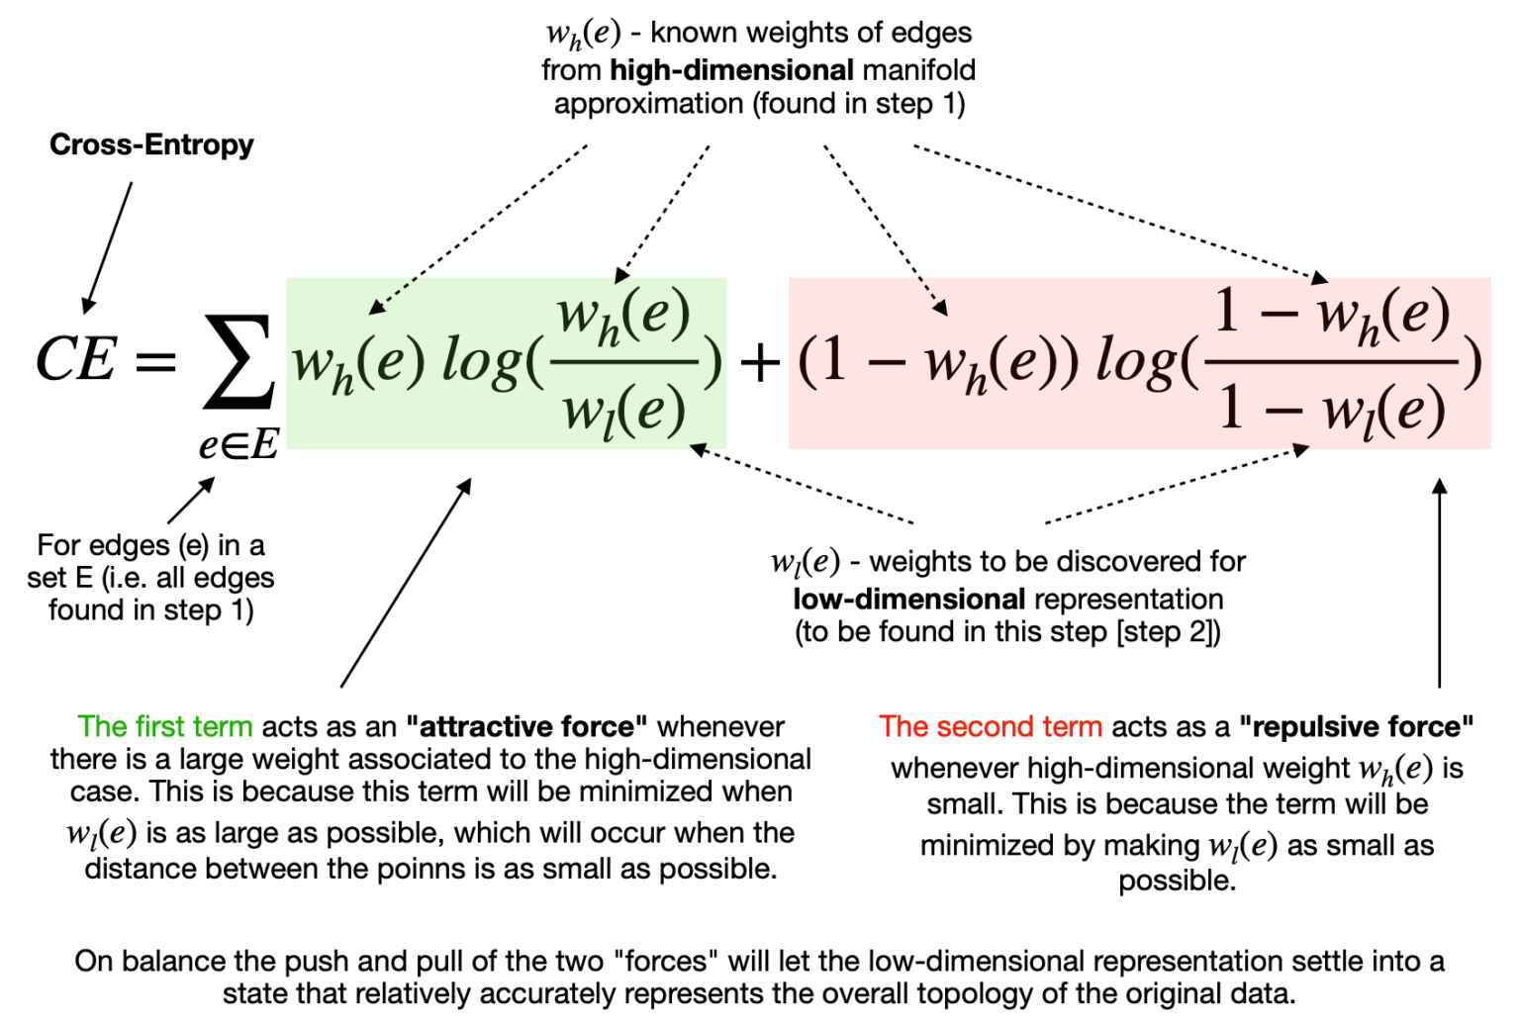
UMAP: Uniform Manifold Approximation and Projection
Step 2 - Finding a low-dimensional representation: → After learning the approximate manifold from the higher-dimensional space. → Project the learned manifold into a lower-dimensional space.
Minimum distance: Switch to standard Euclidean distance in the low-dimensional space. Hyperparameter (_min_dist; default=0.1) to define the minimum distance between embedded points. Aim to control the minimum spread of points → avoid overlapping of points in the lower-dimensional embedding.
Minimizing the cost function (Cross-Entropy): With the minimum distance specified, the algorithm can start looking for a good low-dimensional manifold representation.

