Slide 1
Machine Learning
Review

Slide 2
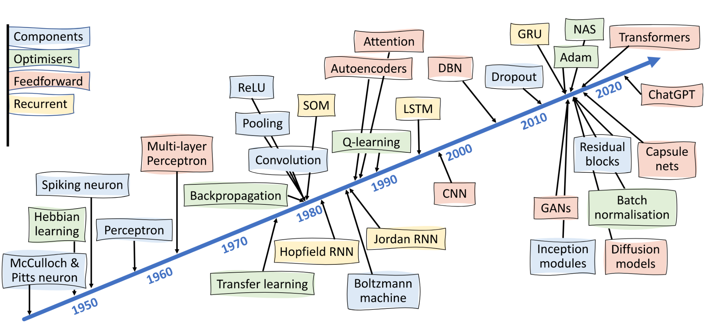
Deep learning
Lones et al. Patterns 5 (10), 2024.

Slide 3
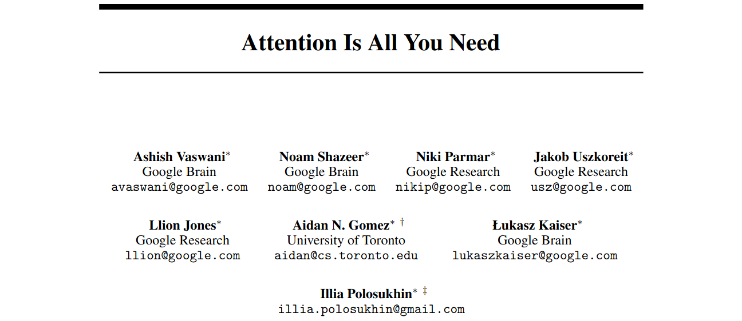
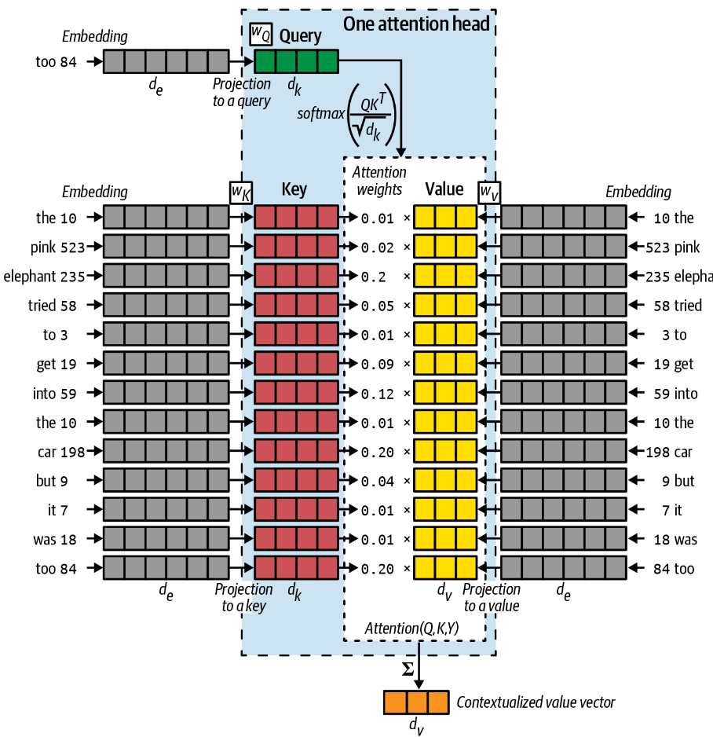
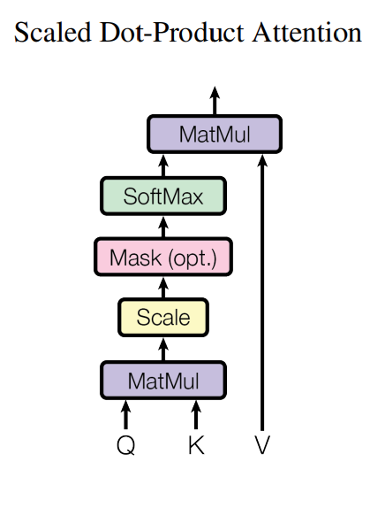
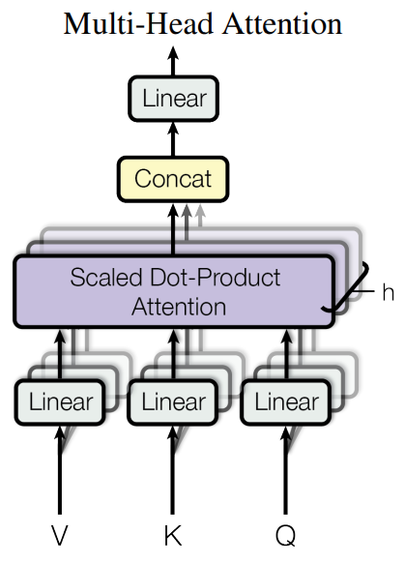
A mechanism relating different position of a sequence in order to compute representation of a sequence.

Slide 4
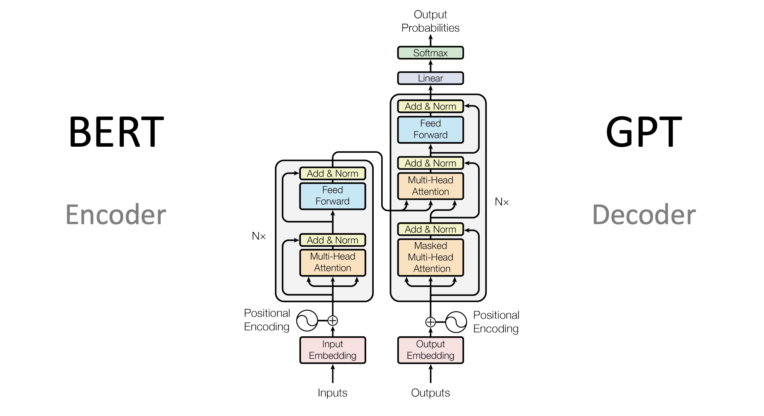
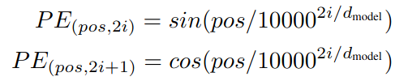
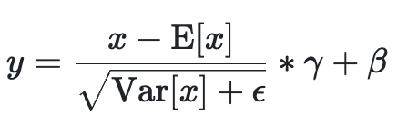
Positional encoding: in order for the model to make use of the order of the sequence. – takes the form of geometric progression
Residual connection: – Forward pass signal
– Vanishing gradients
LayerNorm: play important role in controlling gradient scales.
FFN: applied to each position separately
– perform non-linear feature transformation

Slide 5
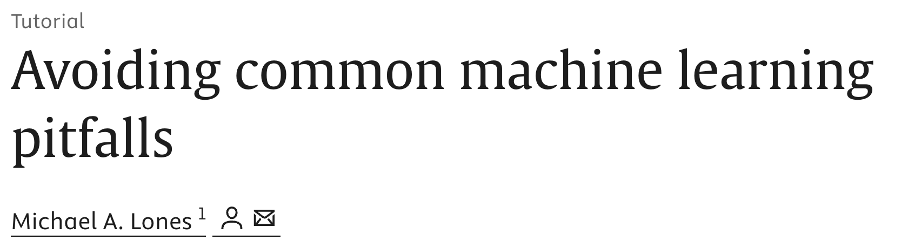
Thank You

